Slide 1
SCRUM IN SOFTWARE DEVELOPMENT
Dhatchitha Prakash

Slide 2
01
INTRODUCTION
What is Scrum?

Slide 3
What is Scrum?
Scrum is an Agile framework that helps teams manage complex projects efficiently. Developed by Ken Schwaber and Jeff Sutherland, it promotes self-organization, adaptability, and continuous improvement. By breaking projects into smaller tasks, Scrum ensures faster delivery, better collaboration, and higher customer satisfaction.

Slide 4
02
FEATURES OF SCRUM
Silent features of Scrum

Slide 5
Silent features of Scrum
01
Lightweight framework
02
Emphasizes self-organization
03
Easy to understand and implement
04
Encourages teamwork and collaboration

Slide 6
03
SCRUM LIFECYCLE
Scrum Process

Slide 7
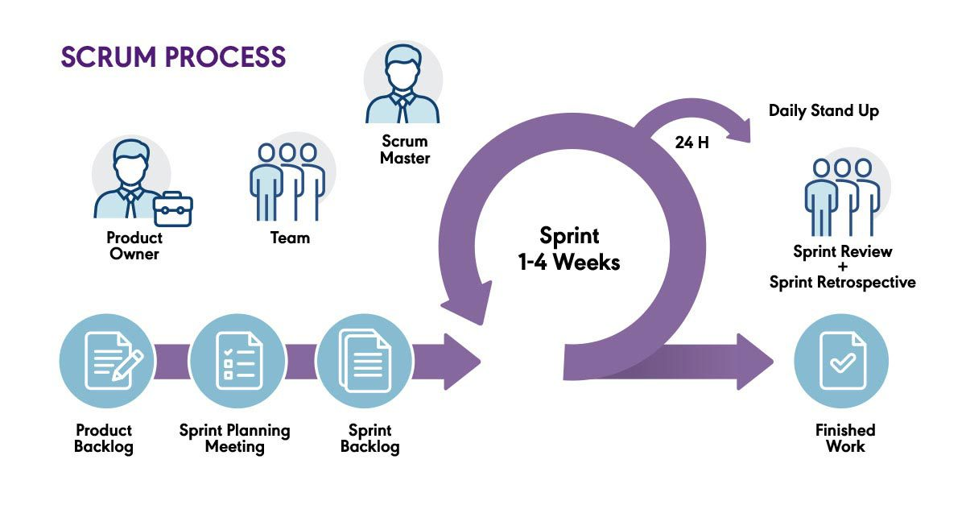
Scrum Lifecycle

Slide 8
04
ADVANTAGES OF SCRUM

Slide 9
Advantages of Scrum
Faster and cost-effective development
Adaptive to changes with short sprints
Works with a divide-and-conquer approach
Improves product quality with constant feedback
Focuses on customer satisfaction

Slide 10
05
DISADVANTAGES OF SCRUM

Slide 11
Disadvantages of Scrum
No mid-sprint changes allowed
Challenging for projects with unclear definitions
Daily meetings and frequent reviews require time and effort

Slide 12
06
CONCLUSION
Scrum

Slide 13
Conclusion
Scrum enhances productivity and self-organization.
Improves product quality and customer satisfaction.
However, handling changes during a sprint can be challenging.
Despite its limitations, Scrum remains a widely used Agile framework.

Slide 14
Thank You!
Do you have any questions?

