Slide 1
Task 2 Report Structure
Customer Retention & Churn Analysis
Data Science & Analytics Internship – Future Interns
Submitted By:
Vanukuri.Dhathri
Task 2
Date:
19 May 2026

Slide 2
Objective
Objective:
The objective of this project is to analyze customer retention and churn patterns to identify customer behavior, retention trends, and factors affecting customer loss using data analytics and visualization techniques.

Slide 3
Dataset Information
Dataset Information
Dataset Name: Customer Churn Dataset
Number of Rows: 7000+
Number of Columns: 20+
important Columns:
• Customer ID
• Gender
• Tenure
• Monthly Charges
• Total Charges
• Contract Type
• Internet Service
• Churn

Slide 4
Tools & Technologies Used
Tools & Technologies Used
• Python
• Pandas
• Matplotlib
• Seaborn
• Jupyter Notebook
• VS Code

Slide 5
Data Cleaning Process
Data Cleaning Process
• Removed missing values
• Checked duplicate records
• Converted data types
• Handled inconsistent values
• Verified churn column data

Slide 6
Customer Churn Analysis
Add:
Pie chart screenshot
Churn distribution graph
Insights
• A significant percentage of customers left the service
• Customers with month-to-month contracts showed higher churn
• Long-term contract customers had better retention

Slide 7
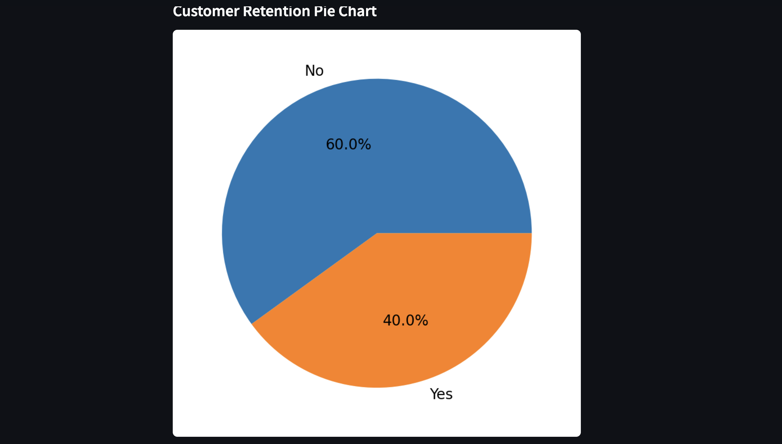
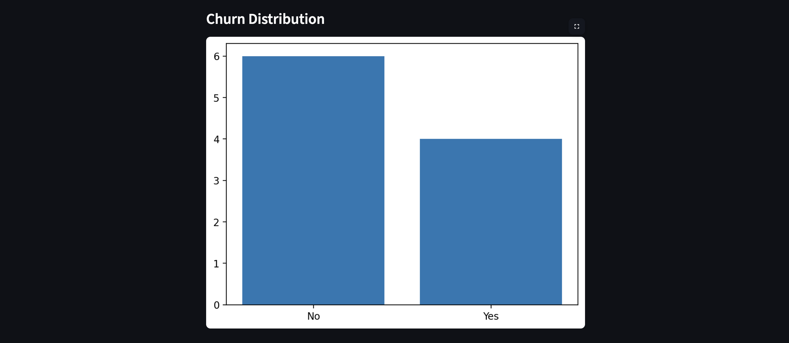
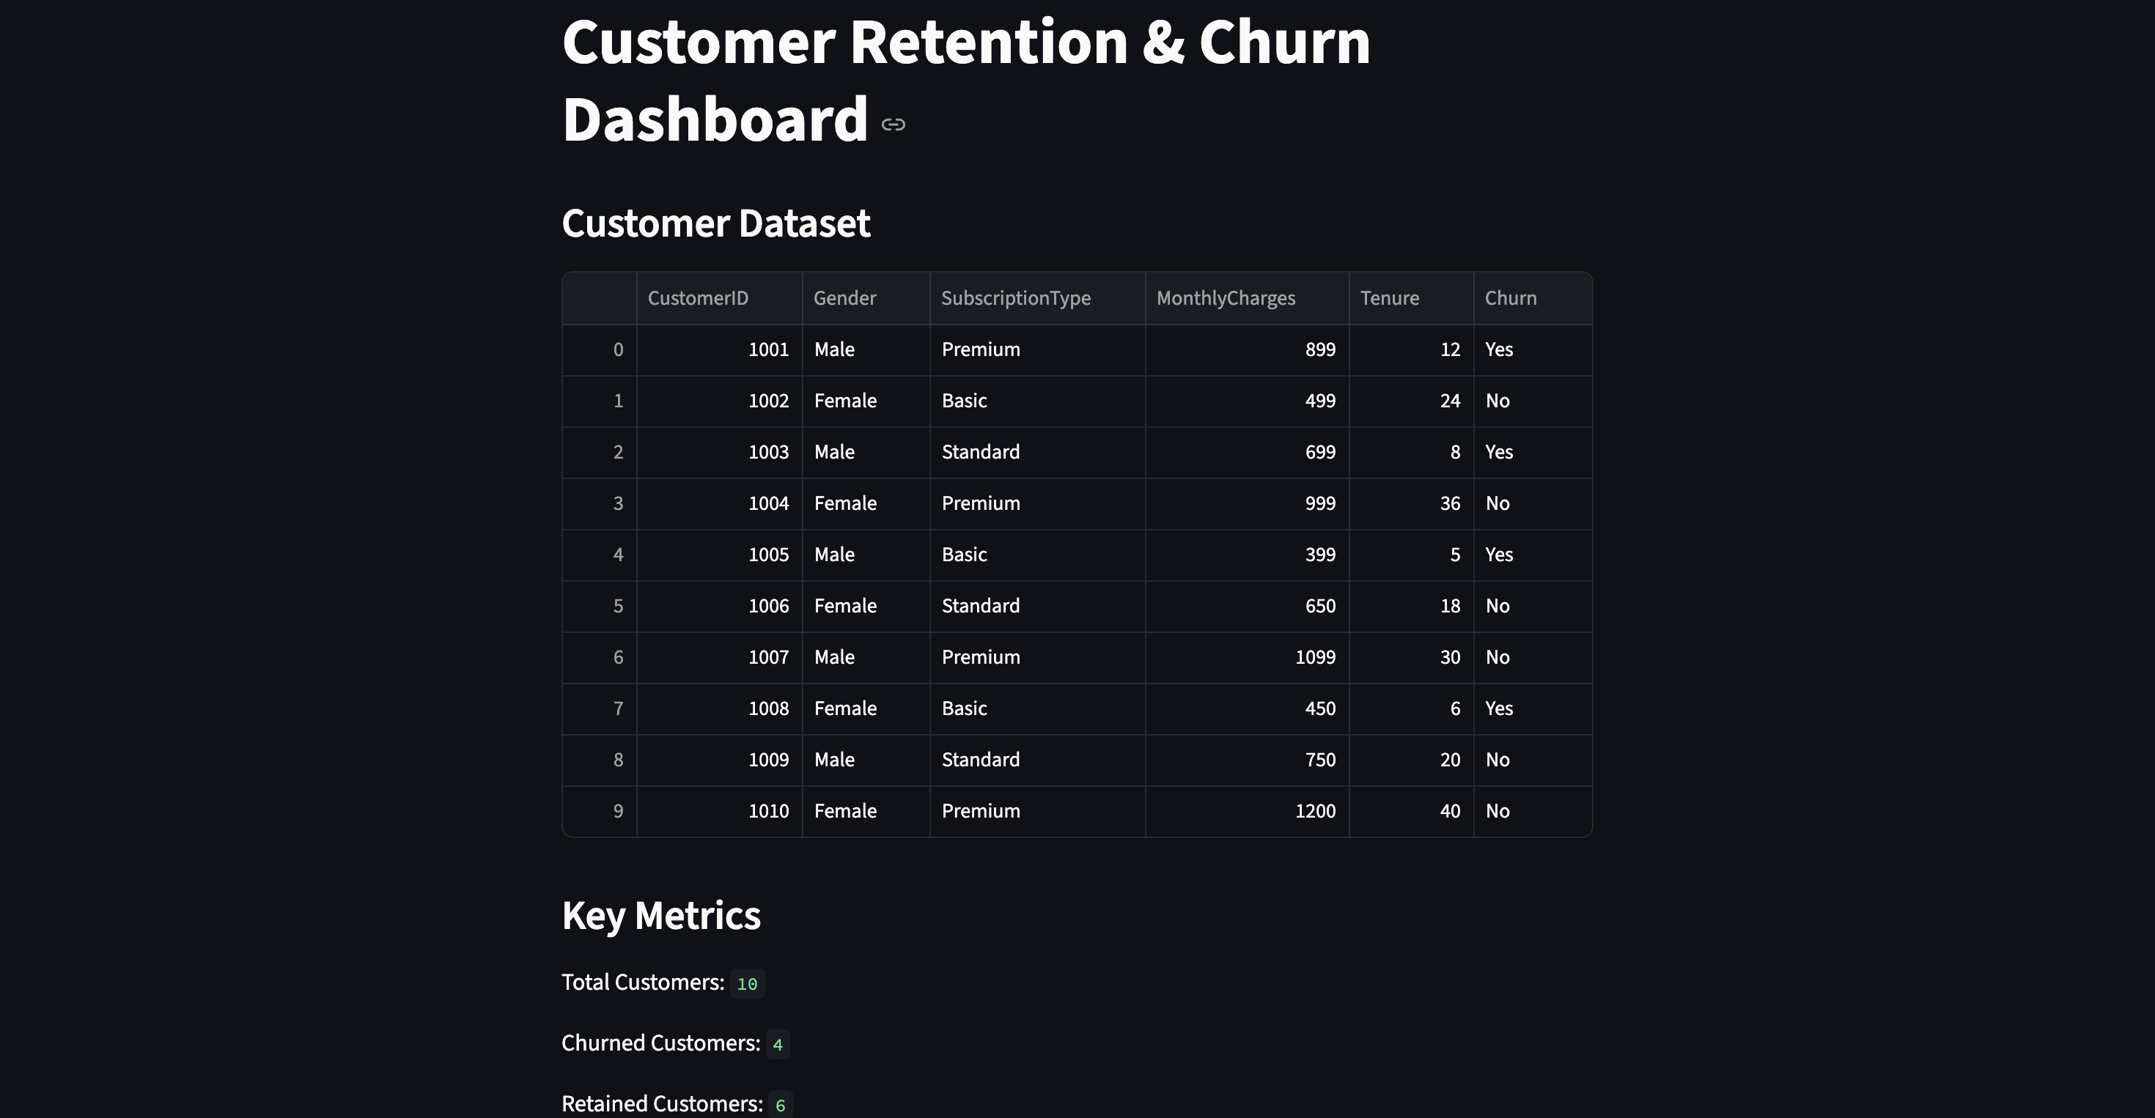
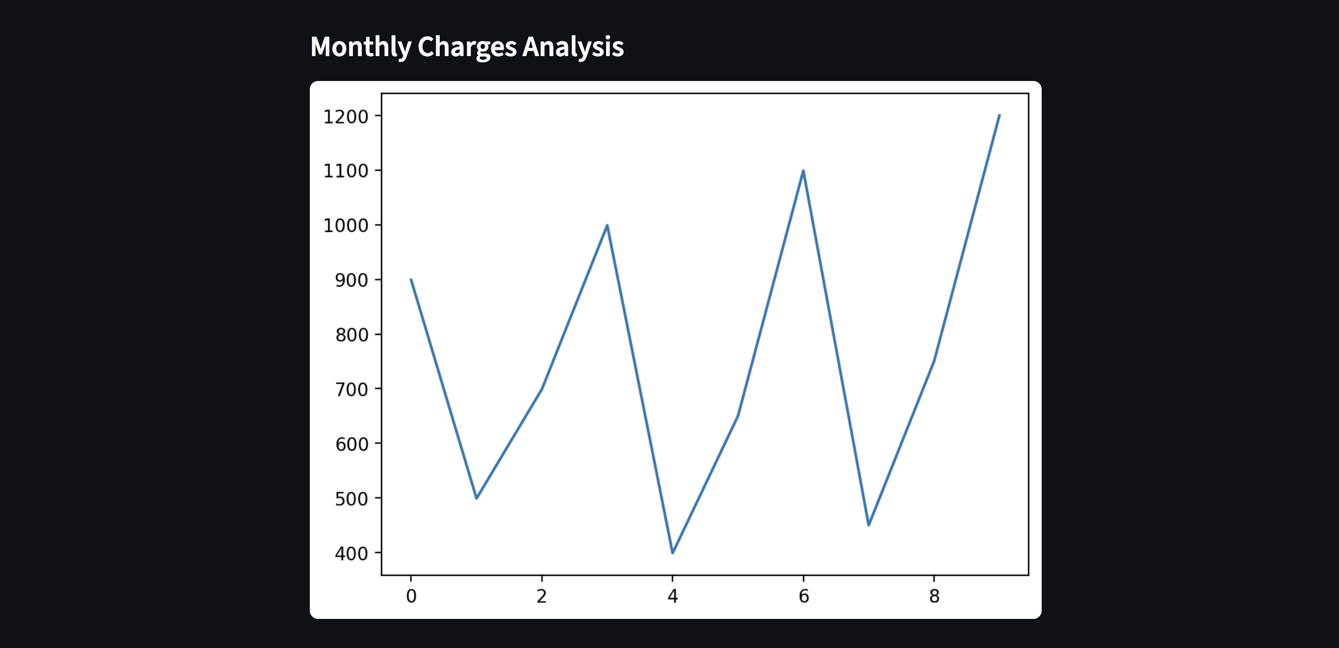
EXAMPLES

Slide 8
Contract Type Analysis
Add:
Bar chart screenshot
Insights:
• Month-to-month contracts had the highest churn rate
• Two-year contracts showed strong customer retention
• Contract duration impacts customer loyalty

Slide 9
Monthly Charges Analysis
Add:
Histogram/boxplot screenshot
Insights:
• Customers with higher monthly charges were more likely to churn
• Pricing influenced customer retention behavior

Slide 10
Recommendations
• Offer discounts for long-term contracts
• Improve customer support quality
• Introduce loyalty programs
• Analyze high-risk customers regularly
• Reduce churn through targeted retention campaigns

Slide 11
Conclusion
Conclusion
This project helped identify customer churn patterns and key retention factors.
The analysis provided business insights to improve customer satisfaction
and reduce customer loss.

Slide 12
GitHub Repository
GitHub Repository:
https://github.com/dhathri-252/FUTURE_DS_02

Slide 13
Thank You

