Slide 1
Task 3 Report Structure
Marketing Funnel & Conversion Performance Analysis
Data Science & Analytics Internship – Future Interns
Submitted By:
Vanukuri.Dhathri
Task 3
Date:
21 May 2026

Slide 2
Objective
The objective of this project is to analyze marketing funnel data
to identify conversion drop-offs, channel performance,
and opportunities to improve customer conversion.

Slide 3
Dataset Information
Dataset Information
Dataset Name: Marketing Funnel Dataset
Number of Rows: 5000+
Important Columns:
• Lead Source
• Campaign Name
• Clicks
• Conversions
• Revenue
• Conversion Rate

Slide 4
Tools Used
Tools & Technologies Used
• Python
• Pandas
• Matplotlib
• Power BI
• Jupyter Notebook
• VS Code

Slide 5
Data Cleaning
Data Cleaning Process
• Removed missing values
• Checked duplicate records
• Formatted date columns
• Verified conversion metrics

Slide 6
Funnel Analysis
Insert:
Funnel chart screenshot
Conversion graph
Insights:
• Significant drop-offs occurred during conversion stages
• Some channels performed better than others
• Funnel optimization can improve customer conversion

Slide 7
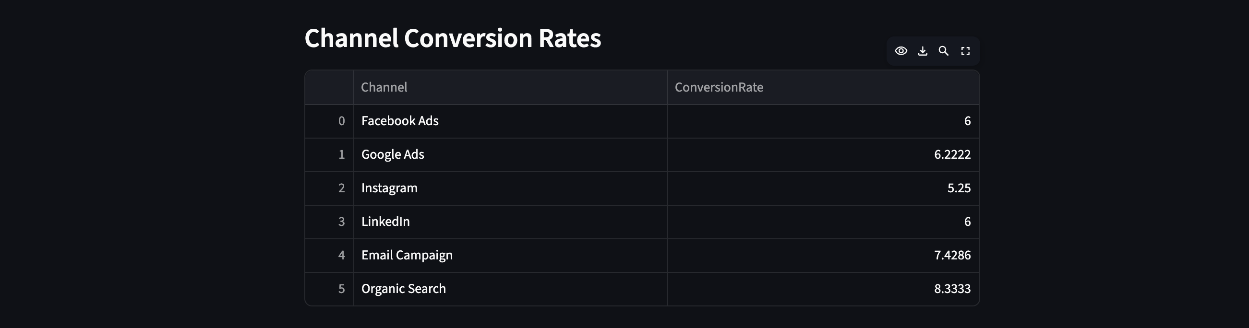

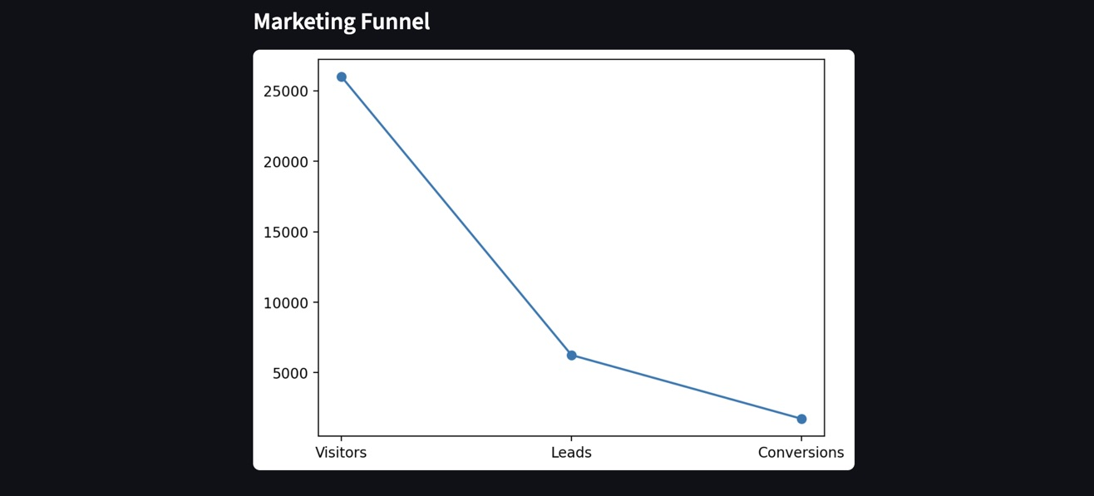
Example visuals:

Slide 8
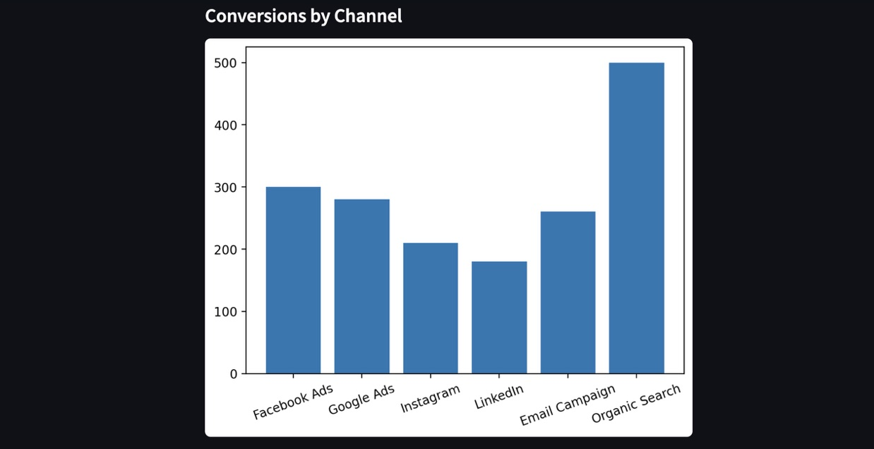
Channel Performance
Insert:
Bar chart
Pie chart
Insights
• Social media generated higher traffic
• Email marketing achieved better conversion rates
• Paid campaigns produced higher engagement

Slide 9
Recommendations
Recommendations
• Improve low-performing funnel stages
• Optimize campaign targeting
• Increase focus on high-converting channels
• Monitor conversion metrics regularly

Slide 10
Conclusion
Conclusion
This project helped analyze marketing funnel performance
and customer conversion behavior using data analytics techniques.

Slide 11
GitHub Link
https://github.com/dhathri-252/FUTURE_DS_03

Slide 12
Thank You

