Slide 1
AI RAG Chatbot – Architecture and Flow
Coding Round Task – AI-based Document QA System
Sree Gnyana Dhathri Paladi
GitHub: dhathri-paladi/ai-rag-chatbot: RAG-based document chatbot using Python, agents, and HuggingFace embeddings

Slide 2
Agent-Based Architecture with MCP Integration
[ User Input ]
│
[ Streamlit UI ]
│
[ Coordinator (main.py) ]
│
┌────┼────────────┬────────────┐
[IngestionAgent] [RetrievalAgent] [QueryAgent]
(File Parsing) (HF Embeddings) │
[LLMResponseAgent]
(Mock LLM Answer)

Slide 3
System Flow and Message Passing
User uploads document and asks a question via UI
main.py coordinates all agent communication
Ingestion Agent parses and chunks the file
Retrieval Agent embeds it using Hugging Face
Query Agent finds matching content
LLMResponse Agent generates final answer
All communication uses a message-passing structure with metadata like sender, receiver, trace ID

Slide 4
Tech Stack
Languages/Frameworks
Python 3.10
Streamlit (for UI)
OOP Design with Modular Agents
Libraries
sentence-transformers (HuggingFace)
PyMuPDF, python-docx, python-pptx, pandas, torch
Mock LLM:
Simulates GPT-style output locally, no API required

Slide 5
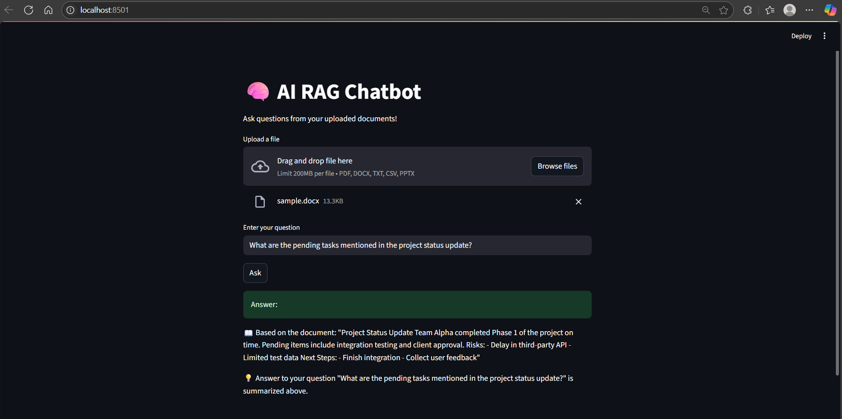
Working Application – Screenshots
Input/Output Interaction" User asks about pending tasks → Chatbot extracts from document and responds.
User → Upload File & Ask Question → [UI] → Get Answer ← Backend Agents

Slide 6
Challenges & Future Scope
Challenges:
Designing message-passing interface
Handling multiple document formats
Maintaining clean agent separation
Future Improvements:
Replace MockLLM with real OpenAI/GPT API
Add PDF export of answers
Deploy as a hosted web app (e.g., Streamlit Cloud)

