Slide 1
D211
Doug Haunsperger

Slide 2

Agenda
1. Describe the technical environment used to create the dashboard
2. Demonstrate the functionality of the dashboard
3. Explain the SQL scripts used to support the creation of the dashboard
4. Explain how the data streams were prepared to support the analysis
5. Describe how data were aligned with other data points
6. Demonstrate how the databases were created
7. Explain how referential integrity was enforced in the database

Slide 3
Technical environment

Slide 4
Tools Used
Skillable Labs on Demand
pgAdmin4 version 5.2
Microsoft Excel (Latest Office 365 version)
Tableau Desktop version 2021.4.19 (within lab)
Version 2023.1.3 (on my desktop)

Slide 5
Database creation

Slide 6
Table Creation Script
CREATE TABLE nhanes_demo
(
patient_num varchar(10) PRIMARY KEY,
gender varchar(10),
age int,
marital varchar(30),
hh_size int,
children_under5 int,
children_6to18 int,
income int
);
CREATE TABLE vitd
(
patient_num varchar(10) PRIMARY KEY REFERENCES nhanes_demo,
tot_vitd numeric(5,2),
tot_vitd_comment int,
vitd2 numeric(5,2),
vitd2_comment int,
vitd3 numeric(5,2),
vitd3_comment int,
epivitd3 numeric(5,2),
epivitd3_comment int
);

Slide 7
Referential integrity

Slide 8
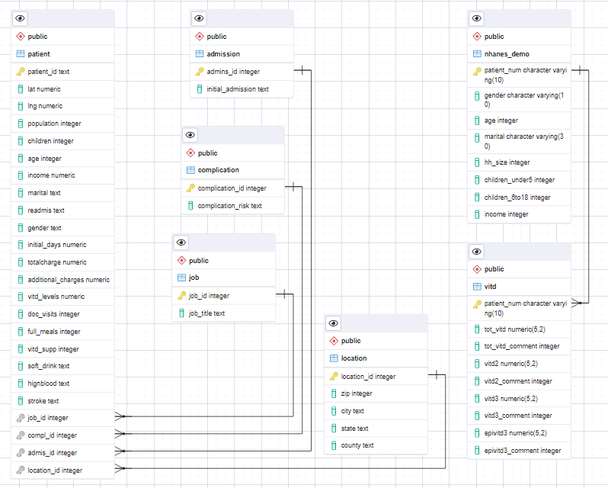
ERD
Foreign key on vitd table references nhanes_demo table primary key

Slide 9
Data prep

Slide 10
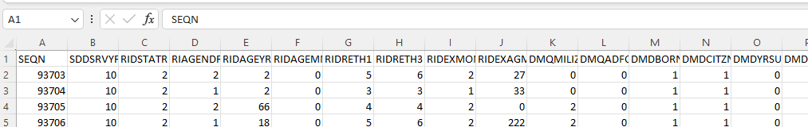
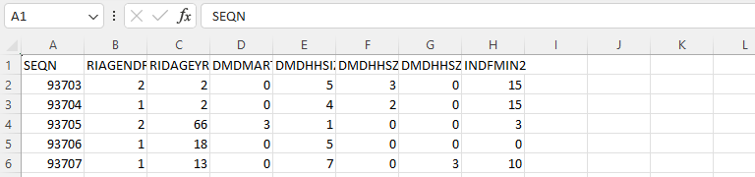
Column Selection
Categorical values also need re-expression as text

Slide 11
Sql scripts

Slide 12
Tableau Custom SQL Script
SELECT d.patient_num,
v.tot_vitd,
CASE WHEN d.gender = '1' THEN 'Male'
WHEN d.gender = '2' THEN 'Female'
ELSE 'NULL' END AS gender,
d.age,
CASE WHEN d.marital = '1' THEN 'Married'
WHEN d.marital = '2' THEN 'Widowed'
WHEN d.marital = '3' THEN 'Divorced'
WHEN d.marital = '4' THEN 'Separated'
WHEN d.marital = '5' THEN 'Never Married'
WHEN d.marital = '6' THEN 'Partnership'
ELSE 'NULL' END AS marital,
d.hh_size,
d.children_under5,
d.children_6to18,
CASE WHEN d.income = '1' THEN '< $5k'
WHEN d.income = '2' THEN '$5k - $10k'
WHEN d.income = '3' THEN '$10k - $15k'
WHEN d.income = '4' THEN '$15k - $20k'
WHEN d.income = '5' THEN '$20k - $25k'
WHEN d.income = '6' THEN '$25k - $35k'
WHEN d.income = '7' THEN '$35k - $45k'
WHEN d.income = '8' THEN '$45k - $55k'
WHEN d.income = '9' THEN '$55k - $65k'
WHEN d.income = '10' THEN '$65k - $75k'
WHEN d.income = '14' THEN '$75k - $100k'
WHEN d.income = '15' THEN '> $100k'
ELSE 'NULL' END AS income
FROM public.nhanes_demo AS d
INNER JOIN public.vitd AS v
ON d.patient_num = v.patient_num

Slide 13
Data alignment

Slide 14
Tableau Calculated Fields
Marital Status
Gender
Income
IF [NHANES Marital Status] == 'Married' OR [Marital] == 'Married' THEN 'Married'
ELSEIF [NHANES Marital Status] == 'Divorced' OR [Marital] == 'Divorced' THEN 'Divorced'
ELSEIF [NHANES Marital Status] == 'Separated' OR [Marital] == 'Separated' THEN 'Separated'
ELSEIF [NHANES Marital Status] == 'Never Married' OR [Marital] == 'Never Married' THEN 'Never Married'
ELSEIF [NHANES Marital Status] == 'Widowed' OR [Marital] == 'Widowed' THEN 'Widowed'
ELSEIF [NHANES Marital Status] == 'Partnership' THEN 'Partnership'
ELSE 'NULL' END
IF [NHANES Gender] == 'Male' OR [Gender] == 'Male' THEN 'Male'
ELSEIF [NHANES Gender] == 'Female' OR [Gender] == 'Female'
THEN 'Female'
ELSE 'Other' END
IF [NHANES Income Range] == '< $5k' OR [Income] < 5000 THEN '< $5k'
ELSEIF [NHANES Income Range] == '$5k - $10k' OR [Income] < 10000 THEN '$5k - $10k'
ELSEIF [NHANES Income Range] == '$10k - $15k' OR [Income] < 15000 THEN '$10k - $15k'
ELSEIF [NHANES Income Range] == '$15k - $20k' OR [Income] < 20000 THEN '$15k - $20k'
ELSEIF [NHANES Income Range] == '$20k - $25k' OR [Income] < 25000 THEN '$20k - $25k'
ELSEIF [NHANES Income Range] == '$25k - $35k' OR [Income] < 35000 THEN '$25k - $35k'
ELSEIF [NHANES Income Range] == '$35k - $45k' OR [Income] < 45000 THEN '$35k - $45k'
ELSEIF [NHANES Income Range] == '$45k - $55k' OR [Income] < 55000 THEN '$45k - $55k'
ELSEIF [NHANES Income Range] == '$55k - $65k' OR [Income] < 65000 THEN '$55k - $65k'
ELSEIF [NHANES Income Range] == '$65k - $75k' OR [Income] < 75000 THEN '$65k - $75k'
ELSEIF [NHANES Income Range] == '$75k - $100k' OR [Income] < 100000 THEN '$75k - $100k'
ELSEIF [NHANES Income Range] == '> $100k' OR [Income] > 100000 THEN '> $100k'
ELSE 'NULL' END

Slide 15
DASHBOARD demo

Slide 16




Thank you
Doug Haunsperger
dhaunsp@wgu.edu

