Slide 1
Online
Adaptive
Assessment
Platform

Slide 2
Members
Devarshi Patel 160770107107
Dhaval Patel 160770107108
Dhruvi Patel 160770107111
Ferin Patel 160770107114
Hardi Patel 160770107115
Internal Guide : Prof Neeti Shah

Slide 4
Introduction

Slide 5
In the age of digital media e-books and other material is easily available on the internet. We can read that content on mobile or laptops. But this approach may sound boring sometimes and learnings are also needed to be evaluated. In that case we can look for online test for the particular subjects. And the most probable solution is to provide a platform that can evaluate learnings. It should be adaptive in way that it handles every person in different way , it should asses the person after every response .Tests using adaptive techniques are shorter, more precise, and more reliable than tests using other techniques.

Slide 6
Abstract

Slide 7
Aspirants/Students can be assessed on different fields using this website. Fields can be Reasoning, Aptitude, Technical MCQ, Coding etc. This will be an online platform with questions at different levels (Difficulty). Candidate would start at assessment with a medium difficulty question and depending on its response, the platform should decide the next level of questions to be shown (level would increase or decrease as per response). Each question would be assigned a weight-age and time duration.

Slide 8
Objectives

Slide 9
Providing Questions According To User Performance
Providing Analysis After Completion Of Test
Providing References Content For Further Reading For Improvement
Third Party Integration Platform For School And Collages To Carry Out Tests
Competitive Exam Platform

Slide 10
Work Carried Out
Till Date

Slide 11
We have researched various topics how the platform works and it can be more adaptable to the end user.
We have also learned some tools and technologies and found out which will work best for us.
Parse Server As A Back-end (BaaS)
Vue.js as Front End Technology
MongoDB as Database Solution

Slide 12
Future Work

Slide 13
Defining Database Schema and Data Structures
Research In Machine Learning for analysing the results
Building A Restful API for Authentication and Database access
Building A Question Bank

Slide 14
Reference

Slide 15
www.researchgate.net
parseplatform.org
www.mongodb.com

Slide 16
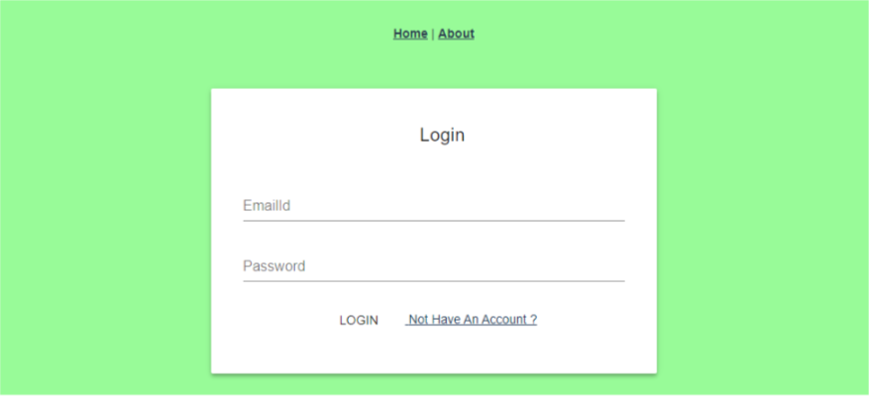
Login Page

