Slide 1
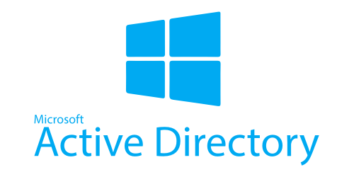

Active Directory Domain Services
Name : Avinash Solanki
Enrollment No. : 201818100017
Guided By : Mr.Girish Vidhani
Course : B.sc IT IMS and Cyber Security
Department : Department Of Animation ITIMS and Mobile Application

Slide 2
Points To Be Covered
Overview of AD DS
AD DS Physical Components
AD DS Logical Components

Slide 3
Overview of AD DS
Protocol
What is Authentication?
What is Authorization?
Why Deploy AD DS?
Centralized Network Management
Requirements for Installing AD DS
Overview of AD DS and DNS
Overview of AD DS Components

Slide 4
Protocol
Lightweight Directory Access Protocol (LDAP)
X.500 Standard
Based on TCP/IP
A method for accessing, searching, and modifying a directory service
A Client Server Model

Slide 5


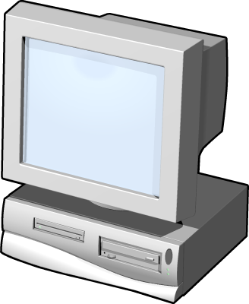
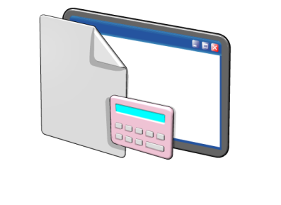
What is Authentication?
Authentication is the process of verifying a user’s identity on a network
Network authentication: grants access to network resources
Interactive logon: grants access to the local computer

Slide 6

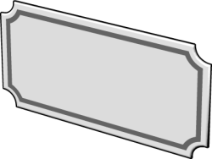






What is Authorization?
Authorization is a process of verifying that an authenticated user has permission to perform an action
Security principals are issued security identifiers (SIDs) when the account is created
User accounts are issued security tokens during authentication that include the user’s SID and all related group SIDs
Shared resources on a network include access control lists (ACL) that define who can access the resource
The security token is compared against the Discretionary Access Control List (DACL) on the resource and access is granted or denied

Slide 7
Why Deploy AD DS?
AD DS provides a centralized system for managing users, computers, and other resources on a network
AD DS features include:
Centralized directory
Single sign-on access
Integrated security
Scalability
Common management interface

Slide 8
Centralized Network Management
AD DS centralizes network management by providing:
Single location and set of tools for managing user and group accounts
Single location for assigning access to shared network resources
Directory service for AD DS enabled applications
Options for configuring security policies that apply to all users and computers
Group policies to manage user desktops and security settings

Slide 9
Requirements for Installing AD DS
Object | Description
TCP/IP | Configure appropriate TCP/IP and DNS server addresses.
Credentials | To install a new AD DS forest, you need to be local Administrator on the server. To install an additional domain controller in an existing domain, you need to be a member of the Domain Admins group.
Domain Name System )DNS) Infrastructure | Verify that a DNS infrastructure is in place. When you install AD DS, you can include DNS server installation, if it is needed. When you create a new domain, a DNS delegation is created automatically during the installation process. Creating a DNS delegation requires credentials that have permissions to update the parent DNS zones.

Slide 10
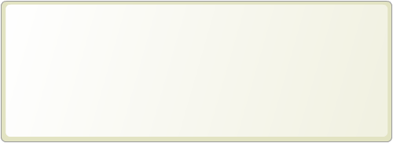
Component Overview
AD DS is composed of both physical and logical components
Physical Components | Logical Components
Data store Domain controllers Global catalog server Read-Only Domain Controller (RODC) | Partitions Schema Domains Domain trees Forests Sites Organizational units (OUs)

Slide 11
2. AD DS Physical Components
Domain Controllers
Global Catalog Servers
Data Store
Replication

Slide 12
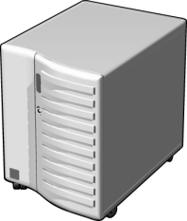
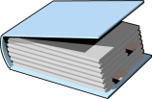
Domain Controllers
A domain controller is a server with the AD DS server role installed that has specifically been promoted to a domain controller
Domain controllers:
Host a copy of the AD DS directory store
Provide authentication and authorization services
Replicate updates to other domain controllers in the domain and forest
Allow administrative access to manage user accounts and network resources

Slide 13


Global Catalog Servers
Global catalog servers are domain controllers that also store a copy of the global catalog
The global catalog:
Contains a copy of all AD DS objects in a forest that includes only some of the attributes for each object in the forest
Improves efficiency of object searches by avoiding unnecessary referrals to domain controllers
Required for users to log on to a domain

Slide 14
What is the AD DS Data Store?
The AD DS data store contains the database files and processes that store and manage directory information for users, services, and applications
The AD DS data store:
Consists of the Ntds.dit file
Is stored by default in the %SystemRoot%\NTDS folder on all domain controllers
Is accessible only through the domain controller processes and protocols

Slide 15
What is AD DS Replication?
AD DS replication copies all updates of the AD DS database to all other domain controllers in a domain or forest
AD DS replication:
The AD DS replication topology is created automatically as new domain controllers are added to the domain
Ensures that all domain controllers have the same information
Uses a multimaster replication model
Can be managed by creating AD DS sites

Slide 16
Lesson 3: Overview of AD DS Logical Components
AD DS Schema
The Basics
AD DS Objects
Demo: Installation and Management

Slide 17
What is the AD DS Schema?
The AD DS Schema:
Defines every type of object that can be stored in the directory
Enforces rules regarding object creation and configuration
Object Types | Function | Examples
Class Object | What objects can be created in the directory | User Computer
Attribute Object | Information that can be attached to an object | Display name

Slide 18
The Basics: Domains
Domains are used to group and manage objects in an organization
Domains:
An administrative boundary for applying policies to groups of objects
A replication boundary for replicating data between domain controllers
An authentication and authorization boundary that provides a way to limit the scope of access to resources

Slide 19
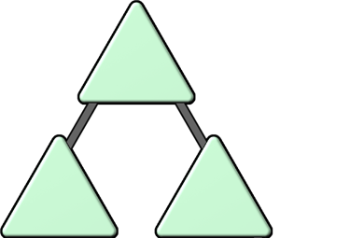
Trees
contoso.com
A domain tree is a hierarchy of domains in AD DS
emea.contoso.com
na.contoso.com
All domains in the tree:
Share a contiguous namespace with the parent domain
Can have additional child domains
By default create a two-way transitive trust with other domains

Slide 20
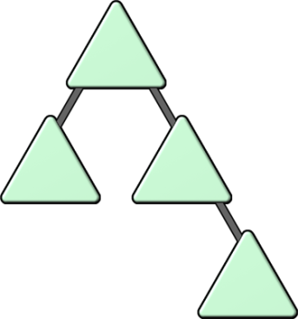
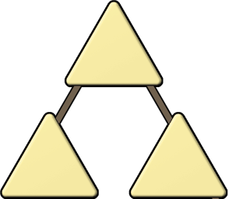
Forests
A forest is a collection of one or more domain trees
Forests:
Share a common schema
Share a common configuration partition
Share a common global catalog to enable searching
Enable trusts between all domains in the forest
Share the Enterprise Admins and Schema Admins groups

Slide 21
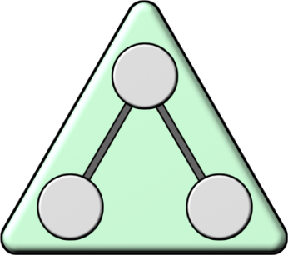
Organizational Units (OUs)
OUs are Active Directory containers that can contain users, groups, computers, and other OUs1
OUs are used to:
Represent your organization hierarchically and logically
Manage a collection of objects in a consistent way
Delegate permissions to administer groups of objects
Apply policies

Slide 22
AD DS Objects
Object | Description
User | Enables network resource access for a user
InetOrgPerson | Similar to a user account Used for compatibility with other directory services
Contacts | Used primarily to assign e-mail addresses to external users Does not enable network access
Groups | Used to simplify the administration of access control
Computers | Enables authentication and auditing of computer access to resources
Printers | Used to simplify the process of locating and connecting to printers
Shared folders | Enables users to search for shared folders based on properties

Slide 23
Practical Demo: Installation and Management
Observe the installation of AD DS
Installation occurs without promotion to a domain controller
Domain Controller Promotion
Active Directory Users and Computers
Active Directory Administrative Center
Active Directory Sites and Services

Slide 24


