Slide 1
YOUNG PEOPLE CLASSIFICATION
CS513 Knowledge Discovery & Data Mining
Final Project

Slide 2


TEAM MEMBERS
Dhavala Sowmya Devanshu

Slide 3
INTRODUCTION & MOTIVATION
“Young People Survey” data set
Interesting data set spanning across diverse behavior and preference metrics
DataSource: https://www.kaggle.com/miroslavsabo/young-people-survey

Slide 4
DATASET
1010 rows ,140columns
Target variable: Gender
Other variables:
Music Preferences (Integer)
Movie Preferences (Integer)
Finances(Integer)
Age(Integer)
And so on

Slide 5
DATA CLEANING & PRE-PROCESSING
Multiple missing values
Approach 1: replace missing values with mean of column
Approach 2: omit missing values
Normalize the Integer columns for certain algorithms like KNN
Training and Test Data

Slide 6
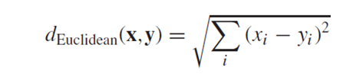
Algorithm 1- KNN
K nearest neighbors found using Euclidean distance metric:
Predictors used: Satisfaction Level, Last Evaluation, Number of Projects, Average Monthly Hours, Time spent at the company
K = 2 (0.969556 accuracy)

Slide 7
Algorithm 1- KNN
K = 3 (0.972444 accuracy)
K = 5 (0.968889 accuracy)

Slide 8
Algorithm 1- KNN
K = 9 (0.969556 accuracy)
K = 15 (0.966000 accuracy)

Slide 9
Algorithm 2 – Random Forest
Used all features after data cleaning to classify smoker, alcoholic, gender, and liar.
For Smoker, number of Trees (ntree) = 1000
0.4936709 accuracy
For Smoker, number of Trees (ntree) = 2000
0.5 accuracy
For Smoker, number of Trees (ntree) = 3000
0.5063291 accuracy

Slide 10
Algorithm 2 – Random Forest
For Gender, number of Trees (ntree) = 1000
0.874 accuracy
For Gender, number of Trees (ntree) = 2000
0.88 accuracy
For Gender, number of Trees (ntree) = 3000
0.88 accuracy
For Liar, number of Trees (ntree) = 1000
0.5822785 accuracy
For Liar, number of Trees (ntree) = 2000
0.5886076 accuracy
For Liar, number of Trees (ntree) = 3000
0.5822785 accuracy

Slide 11
Algorithm 2 – Random Forest
For Alcoholic, number of Trees (ntree) = 1000
0.65823 accuracy
For Alcoholic, number of Trees (ntree) = 2000
0.65823 accuracy
For Alcoholic, number of Trees (ntree) = 3000
0.65823 accuracy

Slide 12
Algorithm 2 – Random Forest
Conclusion for random forest model:
As the number of trees increase accuracy may or may not increase.
Sometimes the accuracy of training dataset is less than the test dataset even though training has more data in it. So the size of data is also an important factor apart from number of trees.

Slide 13

Algorithm 3 – Neural Network
Features used All columns except the categorical data like smoker, alcoholic etc
Approach 1: replace missing value with mean of column
Learning Rate: 0.05 Hidden Layers = 5
0.9207920792 accuracy (1= Female, 0= Male)
Learning Rate: 0.1 Hidden Layers = 5
0.900990099 accuracy

Slide 14

Algorithm 3 – Neural Network
Approach 1: omit missing value (684 columns)
Learning Rate: 0.05 Hidden Layers = 5
0.9197080292 accuracy (1= Female, 0= Male)
Learning Rate: 0.05 Hidden Layers = 10
0.9051094891 accuracy

Slide 15
Algorithm 4 – C5.0
Extra!
Interesting dependencies between seemingly independent aspects of an individual

Slide 16
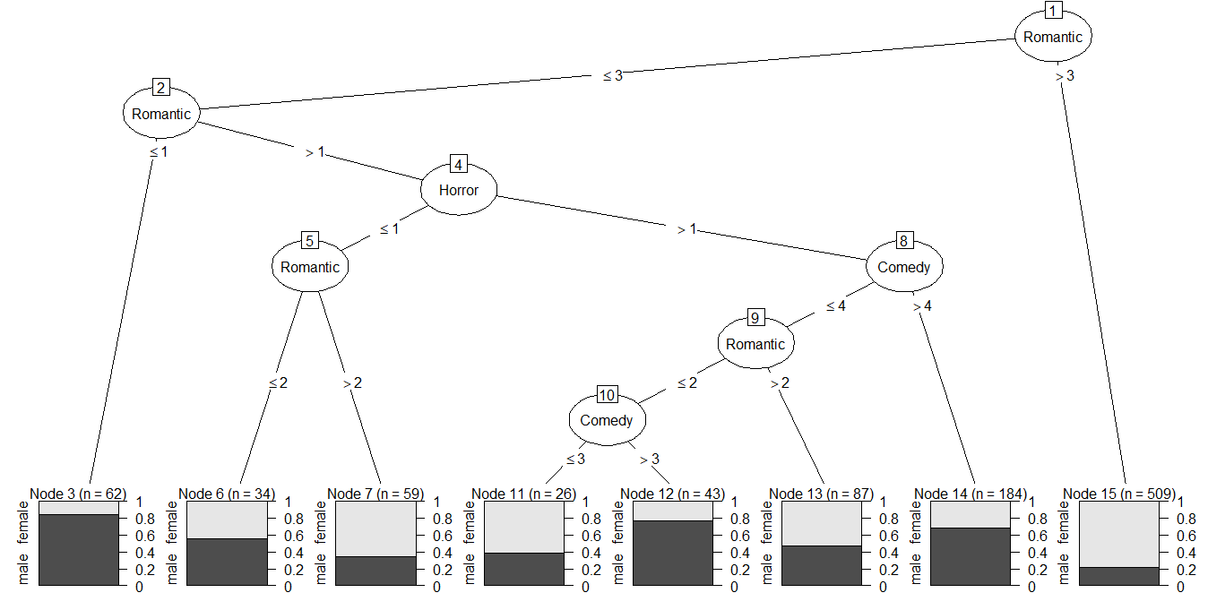
Classify gender based on horror, comedy and romantic movie ratings

Slide 17
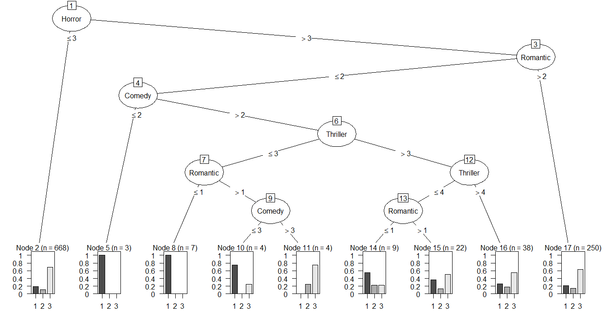
1 | drinks a lot
2 | never drinks
3 | social drinker
Classify drinking habits based on horror, comedy, thriller and romantic movie ratings

Slide 18
Algorithm 4 - Naïve Bayes
Used all predictors
0.873111 accuracy

Slide 19
Algorithm 5 – Support Vector Machine
SVM method in R for classification used to divide data in two sets using a hyperplane.
Predictors used – Satisfaction Level, Last Evaluation, Number of Projects, Average Monthly Hours and Time spent at company.
Default parameters - Radial kernel function, Gamma = 1 / 5, Cost = 1
RMSE: 0.1867857
After tuning the parameters – Gamma = 2, Cost = 10
RMSE: 0.1598611

Slide 20
Conclusion
Highest accuracies for each algorithm:
Top features for prediction: Number of Projects, Time Spent at the Company and Satisfaction Level (from Random Forest)
Algorithm | Parameters | Accuracy
KNN | K = 3 | 0.972444
Random Forest | Ntree = 3000 | 0.974000
Neural Network | Learning Rate = 0.1 Hidden Layers = 4 | 0.9477777778
Naïve Bayes | All predictors | 0.873111
Support Vector Machine | Gamma = 2 Cost = 10 | 0.974444

Slide 21
THANK YOU

