Slide 1
YOUNG PEOPLE SURVEY DATA CLASSIFICATION
CS513 Knowledge Discovery & Data Mining
Final Project

Slide 2


TEAM MEMBERS
Dhavala Sowmya Devanshu

Slide 3
INTRODUCTION & MOTIVATION
“Young People Survey” data set
Interesting data set spanning across diverse behavior and preference metrics
DataSource: https://www.kaggle.com/miroslavsabo/young-people-survey

Slide 4
DATASET
1010 rows ,140 columns
Target variable: Gender
Other variables:
Music Preferences (Integer)
Movie Preferences (Integer)
Finances(Integer)
Fears (Integer)
And so on

Slide 5
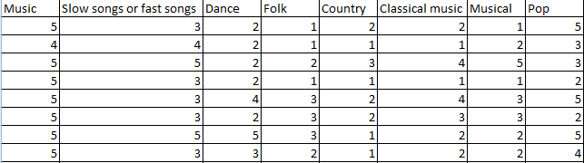
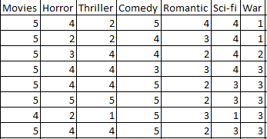
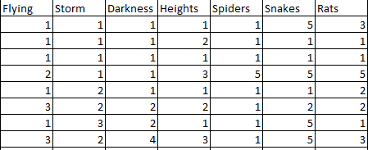

Slide 6
DATA CLEANING & PRE-PROCESSING
Multiple missing values
Approach 1: replace missing values with mean of column
Approach 2: omit missing values
Normalize the Integer columns for certain algorithms like KNN
Training and Test Data

Slide 7
Algorithm 1 - Naïve Bayes
Works on the assumption that given a class the occurrence of a certain feature is independent of other features
Based on the Bayes theorem of conditional probability
P(A/B) = P(B/A) * (P(A) /P(B))

Slide 8


Algorithm 1– Naïve Bayes
Approach 1 : Omit NA
Dataset : All predictors
Accuracy: 0.902439
Approach 2 : Replaced NAs with mean/mode and removed the highly correlated factors
Dataset : All predictors(except highly
correlated factors
Accuracy: 0.9405941

Slide 9
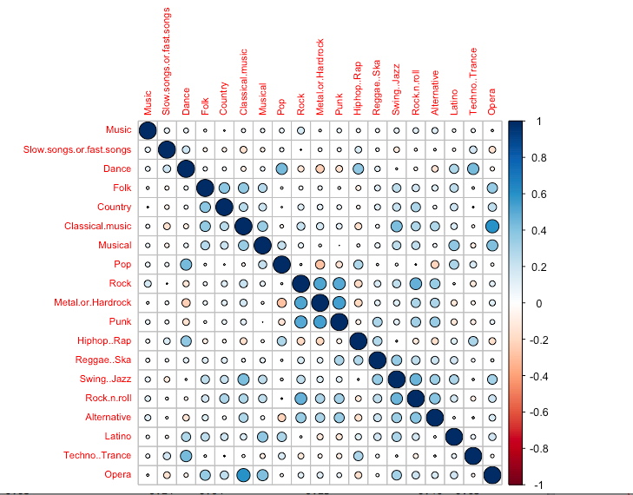
Correlation Matrix – Music Preferences

Slide 10
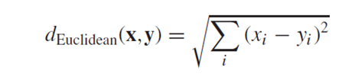
Algorithm 2- KNN
K nearest neighbors found using Euclidean distance metric:
Predictors used: Entire Dataset
Classification : Male/Female

Slide 11


Algorithm 2- KNN
Approach 1 : Omit NA
K = 17,19 (0.859 accuracy)
K=15(0.848 accuracy)

Slide 12


Algorithm 2- KNN
Approach 2 : Replaced NA’s with mean/mode
K = 17 (0.8844 accuracy)
K = 19 (0.8943 accuracy)

Slide 13

Algorithm 2- KNN
Approach 3 : Non-Normalized Data, replaced NA’s with mean/mode
K = 19 (0.9240924 accuracy)
Accuracy increased !!

Slide 14
Conclusion for KNN
Classification accuracy increased as the value of k increased.
There was not much increase in accuracy after replacing missing values.

Slide 15

Algorithm 3 – Random Forest
Used all features after data cleaning to classify gender.
Approach 1: Replaced integer “NA” values with mean and factor “NA” values with mode.
For Gender, number of Trees (ntree) = 1000
0.9306 accuracy

Slide 16
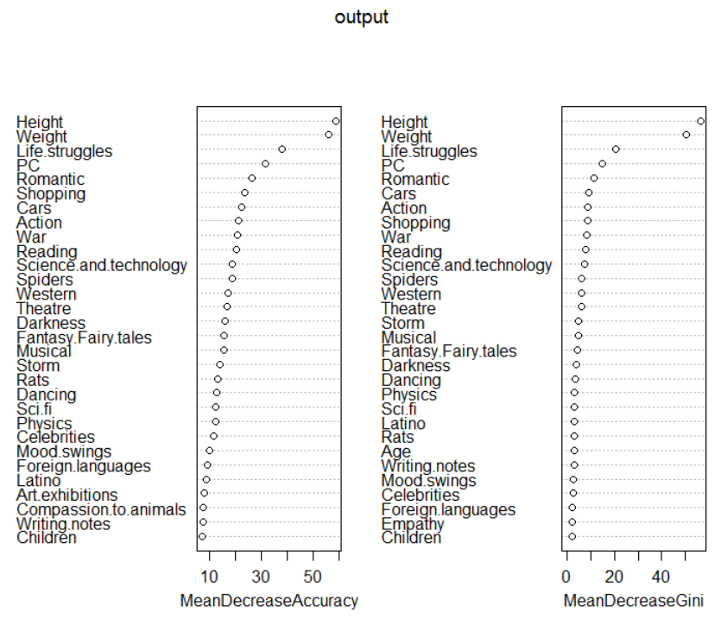
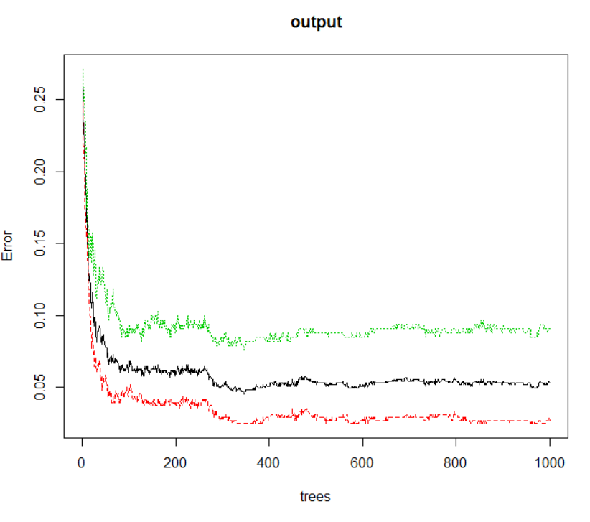

Slide 17
Algorithm 3 – Random Forest
For Gender, number of Trees (ntree) = 2000
0.9307 accuracy

Slide 18
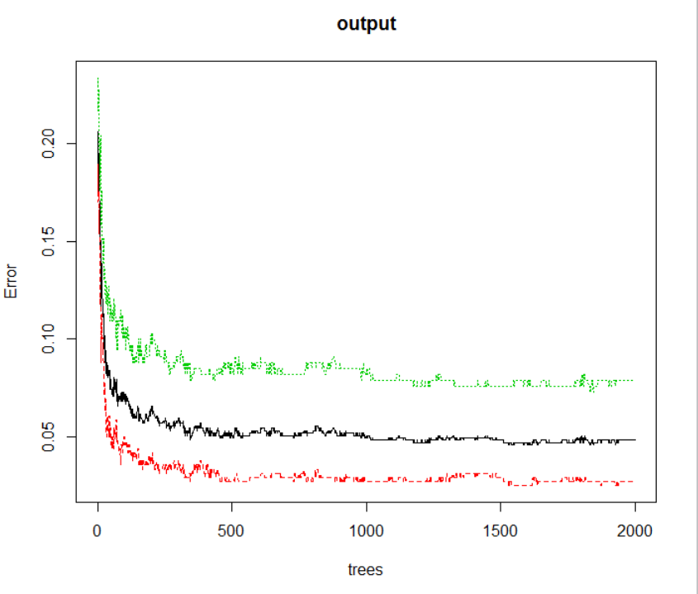

Slide 19

Algorithm 3 – Random Forest
For Gender, number of Trees (ntree) = 3000
0.94 accuracy

Slide 20
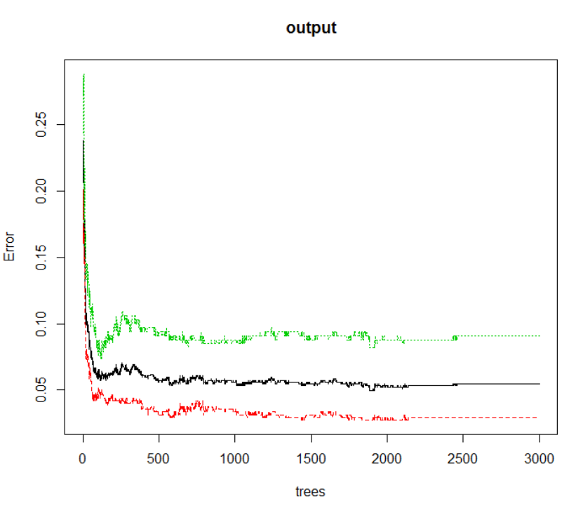

Slide 21

Algorithm 3 – Random Forest
Approach 2: Omitting NA values. (684 columns)
For Gender, number of Trees (ntree) = 1000
0.9416 accuracy

Slide 22
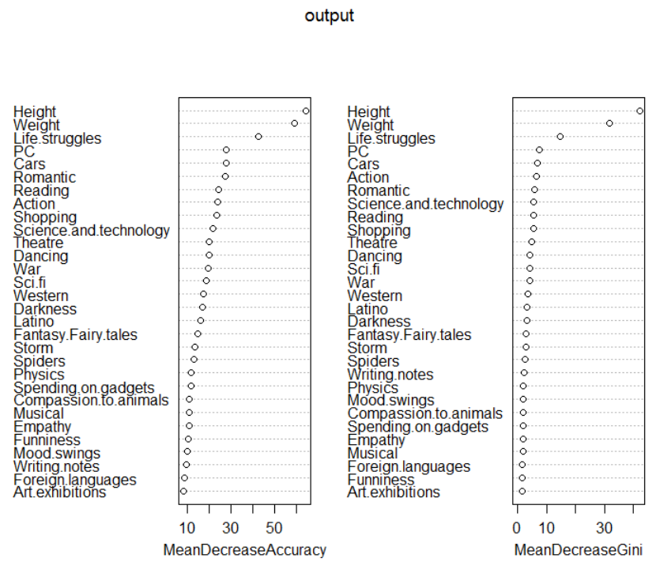
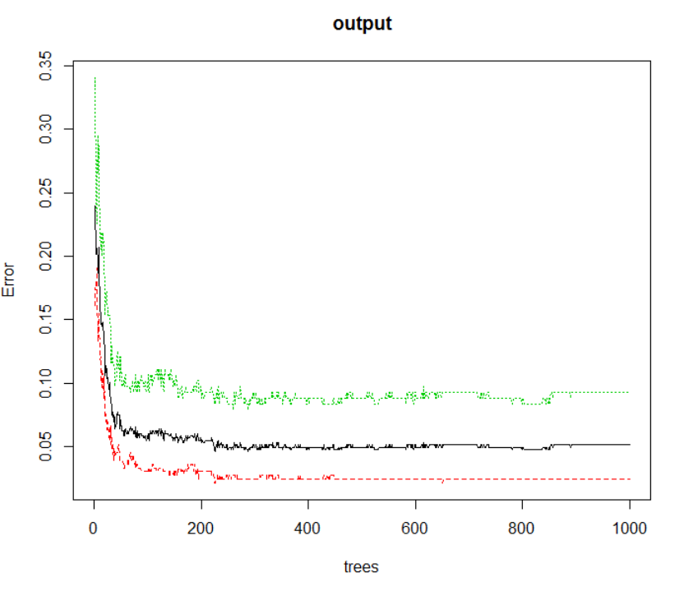

Slide 23
Algorithm 3 – Random Forest
For Gender, number of Trees (ntree) = 2000
0.9416 accuracy

Slide 24
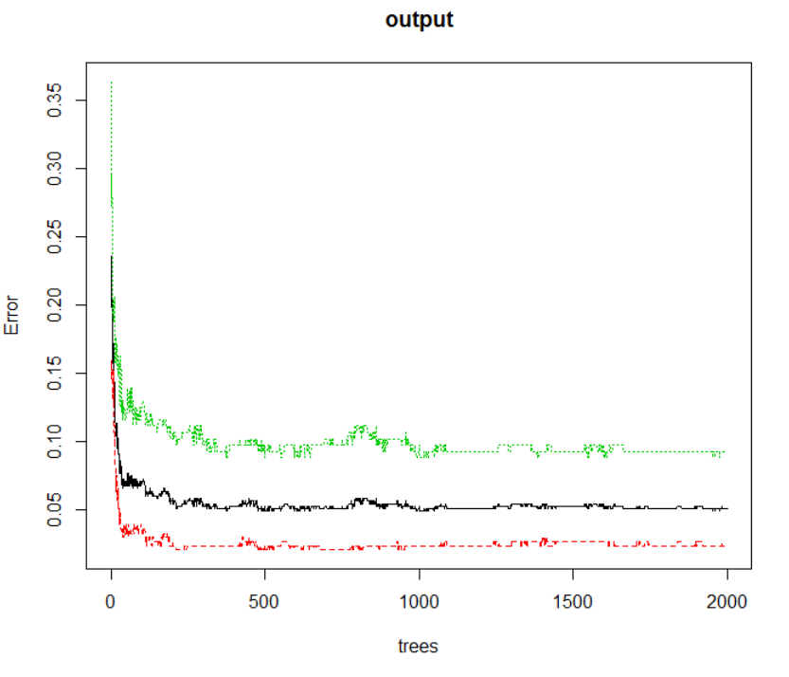

Slide 25
Algorithm 3 – Random Forest
For Gender, number of Trees (ntree) = 3000
0.9416 accuracy

Slide 26
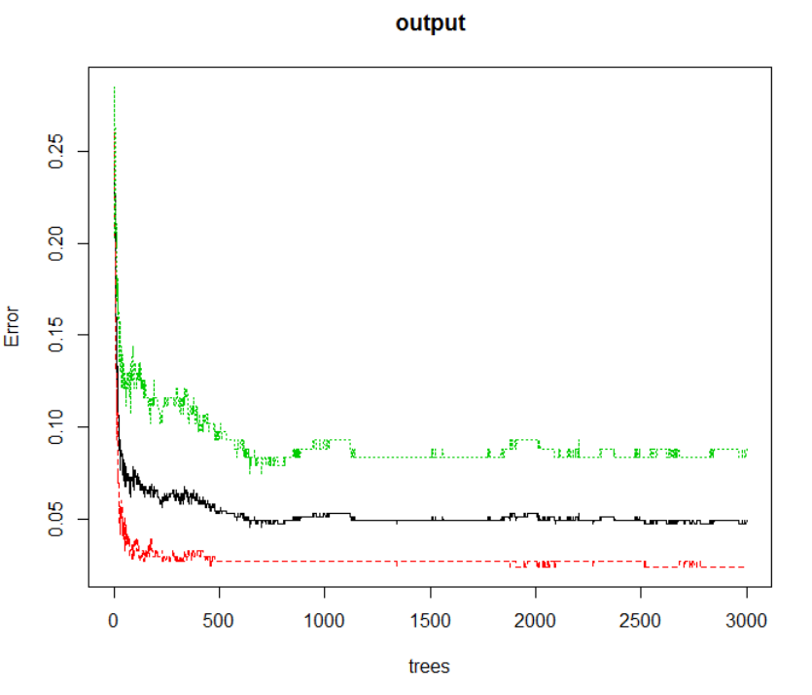

Slide 27
Algorithm 3 – Random Forest
Interesting/Fun prediction:
Who do you think is more romantic?
Who do you think like more cars?
Who thinks ahead of time?
Who gives the final judgement?

Slide 28
Algorithm 3 – Random Forest
Answers:
Who do you think is more romantic? Female
Who do you think like more cars? Male
Who thinks ahead of time? Male
Who gives the final judgement? Female

Slide 29
Algorithm 3 – Random Forest
Conclusion for random forest model:
As the number of trees increase accuracy may or may not increase.
Sometimes the accuracy of training dataset is less than the test dataset even though training has more data in it. So the size of data is also an important factor apart from number of trees.

Slide 30
Algorithm 4 – Neural Network
Data set: All columns except categorical data like smoker, alcoholic etc
Classification : Gender

Slide 31

Algorithm 4 – Neural Network
Approach 1: replace missing value with mean/ mode
Learning Rate: 0.05 Hidden Layers = 5
0.9405940594 accuracy (1= Female, 0= Male)
Learning Rate: 0.1 Hidden Layers = 5
0.896039604 accuracy

Slide 32

Algorithm 4 – Neural Network
Approach 2: omit missing value (684 rows)
Learning Rate: 0.05 Hidden Layers = 5
0.9343065693 accuracy (1= Female, 0= Male)
Learning Rate: 0.05 Hidden Layers = 10
0.8467153285 accuracy

Slide 33

Algorithm 4 – Neural Network
Approach 3: omit age, height, weight
Learning Rate: 0.05 Hidden Layers = 5
0.8861386139 accuracy (1= Female, 0= Male)

Slide 34
Conclusion for ANN
Accuracy higher by replacing NAs vs. omitting NAs
Increasing learning rate decreases accuracy
Weight and Height impact on classification

Slide 35
Algorithm 5 – C5.0
Extra!
Interesting dependencies between seemingly independent aspects of an individual

Slide 36
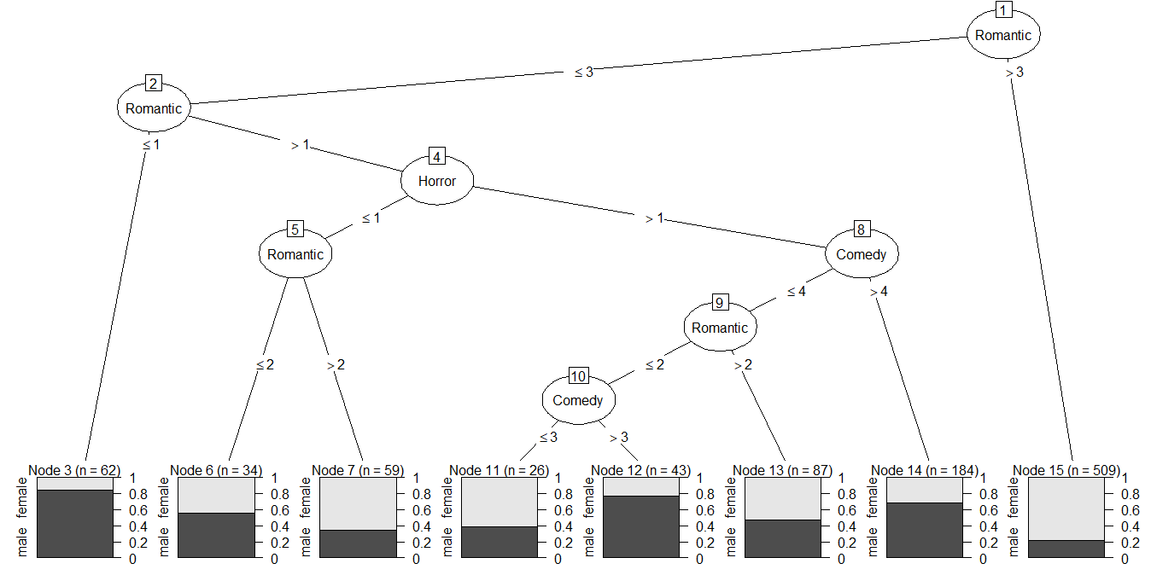
Classify gender based on horror, comedy and romantic movie ratings

Slide 37
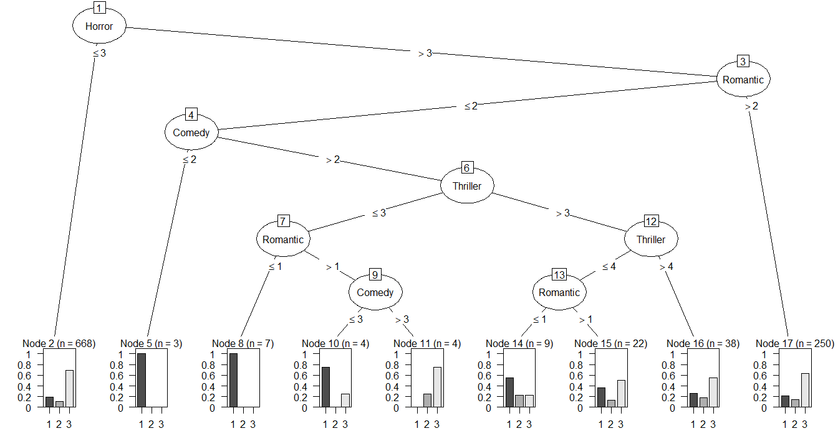
1 | drinks a lot
2 | never drinks
3 | social drinker
Classify drinking habits based on horror, comedy, thriller and romantic movie ratings

Slide 38
Conclusion
Highest accuracies for each algorithm:
Algorithm | Parameters | Accuracy
KNN | K = 19,Non Normalized | 0.9240924
Naïve Bayes | All predictors | 0.94059
Random Forest | Ntree = 3000 | 0.9416
Neural Network | Learning Rate = 0.05 Hidden Layers = 5 Replace values | 0.9405940594

Slide 39
THANK YOU

