Slide 1
YOUNG PEOPLE CLASSIFICATION
CS513 Knowledge Discovery & Data Mining
Final Project

Slide 2


TEAM MEMBERS
Dhavala Sowmya Devanshu

Slide 3
INTRODUCTION & MOTIVATION
“Young People Survey” data set
Interesting data set spanning across diverse behavior and preference metrics
DataSource: https://www.kaggle.com/miroslavsabo/young-people-survey

Slide 4
DATASET
1010 rows ,140columns
Target variable: Gender
Other variables:
Music Preferences (Integer)
Movie Preferences (Integer)
Finances(Integer)
Age(Integer)
And so on

Slide 5
DATA CLEANING & PRE-PROCESSING
Multiple missing values
Approach 1: replace missing values with mean of column
Approach 2: omit missing values
Normalize the Integer columns for certain algorithms like KNN
Training and Test Data

Slide 6
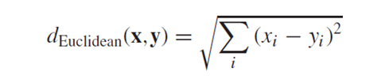
Algorithm 1- KNN
K nearest neighbors found using Euclidean distance metric:
Predictors used: Entire Dataset
Classification : Male/Female

Slide 7


Algorithm 1- KNN
Approach 1 : Omit NA
K = 17,19 (0.859 accuracy)
K=15(0.848 accuracy)

Slide 8


Algorithm 1- KNN
Approach 2 : Replaced NA’s with mean/mode
K = 17 (0.8844 accuracy)
K = 19 (0.8943 accuracy)

Slide 9
Conclusion for KNN
Classification accuracy increased as the value of k increased.
There was not much increase in accuracy after replacing missing values.

Slide 10
Algorithm 2 - Naïve Bayes
Works on the assumption that given a class the occurrence of a certain feature is independent of other features
Based on the Bayes theorem of conditional probability
P(A/B) = P(B/A) * (P(A) /P(B))

Slide 11


Algorithm 2– Naïve Bayes
Approach 1 : Omit NA
Dataset : All predictors
Accuracy: 0.902
Approach 1 : Replaced NAs with mean/mode
Dataset : All predictors
Accuracy: 0.943

Slide 12

Algorithm 3 – Random Forest
Used all features after data cleaning to classify gender.
Approach 1: Replaced integer “NA” values with mean and factor “NA” values with mode.
For Gender, number of Trees (ntree) = 1000
0.9306 accuracy

Slide 13
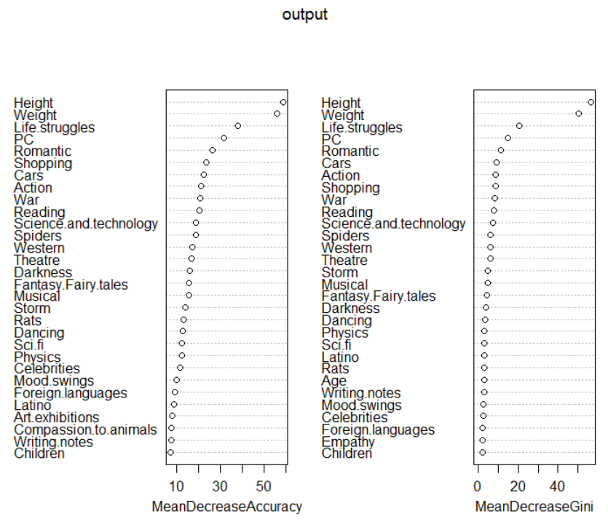
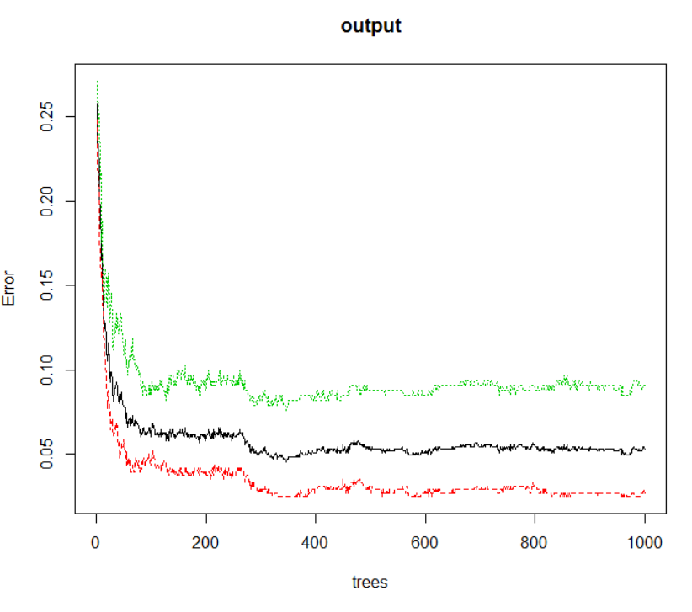

Slide 14
Algorithm 3 – Random Forest
For Gender, number of Trees (ntree) = 2000
0.9307 accuracy

Slide 15
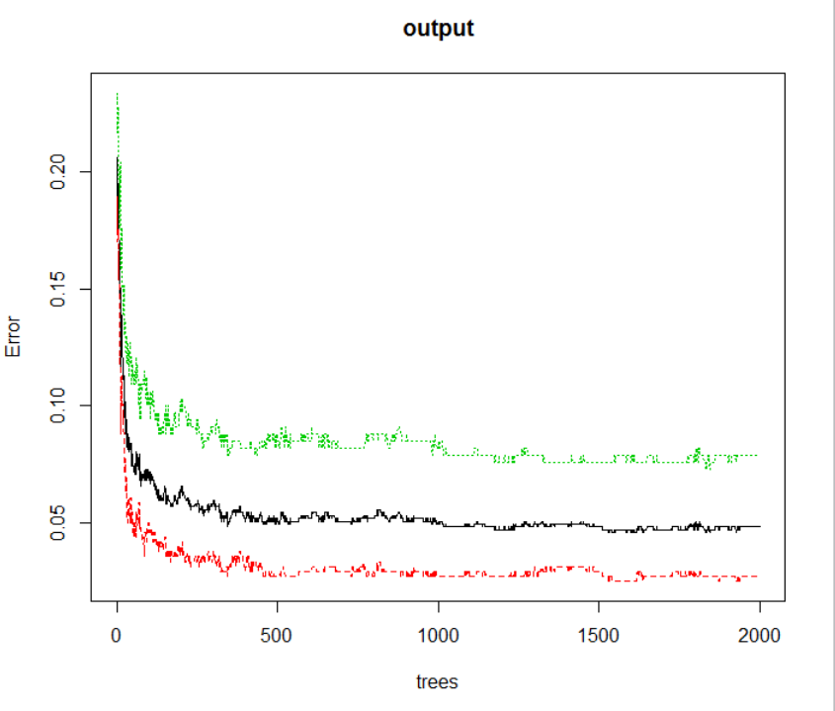

Slide 16

Algorithm 3 – Random Forest
For Gender, number of Trees (ntree) = 3000
0.94 accuracy

Slide 17
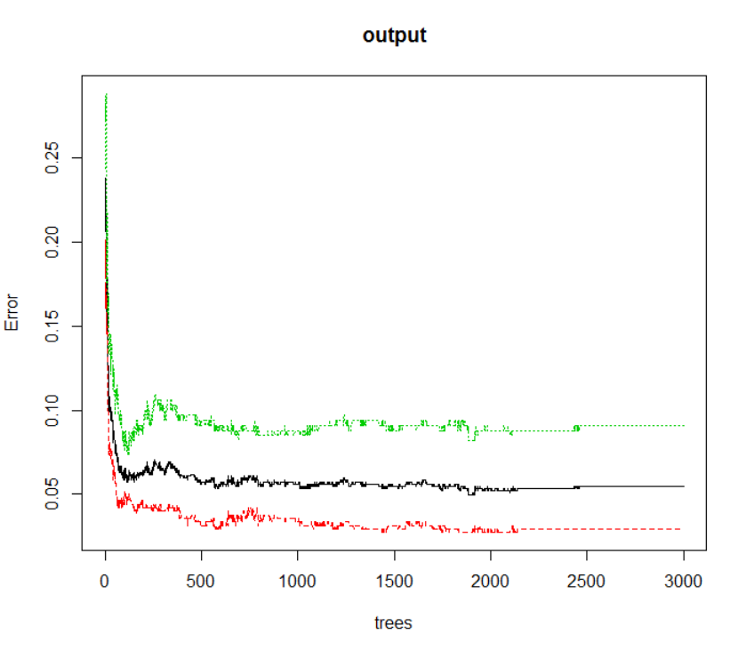

Slide 18

Algorithm 3 – Random Forest
Approach 2: Omitting NA values. (684 columns)
For Gender, number of Trees (ntree) = 1000
0.9416 accuracy

Slide 19
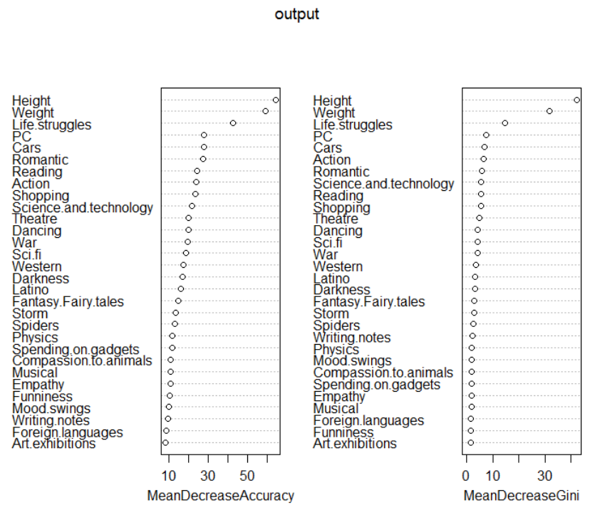
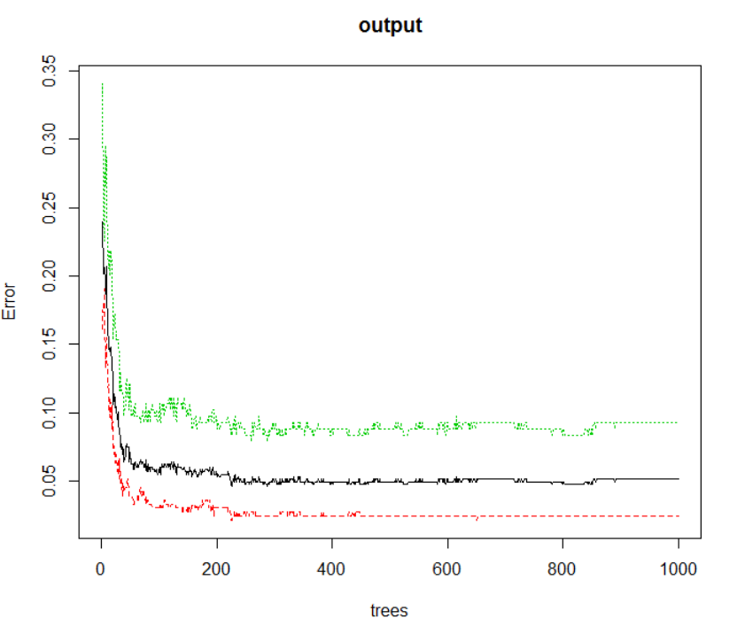

Slide 20
Algorithm 3 – Random Forest
For Gender, number of Trees (ntree) = 2000
0.9416 accuracy

Slide 21
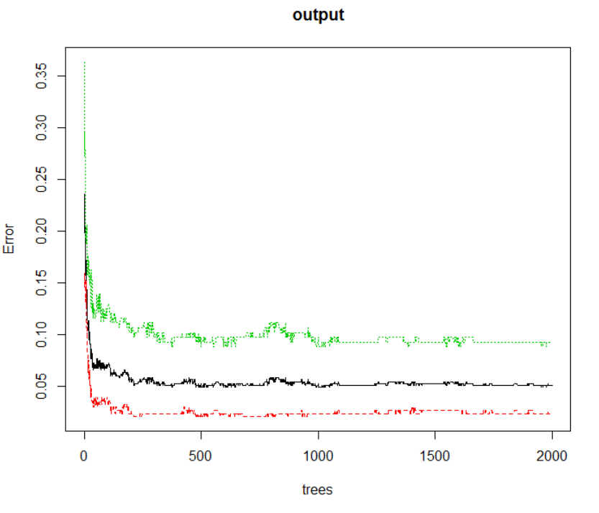

Slide 22
Algorithm 3 – Random Forest
For Gender, number of Trees (ntree) = 3000
0.9416 accuracy

Slide 23
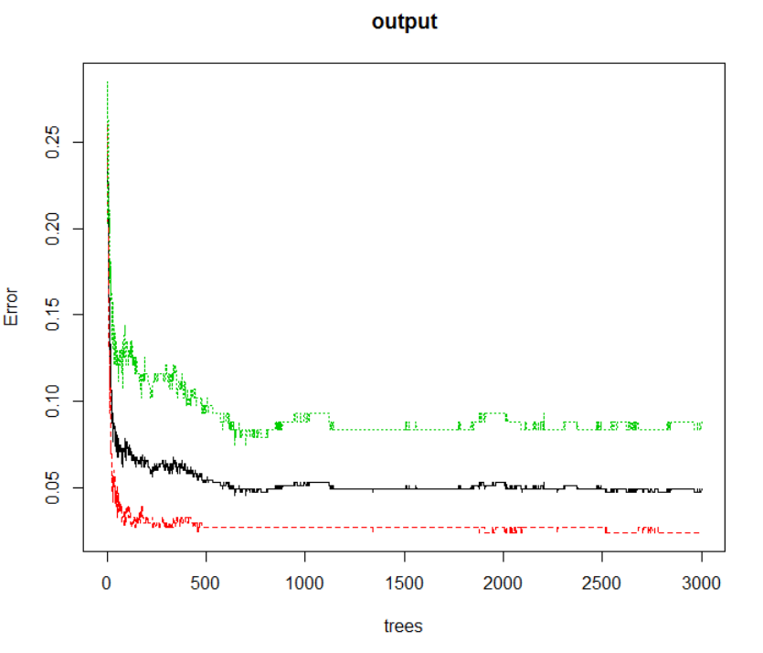

Slide 24
Algorithm 3 – Random Forest
Interesting/Fun prediction:
Who do you think is more romantic?
Who do you think like more cars?
Who thinks ahead of time?
Who gives the final judgement?

Slide 25
Algorithm 3 – Random Forest
Answers:
Who do you think is more romantic? Female
Who do you think like more cars? Male
Who thinks ahead of time? Male
Who gives the final judgement? Female

Slide 26
Algorithm 3 – Random Forest
Conclusion for random forest model:
As the number of trees increase accuracy may or may not increase.
Sometimes the accuracy of training dataset is less than the test dataset even though training has more data in it. So the size of data is also an important factor apart from number of trees.

Slide 27

Algorithm 4 – Neural Network
Features used All columns except the categorical data like smoker, alcoholic etc
Approach 1: replace missing value with mean of column
Learning Rate: 0.05 Hidden Layers = 5
0.9207920792 accuracy (1= Female, 0= Male)
Learning Rate: 0.1 Hidden Layers = 5
0.900990099 accuracy

Slide 28

Algorithm 4 – Neural Network
Approach 2: omit missing value (684 columns)
Learning Rate: 0.05 Hidden Layers = 5
0.9197080292 accuracy (1= Female, 0= Male)
Learning Rate: 0.05 Hidden Layers = 10
0.9051094891 accuracy

Slide 29
Algorithm 5 – C5.0
Extra!
Interesting dependencies between seemingly independent aspects of an individual

Slide 30
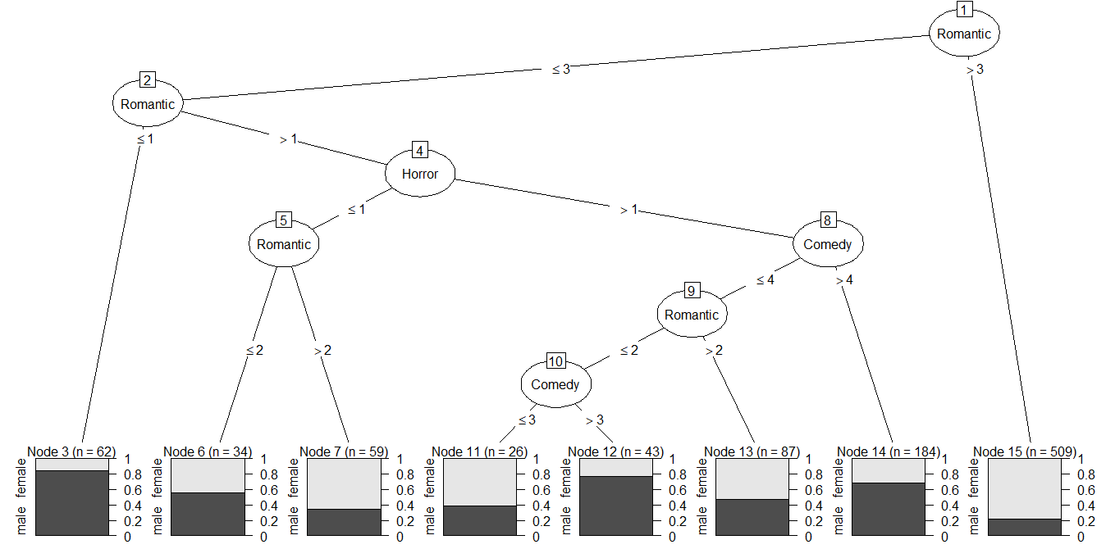
Classify gender based on horror, comedy and romantic movie ratings

Slide 31
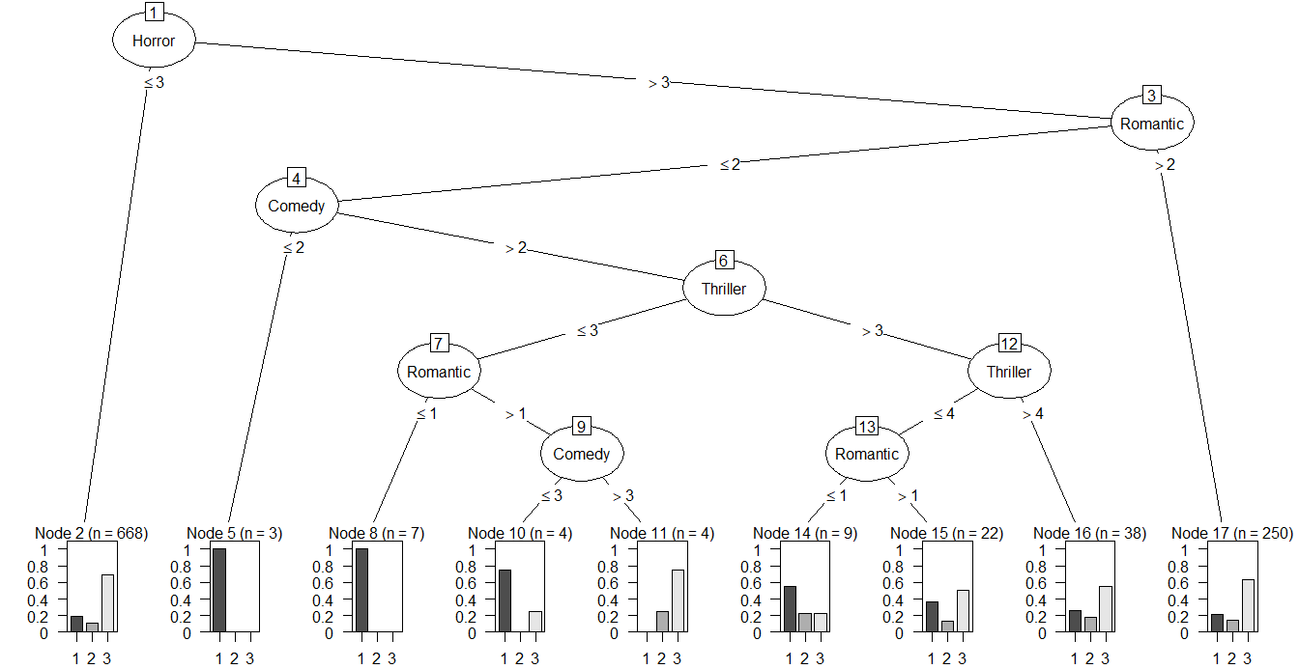
1 | drinks a lot
2 | never drinks
3 | social drinker
Classify drinking habits based on horror, comedy, thriller and romantic movie ratings

Slide 32
Conclusion
Highest accuracies for each algorithm:
Top features for prediction: Number of Projects, Time Spent at the Company and Satisfaction Level (from Random Forest)
Algorithm | Parameters | Accuracy
KNN | K = 19,All predictors | 0.8943
Naïve Bayes | All predictors | 0.943894
Random Forest | Ntree = 3000 | 0.9416
Neural Network | Learning Rate = 0.1 Hidden Layers = 4 | 0.9477777778

Slide 33
THANK YOU

