Slide 1
YOUNG PEOPLE CLASSIFICATION
CS513 Knowledge Discovery & Data Mining
Final Project

Slide 2


TEAM MEMBERS
Dhavala Sowmya Devanshu

Slide 3
INTRODUCTION & MOTIVATION
“Young People Survey” data set
Interesting data set spanning across diverse behavior and preference metrics
DataSource: https://www.kaggle.com/miroslavsabo/young-people-survey

Slide 4
DATASET
1010 rows ,140columns
Target variable: Gender
Other variables:
Music Preferences (Integer)
Movie Preferences (Integer)
Finances(Integer)
Age(Integer)
And so on

Slide 5
DATA CLEANING & PRE-PROCESSING
Multiple missing values
Approach 1: replace missing values with mean of column
Approach 2: omit missing values
Normalize the Integer columns for certain algorithms like KNN
Training and Test Data

Slide 6
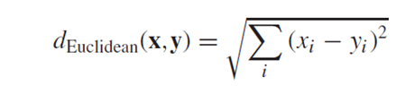
Algorithm 1- KNN
K nearest neighbors found using Euclidean distance metric:
Predictors used: Satisfaction Level, Last Evaluation, Number of Projects, Average Monthly Hours, Time spent at the company
K = 2 (0.969556 accuracy)

Slide 7
Algorithm 1- KNN
K = 3 (0.972444 accuracy)
K = 5 (0.968889 accuracy)

Slide 8
Algorithm 1- KNN
K = 9 (0.969556 accuracy)
K = 15 (0.966000 accuracy)

Slide 9

Algorithm 2 – Random Forest
Used all features after data cleaning to classify gender.
Approach 1: Replaced integer “NA” values with mean and factor “NA” values with mode.
For Gender, number of Trees (ntree) = 1000
0.9306 accuracy

Slide 10
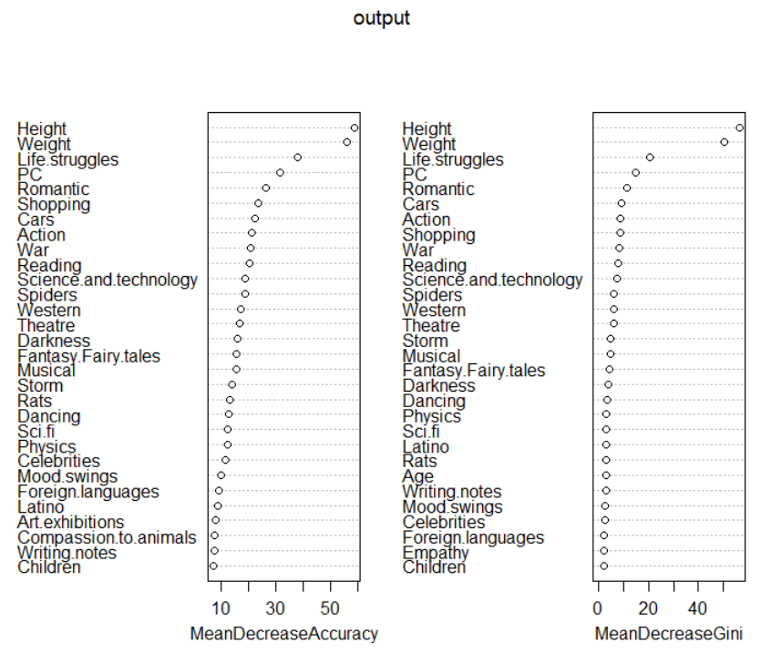
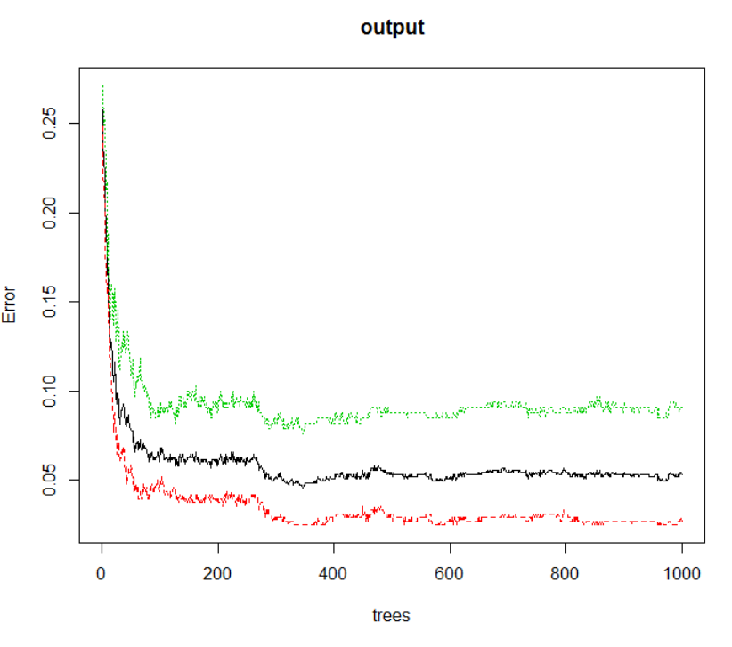

Slide 11
Algorithm 2 – Random Forest
For Gender, number of Trees (ntree) = 2000
0.9307 accuracy

Slide 12
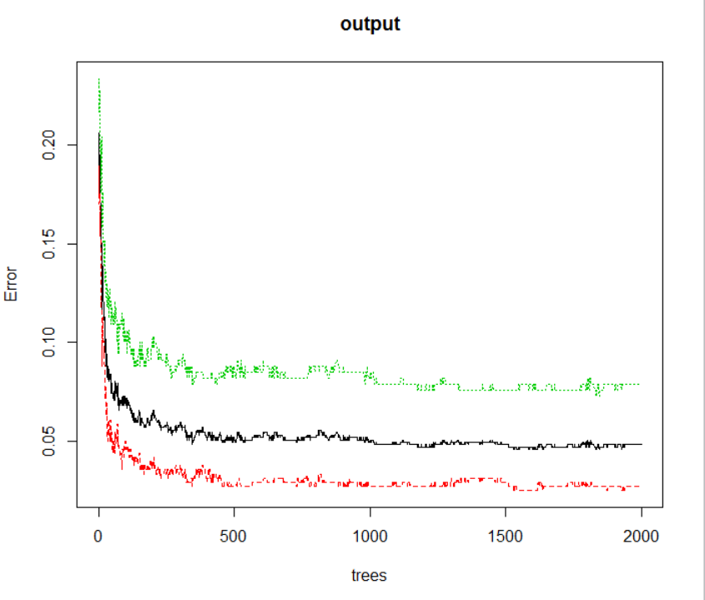

Slide 13

Algorithm 2 – Random Forest
For Gender, number of Trees (ntree) = 3000
0.94 accuracy

Slide 14
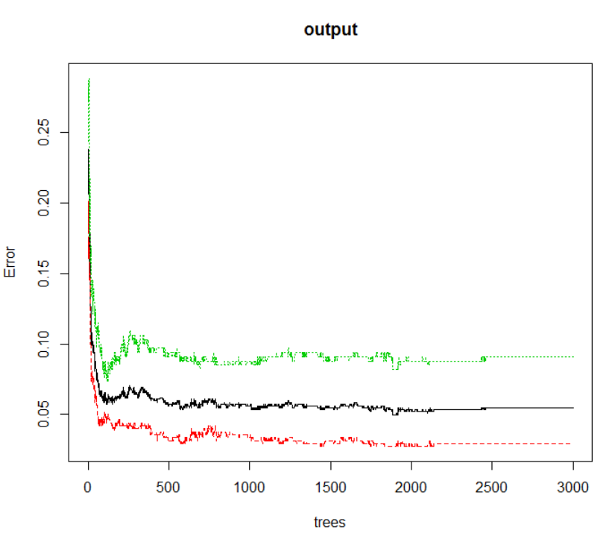

Slide 15

Algorithm 2 – Random Forest
Approach 2: Omitting NA values. (684 columns)
For Gender, number of Trees (ntree) = 1000
0.9416 accuracy

Slide 16
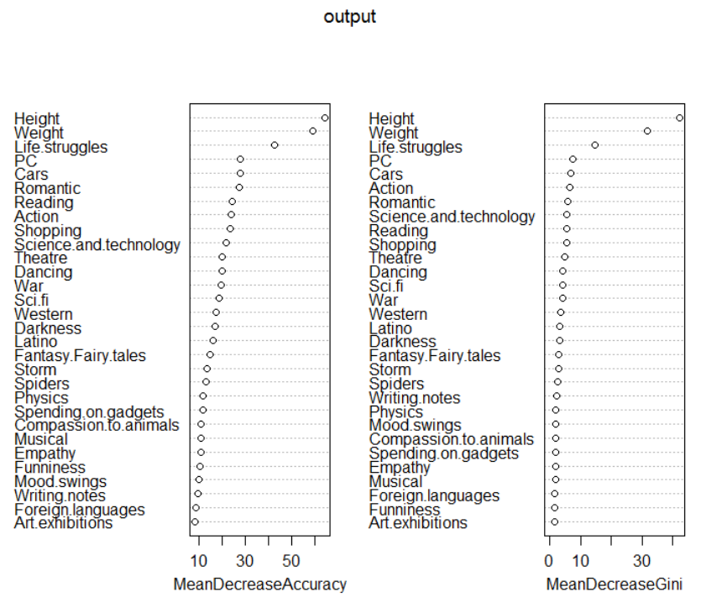
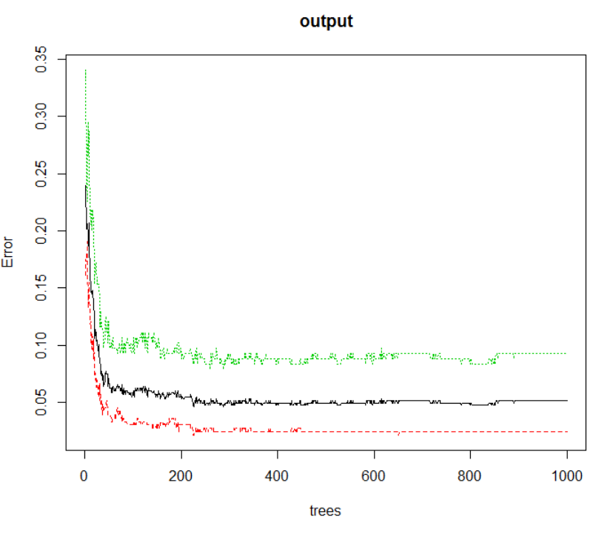

Slide 17
Algorithm 2 – Random Forest
For Gender, number of Trees (ntree) = 2000
0.9416 accuracy

Slide 18
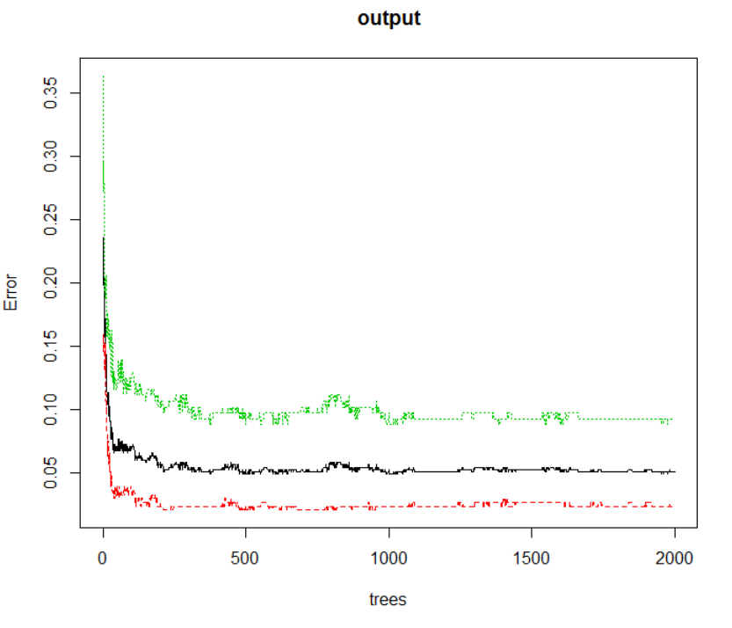

Slide 19
Algorithm 2 – Random Forest
For Gender, number of Trees (ntree) = 3000
0.9416 accuracy

Slide 20
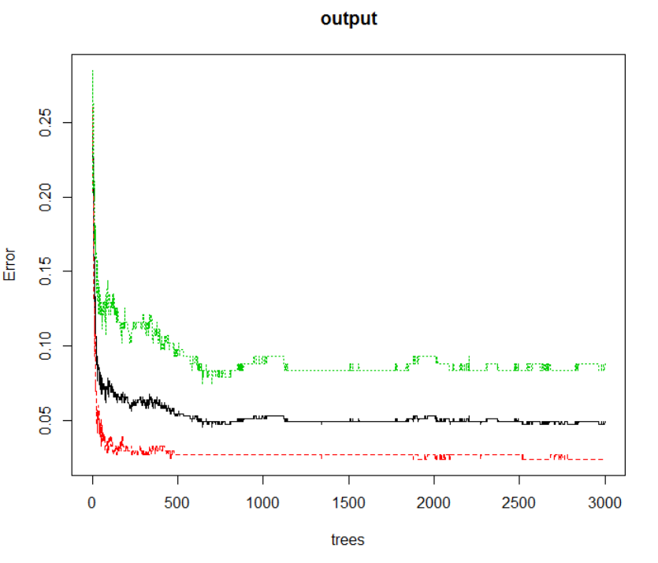

Slide 21
Algorithm 2 – Random Forest
Interesting/Fun prediction:
Who do you think is more romantic?
Who do you think like more cars?
Who thinks ahead of time?
Who gives the final judgement?

Slide 22
Algorithm 2 – Random Forest
Answers:
Who do you think is more romantic? Female
Who do you think like more cars? Male
Who thinks ahead of time? Male
Who gives the final judgement? Female

Slide 23
Algorithm 2 – Random Forest
Conclusion for random forest model:
As the number of trees increase accuracy may or may not increase.
Sometimes the accuracy of training dataset is less than the test dataset even though training has more data in it. So the size of data is also an important factor apart from number of trees.

Slide 24

Algorithm 3 – Neural Network
Features used All columns except the categorical data like smoker, alcoholic etc
Approach 1: replace missing value with mean of column
Learning Rate: 0.05 Hidden Layers = 5
0.9207920792 accuracy (1= Female, 0= Male)
Learning Rate: 0.1 Hidden Layers = 5
0.900990099 accuracy

Slide 25

Algorithm 3 – Neural Network
Approach 2: omit missing value (684 columns)
Learning Rate: 0.05 Hidden Layers = 5
0.9197080292 accuracy (1= Female, 0= Male)
Learning Rate: 0.05 Hidden Layers = 10
0.9051094891 accuracy

Slide 26
Algorithm 4 – C5.0
Extra!
Interesting dependencies between seemingly independent aspects of an individual

Slide 27
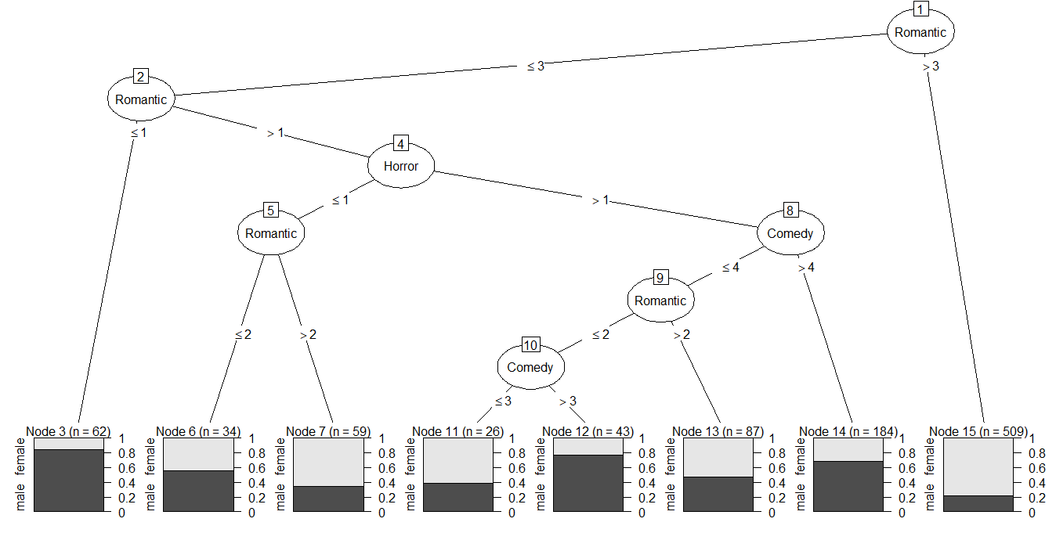
Classify gender based on horror, comedy and romantic movie ratings

Slide 28
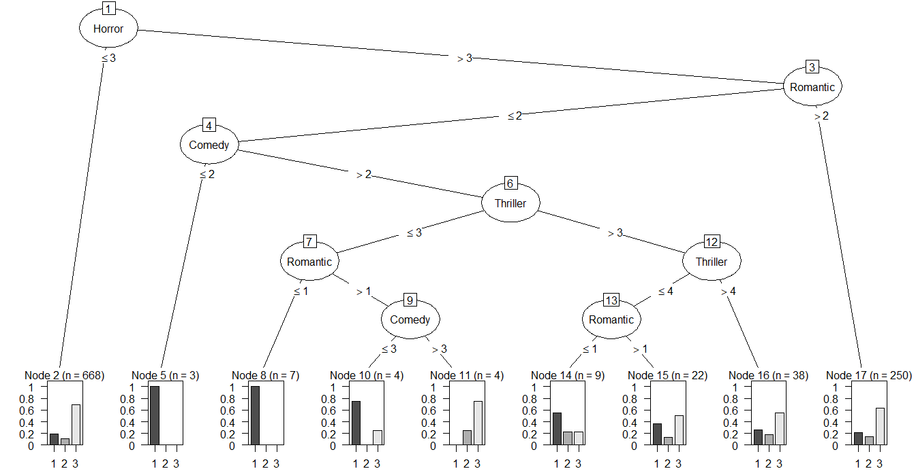
1 | drinks a lot
2 | never drinks
3 | social drinker
Classify drinking habits based on horror, comedy, thriller and romantic movie ratings

Slide 29
Algorithm 4 - Naïve Bayes
Used all predictors
0.873111 accuracy

Slide 30
Algorithm 5 – Support Vector Machine
SVM method in R for classification used to divide data in two sets using a hyperplane.
Predictors used – Satisfaction Level, Last Evaluation, Number of Projects, Average Monthly Hours and Time spent at company.
Default parameters - Radial kernel function, Gamma = 1 / 5, Cost = 1
RMSE: 0.1867857
After tuning the parameters – Gamma = 2, Cost = 10
RMSE: 0.1598611

Slide 31
Conclusion
Highest accuracies for each algorithm:
Top features for prediction: Number of Projects, Time Spent at the Company and Satisfaction Level (from Random Forest)
Algorithm | Parameters | Accuracy
KNN | K = 3 | 0.972444
Random Forest | Ntree = 3000 | 0.9416
Neural Network | Learning Rate = 0.1 Hidden Layers = 4 | 0.9477777778
Naïve Bayes | All predictors | 0.873111
Support Vector Machine | Gamma = 2 Cost = 10 | 0.974444

Slide 32
THANK YOU

