Slide 1
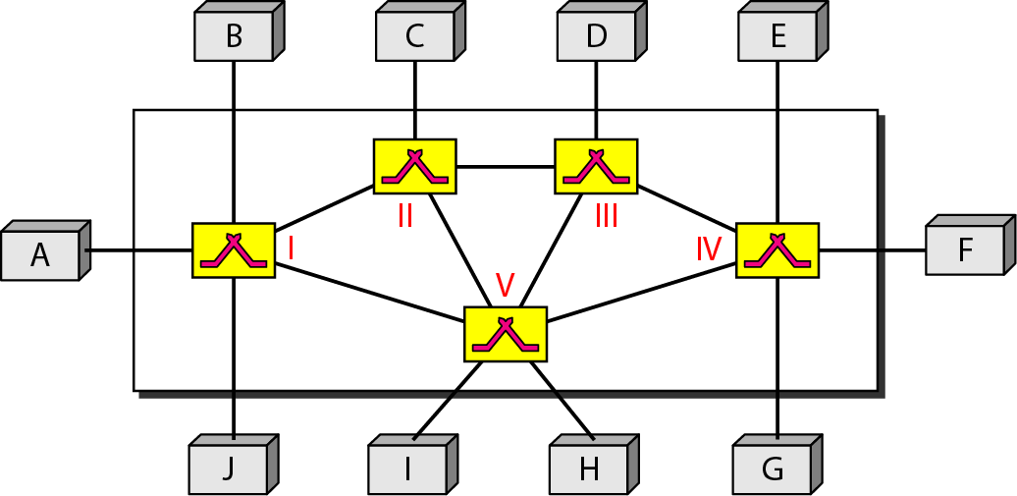
Switching

Slide 2
Switching
A network is a set of connected device
If we have multiple devices, we have the problem of how to connect them to make one-to-one communication
solutions are: mesh, star
if very large networks?
A better solution is Switching
A switched network consists of a series of interlinked nodes, called switches.
Switches are devices capable of creating temporary connections between two or more devices linked to the switch

Slide 3
Switch Network

Slide 4
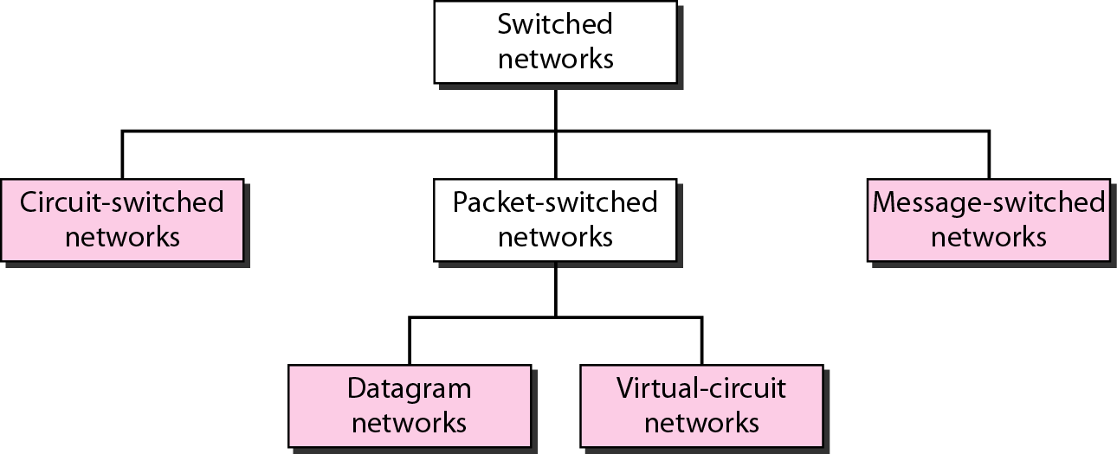
Taxonomy of Switched Network

Slide 5
Circuit-Switched Networks
A circuit-switched network consists of a set of switches connected by physical links. A connection between two stations is a dedicated path made of one or more links.
However, each connection uses only one dedicated channel on each link. Each link is normally divided into n channels by using FDM or TDM.
A circuit-switched network is made of a set of switches connected by physical links, in which each link is divided into n channels.

Slide 6
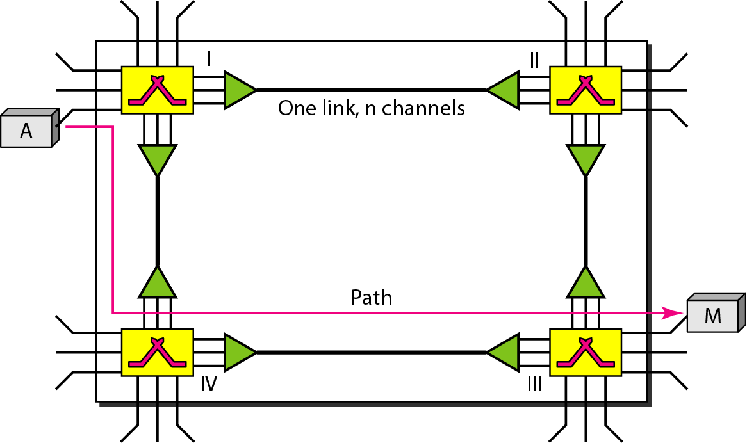
Circuit-Switched Networks

Slide 7
Circuit-Switched Networks
Circuit switching takes place at the physical layer.
Before starting communication, the stations must make a reservation for the resources to be used during the communication. These resources, such as channels bandwidth, switch buffers, switch processing time, and switch input/output ports, must remain dedicated during the entire duration of data transfer until the teardown phase.
Data transferred between the two stations are not packetized
The data are a continuous flow sent by the source station and received by the destination station, although there may be periods of silence.

Slide 8
Example 8.1
As a trivial example, let us use a circuit-switched network to connect eight telephones in a small area. Communication is through 4-kHz voice channels. We assume that each link uses FDM to connect a maximum of two voice channels. The bandwidth of each link is then 8 kHz. Figure 8.4 shows the situation. Telephone 1 is connected to telephone 7; 2 to 5; 3 to 8; and 4 to 6. Of course the situation may change when new connections are made. The switch controls the connections.

Slide 9
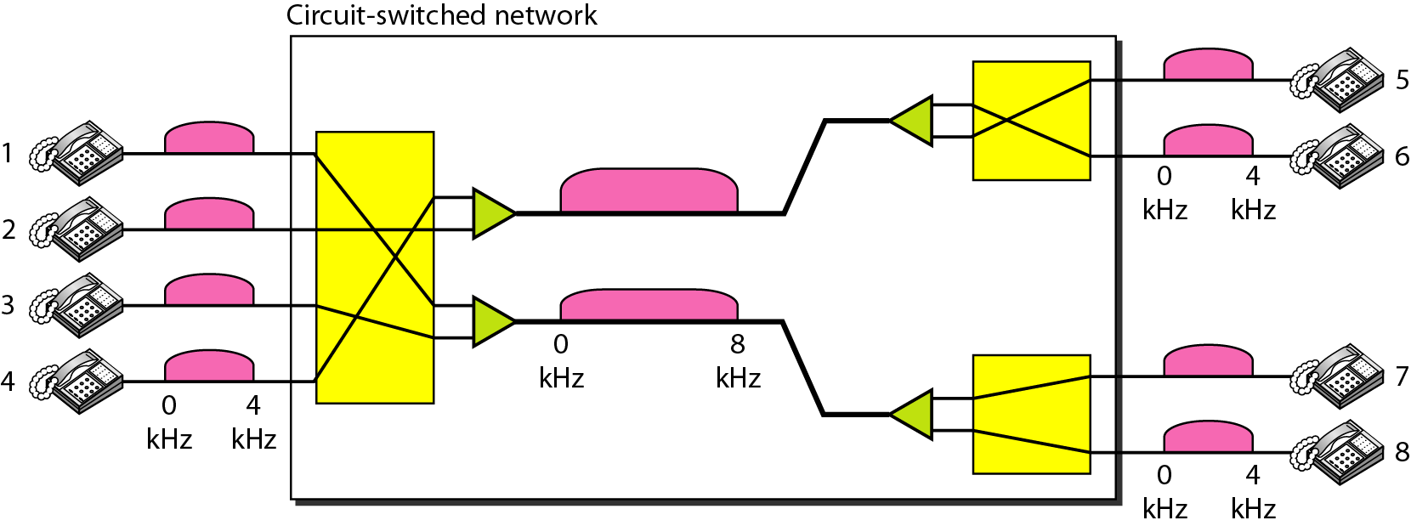
Circuit-switched network used in Example 8.1

Slide 10
Example 8.2
As another example, consider a circuit-switched network that connects computers in two remote offices of a private company. The offices are connected using a T-1 line leased from a communication service provider. There are two 4 × 8 (4 inputs and 8 outputs) switches in this network. For each switch, four output ports are folded into the input ports to allow communication between computers in the same office. Four other output ports allow communication between the two offices. Figure 8.5 shows the situation.

Slide 11
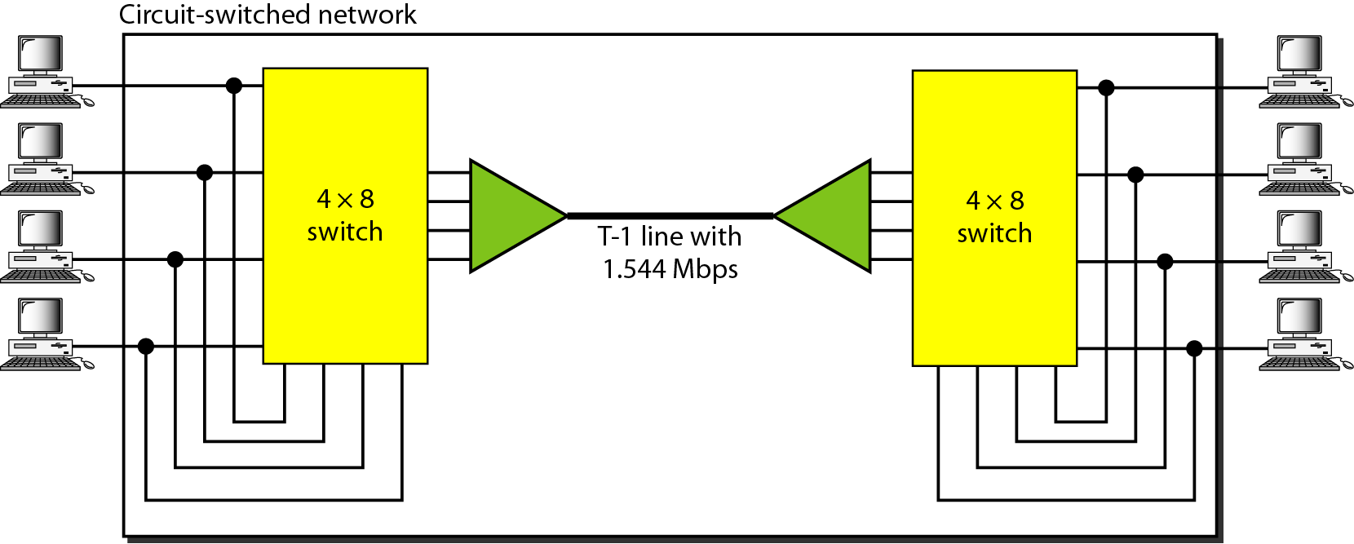
Circuit-switched network used in Example 8.2

Slide 12
Three Phases in Circuit-switched network
The actual communication in a circuit-switched network requires three phases
Connection Setup Phase
Data Transfer
Connection teardown

Slide 13
Circuit-switched network
Connection Setup Phase
Before the two parties (or multiple parties in a conference call) can communicate, a dedicated circuit (combination of channels in links) needs to be established.
The end systems are normally connected through dedicated lines to the switches, so connection setup means creating dedicated channels between the switches
In the next step to making a connection, an acknowledgment from system M needs to be sent in the opposite direction to system A .
Only after system A receives this acknowledgment is the connection established.

Slide 14
Circuit-switched network
Data Transfer Phase
After the establishment of the dedicated circuit (channels), the two parties can transfer data
Teardown Phase
When one of the parties needs to disconnect, a signal is sent to each switch to release the resources.

Slide 15
Circuit-switched network
Efficiency
It can be argued that circuit-switched networks are not as efficient as the other two types of networks because resources are allocated during the entire duration of the connection.
These resources are unavailable to other connections.
In a telephone network, people normally terminate the communication when they have finished their conversation.
However, in computer networks, a computer can be connected to another computer even if there is no activity for a long time. In this case, allowing resources to be dedicated means that other connections are deprived.

Slide 16
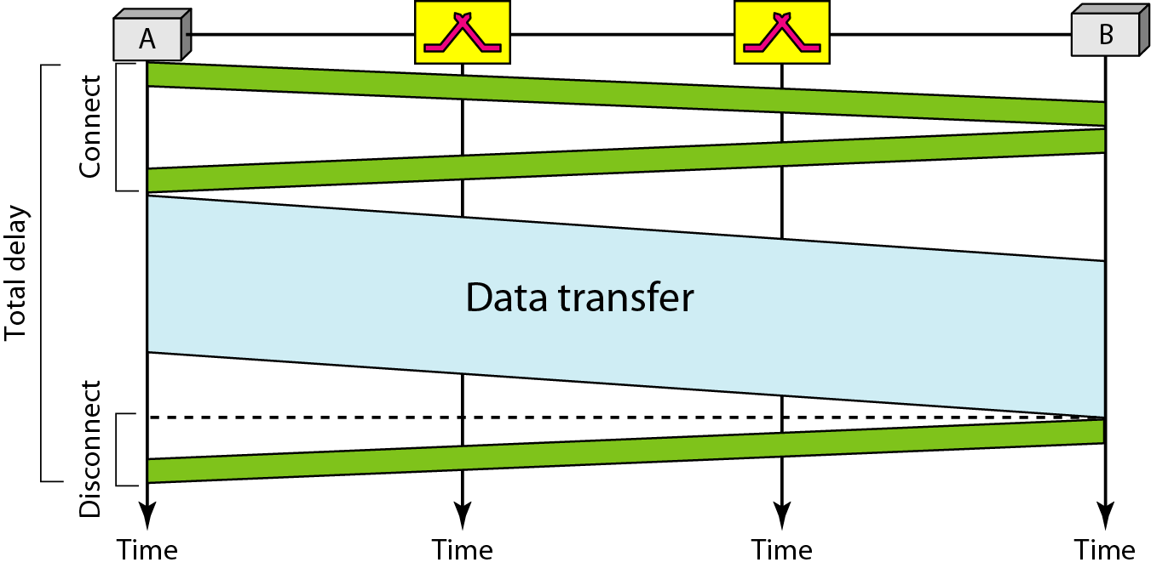
Circuit-switched network
Delay

Slide 17
Circuit-switched network
Application
Switching at the physical layer in the traditional telephone network uses
the circuit-switching approach.

Slide 18
Packet Switching
In data communications, we need to send messages from one end system to another.
If the message is going to pass through a packet-switched network, it needs to be divided into packets of fixed or variable size.
The size of the packet is determined by the network and the governing protocol
In a packet-switched network, there is no resource reservation;
resources are allocated on demand.

Slide 19
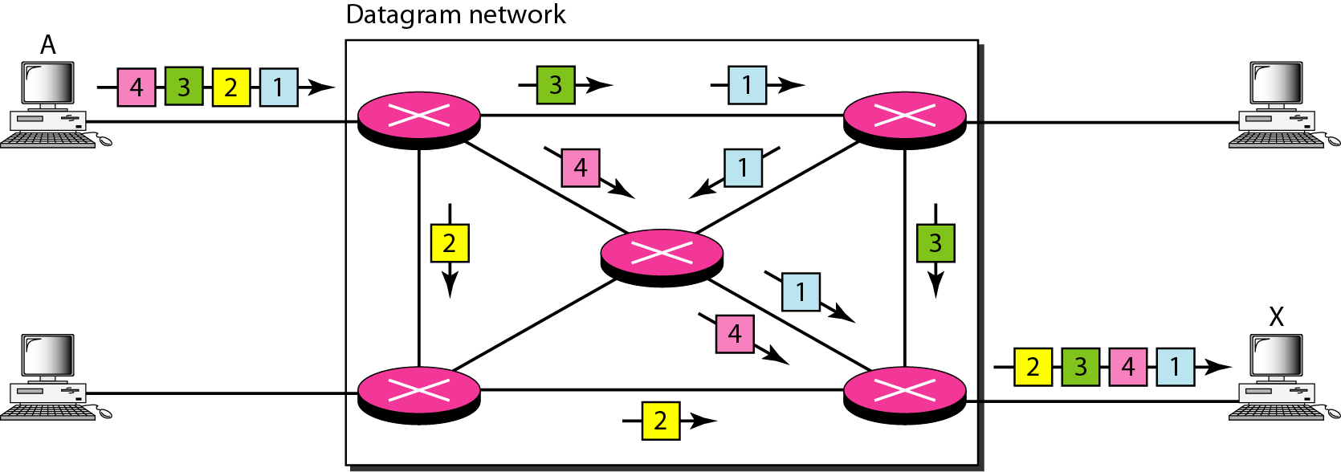
Datagram Networks
In a datagram network, each packet is treated independently of all others.
Even if a packet is part of a multipacket transmission, the network treats it as though it existed alone.
Packets in this approach are referred to as datagrams.
Datagram switching is normally done at the network layer.

Slide 20
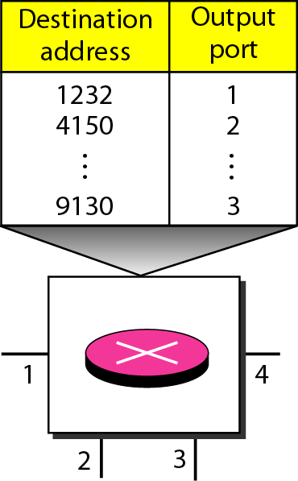
Routing table in a datagram network
If there are no setup or teardown phases, how are the packets routed to their destinations in a datagram network?
In this type of network, each switch (or packet switch) has a routing table which is based on the destination address.
The routing tables are dynamic and are updated periodically.
The destination address in the header of a packet in a datagram network remains the same during the entire journey of the packet.

Slide 21
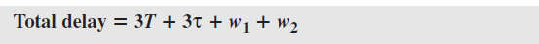
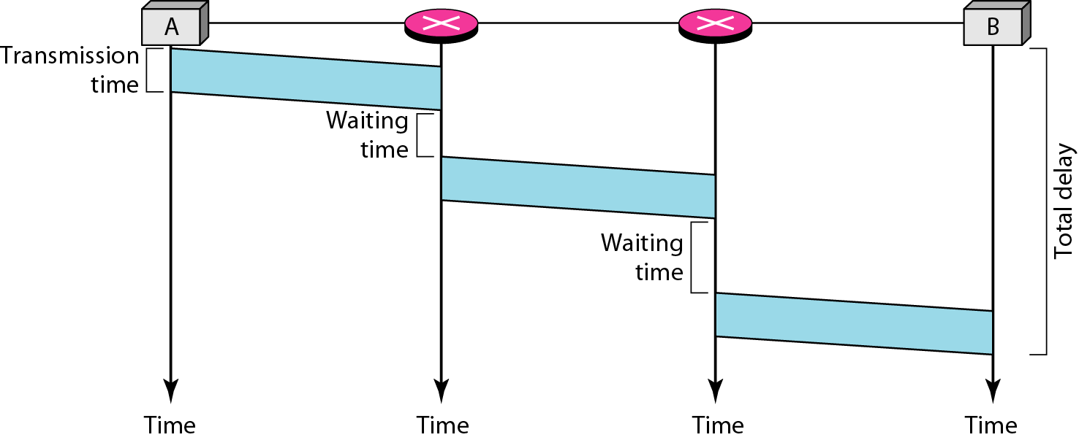
Delay in a datagram network
The efficiency of a datagram network is better than that of a circuit-switched network;
resources are allocated only when there are packets to be transferred.
If a source sends a packet and there is a delay of a few minutes before another packet can
be sent, the resources can be reallocated during these minutes for other packets from
other sources.

Slide 22
Datagram network
Switching in the Internet is done by using the datagram approach to packet switching at the network layer.

Slide 23
Virtual Circuit Networks
A virtual-circuit network is a cross between a circuit-switched network and a datagram network. It has some characteristics of both.
As in a circuit-switched network, there are setup and teardown phases in addition to the data transfer phase.
Resources can be allocated during the setup phase, as in a circuit-switched network, or on demand, as in a datagram network.
As in a datagram network, data are packetized and each packet carries an address in the header. However, the address in the header has local jurisdiction (it defines what the next switch should be and the channel on which the packet is being carried), not end-to-end jurisdiction. The reader may ask how the intermediate switches know where to send the packet if there is no final destination address carried by a packet.
As in a circuit-switched network, all packets follow the same path established during the connection.

Slide 24
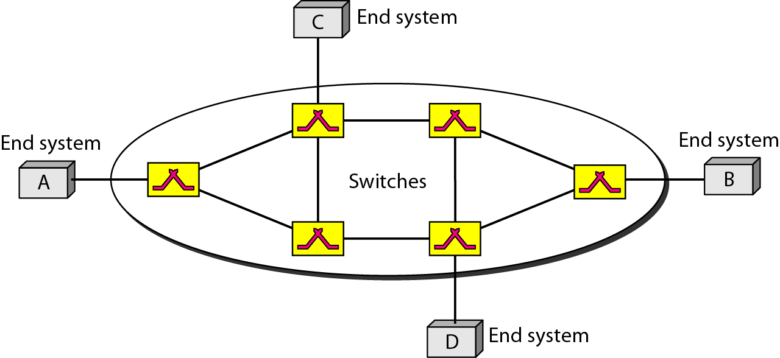
Virtual Circuit Networks
The network has switches that allow traffic from sources to destinations.
A source or destination can be a computer, packet switch, bridge, or any other device that connects other networks.

Slide 25
Virtual Circuit Networks
Addressing
global and local (virtual-circuit identifier) addressing .
Global Addressing
A source or a destination needs to have a global address—an address that can be unique in the scope of the network or internationally if the network is part of an international network.

Slide 26
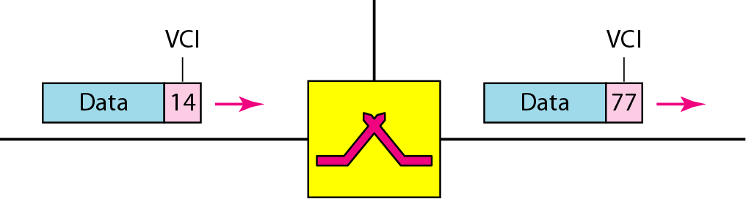
Virtual Circuit Networks
Virtual-Circuit Identifier
The identifier that is actually used for data transfer is called the virtual-circuit identifier (VCI) or the label.
A VCI, unlike a global address, is a small number that has only switch scope;
it is used by a frame between two switches.
When a frame arrives at a switch, it has a VCI; when it leaves, it has a different VCI.

Slide 27
Three Phases in Virtual-Circuit Network
The actual communication in a circuit-switched network requires three phases
Connection Setup Phase
Data Transfer
Connection teardown

Slide 28
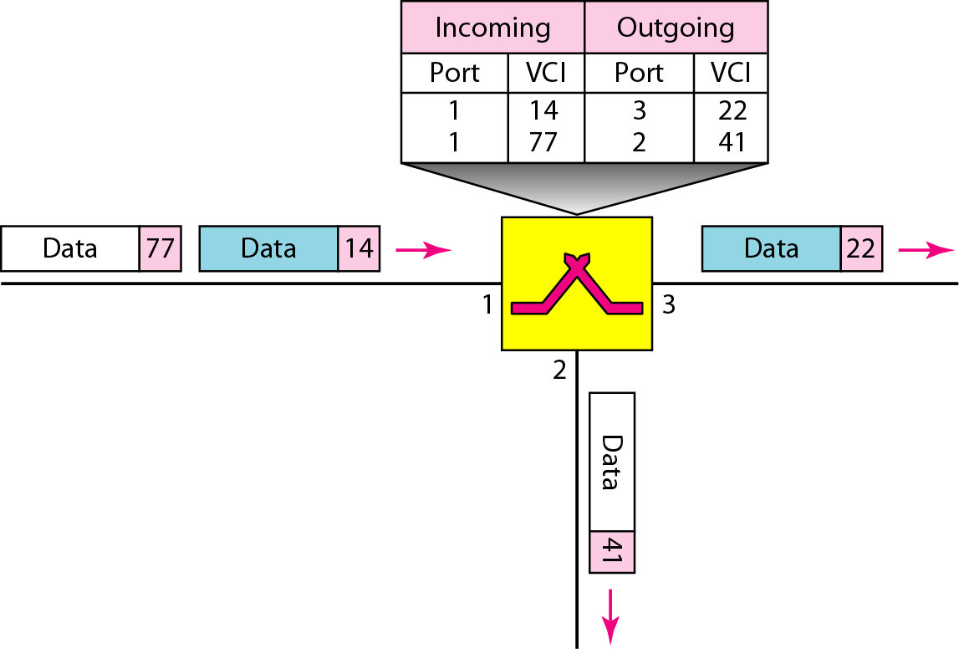
Virtual – Circuit network
Setup Phase
In the setup phase, the source and destination use their global addresses to help switches make table entries for the connection
Switch and tables in a virtual-circuit network

Slide 29
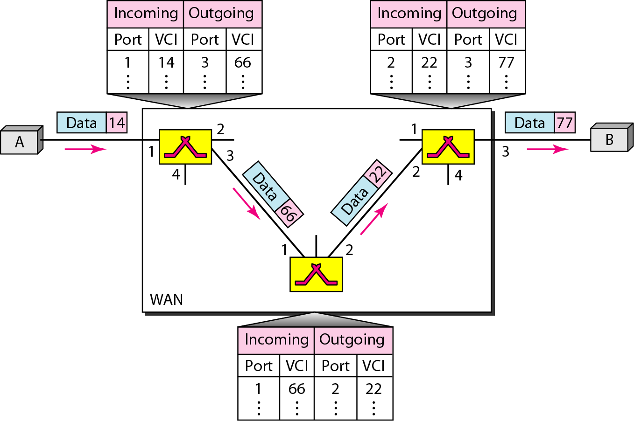
Virtual – Circuit network
Source-to-destination data transfer in a virtual-circuit network

Slide 30
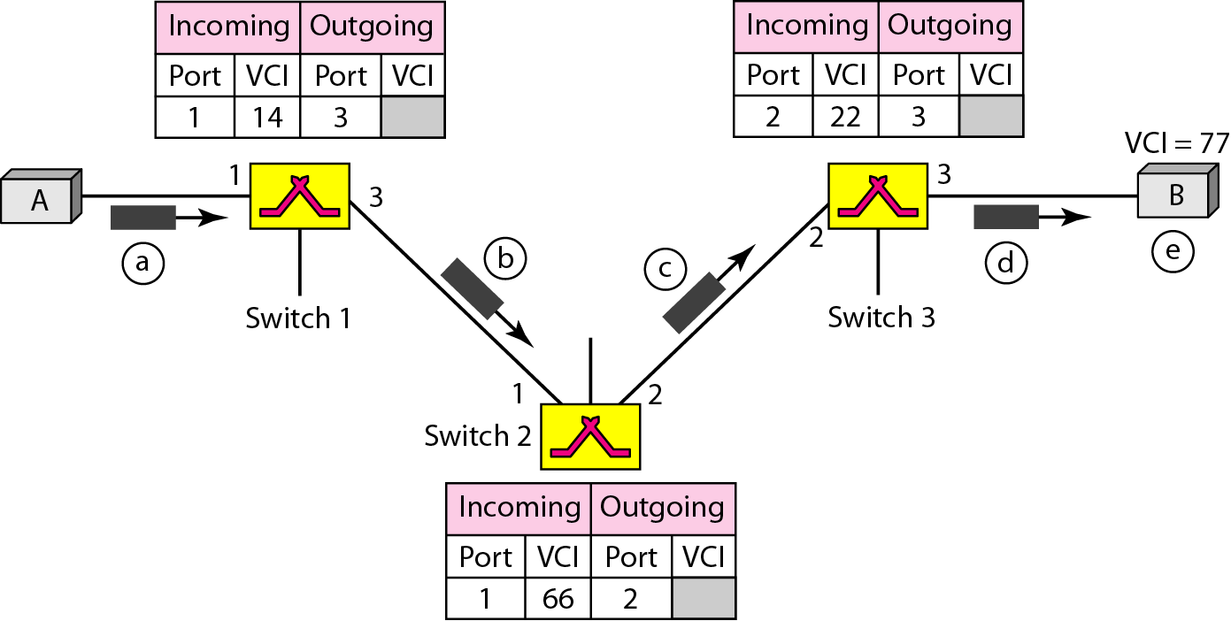
Virtual – Circuit network
Setup request in a virtual-circuit network

Slide 31
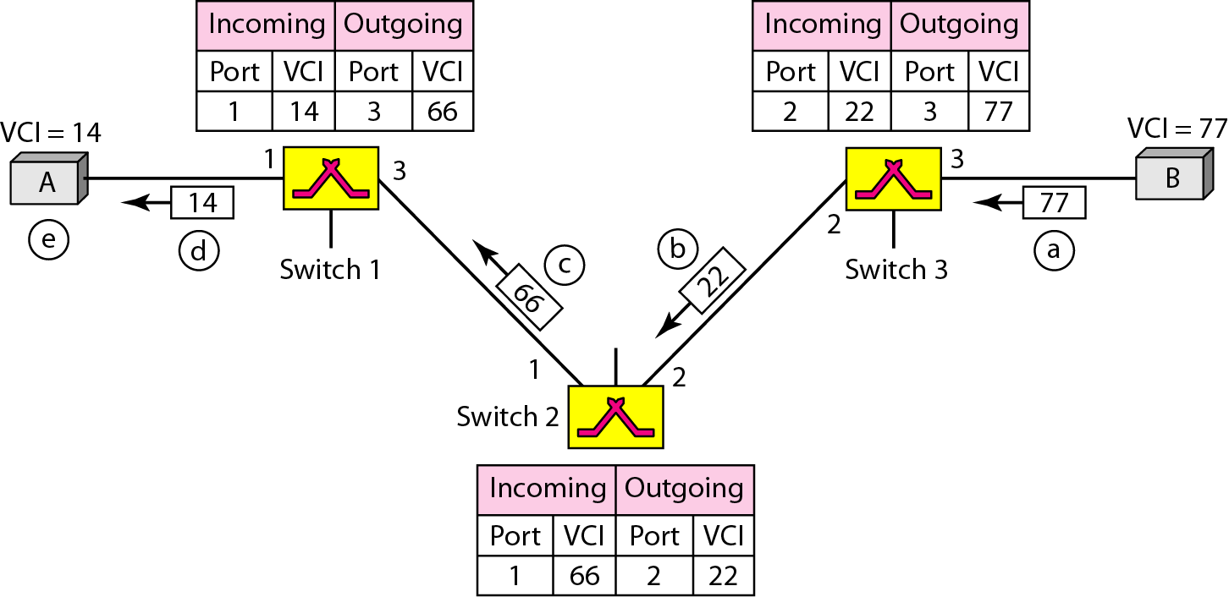
Virtual – Circuit network
Setup acknowledgment in a virtual-circuit network

Slide 32
Virtual – Circuit network
Teardown Phase
In the this phase source A, after sending all frames to B, sends a special frame called a teardown request.
Destination B responds with a teardown confirmation frame. All switches delete the corresponding entry from their tables.

Slide 33
Virtual – Circuit network
In virtual-circuit switching, all packets belonging to the same source and destination travel the same path;
but the packets may arrive at the destination with different delays if resource allocation is on demand.

Slide 34
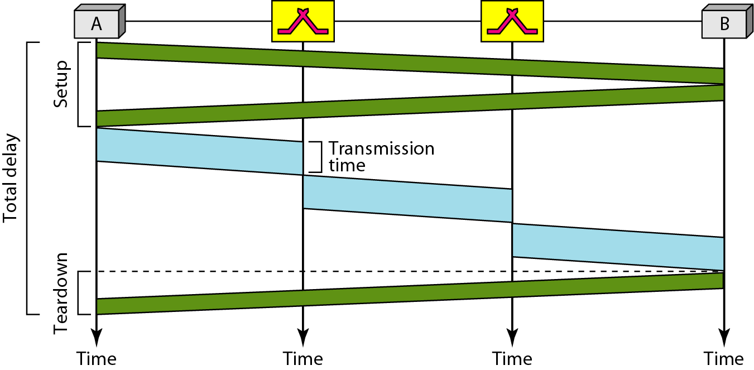
Virtual – Circuit network
Delay
Total delay = 3T + 3τ + setup delay + teardown delay

Slide 35
Structure of Switch
We use switches in circuit-switched and packet-switched networks. In this section, we discuss the structures of the switches used in each type of network.
Circuit switching today can use either of two technologies:
Space-division switch
Time-division switch

Slide 36
Space – Division Switch
In space-division switching, the paths in the circuit are separated from one another spatially.
This technology was originally designed for use in analog networks but is used currently in both analog and digital networks
Crossbar Switch
Crossbar switch connects n inputs to m outputs in a grid, using electronic microswitches (transistors) at each crosspoint
The major limitation of this design is the number of crosspoints required
To connect n inputs to m outputs using acrossbar switch requires n × m crosspoints.
For example, to connect 1000 inputs to 1000 outputs requires a switch with 1,000,000 crosspoints.

Slide 37
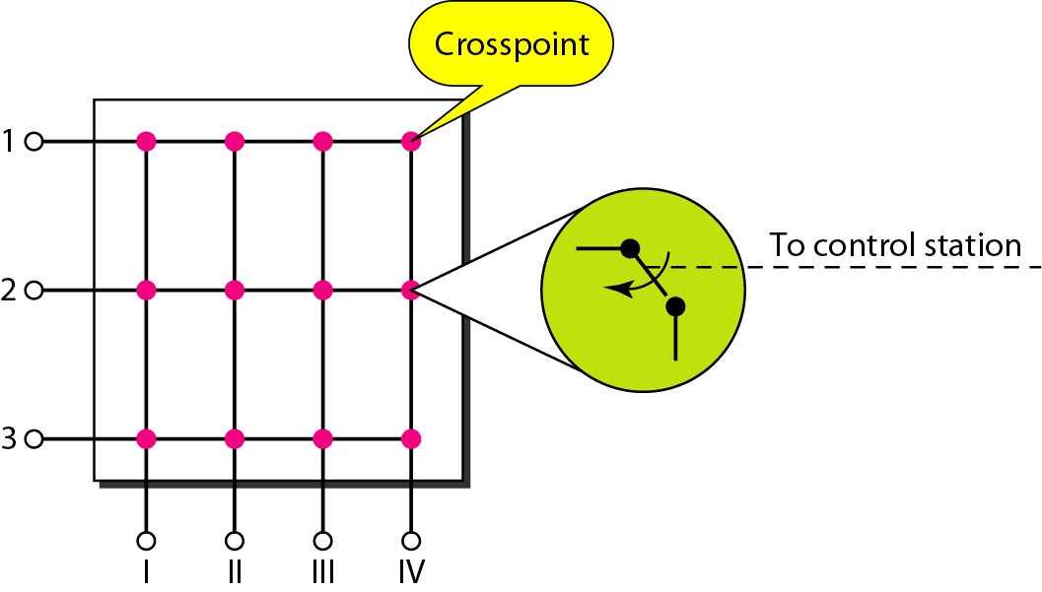
Crossbar Switch
Crossbar switch [?] with this number of crosspoints is impractical.
Such a switch is also inefficient because statistics show that, in practice, fewer than 25 percent of the crosspoints are in use at any given time. The rest are idle

Slide 38
Multistage crossbar switch:
To design a three-stage switch, we follow these steps:
1. We divide the N input lines into groups, each of n lines. For each group, we use one crossbar of size n × k, where k is the number of crossbars in the middle stage. In other words, the first stage has N/n crossbars of n × k cross points.
2. We use k crossbars, each of size (N/n) × (N/n) in the middle stage.
3. We use N/n crossbars, each of size k × n at the third stage.

Slide 39
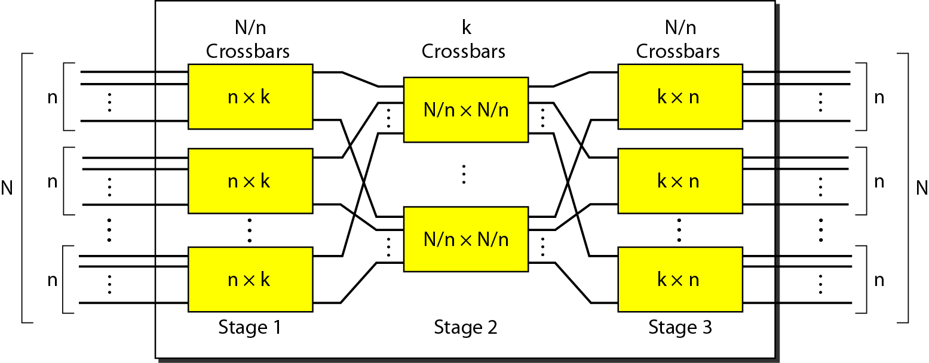

Multistage Crossbar switch

Slide 40
Example 8.3
Design a three-stage, 200 × 200 switch (N = 200) with k = 4 and n = 20.
Solution
In the first stage we have N/n or 10 crossbars, each of size 20 × 4. In the second stage, we have 4 crossbars, each of size 10 × 10. In the third stage, we have 10 crossbars, each of size 4 × 20. The total number of crosspoints is 2kN + k(N/n)², or 2000 crosspoints. This is 5 percent of the number of crosspoints in a single-stage switch (200 × 200 = 40,000).

Slide 41
Example 8.4
Redesign the previous three-stage, 200 × 200 switch, using the Clos criteria with a minimum number of crosspoints.
Solution
We let n = (200/2)^{1/2}, or n = 10. We calculate k = 2n − 1 = 19. In the first stage, we have 200/10, or 20, crossbars, each with 10 × 19 crosspoints. In the second stage, we have 19 crossbars, each with 10 × 10 crosspoints. In the third stage, we have 20 crossbars each with 19 × 10 crosspoints. The total number of crosspoints is 20(10 × 19) + 19(10 × 10) + 20(19 ×10) = 9500.

Slide 42
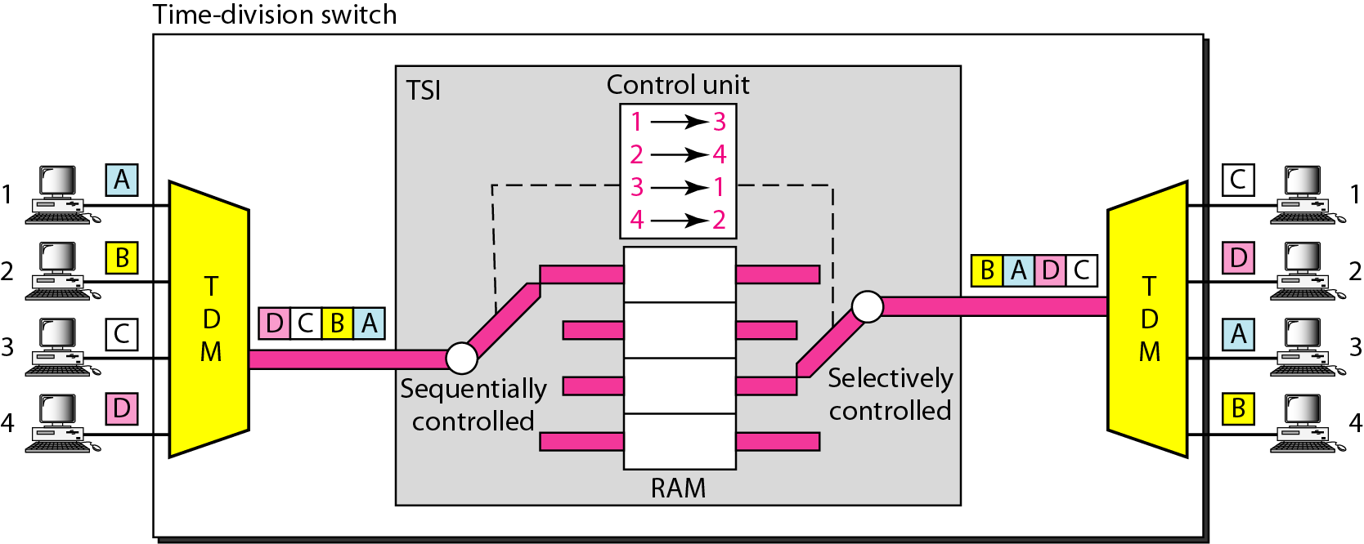
Time – Division Switch
Time-division switching uses time-division multiplexing (TDM) inside a switch.
The most popular technology is called the time-slot interchange (TSI).

Slide 43
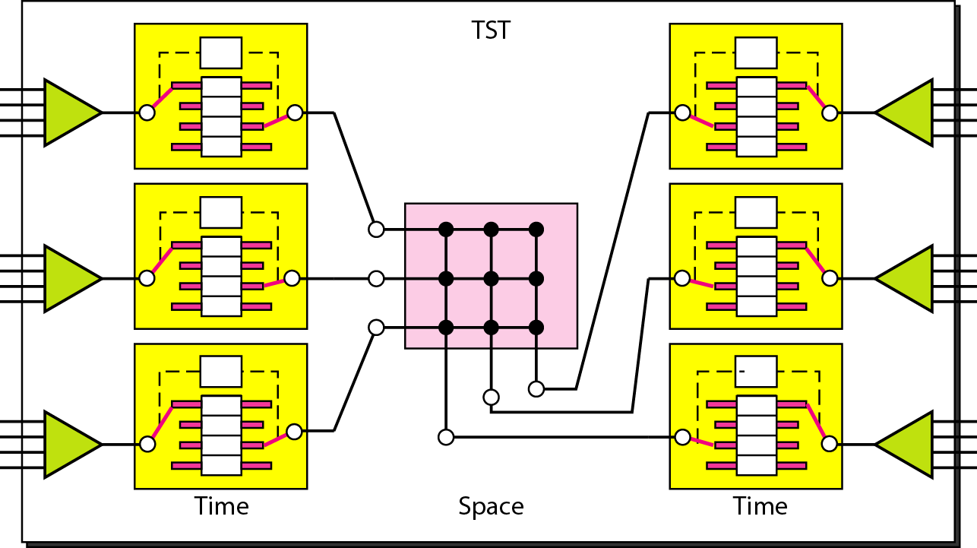
Time-space-time switch

Slide 44
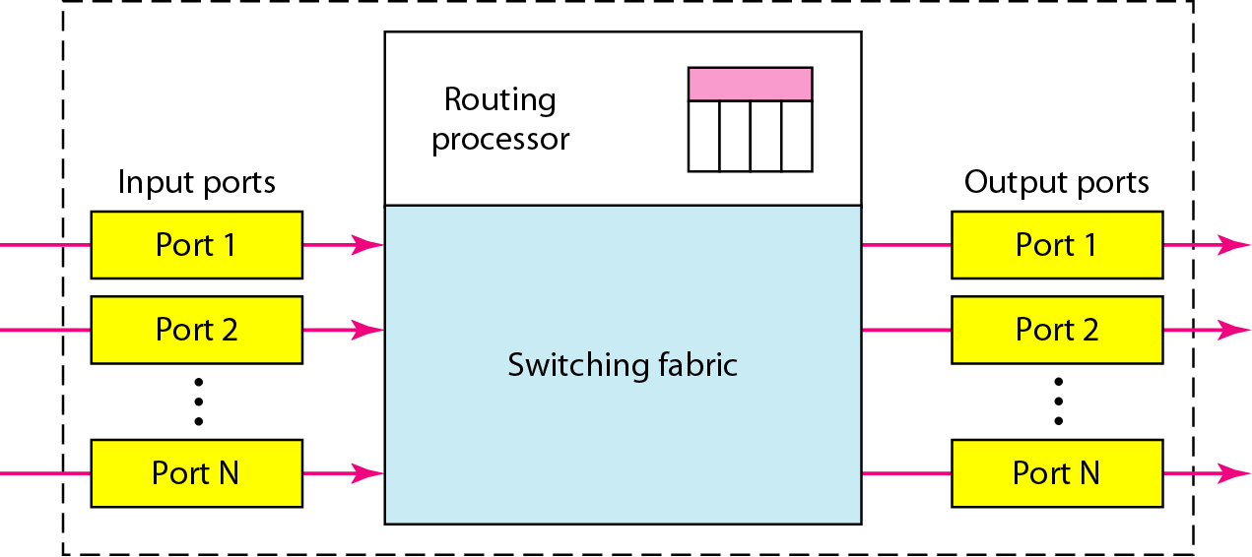
Structure of Packet switch
A switch used in a packet-switched network has a different structure from a switch used in a circuit-switched network.
Packet switch has four components: input ports, output ports, the routing processor, and the switching fabric

Slide 45
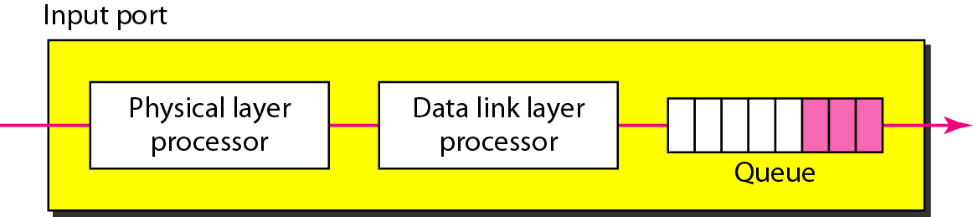
Structure of Packet switch
An input port performs the physical and data-link functions of the packet switch.
The bits are constructed from the received signal.
The packet is decapsulated from the frame. Errors are detected and corrected.
The packet is now ready to be routed by the network layer.
In addition to a physical-layer processor and a data-link processor, the input port has buffers (queues) to hold the packet before it is directed to the switching fabric.

Slide 46
Structure of Packet switch
Routing processor
The routing processor performs the functions of the network layer. The destination
address is used to find the address of the next hop and, at the same time, the output port number from which the packet is sent out.
This activity is sometimes referred to as table lookup because the routing processor searches the routing table

Slide 47
Structure of Packet switch
Switching fabrics
This activity is sometimes referred to as table lookup because the routing processor searches the routing table
The most difficult task in a packet switch is to move the packet from the input queue to the output queue.
The speed with which this is done affects the size of the input/output queue and the overall delay in packet delivery.
In the past, when a packet switch was actually a dedicated computer, the memory of the computer or a bus was used as the switching fabric.
The input port stored the packet in memory; the output port retrieved the packet from memory.
Today, packet switches are specialized mechanisms that use a variety of switching fabrics

Slide 48
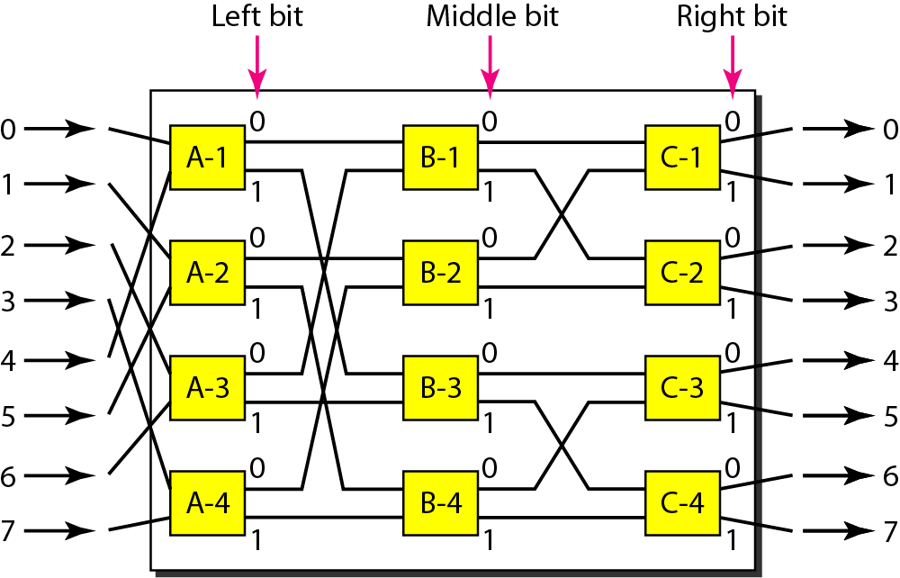
A banyan switch – switching fabric
For n inputs and n outputs, we have log2n stages with n/2 microswitches at each stage.
The first stage routes the packet based on the high-order bit of the binary string.
The second stage routes the packet based on the second high-order bit, and so on.

Slide 49
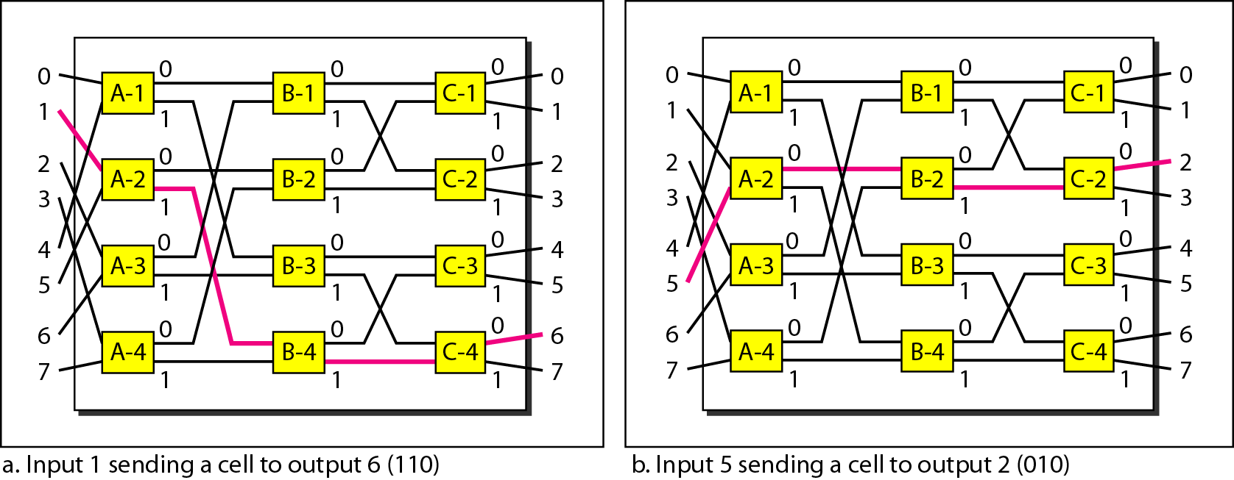
A banyan switch – switching fabric

Slide 50
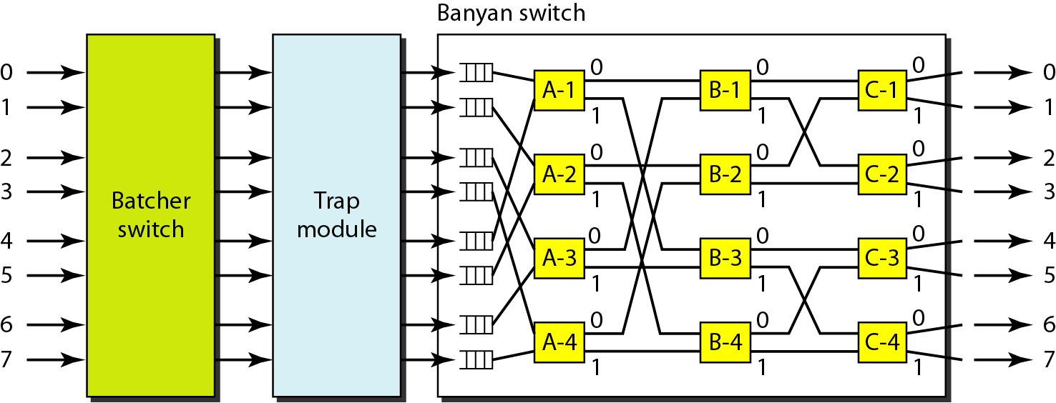
Batcher-banyan switch
The problem with the banyan switch is the possibility of internal collision even when two packets are not heading for the same output port.
We can solve this problem by sorting the arriving packets based on their destination port.

