Slide 1
2CEIT501:Computer Architecture & Organization

Slide 2
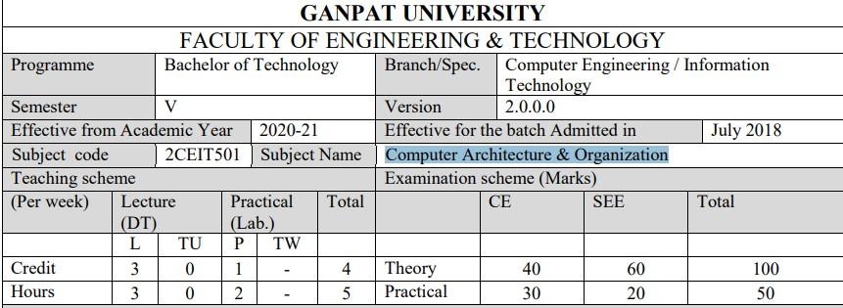

Slide 3
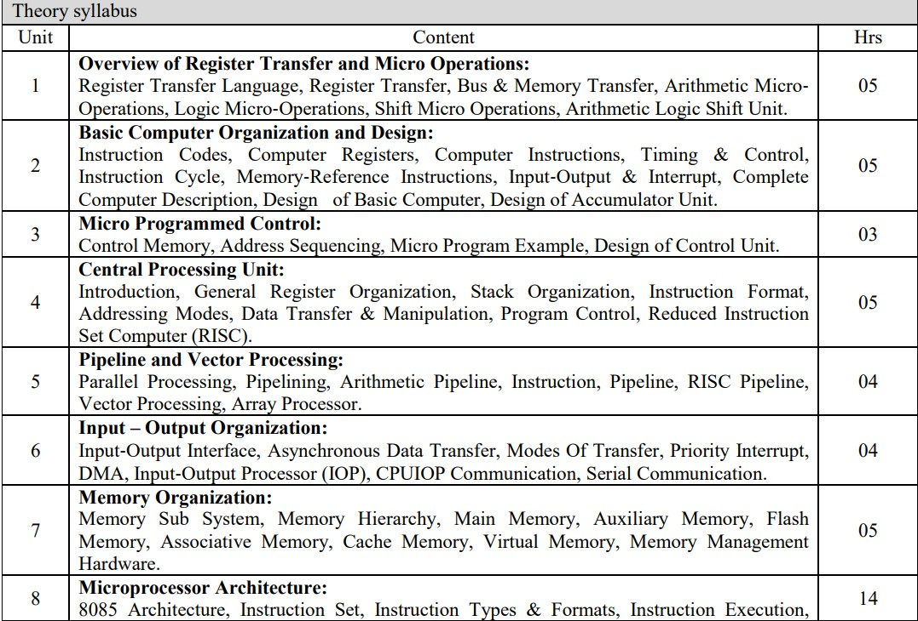

Slide 4
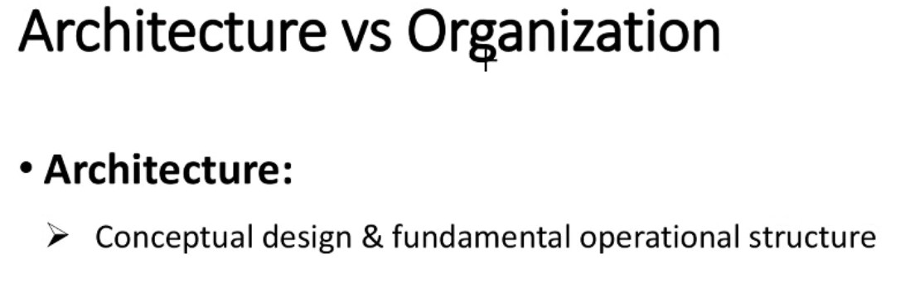

Slide 5
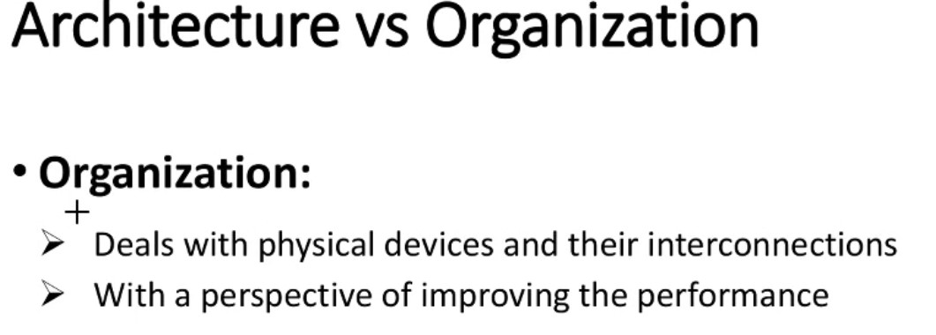

Slide 6
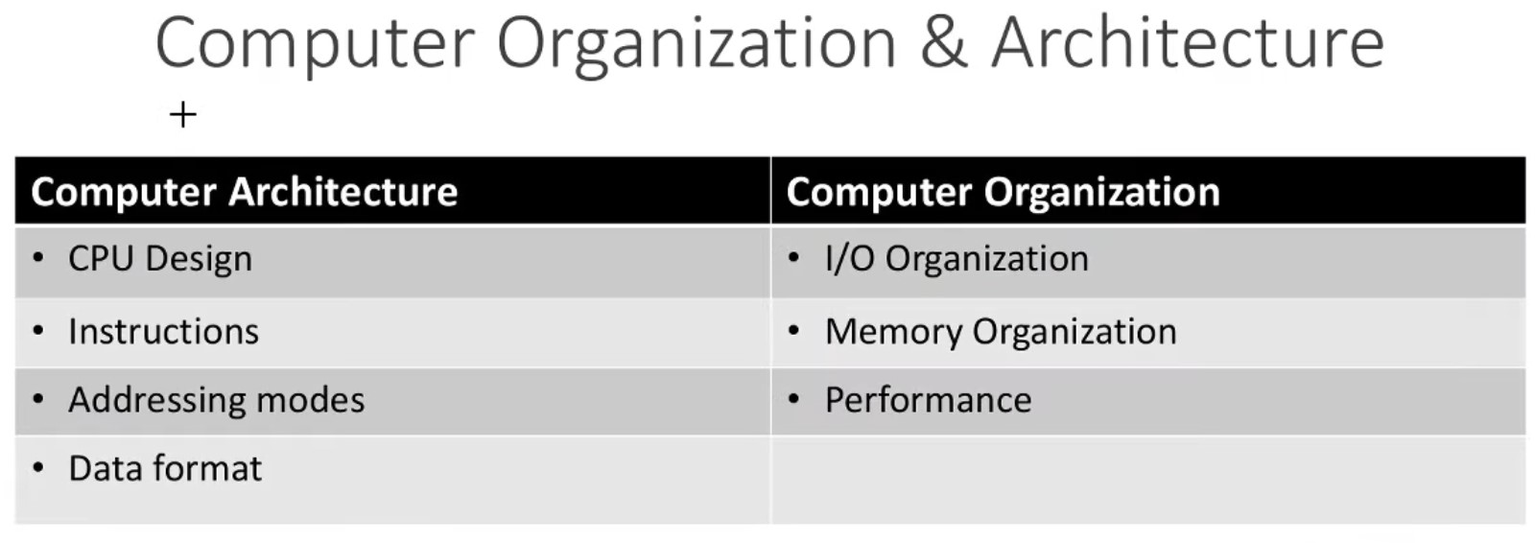

Slide 7
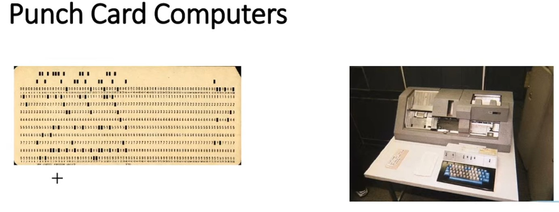

Slide 8
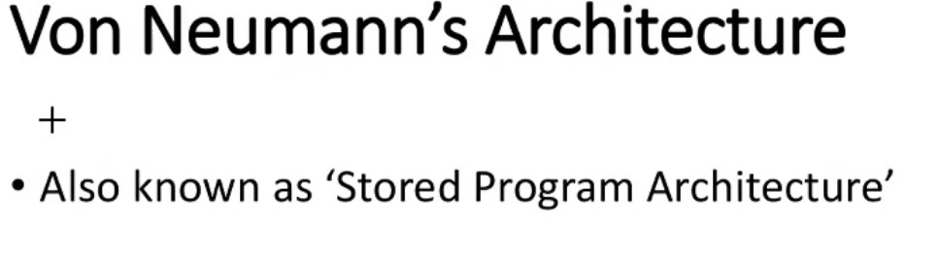

Slide 9
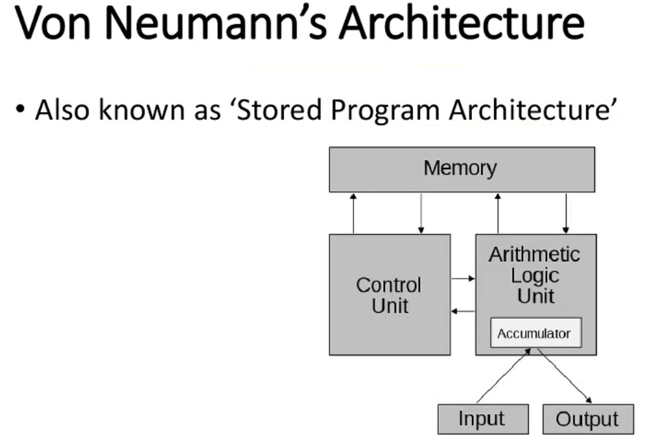

Slide 10
Harvard Architecture

Slide 11
Memory Organization

Slide 12
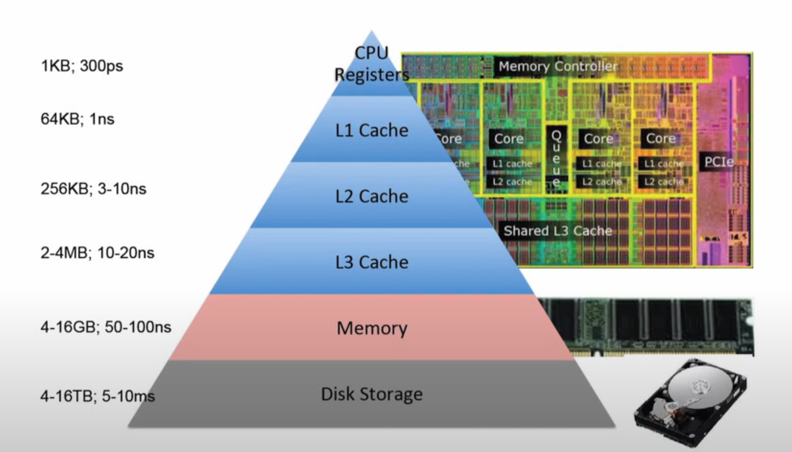
Memory Hierarchy

Slide 13
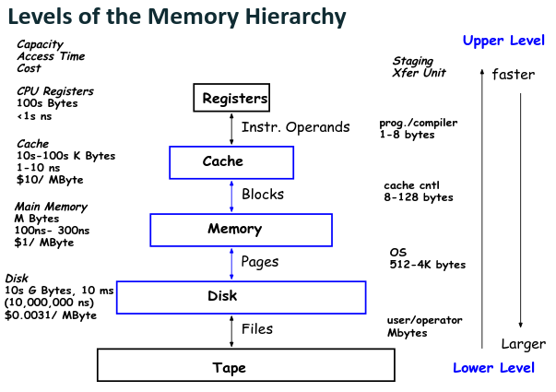

Slide 14
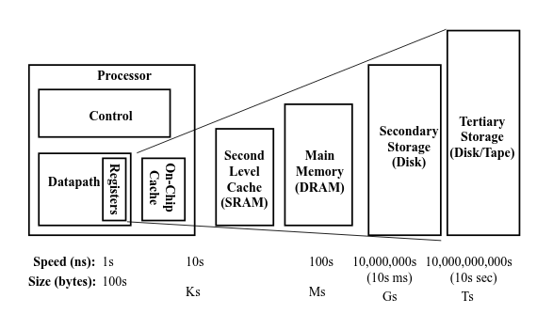
Levels of the Memory Hierarchy

Slide 15
Levels of the Memory Hierarchy
Main memory directly communicates with the CPU.
Devices that provides backup storage are called auxiliary memory.
A special very high speed memory is sometimes used to increase the speed of processing
by making current programs and data available to the CPU at the rapid rate.

Slide 16
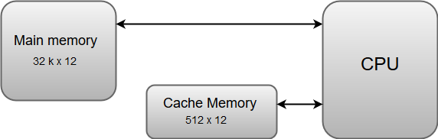

Slide 17
Memory
A physical device used for storage in computer system.
Stores program and associated data.

Slide 18
Memory hierarchy
Computers have limited storage.
Users tend to store more information and data with time.
At a time, CPU runs only finite number of instructions.
Computers can be benefited with extra storage.

Slide 19
Associative Memory

Slide 20
Associative Memory
Content Addressable memory
E.g.:
Student information
Bank information

Slide 21
Associative Memory
RAM
Memory accessed using location address
Needs to search the content of each location one after other
Requires the hardware for read and write operations
Associative Memory
Memory accessed using content
Search is done simultaneously
Requires the hardware for read and write as well as the search operations

Slide 22
Associative Memory
Faster access
Expensive

Slide 23
Associative Memory
Associative cache
Translation look aside buffer

Slide 24
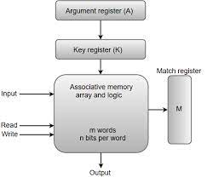
Associative Memory
Arguement Register
For searching
Key register
For masking (Conditional search)

Slide 25
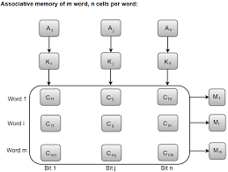
Associative Memory
Each cell implemented using flip flop and search logic

Slide 26
Associative Memory – Match logic
Output x_{j} = 1 when A_{j} and F_{ij} matches.
M_{i} =1, when all the x_{j}’^{s} are 1

Slide 27
Associative Memory – One cell logic
Cell using flip-flop
S | R | Q(t) | Q(t+1)
0 | 0 | Q | Q (retain)
0 | 1 | Q | 0 (Reset)
1 | 0 | Q | 1 (Set)
1 | 1 | Q | X (in valid)

Slide 28
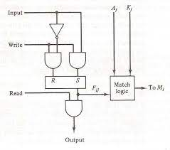

Associative Memory
Aj | Fij | xi
0 | 0 | 1
0 | 1 | 0
1 | 0 | 0
1 | 1 | 1
Using NOR gate: Match logic can
be implemented

Slide 29


Inclusion of flag bit
Considering all the bits:

Slide 30
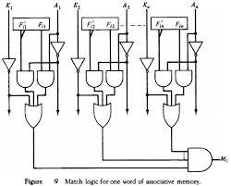
Associative Memory
Considering all the bits:

Slide 31
Associative Memory
Read operation
Compare the argument register (after the masking effect of flag register) with all the location simultaneously.
The location corresponding to the matching content will have the match bit as 1.
The location with match bit as 1 are accessed in sequence.

Slide 32
Associative Memory
Write operation
Case:1 Cache is empty (all tags=0)
Write the data sequentially.
Case:2 Cache is in use (some tags ≠ 0)
Find the first location with tag=0, which indicates that the location do not have valid input.
Write the content at the found location.

Slide 33
Cache
Locality of reference: The processor accesses some data and instructions now, there is a high chance that the same data will be required in future or the neighboring data may be required in future.
Execution of same instruction again: Temporal locality
Execution of neighboring instruction: Spatial locality
for(i=0; i<3;i++)
for (j=0; j<3;j++)
printf(“%d, %d”, i, j);

Slide 34
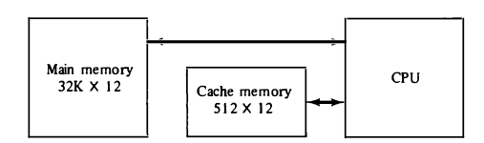
Cache
If the active portions of the program and data are placed in a fast small memory, the average memory access time can be reduced, thus reducing the total execution time of the program. Such a fast small memory is referred to as a cache memory.

Slide 35
Cache
When the CPU needs to access memory, the cache is examined.
If the word is found in the cache, it is read from the fast memory.
If the word addressed by the CPU is not found in the cache, the main memory is accessed to read the word.

Slide 36
Cache
A block of words containing the one just accessed is then transferred from main memory to cache memory. The block size may vary from one word (the one just accessed) to about 16 words adjacent to the one just accessed.
In this manner, some data are transferred to cache so that future references to memory find the required words in the fast cache memory.

Slide 37
Terms related to Cache
Word: The content stored at one address location.
Block: The local content comprising of group of words, which is currently in demand.

Slide 38
Terms related to Cache
The performance of cache memory is frequently measured in terms of a quantity called hit ratio.
When the CPU refers to memory and finds the word in cache, it is said to produce a main memory and it counts as a hit. If the word is not found in cache, it is in miss.
The higher hit ratio indicates faster average access time.

Slide 39
Terms related to Cache
Average memory access time:
hit * (hit access time) + miss * (miss access time)

Slide 40
Cache mapping
The transformation of data from main memory to cache memory is referred to as a mapping process.
Associative mapping
Direct mapping
Set associative mapping

Slide 41
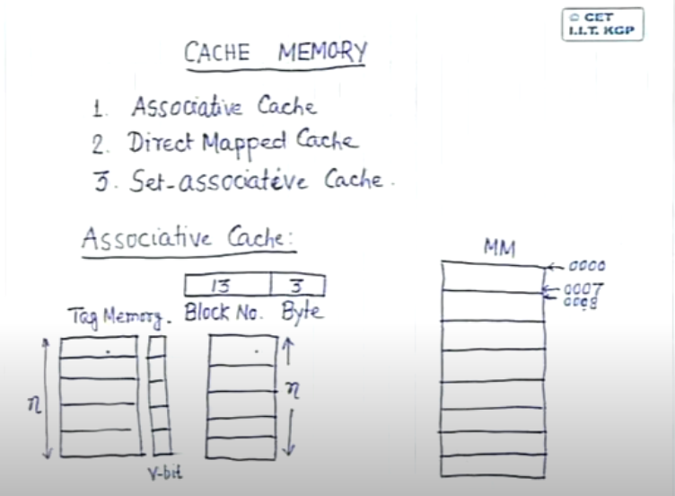
Cache Memory

Slide 42
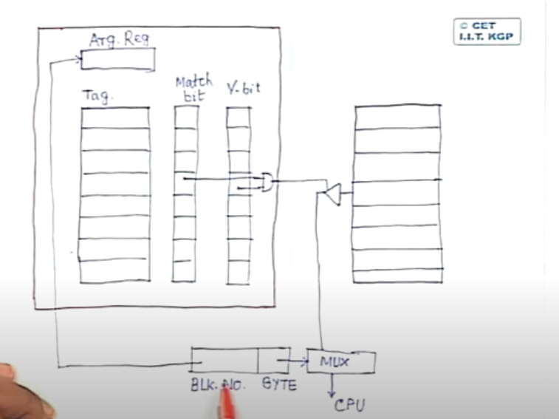
Associative cache

Slide 43
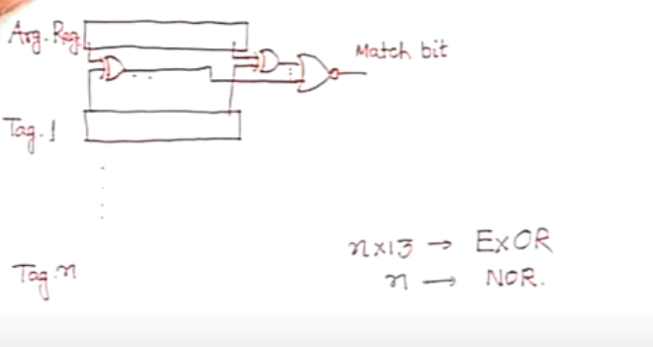
Associative cache (Match Bit)

Slide 44
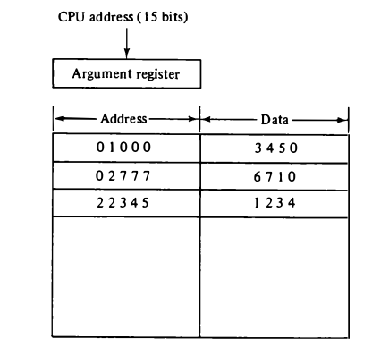
Associative cache
Write:
It stores both the address and data of the memory word.
This permits any location in cache to store any word from main memory.
Read:
Simultaneous search of address.
Read the locations where exists.

Slide 45
Associative Memory Example :
MM Size | Cache Size | Block Size | Tag Size | Tag directory Size | Comparator
128 KB | 16KB | 256 B | 9 bits | (9 * 64 ) bits | 64
32 GB | 32 KB | 1 KB | 25 bits | (25 * 32 ) bits | 32
128 MB | 512 KB | 1 KB | 17 BITS | (17 * 512 ) bits | 512
16 GB |  | 4 KB | 22 bits | Can not get
64 MB |  | 64 KB | 10 bits | Can not get
 | 512 KB |  | 7 bits
MM = Physical Address
MM = 17 bits
Block No
Block Offset
Block No
Block Offset
9 bits = tag size | 8 bits

Slide 46
Associative Memory Example :
MM Size | Cache Size | Block Size | Tag Size | Tag directory Size | Comparator
128 KB | 16KB | 256 B | 9 bits | (9 * 64 ) bits | 64
MM
MM = 17 bits
Block No
Block Offset (B Size)
Block No
Block Offset
17-8 = 9 bits = tag size | 8 bits
Cache size = 16 KB = 2 ¹⁴
Block size = 256 B = 2 ⁸
Cache size = 2 ¹⁴
Block size = 2 ⁸
= 2 ⁶ = 64 line in cache

Slide 47
Associative Memory Example :
MM Size | Cache Size | Block Size | Tag Size | Tag directory Size | Comparator
32 GB | 32 KB | 1 KB | 25 bits | (25 * 32 ) bits | 32
MM
MM = 35 bits
Block No
Block Offset
Block No
Block Offset
35-10 = 25 bits = tag size | 10 bits
Cache size = 32 KB = 2 ¹⁵
Block size = 1 KB = 2 ¹⁰
Cache size = 2 ¹⁵
Block size = 2 ¹⁰
= 2 ⁵ = 32 line in cache

Slide 48
Associative Memory Example :
MM Size | Cache Size | Block Size | Tag Size | Tag directory Size | Comparator
128 MB | 512 KB | 1 KB | 17 Bits | (17 * 512 ) bits | 512
MM = 17+10 = 27 bits = 2 ²⁷ = 128 MB
MM
Block No
Block Offset
Block No
Block Offset
17 bits = tag size | 10 bits
Cache size = 512 KB = 2 ¹⁹
Block size = 1 KB = 2 ¹⁰
Cache size = 2 ¹⁹
Block size = 2 ¹⁰
= 2 ⁹ = 512 line in cache

Slide 49
Associative Memory Example :
MM Size | Cache Size | Block Size | Tag Size | Tag directory Size | Comparator
16 GB | X | 4 KB | 22 bits | Can not get | X
MM = 2 ³⁴ = 34 bits = 16 GB
MM
Block No
Block Offset
Block No
Block Offset
34- 12 = 22 bits = tag size | 4K = 12 bits

Slide 50
Associative Memory Example :
MM Size | Cache Size | Block Size | Tag Size | Tag directory Size | Comparator
64 MB | x | 64 KB | 10 bits | Can not get | x
MM = 2 ²⁶ = 26 bits = 64MB
MM
Block No
Block Offset
Block No
Block Offset
26 - 16 = 10 bits = tag size | 64KB = 16 bits

Slide 51
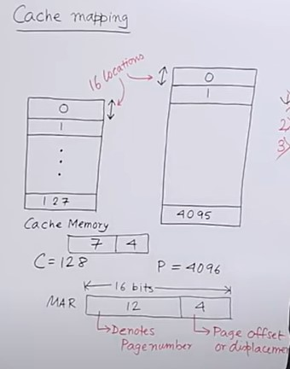
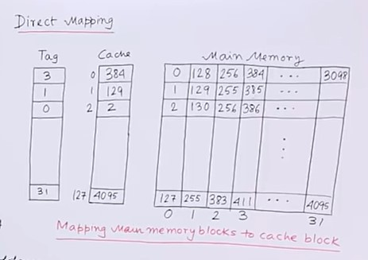
Direct Mapped Cache

Slide 52
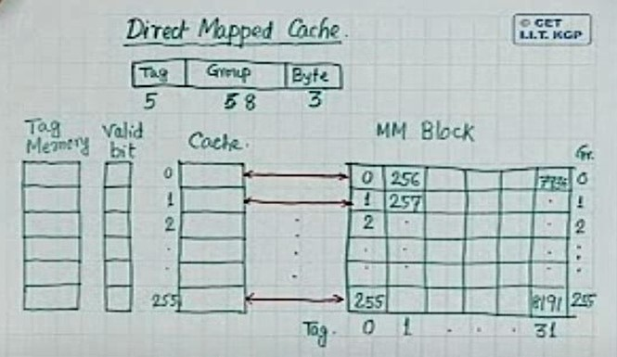
Direct Mapped Cache

Slide 53
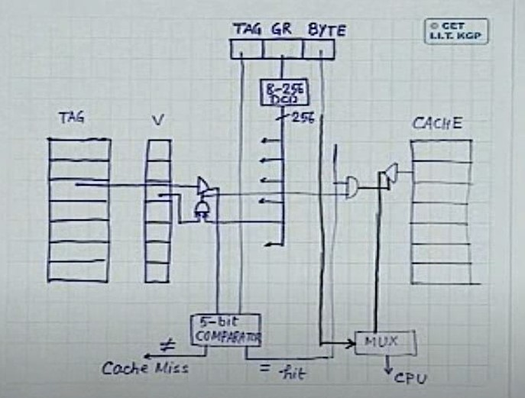
Direct Mapped Cache

Slide 54
Discuss direct cache mapping technique. Complete missing parameter in below table using direct cache mapping technique, assume memory is byte addressable.
QueNO | M.M (size) | Cache Size | Block Size | Tag Bit | Tag Directory
1 | 128kb | 16kb | 256b | _______ | _________
2 | 32 Gb | 32kb | 1 kb | _______ | _________
3 | _______ | 512 kb | 1 kb | 7 | _______
4 | 16 Gb | ______ | 4 kb | 10 | ______
5 | 64MB | ______ | _______ | 10 | _______
6 | _______ | 512 kb | _______ | 7 | ______

Slide 55
Set Associativity

Slide 56
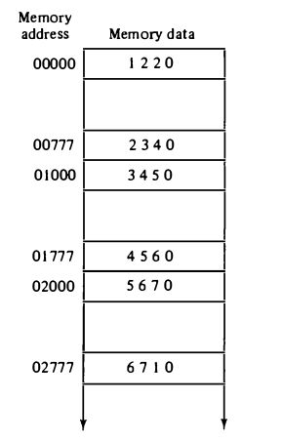
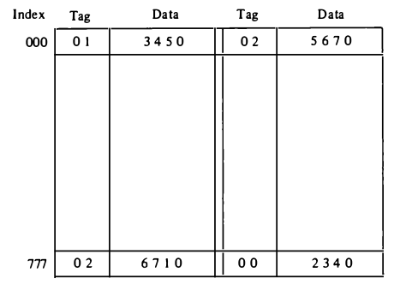
Set Associativity

Slide 57
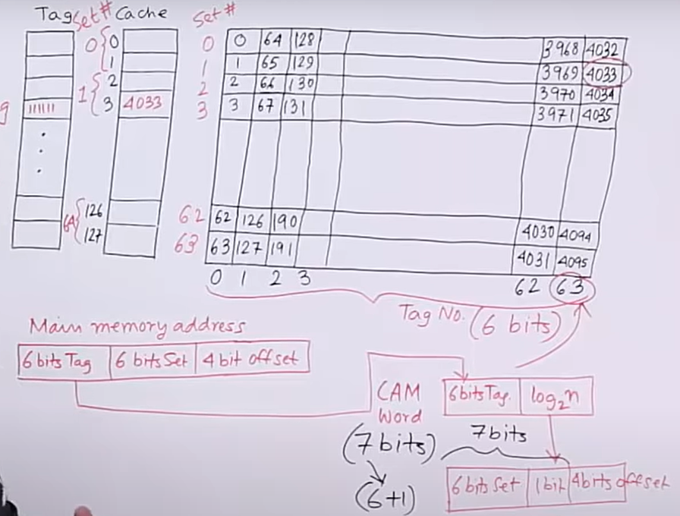

Slide 58
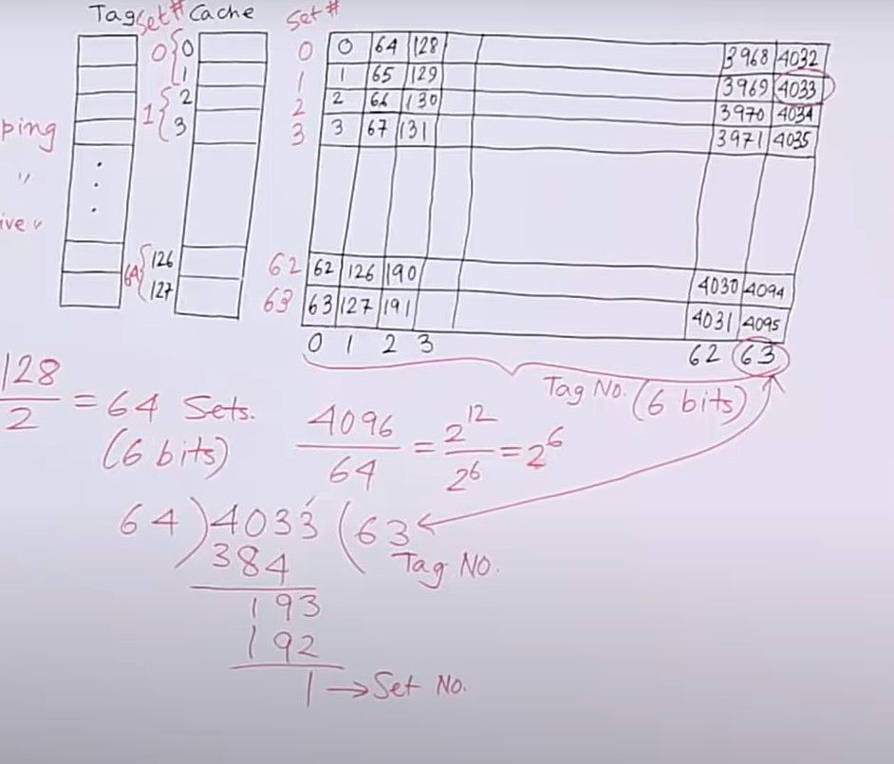

Slide 59
Main Memory
The main memory acts as the central storage unit in a computer system. It is a relatively large and fast memory which is used to store programs and data during the run time operations.
RAM integrated circuit chips: The RAM integrated circuit chips are further classified into two possible operating modes, static and dynamic.
The primary compositions of a static RAM are flip-flops that store the binary information. The nature of the stored information is volatile, i.e. it remains valid as long as power is applied to the system. The static RAM is easy to use and takes less time performing read and write operations as compared to dynamic RAM.

Slide 60
Main Memory
The dynamic RAM exhibits the binary information in the form of electric charges that are applied to capacitors. The capacitors are integrated inside the chip by MOS transistors. The dynamic RAM consumes less power and provides large storage capacity in a single memory chip.

Slide 61
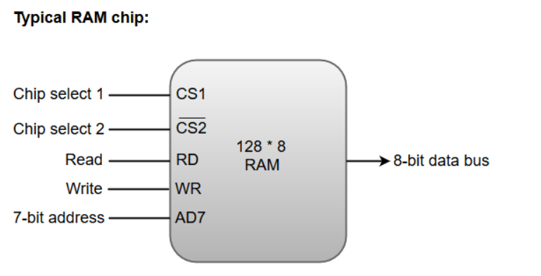
RAM Chip
RAM chips are available in a variety of sizes and are used as per the system requirement. The following block diagram demonstrates the chip interconnection in a 128 * 8 RAM chip.

Slide 62
RAM Chip
A 128 * 8 RAM chip has a memory capacity of 128 words of eight bits (one byte) per word. This requires a 7-bit address and an 8-bit bidirectional data bus.
The 8-bit bidirectional data bus allows the transfer of data either from memory to CPU during a read operation or from CPU to memory during a write operation.
The read and write inputs specify the memory operation, and the two chip select (CS) control inputs are for enabling the chip only when the microprocessor selects it.
The bidirectional data bus is constructed using three-state buffers.
The output generated by three-state buffers can be placed in one of the three possible states which include a signal equivalent to logic 1, a signal equal to logic 0, or a high-impedance state.

Slide 63
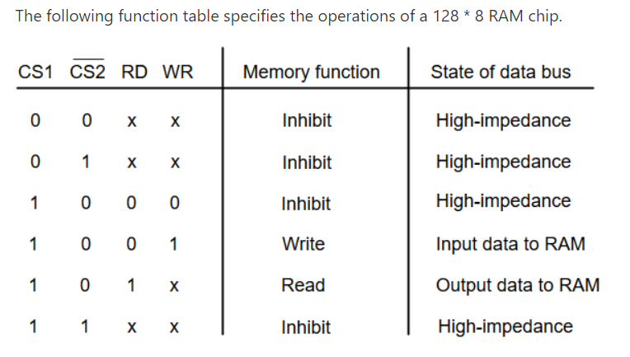
RAM Chip
From the functional table, we can conclude that the unit is in operation only when CS1 = 1 and CS2 = 0. The bar on top of the second select variable indicates that this input is enabled when it is equal to 0.

Slide 64
Auxiliary Memory :
Most common auxiliary memory devices – Magnetic Disks & Tapes.
The average time required to reach a storage location in memory and obtain its content is called the access time.
Compact Disk – only one surface for storage
Magnetic Disk – Both surface store data
Number of disk are there in Magnetic Disks and it is called as platter.
3 platter – 6 side storage available
In magnetic surface store data is called recording.

Slide 65
Read or Write on the surface then required one small pointer is called Read/Write head.
Each Surface have particular R/W Head.
Attach R/W head to one hardware is called as arms.
The arms are attached with column wise structure is called Arms assembly.
Disk rotation happens in only single direction.
Arm assembly
R/W Head
Arms
Spindle

Slide 66
Divide such surface in concentrical track .
Concentric track because there is only one centre.
Tracks also divided further into sector.
Collection of consecutive sector of track is called cluster. (only in one track)

Slide 67
Disk access time = seek time + Rotational latency (delay) + 1 sector
transfer time + additional delay
Sector is smallest unit of disk, which can be read or write at onces.
Sector is the addressable unit of the disc.
Disk access time is nothing but 1 sector access time.
All arms are move together. (1 R/W Head is outer most track then all R/W head will be on outer most track)

Slide 68
First R/W head move to particular track.
Move particular arm forward or backward some time is required. So that R/W head can reach to particular track & this time is called as seek time.
Then spindle come to a picture.
The spindle rotate the disk & particular sector comes under R/W head, takes some time is called rotational latency (delay).
Then read or write happens. So time take is called transfer time.
Also required some additional delay if given then put otherwise zero.
Disk access time = seek time + Rotational latency (delay) + 1 sector
transfer time + additional delay

Slide 69
Seek time : Time required to position the arm over the track.
Rotational delay : Time required to rotate desired sector under R/W
head.
Transfer Time : Time required to read or write 1 sector.
Additional delay : Disk controller – hardware delay

Slide 70



R/W head always at end of some sector & Starting of some sector.
In fig now R/W head is at starting sector of 2 & end of sector 1.
If read sector 2 then no any extra time required.
Note – Disk rotate in single direction.
If read sector 1 then directly not possible – rotate whole disc.
R/W Head

