Slide 1
Unit – 4 Central Processing Unit

Slide 2
Topics to be covered
Introduction
General Register Organization
Stack Organization
Instruction format
Addressing Modes
Data transfer and manipulation
Program Control
Reduced Instruction Set Computer (RISC)
Complex Instruction Set Computer (CISC)

Slide 3
General Register Organization

Slide 4
Clock
Input
R1
R2
R3
R4
R5
R6
R7
Load
(7 lines)
MUX - A
MUX - B
SEL A
SEL B
3x8
decoder
A - bus
B - bus
Arithmetic Logic Unit
(ALU)
SEL D
OPR
Output

Slide 5
General Register Organization
Example: R1 R2 + R3
To perform the above operation, the control must provide binary selection variables to the following selector inputs:
MUX A selector (SELA): to place the content of R2 into bus A.
MUX B selector (SELB): to place the content of R3 into bus B.
ALU operation selector (OPR): to provide the arithmetic addition A + B.
Decoder destination selector (SELD): to transfer the content of the output bus into R1.
Control Word:
SELA
SELB
SELD
OPR

Slide 6
General Register Organization
Binary Code | SELA | SELB | SELD
000 | Input | Input | None
001 | R1 | R1 | R1
010 | R2 | R2 | R2
011 | R3 | R3 | R3
100 | R4 | R4 | R4
101 | R5 | R5 | R5
110 | R6 | R6 | R6
111 | R7 | R7 | R7
OPR Select | Operation | Symbol
00000 | Transfer A | TSFA
00001 | Increment A | INCA
00010 | A + B | ADD
00101 | A – B | SUB
00110 | Decrement A | DECA
01000 | A and B | AND
01010 | A or B | OR
01100 | A xor B | XOR
01110 | Complement A | COMA
10000 | Shift right A | SHRA
11000 | Shift left A | SHLA
Encoding of Register Selection Fields
Encoding of ALU Operations

Slide 7
Stack Organization

Slide 8
Stack Organization
A stack is a storage device that stores information in such a manner that the item stored last is the first item retrieved (LIFO).
The register that holds the address for the stack is called a stack pointer (SP) because its value always points at the top item in the stack.
The physical registers of a stack are always available for reading or writing. It is the content of the word that is inserted or deleted.
There are two types of stack organization
Register stack – built using registers
Memory stack – logical part of memory allocated as stack

Slide 9
Register Stack
Address
C
B
A
63
FULL
EMTY
4
SP
3
2
1
0
DR

Slide 10
Register Stack
A stack can be placed in a portion of a large memory or it can be organized as a collection of a finite number of memory words or registers. Figure shows the organization of a 64-word register stack.
The stack pointer register SP contains a binary number whose value is equal to the address of the word that is currently on top of the stack.
In a 64-word stack, the stack pointer contains 6 bits because 2⁶ = 64.
Since SP has only six bits, it cannot exceed a number greater than 63 (111111 in binary).
The one-bit register FULL is set to 1 when the stack is full, and the one-bit register EMTY is set to 1 when the stack is empty of items.
DR is the data register that holds the binary data to be written into or read out of the stack.

Slide 11
Register Stack
PUSH Operation
POP Operation
SP ← SP + 1
DR ← M[SP]
M[SP] ← DR
SP ← SP - 1
IF (SP= 0) then (FULL ← 1)
IF (SP= 0) then (EMTY ← 1)
EMTY ← 0
FULL ← 0

Slide 12
Memory Stack
Address
PC
Program
(instructions)
1000
AR
Data
(operands)
2000
Stack
3000
3997
SP
3998
3999
4000
4001
DR

Slide 13
Memory Stack
The implementation of a stack in the CPU is done by assigning a portion of memory to a stack operation and using a processor register as a stack pointer.
Figure shows a portion of computer memory partitioned into three segments: program, data, and stack.
The program counter PC points at the address of the next instruction in the program which is used during the fetch phase to read an instruction.
The address registers AR points at an array of data which is used during the execute phase to read an operand.
The stack pointer SP points at the top of the stack which is used to push or pop items into or from the stack.
We assume that the items in the stack communicate with a data register DR.

Slide 14
Memory Stack
PUSH Operation
POP Operation
SP ← SP - 1
DR ← M[SP]
M[SP] ← DR
SP ← SP + 1

Slide 15
Reverse Polish Notation
The common mathematical method of writing arithmetic expressions imposes difficulties when evaluated by a computer.
The Polish mathematician Lukasiewicz showed that arithmetic expressions can be represented in prefix notation as well as postfix notation.
Infix
Prefix or Polish
Postfix or reverse Polish
A + B
+ AB
AB +
A * B + C * D
AB * CD * +
Reverse Polish

Slide 16
Evaluation of Arithmetic Expression
(3 * 4) + (5 * 6)
3 4 * 5 6 * +
42
3
4
3
12
5
12
6
5
12
30
12
42
3
4
*
5
6
*
+

Slide 17
Instruction Formats

Slide 18
Instruction Formats
Instructions are categorized into different formats with respect to the operand fields in the instructions.
Three Address Instructions
Two Address Instruction
One Address Instruction
Zero Address Instruction
RISC Instructions

Slide 19
Three Address Instruction
Computers with three-address instruction formats can use each address field to specify either a processor register or a memory operand.
The program in assembly language that evaluates X = (A + B) * (C + D) is shown below.
The advantage of three-address format is that it results in short programs when evaluating arithmetic expressions.
The disadvantage is that the binary-coded instructions require too many bits to specify three addresses.
ADD R1, A, B
R1← M[A]+ M[B]
ADD R2, C, D
R2← M[C]+ M[D]
MUL X, R1, R2
M[X]← R1 * R2

Slide 20
Two Address Instruction
Two address instructions are the most common in commercial computers. Here again each address field can specify either a processor register or a memory word.
The program to evaluate X = (A + B) * (C + D) is as follows:
MOV R1, A
R1← M[A]
ADD R1, B
R1← R1+ M[B]
MOV R2, C
R2← M[C]
ADD R2, D
R2← R2+ M[D]
MUL R1, R2
R1← R1 * R2
MOV X, R1
M[X]← R1

Slide 21
One Address Instruction
One address instructions use an implied accumulator (AC) register for all data manipulation.
For multiplication and division these is a need for a second register.
However, here we will neglect the second register and assume that the AC contains the result of all operations.
The program to evaluate X = (A + B) * (C + D) is
LOAD A
AC← M[A]
ADD B
AC← AC+M[B]
STORE T
M[T]←AC
LOAD C
AC← M[C]
ADD D
AC← AC+M[D]
MUL T
AC← AC*M[T]
STORE X
M[X]←AC

Slide 22
Zero Address Instruction
A stack-organized computer does not use an address field for the instructions ADD and MUL.
The PUSH and POP instructions, however, need an address field to specify the operand that communicates with the stack.
The program to evaluate X = (A + B) * (C + D) will be written for a stack-organized computer.
To evaluate arithmetic expressions in a stack computer, it is necessary to convert the expression into reverse polish notation.
PUSH A
TOS← M[A]
PUSH B
TOS← M[B]
ADD
TOS←(A+B)
PUSH C
TOS← M[C]
PUSH D
TOS← M[D]
ADD
TOS←(C+D)
MUL
TOS←(C+D)*(A+B)
POP X
M[X] ← TOS

Slide 23
RISC Instruction
The instruction set of a typical RISC processor is restricted to the use of load and store instructions when communicating between memory and CPU.
All other instructions are executed within the registers of the CPU without referring to memory.
A program for a RISC type CPU consists of LOAD and STORE instructions that have one memory and one register address, and computational-type instructions that have three addresses with all three specifying processor registers.
The following is a program to evaluate X = (A + B) * (C + D)
LOAD R1, A
R1← M[A]
LOAD R2, B
R2← M[B]
LOAD R3, C
R3← M[C]
LOAD R4, D
R4← M[D]
ADD R1, R1, R2
R1← R1+R2
ADD R3, R3, R4
R3← R3+R4
MUL R1, R1, R3
R1← R1*R3
STORE X, R1
M[X] ← R1

Slide 24
Addressing Modes

Slide 25
Addressing Modes
The addressing mode specifies a rule for interpreting or modifying the address field of the instruction before the operand is actually referenced.
Computers use addressing mode techniques for the purpose of accommodating one or both of the following provisions:
To give programming versatility to the user by providing such facilities as pointers to memory, counters for loop control, indexing of data, and program relocation.
To reduce the number of bits in the addressing field of the instruction.
There are basic 10 addressing modes supported by the computer.

Slide 26
Addressing Mode :
Implied Mode (Implicit Mode)
Immediate Mode
Register mode
Register indirect mode
Autoincrement or Autodecrement mode
Direct address mode
Indirect address mode
Relative address mode
Indexed address mode
Base Register address mode

Slide 27
1. Implied Mode (Implicit Mode) :
Opcode | Address
Operand is specified implicitly in the definition of instruction.
Used for zero address and one address instructions.
INCA – Increment AC : AC ← AC + 1
CMA – Complement Accumulator
ADD – Addition of two value from Stack

Slide 28
2. Immediate Mode:
Operand is specified in the instruction itself.
Instructions has an operand field rather than an address field.
Useful for initializing registers to a constant value.
Opcode | Mode | Address (Operand)
immediate
Operand value

Slide 29
3. Register Mode: (Absolute Mode)
Address part of instruction specifies a register, which holds the operand.
Operand is present in the register.
Register number is written in instruction.
Address field of instruction specifies effective address.
ADD R1 R2
R1 ← R1 + R2
Opcode | Mode | Address (Operand)
Register No

Slide 30
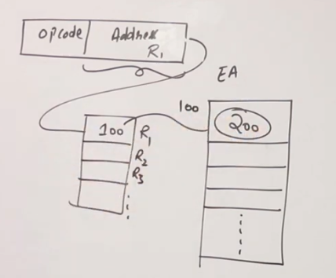
4. Register Indirect Mode :
Register contains address of operand rather than operands itself.
Used to shorten the instruction length.
ADD R1,(R2) : R1 ← R1 + M[(R2)]

Slide 31
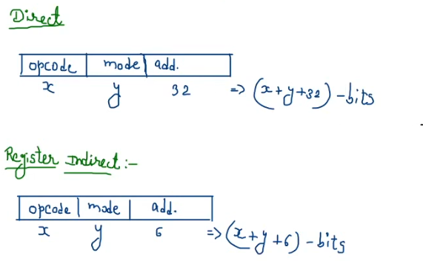
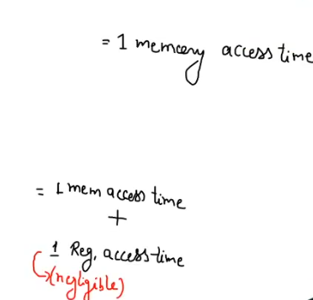
Assume a system with 4GB main memory & CPU has 64 general purpose registers.
MM add = 32 bit
Register references = 6 bit

Slide 32

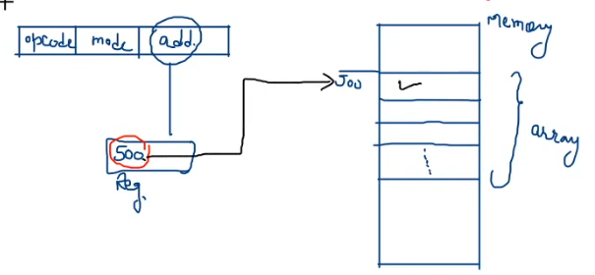
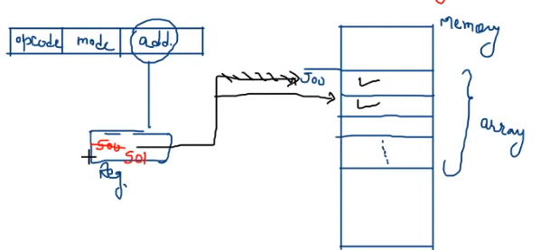
5. Autoincrement or Autodecrement Mode :
Used to access table of content (array) sequentially.
Variant of register indirect mode.
Content of register (effective address) is Automatically increment or decrement.

Slide 33
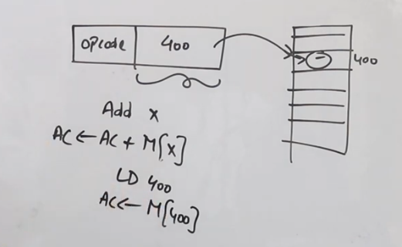
6. Direct Addressing Mode : (Absolute Addressing Mode)
Actual address is given in the instruction.
Use to access variable.

Slide 34
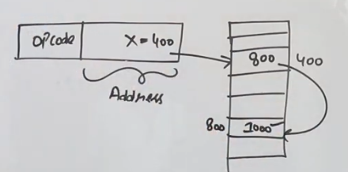
7. Indirect Addressing Mode :
Used to implement pointer and passing parameters.
2 memory access required.
ADD X
AC ← AC + M [ M[X] ]
EA = 800
EA = M [x]

Slide 35
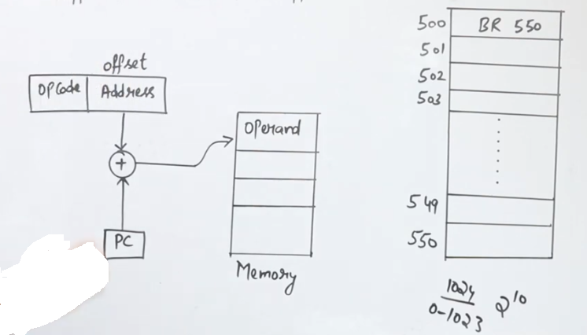
8. Relative Addressing Mode :
Used for program control instruction like branch & jump.
Effective Address = Program counter + Address part of instruction
EA = PC + Offset (Displacement)
EA = 501 + 50 = 551 - False
EA = 501 + 49 = 550 - True

Slide 36






9. Base Register Addressing Mode :
Used in program relocation.
Main memory size limited – So process swap in & swap out frequently
Change the location of process in main memory
BR 160
BR 60
EA = Base Register value + Displacement
= 400 +60 = 460
BR 160
Base Register store the base address value.

Slide 37
10. Indexed Addressing Mode :
Use to access or implement array efficiently
Multiple register required to implement
Any element can be accessed without change in instruction
Opcode | Address
BA = 100
100
101
102
103
104
EA = Base + Indexed Register value
= 100 +4 = 104

Slide 38
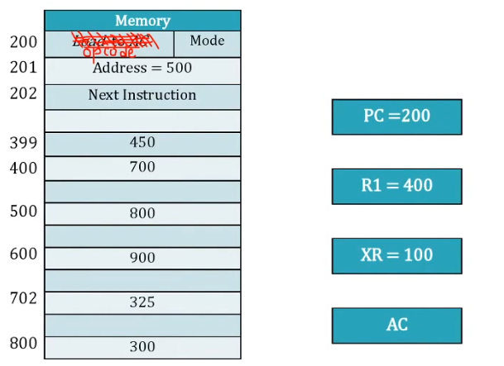
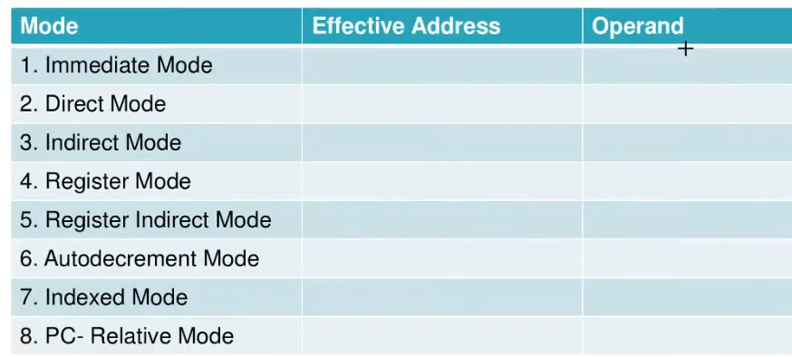
Opcode | Mode | Address (Operand)
500
201
500
500
800
800
300
---
400
Index Register
400
700
Target Inst.
399
450
500+100 = 600
900
202+500 = 702
---

Slide 39
Data transfer & manipulation instructions

Slide 40
Data transfer instructions
Data transfer instructions move data from one place in the computer to another without changing the data content.
The most common transfers are between memory and processor registers, between processor registers and input or output, and between the processor registers themselves.
Name | Mnemonic
Load | LD
Store | ST
Move | MOV
Exchange | XCH
Input | IN
Output | OUT
Push | PUSH
Pop | POP

Slide 41
Data manipulation instructions
Data manipulation instructions perform operations on data and provide the computational capabilities for the computer.
The data manipulation instructions in a typical computer are usually divided into three basic types:
Arithmetic instructions
Logical and bit manipulation instructions
Shift instructions

Slide 42
1. Arithmetic Instructions
Name | Mnemonic
Increment | INC
Decrement | DEC
Add | ADD
Subtract | SUB
Multiply | MUL
Divide | DIV
Add with carry | ADDC
Subtract with borrow | SUBB
Negate (2’s complement) | NEG

Slide 43
2. Logical & Bit Manipulation Instructions
Name | Mnemonic
Clear | CLR
Complement | COM
AND | AND
OR | OR
Exclusive-OR | XOR
Clear carry | CLRC
Set carry | SETC
Complement carry | COMC
Enable interrupt | EI
Disable interrupt | DI

Slide 44
3. Shift Instructions
Name | Mnemonic
Logical shift right | SHR
Logical shift left | SHL
Arithmetic shift right | SHRA
Arithmetic shift left | SHLA
Rotate right | ROR
Rotate left | ROL
Rotate right through carry | RORC
Rotate left through carry | ROLC

Slide 45
Program Control

Slide 46
Program Control
A program control type of instruction, when executed, may change the address value in the program counter and cause the flow of control to be altered.
The change in value of the program counter as a result of the execution of a program control instruction causes a break in the sequence of instruction execution.
Name | Mnemonic
Branch | BUN
Jump | JMP
Skip | SKP
Call | CALL
Return | RET
Compare (by subtraction) | CMP
Test (by ANDing) | TST

Slide 47




Status Bit Conditions
A
B
8
8
$$C_{7}$$
8-bit ALU
$$C_{8}$$
V | Z | S | C
$$F_{7}−F_{0}$$
$$F_{7}$$
Check for zero output
8
Output F

Slide 48
Status Bit Conditions
Bit C (carry) is set to 1 if the end carry C₈ is 1. It is cleared to 0 if the carry is 0.
Bit S (sign) is set to 1 if the highest-order bit F₇ is 1. It is set to 0 if the bit is 0.
Bit Z (zero) is set to 1 if the output is zero and Z = 0 if the output is not zero.
Bit V (overflow) is set to 1 if the exclusive-OR of the last two carries is equal to 1, and cleared to 0 otherwise. This is the condition for an overflow when negative numbers are in 2’s complement.

Slide 49
Conditional Branch Instructions
Mnemonic | Branch Condition | Tested Condition
BZ | Branch if zero | Z = 1
BNZ | Branch if not zero | Z = 0
BC | Branch if carry | C = 1
BNC | Branch if no carry | C = 0
BP | Branch if plus | S = 0
BM | Branch if minus | S = 1
BV | Branch if overflow | V = 1
BNV | Branch if no overflow | V = 0
Unsigned compare conditions (A – B)
BHI | Branch if higher | A > B
BHE | Branch if higher or equal | A ≥ B
BLO | Branch if lower | A < B

Slide 50
Conditional Branch Instructions
Mnemonic | Branch Condition | Tested Condition
BLOE | Branch if lower or equal | A ≤ B
BE | Branch if equal | A = B
BNE | Branch if not equal | A ≠ B
Signed compare conditions (A – B)
BGT | Branch if greater than | A > B
BGE | Branch if greater or equal | A ≥ B
BLT | Branch if less than | A < B
BLE | Branch if less or equal | A ≤ B
BE | Branch if equal | A = B
BNE | Branch if not equal | A ≠ B

Slide 51
Program Interrupt
The interrupt procedure is, in principle, quite similar to a subroutine call except for three variations:
The interrupt is usually initiated by an internal or external signal rather than from the execution of an instruction.
The address of the interrupt service program is determined by the hardware rather than from the address field of an instruction.
An interrupt procedure usually stores all the information necessary to define the state of the CPU rather than storing only the program counter.
After a program has been interrupted and the service routine been executed, the CPU must return to exactly the same state that it was when the interrupt occurred. Only if this happens will the interrupted program be able to resume exactly as if nothing had happened.

Slide 52
Program Interrupt
The state of the CPU at the end of the execute cycle (when the interrupt is recognized) is determined from:
The content of the program counter
The content of all processor registers
The content of certain status conditions
The interrupt facility allows the running program to proceed until the input or output device sets its ready flag. Whenever a flag is set to 1, the computer completes the execution of the instruction in progress and then acknowledges the interrupt.
• The result of this action is that the return address is started in location 0. The instruction in location 1 is then performed; this initiates a service routine for the input or output transfer. The service routine can be stored in location 1.

Slide 53
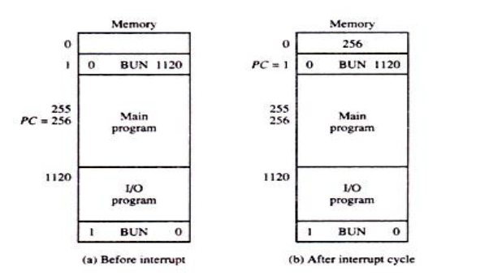

Slide 54
The service routine must have instructions to perform the following tasks:
1. Save contents of processor registers.
2. Check which flag is set.
3. Service the device whose flag is set.
4. Restore contents of processor registers.
5. Turn the interrupt facility on.
6. Return to the running program.

Slide 55
Program Status Word (PSW)
The collection of all status bit conditions in the CPU is sometimes called a program status word or PSW.
The PSW is stored in a separate hardware register and contains the status information that characterizes the state of the CPU.

Slide 56
Types of interrupts
There are three major types of interrupts that cause a break in the normal execution of a program. They can be classified as:
External interrupts
Internal interrupts
Software interrupts

Slide 57
1. External Interrupt
External interrupts come from
Input-output (I/O) devices
Timing device
Circuit monitoring the power supply
Any other external source
Examples that cause external interrupts are
I/O device requesting transfer of data
I/O device finished transfer of data
Elapsed time of an event
Power failure
External interrupts are asynchronous.
External interrupts depend on external conditions that are independent of the program being executed at the time.

Slide 58
2. Internal interrupts (Traps)
Internal interrupts arise from Illegal or erroneous use of an instruction or data. Internal interrupts are also called traps.
Examples of interrupts caused by internal error conditions like
Register overflow
Attempt to divide by zero
invalid operation code
stack overflow
protection violation.
These error conditions usually occur as a result of a premature termination of the instruction execution.
Internal interrupts are synchronous with the program. If the program is rerun, the internal interrupts will occur in the same place each time.

Slide 59
3. Software interrupts
A software interrupt is a special call instruction that behaves like an interrupt rather than a subroutine call.
The most common use of software interrupt is associated with a supervisor call instruction. This instruction provides means for switching from a CPU user mode to the supervisor mode.
When an input or output transfer is required, the supervisor mode is requested by means of a supervisor call instruction. This instruction causes a software interrupt that stores the old CPU state and brings in a new PSW that belongs to the supervisor mode.
The calling program must pass information to the operating system in order to specify the particular task requested.

Slide 60
Reduced Instruction Set Computer (RISC)

Slide 61
Reduced Instruction Set Computer (RISC)
Characteristics of RISC are as follows:
Relatively few instructions
Relatively few addressing modes
Memory access limited to load and store instructions
All operations done within the registers of the CPU
Fixed-length, easily decoded instruction format
Single-cycle instruction execution
Hardwired rather than microprogrammed control
A relatively large number of registers in the processor unit
Use of overlapped register windows to speed-up procedure call and return
Efficient instruction pipeline
Compiler support for efficient translation of high-level language programs into machine language programs

Slide 62
Complex Instruction Set Computer (CISC)

Slide 63
Complex Instruction Set Computer (CISC)
Characteristics of CISC are as follows:
A larger number of instructions – typically from 100 to 250 instructions
Some instructions that perform specialized tasks and are used infrequently
A large variety of addressing modes – typically from 5 to 20 different modes
Variable-length instruction formats
Instructions that manipulate operands in memory

Slide 64
Overlapped Register Window
A characteristic of some RISC processors is their use of overlapped register windows to provide the passing of parameters and avoid the need for saving and restoring register values.
Each procedure call results in the allocation of a new window consisting of a set of registers from the register file for use by the new procedure.
Windows for adjacent procedures have overlapping registers that are shared to provide the passing of parameters and results.

Slide 65
Overlapped Register Window
R15
Common to D and A
R10
R73
Local to D
R64
R63
Common to C and D
R58
Proc D
R57
Local to C
R48
R47
Common to B and C
Window size = L + 2C + G
R42
Proc C
R41
Register file = (L + C) W + G
Local to B
R32
R31
Common to A and B
R9
R26
Common to all procedures
Proc B
R25
Local to A
R16
R0
R15
Global registers
Common to A and D
R10
Proc A

Slide 66
Overlapped Register Window
Suppose that procedure A calls procedure B.
Registers R26 through R31 are common to both procedures, and therefore procedure A stores the parameters for procedure B in these registers.
Procedure B uses local registers R32 through R41 for local variable storage.
If procedure B calls procedure C, it will pass the parameters through registers R42 through R47.
When procedure B is ready to return at the end of its computation, the program stores results of the computation in registers R26 through R31 and transfers back to the register window of procedure A.
Note that registers R10 through R15 are common to procedures A and D because the four windows have a circular organization with A being adjacent to D.

Slide 67
The concept of overlapped register windows is shown in figure. The system had a total of 74 registers. Register R0 through R9 are global registers that hold parameters shared by all procedures.
The other 64 registers are divided into four windows to accommodate procedure A, B, C and D. Each register window consists of 10 local registers and two sets of six registers common to adjacent windows.
Only one register window is activated at any given time with a pointer indicating the active window.
The high register of the calling procedure overlap the low registers of the called procedure, and therefore the parameters automatically transfer from calling to called procedure.

Slide 68
The organization of register windows will have the following relationships:
Number of global registers = G
Number of local registers in each window = L
Number of register common to two windows = C
Number of windows = W
The number of registers available for each window is calculated as follows:
Window size = L + 2C + G = 10 + 2*6 + 10 = 32
The total number of register needed in the processor is
Register file = (L + C) W + G = (10 + 6 ) *4 + 10 = 74

Slide 69
RISC | CISC
Reduced instruction set computer | Complex instruction set computer
There are few addressing modes. Most instructions have register to register addressing modes. | There are many addressing modes.
There are few instructions. | There are many instructions.
It can include simple instructions and takes one cycle. | It can include complex instructions and takes multiple cycles.
Hardware executes the instructions. | Micro-program executes the instructions.
There are Fixed format instructions. | There are Variable format instructions.
It can be easier to decode as instructions have a fixed format. | It can be complex to decode as instructions have variable format.
There are multiple register sets are used. | A single register set is used.
RISC is highly pipelined. | CISC is not pipelined or less pipelined.
Require more RAM. | Require less RAM

