Slide 1

School of Computer Engineering
Presentation for TY Project (Final Review ), Sem V, 2021-22
Secured Framework for pocket smart cards
GROUP NAME:
KAPIL KHAIRKAR [SCET43]
SHUBHAM KOTGIRE [SCET209]
SHUBHAM KOTKAR[SCET230]
DHAWAL HEMANE [TEE11]
Guide:
Mrs. Jayshree Kulkarni

Slide 2
Index
Introduction (Motivation, Problem Statement, Objectives & Scope)
Literature Survey
System Design (block diagram/proposed system and UML diagrams)
Methodology
Conclusion
References

Slide 3
Introduction
People nowadays are victims of payment fraud, which leads to a loss of trust in banks that facilitate fraud, as well as an increase in payment volume, culminating in financial loss over time. Since a result, in order to provide a vital response to fraudulent credit card payments, we must focus on complex capital management security, as attackers will definitely devise new ways to get access to the system.

Slide 4
Motivation
The Credit Card Fraud Detection Problem involves looking back at previous credit card transactions and knowing which ones turned out to be fraudulent. This system is then used to see if a new transaction has occurred, and if so, whether it is a fraud or not. Our mission is to locate each and every one of them. Fraudulent transactions are reduced to a minimum, while erroneous transactions are reduced to a minimum. A significant premium is placed on the creation of an efficient and secure electronic payment system that can detect whether a transaction is fraudulent or not. We'll look at credit card fraud and how to spot it in this study. When someone uses another person's credit card for their own personal use without the owner's knowledge, this is known as credit card fraud.

Slide 5
Problem statement
To build card security platform which provides rules, regulations, and security measures to protect Customer’s privacy,data,and the money involved.

Slide 6
Objective and scope
The only ones raising worry are contactless cards that employ the NFC interface for quick and efficient transactions on small amounts of money. The contactless cards are made of modern technology, with a coil and chips that are triggered by an emitted RF field using the induction principle. A major goal is to develop a dependable and secure electronic payment system that can detect whether or not a transaction is fraudulent. In this study, we'll look at credit card fraud and how to recognise it. Credit card fraud occurs when someone uses another person's credit card for their own personal gain without the owner's knowledge.

Slide 7
Literature survey
S no. | Research paper | Pros | Cons
1 | Applying Relay Attacks to google wallet | Possible workarounds, Google Wallet pin verification | Relay apps needs access to secure element , Transaction Limits
2 | The Dangers of Verify PIN on Contactless Cards | Attack scenario presents a viable exploit , Undermines the security of Chip & PIN
3 | Internet of smart cards | Majorly focuses on relay attack that use man in the middle approach. | No particular generalised idea due to multiple solution
4 | A RESEARCH SURVEY: RFID SECURITY & PRIVACY ISSUE | It allows major secure and cheap base user privacy services | Difficult solution due to suffer form higher dimension
5 | NFC Payment Spy: A Privacy Attack on Contactless Payments | Describe various attack design , attack results along with solutions to card collision. | Complex solution with respect to algorithm

Slide 8
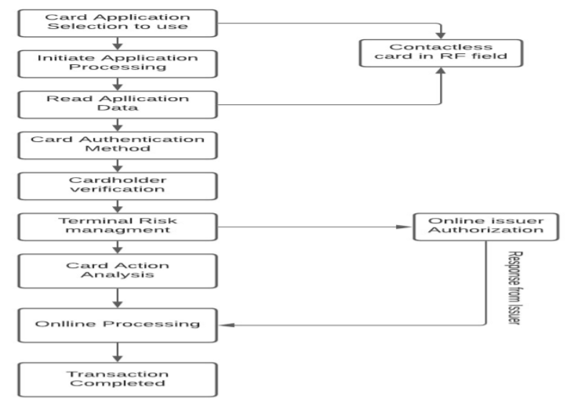
Block diagram

Slide 9
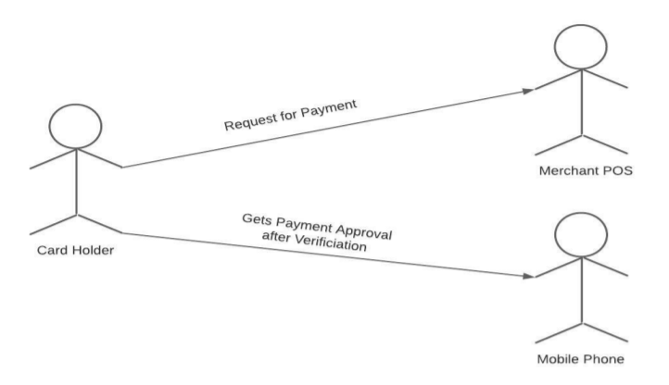
UML diagram

Slide 10
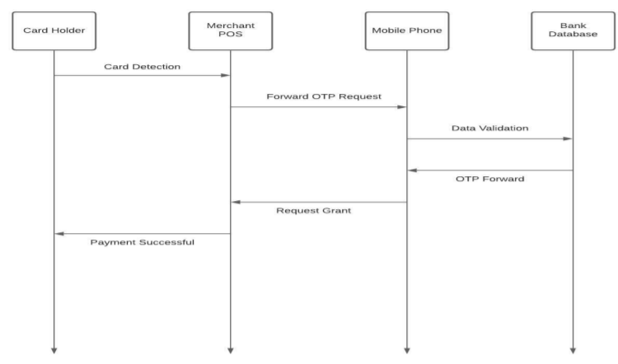
Sequence diagram

Slide 11
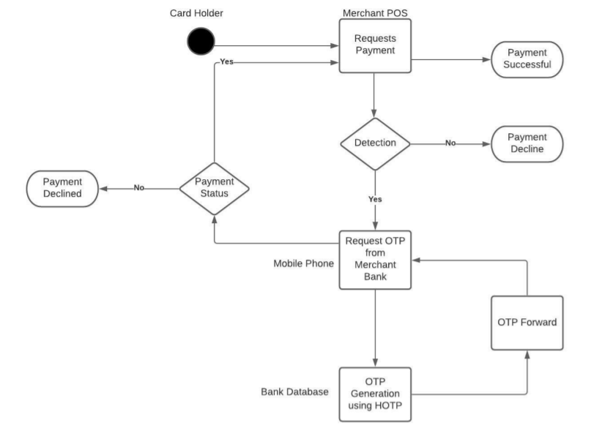
Activity Diagram

Slide 12
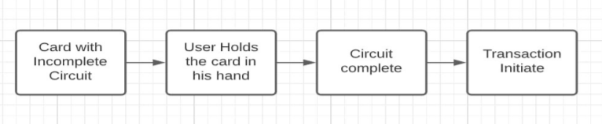
Methodology
This approach is based on ensuring the security of contactless payment cards. The major goal of this strategy is to only activate the card when it is in the hands of a human. A semi-circuit in the card can be used to do this. The circuit will be completed once the card holder holds the card to finish the transaction because we humans have electrons in our bodies. This will ensure that the card is in the hands of the cardholder, allowing us to proceed with the transaction.

Slide 13
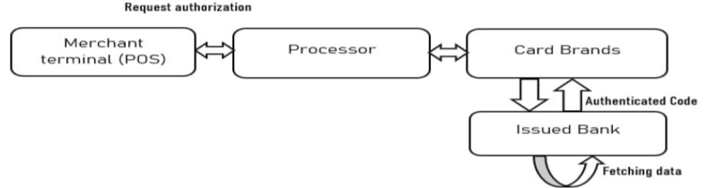
Methodology
This is a second authentication factor in which the user verifies its unique identification in relation to the smart mole. Here, we'll look at how to create and authenticate using a one-time-pad, which provides a quick and secure way to create authentication. HOTP (HMAC based one-time password) designated RFC 4226 is the major otp generating technique we use, and it also supports authenticated services. OATH/ HOTP (RFC 4226). The Pos (merchant terminal) sends an authorization request to the processor, who then sends it to the card brand, who then sends it to the bank branch, where the user's financial information is registered. After that, the bank retrieves data from the user, such as account balances, and generates an authorization number, which is then sent back to the POS.

Slide 14
Conclusion
We showed how, when combined with other known contactless card weaknesses, this feature may be used by an attacker to carry out illicit operations like identity theft or fraudulent financial transactions. Based on the technique described above, we may deduce that this initiative is being used to secure contactless payment cards. This initiative consists of numerous entities such as users, merchants, and bank issuers that all work together to ensure the easy and secure deployment of contactless transactions.

Slide 15
Reference
M. Roland, J. Langer and J. Scharinger, "Applying relay attacks to Google Wallet," 2013 5th International Workshop on Near Field Communication (NFC), 2013, pp. 1-6, doi: 10.1109/NFC.2013.6482441
. The Dangers of Verify PIN on Contactless Cards [By] M. Emms, B. Arief, T. Defty, J. Hannon, F. Hao, A. van Moorsel Newcastle upon Tyne: Newcastle University: Computing Science, 2012. (Newcastle University, Computing Science, Technical Report Series, No. CS-TR-1332)
Luigi Sportiello, “Internet of Smart Cards”: A pocket attacks scenario,International Journal of Critical Infrastructure Protection, Volume 26,2019,100302,ISSN 1874-5482,https://doi.org/10.1016/j.ijcip.2019.05.005. (https://www.sciencedirect.com/science/article/pii/S1874548219300642)
David C. Wyld (Eds) : ICCSEA, SPPR, CSIA, WimoA, UBIC - 2013 pp. 255–261, 2013. © CS & IT-CSCP 2013
NFC Payment Spy: A Privacy Attack on Contactless Payment

