Slide 1
GVIM
GVIM, or "GNU Vi Improved," is a highly configurable and advanced text editor that is based on the Unix Vi editor. It is often used for programming and scripting tasks, but can also be used for general text editing. Some of the key features of GVIM include:

Slide 2
Syntax highlighting and color schemes: GVIM can automatically highlight and color code different elements of your code, making it easier to read and understand.
Code folding: GVIM can fold sections of code to make it easier to navigate large files.
Plug-in support: GVIM has a wide range of third-party plug-ins available that can add additional functionality, such as code completion and error checking.

Slide 3
Multi-level undo/redo: GVIM allows you to undo and redo multiple levels of changes, making it easy to recover from mistakes.
Split screen support: GVIM can split the screen into multiple panes, allowing you to view and edit multiple files at the same time.
Integrated help system: GVIM includes built-in help documentation and tutorials, making it easy to learn and use.

Slide 4
One of the most distinctive features of GVIM is its modal editing, it operates in two different modes: command mode and insert mode. In command mode, you can navigate and manipulate the text, in insert mode you can insert new text.
GVIM is a powerful and flexible tool, and it is widely used by programmers and system administrators for tasks such as coding, debugging, and writing scripts. It is available for most operating systems, including Windows, Mac, and Linux.

Slide 5
Customization: GVIM is highly customizable, allowing users to adjust settings such as font, color scheme, and key bindings. It also allows you to create and edit your own macros and to define your own commands.
Scripting: GVIM supports scripting in a variety of languages, including Vim script, Perl, Python, and Ruby, which allows you to automate repetitive tasks and to extend the functionality of the editor.
Regular Expressions: GVIM supports regular expressions for searching and replacing text, which can be a powerful tool for editing large or complex files.

Slide 6
Integrated Development Environment (IDE): GVIM can be configured as a complete IDE, with features such as code completion, error checking, and debugging.
Command line interface: GVIM can be launched from the command line, allowing users to quickly open and edit files without having to launch the full graphical user interface.
Remote editing: GVIM supports editing files on remote servers using protocols such as SSH and FTP.

Slide 7
Overall, GVIM is a powerful and versatile text editor that can be tailored to suit the needs of individual users. Whether you're a programmer, system administrator, or just someone who needs a powerful text editor, GVIM is a great choice.

Slide 8
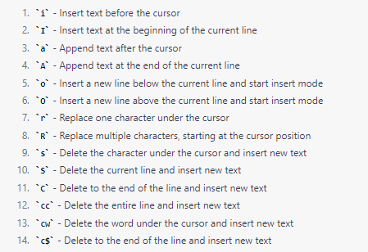
In GVIM, insert mode allows you to insert new text into the document. Here is a list of some commonly used insert mode commands:

Slide 9
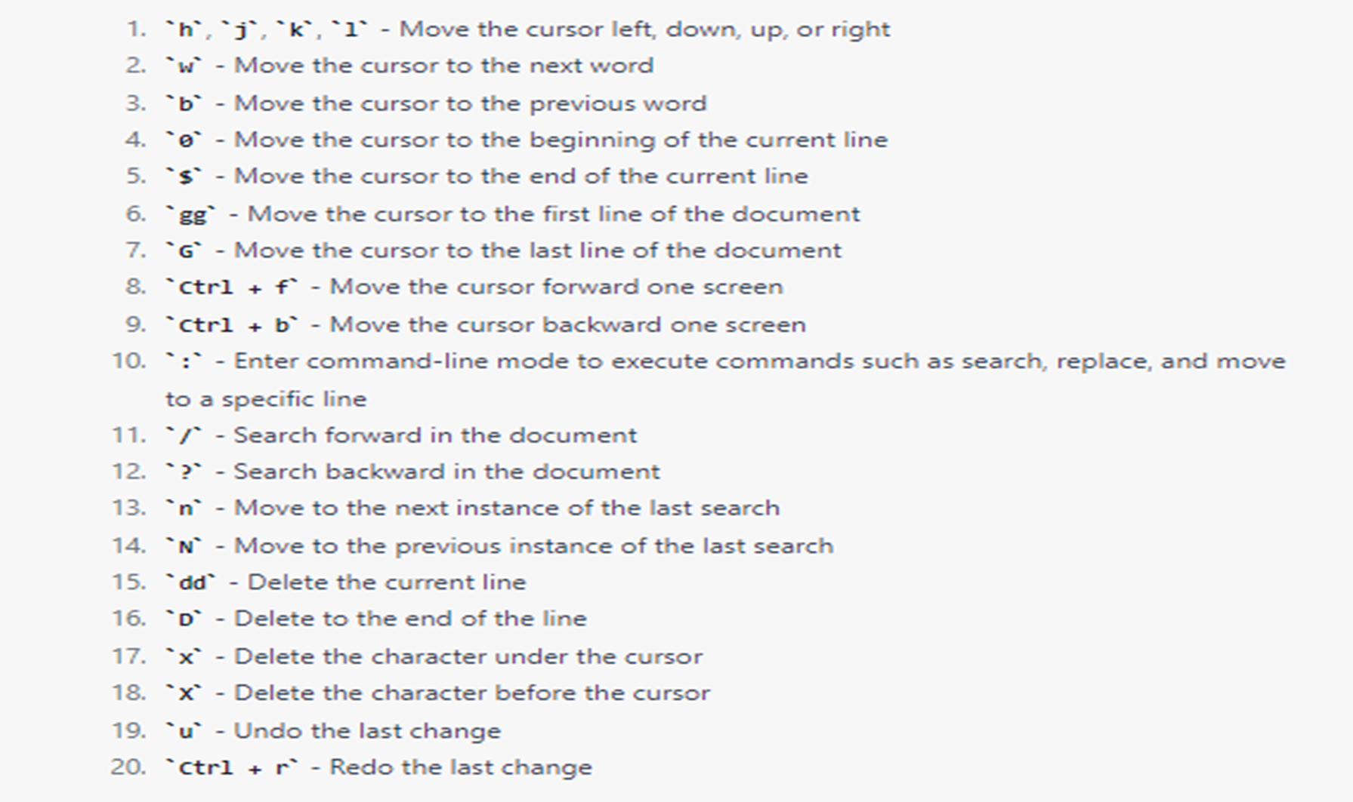
In GVIM, escape mode allows you to navigate and manipulate the text in the document without inserting new text. Here is a list of some commonly used escape mode commands:

Slide 10
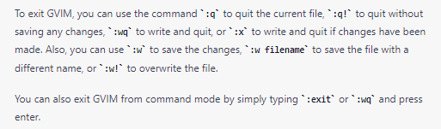
To exit GVIM, you can use the command

Slide 11
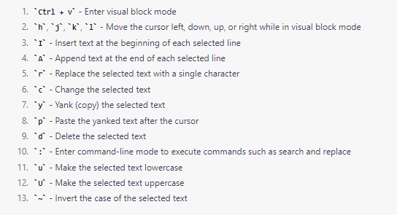
In GVIM, visual block mode allows you to select and manipulate multiple columns of text at once. Here is a list of some commonly used visual block mode commands:

Slide 12
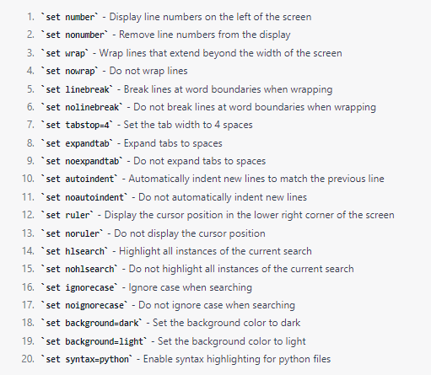
GVIM has a wide range of options that can be set to customize the behavior and appearance of the editor. Here is a list of some commonly used options:

Slide 13
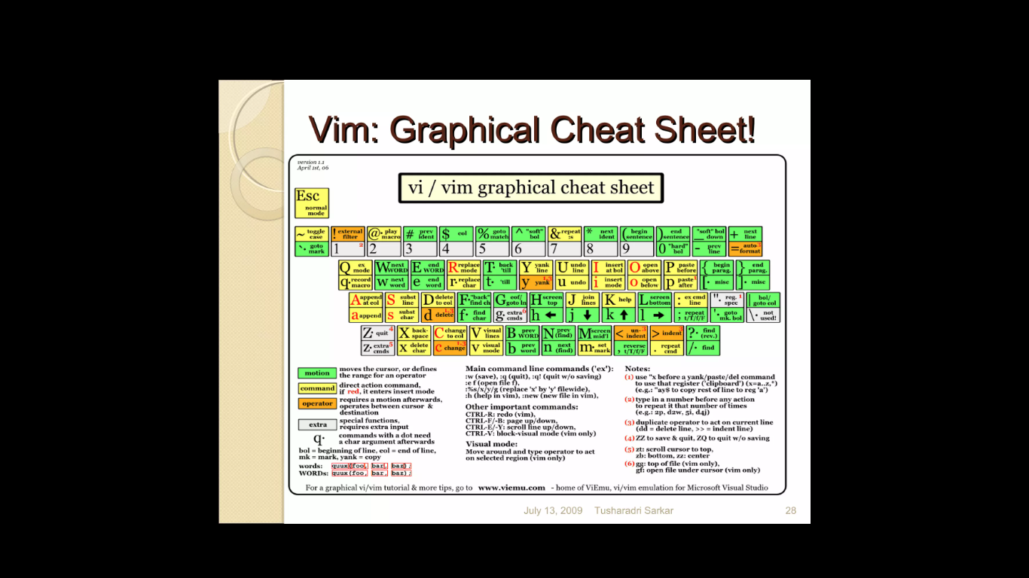

Slide 14
