Slide 1
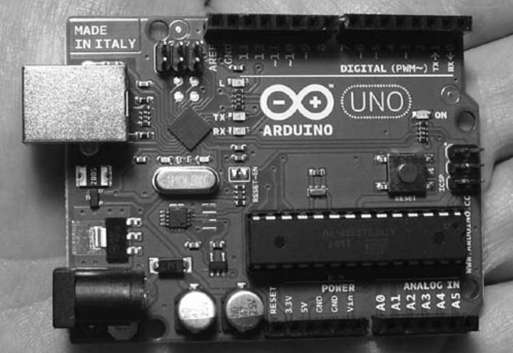
What is Arduino ?
The Arduino is a tiny computer system that can be programmed with your instructions to interact with various forms of input and output

