Slide 2
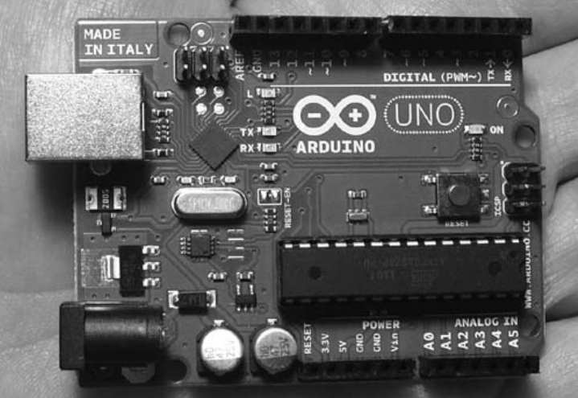
What is Arduino ?
The Arduino is a tiny computer system that can be programmed with your instructions to interact with various forms of input and output

Slide 3
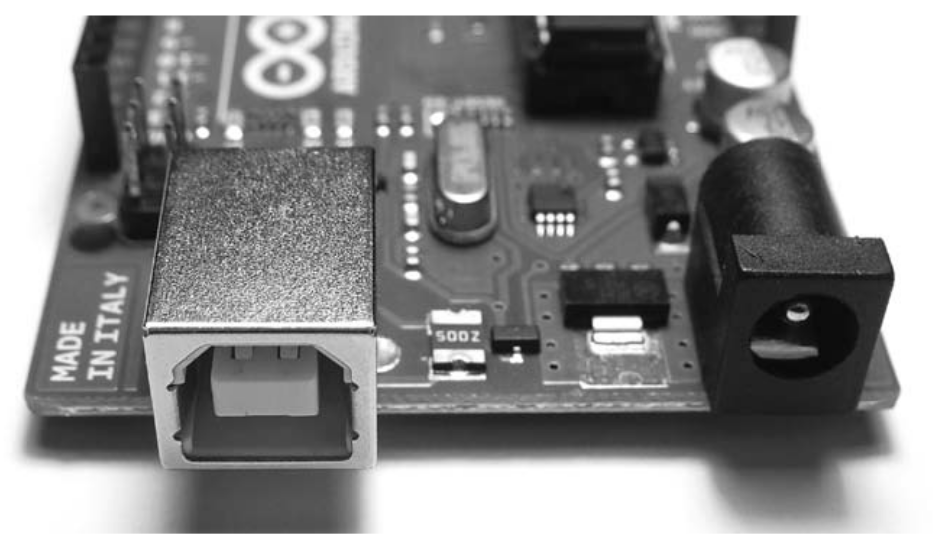
Quick Tour of Arduino
USB Connector
Connects Arduino to Computer
To Supply Power
Upload Instructions to Arduino
Send and Receive Data

Slide 4
Quick Tour of Arduino
Power the Arduino with DC 9-12V plug

Slide 5
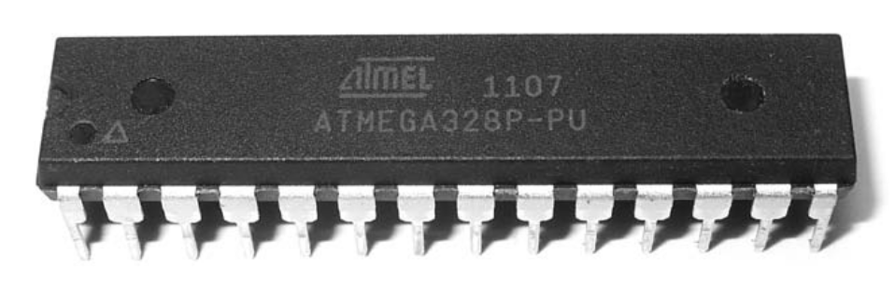
Quick Tour Arduino
MicroController
Brain of the Arduino
Executes Instructions
Contains Memory

Slide 6
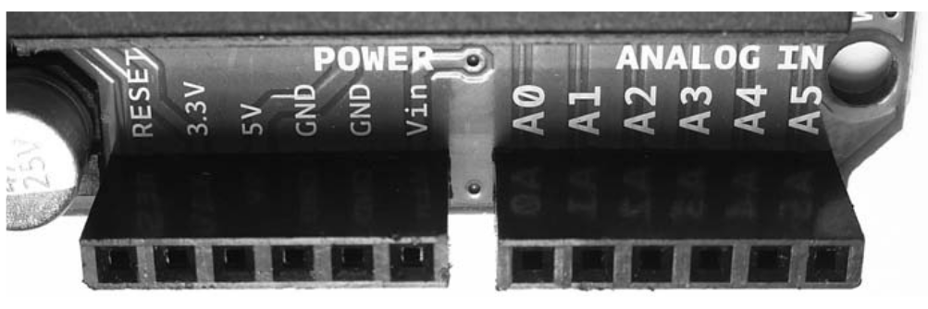
Quick Tour Arduino
Analog Inputs
Six Analog In Pins
Measure Electrical Signals vary in voltage

Slide 7
Quick Tour of Arduino
Power Connections
External RESET

Slide 8
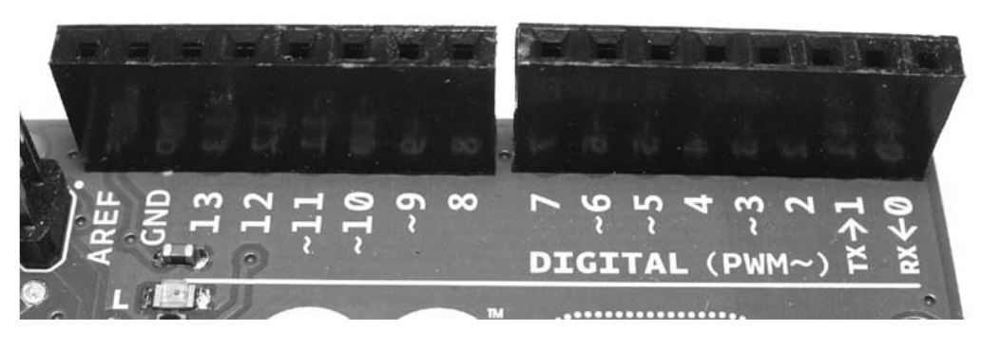
Quick Tour of Arduino
Digital Input and Output Pins
Detect the prescence of signal or Can Generate on Command
‘ ~ ‘ Labelled pins can generate varying electrical signal

Slide 9
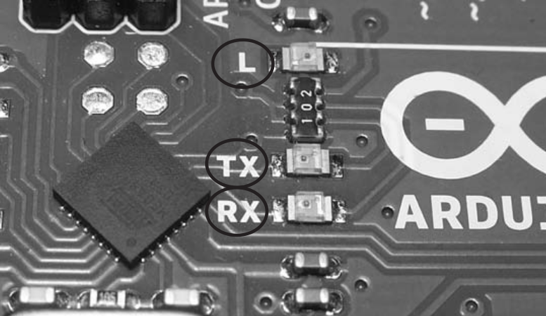
Quick Tour of Arduino
On Board Led’s
TX, RX light up when Data being Transmitted and Received
L is connected to Digital Pin 13

Slide 10
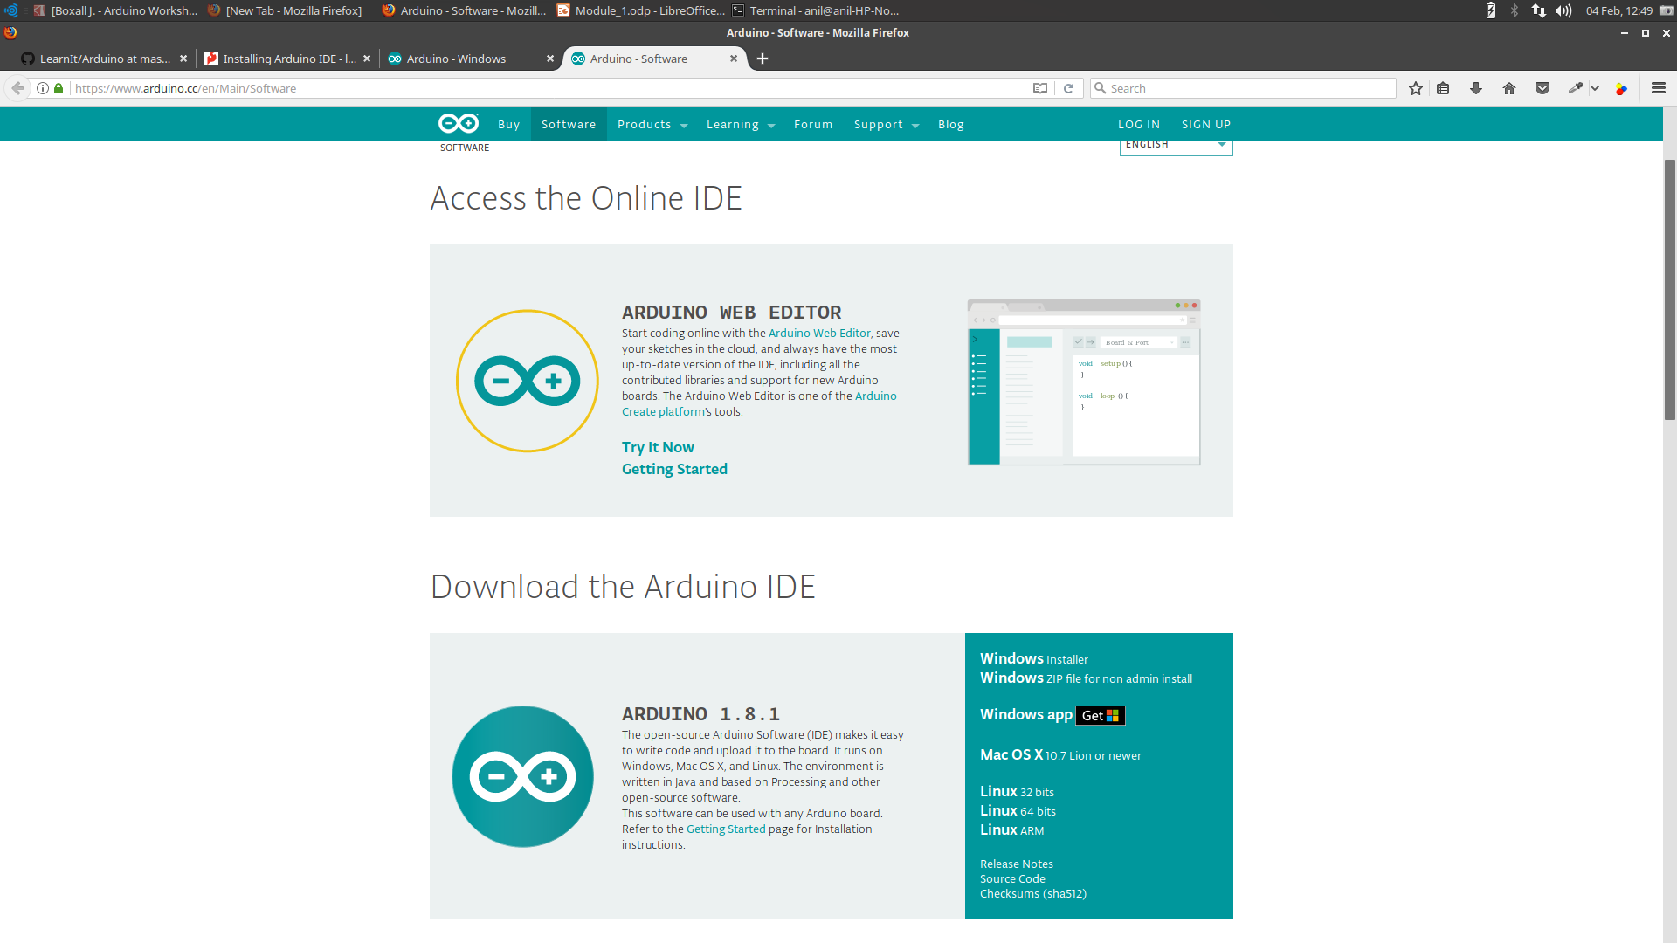
Software - Download
Arduino.cc/en/Main/Software
Select Installer

Slide 11
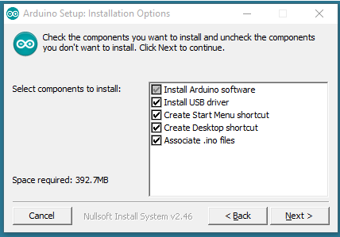
Installation
Double click on the Downloaded Exe File
Allow OS to install Drivers

Slide 12
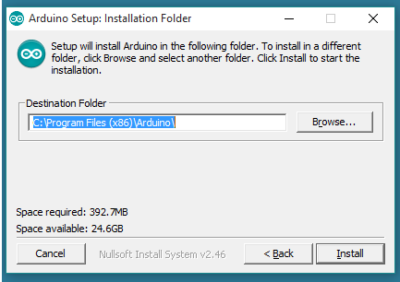
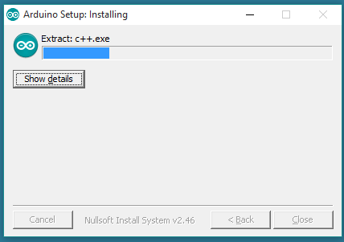
installation

Slide 13
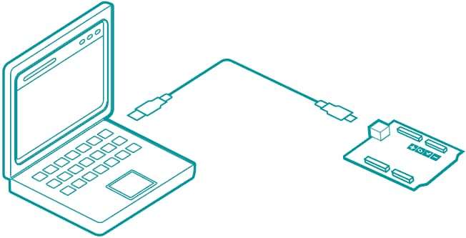
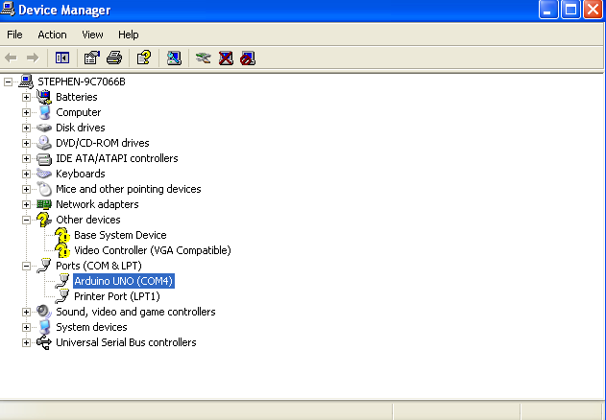
Installation - Driver
Connect Arduino to Computer using USB Cable
Open Device Manger
Look under Ports
Note Arduino UNO COM port

Slide 14
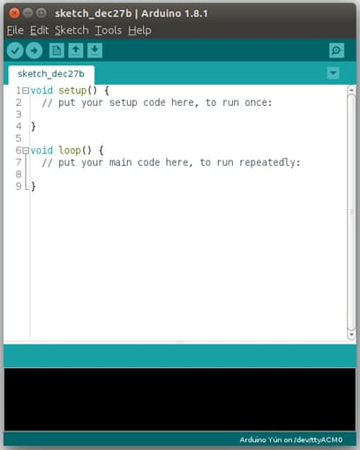
IDE – Test Run
Double Click on the Arduino Icon in Desktop
The Tab is known as Sketch
It Contains the program that tells your board what to do

Slide 15
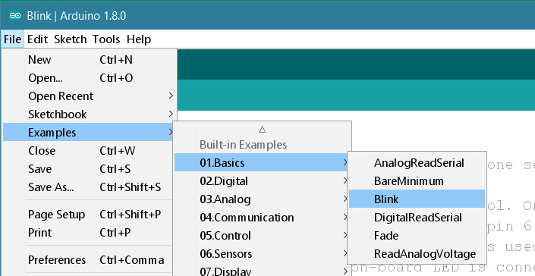
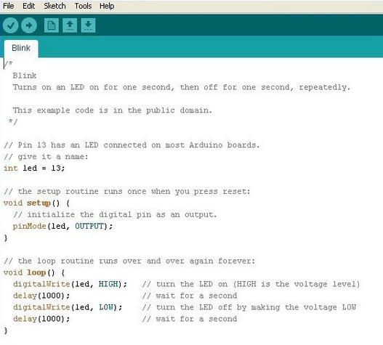
Test Run - Blink It
Go to File->Examples-> Basics-> Blink and click on it

Slide 16
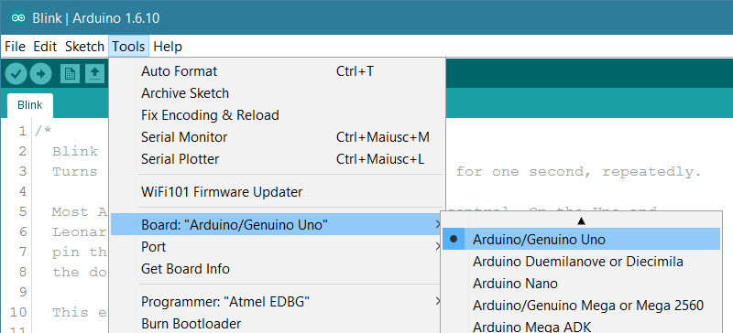
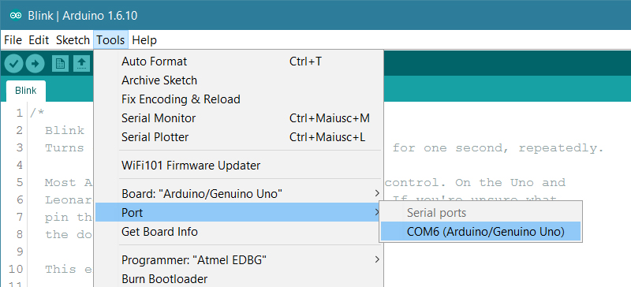
Test Run - Blink It
Select Board type in Tools -> Board
Select UNO
Select COM port noted Previously in Tools -> Port

Slide 17
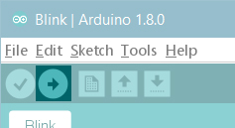
Test Run - Upload
Click the upload button
you should see the RX and TX leds on the board flashing
After few seconds on board led blinks

Slide 18
Introduction to C Programming

Slide 19
Online Editor and Compiler

Slide 20
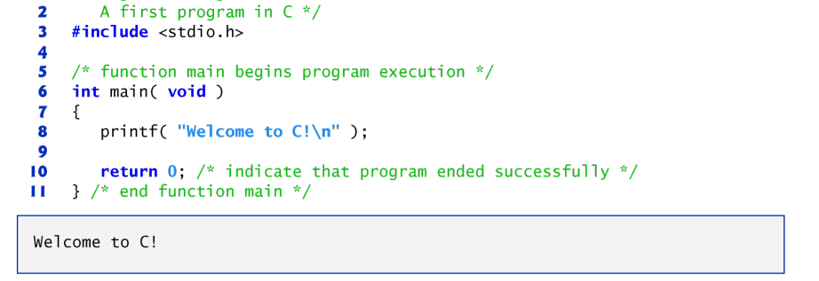
First Program in C

Slide 21
Lines beginning with # are processed by the preprocessor before the program is compiled
Line 3 tells the preprocessor to include the contents of the standard input/output header (<stdio.h>) in the program
This header contains information used by the compiler when compiling calls to standard input/output library functions such as printf

Slide 22
Line 6
int main( void )
is a part of every C program.
The parentheses after main indicate that main is a program building block called a function
C programs contain one or more functions, one of which must be main.
Every program in C begins executing at the function main.

Slide 23
Line 8
printf( "Welcome to C!\n" );
instructs the computer to perform an action, namely to print on the screen the string of characters marked by the quotation marks.

