Slide 2
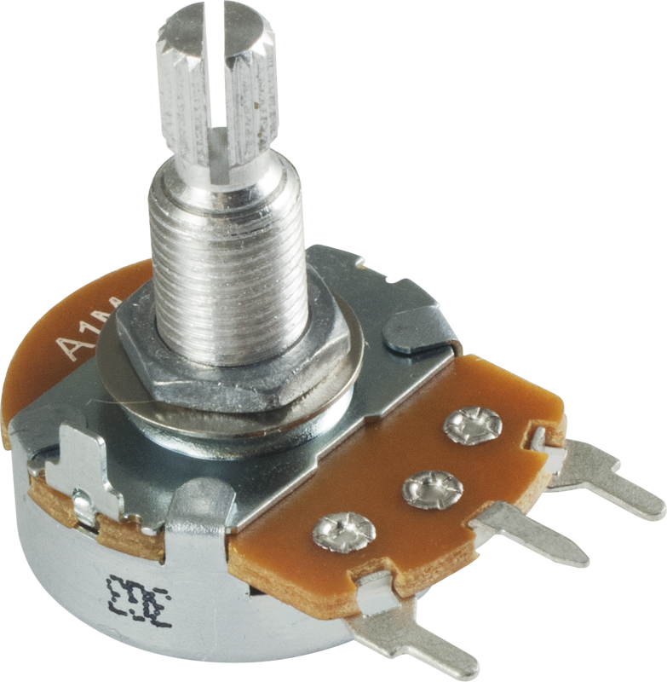
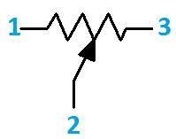
Reading Potentiometer
Also known as voltage divider
When powered with 5v , the middle pin outputs a voltage between 0 to 5 depending on the position of the knob

Slide 3
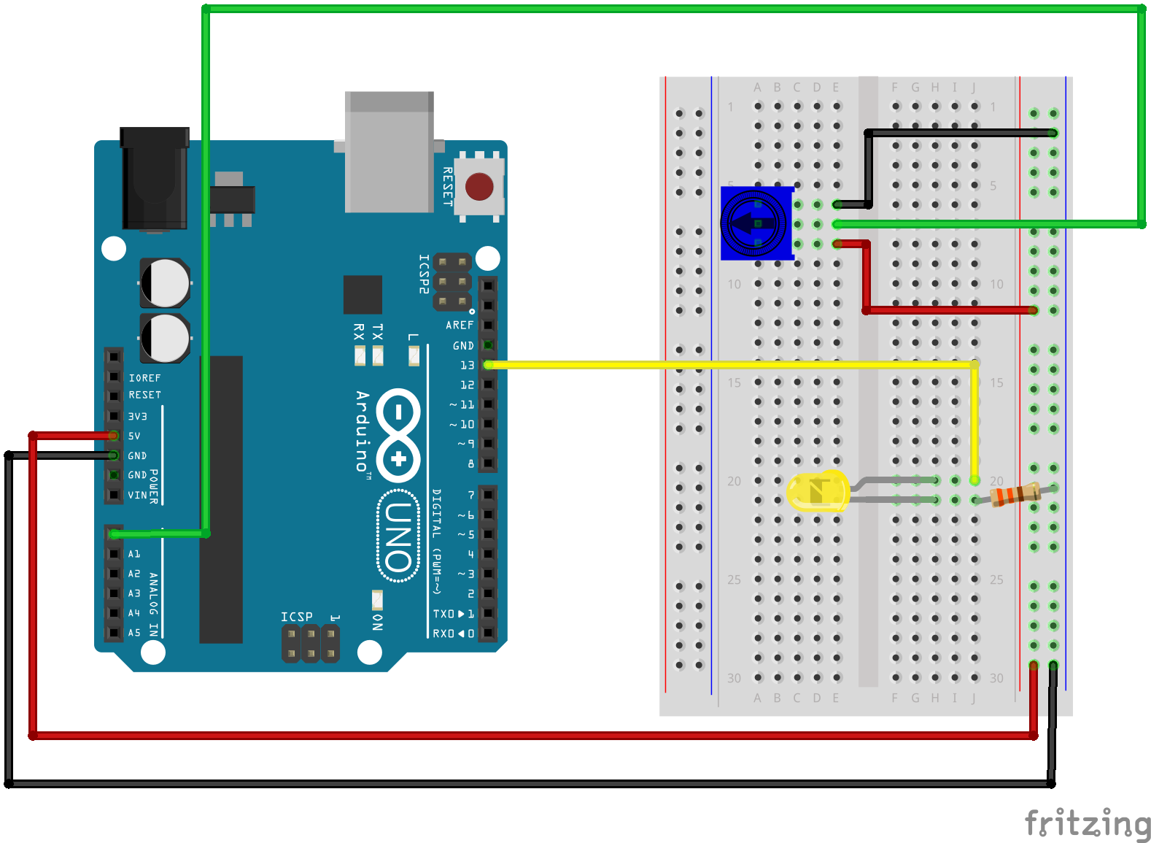
Circuit

Slide 4
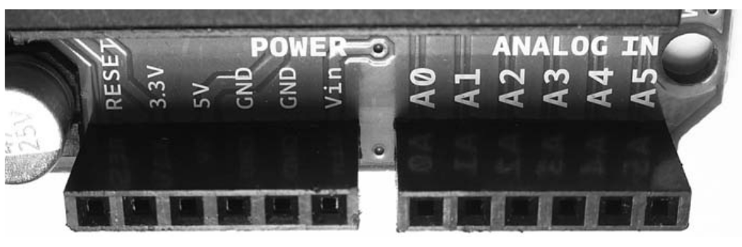
analogRead()
Reads the value from the specified analog pin
it will map input voltages between 0 and 5 volts into integer values between 0 and 1023 - 10 bit ADC
Resolution
5/1024 = 4.9mv

Slide 5
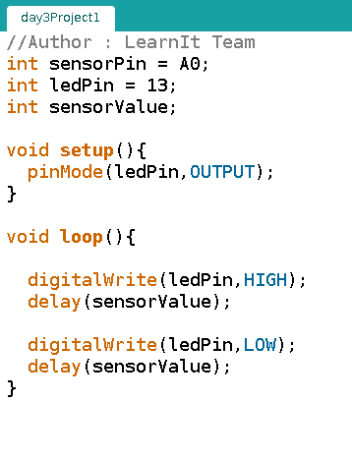

Slide 6
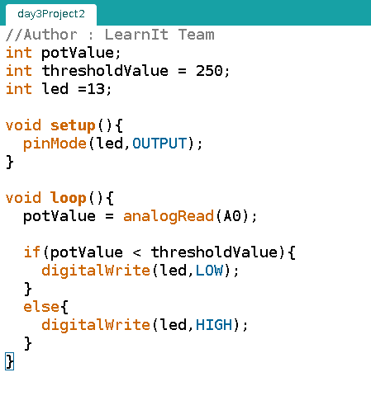

Slide 7
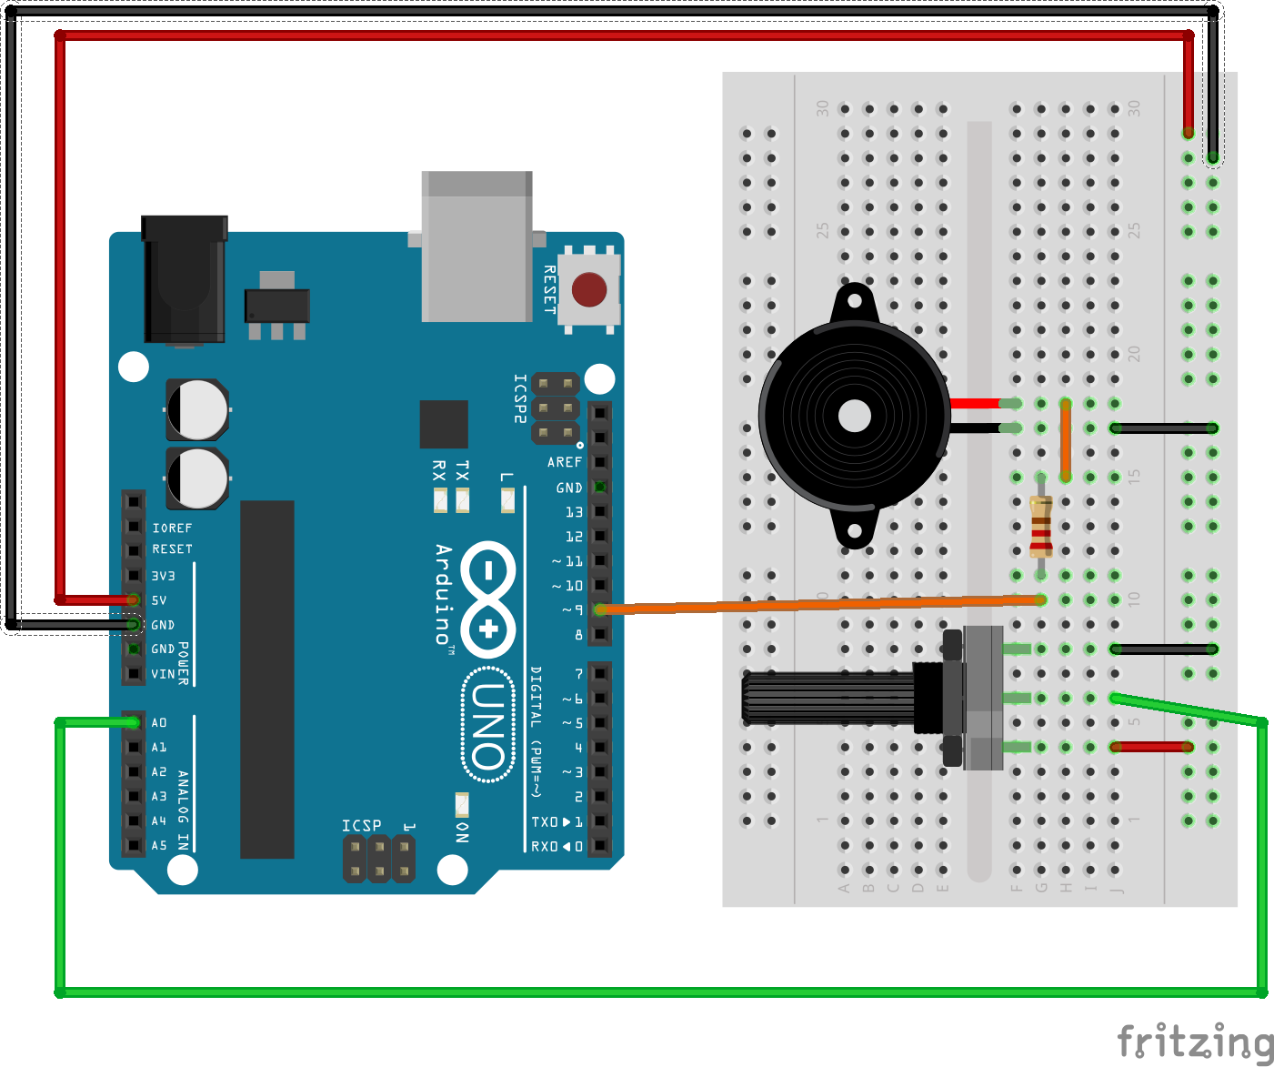
Volume Controller
100 Ohm R

Slide 8
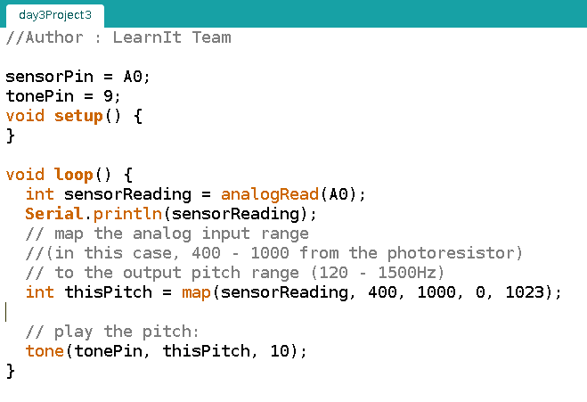

Slide 9
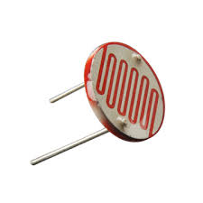
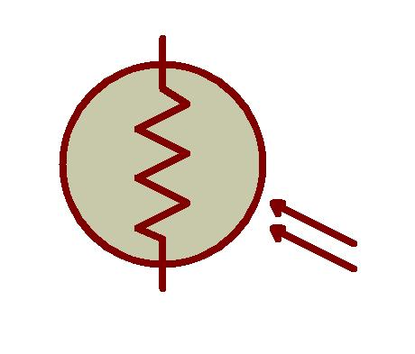
Sense your Environment
Photoresistor
Changes resistance based on how much light the sensor receives
Voltage Divider is used with sensor

Slide 10
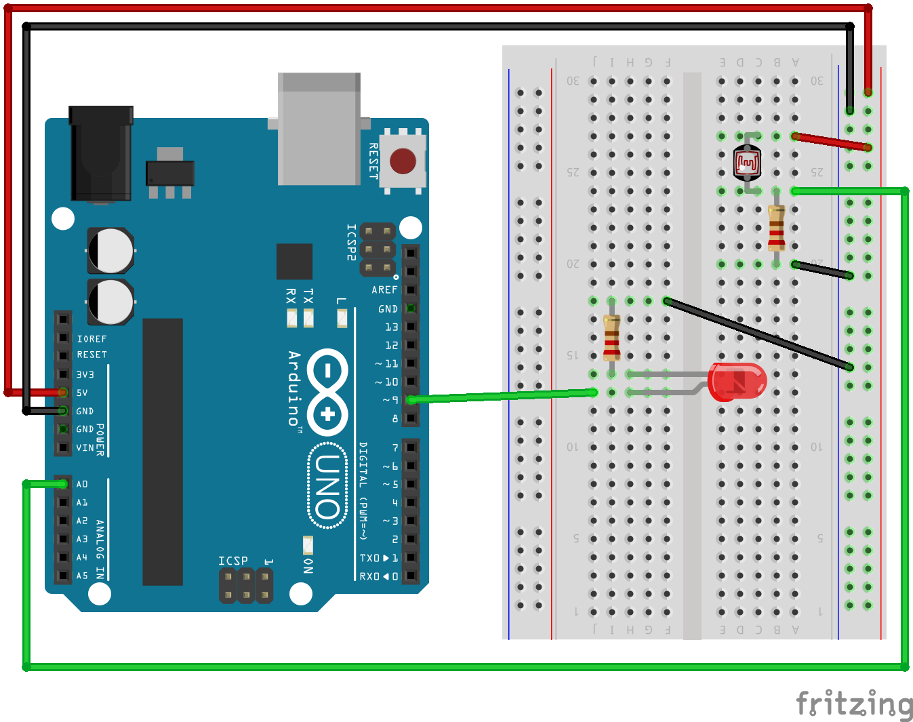
LDR R - 10k

Slide 11
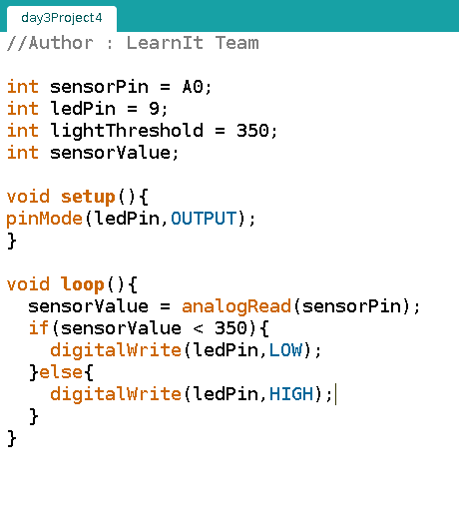

Slide 12
