Slide 1
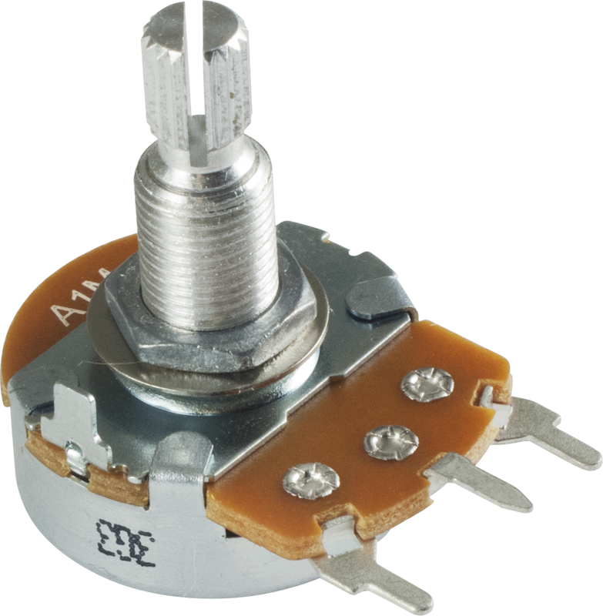
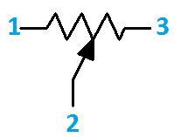
Reading Potentiometer
Also known as voltage divider
When powered with 5v , the middle pin outputs a voltage between 0 to 5 depending on the position of the knob

Slide 2
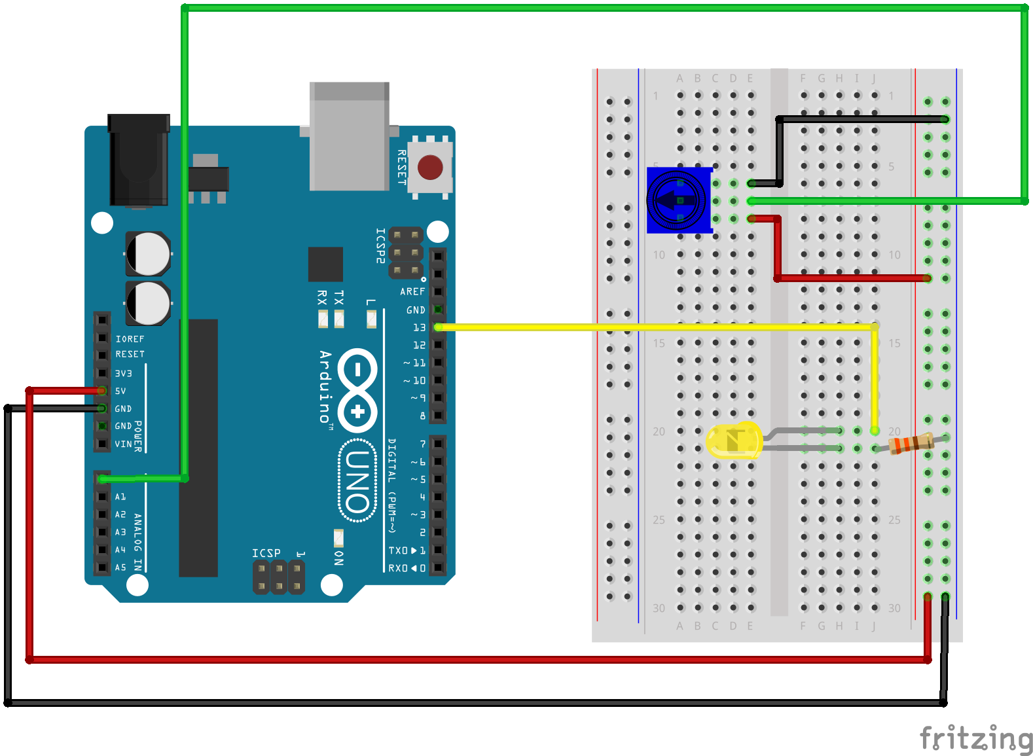
Circuit

Slide 3
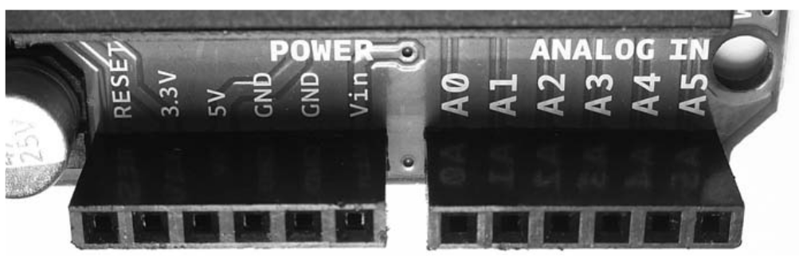
analogRead()
Reads the value from the specified analog pin
it will map input voltages between 0 and 5 volts into integer values between 0 and 1023 - 10 bit ADC
Resolution
5/1024 = 4.9mv

Slide 4
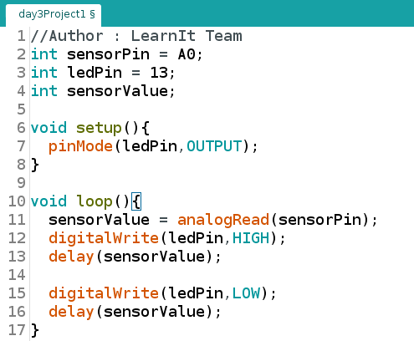
Change the speed of led

Slide 5
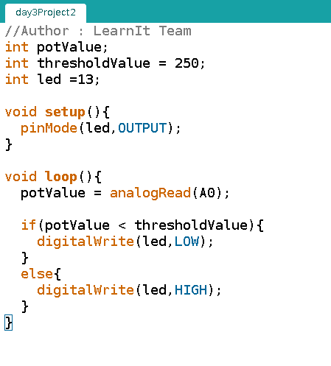
LED On/Off By Position

Slide 6
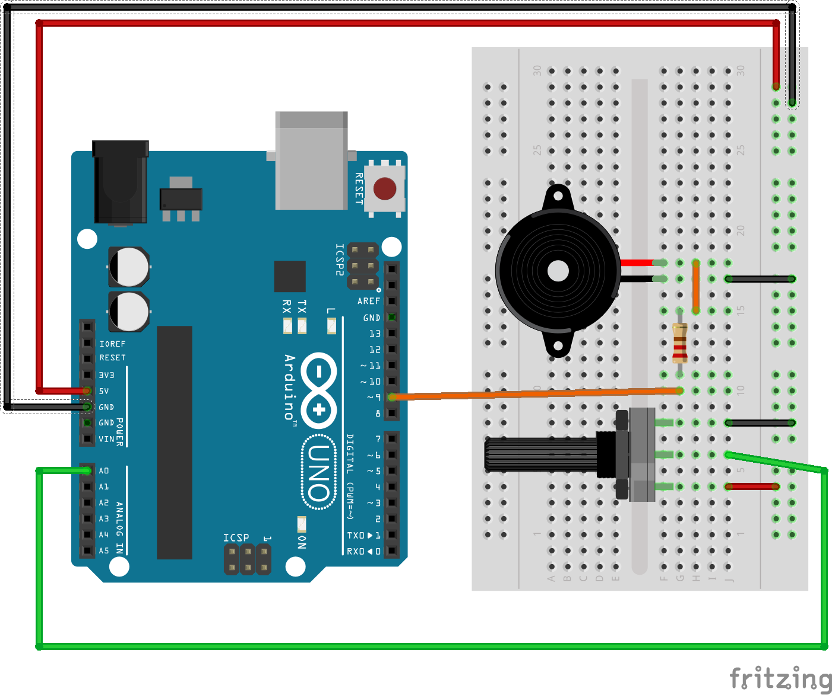
Volume Controller
100 Ohm R

Slide 7
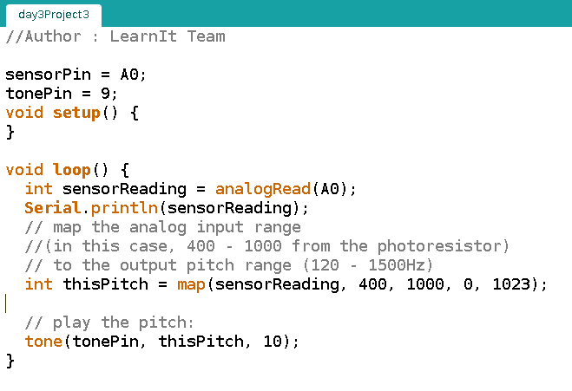
Volume Knob

Slide 8
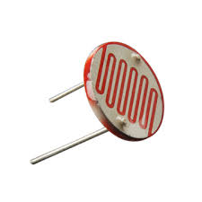
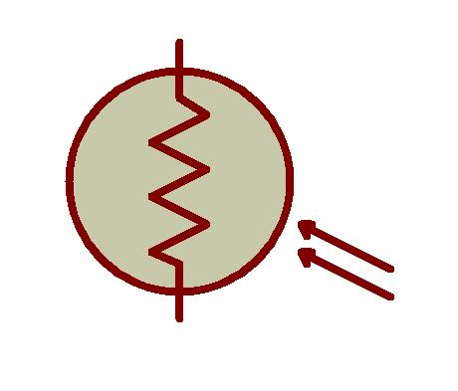
Sense your Environment
Photoresistor
Changes resistance based on how much light the sensor receives
Voltage Divider is used with sensor

Slide 9
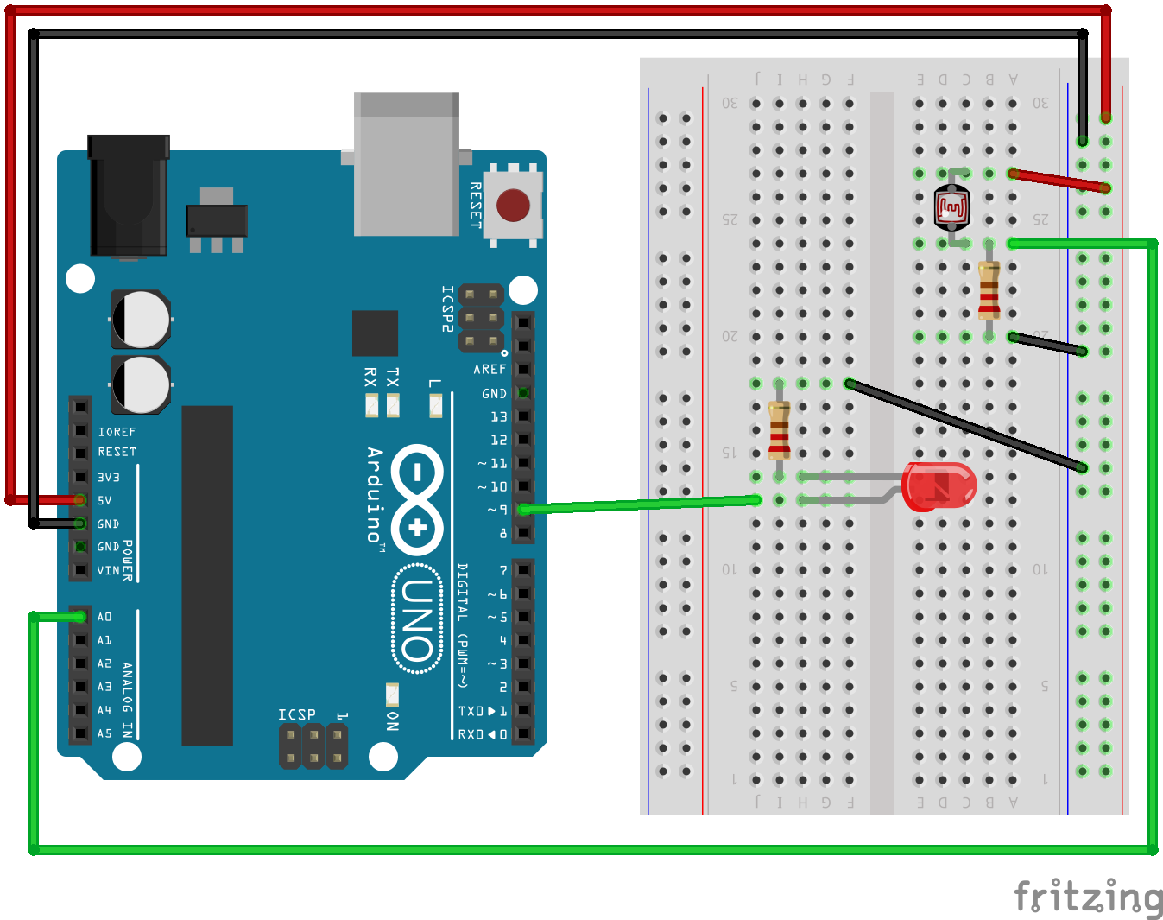
LDR R - 10k

Slide 10
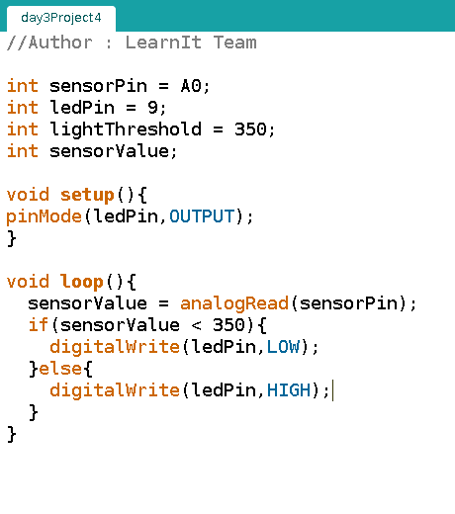
On/Off Led

Slide 11
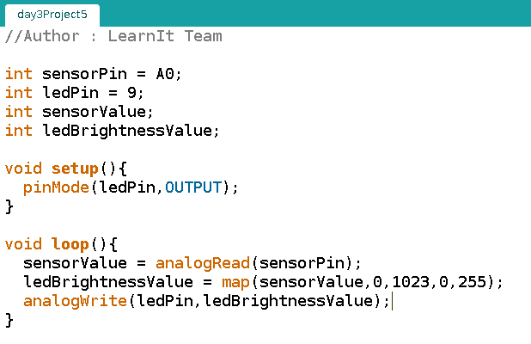
How Bright is Out there

Slide 12

Servo Control
Servo motors can turn into a specified position – usually 180⁰
Varying pulse width of output voltage will move servo to specific position
Servo Library is used to control Servo

Slide 13
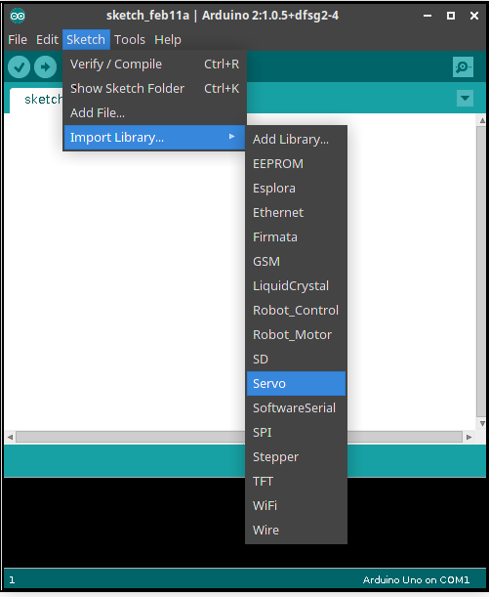
Library
Libarary is a group of Funtions
Libraries are used to extend the functionality of skecthes
Servo is one of the preinstalled library

Slide 15
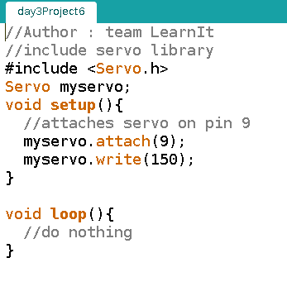

Slide 16
#include is a preprocessor command, inserts a library into sketch
servo library adds new commands that let you control servo

Slide 17
To Control Servo
Create a “Servo object”
Attach it to Digital Pin
Write number of degrees to move – 0 to 180

Slide 18
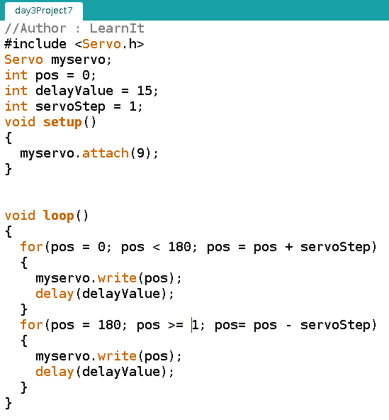
Sweep It

Slide 19
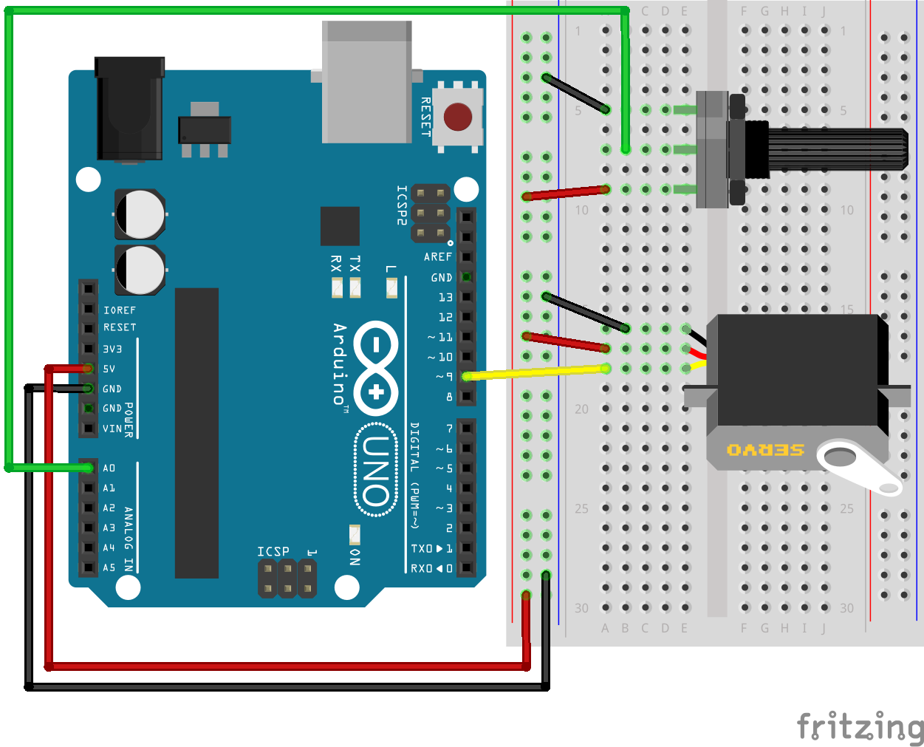
Control the Servo Position

Slide 20
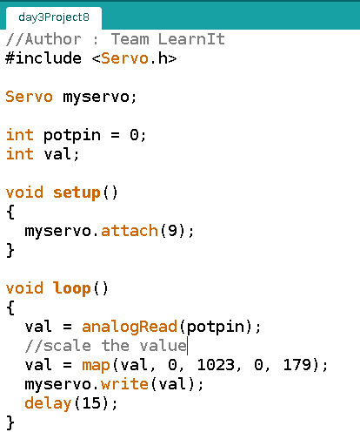

Slide 21
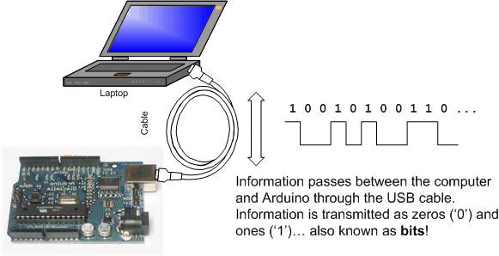
Serial Communication
So far we only used led’s to display the output
sketch can use usb connection to send messages to or receive them from your computer

Slide 22
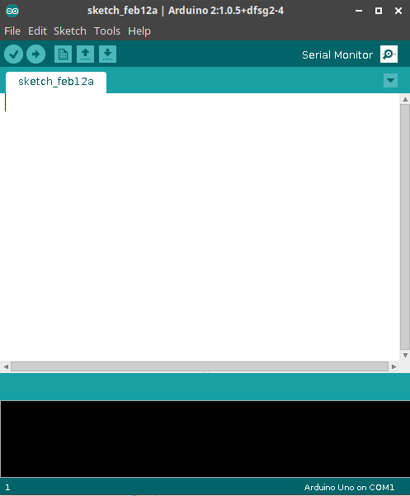
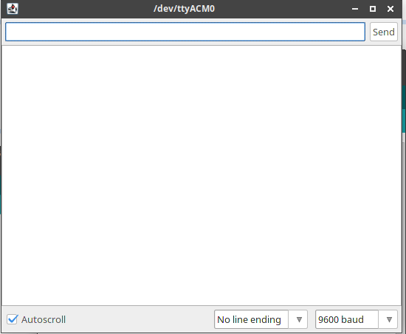
Serial Monitor

Slide 23
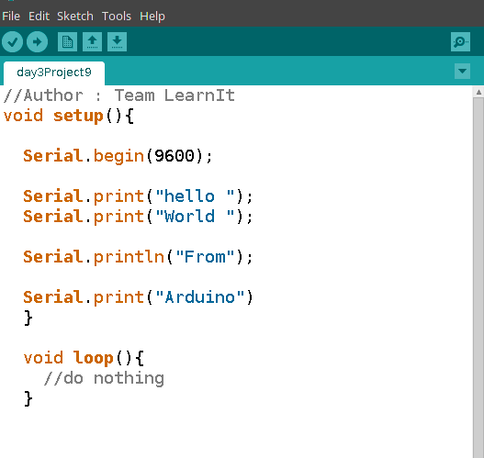
Hello world from Arduino
Upload it
Open Serial monitor

Slide 24
Starting the Serial Monitor
Before we can use the Serial Monitor, we need to activate it by adding this function to our sketch in void setup() :
Serial.begin(9600);
9600 is the speed at which the data will travel between the computer and the Arduino known as Baud Rate
This value must match the speed setting at the bottom right of the Serial Monitor

Slide 25
To send text to the Serial Monitor to be displayed in the output window,you can use Serial.print
You can also use Serial.println to display text and then force any following text to start on the next line

Slide 26
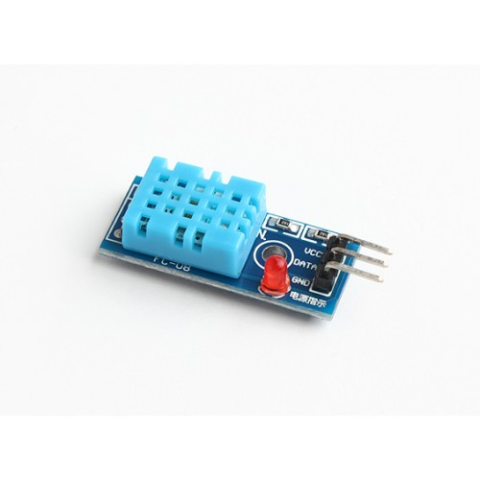
Sense your Environment
This project uses DHT11 sensor
Used to sense Temparature and Humidity
Dht library is used for interfacing

Slide 27
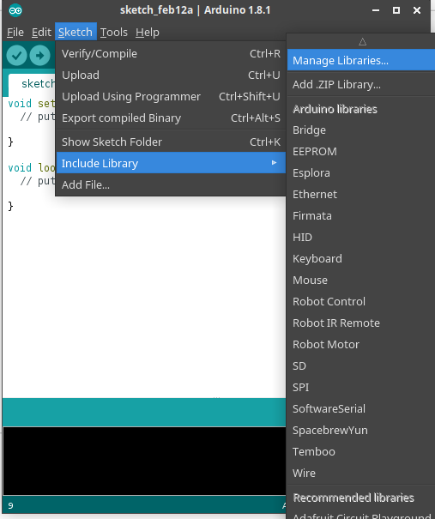
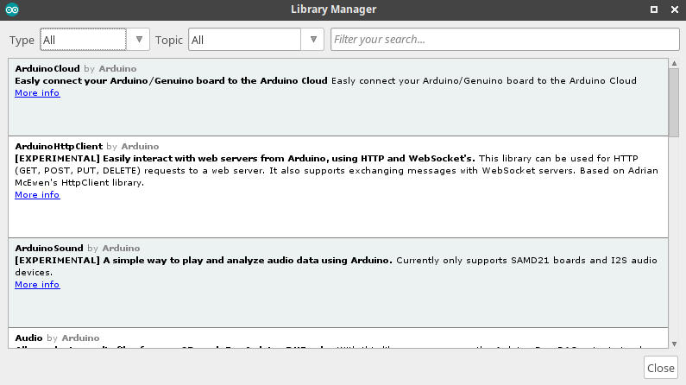
Adding External Libraries
Go to Sketch -> Include Library and click on the Mange libraries
You will get libarary manager

Slide 28
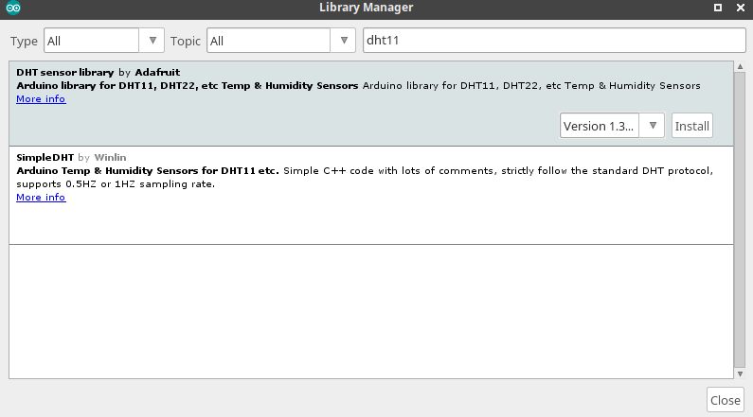
In search Enter dht11
Select DHT sensor Library
And click install

Slide 29
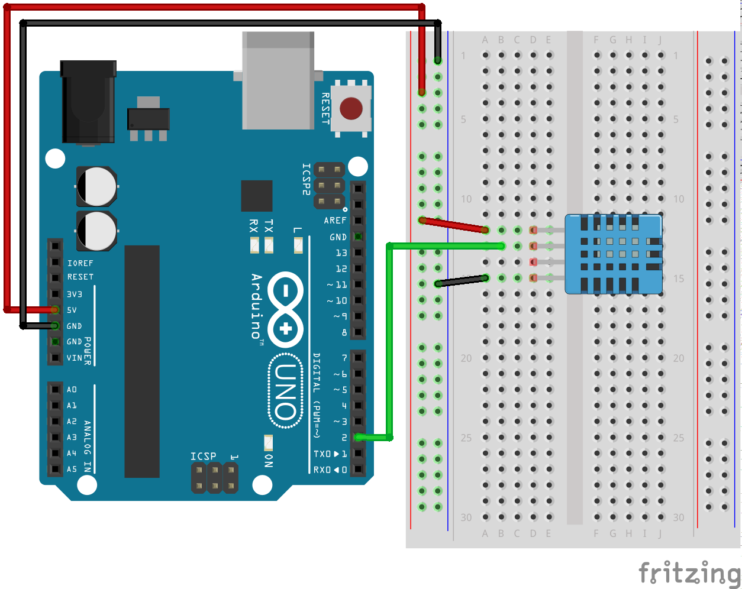

Slide 30
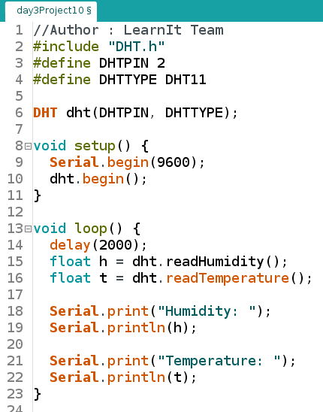

Slide 31
Control Arduino using Computer
Serial line is used to upload the code from Computer to Arduino
Same is used for sending commands to Arduino from PC
Serial.available()
Used to check the number of characters received
Serial.read()
Used to read the received characters one at a time

Slide 32
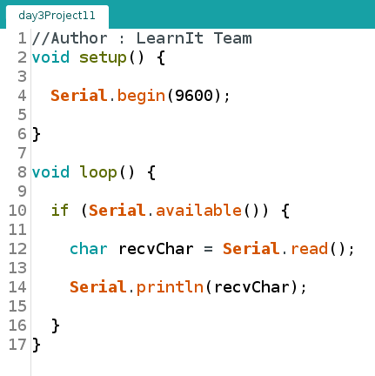
Read a character
Upload the code
Open serial Monitor
Check Baud rate
Type input line you will get it displayed

Slide 33
Begin the serial communication
If any data received
Save it in variable
Print in the serial monitor

Slide 34
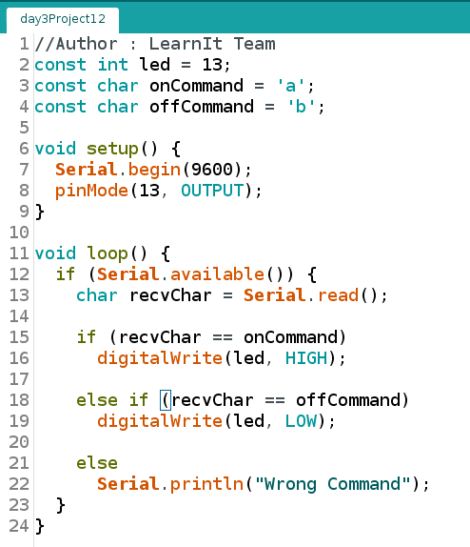
Control On-Board led using Serial Monitor

