Slide 2
Arduino-Arduino communication through the serial ports
Serial is used for communication between the Arduino board and a computer or other devices
All Arduino boards have at least one serial port
Requires only 2 pins
Communication either half-duplex or full-duplex

Slide 3
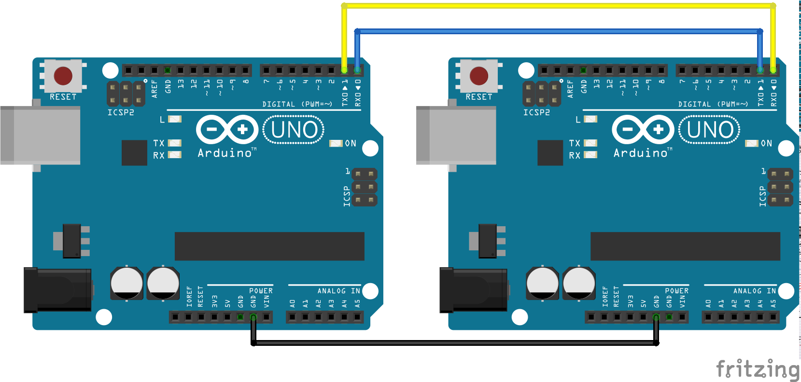

Slide 4
Remove Connections Before Upload Code

Slide 5
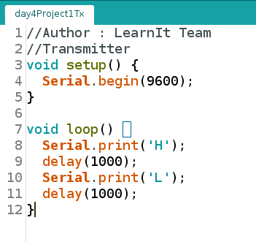
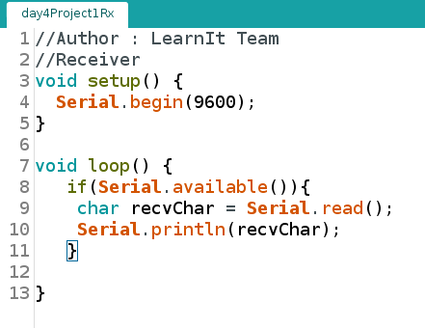
Transmitter Receiver

Slide 6
Control Rx from Tx

