Slide 1

CSCD - GROUP 2 - CAPSTONE PROJECT · FINAL PRESENTATION
Ghost Identity Hunter
>>
Multi-Vector OSINT Collection
>>
Graph-Based Identity Correlation
Automated OSINT Attribution Platform
>>
Chain-of-Custody Reporting
Version 0.1.0 · August 2026

Slide 2
OVERVIEW
Agenda
01
Intro, Team & Scope of Work — Guna (2 min)
02
Problem Statement & OSINT Landscape — Rekha (3 min)
03
Architecture & Flow Walkthrough — Dhaya (5 min)
04
Live Tool Demos — Phone, Maigret, Rest of Tools (15 min)
05
Next Steps & Closing — Vindhya, Guna (2 min)
1 / 30

Slide 3
CSCD Group 2
Team Members
01
C Gunasekaran - Group Lead (Guna)
02
Dr. Kanti Singh Sangher
03
Rekha Saraswat
04
Vindya Narsian
05
Soumo Dutta
06
Dhayanidhi Rajasekaran (Dhaya)
2 / 30

Slide 4
SECTION 1 — SUMMARY · REKHA · 3 MIN
Business Impact & Objectives
THE PROBLEM
THE SOLUTION
Threat actors construct synthetic identities by compartmentalizing their footprint:
• Burner / VoIP phone numbers (no personal ID required)
• Disposable or forwarding email addresses
• Usernames registered across dozens of platforms
• Stolen or stock profile photographs
Manual OSINT correlation across multiple tools is:
• Time-consuming — hours per investigation
• Error-prone — no quantified confidence
• Inconsistent across analysts
• Missing chain-of-custody audit trail
Ghost Identity Hunter automates the full attribution pipeline:
✓ Multi-vector OSINT collection (phone, email,
username, image) via BFS orchestration
✓ Graph-theoretic correlation links fragmented
artifacts into unified persona clusters
✓ Quantified confidence scoring per relationship
with staleness decay model
✓ Generated HTML Report
✓ Zero infrastructure cost — local CLI, SQLite,
no cloud dependency
3 / 30

Slide 5
SECTION 2 — COMPONENT SPECIFICATIONS
Key Components & Technologies
BFS Orchestrator
Phone Intelligence
Python deque · MAX_DEPTH=2 · per-investigation SQLite isolation
phoneinfoga (subprocess) · phonenumbers · E.164 · VoIP detection
Email Intelligence
Username Enumeration
Holehe (100+ services) · HIBP API
Sherlock / Maigret · httpx · 400+ platforms · false-positive suppression
Image Intelligence
Identity Graph
Pillow (EXIF) · face_recognition (dlib)
NetworkX DiGraph · Connected components · pyvis interactive visualization
Confidence Scorer
Report & Export
Typed link weights · staleness decay · cross-type density metric
Jinja2 HTML · Pandoc/LaTeX PDF · JSON & CSV export
400+
5
100+
4
Platforms probed
OSINT modules
Email services (Holehe)
Report export formats
4 / 30

Slide 6
SECTION 2 — ARCHITECTURAL DESIGN · DHAYA · 5 MIN
4-Layer Pipeline Architecture
INGESTION LAYER
CLI (Click) → Seed Validation → BFS Orchestrator
▼
COLLECTION LAYER
Phone · Email · Username · Image · Breach Modules
▼
CORRELATION LAYER
NetworkX Identity Graph → Connected Components → Confidence Scorer
▼
REPORTING LAYER
SQLite Persistence → HTML / PDF Report → JSON / CSV Export
5 / 30

Slide 7
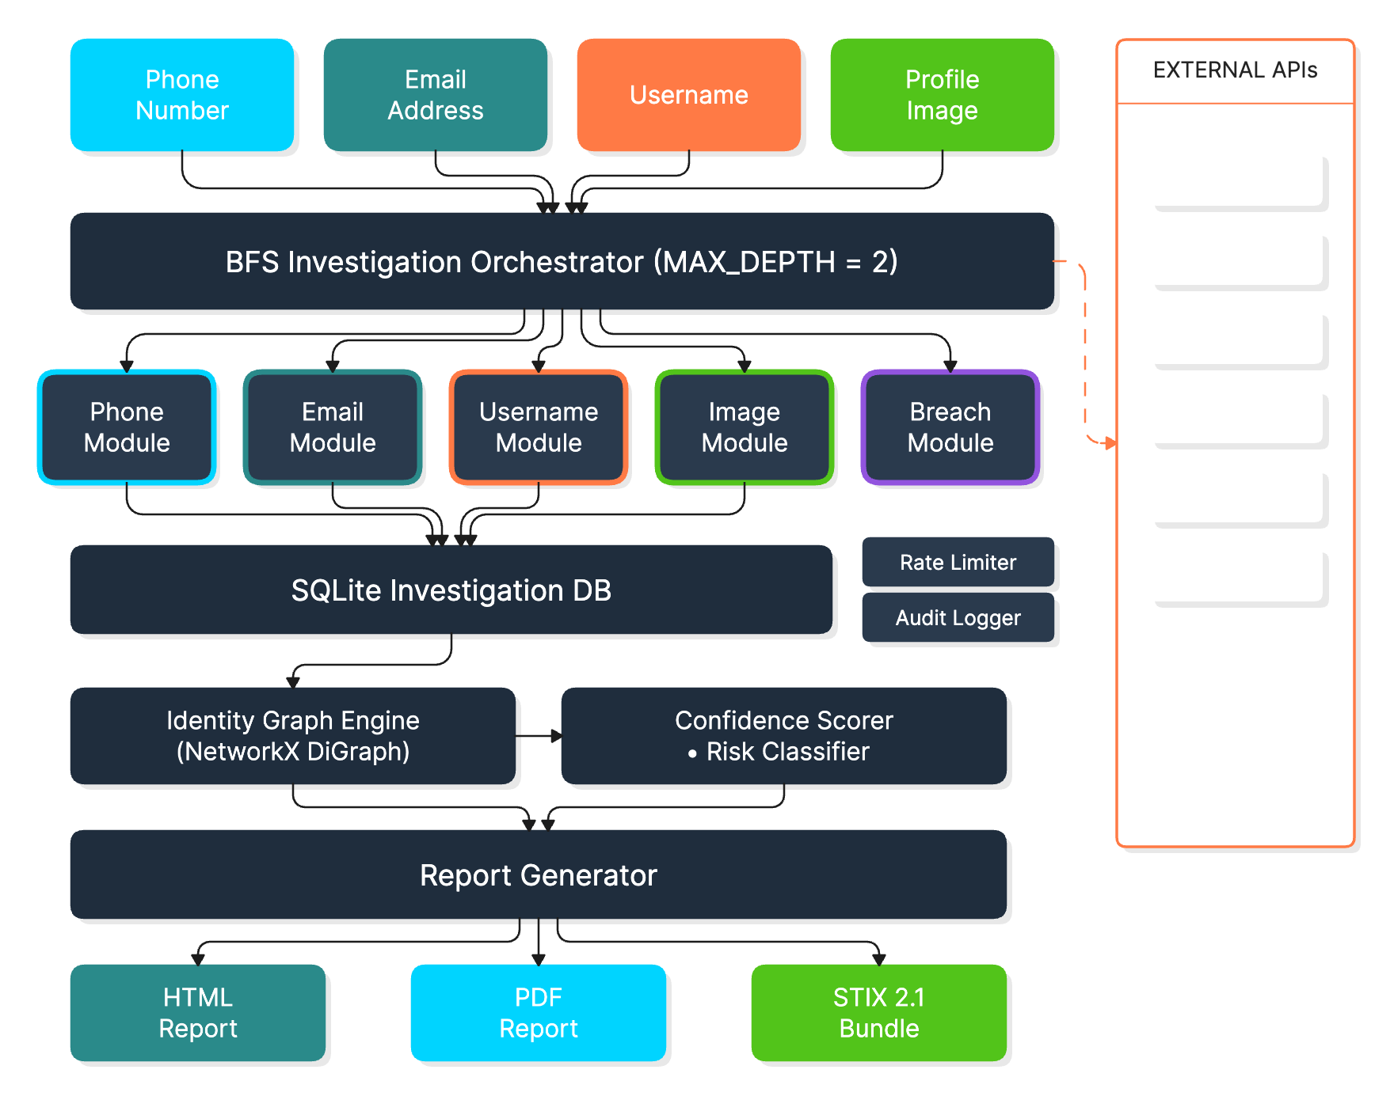
SECTION 2 — ARCHITECTURAL DESIGN
Solution Architecture
6 / 30

Slide 8
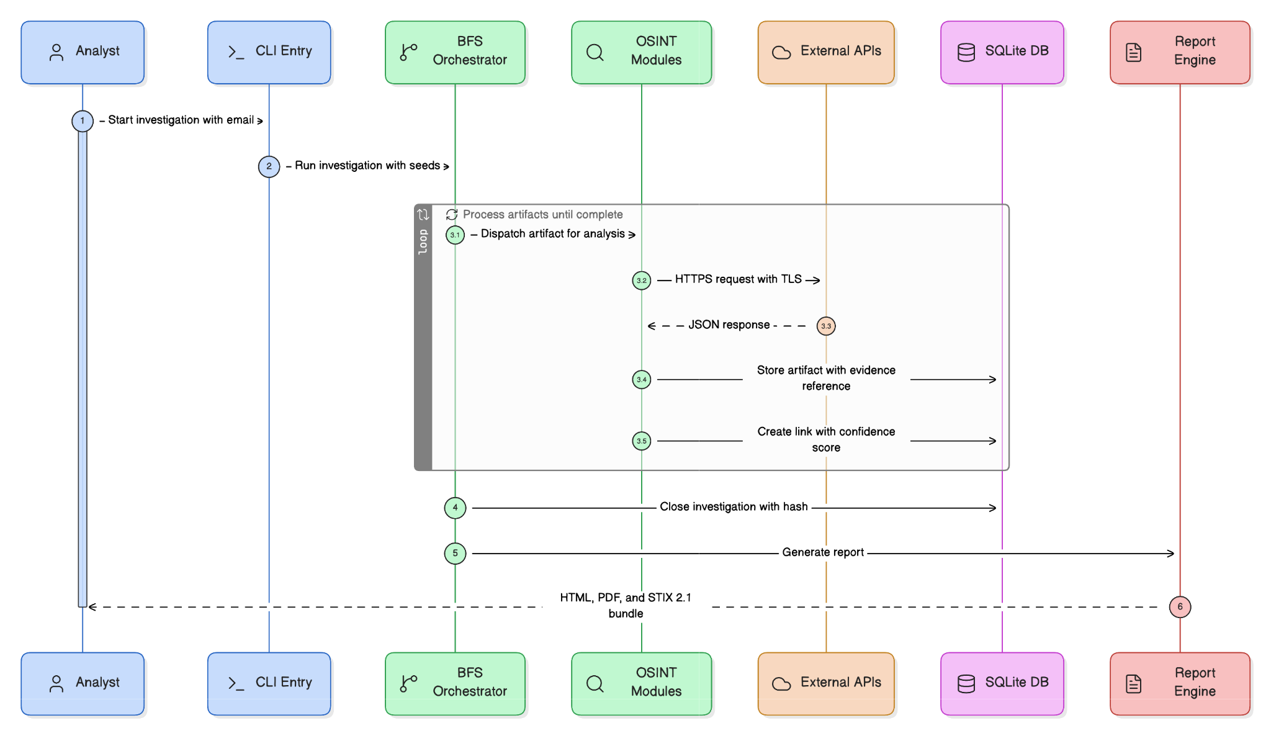
SECTION 2 — ARCHITECTURAL DESIGN
Sequence Diagram
7 / 30

Slide 9
SECTION 2 — ARCHITECTURAL DESIGN · DHAYA
Sequence Walkthrough — End-to-End Investigation
CLI
1
Seed & Dispatch
cli.py investigate calls orchestrator.run_investigation(); seeds load into the BFS queue
BFS
2
Per-Artifact Processing
Each artifact hits its OSINT module, external-tool dispatch, and the plugin system in parallel
Discover
3
Expand the Frontier
New discovered artifacts are deduped, persisted, and queued for the next BFS depth level
Score
4
Correlate & Finalize
analyze_correlation() builds the identity graph; results are stored in investigation_metadata
Report
5
Auto-Generate Report
generate_html_report() / generate_json_report() render the finished investigation to reports/
8 / 30

Slide 10
SECTION 2 — ARCHITECTURAL DESIGN · DHAYA
Sequence Walkthrough — How the Report Gets Produced
Read
1
Load Investigation
cli.py report reads artifacts, links, platform presences and the audit trail from SQLite
Link
2
Correlate Identities
linker.correlate_identities() rebuilds the identity graph and groups connected components
Score
3
Score & Classify
compute_identity_risk_score() and classify_risk_level() attach risk to each identity profile
Render
4
Build Sections & Graph
Timeline, key findings, risk matrix, heatmap, and an embedded pyvis relationship graph are built
Write
5
Render & Save
Jinja2 renders the selected template; HTML is written to reports/{investigation_id}_report.html
9 / 30

Slide 11
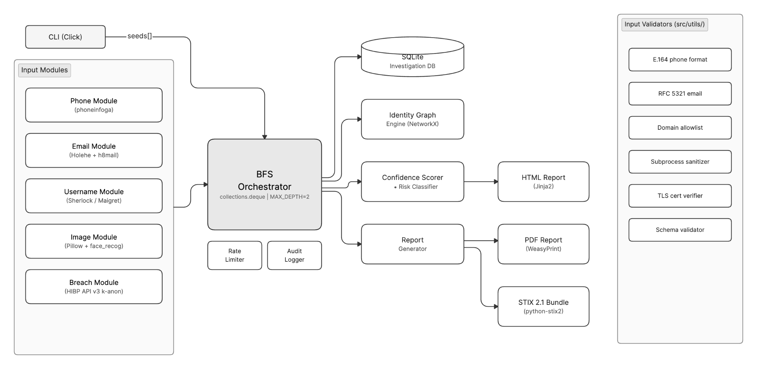
SECTION 2 — ARCHITECTURAL DESIGN
Component Interaction
10 / 30

Slide 12
SECTION 2 — DATA FLOW & TRUST BOUNDARIES
Zero Trust Data Flow
TRUSTED — LOCAL HOST
UNTRUSTED — EXTERNAL APIs
SANITIZED — PARSED OUTPUT
CLI Input Validation
HaveIBeenPwned API
Schema Validation
BFS Orchestrator
Holehe HTTP Probes
No eval() / exec()
HTTPS TLS 1.3 ->
Parsed Output ->
SQLite DB (local)
Sherlock / Maigret Probes
Type-checked insertion
Module Dispatcher
WHOIS Servers
Provenance metadata
Audit Logger
Reverse Image APIs
Evidence chain store
TLS verify=True enforced · API keys in env vars only · No credentials in URLs · Rate limiting per module
11 / 30

Slide 13
SECTION 2 — TECHNOLOGY STACK
Validated Technology Matrix
Layer
Technology
Version
Justification
Language
Python
3.10+
OSINT ecosystem; async support
CLI
Click
≥8.1.0
Type-safe argument parsing
Phone Intel
phonenumbers / phoneinfoga
≥8.13
E.164 parsing; carrier resolution
Email Intel
holehe
Latest
100+ service registration detection
Username Enum
Sherlock / Maigret
Latest
400+ platform parallel probing
Image Analysis
Pillow + face_recog
≥10.0
EXIF extraction; local face similarity
Graph Engine
NetworkX + pyvis
≥3.0
Connected components; interactive viz
Breach Intel
HIBP API v3
—
k-anonymity; no full hash transmitted
Report / Export
Jinja2 + Pandoc (LaTeX)
≥3.1
HTML / PDF / JSON / CSV
Persistence
SQLite3
stdlib
Zero-dependency; investigator-local
Testing / Lint
pytest + ruff
≥7.0
71% coverage (572 tests); ruff cleanup in progress
12 / 30

Slide 14
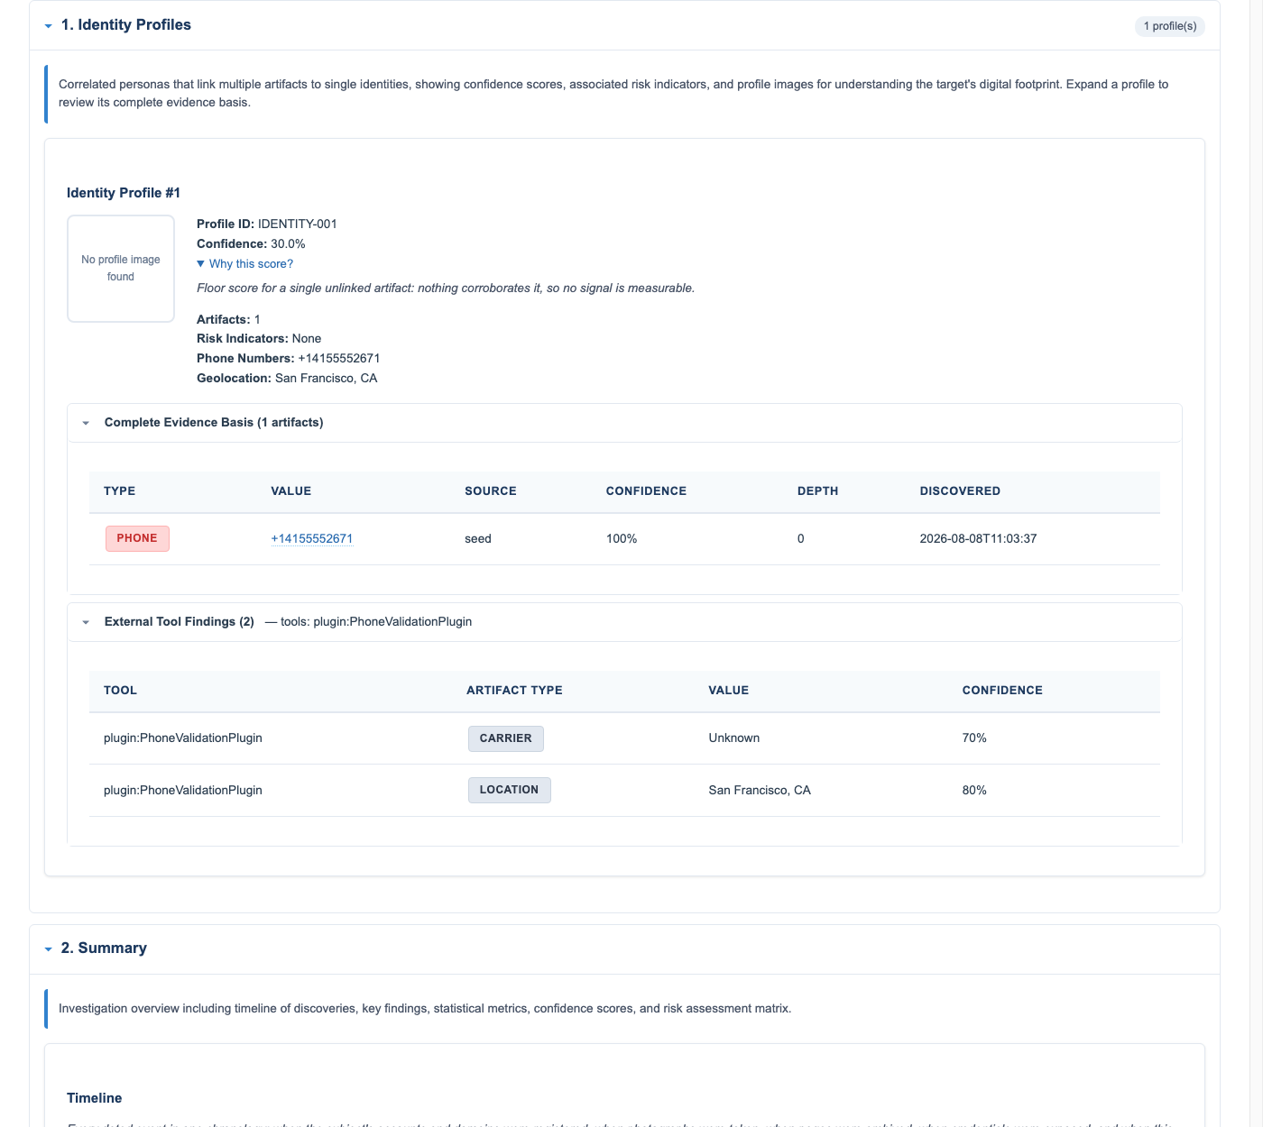
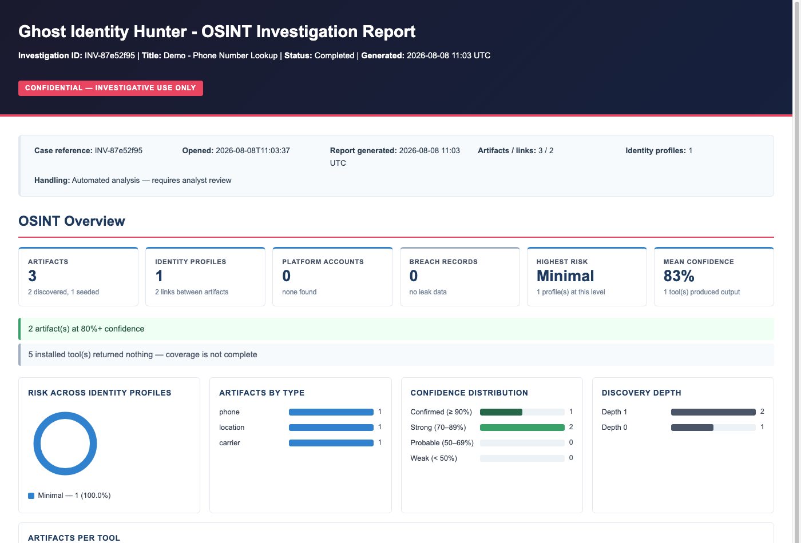
LIVE DEMO — PHONE NUMBER LOOKUP · KANTI · 5 MIN
Phone Number Lookup — Real Investigation Report
Investigation overview & risk dashboard
Evidence basis + PhoneValidationPlugin findings
13 / 30

Slide 15
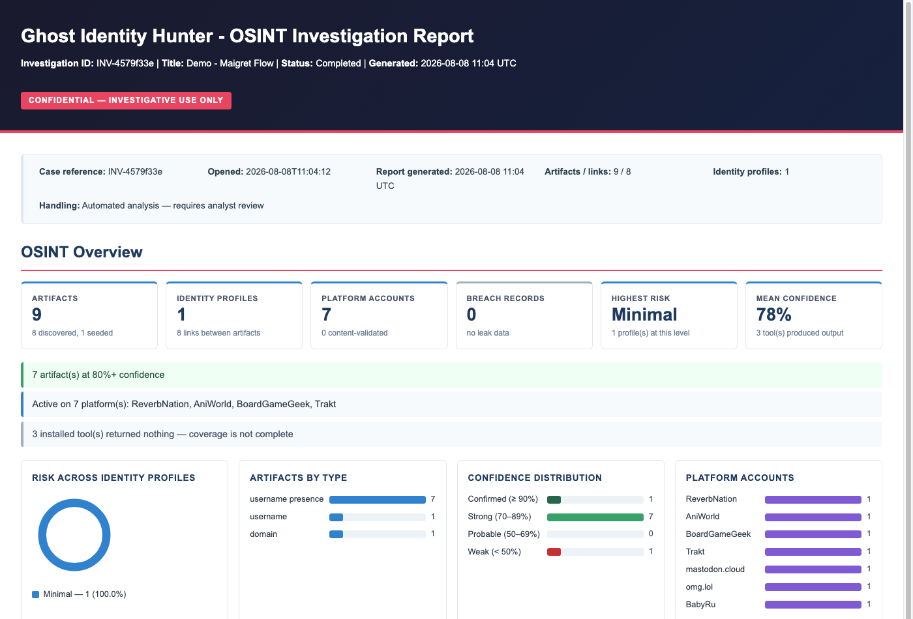
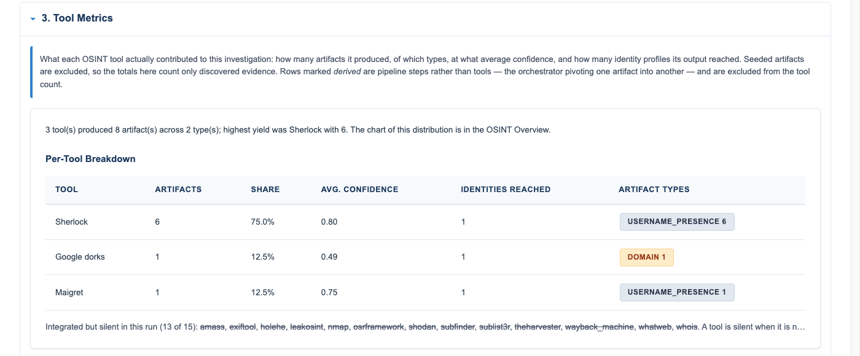
LIVE DEMO — MAIGRET FLOW · SOUMO · 5 MIN
Maigret Flow — Real Investigation Report
Investigation overview — 9 artifacts, 7 platforms
Per-tool breakdown — Sherlock, Google Dorks, Maigret
14 / 30

Slide 16
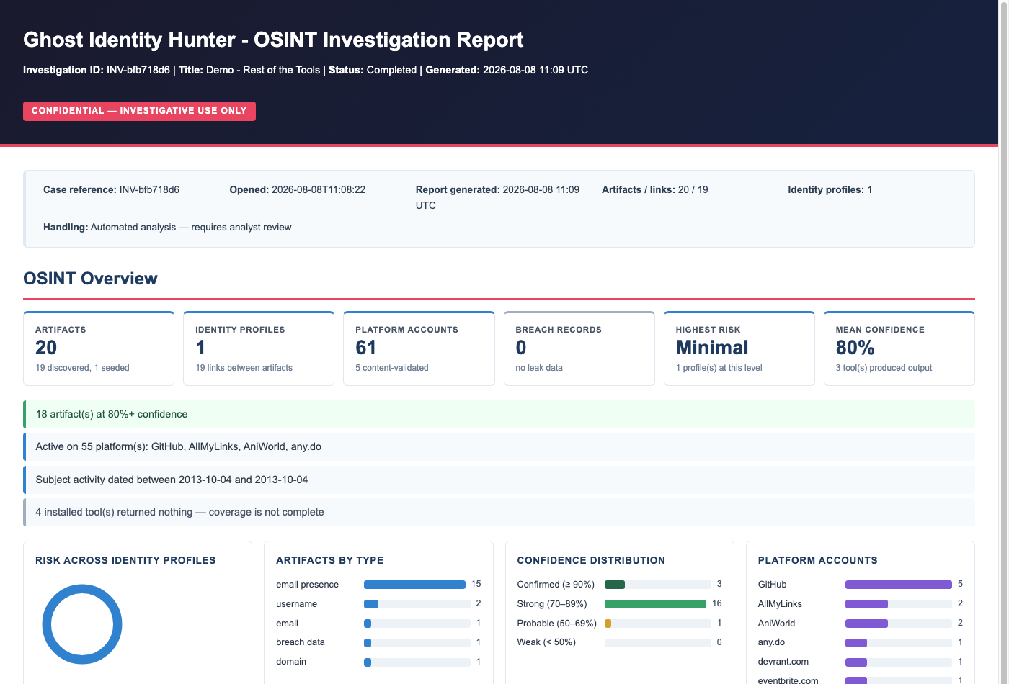
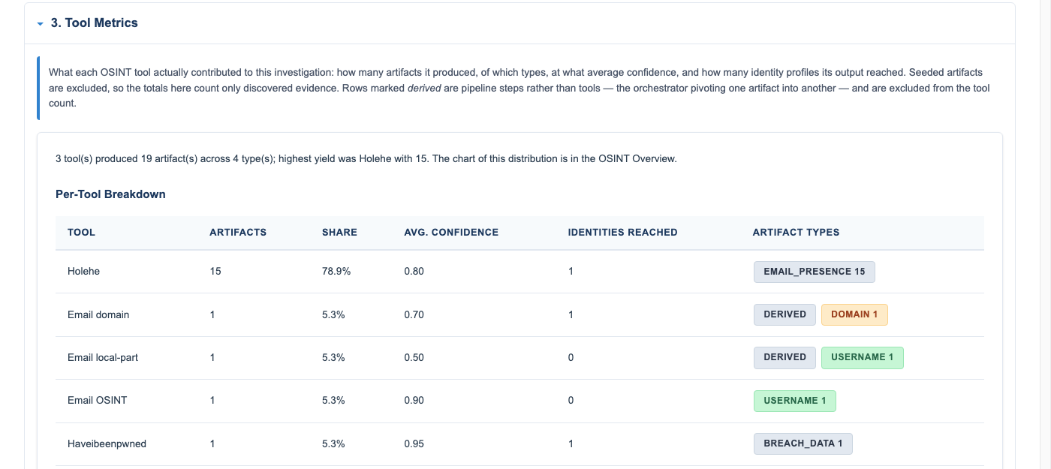
LIVE DEMO — REST OF THE TOOLS · VINDHYA · 5 MIN
Holehe, WHOIS & the Rest of the Toolkit
Investigation overview — test@example.com
Per-tool breakdown — Holehe found 15 real registered accounts
15 / 30

Slide 17
SECTION 6 — WHAT'S NEXT
Future Roadmap — Next Phases
P1
Next
Concurrency
Hardening
Fix rate-limiter lock-during-sleep bug; move Google Dorks onto the pooled HTTP session
P2
Next
Performance
ProcessPoolExecutor for CPU-bound face matching; async I/O for platform fan-out
P3
Next
CTI Export
Implement STIX 2.1 bundle export — ThreatActor / Indicator / Relationship / Note SDOs
P4
Next
Quality Gate
Add mypy --strict to CI; raise coverage on exports.py and http_client.py toward 85%
P5
Next
Provider Growth
Expand keyed-API and plugin coverage toward parity with commercial OSINT platforms
16 / 30

Slide 18
SUMMARY
Ghost Identity Hunter:
400+
7
► Automated BFS OSINT collection across 4 artifact types
► Graph-theoretic persona correlation with quantified confidence
Platforms via Sherlock/Maigret
ATT&CK techniques covered
► STRIDE-modeled security controls mapped to NIST SP 800-53
► 7 MITRE ATT&CK techniques detected (T1585–T1650)
8
$0
► Legally defensible HTML / PDF / JSON / CSV output
► Zero infrastructure cost · Passive OSINT only
NIST controls implemented
Infrastructur e cost
Version 0.1.0 · Capstone Program · August 2026

Slide 19
CSCD — GROUP 2 · CAPSTONE PROJECT
Questions & Discussion
>>
Full documentation in /docs
>>
Live CLI demo available on request
Ghost Identity Hunter — Thank You
>>
Open floor for questions & discussion
Version 0.1.0 · Capstone Program

Slide 20
Appendix
Supporting technical detail — threat modeling, schema, scoring algorithm, quality metrics, limitations and tool internals

Slide 21
SECTION 3 — CYBER DEFENSE & THREAT MODELING
STRIDE Threat Model — Platform Threats
S
Spoofing
Medium
Adversary lookalike domain returns false OSINT positives
T
Tampering
High
Local filesystem access corrupts SQLite evidence chains
R
Repudiation
Medium
No signed audit log; investigator denies query history
I
Info Disclosure
High
PII in HTTP query params or stdout in CI/CD environments
D
Denial of Service
Low
Unbounded BFS traversal exhausts external API rate limits
E
Elev. of Privilege
Critical
Shell metacharacters in OSINT response → subprocess inject
17 / 30

Slide 22
SECTION 3 — THREAT MODELING
MITRE ATT&CK Coverage
T1585.001
Establish Accounts — Social Media
Sherlock/Maigret parallel enumeration across 400+ platforms
T1585.002
Establish Accounts — Email Accounts
Holehe registration detection; disposable domain classification
T1586
Compromise Accounts
HIBP breach correlation; stolen credentials to active accounts
T1598
Phishing for Information
Phone/email artifacts in social engineering from breach data
T1650
Acquire — Prepaid/VoIP Numbers
phoneinfoga carrier & line-type detection; VoIP flag
T1566.003
Spearphishing via Service
Profile image reverse search reveals stolen impersonation photos
T1056.003
Input Capture — Web Portal
Breach data links account credentials to targeted services
18 / 30

Slide 23
SECTION 3 — SECURITY CONTROLS
NIST SP 800-53 Rev. 5 Control Mapping
PREVENTIVE
SI-10
Input Validation
E.164/RFC5321 format checks; subprocess list args only — no shell=True
PREVENTIVE
IA-5
Secrets Mgmt
API keys from env vars only; .env excluded from VCS via .gitignore
PREVENTIVE
SC-8
TLS Enforcement
httpx verify=True; HTTP-to-HTTPS redirect enforcement; min TLS 1.2
DETECTIVE
AU-2
Event Logging
ISO 8601 timestamps; module name; SHA-256 hashed artifact values
DETECTIVE
AU-3
Evidence Provenance
source_module + raw_evidence_ref + discovered_at per artifact row
DETECTIVE
SI-7
DB Integrity
SHA-256 hash of SQLite DB computed on close; verified on report gen
RESPONSIVE
SC-5
Rate Limit Backoff
Exp. backoff with jitter on HTTP 429; max 3 retries per endpoint
RESPONSIVE
IR-4
Evidence Packaging
Signed timestamped ZIP: SQLite DB + raw evidence + report on close
19 / 30

Slide 24
SECTION 4 — IMPLEMENTATION BLUEPRINT
Delivery Milestones — 4-Week Roadmap
Wk 1–2
Phase 1
Design &
Core Infrastructure
SQLite schema · BFS orchestrator · CLI entry point
Wk 1–2
Phase 2
Collection Modules
Phone · Email · Username · Image · Breach modules + unit tests
Wk 2–3
Phase 3
Correlation Engine
NetworkX graph · Connected components · Confidence scorer
Wk 2–3
Phase 4
Reporting & Export
Jinja2 HTML · WeasyPrint PDF · python-stix2 CTI bundle
Wk 3–4
Phase 5
Integration & Hardening
End-to-end tests · Injection hardening · Rate-limit compliance
20 / 30

Slide 25
SECTION 4 — PHASE 1: STORAGE LAYER
SQLite Investigation Schema
investigations
artifacts
investigation_id TEXT PK
artifact_id TEXT PK
title TEXT
investigation_id TEXT FK
status TEXT CHECK(...)
artifact_type TEXT CHECK
created_at DATETIME
value TEXT
source_module TEXT
completed_at DATETIME
confidence REAL CHECK(0-1)
db_sha256 TEXT
raw_evidence_ref TEXT
artifact_links
platform_presence
link_id TEXT PK
presence_id TEXT PK
source_artifact TEXT FK
platform_name TEXT
target_artifact TEXT FK
profile_url TEXT
link_type TEXT
username TEXT
confidence REAL CHECK(0-1)
is_verified BOOLEAN
evidence TEXT (JSON)
raw_evidence_ref TEXT
PK = Primary Key FK = Foreign Key CHECK = DB Constraint · Also present: investigation_metadata, audit_trail, evidence, geocode_cache
21 / 30

Slide 26
SECTION 4 — PHASE 3: CORRELATION ENGINE
Identity Graph & Confidence Scoring
IDENTITY GRAPH (NetworkX DiGraph)
CONFIDENCE SCORING MODEL
Nodes: Artifact records (phone, email,
username, image)
Edges: Directed weighted relationships
(link_type + confidence score)
Algorithm:
1. Build DiGraph from DB artifacts + links
2. Find weakly connected components
3. Each component = one persona cluster
4. Score = cross-type link density / 5.0
(capped at 1.0)
Risk classification per cluster:
burner_or_voip_phone
disposable_email_address
credential_breach_exposure
stolen_profile_photograph
Link Type
Score
exact_match
1.00
registered_with
0.90
breach_linked
0.80
image_match
0.70
username_pattern
0.60
temporal_match
0.40
Staleness Decay: >365 days → ×0.80 | >730 days → ×0.60
22 / 30

Slide 27
SECTION 4 — PHASE 3: CORRELATION ENGINE
Confidence Scoring Algorithm — How It Works
Base
1
Base Score by Link Type
BASE_SCORES lookup: exact_match 1.00 down to temporal_match 0.40 (scorer.py)
Decay
2
Freshness Decay
>365 days → ×0.80 | >730 days → ×0.60, applied to the base score
×Src
3
Source Reliability
score = base × source_reliability (0.0–1.0, defaults to 1.0)
Clamp
4
Bound & Round
round(min(score, 1.0), 3) → final per-link confidence value
ΣCap
5
Risk Aggregation
Σ indicator weights, capped at 1.0 → critical ≥.8, high ≥.6, medium ≥.4, low ≥.2
23 / 30

Slide 28
SECTION 4 — PHASE 4: REPORTING & EXPORT
Investigation Reports & Export Formats
REPORT STRUCTURE
PDF EXPORT PIPELINE
Section
Format
Content
pandoc (primary)
Executive Summary
HTML + PDF
Seed artifacts; persona count; confidence
HTML → PDF via a LaTeX engine
Identity Profile
HTML + PDF
Consolidated emails, phones, usernames, images
xelatex → pdflatex → lualatex
Platform Presence Matrix
HTML + PDF
Profile URLs, creation dates, verification status
Ordered LaTeX engine fallback chain
Relationship Graph
HTML only
Interactive pyvis force-directed graph
wkhtmltopdf
Fallback if no LaTeX engine is present
Breach Exposure
HTML + PDF
Breaches per artifact; data types; pwd exposure
Evidence Chain
HTML + PDF
Ordered audit trail with raw evidence references
weasyprint
Final fallback, pure-Python HTML→PDF
CSV Export
CSV file
Flat artifact & link tables for spreadsheet analysis
CSV / JSON
Always available, no external engine required
24 / 30

Slide 29
SECTION 5 — PRODUCTION-READY QUALITY STANDARDS
Code Quality, Constraints & Compliance
CODE QUALITY STANDARDS
OPERATIONAL CONSTRAINTS
LEGAL & ETHICAL
Type Annotations
BFS Depth
✓ Passive OSINT only
Type hints throughout (mypy gate planned)
MAX 2 hops
Linting
✓ No credential stuffing
HIBP Rate
37 ruff findings (28 auto-fixable); cleanup in progress
≥1,500 ms
✓ No active exploitation
Test Coverage
Subprocess
71% line coverage · 572 / 572 tests passing
30 sec timeout
✓ GDPR / CCPA / IT Act 2000 compliance
Docstrings
HTTP Conn
Google style; all public APIs
10 sec timeout
✓ API ToS adherence + rate limits
Dep Pinning
DB Warning
requirements.lock via pip-compile
500 MB soft limit
✓ Full chain-of-custody audit trail
Secrets Scanning
Log PII
✓ Admissibility-ready evidence packaging
git-secrets pre-commit; no keys in VCS
SHA-256 hashed
25 / 30

Slide 30
SECTION 5 — VERIFIED RESULTS
Performance, Testing & Results
Test Suite
Line Coverage
572 tests · 0 failures · ~32–46s full run (pytest)
71% overall (7,327 statements) — measured via pytest --cov
Weakest Modules
Static Analysis
exports.py 32% · http_client.py 61% · tool_checker.py 76%
ruff: 37 findings, 28 auto-fixable — cleanup in progress
Type Checking
Perf Optimization
Type hints throughout source; mypy CI gate not yet wired up
Parallel BFS cut a representative run from hours to ~21s (partial run, external tools disabled)
CI Gate
Investigation Depth
pytest + ruff on pre-commit; mypy and coverage gate planned
MAX_DEPTH=2 default · 30s subprocess / 10s HTTP timeouts
572
71%
37
~21s
Tests passing
Line coverage
Open ruff findings
Runtime (optimized, partial run)
26 / 30

Slide 31
SECTION 6 — HONEST ASSESSMENT
Known Limitations
1
Provider Coverage Gap
High
4 keyed API providers + 22 local CLI plugins vs. Maltego's 99+ transforms
2
No CTI/STIX Export
Medium
Threat-actor / indicator export (STIX 2.1) is designed but not yet implemented
3
Concurrency Risks
High
Nested thread pools can oversubscribe; rate-limiter holds its lock during sleep
4
No Type-Check Gate
Medium
mypy is not wired into CI yet, despite type hints being present throughout
5
Under-tested Modules
Medium
exports.py (32%) and http_client.py (61%) fall well below the 71% average
6
Face-Match Perf
Low
CPU-bound face_recognition runs on threads, not a ProcessPoolExecutor
27 / 30

Slide 32
SECTION 5 — LIVE WORKFLOW WALKTHROUGH
End-to-End Investigation — CLI Walkthrough
Seed
Step 1
Launch Investigation
ghost-hunter investigate --phone +1... --email ... --username ... --depth 2
Collect
Step 2
Parallel Collection
Orchestrator dispatches phone/email/username/image plugins across the BFS frontier
Correlate
Step 3
Graph Correlation
ghost-hunter correlate — builds NetworkX graph, scores links, decays stale evidence
Visualize
Step 4
Graph Review
ghost-hunter graph — opens the interactive pyvis identity graph in-browser
Report
Step 5
Export Evidence
ghost-hunter report --report-format html,pdf,json,csv + ghost-hunter evidence
28 / 30

Slide 33
APPENDIX — TOOL INTERNALS
How Each OSINT Tool Works
Phone Validation
Sherlock
libphonenumber parse · carrier/region from the number, no API call
~400 site GETs · per-site 200/404 rule = found/not-found
Maigret
Holehe
Same probe technique, top 150 sites · run with --no-recursion
Password-reset/signup endpoint probe per site · infers account existence
theHarvester
Passive domain OSINT via search engines + crt.sh · no direct probing
Real screenshots are on the next slide — not mockups. theHarvester wasn't installable here, so it's description-only above.
29 / 30

Slide 34
APPENDIX — TOOL INTERNALS
Tool Output — Reference Screenshots
Phone Validation — evidence & confidence
Sherlock + Maigret — per-tool breakdown
Holehe — per-tool breakdown
30 / 30

