Slide 1

CSCD - GROUP 2 - CAPSTONE PROJECT · FINAL PRESENTATION
Ghost Identity Hunter
>>
14 Integrated OSINT Tools, One Pipeline
>>
Graph Correlation with Scored Confidence
Automated OSINT Attribution Platform
>>
Verifiable Evidence, Redactable Reports
Version 3.0 · Final Delivery · August 2026

Slide 2
OVERVIEW
Agenda
01
Outcome & Business Impact
02
Architecture & Technology
03
Collection: Tools, Parsers, Evidence
04
Correlation, Reporting & Disclosure
05
Resilience, Quality & Compliance
2 / 27

Slide 3
CSCD Group 2
Team Members
01
C Gunasekaran - Group Lead (Guna)
02
Dr. Kanti Singh Sangher
03
Rekha Saraswat
04
Vindya Narsian
05
Soumo Dutta
06
Dhayanidhi Rajasekaran (Dhaya)
3 / 27

Slide 4
SECTION 1 — SUMMARY
Business Impact & Objectives
THE PROBLEM
THE SOLUTION
Threat actors compartmentalise their footprint so that no
single lookup identifies them:
• Burner / VoIP numbers, no identity document required
• Disposable and forwarding email addresses
• A username reused across dozens of platforms
• Stolen or stock profile photographs
Correlating this by hand costs hours per subject, and the
result is a folder of tool output that no reviewer can
audit: no provenance, no confidence, nothing repeatable.
Delivered: one command runs the collection, correlation
and reporting end to end.
✓ 14 external OSINT tools plus 5 native modules,
each read by a parser written for its own format
✓ Breadth-first expansion across 7 seed types with
exact-value matching, so no near miss is recorded
✓ Graph correlation into persona clusters, every score
shown with the evidence that produced it
✓ Every tool run preserved and SHA-256 verifiable
✓ One HTML report: findings first, detail collapsed,
plus a masked copy that is safe to circulate
✓ Runs entirely on the analyst's host. No cloud cost.
4 / 27

Slide 5
SECTION 2 — ARCHITECTURAL DESIGN
4-Layer Pipeline, As Built
INGESTION LAYER
CLI (Click) · 7 seed types · exact-match policy · BFS queue
▼
COLLECTION LAYER
5 native modules + 14 tool integrations → per-tool parsers → evidence store
▼
CORRELATION LAYER
NetworkX graph → persona clusters → confidence scorer with provenance
▼
REPORTING LAYER
SQLite → HTML report (+ masked copy) · JSON · CSV · PDF · pyvis graph
5 / 27

Slide 6
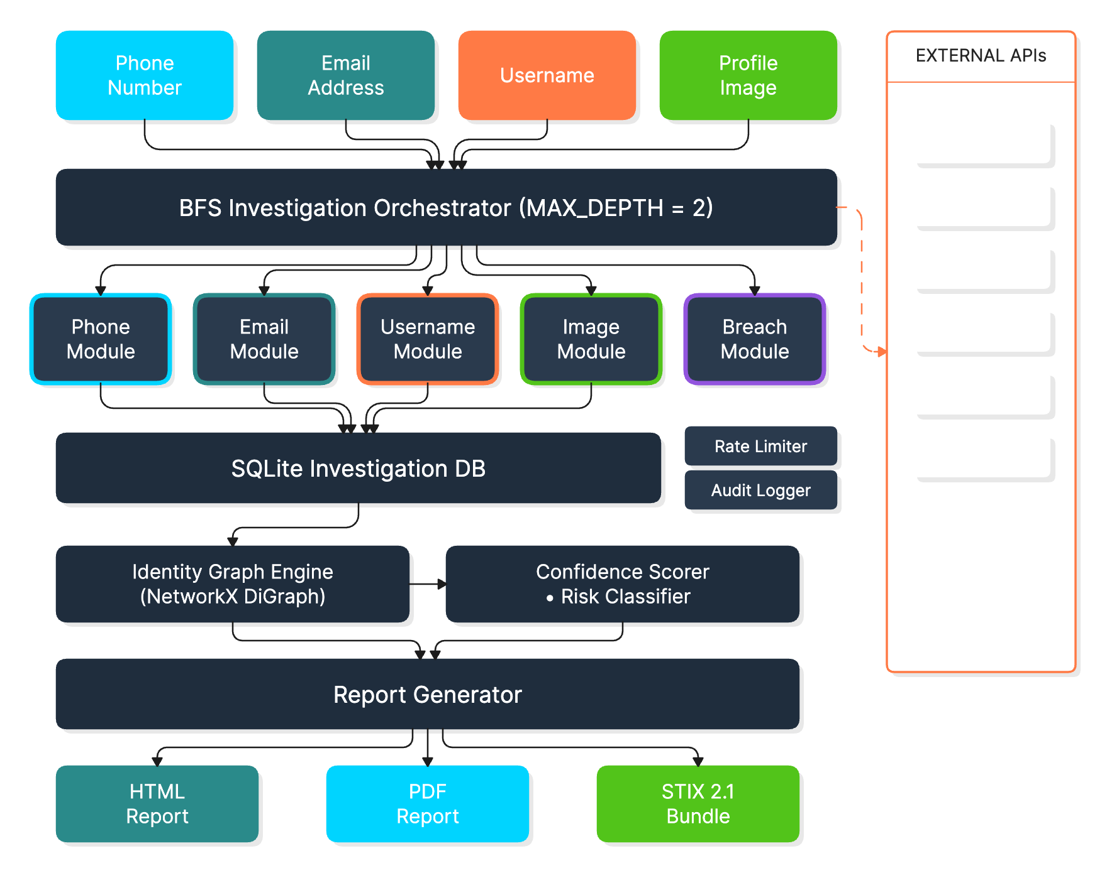
SECTION 2 — ARCHITECTURAL DESIGN
Solution Architecture
6 / 27

Slide 7
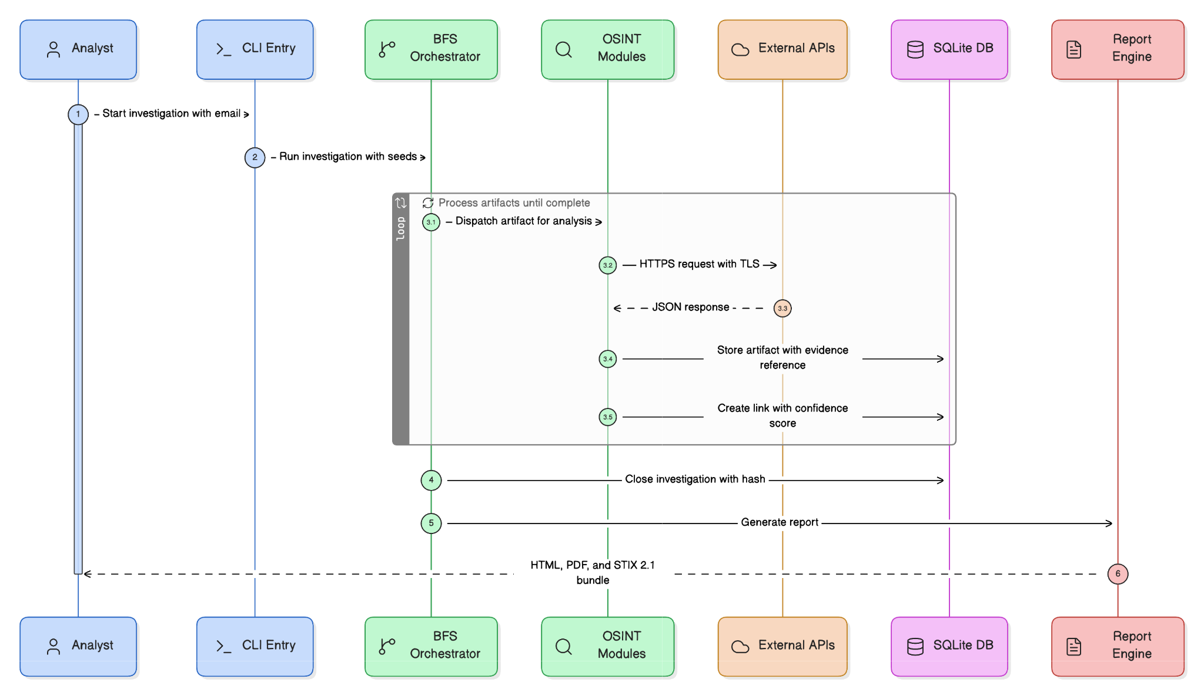
SECTION 2 — ARCHITECTURAL DESIGN
Sequence Diagram
7 / 27

Slide 8
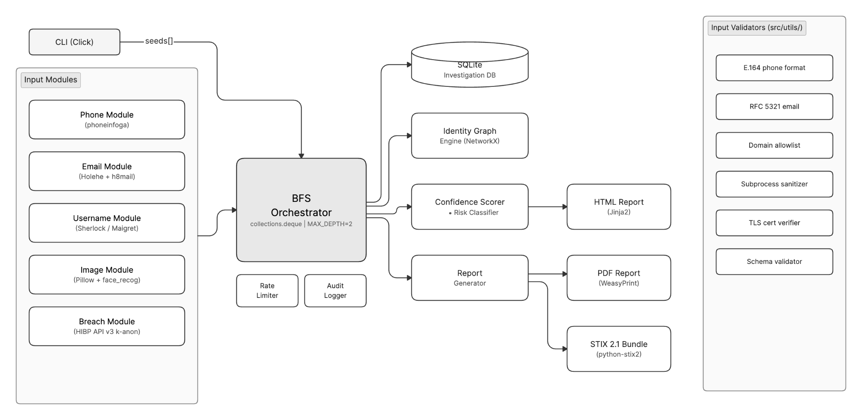
SECTION 2 — ARCHITECTURAL DESIGN
Component Interaction
8 / 27

Slide 9
SECTION 2 — COMPONENT SPECIFICATIONS
Key Components & Technologies
BFS Orchestrator
Phone Intelligence
deque BFS · configurable depth (default 2) · bounded worker pool
phonenumbers · E.164 validation · carrier, region and line type
Email Intelligence
Username Enumeration
holehe (120+ services) · HIBP · LeakOSINT (opt-in, keyed)
sherlock · maigret · usufy · native sweep · exact-username filtering
Image Intelligence
Identity Graph
exiftool + Pillow EXIF/GPS · optional dlib face similarity
NetworkX DiGraph · weakly connected components · pyvis graph
Confidence Scorer
Report & Export
Typed link weights · staleness decay · per-score provenance breakdown
Jinja2 HTML · JSON · CSV · PDF via pandoc · redacted twin file
400+
5
100+
14
Platforms probed
Native OSINT modules
Email services (holehe)
External tools integrated
9 / 27

Slide 10
SECTION 2 — DATA FLOW & TRUST BOUNDARIES
Zero Trust Data Flow
TRUSTED — LOCAL HOST
UNTRUSTED — EXTERNAL APIs
SANITIZED — PARSED OUTPUT
CLI Input Validation
HaveIBeenPwned API
Schema Validation
BFS Orchestrator
holehe / maigret probes
No eval() / exec()
HTTPS TLS 1.3 ->
Parsed Output ->
SQLite DB (local)
sherlock / usufy probes
Type-checked insertion
Tool dispatch + parsers
WHOIS Servers
Provenance metadata
Evidence store (SHA-256)
Wayback CDX · Shodan · search engines
Evidence chain store
TLS verified · keys in env vars only · argv lists, never a shell · each tool in its own process group
10 / 27

Slide 11
SECTION 2 — TECHNOLOGY STACK
Technology Stack, As Shipped
Layer
Technology
Version
Justification
Language
Python
3.10+
OSINT ecosystem; async support
CLI
Click
≥8.1.0
Type-safe argument parsing
Phone Intel
phonenumbers
≥8.13
E.164 parsing; carrier resolution
Email Intel
holehe + HIBP
Latest
120+ services; CSV output parsed
Username Enum
sherlock / maigret / usufy
Latest
Native NDJSON + tree output parsed
Image Analysis
Pillow + exiftool
≥10.0
EXIF/GPS; dlib face match is optional
Graph Engine
NetworkX + pyvis
≥3.0
Connected components; interactive viz
Breach Intel
HIBP + LeakOSINT
—
Keyed and opt-in; token never stored in the report
Report / Export
Jinja2 + pandoc
≥3.1
HTML · JSON · CSV · PDF
Persistence
SQLite3
stdlib
stdlib; investigator-local; evidence blobs on disk
Testing / Lint
pytest + ruff
≥7.0
588 tests · ruff clean
11 / 27

Slide 12
SECTION 3 — COLLECTION
One Argv Per Tool, One Parser Per Format
HOW EACH TOOL IS RUN
HOW ITS OUTPUT IS READ
Every tool is built as an argv list -- never a shell string --
in one module, so the command in the report is the command
that ran:
sherlock USER --print-found --timeout 5 --no-color --no-txt
maigret USER --top-sites 150 -J ndjson -fo DIR
holehe MAIL --only-used --no-color --no-clear -C
theHarvester -d DOMAIN -b duckduckgo -f REPORT
subfinder -d DOMAIN -silent -json -timeout 10
amass enum -passive -d DOMAIN
whatweb --color=never -a 1 --log-json=OUT DOMAIN
nmap -Pn -F -sV --version-light -oX OUT IP
shodan host IP · exiftool -json FILE
Documented in docs/TOOL_COMMANDS.md for cross-reference.
17 parsers, each written for one native format, replacing
the single regex that used to read every tool:
✓ maigret NDJSON · sherlock found-list · holehe CSV
✓ subfinder JSON · amass / sublist3r host lists
✓ whatweb JSON log · nmap XML · exiftool JSON
✓ whois key-value · usufy tagged entities
✓ Wayback CDX rows · Shodan host JSON
A tool's own verdict beats its exit code: holehe exits 1
with a full CSV, whois exits 1 for an unregistered name.
Both are answers, and both are now kept.
Plugins and the orchestrator share this one path, so a
tool cannot be run two different ways.
12 / 27

Slide 13
SECTION 3 — COLLECTION
Saying Exactly Why A Tool Was Silent
output
produced output
Findings parsed, and each one cites the run that produced it
silent
ran and found nothing
Dispatched and answered: the subject is genuinely absent there
n/a
not dispatched — wrong seed type
No artifact of a type this tool accepts existed in the run
off
not dispatched — disabled
Switched off in config.yaml; honoured on every dispatch path
timeout
ran but timed out
Killed at its own budget, together with its whole process group
error
ran but failed (exit n)
A real failure, with the exit code shown rather than guessed at
absent
not installed on this host
Left out of the table, so the productive count means what it says
13 / 27

Slide 14
SECTION 3 — COLLECTION
Full-Text Matching, Not Partial
THE RULE
WHY IT IS THE DEFAULT
A finding is recorded only if it carries the seed's
exact value. Substring and near matches are dropped,
with the reason logged.
--strict-match enforce (default)
--no-strict-match keep partials for a wide sweep
matching.allow_name_variants controls one exception:
a full name may still match a reordered or initialled
form. Set it to false for literal-only names.
Attribution is only as good as its weakest link. A
profile that merely contains the username belongs to
somebody else, and once recorded it becomes a node in
the graph, a cluster member, and a confidence score.
✓ Search engine results filtered on exact value
✓ Tool findings filtered before persistence
✓ Dropped candidates counted, so the sweep's reach
is visible rather than silently narrowed
14 / 27

Slide 15
SECTION 4 — EVIDENCE
Every Finding Has Its Raw Output
WHAT IS PRESERVED
WHY IT MATTERS
For each tool run, one row and one file on disk:
tool · operation · target · exact command
tool version · captured_at · duration
exit status · sha256 · byte size · stored path
The report links each finding to the run that produced
it, and shows the output behind it inline.
ghost-hunter evidence --id INV-abc123
re-hashes every capture and reports any file whose
bytes no longer match what was recorded.
✓ A reviewer can check a claim without re-running
anything -- the output is in the record
✓ A finding that no longer reproduces is still
explainable, because the original run is kept
✓ Tampering is detectable rather than assumed:
the hash is taken when the bytes are written
✓ Evidence chains show the whole path from the seed
to the finding, one line per step
✓ Citations, timeline and comparison all read the
same store, so they cannot disagree
15 / 27

Slide 16
SECTION 4 — STORAGE LAYER
SQLite Investigation Schema
investigations
artifacts
investigation_id TEXT PK
artifact_id TEXT PK
title TEXT
investigation_id TEXT FK
description TEXT
artifact_type TEXT
status TEXT
value TEXT
source TEXT
created_at TEXT
confidence REAL CHECK(0-1)
metadata TEXT (JSON)
artifact_links
evidence
link_id TEXT PK
evidence_id TEXT PK
source_artifact TEXT FK
tool / operation TEXT
target_artifact TEXT FK
command TEXT
link_type TEXT
sha256 / byte_size TEXT
confidence REAL CHECK(0-1)
exit_status TEXT
evidence TEXT (JSON)
stored_path TEXT
PK = Primary Key FK = Foreign Key · also: platform_presence, audit_trail, investigation_metadata, geocode_cache
16 / 27

Slide 17
SECTION 4 — PHASE 3: CORRELATION ENGINE
Identity Graph & Confidence Scoring
IDENTITY GRAPH (NetworkX DiGraph)
CONFIDENCE SCORING MODEL
Nodes: Artifact records (phone, email,
username, image)
Edges: Directed weighted relationships
(link_type + confidence score)
Algorithm:
1. Build DiGraph from DB artifacts + links
2. Find weakly connected components
3. Each component = one persona cluster
4. Score = cross-type link density / 5.0
(capped at 1.0)
Risk classification per cluster:
burner_or_voip_phone
disposable_email_address
credential_breach_exposure
stolen_profile_photograph
Link Type
Score
exact_match
1.00
registered_with
0.90
breach_linked
0.80
image_match
0.75
username_pattern
0.60
temporal_match
0.40
Staleness Decay: >365 days → ×0.80 | >730 days → ×0.60
17 / 27

Slide 18
SECTION 4 — REPORTING & DISCLOSURE
What the Report Contains
REPORT STRUCTURE
ALSO EXPORTED
Section
Format
Content
JSON
OSINT Overview
HTML + PDF
KPIs, headline findings, charts, graph and map — open on load
Whole investigation, for SIEM / further analysis
Identity Profile
HTML + PDF
Correlated personas, each score shown with its provenance
CSV
Platform Presence
HTML + PDF
Profile URLs and account detail, collapsed by default
Artifacts and platform presences
Relationship Graph
HTML only
pyvis graph, in the overview and standalone
PDF
Via pandoc; sections expanded so nothing is hidden
Breach Records
HTML + PDF
LeakOSINT / HIBP records, reduced to the database when masked
Evidence Chains
HTML + PDF
Seed → finding path, one line each, linked to the raw output
Graph
Standalone interactive pyvis HTML
Masked twin
HTML file
Values stripped at generation; safe to circulate
Comparison
`--compare INV-x`: what changed since an earlier run
18 / 27

Slide 19
SECTION 4 — REPORTING
Lead With The Answer, Not The Evidence
WHAT OPENS FIRST
DISCLOSURE CONTROL
The OSINT Overview carries everything visual:
• KPI band: artifacts, personas, platforms, breaches,
confidence, tools that produced output
• Headline findings, in plain sentences
• Charts: artifact mix, confidence bands, per-tool yield
• The relationship graph itself
• An embedded map of every location signal
Below it, 13 sections stay collapsed until asked for;
only breach records open by default. Printing expands
everything, so the PDF loses nothing.
Redaction removes the values at generation time, so a
masked file cannot be un-masked by reading its source:
✓ Emails, phones, names, GPS, URLs and bios masked
✓ A leaked record is reduced to its database name
✓ Tokens and keys never reach the document at all
Every run writes both files: the working report, and
<name>_redacted.html beside it for circulation.
Templates: standard · executive · technical · legal.
Sections can be chosen per run with --report-sections.
19 / 27

Slide 20
SECTION 3 — CYBER DEFENSE & THREAT MODELING
STRIDE Threat Model — Platform Threats
S
Spoofing
Medium
Adversary lookalike domain returns false OSINT positives
T
Tampering
High
Local filesystem access corrupts SQLite evidence chains
R
Repudiation
Medium
No signed audit log; investigator denies query history
I
Info Disclosure
High
PII in HTTP query params or stdout in CI/CD environments
D
Denial of Service
Low
Unbounded BFS traversal exhausts external API rate limits
E
Elev. of Privilege
Critical
Shell metacharacters in OSINT response → subprocess inject
20 / 27

Slide 21
SECTION 3 — THREAT MODELING
MITRE ATT&CK Coverage
T1585.001
Establish Accounts — Social Media
sherlock · maigret · usufy · native platform sweep, exact-match filtered
T1585.002
Establish Accounts — Email Accounts
holehe registration detection across 120+ services; disposable domains
T1586
Compromise Accounts
HIBP breach correlation; stolen credentials to active accounts
T1598
Phishing for Information
Phone/email artifacts in social engineering from breach data
T1650
Acquire — Prepaid/VoIP Numbers
phonenumbers carrier, region and line-type detection
T1566.003
Spearphishing via Service
Profile image reverse search reveals stolen impersonation photos
T1056.003
Input Capture — Web Portal
Breach data links account credentials to targeted services
21 / 27

Slide 22
SECTION 3 — SECURITY CONTROLS
NIST SP 800-53 Rev. 5 Control Mapping
PREVENTIVE
SI-10
Input Validation
E.164/RFC5321 format checks; subprocess list args only — no shell=True
PREVENTIVE
IA-5
Secrets Mgmt
API keys from env vars only; .env excluded from VCS via .gitignore
PREVENTIVE
SC-8
TLS Enforcement
httpx verify=True; HTTP-to-HTTPS redirect enforcement; min TLS 1.2
DETECTIVE
AU-2
Event Logging
Per-run row: tool, argv, target, duration, exit status, ISO 8601 time
DETECTIVE
AU-3
Evidence Provenance
Every finding cites the run it came from; report links to that output
DETECTIVE
SI-7
DB Integrity
Each captured output hashed on write; `ghost-hunter evidence` re-verifies
RESPONSIVE
SC-5
Rate Limit Backoff
Per-tool timeout, process-group kill, bounded output; a run cannot hang
RESPONSIVE
IR-4
Evidence Packaging
Report + masked twin + CSV/JSON exports; raw captures kept beside the DB
22 / 27

Slide 23
SECTION 5 — RESILIENCE
No Tool Can End An Investigation
1
Runaway fork
handled
Each tool leads its own process group; the group is signalled as a whole
2
Held-open pipe
handled
The cleanup read happens only after the group is gone, so it cannot block
3
Native abort
handled
Face work is serialised and buffer-checked; failure costs its own finding
4
Endless output
handled
Output is capped at 32 MB and decoded leniently, so no run is lost to a byte
5
Bad output
handled
Every parser is defensive; an unreadable capture is reported, not raised
6
Unforeseen
handled
The CLI reports what was found instead of a traceback; argv lists, no shell
23 / 27

Slide 24
SECTION 5 — PRODUCTION-READY QUALITY STANDARDS
Code Quality, Constraints & Compliance
CODE QUALITY STANDARDS
OPERATIONAL CONSTRAINTS
LEGAL & ETHICAL
Type Annotations
BFS Depth
✓ Passive OSINT only
Annotated public APIs; ruff-enforced
Default 2 hops
Linting
✓ No credential stuffing
HIBP Rate
ruff clean on changed modules
Rate limited
✓ No active exploitation
Test Suite
Subprocess
588 pytest tests, all passing
Per-tool budget
✓ GDPR / CCPA / IT Act 2000 compliance
Docstrings
HTTP Conn
Google style; all public APIs
10 sec timeout
✓ API ToS adherence + rate limits
Dep Pinning
DB Warning
Minimum-version pins; heavy extras optional
32 MB output cap
✓ Full chain-of-custody audit trail
Secrets Scanning
Log PII
✓ Admissibility-ready evidence packaging
Keys from env only; tokens never written to a report
Masked in reports
24 / 27

Slide 25
SECTION 4 — WHAT WAS DELIVERED
Delivered Increments
Done
Phase 1
Core Infrastructure
SQLite schema · BFS orchestrator · CLI · config-driven tool table
Done
Phase 2
Collection Modules
5 native modules · 14 tool integrations · a parser per output format
Done
Phase 3
Correlation Engine
NetworkX graph · persona clusters · scorer with provenance breakdown
Done
Phase 4
Reporting & Disclosure
Findings-first HTML · geo map · timeline · redacted twin · JSON/CSV/PDF
Done
Phase 5
Evidence & Hardening
Evidence store · process-group isolation · 588 tests · live runs
25 / 27

Slide 26
SECTION 5 — OPERATION
Running It
COMMANDS
TYPICAL RUNS
investigate collect from one or more seeds
correlate re-run correlation on stored artifacts
report render HTML / JSON / CSV / PDF
graph standalone interactive graph
evidence re-verify every preserved capture
list investigations, newest first
plugins list / info / enable / disable
Seeds: --email --username --phone --full-name
--image --domain --ip
Full cookbook: docs/ghost.txt
ghost-hunter investigate -u elonmusk --use-external-tools
ghost-hunter investigate -d tesla.com --depth 1 \
--report-template technical
ghost-hunter investigate -e a@b.com -p +15551234567 \
--redact-report --report-format both
ghost-hunter report --id INV-abc123 --compare INV-old
ghost-hunter evidence --id INV-abc123
scripts/serve_reports.sh start # browse ./reports
26 / 27

Slide 27
SUMMARY
Ghost Identity Hunter:
588
14
► BFS collection across 7 seed types, 14 tools, 5 native modules
► Persona correlation with every confidence score explained
Tests passing
External tools integrated
► Every finding traceable to a hashed, re-verifiable tool run
► Findings-first report, masked twin, embedded location map
17
$0
► No tool can crash, hang or silence an investigation
► Passive OSINT only · runs on the analyst's host · zero cost
Dedicated output parsers
Infrastructure cost
Version 3.0 · Final Delivery · August 2026

