Slide 1
MyVerizon App Sign-in Performance
Asset inventory, HTTP/2 effect and before/after metrics
Proxyman captures on iPhone (iOS 26.6.1), app 22.1.1 build 24941.7
Before 9-Oct-2026 · After 28-Oct-2026

Slide 2
Sign-in to Welcome back is 2.4× faster
Average of 3 before runs (9-Oct) vs average of 4 after runs (28-Oct), same screens
8.2 s
13.5 s
8.4 s
4.4 s
before 19.7 s
before 25.6 s
before 20.4 s
before 15.9 s
Activate tap → Welcome back content
Sum of 6 page times
Spinner time on shared flow
Longest spinner
■ Sign-in loader 7.5 s → 2.5 s. The fdo.myvzw.com v/auth call took 3.9-4.9 s on HTTP/1.1 and 1.07-1.32 s on HTTP/2.
■ Wait for Welcome back skeleton 8.4 s → 2.7 s. getAuthorizationCode and meLanding now follow Face ID with no idle gap.
■ Welcome back batch 3.7 s → 2.2 s. On HTTP/1.1, www.verizon.com used 5 connections and 3 calls queued 1.5-2.0 s. On HTTP/2, all 9 calls share 1 connection and start together (1.7-2.8 s across 4 runs).
■ Same app build in all 7 runs. 22.1.1 (24941.7), same iPhone, same iOS. The visible change is the protocol (HTTP/1.1 → HTTP/2) and faster backend calls.
MyVerizon iOS · Proxyman captures 9-Oct vs 28-Oct 2026
2

Slide 3
Scope and data sources
What is measured and how
Item | Before: 3 runs on 9-Oct | After: 4 runs on 28-Oct
Runs | 20:47, 21:11, 23:08 | 22:27, 23:23, 23:24, 23:27
App / device | 22.1.1 (24941.7), iPhone18,1, iOS 26.6.1 | Same
Flow compared | Launch → Choose your profile → Activate → Face ID → Welcome back | Same
Network source | Proxyman for 20:47 and 21:11 (all HTTP/1.1). App log for 23:08 | Proxyman, all decrypted traffic HTTP/2
Page times | Video frames every 0.5 s, averaged over 3 runs | Video frames every 0.5 s, averaged over 4 runs
■ Page time is measured from the tap or event that opens a screen until it is fully shown. Time the user spends reading a screen is excluded.
■ Before = average of 3 runs, after = average of 4 runs. These are all the captures that cover launch to Welcome back. The other 9 cover other flows (next slide).
■ Protocol is as seen through Proxyman. It is the protocol the app negotiated with the proxy. Different days can also differ in backend load.
MyVerizon iOS · Proxyman captures 9-Oct vs 28-Oct 2026
3

Slide 4
All captures checked
16 Proxyman sessions. 7 cover launch → Welcome back
Capture | Flow | Requests | Used
9-Oct 20:47 | Launch → profile → activate → Face ID → Welcome back | 115, all HTTP/1.1 | Before
9-Oct 21:11 | Launch → profile → activate → Face ID → Welcome back | 98, all HTTP/1.1 | Before
9-Oct 23:08 | Launch → Welcome back, then Shop and Checkout | 0 decoded, 68 in app log | Before
20-Oct 16:41 | No screens detected | 9 | No
20-Oct 17:01 | Verizon Dollars and rewards | 327 | No
20-Oct 17:15 | Offers (Grubhub, Live events) | 820 | No
20-Oct 17:35 | Starts on Welcome back, bill pages | 874 | No
20-Oct 18:51 | Mobile and device pages | 1057 | No
20-Oct 21:55 | Launch while signed in, devices and plans | 168 | No
20-Oct 22:02 | Starts on Welcome back, bill history | 347 | No
20-Oct 22:06 | Account and support pages | 200 | No
20-Oct 22:42 | Starts on Welcome back, Shop | 743 | No
28-Oct 22:27 | Launch → profile → activate → Face ID → Welcome back | 97 (83 HTTP/2) | After
28-Oct 23:23 | Launch → profile → activate → Face ID → Welcome back | 100 (84 HTTP/2) | After
28-Oct 23:24 | Same. Recording starts just after the icon tap | 94 (78 HTTP/2) | After
28-Oct 23:27 | Launch → profile → activate → Face ID → Welcome back | 99 (78 HTTP/2) | After
MyVerizon iOS · Proxyman captures 9-Oct vs 28-Oct 2026
4

Slide 5
Page times per run
Seconds. Before = 3 runs on 9-Oct, after = 4 runs on 28-Oct
Screen | 9-Oct 20:47 | 9-Oct 21:11 | 9-Oct 23:08 | Before avg | 28-Oct 22:27 | 28-Oct 23:23 | 28-Oct 23:24 | 28-Oct 23:27 | After avg | Change
Choose your profile | 4.2 | 5.0 | 2.7 | 4.0 | 1.9 | 2.9 | 2.6 | 4.1 | 2.9 | -1.1
Activate this device | 1.9 | 2.3 | 1.5 | 1.9 | 2.5 | 2.4 | 2.3 | 2.6 | 2.4 | +0.5
Sign-in loader | 7.3 | 6.2 | 9.0 | 7.5 | 2.0 | 2.4 | 2.8 | 2.7 | 2.5 | -5.0
Face ID | 1.0 | 1.0 | 1.0 | 1.0 | 1.0 | 1.0 | 1.5 | 1.0 | 1.1 | +0.1
Welcome back (skeleton) | 7.6 | 8.1 | 9.7 | 8.4 | 2.6 | 3.0 | 2.5 | 2.5 | 2.7 | -5.8
Welcome back (content) | 3.1 | 2.5 | 2.5 | 2.7 | 1.5 | 2.5 | 1.5 | 2.0 | 1.9 | -0.8
Sum of page times | 25.1 | 25.2 | 26.4 | 25.6 | 11.5 | 14.2 | 13.2 | 15.0 | 13.5 | -12.1
Activate tap → content | 19.0 | 17.9 | 22.2 | 19.7 | 7.1 | 8.9 | 8.4 | 8.4 | 8.2 | -11.5
Activate this device is 0.5 s slower. It waits on launchapp/authentication #2, which now returns 76 KB. Face ID is user and sensor time (1.0-1.5 s), not app time.
MyVerizon iOS · Proxyman captures 9-Oct vs 28-Oct 2026
5

Slide 6
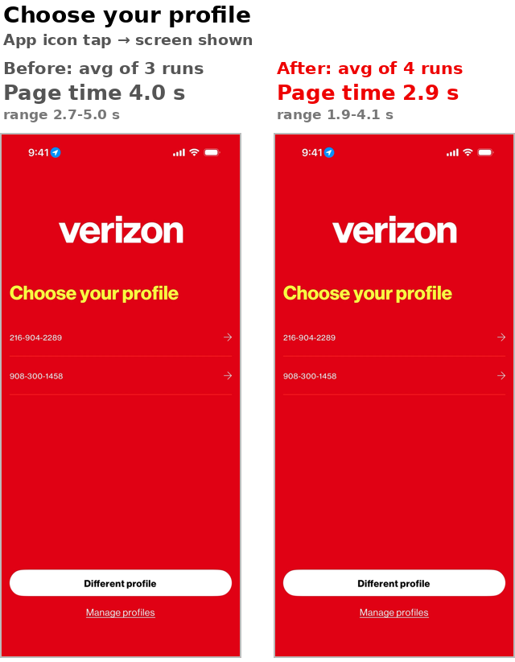
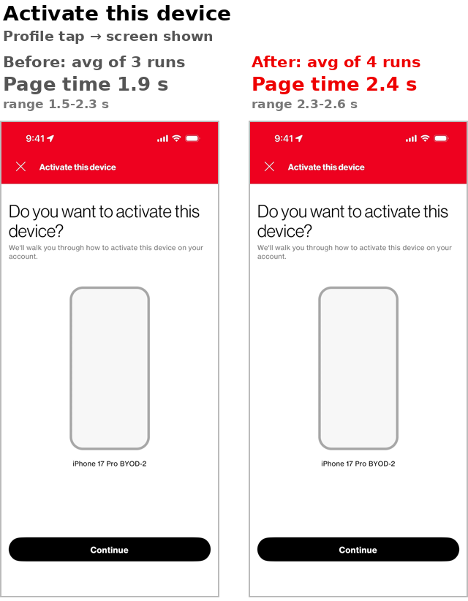
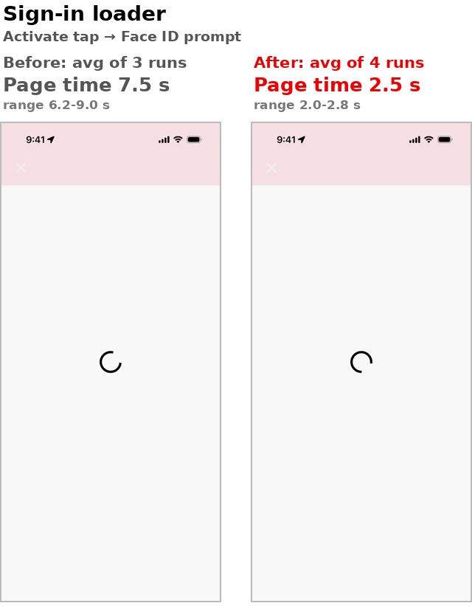
Same screens, before and after (1/2)
Page time = average of 3 before runs and 4 after runs. Screenshots from the 23:08 and 22:27 runs
MyVerizon iOS · Proxyman captures 9-Oct vs 28-Oct 2026
6

Slide 7
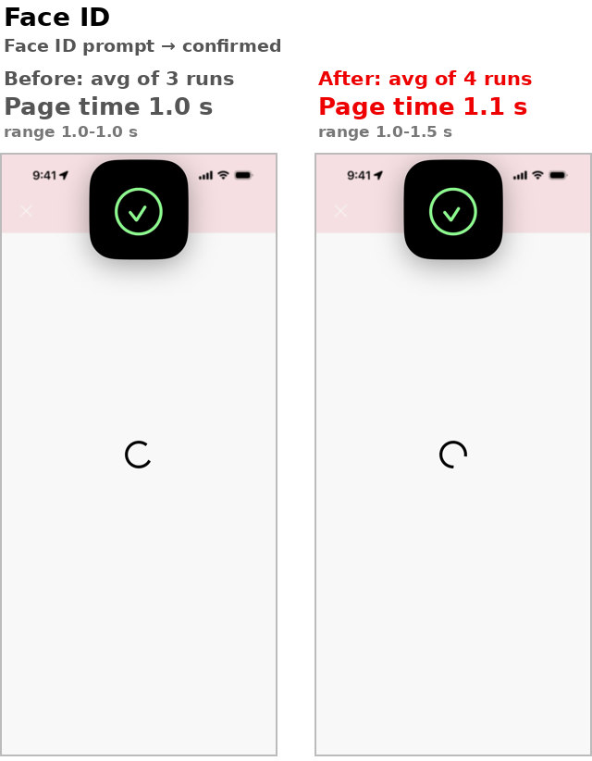
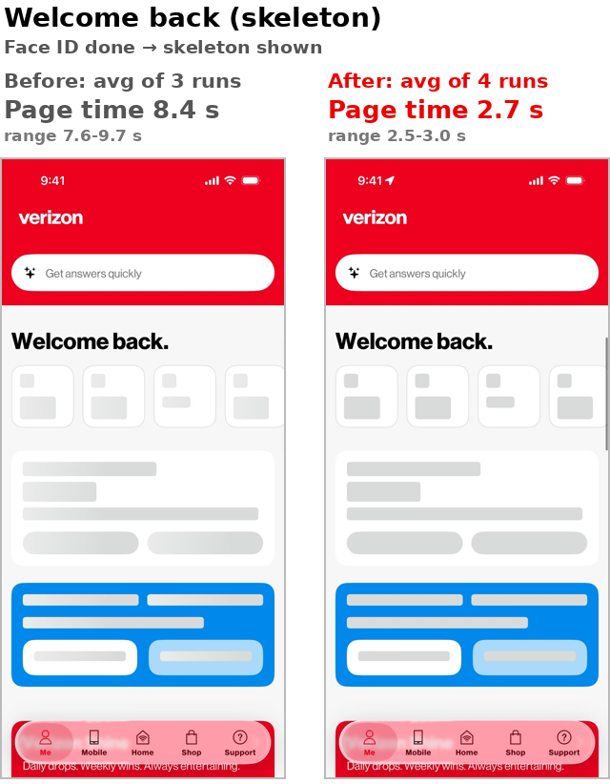
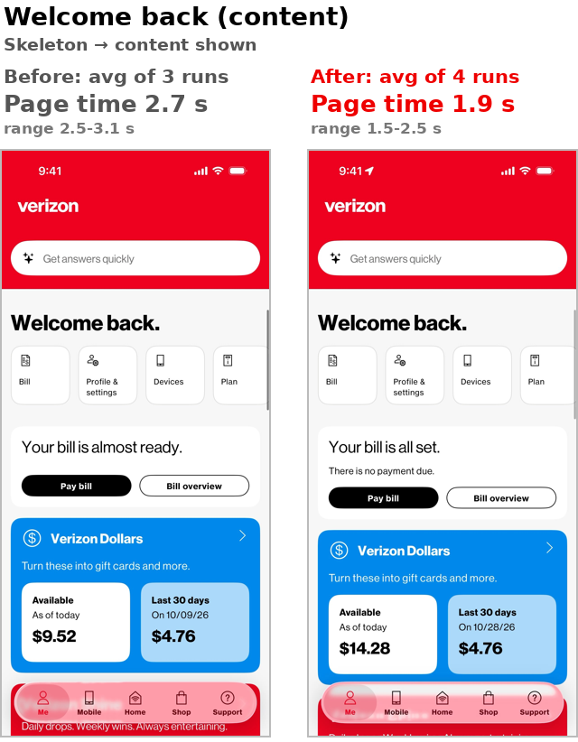
Same screens, before and after (2/2)
Page time = average of 3 before runs and 4 after runs. Screenshots from the 23:08 and 22:27 runs
MyVerizon iOS · Proxyman captures 9-Oct vs 28-Oct 2026
7

Slide 8
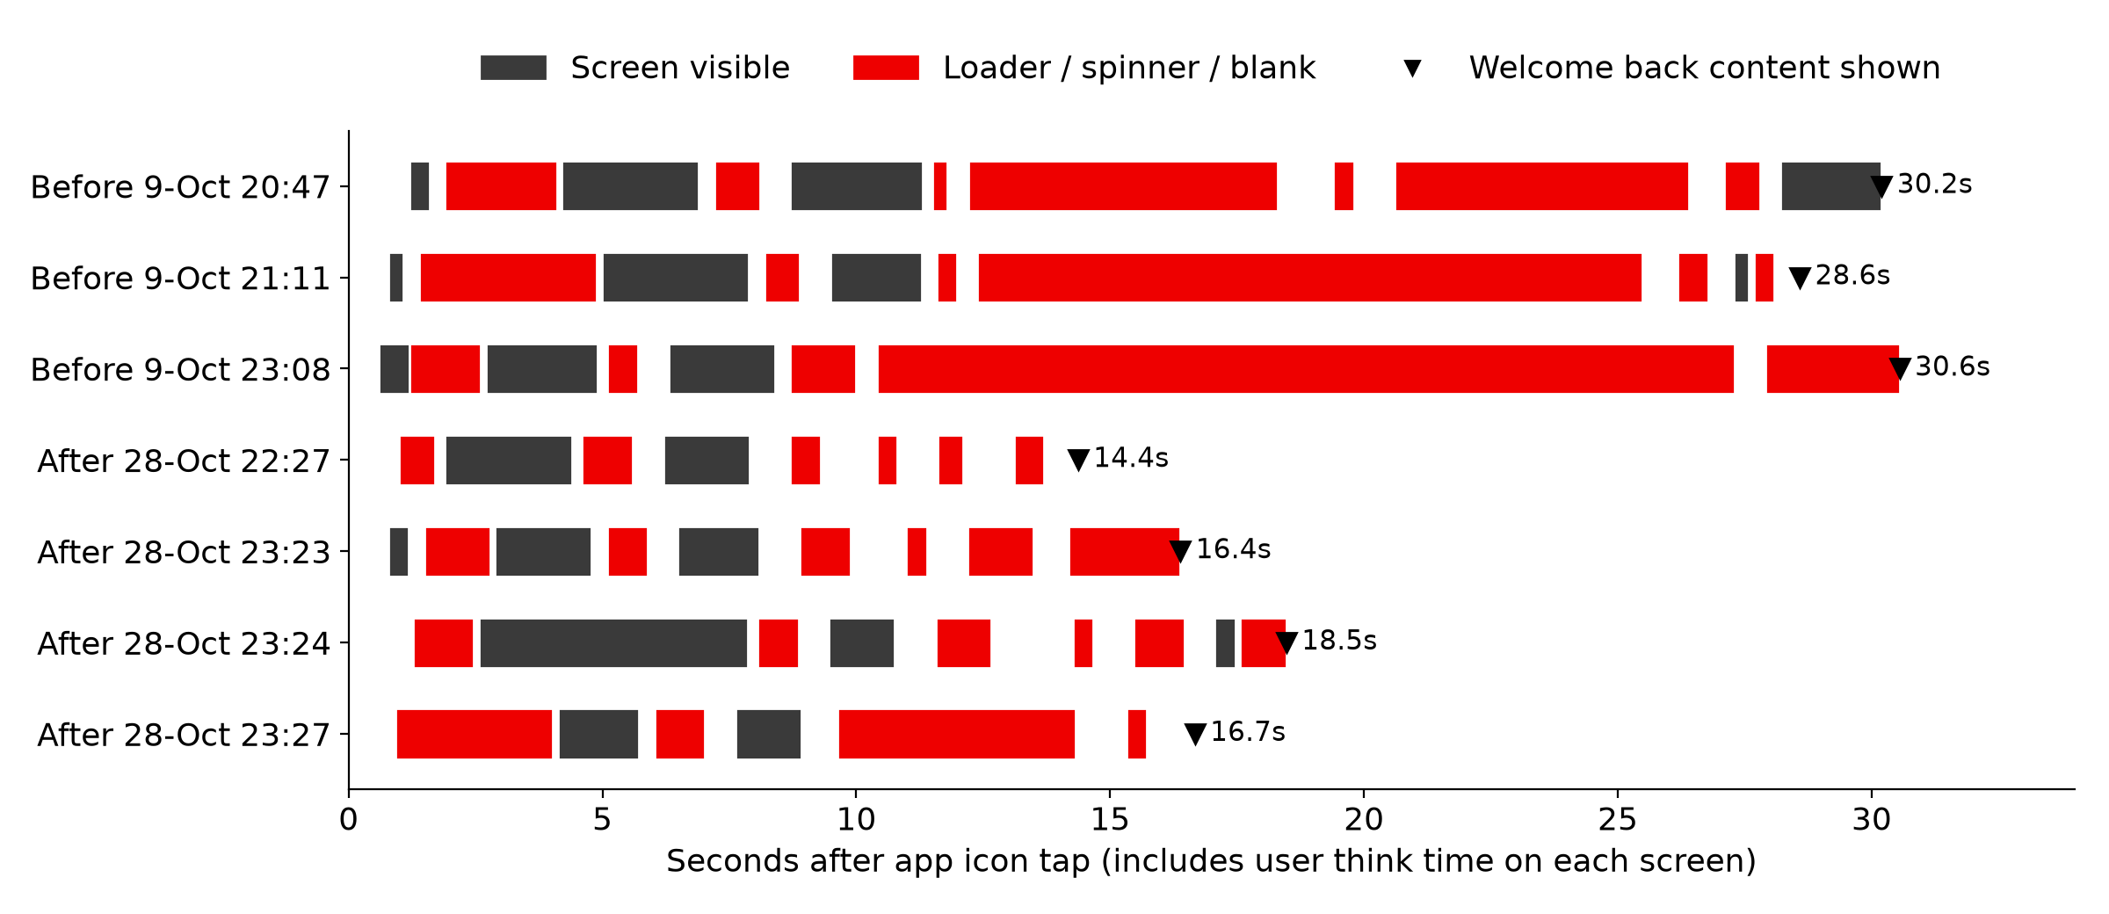
Journey timeline, all 7 runs
Screens and loaders aligned to the app icon tap
■ Before: one 14-17 s loader covers sign-in in every run. Content shows at 28.6-30.6 s.
■ After: loaders of 5 s or less. Content shows at 14.4-18.5 s, including user time on each screen.
MyVerizon iOS · Proxyman captures 9-Oct vs 28-Oct 2026
8

Slide 9
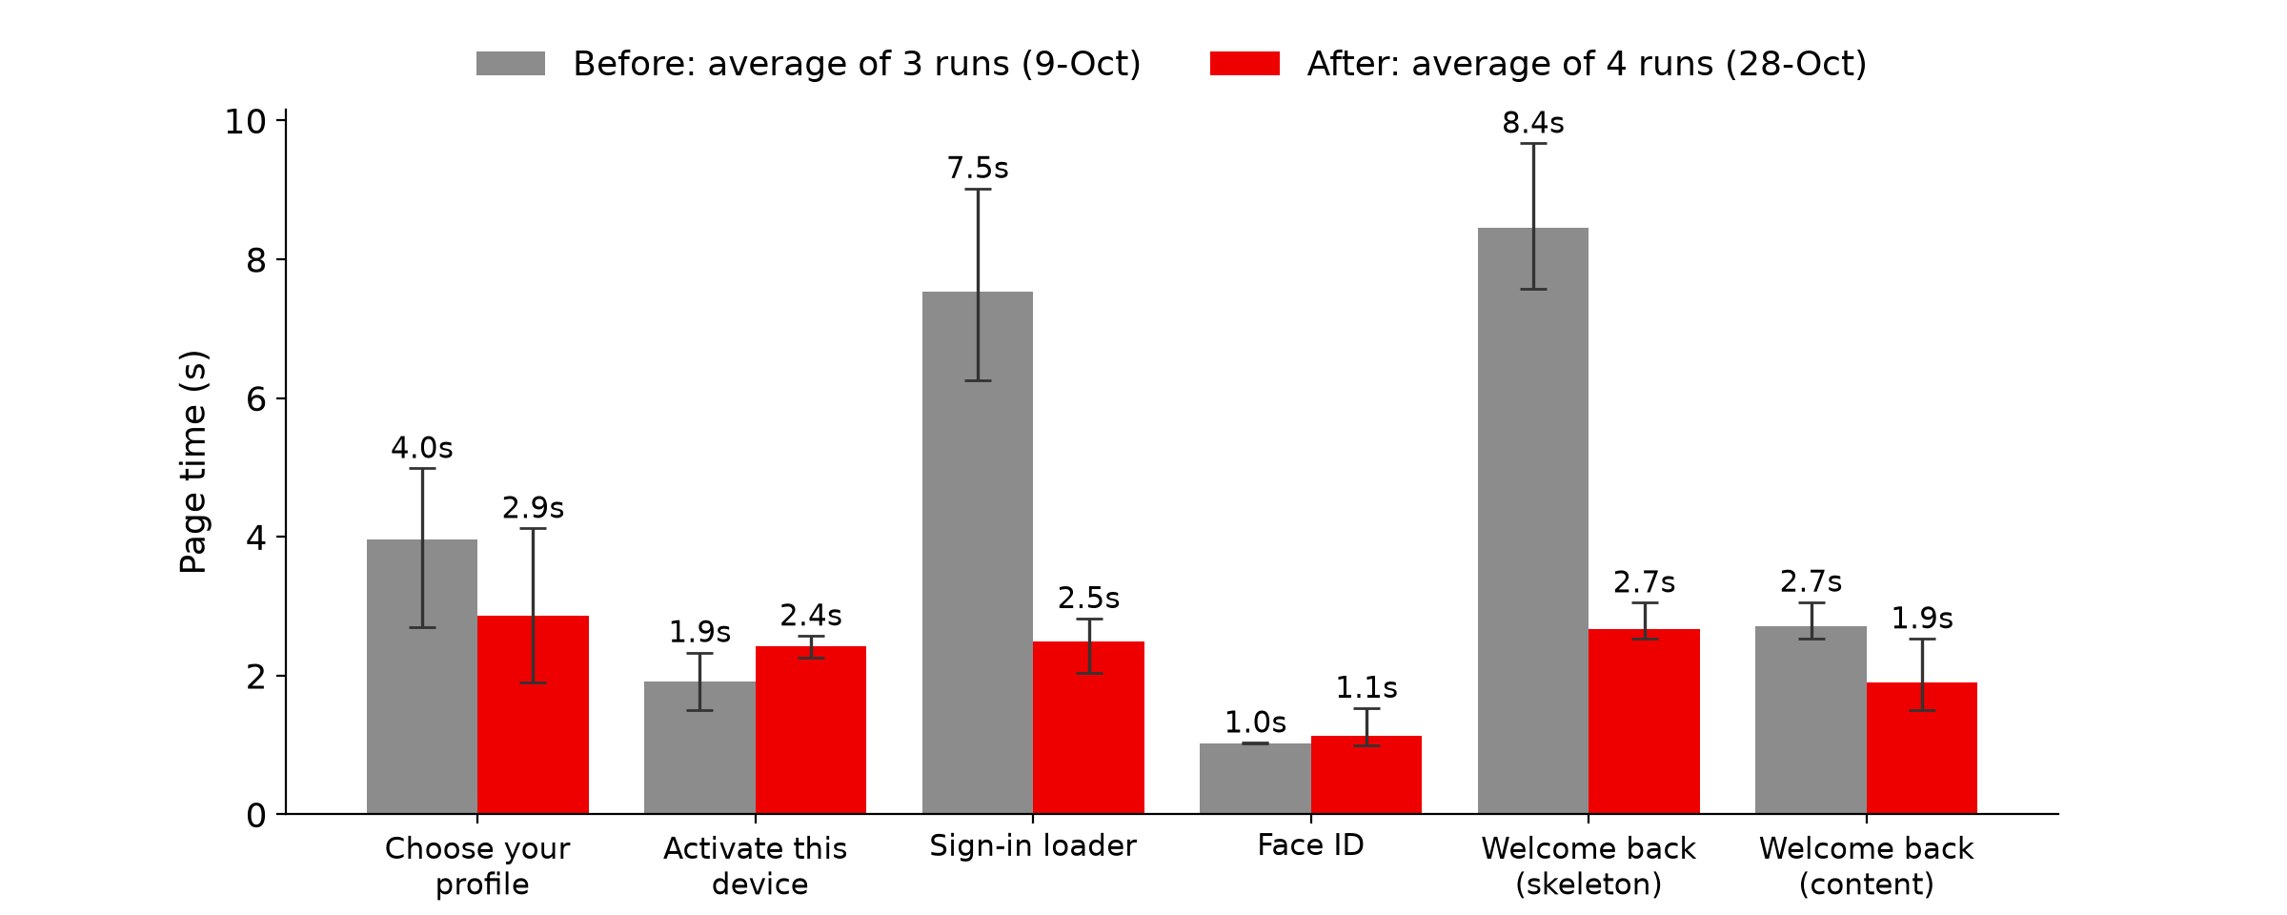
Page time per screen, before and after
Average of 3 before and 4 after runs, whiskers show min-max
Metric | Before avg | After
Sum of page times | 25.6 s | 13.5 s
Activate → content | 19.7 s | 8.2 s
Spinner total | 20.4 s | 8.4 s
Longest spinner | 15.9 s | 4.4 s
API p50 (Proxyman) | 1.45 s | 1.03 s
www.verizon.com conns | 5 | 1
Before API p50 and connections come from the 2 runs with Proxyman data. After values average all 4 runs.
MyVerizon iOS · Proxyman captures 9-Oct vs 28-Oct 2026
9

Slide 10
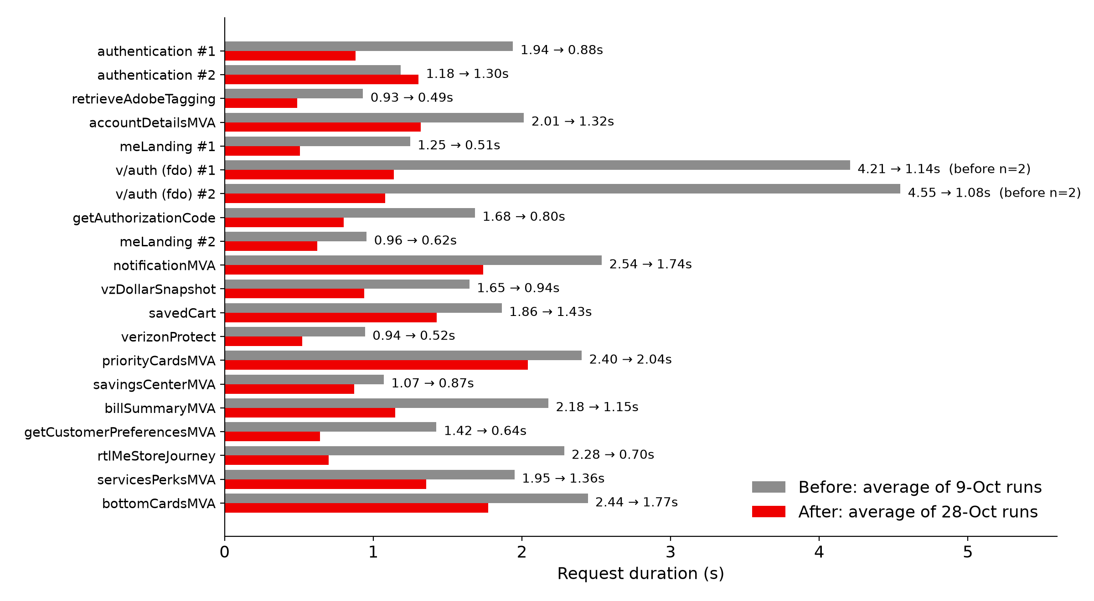
Every shared endpoint, before and after
Median 1.90 s → 1.01 s. Total call time 39.5 s → 21.3 s
■ Averages: 3 before runs vs 4 after runs.
■ Largest drops: fdo v/auth 4.2-4.6 → 1.1 s, authentication #1 1.94 → 0.88 s, getAuthorizationCode 1.68 → 0.80 s, rtlMeStoreJourney 2.28 → 0.70 s.
■ Smaller change: priorityCardsMVA 2.40 → 2.04 s and bottomCardsMVA 2.44 → 1.77 s. These now set the Welcome back time.
■ One regression: launchapp/authentication #2, 1.18 → 1.30 s. Its response is 76 KB.
■ before n=2: fdo.myvzw.com is not in the 23:08 app log.
MyVerizon iOS · Proxyman captures 9-Oct vs 28-Oct 2026
10

Slide 11
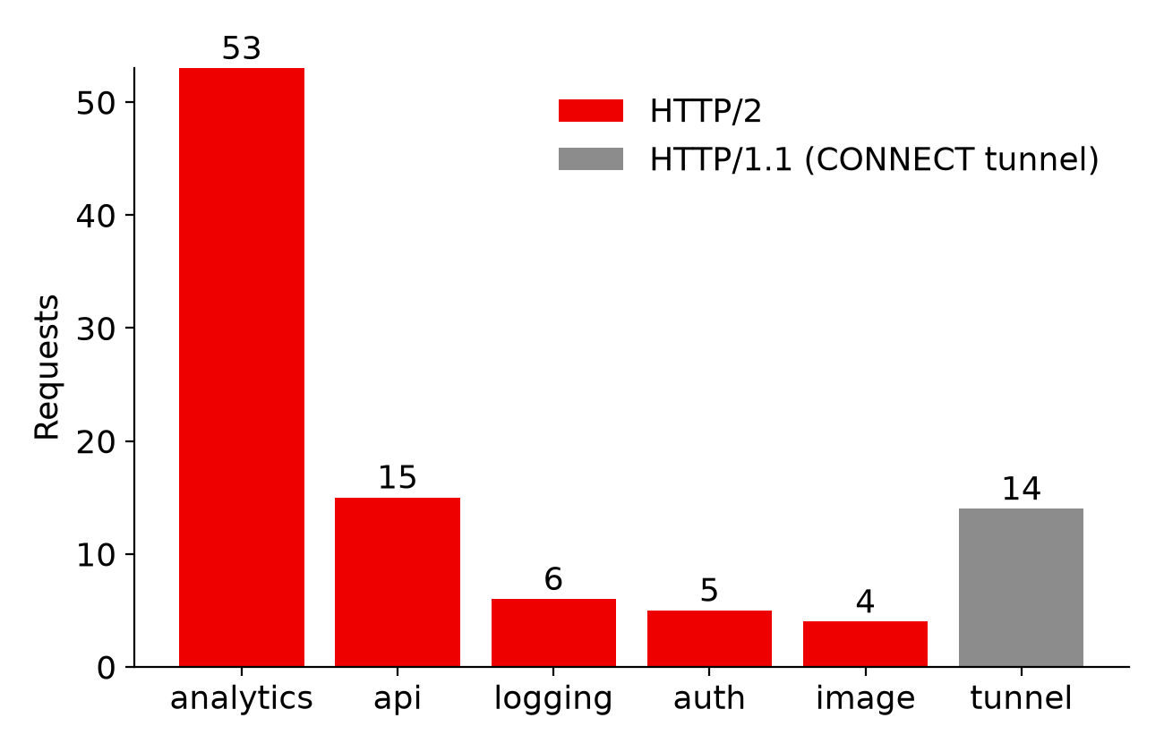
HTTP/2 carries all decrypted app traffic
28-Oct capture, 97 requests across 18 hosts
■ 83 requests on HTTP/2. All API, sign-in, image, logging and analytics calls.
■ 14 HTTP/1.1 entries are CONNECT tunnels. Hosts not decrypted by Proxyman (Apple, Quantum Metric ingest, Adobe edge/demdex, rdd.vzw.com, app-analytics-services.com). Their inner protocol is not visible.
■ Few connections for many requests. 12 new connections served the 83 HTTP/2 requests, about 7 requests per connection.
■ www.verizon.com: 10 calls on 1 connection. mobile-exp.vzw.com: 14 calls on 2 connections.
MyVerizon iOS · Proxyman captures 9-Oct vs 28-Oct 2026
11

Slide 12
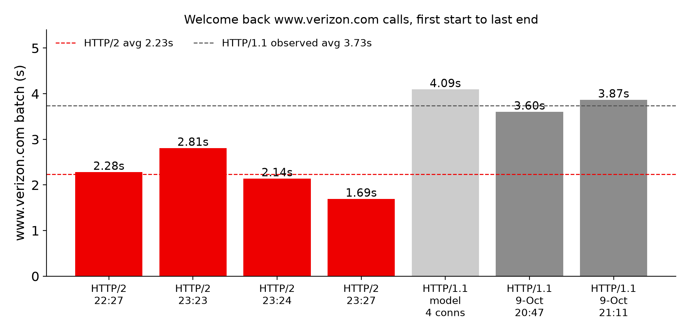
How HTTP/2 helps on Welcome back
9 parallel www.verizon.com calls: 2 HTTP/1.1 runs vs 4 HTTP/2 runs
■ HTTP/1.1, observed on 9-Oct: 5 connections to www.verizon.com. 3 of 9 calls wait 1.5-2.0 s for a free connection. Batch 3.60 s and 3.87 s.
■ HTTP/2, observed on 28-Oct: 1 connection in all 4 runs. All 9 calls start within 20 ms as parallel streams. Batch 1.69-2.81 s, avg 2.23 s, equal to the slowest call.
■ HTTP/1.1 model on 28-Oct 22:27 call times: 4.09 s with 4 connections. Multiplexing alone saves about 1.8 s.
■ One connection, one handshake. Fewer TLS setups and compressed headers also help the 53 small analytics beacons.
MyVerizon iOS · Proxyman captures 9-Oct vs 28-Oct 2026
12

Slide 13
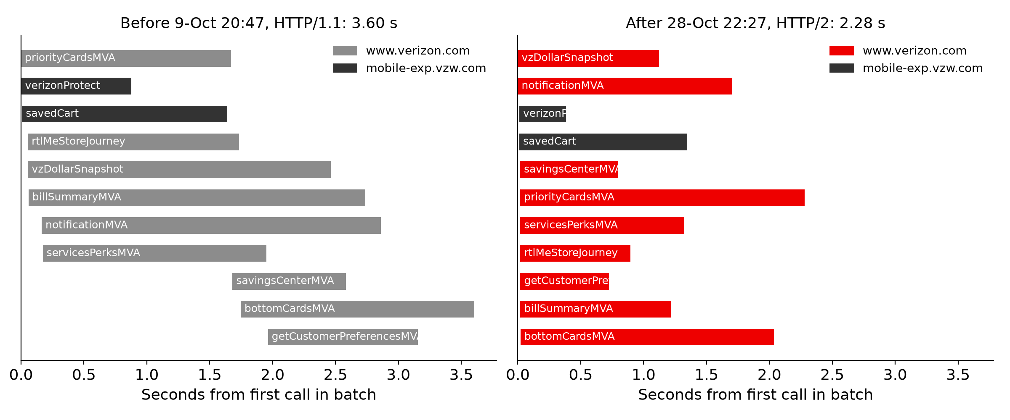
Welcome back data batch, HTTP/1.1 vs HTTP/2
Bars start when each call starts
On HTTP/1.1, savingsCenterMVA, bottomCardsMVA and getCustomerPreferencesMVA start late. On HTTP/2 every call starts at once (same in all 4 after runs).
MyVerizon iOS · Proxyman captures 9-Oct vs 28-Oct 2026
13

Slide 14
Asset inventory: all 18 hosts
28-Oct capture
Host | Reqs | Type | Protocol | Conns | Received | p50 | p95
verizontelecom.sc.omtrdc.net | 26 | analytics 26 | h2 26 | 1 | 7.6 KB | 0.05s | 0.20s
assets.adobedtm.com | 24 | analytics 24 | h2 24 | 1 | 0.0 KB | 0.01s | 0.03s
mobile-exp.vzw.com | 14 | auth 3, logging 6, api 5 | h2 13, h1.1 1 | 2 | 196.5 KB | 0.31s | 1.33s
www.verizon.com | 10 | api 10 | h2 10 | 1 | 51.6 KB | 1.20s | 2.26s
ingestusipv4.quantummetric.com | 6 | tunnel 6 | tunnel | - | 0.0 KB | 0.00s | 0.00s
assets.verizon.com | 3 | image 3 | h2 3 | 1 | 0.0 KB | 0.04s | 0.12s
rdd.vzw.com | 2 | tunnel 2 | tunnel | - | 0.0 KB | 0.00s | 0.00s
fdo.myvzw.com | 2 | auth 2 | h2 2 | 2 | 3.0 KB | 1.07s | 1.08s
itunes.apple.com | 1 | tunnel 1 | tunnel | - | 0.0 KB | 0.00s | 0.00s
sandbox.itunes.apple.com | 1 | tunnel 1 | tunnel | - | 0.0 KB | 0.00s | 0.00s
rl.quantummetric.com | 1 | tunnel 1 | tunnel | - | 0.0 KB | 0.00s | 0.00s
dpm.demdex.net | 1 | tunnel 1 | tunnel | - | 0.0 KB | 0.00s | 0.00s
mobile-collector.newrelic.com | 1 | analytics 1 | h2 1 | 1 | 0.0 KB | 0.62s | 0.62s
cdn.quantummetric.com | 1 | analytics 1 | h2 1 | 1 | 14.5 KB | 0.19s | 0.19s
edge.adobedc.net | 1 | tunnel 1 | tunnel | - | 0.0 KB | 0.00s | 0.00s
firebaselogging-pa.googleapis.com | 1 | analytics 1 | h2 1 | 1 | 0.0 KB | 1.16s | 1.16s
ss7.vzw.com | 1 | image 1 | h2 1 | 1 | 0.0 KB | 0.56s | 0.56s
app-analytics-services.com | 1 | tunnel 1 | tunnel | - | 0.0 KB | 0.00s | 0.00s
MyVerizon iOS · Proxyman captures 9-Oct vs 28-Oct 2026
14

Slide 15
Assets by type
What the app downloads and sends
Type | Requests | Received | Sent | Notes
api | 15 | 136.0 KB | 3.4 KB | 15 calls on www.verizon.com and mobile-exp.vzw.com
auth | 5 | 114.4 KB | 14.4 KB | launchapp/authentication, v/auth, getAuthorizationCode
analytics | 53 | 22.1 KB | 146.9 KB | Adobe, Quantum Metric, Firebase, New Relic
logging | 6 | 0.7 KB | 0.7 KB | logger/logStat on mobile-exp.vzw.com
image | 4 | 0.0 KB | 0.0 KB | assets.verizon.com, ss7.vzw.com. 3 of 4 are 304
tunnel | 14 | 0.0 KB | 0.0 KB | Not decrypted, size unknown
■ Analytics is 55% of all requests (53 of 97) but under 10% of the bytes.
■ Two responses carry most of the data. launchapp/authentication 76 KB and launchapp/meLanding 73 KB.
■ Images are small and mostly cached. They are not a bottleneck on these screens.
MyVerizon iOS · Proxyman captures 9-Oct vs 28-Oct 2026
15

Slide 16
Analytics and third-party cost
Traffic that is not needed to draw the screen
Vendor | Requests | During spinner | Received | Sent
Adobe Analytics / Launch | 52 | 26 | 7.6 KB | 47.3 KB
Quantum Metric | 8 | 5 | 14.5 KB | 0.0 KB
First-party telemetry (logger/logStat) | 6 | 3 | 0.7 KB | 0.7 KB
Apple | 2 | 0 | 0.0 KB | 0.0 KB
Undecrypted (rdd.vzw.com) | 2 | 0 | 0.0 KB | 0.0 KB
New Relic | 1 | 0 | 0.0 KB | 1.6 KB
Google Firebase | 1 | 0 | 0.0 KB | 98.0 KB
Google Analytics | 1 | 0 | 0.0 KB | 0.0 KB
■ 34 analytics calls fire while a spinner is on screen. They compete with sign-in calls for the network and CPU.
■ Firebase batch upload is 98 KB. It waited up to 0.67 s on the device before sending.
■ Adobe Launch rules file is checked 23 times in 14 s though it is cached for one hour.
MyVerizon iOS · Proxyman captures 9-Oct vs 28-Oct 2026
16

Slide 17
Caching and payload findings
Cheap fixes on the server and client side
Item | Observed | Fix
Adobe launch-…-rules.zip | 23 revalidations (304) in 14 s, max-age 3600 | Reuse cached copy until max-age expires
verizon/rockettes image | 3 revalidations in 1 s, no max-age | Send Cache-Control: max-age
launchapp/authentication #2 | 76 KB. navigationPatterns 12.9 KB, requestCookies 8.3 KB | Trim or cache static maps
launchapp/meLanding | 73 KB. molecules 34.7 KB, actions 22.3 KB | Split above-the-fold data from the rest
Duplicated blocks | noConnectionPage 3.5 KB sent twice, ShoppingConfig 3.0 KB | Send once per session
fdo.myvzw.com | 2 sign-in calls, about 1.07 s each, no CDN | Front with CDN or keep connection warm
MyVerizon iOS · Proxyman captures 9-Oct vs 28-Oct 2026
17

Slide 18
Client-side findings
Time spent on the device, not on the network
■ Gaps with no request in flight. 0.78 s and 0.76 s on the critical path, plus 0.76 s of spinner with no network work.
■ 10 synchronous calls on the main thread (badge number). These block UI updates.
■ Face ID availability checked 12 times in 0.51 s. One check is enough.
■ Slow tap feedback. 2 of 2 taps showed a pressed state after more than 150 ms. Worst 657 ms on Choose your profile.
■ One 217 ms frame hitch during the launch animation.
■ Launch → first API call 5.55 s in the report includes the springboard. From app process start it is about 0.8 s.
MyVerizon iOS · Proxyman captures 9-Oct vs 28-Oct 2026
18

Slide 19
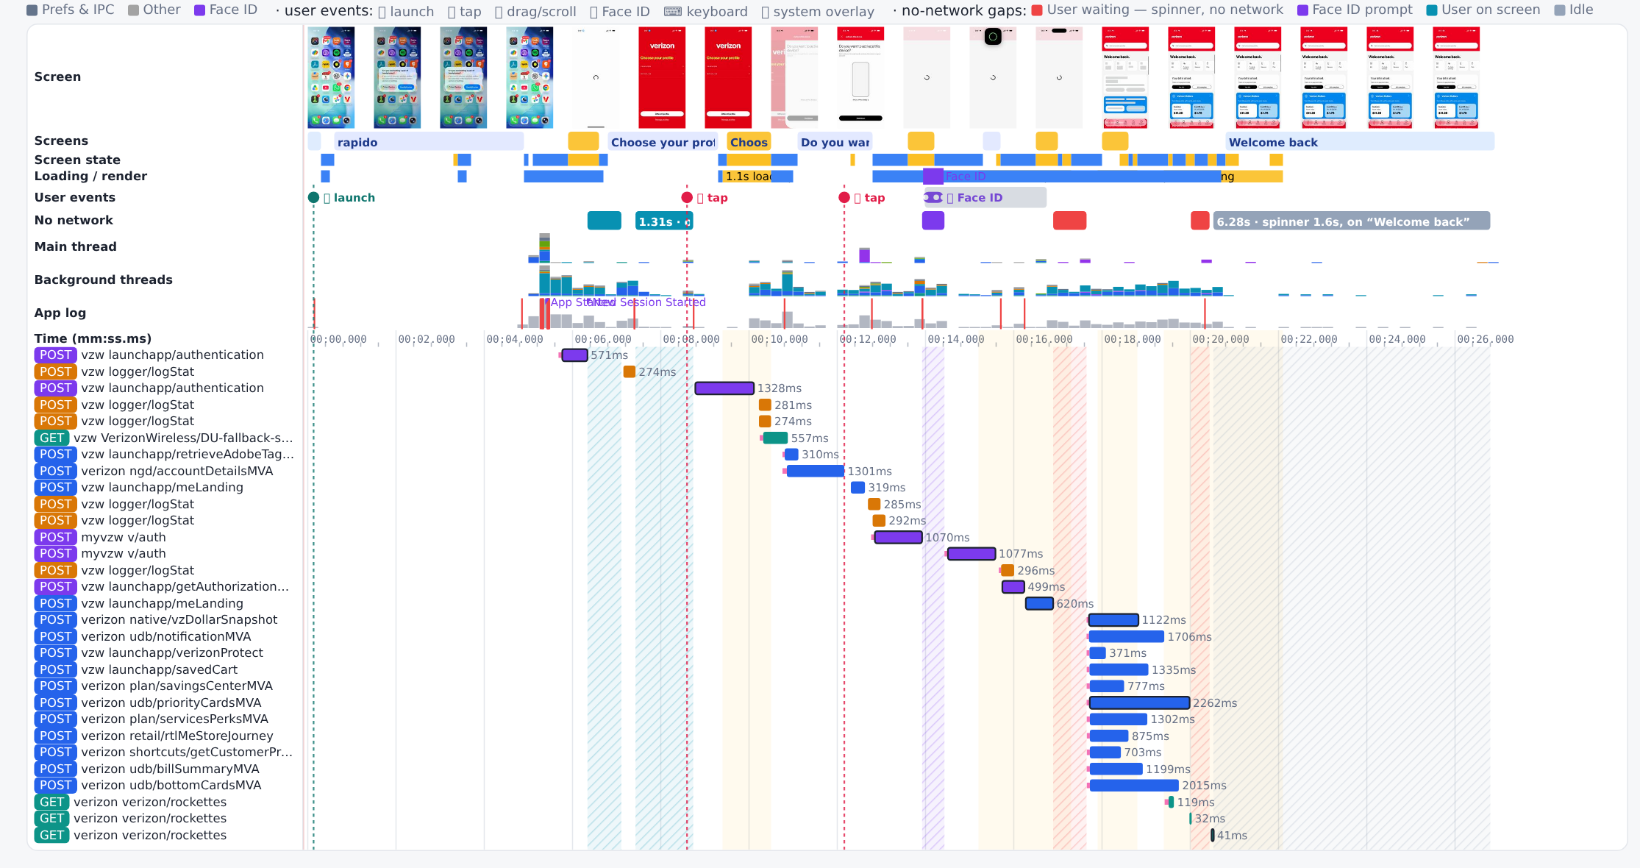
Report view: after (28-Oct) request timeline
Proxyman report, Timeline tab
MyVerizon iOS · Proxyman captures 9-Oct vs 28-Oct 2026
19

Slide 20
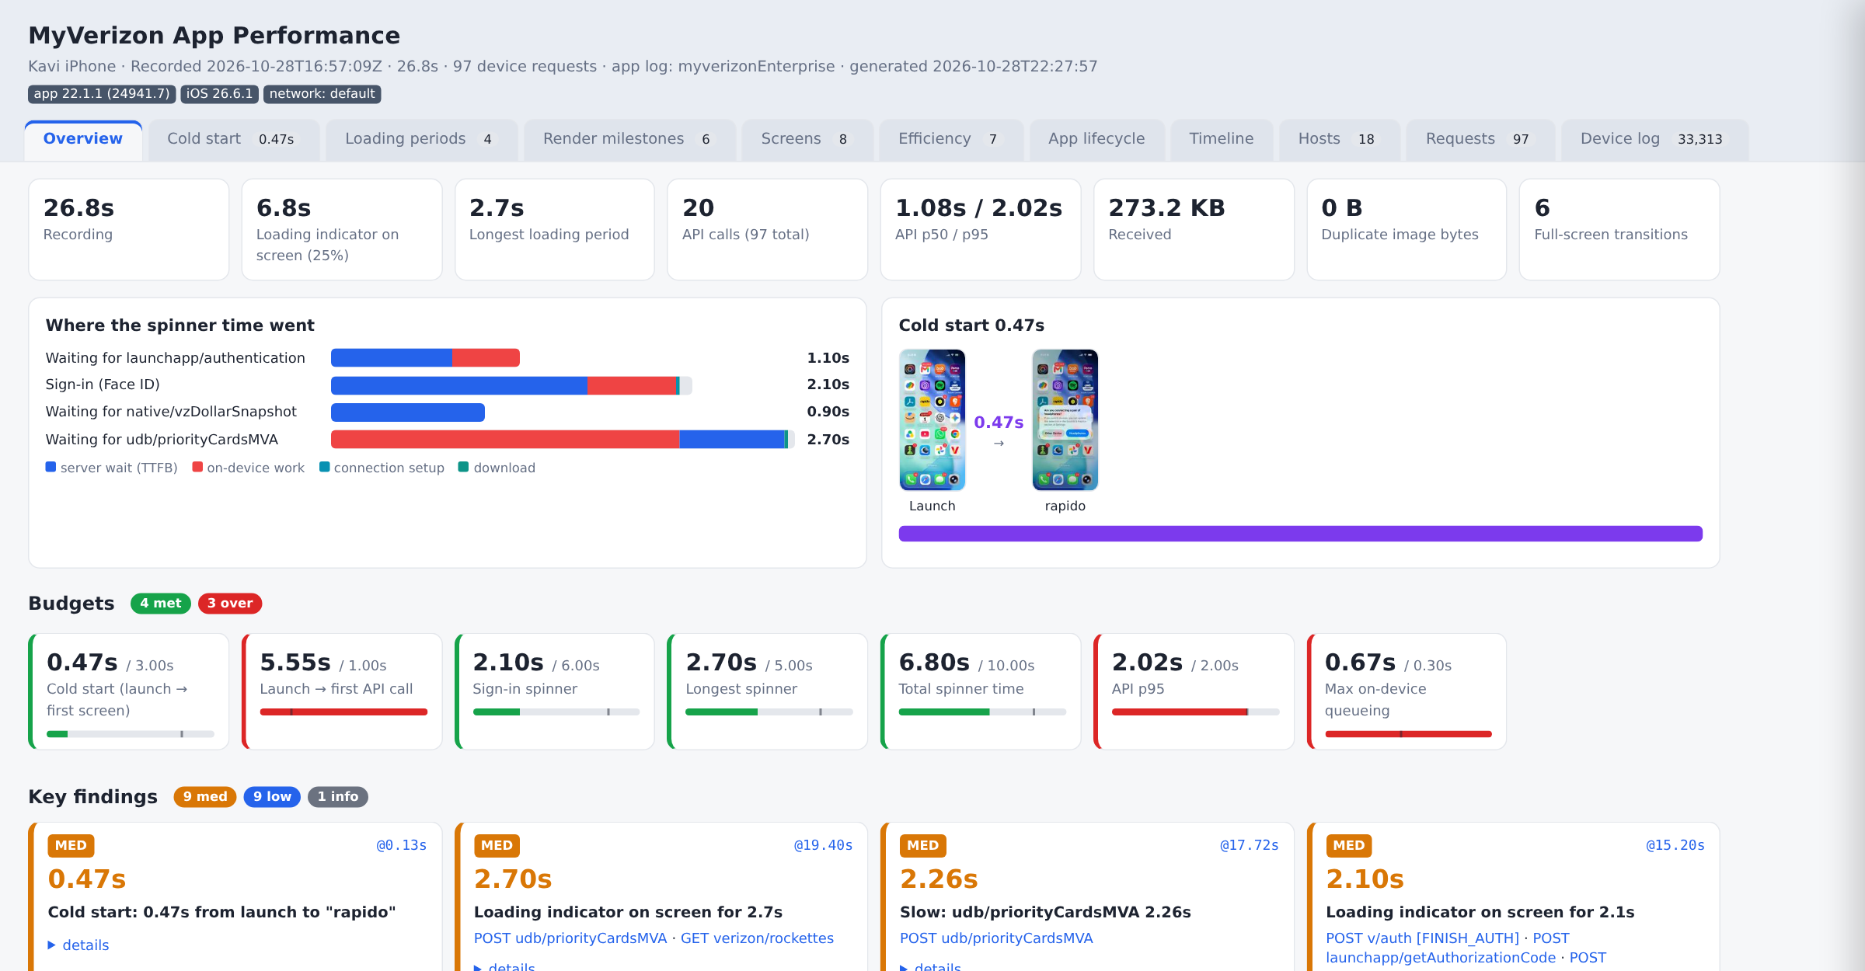
Report view: after (28-Oct) overview
Proxyman report, Overview tab
MyVerizon iOS · Proxyman captures 9-Oct vs 28-Oct 2026
20

Slide 21
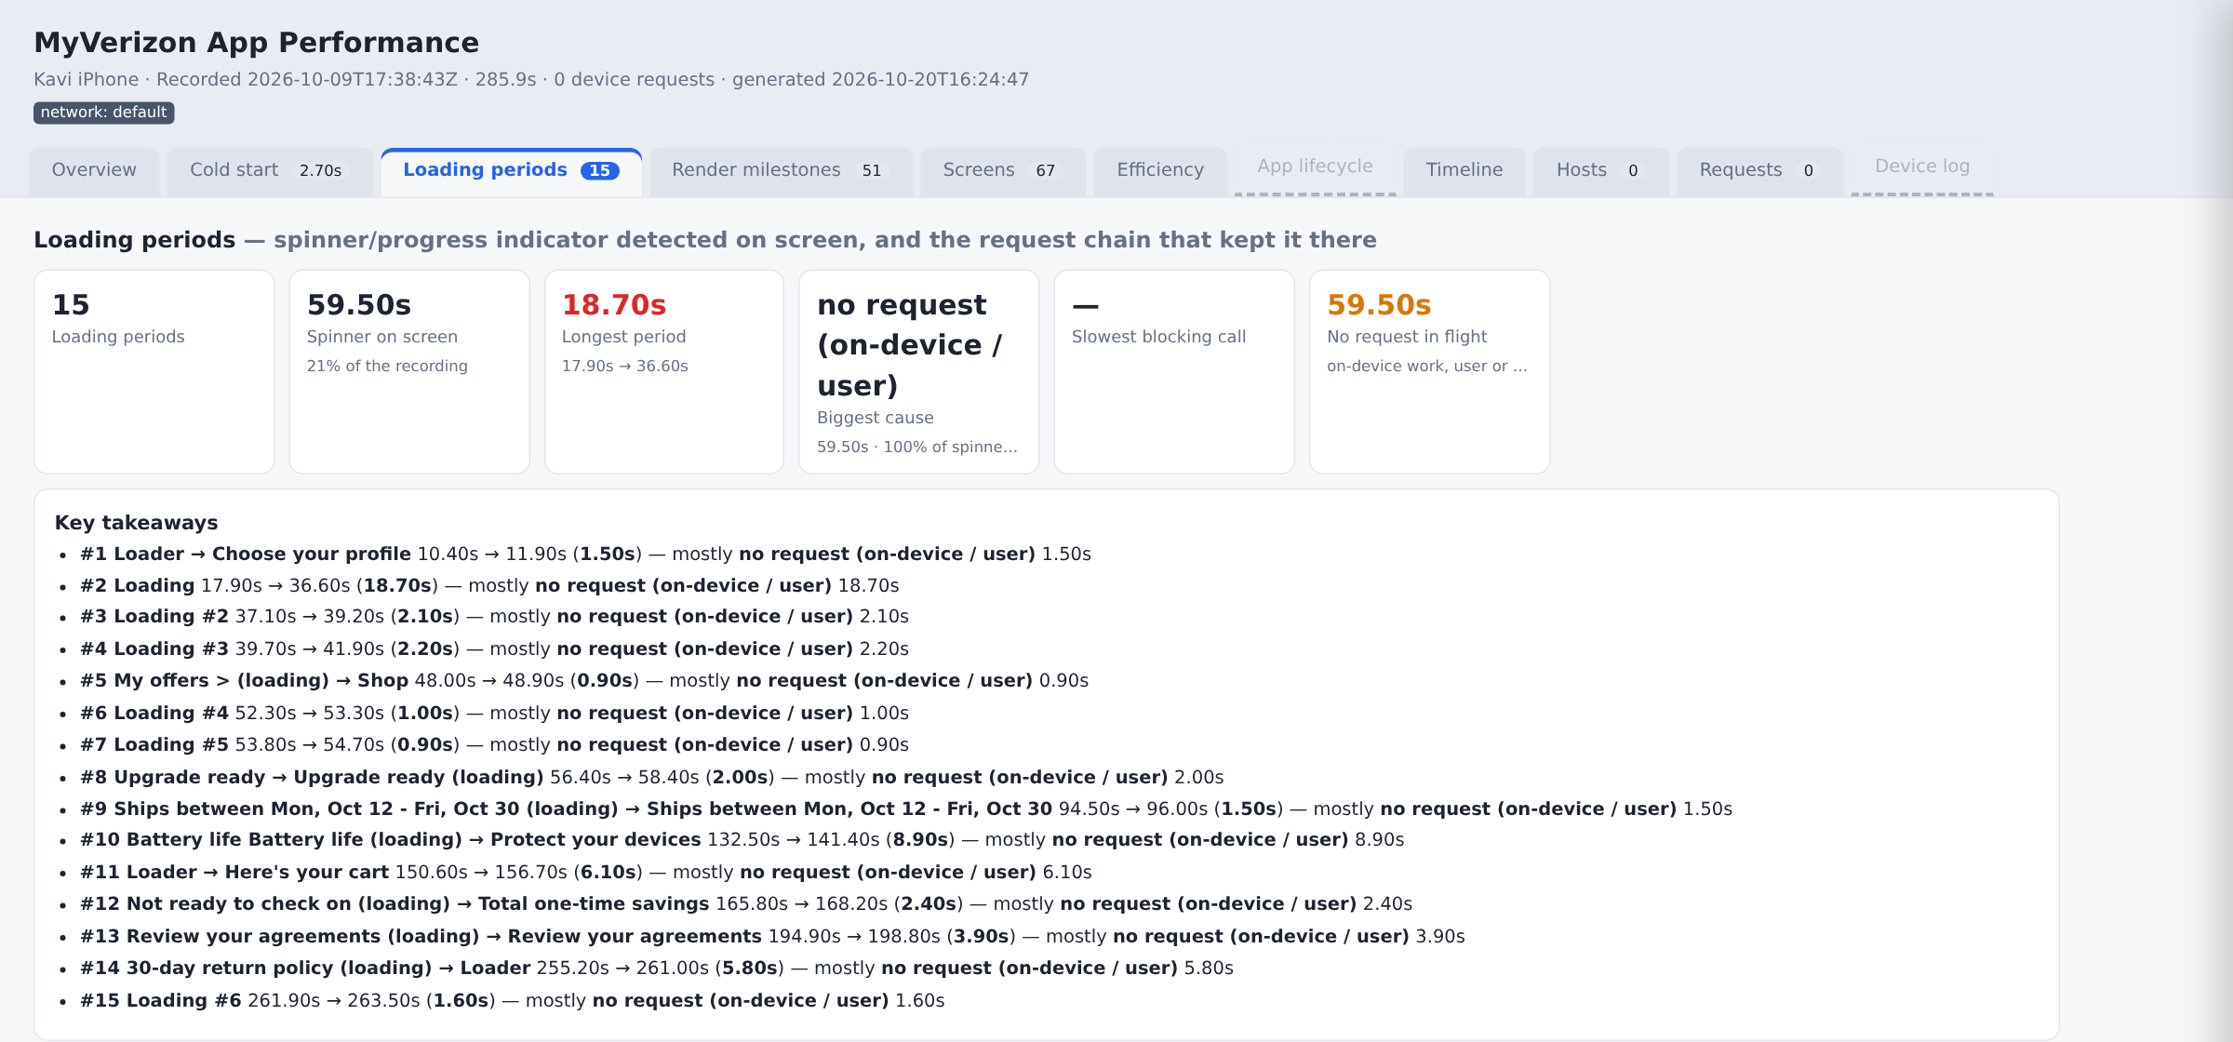
Report view: before (9-Oct 23:08) loading periods
One of the 3 before runs. The 18.7 s loader is the main cost
MyVerizon iOS · Proxyman captures 9-Oct vs 28-Oct 2026
21

Slide 22
Next improvements
Ranked by expected time saved on Welcome back
# | Action | Expected gain | Owner
1 | Cut on-device gaps between sign-in calls (prefetch, start next call on response) | up to 2.6 s | App
2 | Speed up udb/priorityCardsMVA and bottomCardsMVA on www.verizon.com | up to 1.9 s | API
3 | Defer analytics and Firebase upload until the spinner clears | 0.5-0.9 s | App
4 | Trim launchapp/authentication and meLanding payloads | 0.2-0.4 s | API
5 | Honour max-age for Adobe rules and add max-age to images | fewer requests | App / CDN
6 | Move badge calls off the main thread, single Face ID check | smoother UI | App
7 | Keep HTTP/2 on all hosts and coalesce hosts where possible | fewer handshakes | Platform
Gains 1 and 2 come from the report savings estimate. They overlap, so they do not add up exactly.
MyVerizon iOS · Proxyman captures 9-Oct vs 28-Oct 2026
22

