Slide 1
Network Analysis
Dr. Shaina Race
Institute for Advanced Analytics
Spring 2018

Slide 2
Community Detection
i.e. Clustering

Slide 3
Clustering in Graphs
Can still use classical algorithms (k-means) in most cases
Edge weights must reflect similarity and not distance
Use the adjacency matrix like a data matrix
The “observations” and “variables” are the same entities, but you simply characterize an observation by its similarity to others.
Families of algorithms designed specifically for graphs
Spectral (Eigenvector) methods
Modularity
Minimum Spanning Trees
Theorem: Nothing works best all the time!

Slide 4
Spectral Clustering
(Spectral ➔ Eigenvalues/Eigenvectors. Yay!)

Slide 5
Not just for Graphs!
Keep in mind the following methods operate on a similarity matrix (i.e. adjacency matrix).
If you develop a notion of similarity using traditional data, these methods can be useful for clustering any data!

Slide 6
The Laplacian Matrix
Spectral methods typically use a Laplacian Matrix.
Let A be an adjacency matrix for a graph (or a similarity matrix for some data)
Let D be a diagonal matrix containing the degrees of each node:
D = diag{d₁,d₂, … ,d_{n}}
The Laplacian matrix is defined as L = D-A

Slide 7
Simple Spectral Clustering
The Laplacian matrix is defined as L = D-A
The Fiedler vector is the eigenvector associated with the second smallest eigenvalue of L.
Baltimore Ravens' ex-Offensive Lineman John Urschel can tell you about it

Slide 8
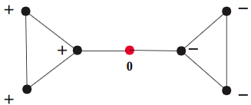
Simple Spectral Clustering
Use the signs of the entries in the Fiedler vector.
Nodes associated with positive entries in one cluster
Nodes associated with negative entries in second cluster
Arbitrarily assign nodes associated with zero entries (often called Articulation Points – sometimes they are brokers)
-.44
-.44
-.33
0
.33
.44
.44

Slide 9
Exploring Articulation Points
A=matrix(c(0,1,1,0,0,0,0,1,0,1,0,0,0,0,1,1,0,1,0,0,0,0,0,1,0,1,0,0,0,0,0,1,0,1,1,0,0,0,0,1,0,1,0,0,0,0,1,1,0),nrow=7)
library("igraph")
g=graph_from_adjacency_matrix(A)
plot(g)
D=diag(rowSums(A))
L-D-A
spectrum=eigen(L)
spectrum$vectors[,6]

Slide 10
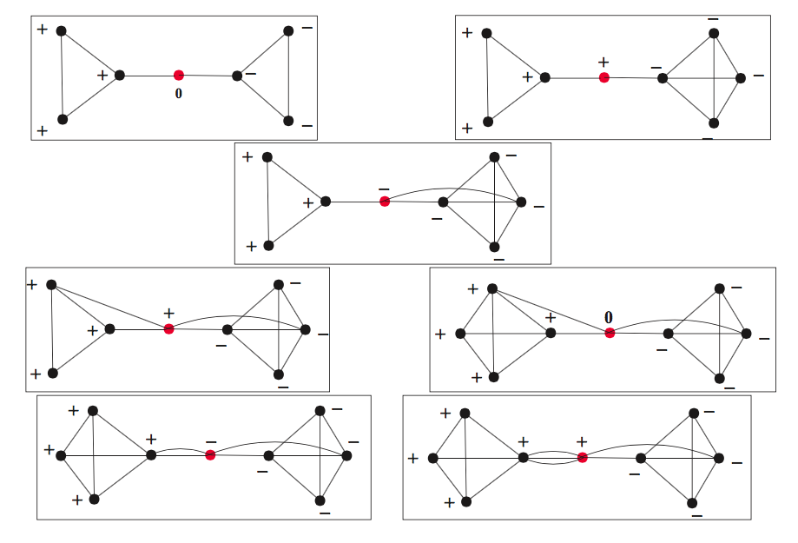
Simple Spectral Clustering

Slide 11
Simple Spectral Clustering
How to get more than two clusters? (Two Ways)
Repeat process on each cluster.
Use additional eigenvectors (Two Ways)
Use the sign patterns (shown below)
Cluster the rows of the eigenvectors with k-means (Next Slide)
v₆ v₅
-.44 0.28
-.44 0.28
-.33 -0.16
0 -0.79
.33 -0.16
.44 0.28
.44 0.28
-,+
+ +
- -
+ -

Slide 12
Simple Spectral Clustering
Use k-means to cluster the rows of the eigenvectors
(Get to choose k in this case)
v₆ v₅
-.44 0.28
-.44 0.28
-.33 -0.16
0 -0.79
.33 -0.16
.44 0.28
.44 0.28

Slide 13
Advanced Spectral Clustering
NCUT
Ratio Cut
Normalized Spectral Clustering
…Long list of algorithms
All involve the Laplacian Matrix, typically normalized in different ways, and k-means run on Eigenvectors

Slide 14
Modularity Maximization
Currently the most popular algorithm for community detection.
Developed in 2006 by Mark Newman (UMichigan)
Algorithm Intuition:
Compare the observed network to what you would expect to find at random.
Where are there more edges than expected?
These areas may define communities.

Slide 15
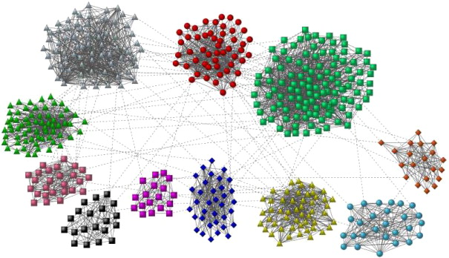
Modularity Maximization

Slide 16
Modularity
Modularity is a number that describes the extent to which given groups form communities in a graph.
Fraction of edges within groups minus the expected fraction if edges were distributed at random.
Number in range [-1, 1)
negative => random partition
(We’d expect to find more edges within our groups if they were distributed at random)
nearer 1 => better communities (components)
(We see far more edges within our groups than we’d expect to find at random)

Slide 17
Modularity Maximization
Picks the partitioning of the vertices that maximizes the modularity.

Slide 18
Modularity Maximization
Let A be the adjacency matrix of the graph
Let P be a matrix containing the expected number of edges between each vertex.
Notes:
It’s like we’re rewiring the graph by cutting all the edges in half and attaching them to others. So it’s a completely random remake of a graph with the same exact degree distribution as the observed graph. concept of configuration models.

Slide 19
Modularity Maximization
P(stub is connected to i) = 3/16
P(stub is connected to j) = 3/16
If i and j are independent,
P(i <-> j) = P(i) • P(j)
So the expected value of the number of complete edges between i and j is
P(i)•P(j) • 16.

Slide 20
Modularity Maximization
B = A-P is the modularity matrix
The first eigenvector of the modularity matrix partitions the graph in two components.
Repeat procedure on each component until the first eigenvalue is negative.

Slide 21
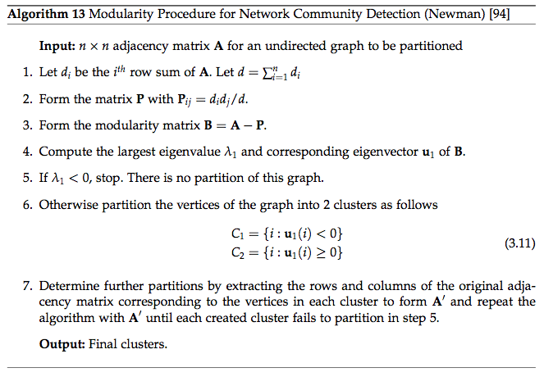

Slide 22
Modularity Maximization
Advantages
Automatically determines number of clusters
Intuitive rationale for/definition of a community
Easy to program and compute
Disadvantages
Node can belong to only one community (hard clustering)
If first eigenvalue of modularity matrix is negative – no clusters.
(could be advantage)

Slide 23
Minimum Spanning Trees
An alternative

Slide 24
Minimum Spanning Trees (or maximal spanning trees in the case of network similarity)
Equivalent to Single Linkage hierarchical clustering.
Creates a tree (graph with no cycles) that connects every node.
Cutting all edges of the tree whose weight doesn’t meet a pre-specified threshold will result in clusters.
Changing threshold changes the number of clusters.

Slide 25
Building the Maximum Spanning Tree (When edge weights reflect similarity)
5
5
4
4
3
3
3
1
3
4
2
4
5

Slide 26
Add the most similar edges to the spanning tree, as long as no cycles are created. Repeat.
5
5
4
4
3
3
1
3
4
2
4
5

Slide 27
Add the most similar edges to the spanning tree, as long as no cycles are created. Repeat.
5
5
4
4
3
3
1
3
4
2
4
5

Slide 28
Add the most similar edges to the spanning tree, as long as no cycles are created. Repeat.
5
5
4
4
3
3
1
3
4
2
4
Addition of this edge would have created a cycle.
5

Slide 29
Add the most similar edges to the spanning tree, as long as no cycles are created. Repeat.
5
5
4
4
3
3
1
3
4
2
4
Addition of this edge would have created a cycle.
5

Slide 30
Cut the tree at some threshold.
For example, cut all red edges < 2
5
5
4
4
3
3
1
3
4
2
4
5

Slide 31
Cut all tree edges < 2
You pick the threshold, then number of clusters determined automatically.
5
5
4
4
3
3
1
3
4
2
4
5

Slide 32
Ensemble Clustering
Try many different clustering algorithms
(Or even k-means with different starting points)
Create a network where the weight of the edge is the number of times that obs i was clustered with obs j.
Partition the resulting network.

