Slide 1
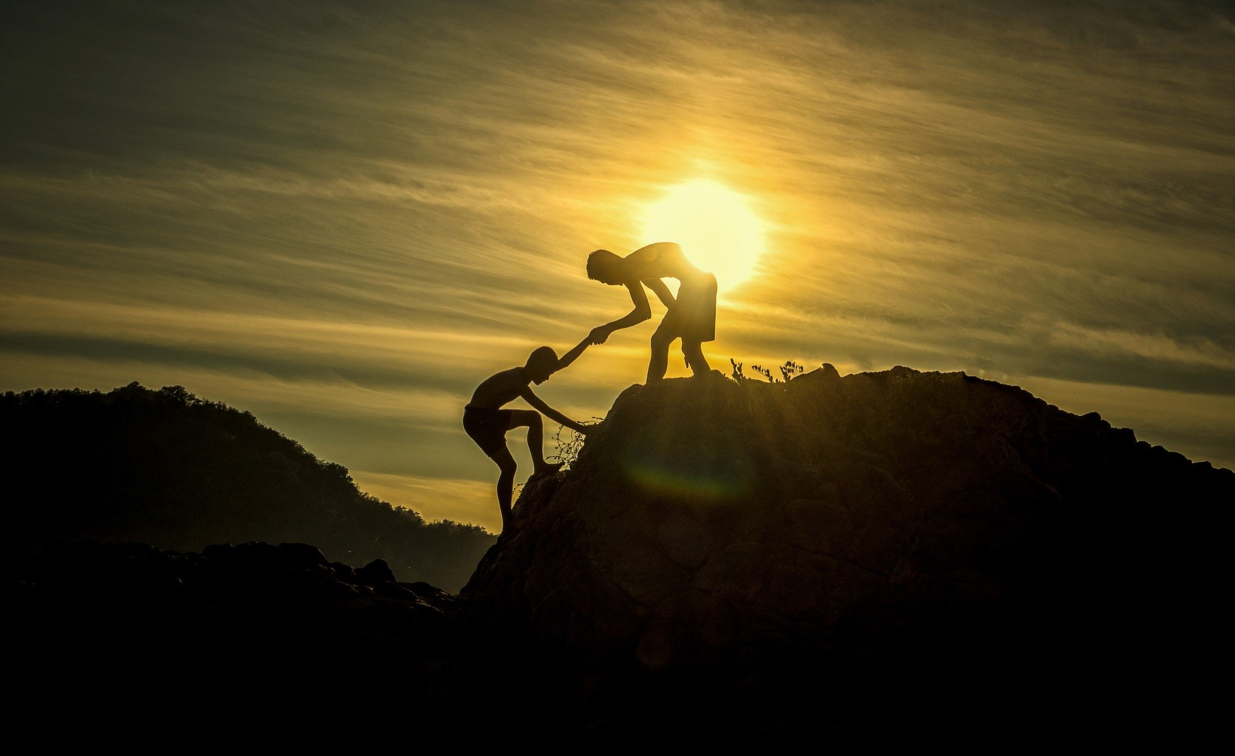
Advanced Software Engineering:
Project Presentation
Manuel Wetzel
5905233
Felix Schütz
6923946
Arbër Rrapaj
1848380
Sascha Kipper
9836038
Notes:
We are Manuel, Felix, Arber and Sascha, and this is our ASE Project Presentation.

Slide 2

The worlds smartest* PDA.
* kind of
Notes:
Today we present you Gunter: The words smartest PDA!

Slide 3

Agenda
1
Requirements Analysis
2
Introducing Gunter
3
A Day with Gunter
4
Conclusion
Advanced Software Engineering: Project Presentation - PDA | 3
Notes:
Here‘s an overview of our agenda.
Requirements (Go over project requirements and later come back to it to show that we‘ve fulfilled them)
Introducing Gunter (Basic Concept, Technology Stack, Use Case Overview, API Overview)
A Day With Gunter (subsequently go over all Use Cases, including description, diagram, live demo)
Conclusion: Shortly conclude about Gunters abilities and how he fulfills the project requirements
3

Slide 4
Agenda
1
Requirements Analysis
2
Introducing Gunter
3
A Day with Gunter
4
Conclusion
Advanced Software Engineering: Project Presentation - PDA | 4
Notes:
Let‘s start with the analysis of the project requirements.
4

Slide 5
Requirements Analysis
Requirements Checklist:
3 Characteristics of a PDA
At least 4 Use Cases
At least 4 Services per Use Case
All Use Cases are functional & executable
Advanced Software Engineering: Project Presentation - PDA | 5
Notes:
Four main requirements for the PDA we had to implement:
[Punkte aufzählen…]
Over the course of this presentation we will get back to this list to check whether Gunter fulfills these requirements or not. The first point, the 3 characteristics of a PDA, can be further subdivided into… [next slide]

Slide 6
Requirements Analysis
Checklist PDA:
Speech Dialogue
Proactivity
Personal
Preferences
Advanced Software Engineering: Project Presentation - PDA | 6
Notes:
Three given requirements that an PDA has to fulfil:
Speech Dialogue
Proactivity
Personal Preferences
We will put this checklist in out pocket and get back to it later in the presentation, to verify that Gunter fulfills there requirements

Slide 7
Agenda
1
Requirements Analysis
2
Introducing Gunter
3
A Day with Gunter
4
Conclusion
Advanced Software Engineering: Project Presentation - PDA | 7
Notes:
7

Slide 8
Introducing Gunter
Technology Stack:
Frontend: Vue.js
Backend: Node.js + TingoDB
APIs: VVS, Deutsche Bahn, Google Calendar, Microsoft Azure Maps: Places and Weather, Daily Quote (They Said So Quotes)
Notifications through browser (service worker)
Advanced Software Engineering: Project Presentation - PDA | 8
Notes:
This is the technology stack Gunter is built with (read what the slide says)…

Slide 9
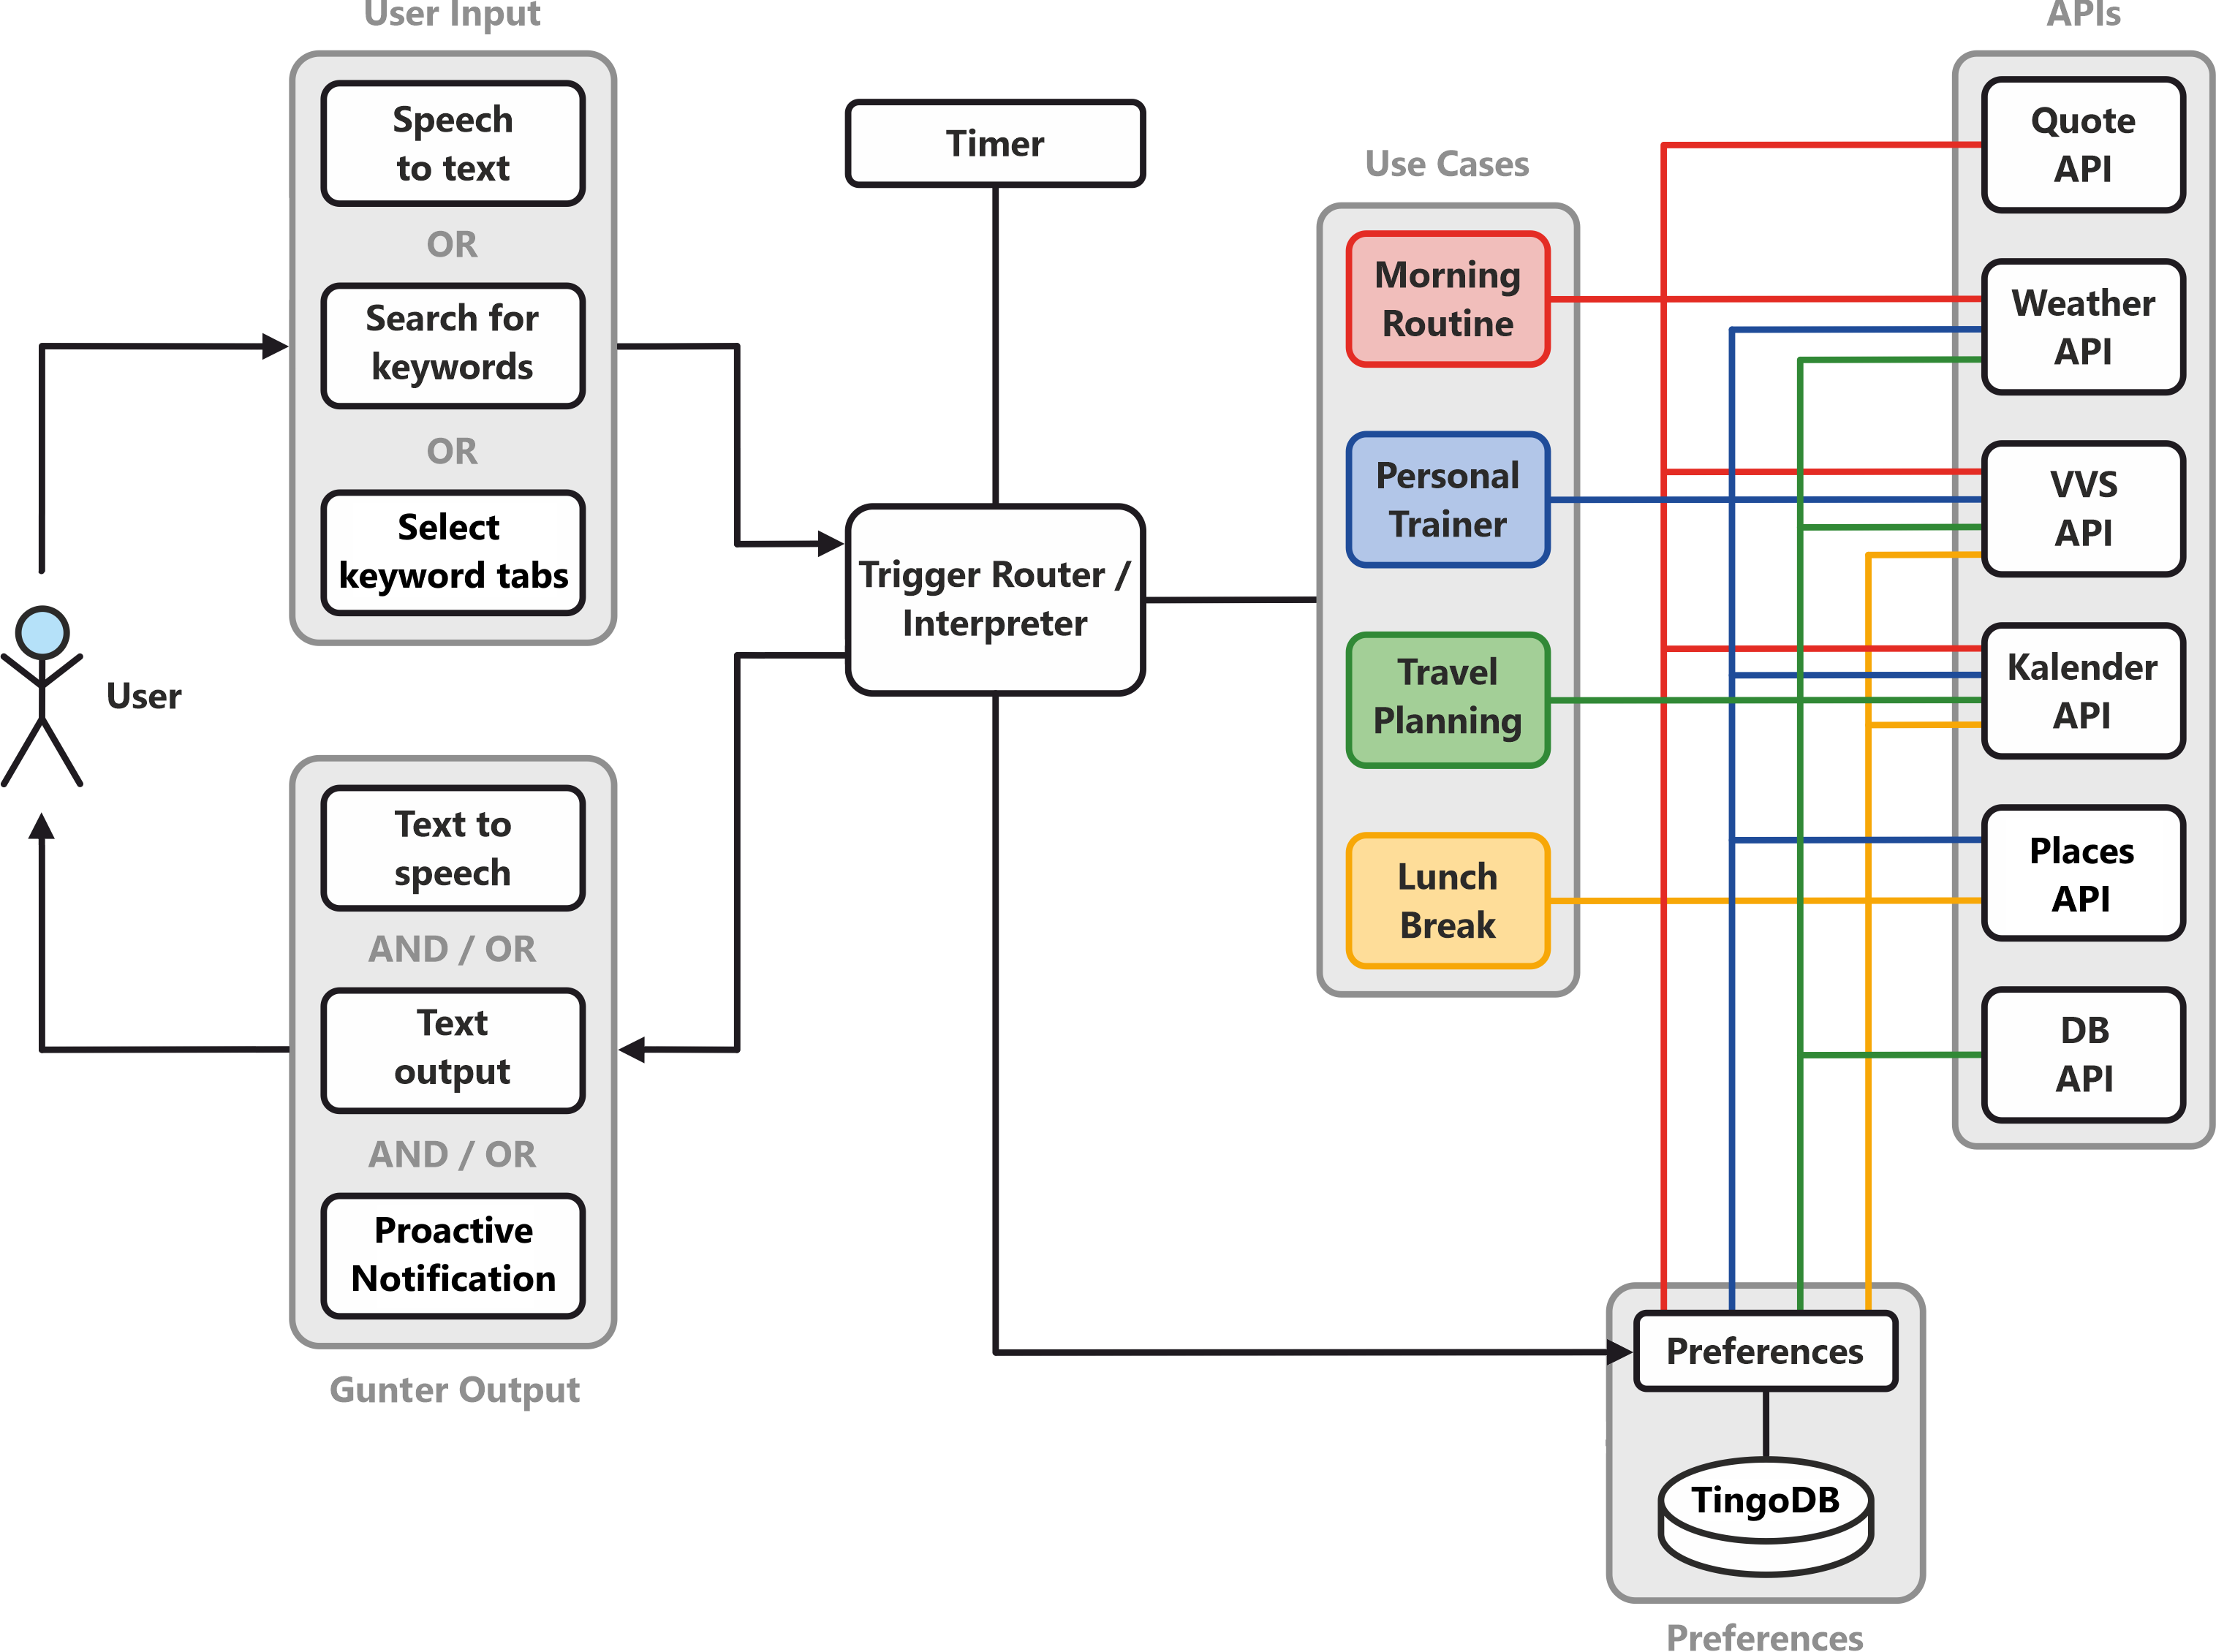
Notes:
… and this is an overview diagram of Gunter. Gunter offers three kinds of user input (each of them will be shown at least once during the live demos):
Speech to text
Search for keywords
select keyword tabs directly
I will show you this in one minute. The user input is handled and routed towards the called use case, of which we have four:
Morning Routine
Personal Trainer
Travel Planning
Lunch Break
Each of these use cases uses a different combination of APIs to fulfill the users request. You can see this depicted here, but later, each use case will be presented indivually again and there I will go over this in more detail. The use cases also take user preferences into account, which are stored in TingoDB, and also accessible for the Router itself to handle user input based on the users preferences.
A timer can trigger the Router, in order for Gunter to proactively notify the user. Apart from proactive notifications, Gunter communicates with the user via Text to Speech and / or text output.

Slide 10
Introducing Gunter
Requirements Checklist:
3 Characteristics of a PDA
At least 4 Use Cases
At least 4 Services per Use Case
All Use Cases are functional & executable
Advanced Software Engineering: Project Presentation - PDA | 10
Notes:
As the previous diagram showed, Gunter already fulfills some of these requirements:
Gunter provides at least 4 use cases
The use cases respectively use at least 4 services each

Slide 11
Agenda
1
Requirements Analysis
2
Introducing Gunter
3
A Day with Gunter
4
Conclusion
Advanced Software Engineering: Project Presentation - PDA | 11
Notes:
Now we will demonstrate you a typical day in your life with Gunters assistance.
11

Slide 12
A Day with Gunter
Your typical Friday:
Getting up in time for the first appointment
Having lunch in between appointments
Doing some physical exercise in between appointments
Open-minded for a weekend-trip to get out of the city
Advanced Software Engineering: Project Presentation - PDA | 12
Notes:
A typical Friday in your life, and moments when Gunter can assist you:
[Read points]

Slide 13
Use Case 1: Morning Routine
Gunter wakes up the user in the morning, based on:
User preferences (time the user need to get ready)
User calendar (time it takes to travel to first appointment)
Gunter presents the VVS route to the first event and weather forecast for the day
Gunter optionally reads a daily qoute
Advanced Software Engineering: Project Presentation - PDA | 13

Slide 14
Use Case 1: Morning Routine
Gunter
<<include>>
Query user calendar
<<include>>
Query user preferences
Wake up user with event reminder and transport recommedation
<<include>>
Query daily quote
<<include>>
Query VVS connections
User
<<include>>
Query weather information
Advanced Software Engineering: Project Presentation - PDA | 14

Slide 15







Use Case 1: Morning Routine
VVS
DB
Calendar
Preferences
Quotes
Places
Weather
Wake up the user: → Alarm = Appointment – Transportation – Time to get ready
Advanced Software Engineering: Project Presentation - PDA | 15
Notes:
Wake up user:
VVS (Time to travel to first appointment)
Calendar (Time and location of first appointment)
Preferences (Time to get ready in the morning)

Slide 16
Use Case 1: Morning Routine
VVS
DB
Calendar
Preferences
Quotes
Places
Weather
Wake up the user
Display VVS route to event
Advanced Software Engineering: Project Presentation - PDA | 16
Notes:
2. Display VVS route:
VVS (Route to appointment)
Calendar (Appointment time and location)

Slide 17
Use Case 1: Morning Routine
VVS
DB
Calendar
Preferences
Quotes
Places
Weather
Wake up the user
Display VVS route to event
Display weather and daily quote (→ preferred category)
Advanced Software Engineering: Project Presentation - PDA | 17
Notes:
3. Display weather and daily quote:
Preferences (Daily Quote category)
Quotes (get daily quote)
Weather (Get weather information)

Slide 18
Use Case 1: Morning Routine
Live Demo Placeholder
Advanced Software Engineering: Project Presentation - PDA | 18
Notes:
Script for each live demo:
Illustrate prerequisites (calendar entries to which the use case is applicable, user preferences set in Gunter)
Illustrate proactivity if possible

Slide 19
Use Case 1: Morning Routine
Checklist:
Speech Dialogue
Proactivity
Personal
Preferences
Advanced Software Engineering: Project Presentation - PDA | 19
Notes:
As the first use case / live demo has shown, Gunter fulfills all three characteristics of a PDA: Speech Dialogue, Proactivity and Personal Preferences.

Slide 20
Use Case 1: Morning Routine
Requirements Checklist:
3 Characteristics of a PDA
At least 4 Use Cases
At least 4 Services per Use Case
All Use Cases are functional & executable
Advanced Software Engineering: Project Presentation - PDA | 20
Notes:
So we can check the first box in this list as well.

Slide 21
Use Case 2: Lunch Break
Gunter suggests a restaurant for the lunch break, based on:
The users current location
User calendar (amount of free time for lunch break)
Optionally, a VVS route to the suggested restaurant is displayed
Advanced Software Engineering: Project Presentation - PDA | 21

Slide 22
Use Case 2: Lunch Break
Gunter
<<include>>
Query user calendar
<<include>>
Query user preferences
Notify user about restaurant suggestions for the lunch break
Query VVS connections
User
<<include>>
<<include>>
Query places service, location
Advanced Software Engineering: Project Presentation - PDA | 22

Slide 23
Use Case 2: Lunch Break
VVS
DB
Calendar
Preferences
Quotes
Places
Weather
Monitor users calendar and notify for possible lunch break → Minimum duration, maximal distance as preferred
Advanced Software Engineering: Project Presentation - PDA | 23
Notes:
Monitor calendar for possible lunch break times:
Calendar (monitor calendar and appts)
Preferences (Min duration, max distance, notification time as preferred)

Slide 24
Use Case 2: Lunch Break
VVS
DB
Calendar
Preferences
Quotes
Places
Weather
Monitor users calendar and notify for possible lunch break
Suggestion for nearby restaurant
Advanced Software Engineering: Project Presentation - PDA | 24
Notes:
2. Suggestion for nearby restaurant:
Calendar (monitored for free spot)
Preferences (see previous slide)
Places (get restaurant suggestion)

Slide 25
Use Case 2: Lunch Break
VVS
DB
Calendar
Preferences
Quotes
Places
Weather
Monitor users calendar and notify for possible lunch break
Suggestion for nearby restaurant
Display VVS route to restaurant
Advanced Software Engineering: Project Presentation - PDA | 25
Notes:
3. Display VVS route to restaurant:
VVS
Places (get restaurant address)

Slide 26
Use Case 2: Lunch Break
Live Demo Placeholder
Advanced Software Engineering: Project Presentation - PDA | 26

Slide 27
Use Case 3: Personal Trainer
Gunter monitors the users calendar for free spots, and suggests occasions to do physical exercise
Gunter suggests:
Indoors / Outdoors activity based on weather forecast
Travel distance according to user preferences
VVS route to training location
Advanced Software Engineering: Project Presentation - PDA | 27

Slide 28
Use Case 3: Personal Trainer
Gunter
<<include>>
Query user calendar
<<include>>
Query user preferences
Remind user about free slots and recommendations for physical exercise
<<include>>
Query places service
<<include>>
Query VVS connections
User
<<include>>
Query weather forecast
Advanced Software Engineering: Project Presentation - PDA | 28

Slide 29
Use Case 3: Personal Trainer
VVS
DB
Calendar
Preferences
Quotes
Places
Weather
Monitor users calendar and notify for free spots: → Minimum length of free spot, notification time as preferred
Advanced Software Engineering: Project Presentation - PDA | 29
Notes:
Monitor calendar for free spots for physical exercise:
Calendar (free spots)
Preferences (Min duration, Max distance, Notification time before training)

Slide 30
Use Case 3: Personal Trainer
VVS
DB
Calendar
Preferences
Quotes
Places
Weather
Monitor users calendar and notify for free spots
Suggestion for activity based on weather forecast: → Weather good = outdoors; Weather bad = indoors.
Advanced Software Engineering: Project Presentation - PDA | 30
Notes:
2. Suggestion for activity:
Calendar (free spot for activitiy)
Preferences (see last slide)
Places (Spot to train)
Weather (consult forecast to make suggestion about indoors / outdoors)

Slide 31
Use Case 3: Personal Trainer
VVS
DB
Calendar
Preferences
Quotes
Places
Weather
Monitor users calendar and notify for free spots
Suggestion for activity based on weather forecast
Display VVS route to training location
Advanced Software Engineering: Project Presentation - PDA | 31
Notes:
3. Display VVS route to training location:
VVS (display route)
Places (training location)

Slide 32
Use Case 3: Personal Trainer
Live Demo Placeholder
Advanced Software Engineering: Project Presentation - PDA | 32

Slide 33
Use Case 4: Travel Planning
Gunter monitors the users calendar for the upcoming weekend and suggests possible destinations for weekend trips
The suggestions include:
DB ticket prices
A VVS route to Stuttgart main station
The weather forecast for the travel destination
Advanced Software Engineering: Project Presentation - PDA | 33

Slide 34
Use Case 4: Travel Planning
Gunter
<<include>>
Query user calendar
<<include>>
Query user preferences
Notify user about possiblities for a weekend trip
<<include>>
Query DB connections
<<include>>
Query VVS connections
User
<<include>>
Query weather forecast
Advanced Software Engineering: Project Presentation - PDA | 34

Slide 35
Use Case 4: Travel Planning
VVS
DB
Calendar
Preferences
Quotes
Places
Weather
Monitor users calendar and notify for free weekends
Advanced Software Engineering: Project Presentation - PDA | 35
Notes:
Monitor user calendar for free weekends:
Calendar (monitor calendar)

Slide 36
Use Case 4: Travel Planning
VVS
DB
Calendar
Preferences
Quotes
Places
Weather
Monitor users calendar and notify for free weekends
Suggestion for weekend-trip with weather forecast: → Minimum distance of destination as preferred
Advanced Software Engineering: Project Presentation - PDA | 36
Notes:
2. Suggestion for weekend trip location:
DB (get ticket prices and departure times)
Calendar (get free weekend)
Preferences (min distance of location)
Weather (weather forecast at the destination)

Slide 37
Use Case 4: Travel Planning
VVS
DB
Calendar
Preferences
Quotes
Places
Weather
Monitor users calendar and notify for free weekends
Suggestion for weekend-trip with weather forecast
Display VVS route to departure location (Stuttgart Hbf)
Advanced Software Engineering: Project Presentation - PDA | 37
Notes:
3. VVS route to departure location:
VVS

Slide 38
Use Case 4: Travel Planning
Live Demo Placeholder
Advanced Software Engineering: Project Presentation - PDA | 38

Slide 39
Use Case 4: Lunch Break
Requirements Checklist:
3 Characteristics of a PDA
At least 4 Use Cases
At least 4 Services per Use Case
All Use Cases are functional & executable
Advanced Software Engineering: Project Presentation - PDA | 39
Notes:
Now that we‘ve seen all use cases in live demos, we can check the last missing box: All use cases are functional and executable!

Slide 40
Agenda
1
Requirements Analysis
2
Introducing Gunter
3
A Day with Gunter
4
Conclusion
Advanced Software Engineering: Project Presentation - PDA | 40
Notes:
40

Slide 41
Conclusion
Gunter is a smart PDA with useful use cases to proactively assist you in your everyday life
Gunter fulfills all project requirements
…?
Advanced Software Engineering: Project Presentation - PDA | 41
Notes:
Any more concluding points? Actually, this slide is not really necessary. The agenda just looked better with a fourth chapter in it.

Slide 42
Thank you for your watching!
Manuel Wetzel
5905233
Felix Schütz
6923946
Arbër Rrapaj
1848380
Sascha Kipper
9836038
Notes:
Thank you for your attention, etc. Bla bla

Slide 43
gunter.felixsz.de
Notes:
If you‘d like to see Gunter in action, visit him at gunter.felixsz.de!

