Slide 2
Table of contents
Vision
Project Methodology

Slide 3
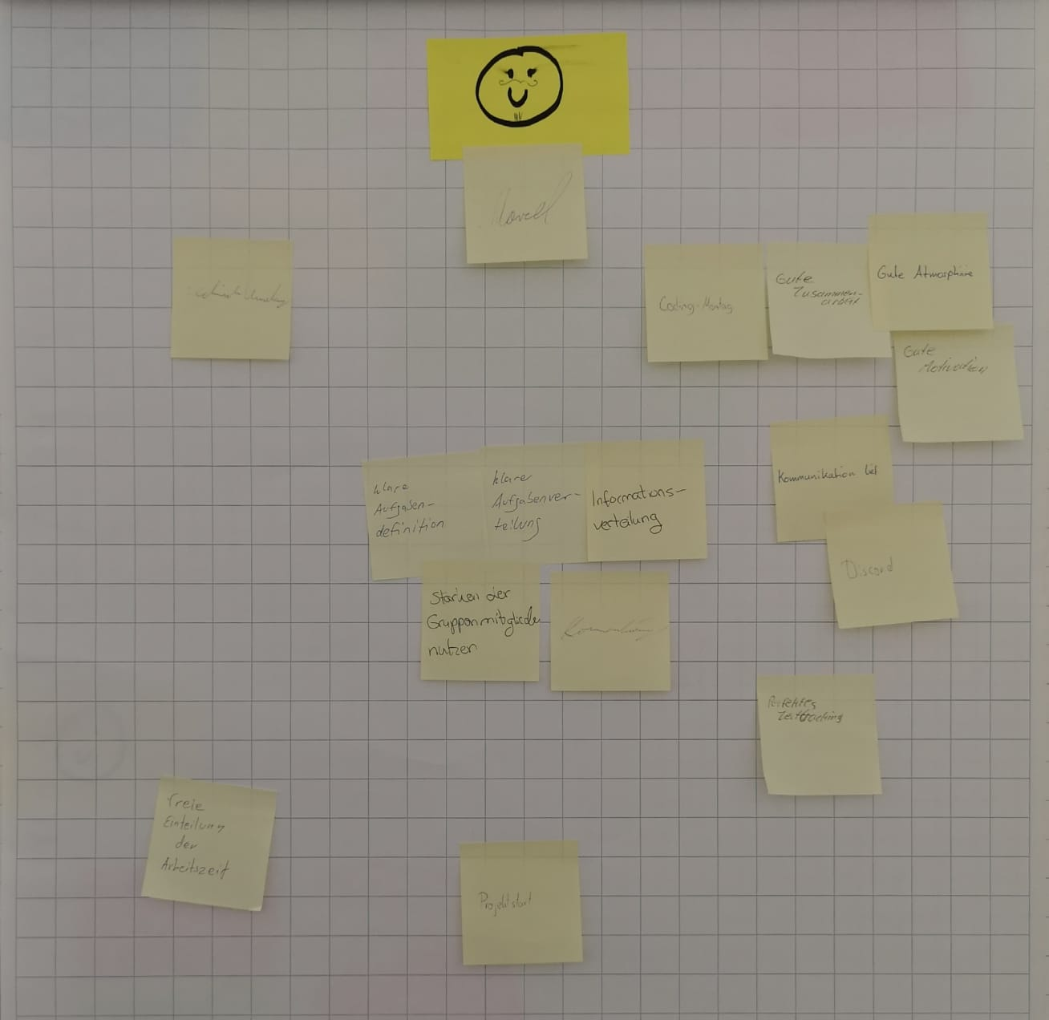
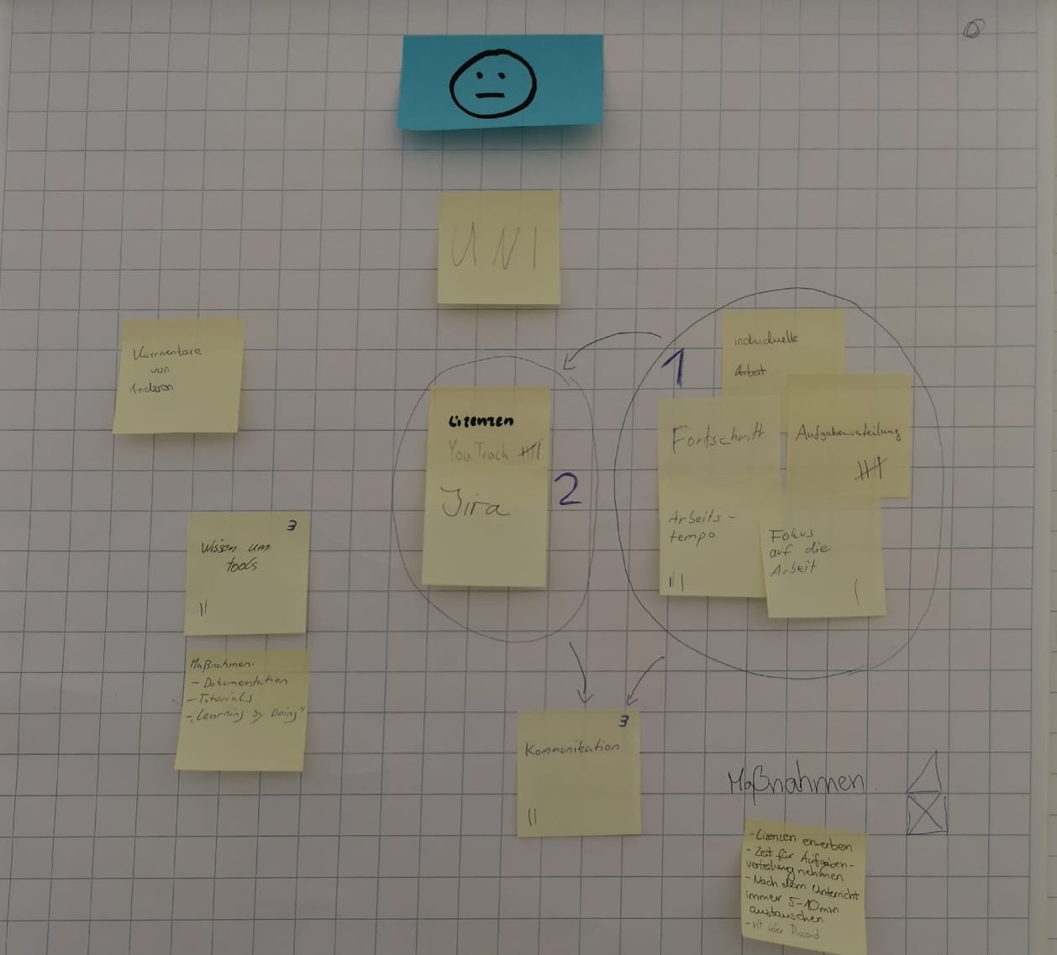
Scrumming
Old:
New:
Server is not reliable
Better task management for each teammember
poor timemanagement
poor time estimation
dividing tasks more clearly

