Slide 2
Table of contents
Vision
Project Methodology

Slide 3
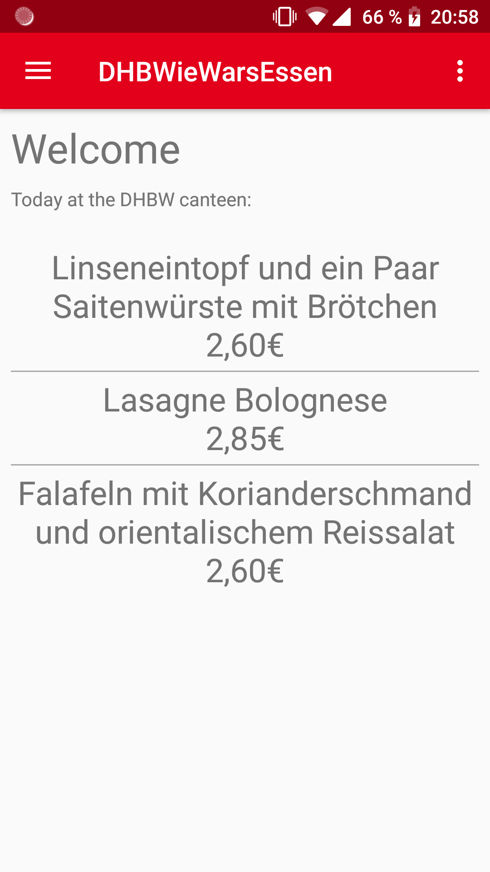
Extend of functionality
Register, Login, Register
View meals for current day
Create rating
Delete rating
Show all ratings
Show user ratings
Save preferences (Login)

Slide 4
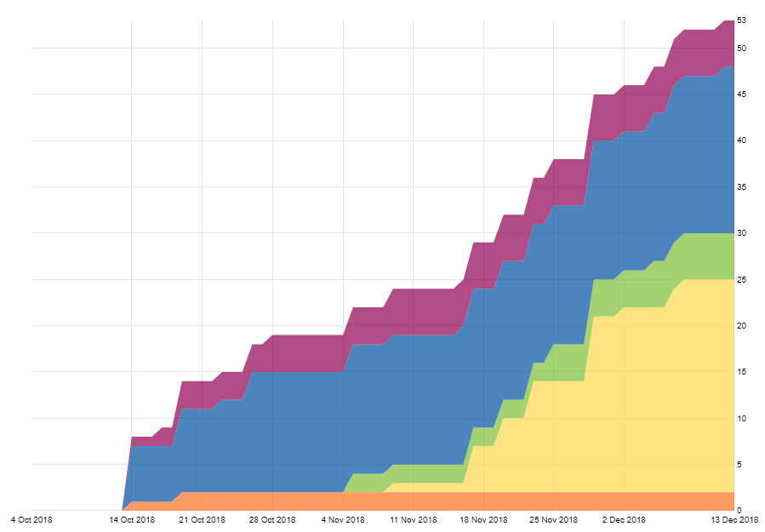
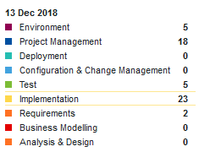
Iterative Process
Working in sprints consisting of tasks
Scrum tasks work towards sprint goal

