Slide 2
Table of contents
Vision
Project Methodology
Project Management
Scrumming
Iterative Process
Demo
Extend of functionality
Class Diagram

Slide 3
Table of contents
Architecture
Automation
Testing – Cucumber

Slide 4

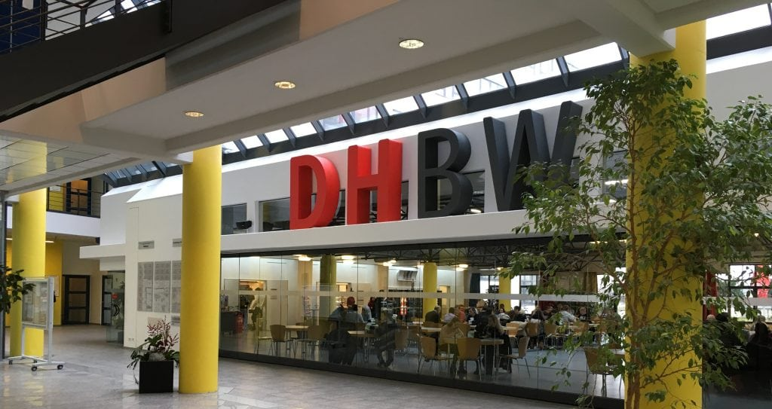
Vision
Rating with stars (0 - 5)
Comments (always keep the price in mind!)
Correcting or deleting?
What happens when you‘re not logged in?
What should I eat?

Slide 5

Project Methodology
Scrum
Break down project into Usecases
Iterative Process
Agile
Our Tool: YouTrack
  Transparency
  Time Tracking

Slide 6
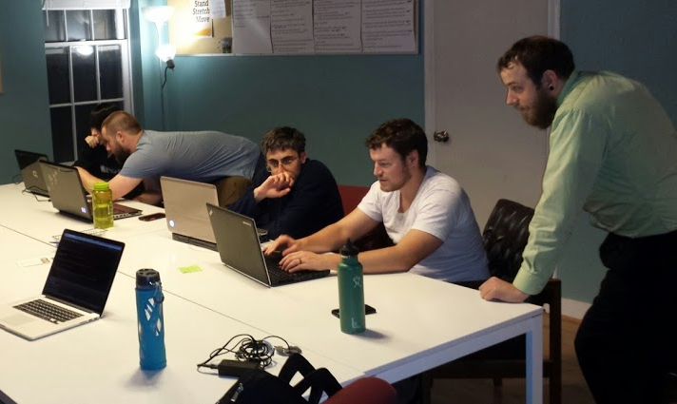

Projektmanagement
Clear who does what
Time tracking in Android Studio
Version control with github
Discord combines everything and enables better communication

Slide 7
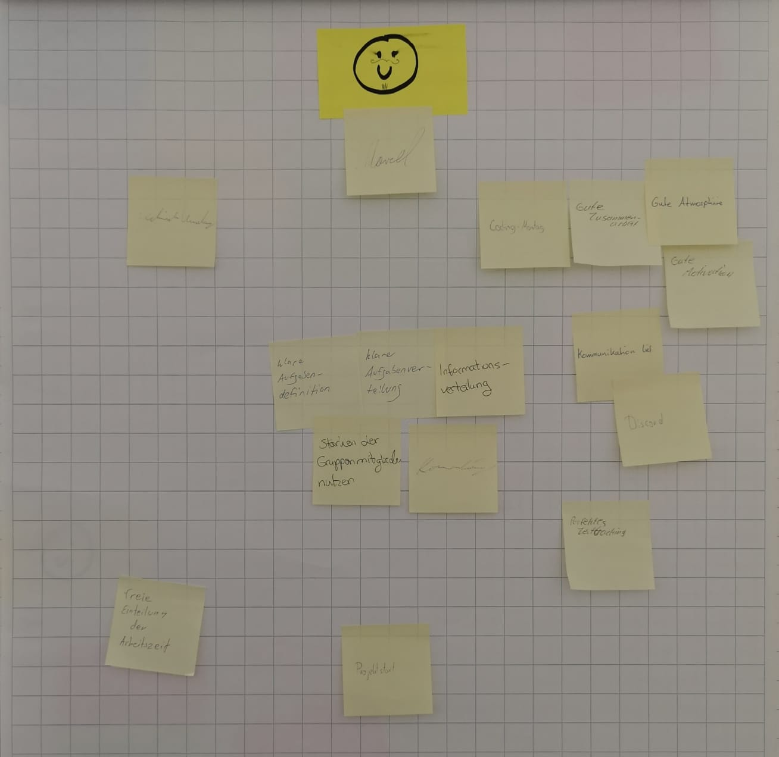
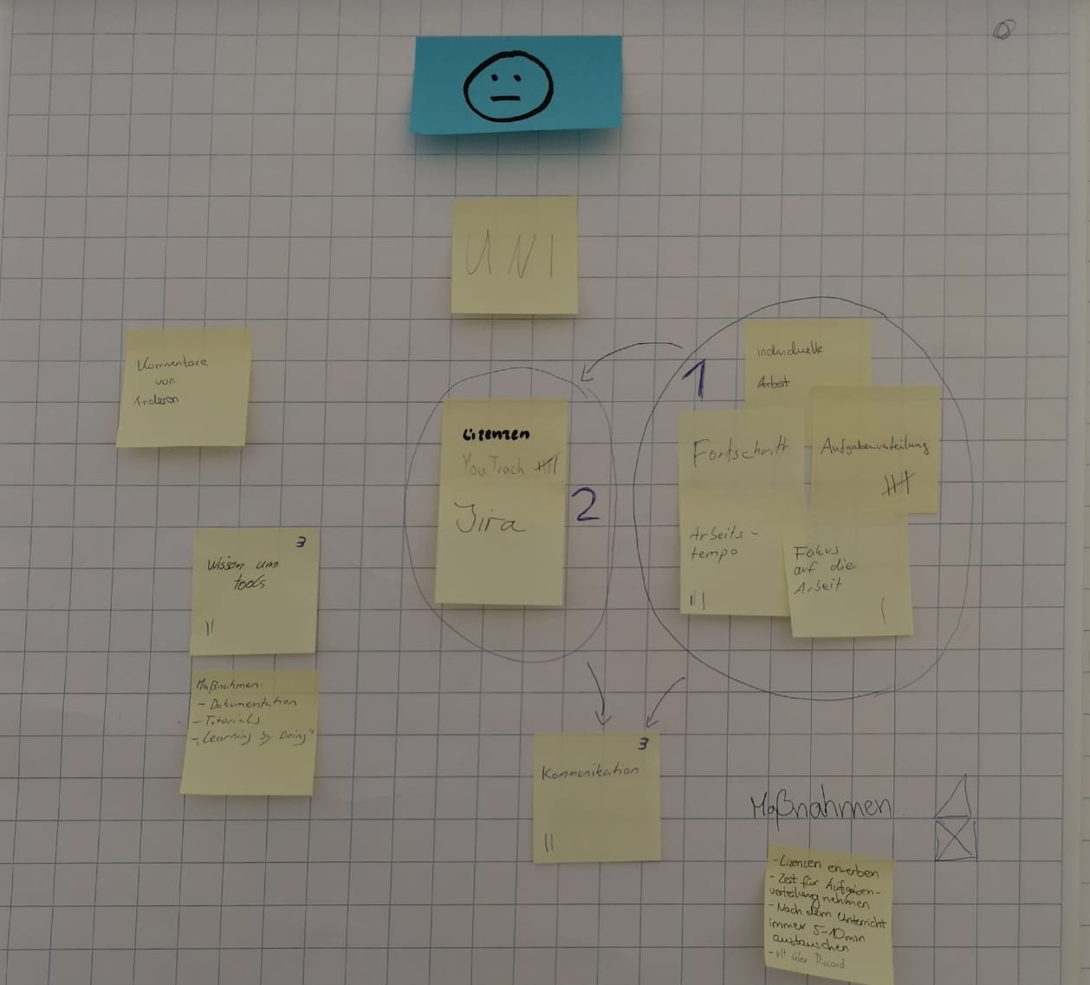
Scrumming
Old:
New:
Server is not reliable
Better task management for each teammember
poor timemanagement
poor time estimation
dividing tasks more clearly

Slide 8
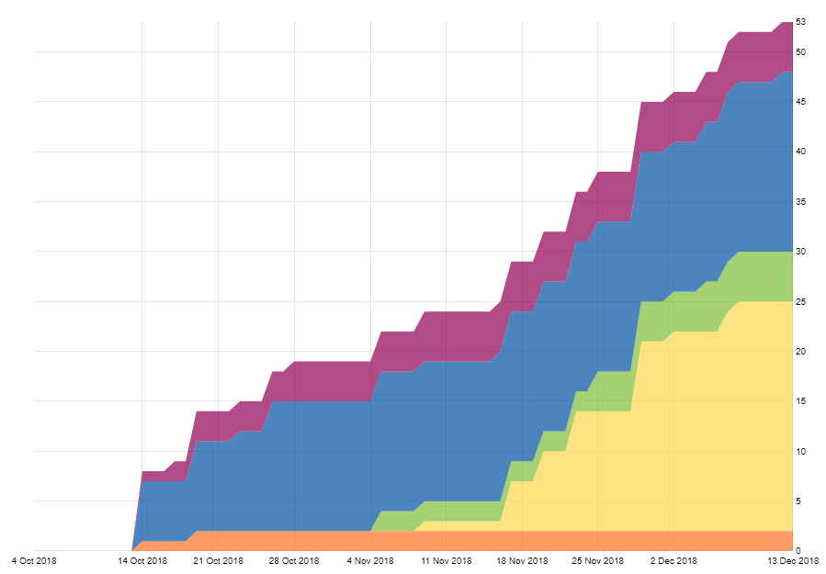
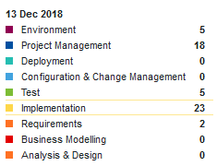
Iterative Process
Working in sprints consisting of tasks
Scrum tasks work towards sprint goal

Slide 9
Demo

Slide 10
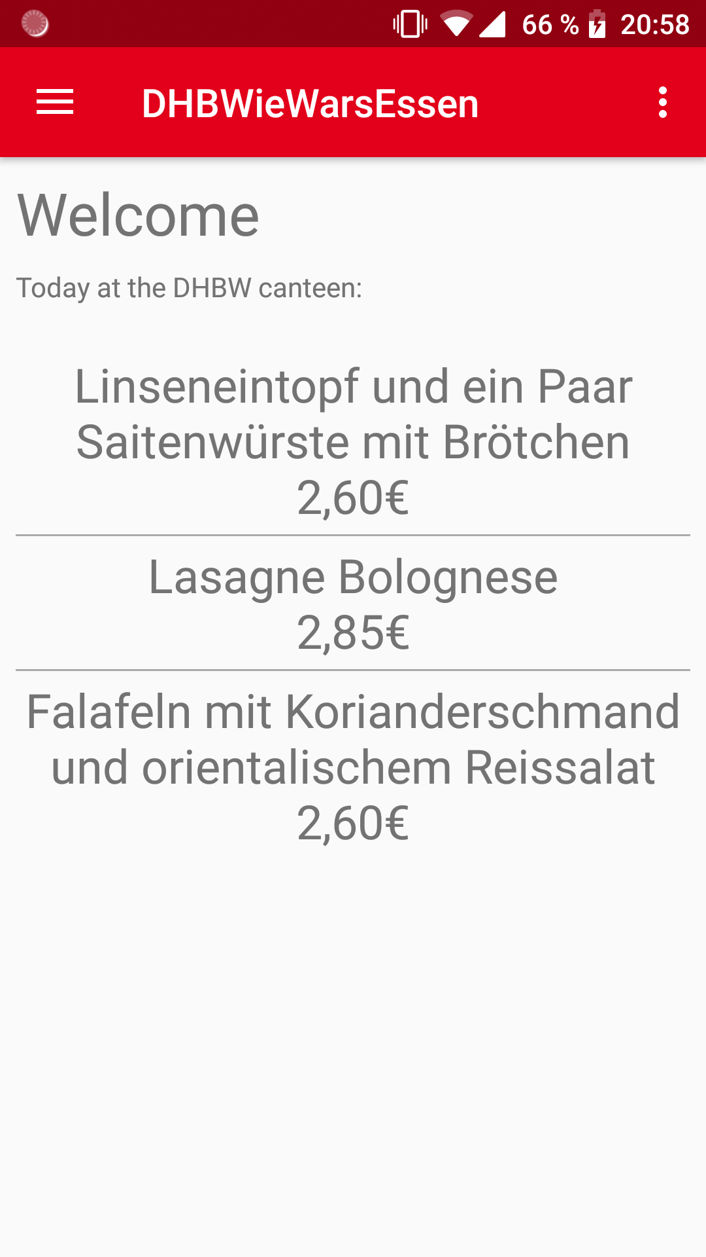
Extend of functionality
Register, Login, Register
View meals for current day
Create rating
Delete rating
Show all ratings
Show user ratings
Save preferences (Login)

Slide 11
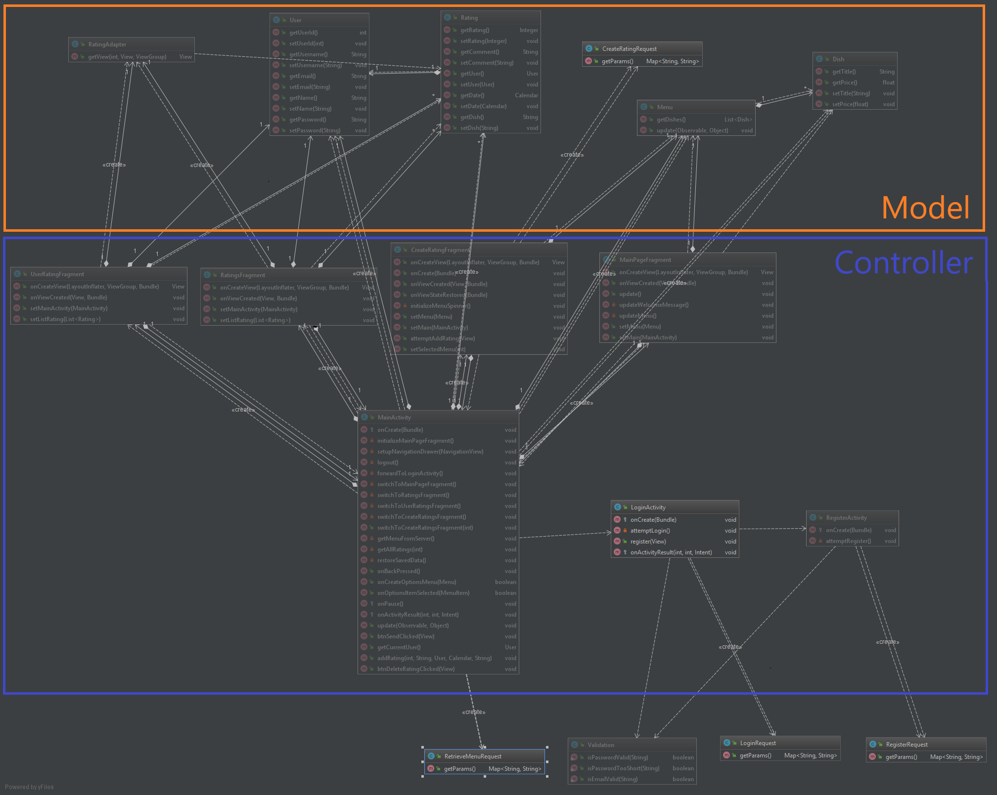
Class Diagram

Slide 12
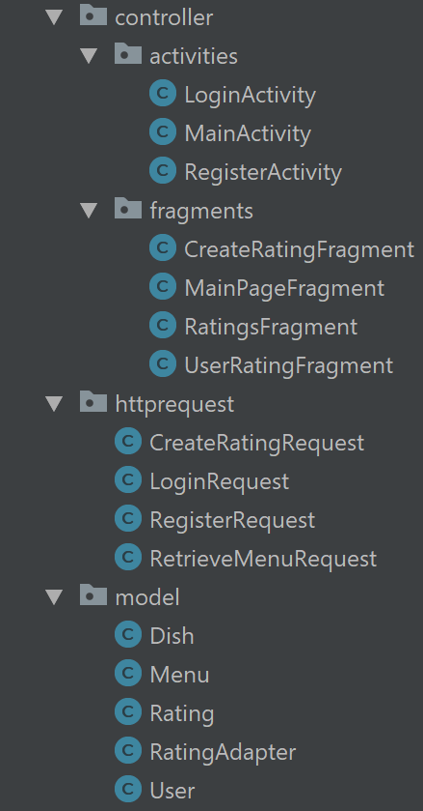
Architecture
Model-View-Controller
View is in the layout package

Slide 13
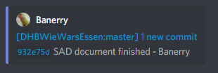
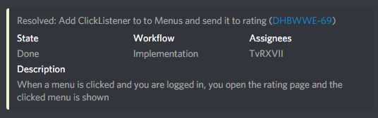
Automation
Discord
  Used as Communication
  Automation by Discord-Bots:
    Github push-notifications
    Youtrack push-notifications

Slide 14
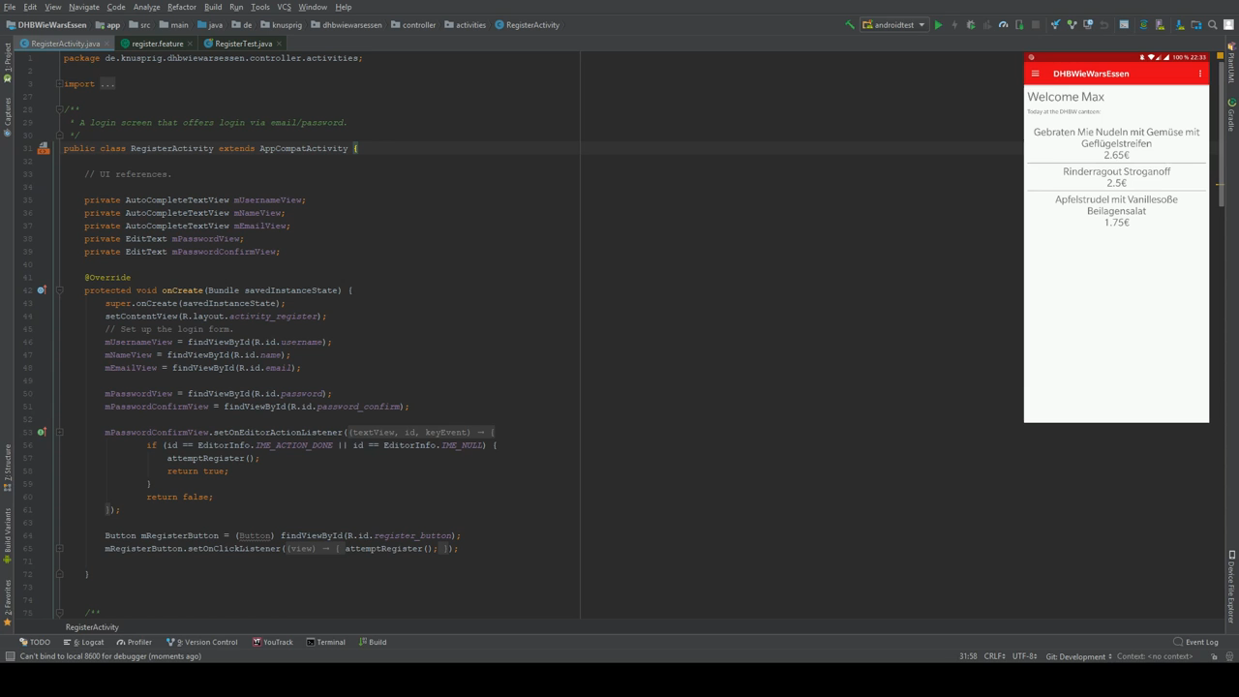
Testing – Cucumber

Slide 15

Any questions?

Slide 16
Thank you for your attention

