Slide 2
Table of contents
Vision
Project Methodology

Slide 3

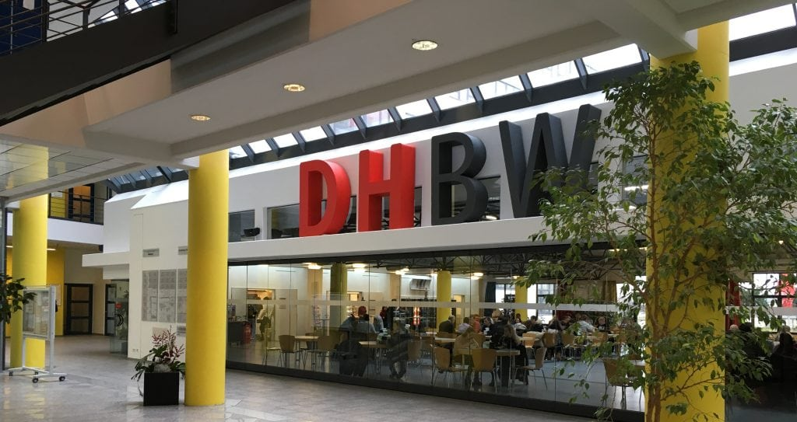
Vision
Rating with stars (0 - 5)
Comments (always keep the price in mind!)
Correcting or deleting?
What happens when you‘re not logged in?
What should I eat?

Slide 4
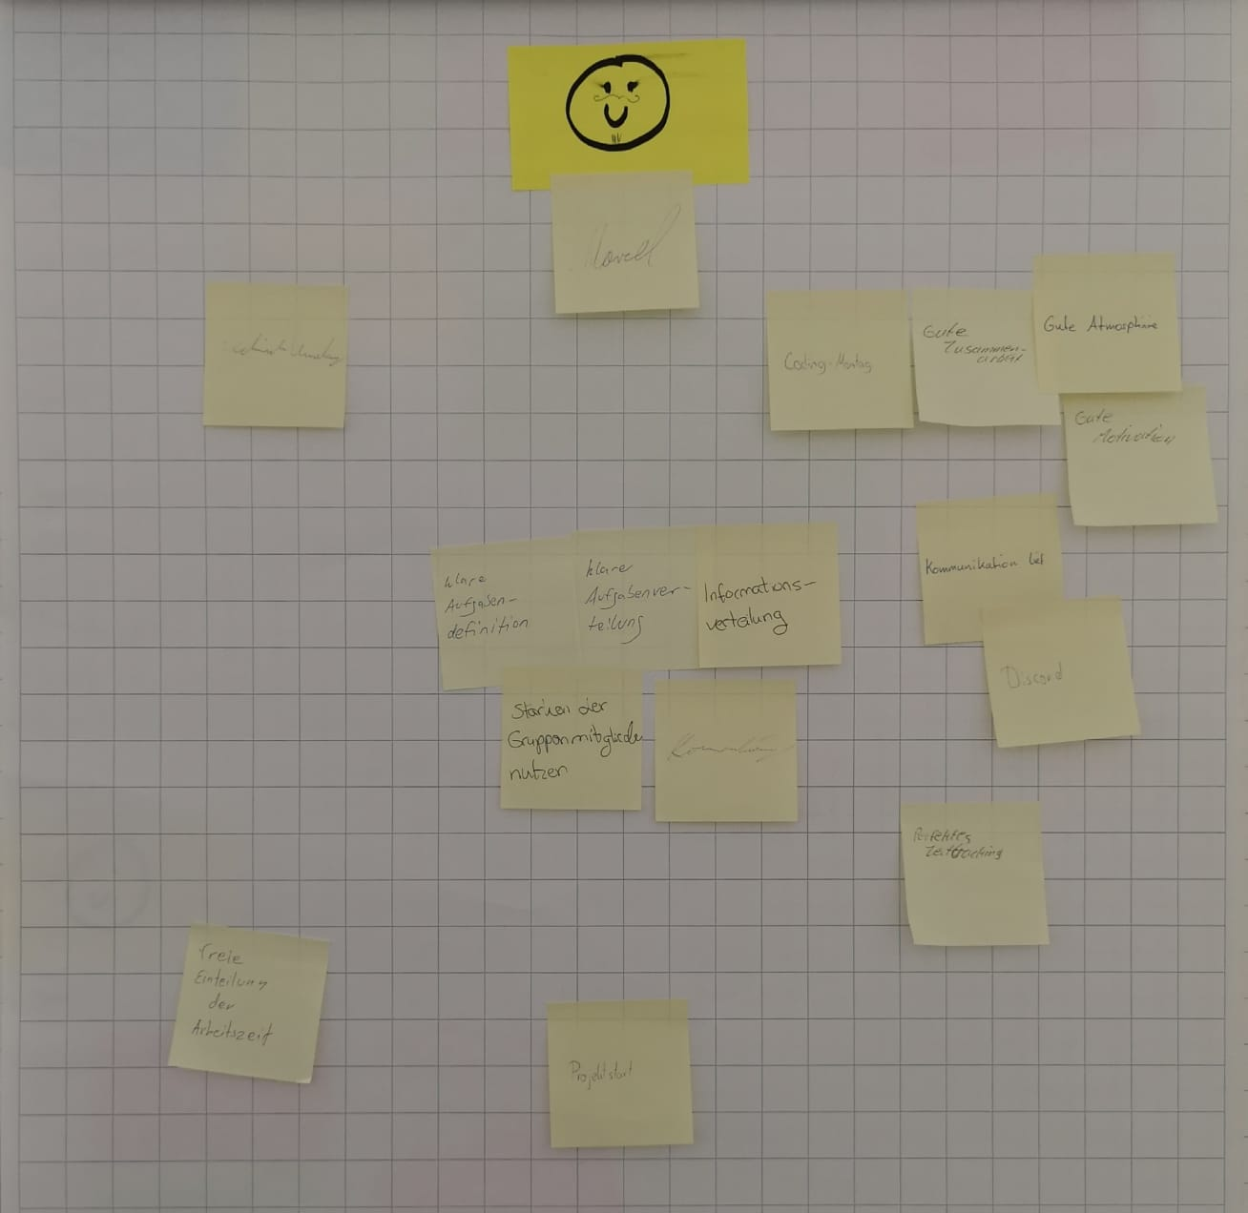
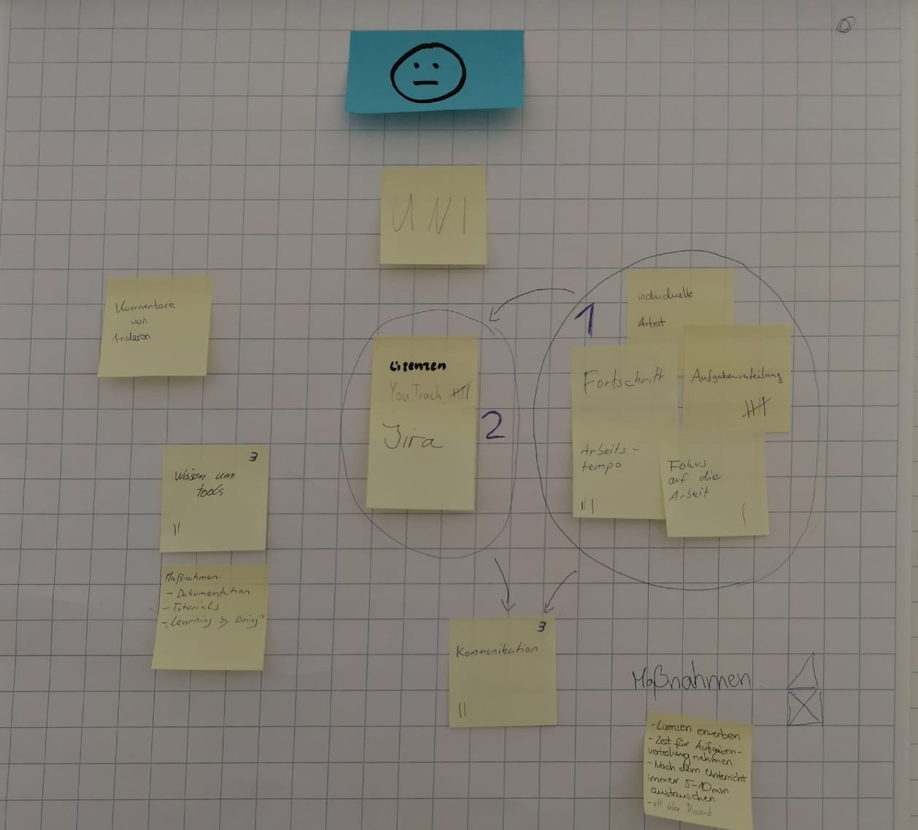
Scrumming
Old:
New:
Server is not reliable
Better task management for each teammember
poor timemanagement
poor time estimation
dividing tasks more clearly

