Slide 2
Table of contents
Vision
Project Methodology
Project Management
Scrumming
Iterative Process
Cost Estimation
Extend of functionality
Demo

Slide 3
Table of contents
Architecture
Automation
Testing
Risk Management
Patterns
Metrics

Slide 4

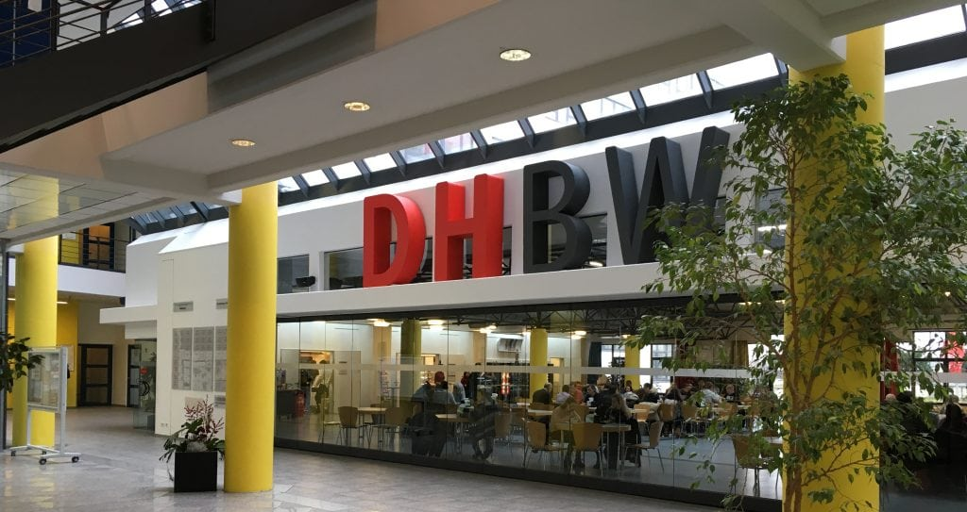
Vision
Rating with stars (0 - 5)
Comments (always keep the price in mind!)
Correcting or deleting?
What happens when you‘re not logged in?

Slide 5

Project Methodology
Scrum
Agile
Break down project into Usecases
Iterative Process
Our Tool: YouTrack
Transparency
Time Tracking

Slide 6
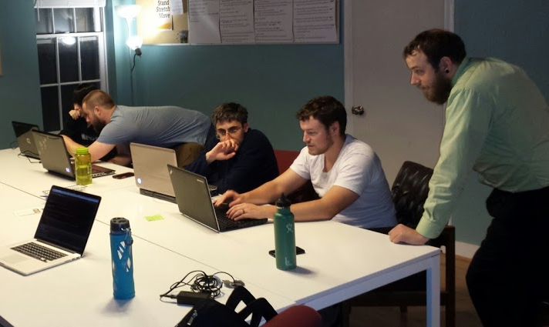

Projektmanagement
Clear who does what
Time tracking in Android Studio
Version control with github
Discord combines everything and enables better communication

Slide 7
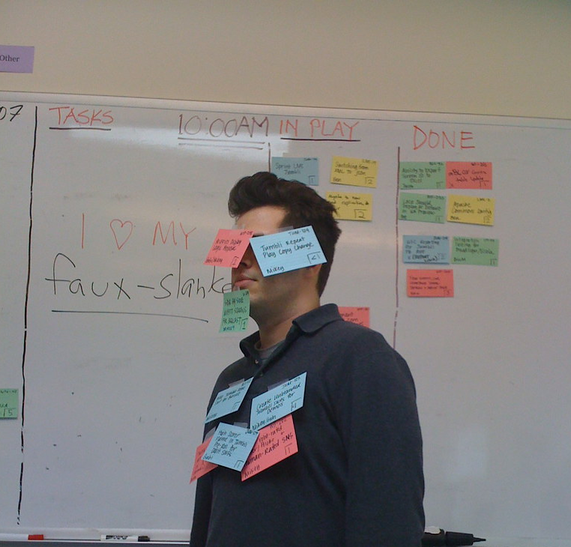
Scrumming
Former Problems (First Retro)
Current Situation (Second Retro)
Time distribution
Unstable Server
Dividing Task was unclear
Better time distribution through YouTrack
Team roles are better organized
Changed Server
Communication with other groups

Slide 8
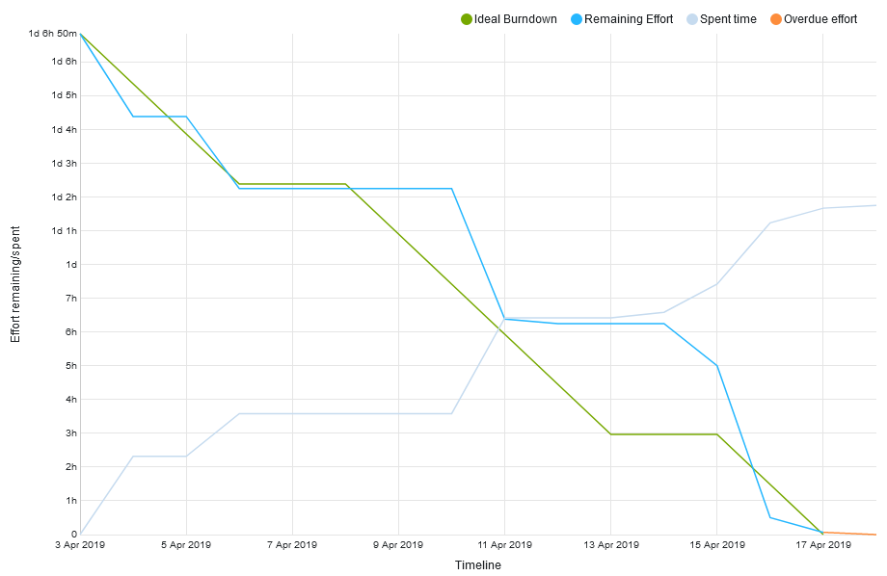
Iterative Process
Working in sprints consisting of tasks
Scrum tasks work towards sprint goal
Burndown-Diagram shows progress in current sprint

Slide 9
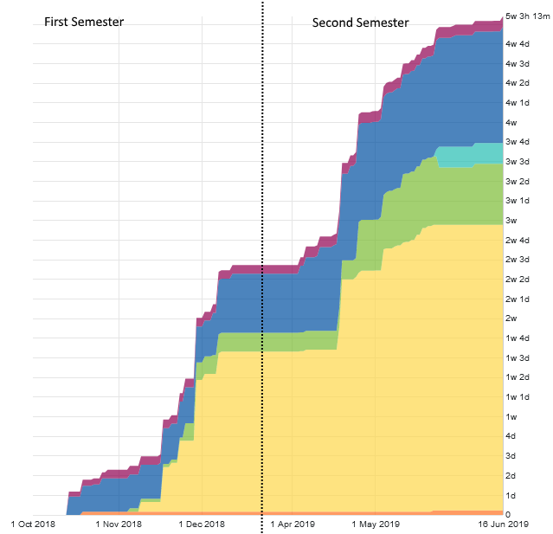
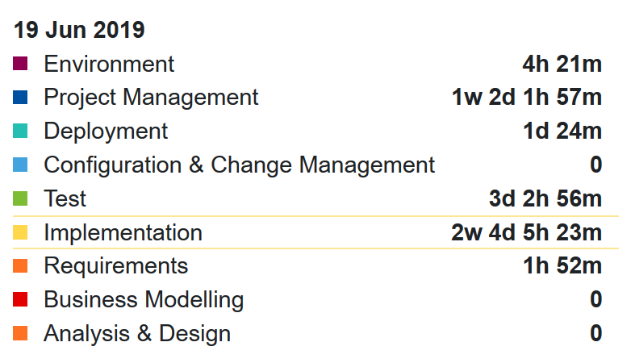
Cumulative Flow Diagram
Time spent on each Workflow

Slide 10
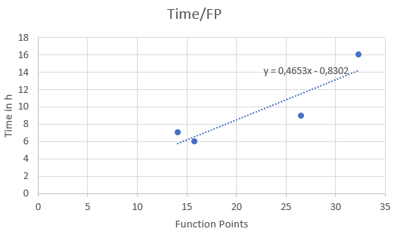
Cost-Estimation
Function Points calculated for each UC
Time-Estimation based on time spent in previous Semester

Slide 11

Cost-Estimation
FP-Estimation based on Calculator
Time-Estimation based on time spent in previous Semester

Slide 12
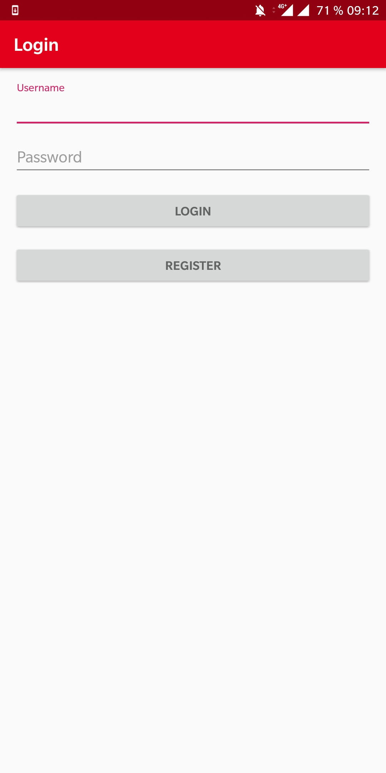
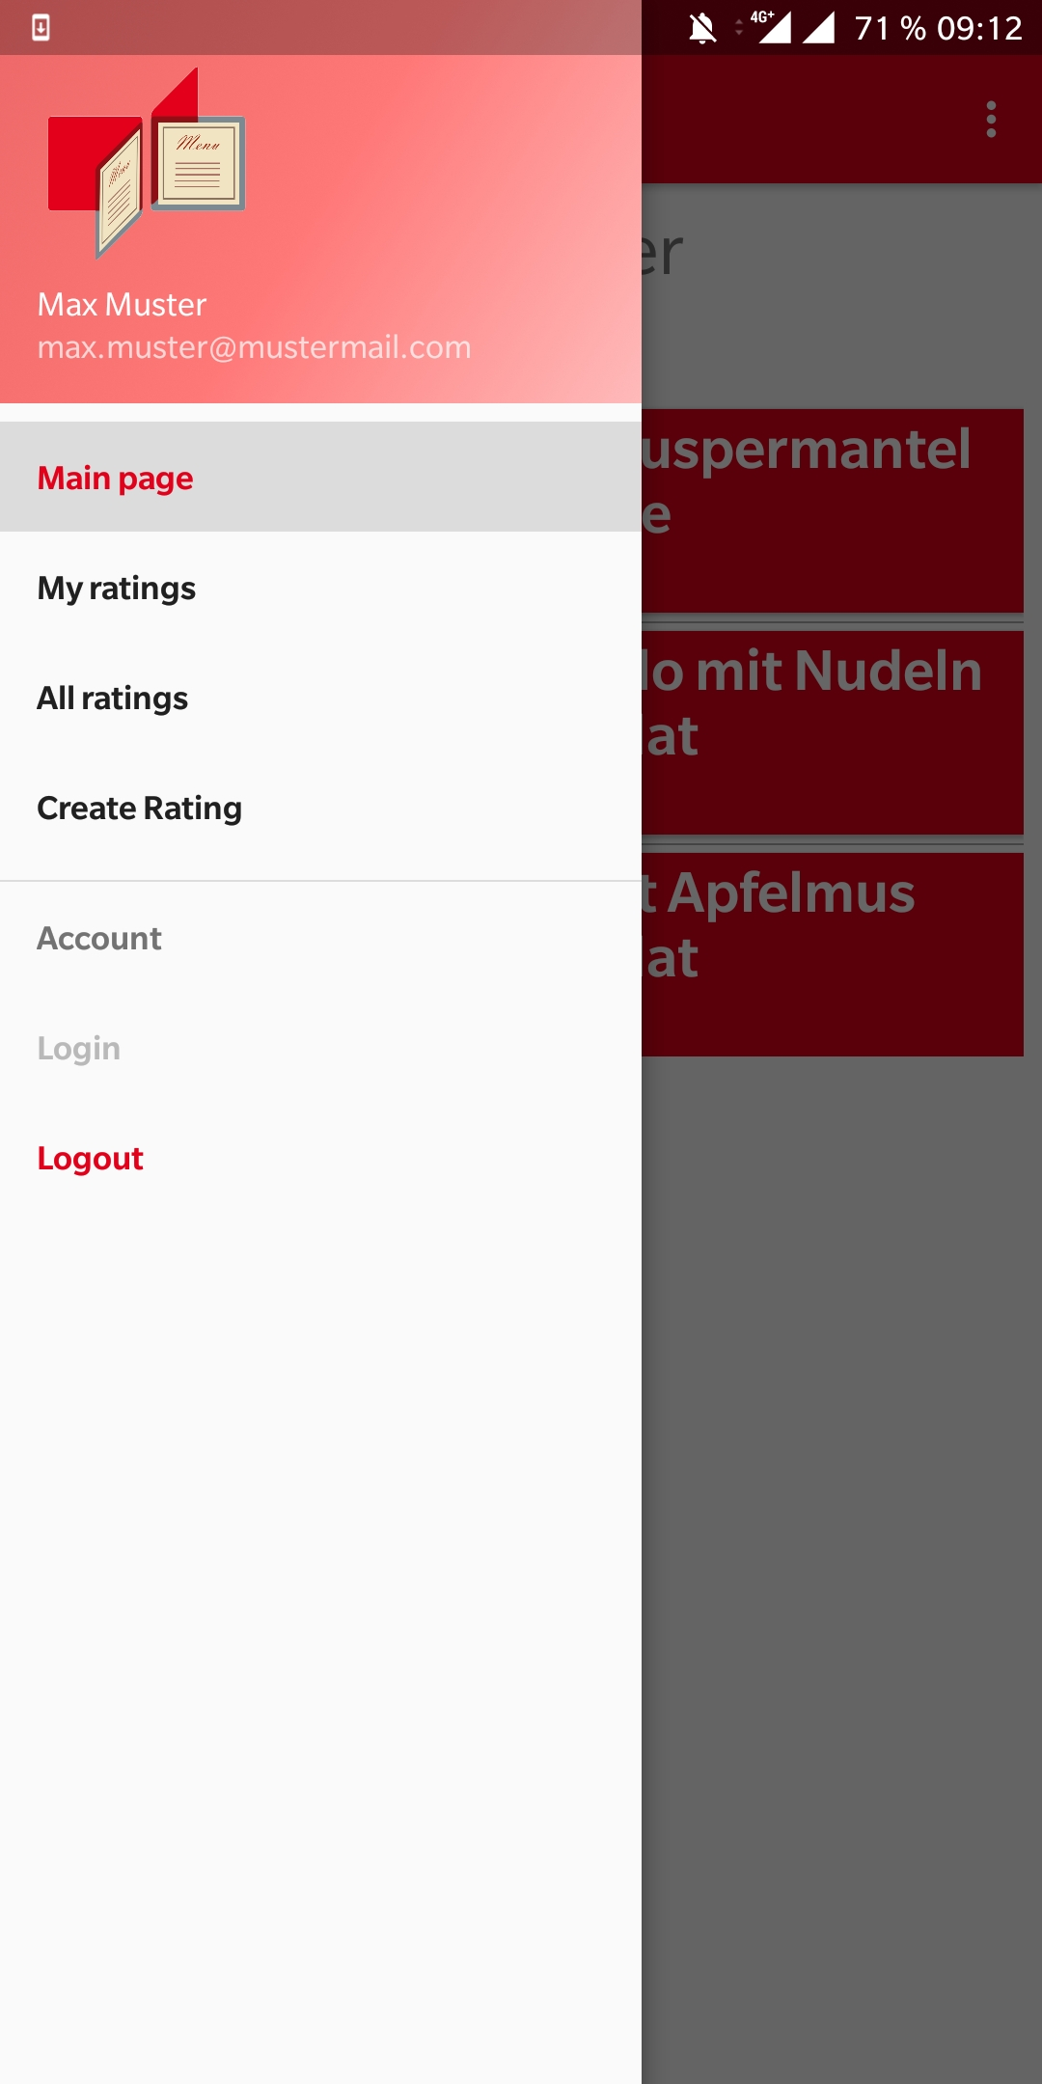
Extend of functionality
Register, Login, Logout

Slide 13
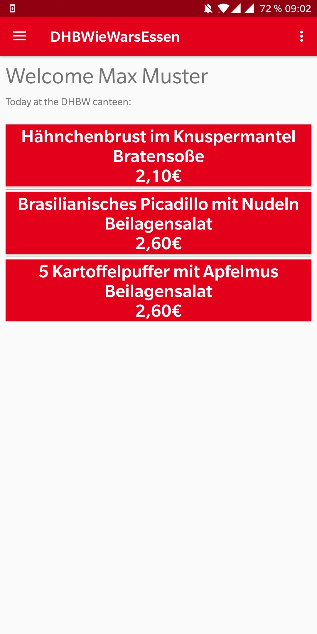
Extend of functionality
Register, Login, Logout
Show meals for current day

Slide 14
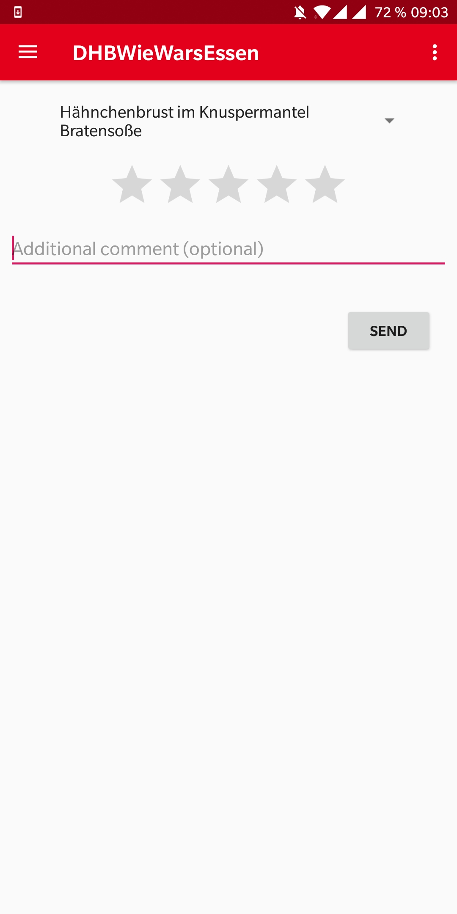
Extend of functionality
Register, Login, Logout
Show meals for current day
Create rating

Slide 15
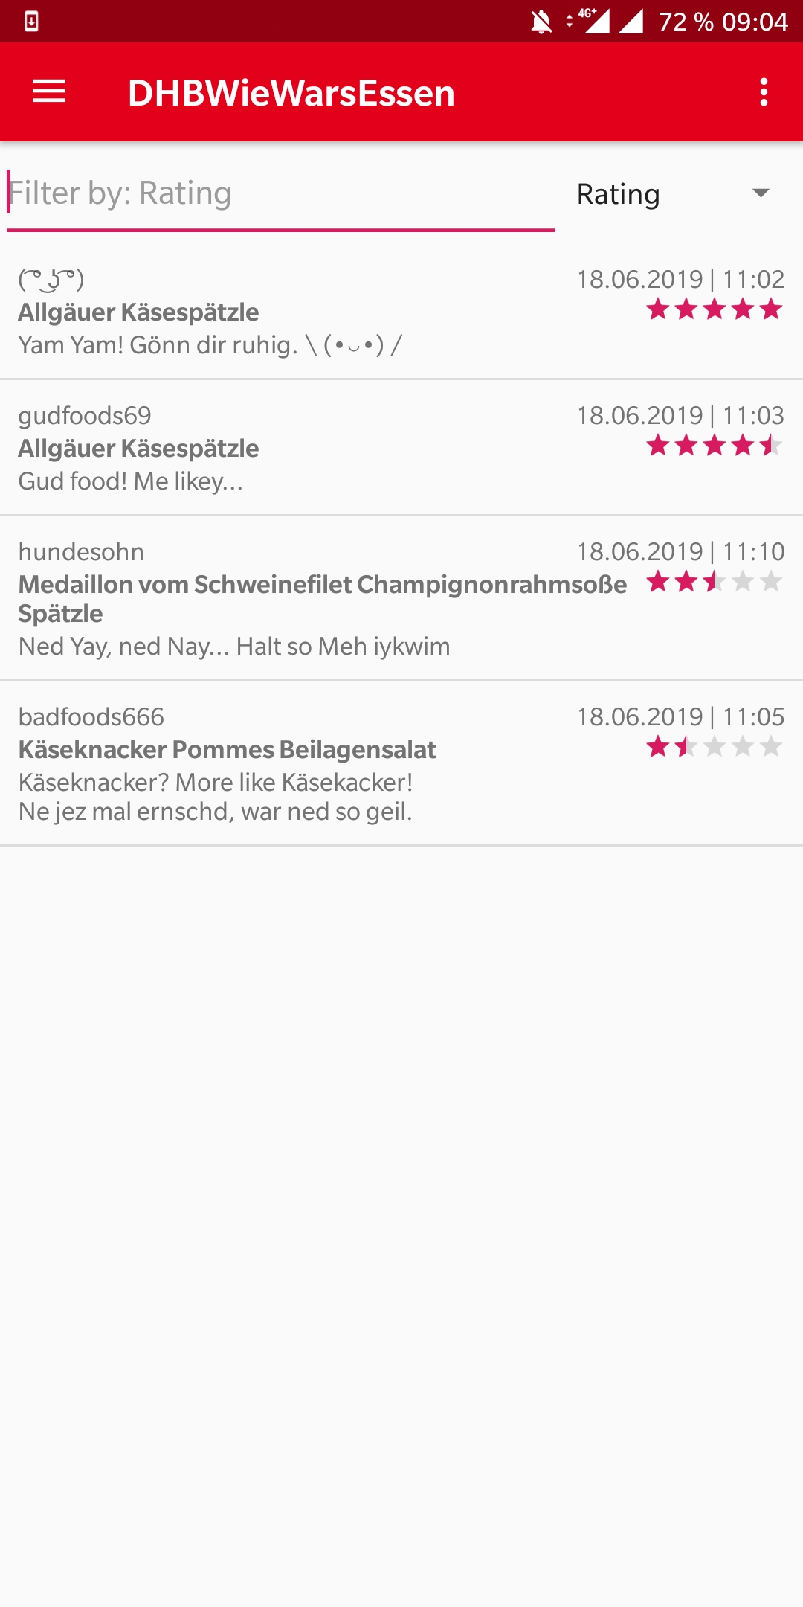
Extend of functionality
Register, Login, Logout
Show meals for current day
Create rating
Show all ratings

Slide 16
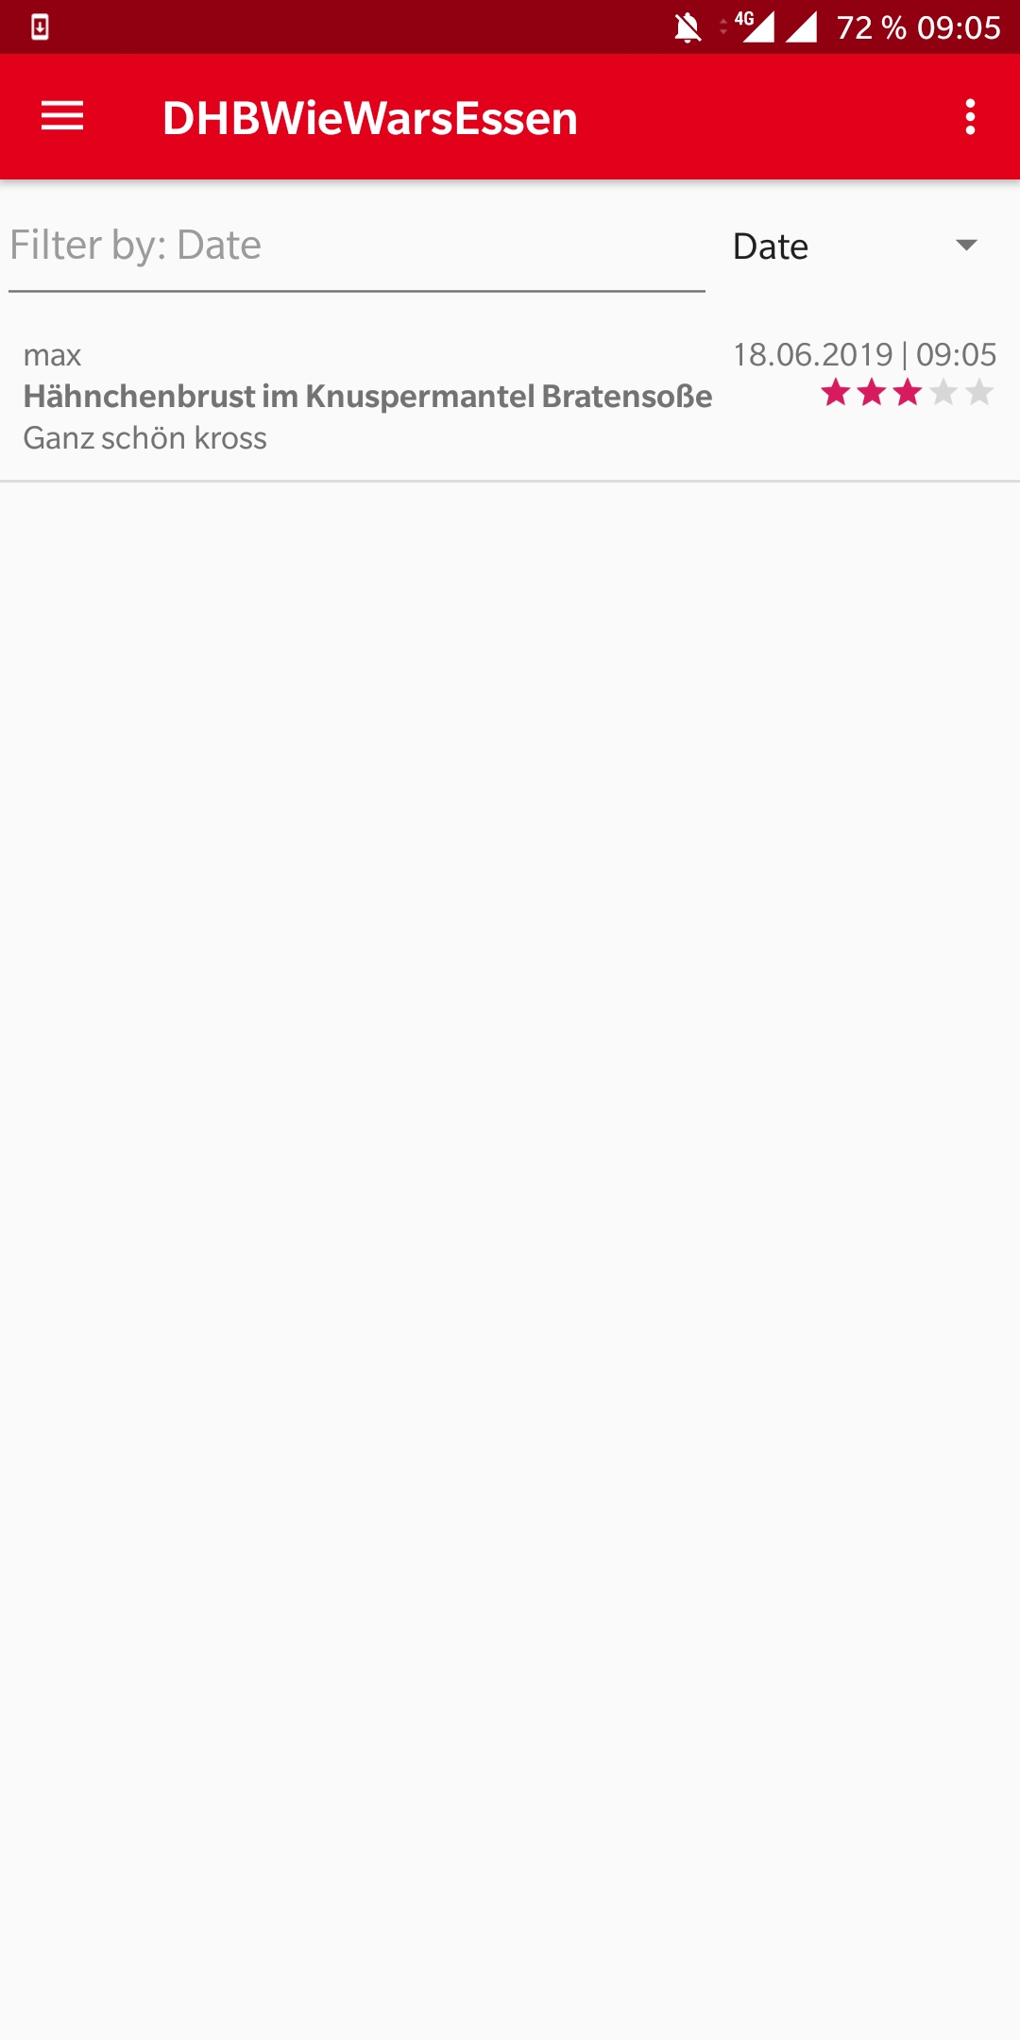
Extend of functionality
Register, Login, Logout
Show meals for current day
Create rating
Show all ratings
Show own ratings

Slide 17
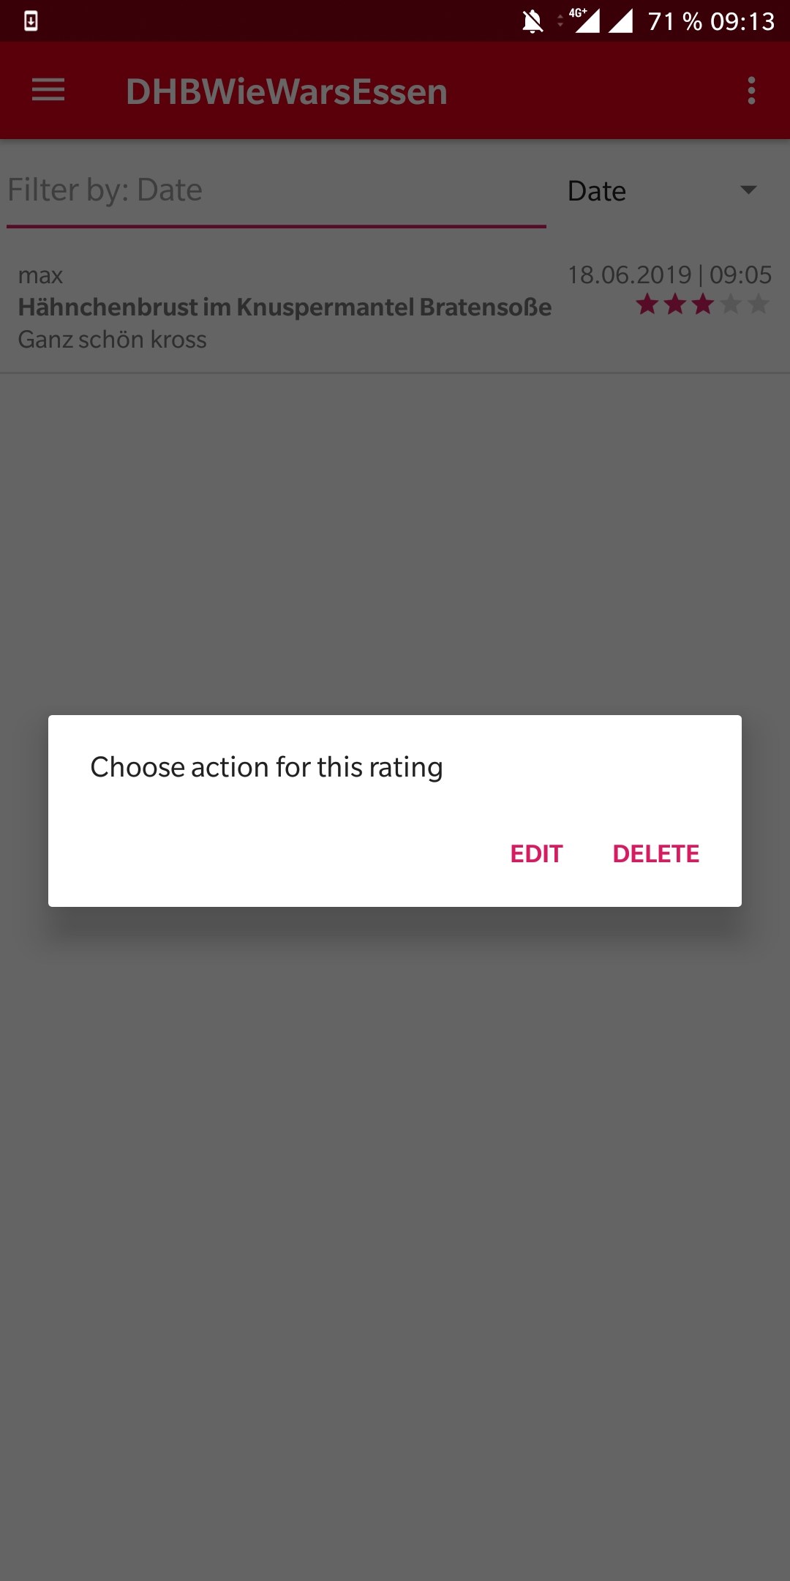
Extend of functionality
Register, Login, Logout
Show meals for current day
Create rating
Show all ratings
Show own ratings
Edit/Delete ratings

Slide 18
DEMO

Slide 19
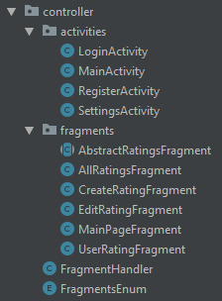
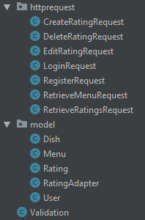
Architecture
Model-View-Controller
View is in the layout package

Slide 20
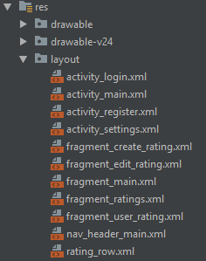
Architecture
Model-View-Controller
View is in the layout package

Slide 21
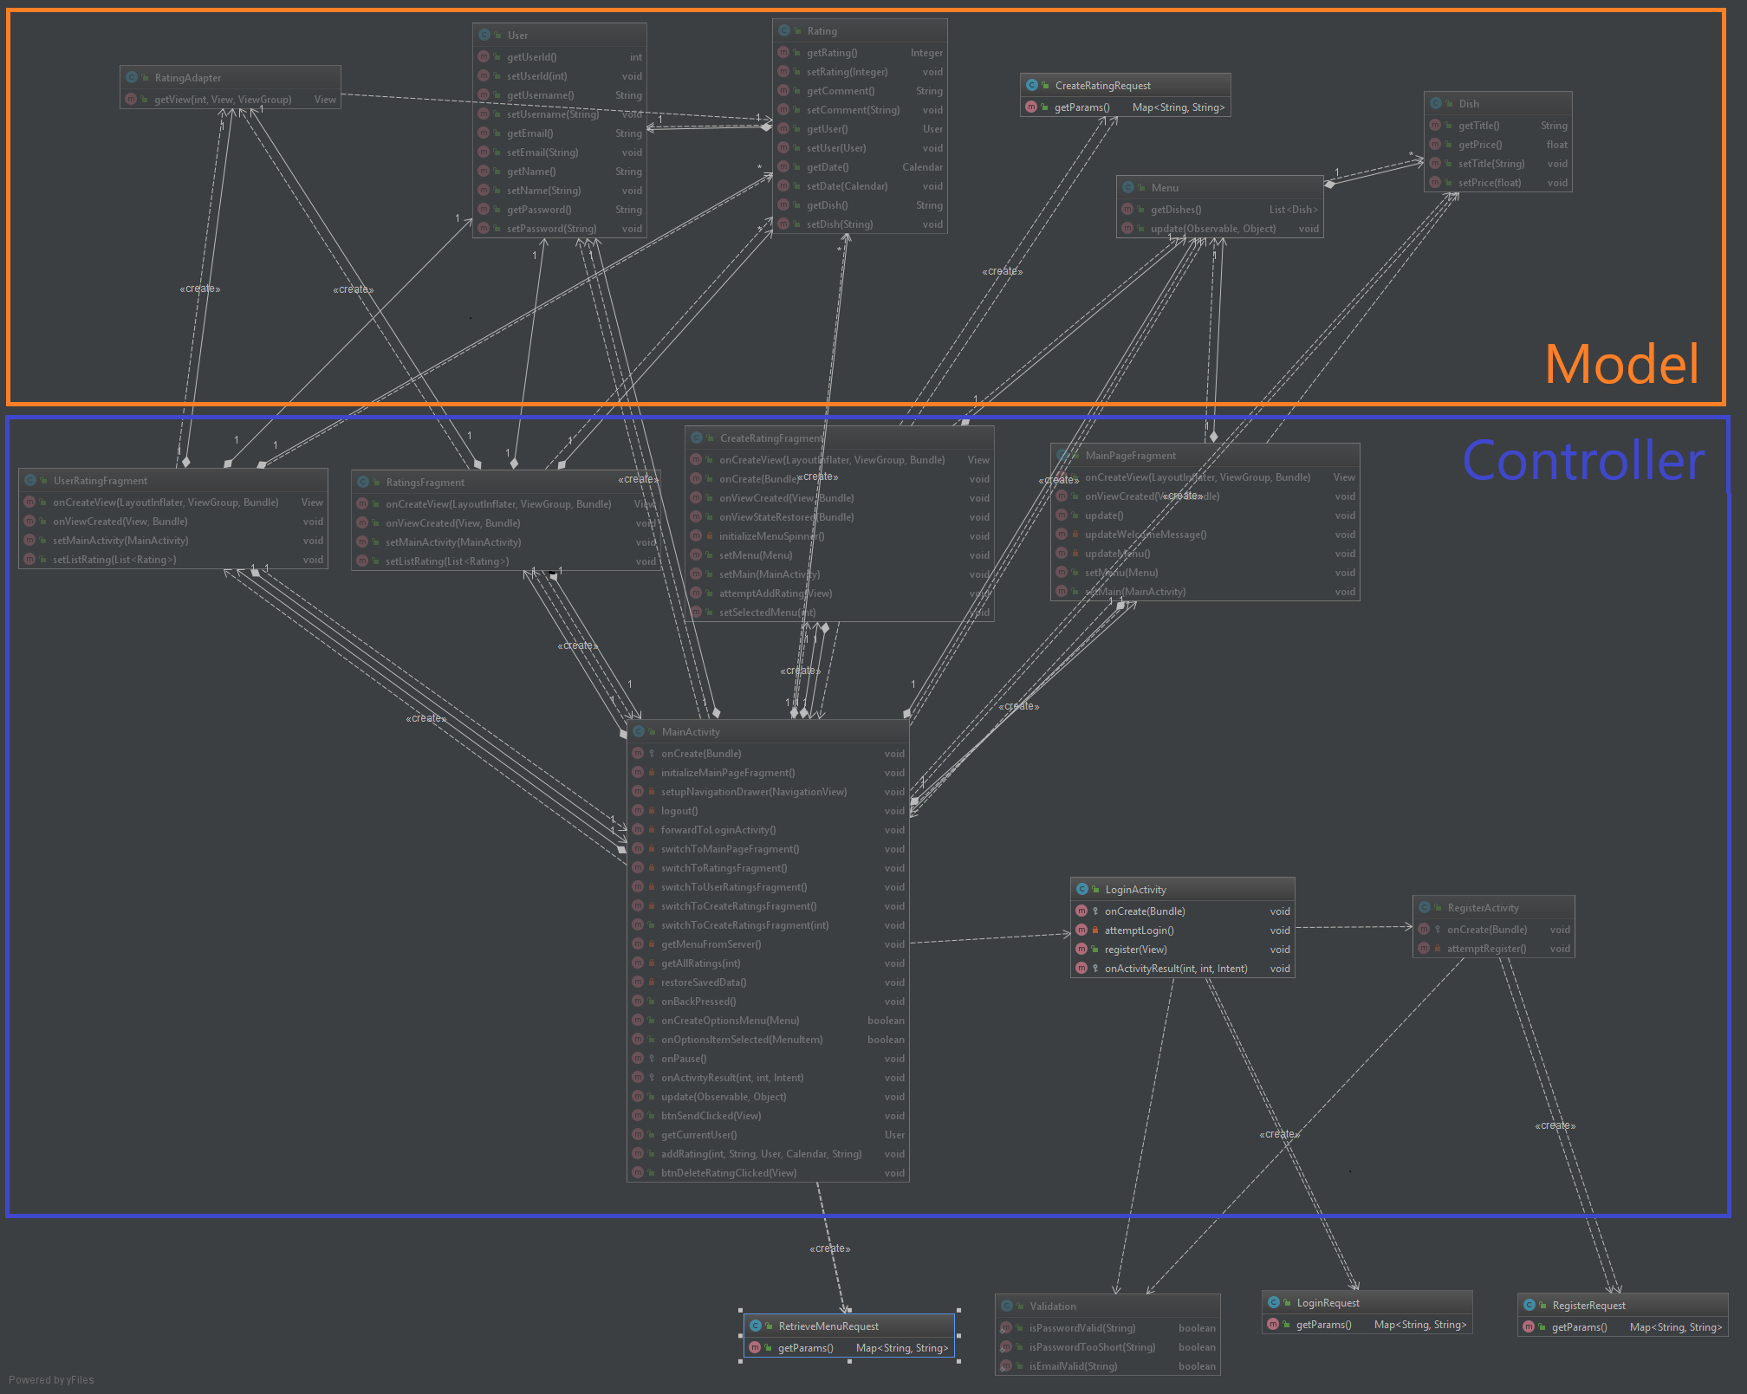
Class Diagram

Slide 22
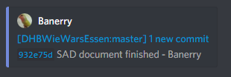
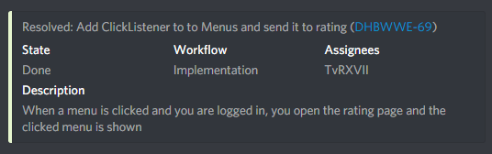
Automation
Discord
Used as Communication
Automation by Discord-Bots:
Github push-notifications
Youtrack push-notifications

Slide 23

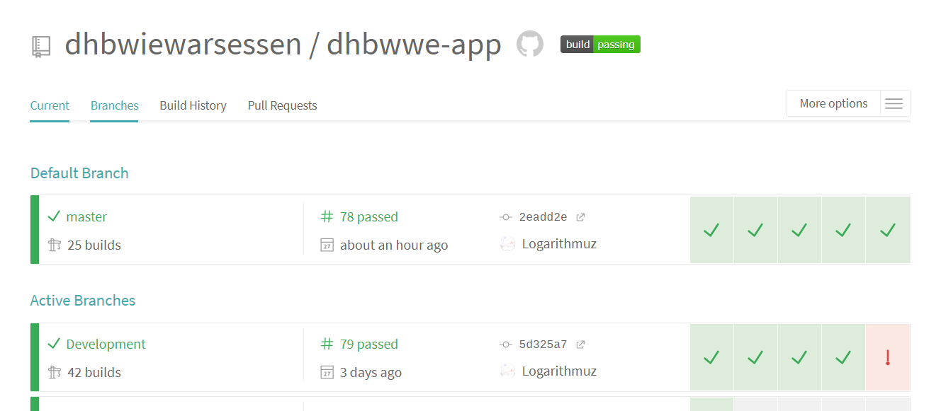
Continuous Integration

Slide 24
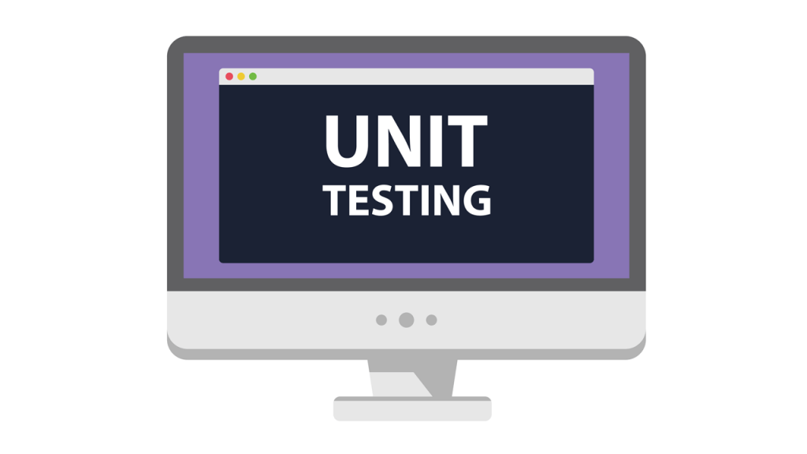
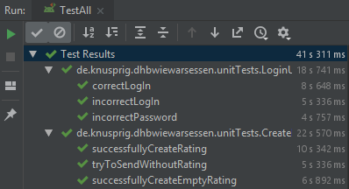

Automated Unit Tests

Slide 25
Cucumber Tests
We had to remove the video from the presentation for git, you can find it here:
https://youtu.be/86zfUB4FoFc

Slide 26
Risk Management
Listed possible Risks
Calculated Risk factor (Prob. Of occurrence * Damage)
Planned a mitigation strategy
Assigned a person in charge

Slide 27
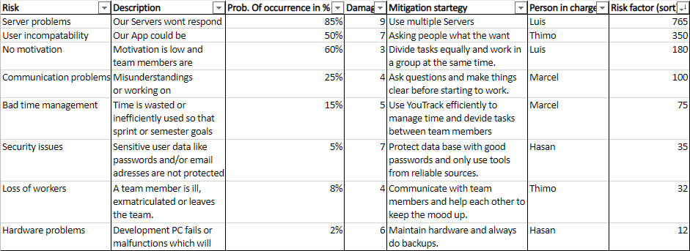
Risk Management

Slide 28
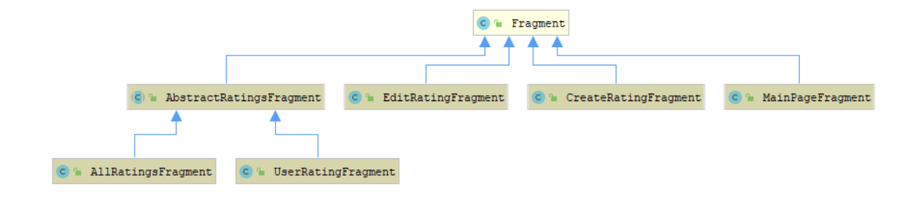
Patterns
Used "template" pattern
Avoids duplicate code
Easy code maintenance

Slide 29

Metrics
SonarQube for Metrics
Android Studio plugin "Metrics Reloaded"
Shows problematic methods with numbers
The higher the number bigger the problem
RFC: class has high responsibility
WMC: the contained methods are complex

Slide 30
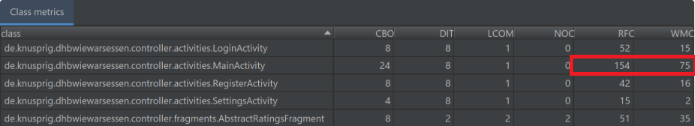
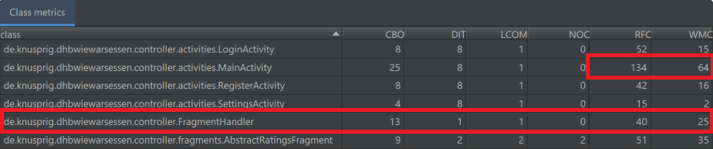
Metrics - Before & After

Slide 31

Any questions?

Slide 32
We had to remove the video from the presentation for git, you can find it here:
https://youtu.be/Sf5BmsZEIxA
Teaser Video

