Slide 1
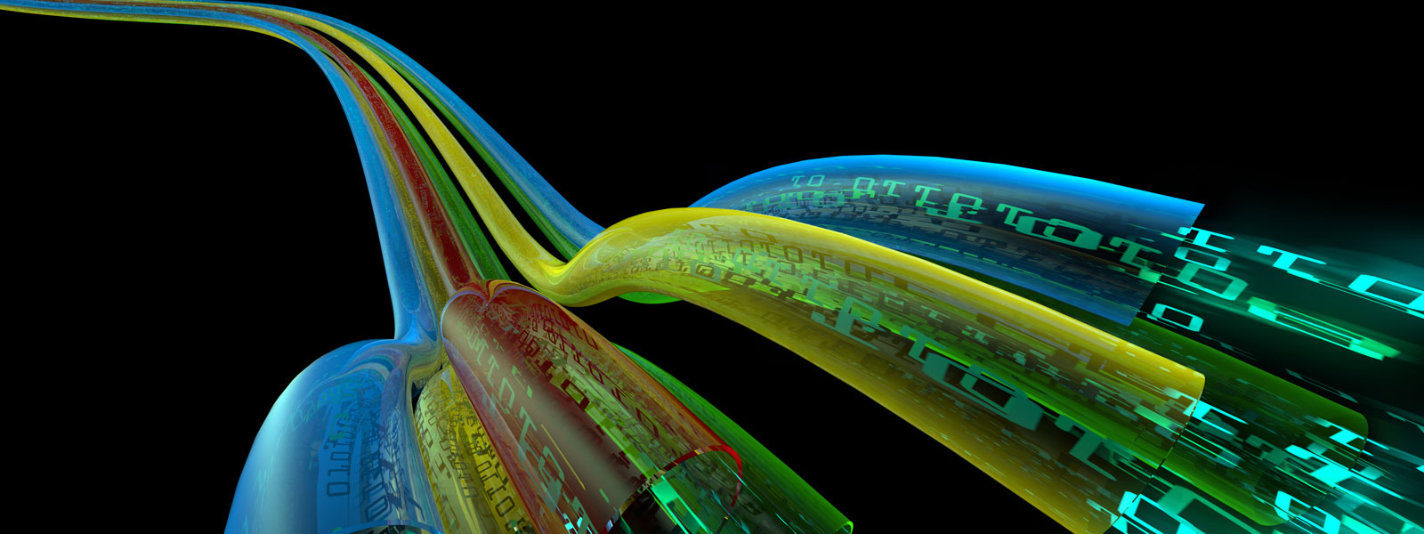
Link Layer Addresses Assignment Mechanism for DHCPv6
IEEE
Monday, 21 May 2018
Tomek Mrugalski
Bernie Volz
IETF draft-bvtm-dhc-mac-assign
Last Edit: 2018-05-16 12:50 ET (BV)
IETF-101 DHC WG

Slide 2
Background (1/2)
RFC 7241 defines cooperation between IEEE 802 and IETF and there are periodic discussions
IEEE 802c split “local” MAC address space into 4 quadrants to provide for different allocation schemes
IEEE 802cq is working on defining allocation mechanisms
Several from IETF leadership (Ralph Droms, Russ Housley, Suresh Krishnan) thought that DHCPv6 might be usable as a MAC address allocation (802cq) mechanism

Slide 3
Background (2/2)
Ralph Droms (IETF) reached out to Bernie Volz (IETF DHC WG co-chair)
Tomek Mrugalski (other IETF DHC WG co-chair) and Bernie discussed and decided to work on issue
Hence, the new I-D: draft-bvtm-dhc-mac-assign
More background about 802c/cq in Pat Thaler’s “Emerging IEEE 802 Work on MAC Addressing” slides from IETF-96 (https://datatracker.ietf.org/meeting/96/materials/slides-96-edu-ieee802work-0/)

Slide 4
Why Not Randomly Assign?
Number of tries | Possible combinations | Collision chance | No collision chance
23 people | 365 days | 49,95% | 50,05%
1024 VMs | 2²⁴ (One OUI) | 3,07% | 96,93%
4824 VMs | 2²⁴ (One OUI) | 50,01% | 49,99%
1M VMs | 2⁴⁴ (Local address quadrant) | 3,08% | 96,92%
1M VMs | 2⁴⁶ (“I know better than IEEE”) | 0,71% | 99,29%
Birthday paradox: https://en.wikipedia.org/wiki/Birthday_problem
Roughly the same probability for IPv6 uniqueness, and IPv6 does DAD
Calculator: https://instacalc.com/28845

Slide 5
Use Cases for MAC addresses
Hypervisor – to allocate the Virtual Machines
Lots of VMs
May have short or long life
May be possible to reuse addresses for different network segments based on data center
IoT devices
Often short lived/disposable
Little need for global MAC address
Individual clients

Slide 6
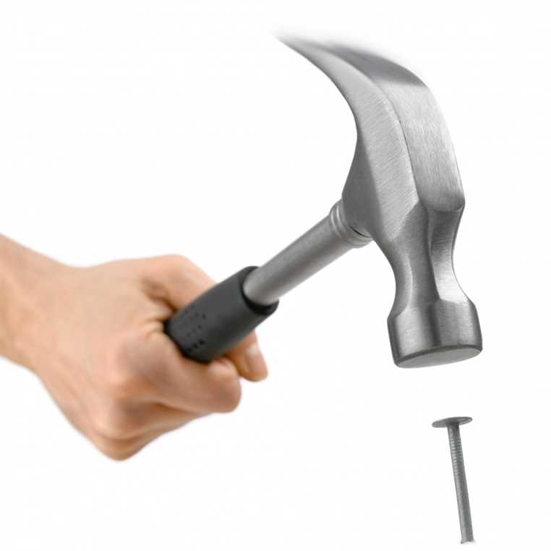
Why DHCPv6?
Existing infrastructure: protocol, network, tools
Servers already know how to manage and assign resources
Protocol easily extensible
Tomek and Bernie are in DHC WG co-chairs and …

Slide 7
DHCPv6 Overview (1/4)
1. Solicit
2. Advertise
Obtain
Client Selects
Advertise – B’s
2. Advertise
Ignores Request as
wrong Server DUID
in Server-ID option
3. Request
w/Server B’s
Server-ID option
T
I
M
E
4. Reply
Client can now use
address(es) and
other parameters
DHCPv6
Server
A
DHCPv6
Server
B
DHCPv6
Client
After T1 period,
client renews
lifetimes
Ignores Renew as
wrong Server DUID
in Server-ID option
5. Renew
w/Server B’s
Server-ID option
Extend
6. Reply
If client no longer
needs lease(s), it can
release it
7. Release
w/Server B’s
Server-ID option
Discard
Ignores Release as
wrong Server DUID
in Server-ID option
8. Reply
Note: Client sends packets via link-local multicast (to FF02::1:2)
Servers unicast reply to client’s link-local address

Slide 8
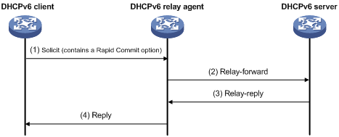
DHCPv6 Overview (2/4)
Above adds relay agent and shows minimal 2 message exchange for initial assignment
Client uses IPv6 link-local address
Server or relay-agent must be present on link
Relay-agents forward request to servers
Return path is reverse of forward path
Client is not aware of relays

Slide 9
DHCPv6 Overview (3/4)
DHCPv6 uses minimal packet header with lots of possible options (TLV encoded)
Options are IETF/IANA assigned
Options can encapsulate other options
Options for assigning resources
IA_NA & IAADDR for address assignment
IA_PD & IAPREFIX for prefix delegation
Assign multiple “resources” in single transaction

Slide 10
DHCPv6 Overview (4/4)
Clients (and servers) identified by DUID
4 DUID types currently defined:
DUID-LL – based on link-layer address
DUID-LLT – based on link-layer address and time
DUID-EN – based on enterprise ID + data
DUID-UUID – based on UUID
Server and clients must handle any DUID type

Slide 11
DHCPv6 Extensibility
New options for DHCPv6 are relatively easily defined via IETF process
Write an individual submission draft
Get WG to adopt draft
Update draft to reach rough consenus
Get draft through WGLC & IESG review
IANA assigns option and RFC (Request for Comments) published

Slide 12
Hence the IETF Draft
Focused on Hypervisor use case where Hypervisor needs a block of MAC addresses to assign to VMs
Can also be used by actual clients, but requires:
IPv6 support
A short-term temporary MAC address for link-local IPv6 address to request DHCPv6 assigned MAC address
Client should use a non-link-layer address for DUID (DUID-EN or DUID-UUID)

Slide 13
Defines 2 New DHCPv6 Options
IA_LL (Identity Association for Link Layer Addresses) Option
Similar to IA_NA and IA_PD
Used as container option for requested / assigned link-layer addresses
LLADDR (Link Layer Addresses) Option
Similar to IAADDR and IAPREFIX
Used to request/assign link-layer addresses

Slide 14
IA_LL Option
0 1 2 3
0 1 2 3 4 5 6 7 8 9 0 1 2 3 4 5 6 7 8 9 0 1 2 3 4 5 6 7 8 9 0 1
+-+-+-+-+-+-+-+-+-+-+-+-+-+-+-+-+-+-+-+-+-+-+-+-+-+-+-+-+-+-+-+-+
| OPTION_IA_LL | option-len |
+-+-+-+-+-+-+-+-+-+-+-+-+-+-+-+-+-+-+-+-+-+-+-+-+-+-+-+-+-+-+-+-+
| IAID (4 octets) |
+-+-+-+-+-+-+-+-+-+-+-+-+-+-+-+-+-+-+-+-+-+-+-+-+-+-+-+-+-+-+-+-+
| T1 (4 octets) |
+-+-+-+-+-+-+-+-+-+-+-+-+-+-+-+-+-+-+-+-+-+-+-+-+-+-+-+-+-+-+-+-+
| T2 (4 octets) |
+-+-+-+-+-+-+-+-+-+-+-+-+-+-+-+-+-+-+-+-+-+-+-+-+-+-+-+-+-+-+-+-+
. .
. IA_LL-options .
. .
+-+-+-+-+-+-+-+-+-+-+-+-+-+-+-+-+-+-+-+-+-+-+-+-+-+-+-+-+-+-+-+-+
IAID identifies instance of IA_LL option to allow for many
T1 is renewal time (from “now” in seconds)
T2 is rebinding time (from “now” in seconds)
IA_LL-options contains one or more IA_LL options

Slide 15
LLADDR Option
0 1 2 3
0 1 2 3 4 5 6 7 8 9 0 1 2 3 4 5 6 7 8 9 0 1 2 3 4 5 6 7 8 9 0 1
+-+-+-+-+-+-+-+-+-+-+-+-+-+-+-+-+-+-+-+-+-+-+-+-+-+-+-+-+-+-+-+-+
| OPTION_LLADDR | option-len |
+-+-+-+-+-+-+-+-+-+-+-+-+-+-+-+-+-+-+-+-+-+-+-+-+-+-+-+-+-+-+-+-+
| link-layer-type | link-layer-len |
+-+-+-+-+-+-+-+-+-+-+-+-+-+-+-+-+-+-+-+-+-+-+-+-+-+-+-+-+-+-+-+-+
| |
| link-layer-address |
| |
+-+-+-+-+-+-+-+-+-+-+-+-+-+-+-+-+-+-+-+-+-+-+-+-+-+-+-+-+-+-+-+-+
| extra-addresses |
+-+-+-+-+-+-+-+-+-+-+-+-+-+-+-+-+-+-+-+-+-+-+-+-+-+-+-+-+-+-+-+-+
| valid-lifetime |
+-+-+-+-+-+-+-+-+-+-+-+-+-+-+-+-+-+-+-+-+-+-+-+-+-+-+-+-+-+-+-+-+
. .
. LLaddr-options .
. .
+-+-+-+-+-+-+-+-+-+-+-+-+-+-+-+-+-+-+-+-+-+-+-+-+-+-+-+-+-+-+-+-+
Link-layer-type and link-layer-len specify requested link-layer address
Link-layer-address specifies starting address requested or assigned
Extra-address specifies number of additional addresses (0 for single address)
Valid-lifetime lifetime of assignment (from “now” in seconds)
LLaddr-options could contain future options specific to assignment

Slide 16
Client / Server Operation (1)
DHCPv6 essentials the same as address / prefix delegation
But a bit simpler overall
Confirm, Decline, and Information-Request client messages not used

Slide 17
Client / Server Operation (2)
For hypervisor model
Hypervisor is client, but does not use resulting link-layer addresses
Hypervisor could obtain large blocks or one link-layer address per VM as needed
Hypervisor provides link-layer address to VMs
VMs could do standard DHCPv6 for IPv6 addresses/delegated prefixes or DHCPv4

Slide 18
Client / Server Operation (3)
If “true” client (e.g. IoT) wants a link-layer address
Could use Temporary MAC address for anonymity (see https://mentor.ieee.org/802.11/dcn/02/11-02-0109-00-000i-temporary-mac-address-for-anonymity.ppt) to do DHCPv6 to get “long term” link-layer address assignment
Clarify client must not use DUID-LL/LLT based on temporary MAC
Client then uses assigned link-layer address for normal DHCPv6, DHCPv4, …

Slide 19
draft-bvtm-dhc-mac-assign Status
Currently an Individual Submission at IETF
Changes under author control
Targeted for DHC Working Group (WG)
WG Adoption requires Adoption Call (authors will request shortly)
If adopted, becomes WG Draft
Changes under WG control (consensus)
Currently no IPR claims against document

Slide 20
Next Steps
Provide feedback to authors
On draft itself
send to the IETF DHC WG list (dhcwg@ietf.org) or email dhc-chairs@ietf.org
Help resolve open issues
Issue tracker
Also review closed issues to confirm action?
Raise new issues if needed
Indicate IEEE interest in this work
Authors will request IETF DHC WG adoption of the draft before IETF-102 (Montreal, July 14-20, 2018)

Slide 21
Useful Links
Draft text
https://datatracker.ietf.org/doc/draft-bvtm-dhc-mac-assign/
Issue tracker for Draft
https://github.com/dhcwg/dhcp-mac/issues
DHC mailing list (draft can be discussed here)
https://www.ietf.org/mailman/listinfo/dhcwg
DHC WG
https://datatracker.ietf.org/wg/dhc

Slide 22

& THANKS
Question or comments …

