Slide 1
Case report

Slide 2
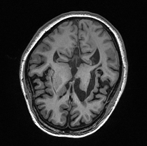
Study outline.
환자의 특수성(case)
- 일반적이지 않은 양쪽 hemi stroke.
- cortical deafness 증상.
Functional Connectivity 분석
- ROI ( auditory cortex 및 sensory motor 영역)
Case vs Control 10명.

Slide 3
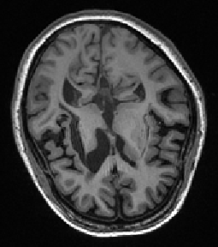
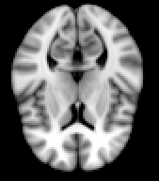
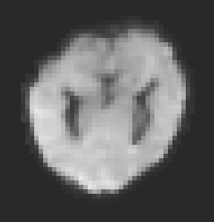
Problem.
< normalization step >
T1
structure
- abnormal ‘lesion’ brain
→ hard to apply common normalization strategy
Resting
EPI
Template
(MNI)

Slide 4
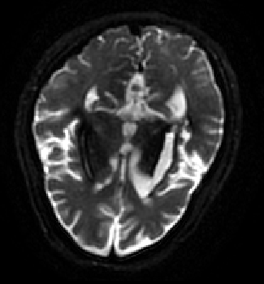
Lesion 확인
Resting EPI
T1
T2
**같은 slice라고 생각되는 raw image
Structure image
1) T1 에서보다 EPI에서 damaged 영역이 더 넓음.
2) T2 영상을 보면 lesion 주변으로 검게 damaged 영역들(?)이 있음이 확인됨.
→ damaged 영역들이 structure T1 영상에서 보이는 것보다 더 넓을 수 있다고 추측.
lesion에 대한 discussion이 더 필요함.

Slide 5
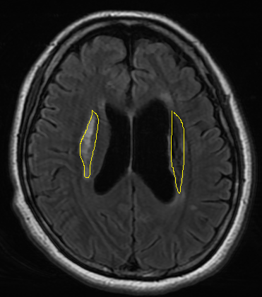


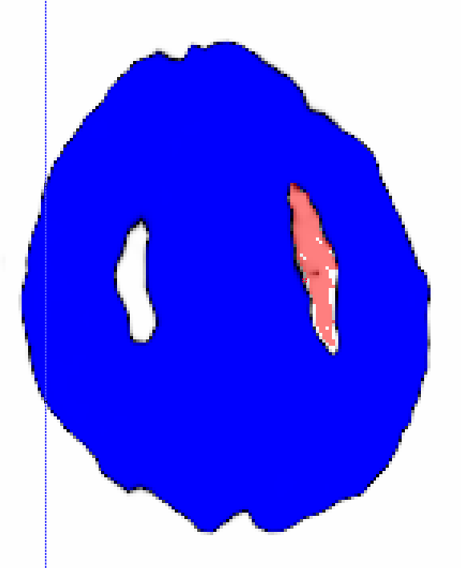
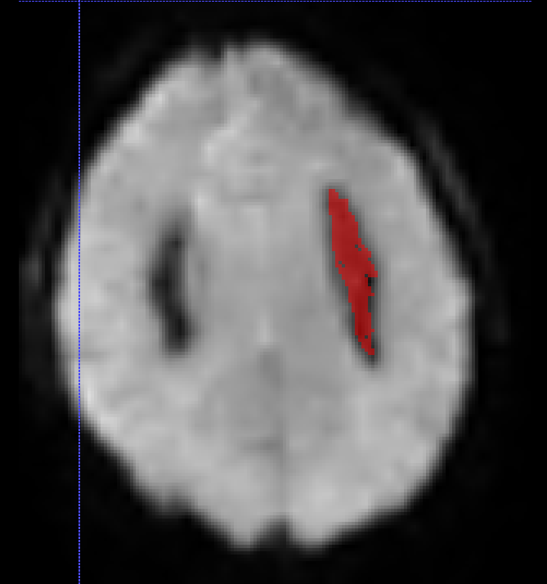
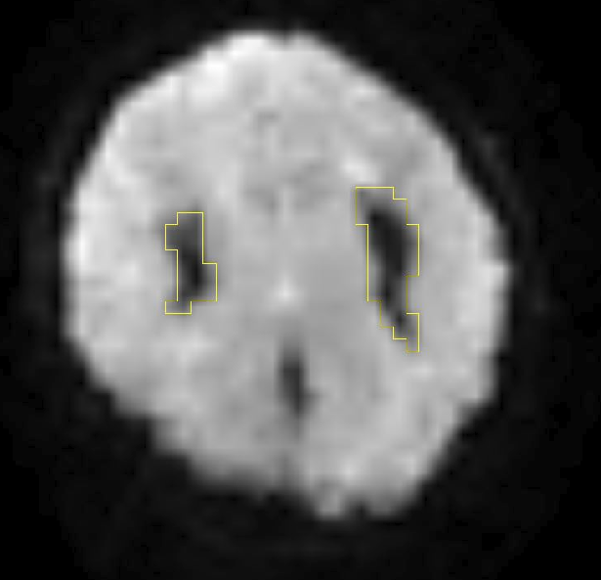
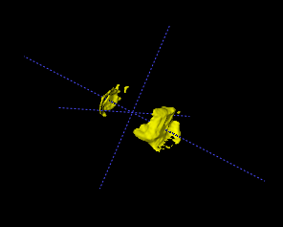
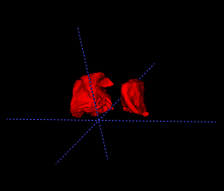
Lesion 확인
**By 곽대원 선생님
**Intensity based reference
**by 강민구 선생님
** 3D ROI
**by EPI lesion ROI

Slide 6
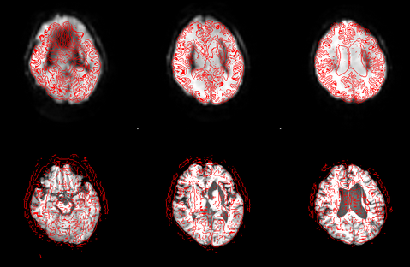
Registration-1
Functional
(EPI)
4x4x4
Transformation info - 1
Structure
(T1)
1x1x1

Slide 7
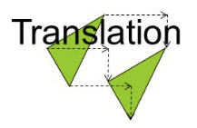
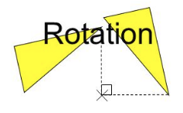
‘Transfomred’
‘Raw’
- robust transformation.
- less detailed.
4x4 matrix

Slide 8
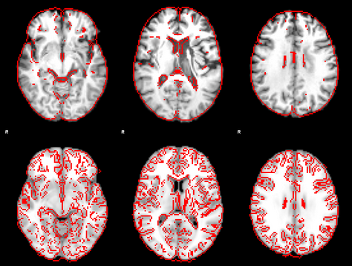
Registration-2
Structure
(T1)
1x1x1
Transformation info - 2
Template
(T1)
2x2x2

Slide 9

‘Transfomred’
‘Raw’
Nonlinear transformation
4x4 matrix
- robust + detailed transformation.

Slide 10
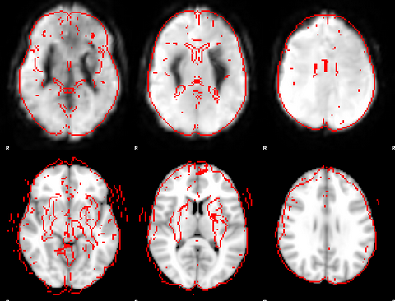
Registration-3
Functional
(EPI)
4x4x4
Transformation info - 1
+
Transformation info - 2
Template
(T1)
2x2x2

Slide 11
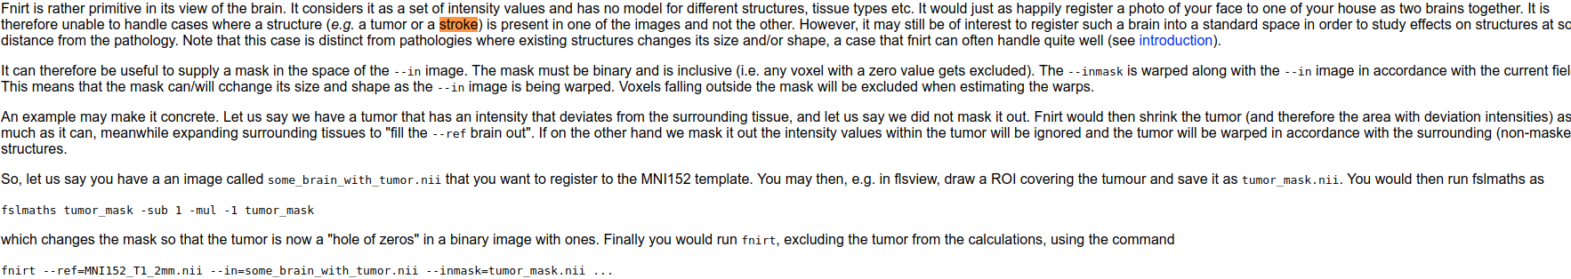
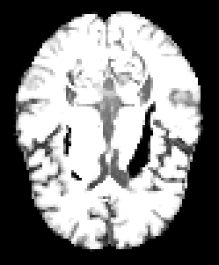
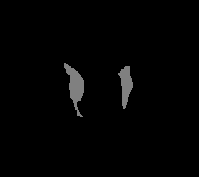

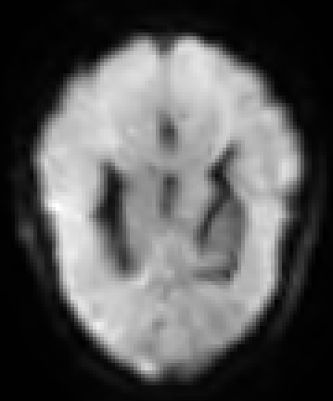
→ Exclude lesion area from the calculation.
Lesion mask
Lesion을 반영한 template
Lesion roi.
Inversion Lesion roi.
lesion정보가 반영된 resting
EPI resting

Slide 12
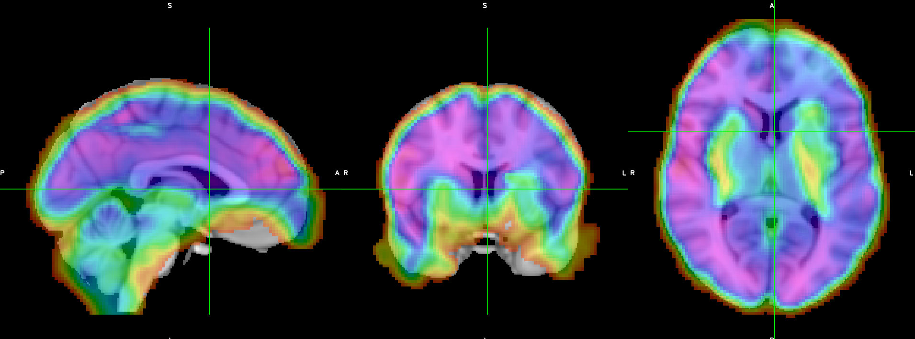
Results.

Slide 13
Subject
Case ; --- 님.
Age ; 39
Data ; resting & T1
Control ; 10명
Age average ; 40.6
Data ; resting & T1

Slide 14
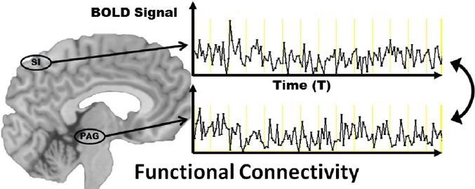
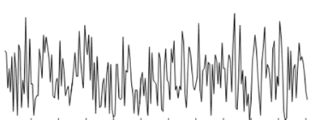
<data>
240 volume = 240 time point
...
Temporal correlation between region.
**resting EPI image.
<method>
Functional Connectivity(FC)
...
얼마나 signal들이 같이 움직이는지.
signal

Slide 15
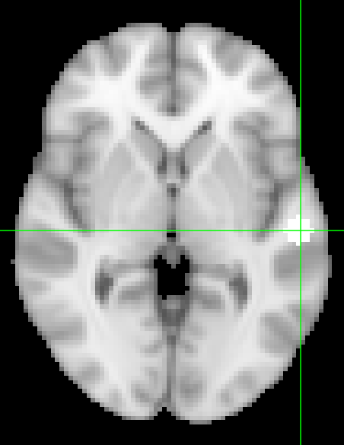
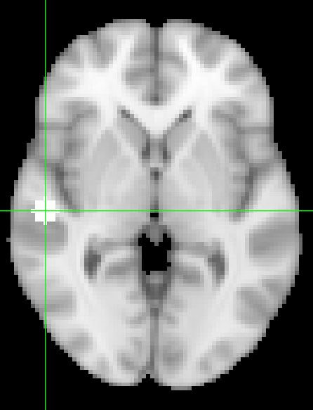
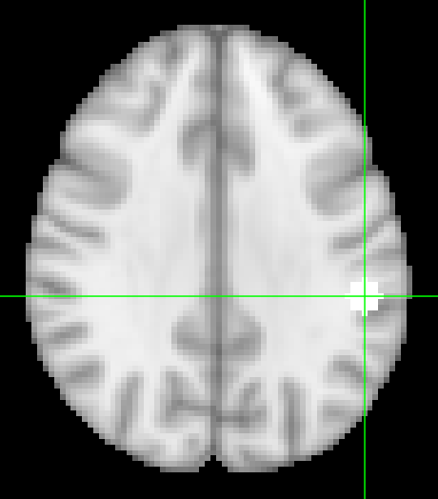
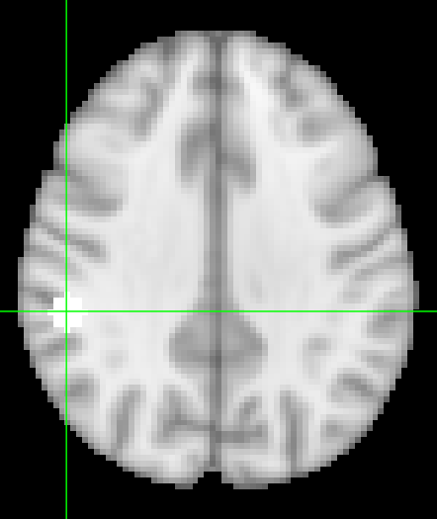
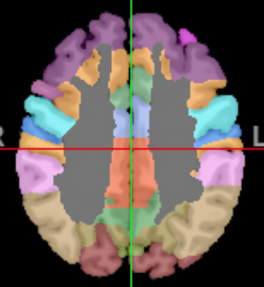
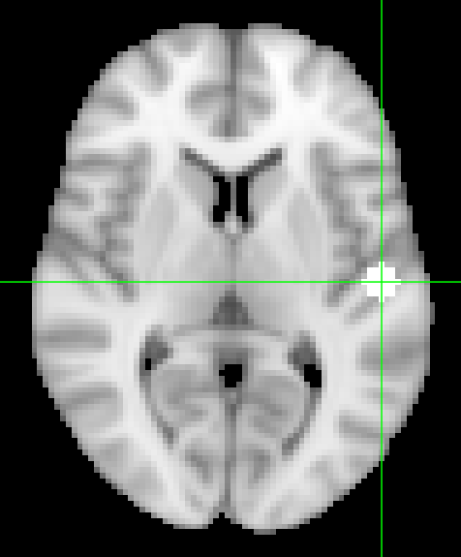
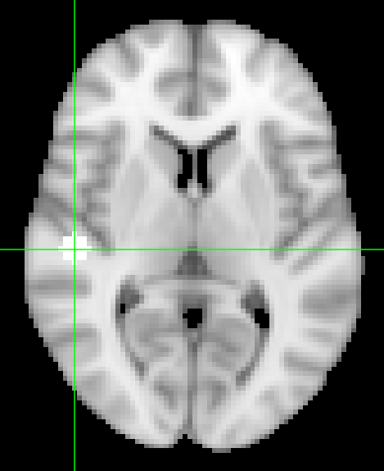
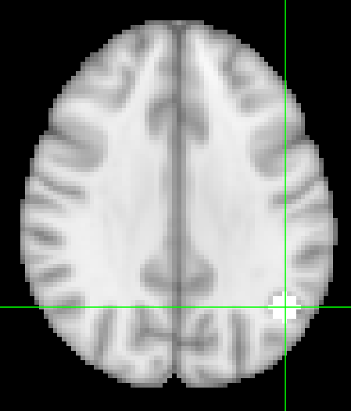
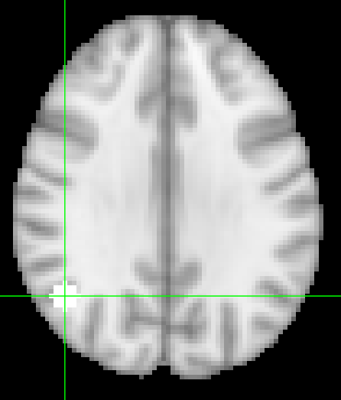
ROI
Auditory
auditory_association(BA22)
Secondary_sensory(BA40)
Brodmann area
primary_auditory(BA41)
Secondary_sensory(BA39)

Slide 16
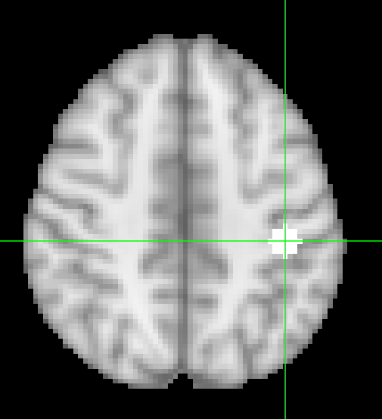
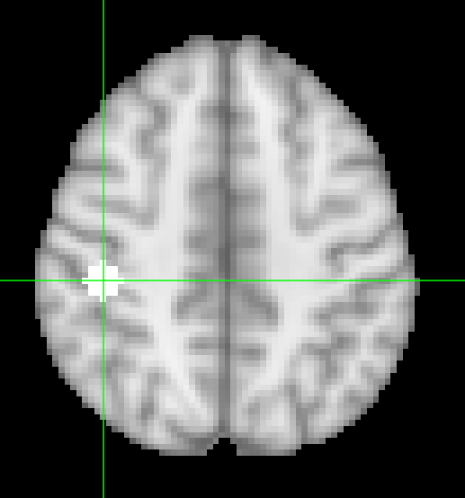
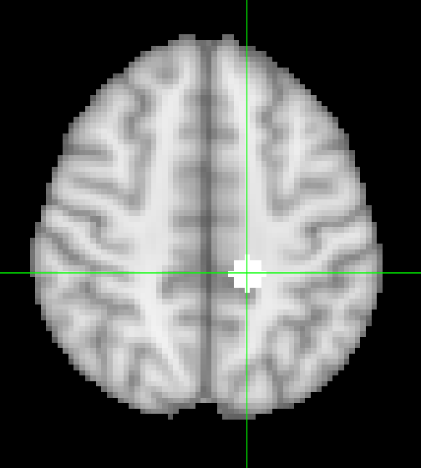
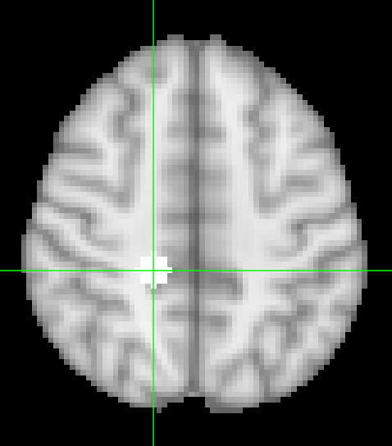
ROI
Sensory
primary_sensory(BA01)
sensory_association(BA05)
Brodmann area

Slide 17
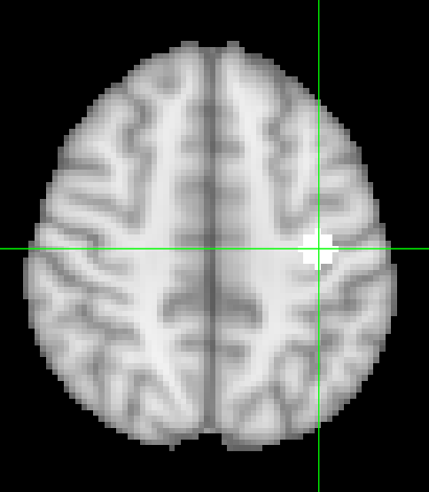
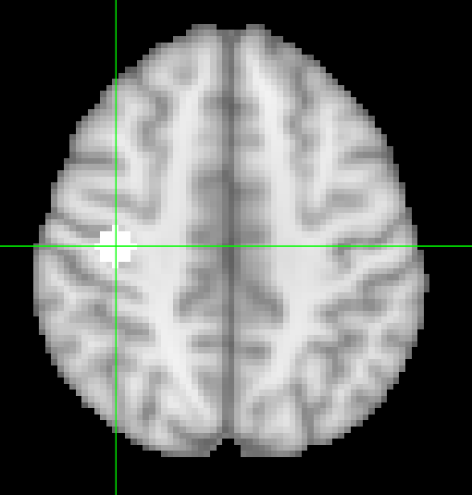
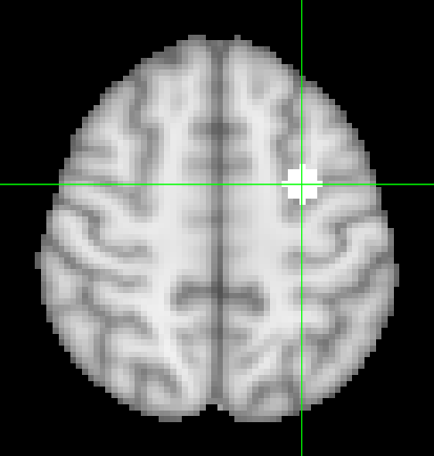
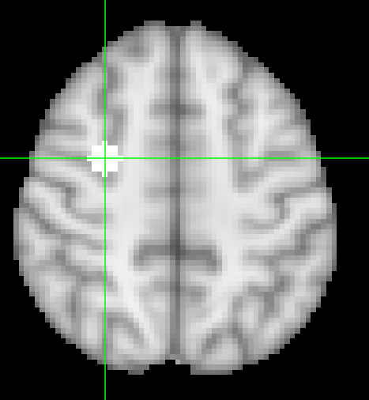
ROI
Sensory
primary_motor(BA04)
pre_motor / SMA(BA06)
Brodmann area

Slide 18
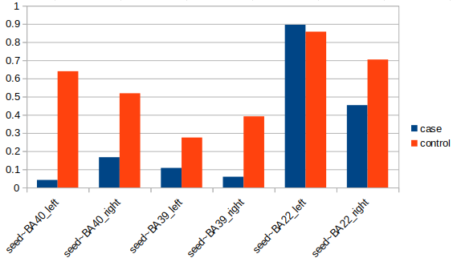
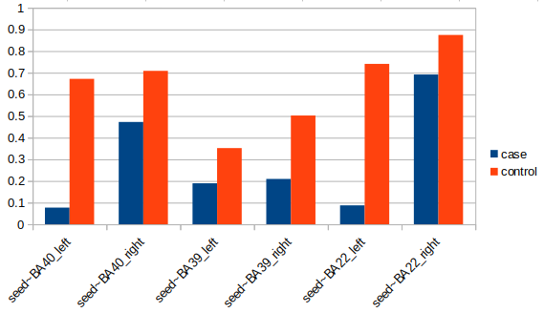
Intra auditory
Left
Right
Seed; BA41_primary auditory

Slide 19
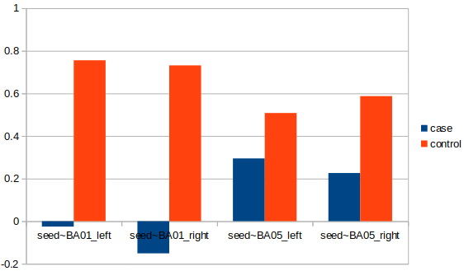
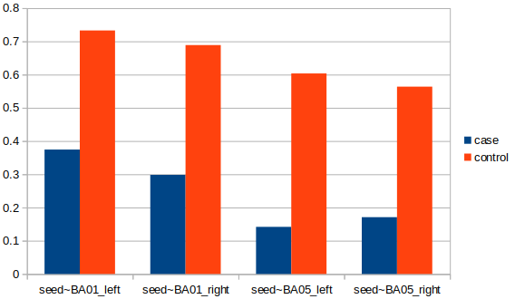
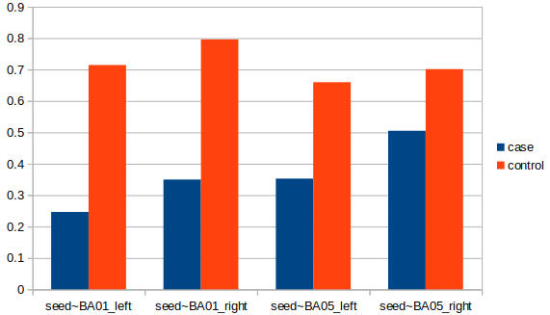
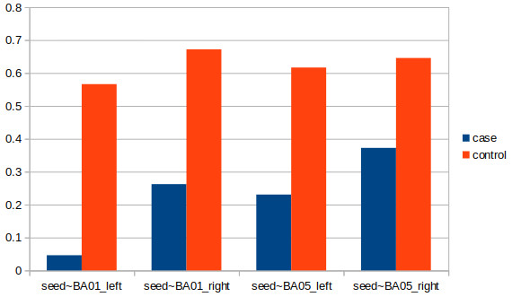
auditory~sensory
Left
Left
Right
Right
Seed; BA41_primary auditory
Seed; BA40 Secondary sensory

Slide 20
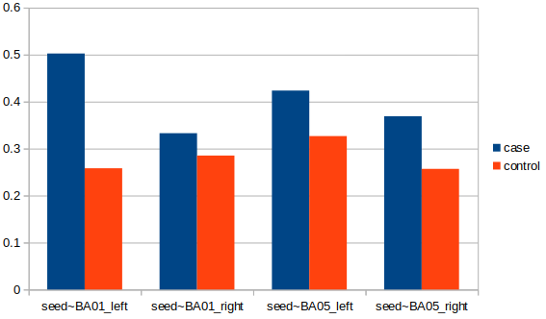
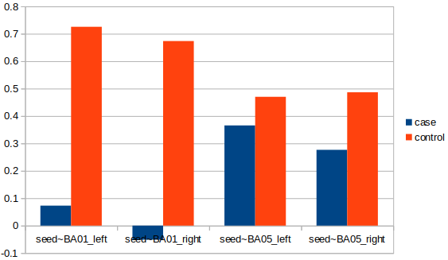
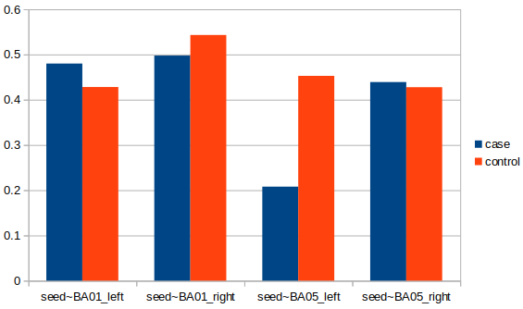
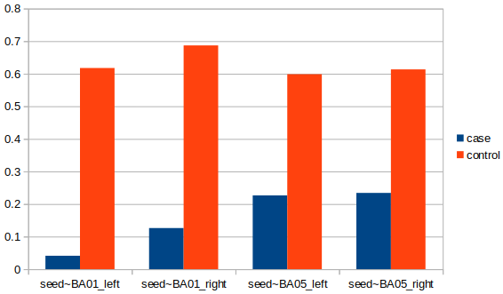
auditory~sensory
Left
Left
Right
Right
Seed; BA39 Secondary sensory
Seed; BA22 auditory association

Slide 21




auditory~motor
Left
Left
Right
Right
Seed; BA41_primary auditory
Seed; BA40 Secondary sensory

Slide 22




auditory~motor
Left
Left
Right
Right
Seed; BA39 Secondary sensory
Seed; BA22 auditory association

Slide 23

Case
Auditory
Intra auditory
Auditory
~ sensory
Intra sensory
Sensory
Auditory
~ motor
Sensory
~ motor
Intra motor
Motor

Slide 24

Control
Auditory
Intra auditory
Auditory
~ sensory
Intra sensory
Sensory
Auditory
~ motor
Sensory
~ motor
Intra motor
Motor

Slide 25
Case
Control

