Slide 1
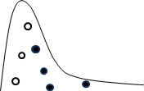
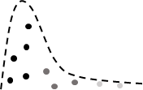
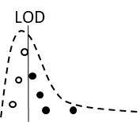
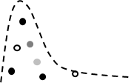

Samples Censored
MLE - NM
Monte Carlo Method
LOD
censored
censored
Dataset
Fit distribution using maximum likelihood
Impute censored points calculate new distribution parameters
Repeat 10000 times to find average distribution parameters
Semiquantitative
censored
censored
censored
censored
censored
censored
Dataset
Fit distribution using maximum likelihood
Impute censored points calculate new distribution parameters
Repeat 10000 times to find average distribution parameters
Summary Statistic for Positive Samples
LOD
LOD
Use mathematical relationships on summary statistic for positive samples
Use distribution to generate values above and below LOD
Calculate new distribution
Repeat 10000 times to find average distribution parameters
Synthesis
Weight each distribution based on GRADE
Generate 10000 values from distributions based on weight
Calculate new distribution
Repeat 10000 times to find average distribution parameters

