Slide 1
Identification of new studies via databases and registers
Identification of new studies via other methods
Records identified from*:
Web of Science (n = 1371)
Google Scholar (n = 989)
Total (n = 2360)
Records removed before screening:
Duplicate records removed (n = 76)
Records identified from:
Citation searching (n = 299)
Identification
Reports sought for retrieval
(n = 2284)
Reports not retrieved
(n = 265)
Records screened
(n = 2019)
Record not in English
(n = 21)
Reports sought for retrieval
(n = 299)
Reports not retrieved
(n = 101)
Screening
Reports assessed for eligibility
(n = 1998)
Reports excluded:
Studies did not have presence/enumerated data on fecal pathogens from animals that could access roofs (n = 1901)
Reports assessed for eligibility
(n = 198)
Reports excluded:
Studies did not have presence or enumerated data on fecal pathogens from animals that could access roof (n = 65)
New studies included in review
(n = 97, GS = 71 WoS =26)
Reports of new included studies
(n = 133)
Total (n=230)
Included

Slide 2
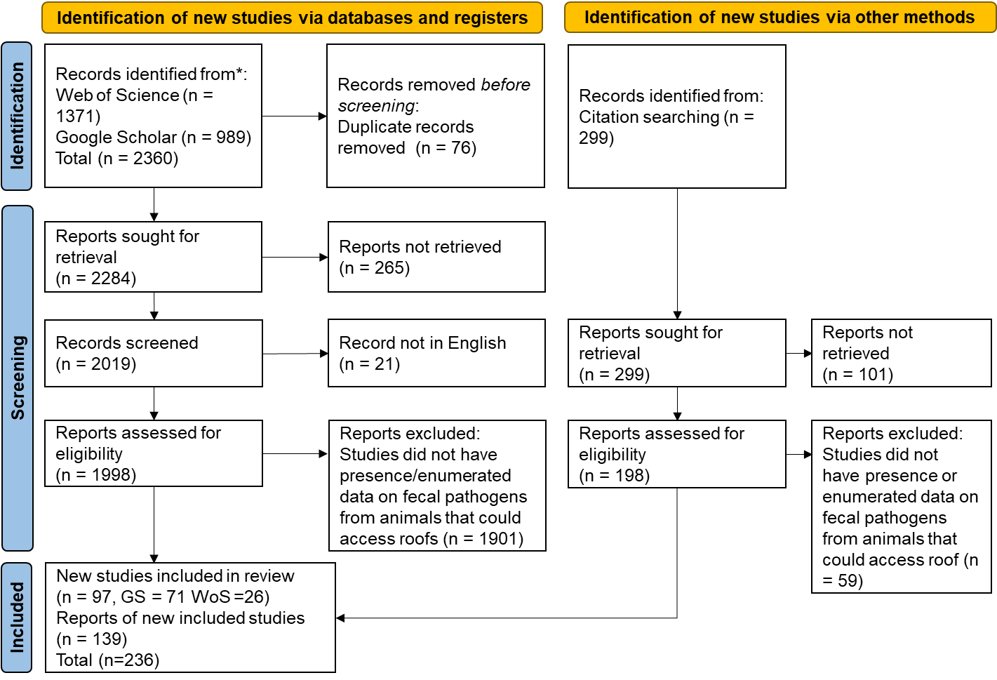

Slide 3


Slide 4
Identification of new studies via databases and registers
Identification of new studies via other methods
Records identified from*:
Web of Science (n = 1371)
Google Scholar (n = 989)
Total (n = 2360)
Records removed before screening:
Duplicate records removed (n = 76)
Records identified from:
Citation searching (n = 299)
Identification
Reports sought for retrieval
(n = 2284)
Reports not retrieved
(n = 265)
Records screened
(n = 2019)
Record not in English
(n = 21)
Reports sought for retrieval
(n = 299)
Reports not retrieved
(n = 101)
Screening
Reports assessed for eligibility
(n = 1998)
Reports excluded:
Studies did not have presence/enumerated data on fecal pathogens from animals that could access roofs (n = 1901)
Reports assessed for eligibility
(n = 198)
Reports excluded:
Studies did not have presence or enumerated data on fecal pathogens from animals that could access roof (n = 65)
New studies included in review
(n = 97, GS = 71 WoS =26)
Reports of new included studies
(n = 133)
Total (n=230)
Included

Slide 5
Systematic Review
Information Source
Data Quality (GRADE)
Grouping
Selection Process
Prevalence Outcomes
Outcomes
Clopper Pearson Exact Method
Pathogen Concentration Outcomes
Synthesis Random Effects Model
Summary Statistics
Summary Statistics for Positive Samples
Semiquantitative
Samples
Substitution
Special Case
Censored
Relationship between normal and lognormal distribution (Jahne 2017)
MLE-NM (Fit R fitdistrplus)
Calculated Directly
Sensitivity (Monte Carlo R mc2d)
Synthesis Monte Carlo weight based on GRADE

Slide 6
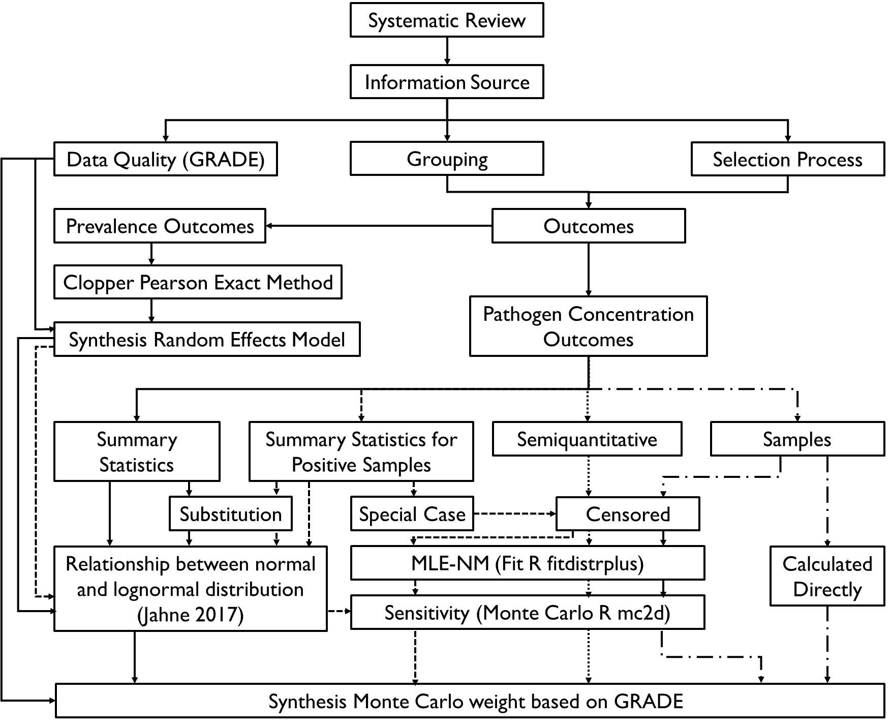

Slide 7
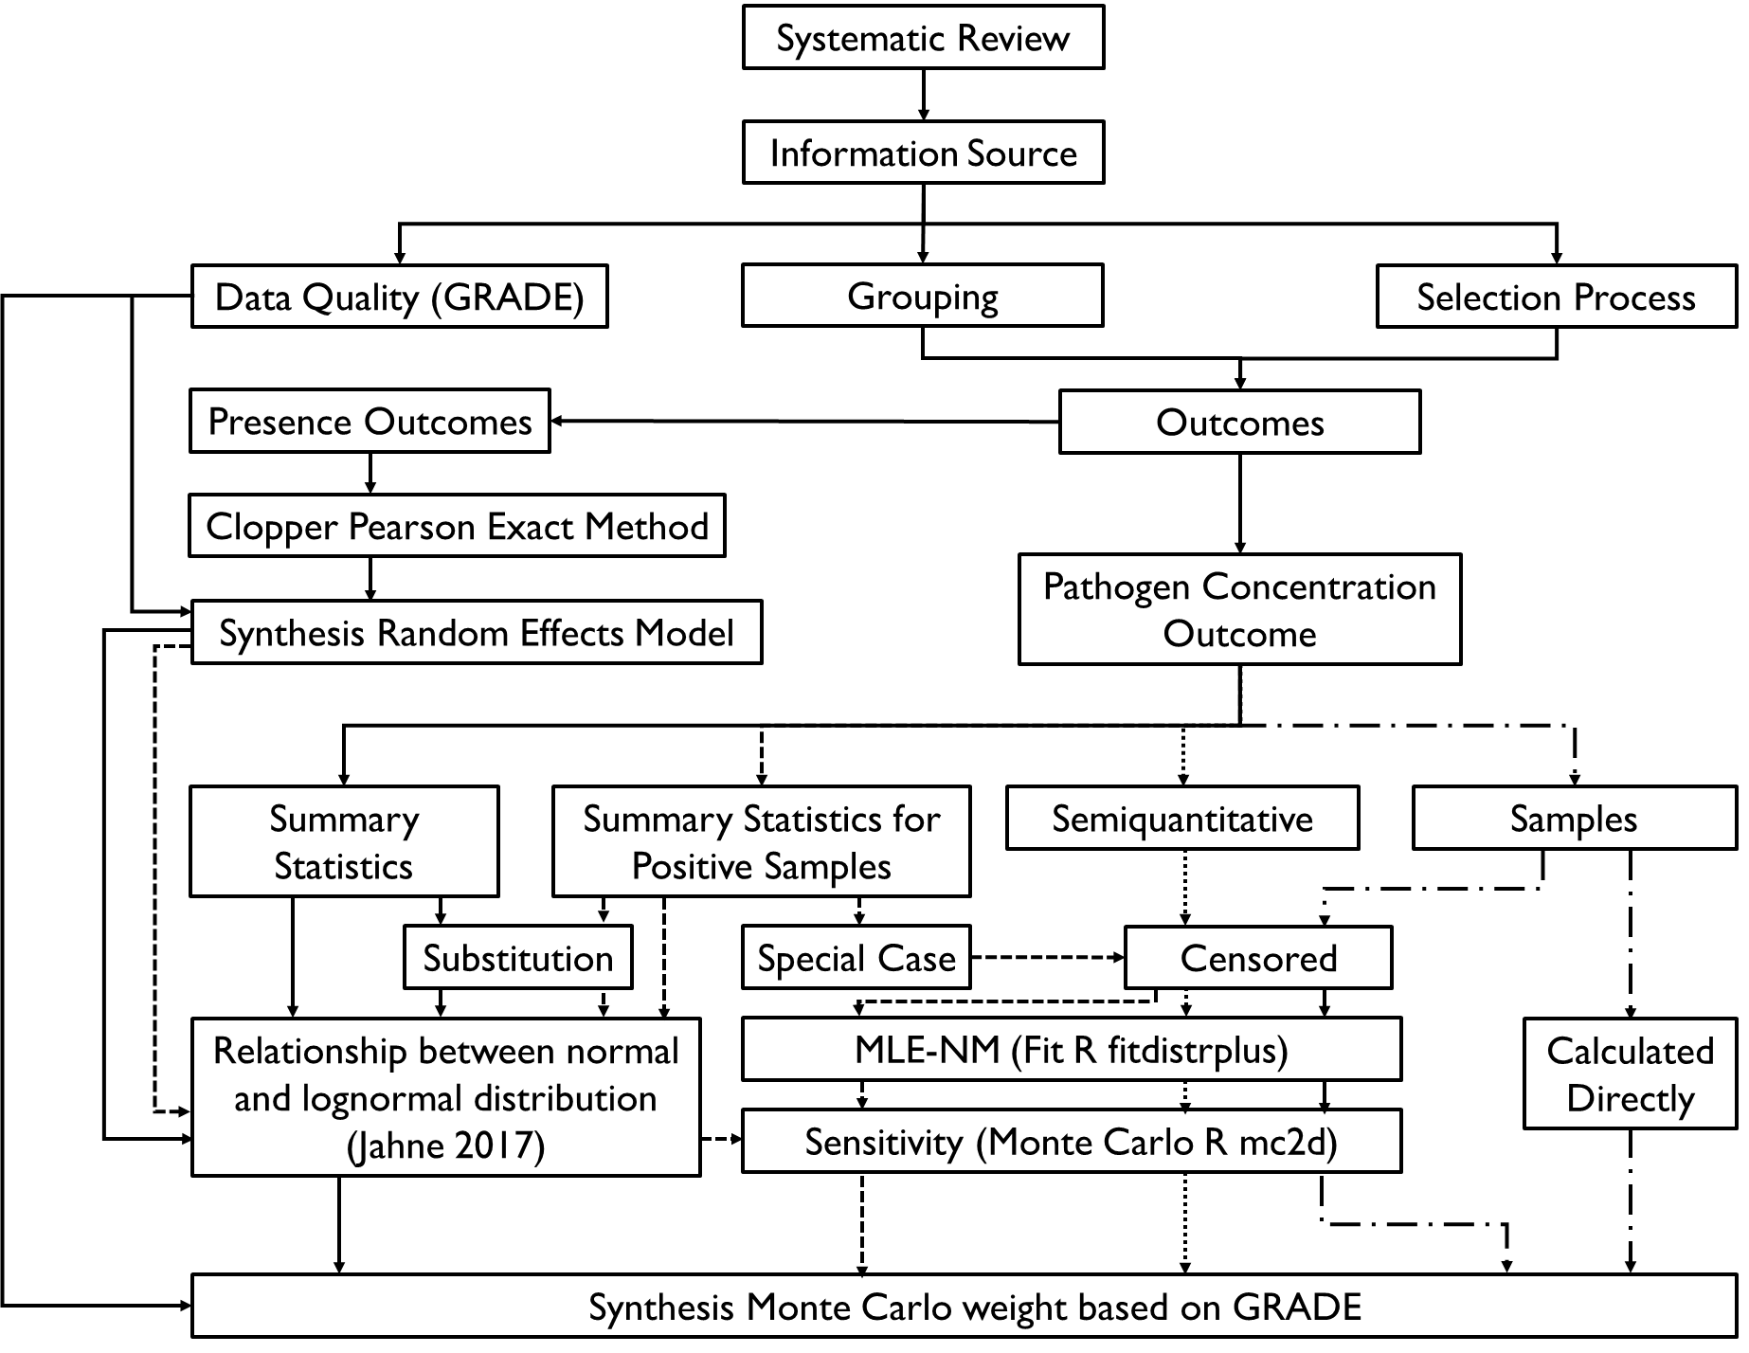

Slide 8
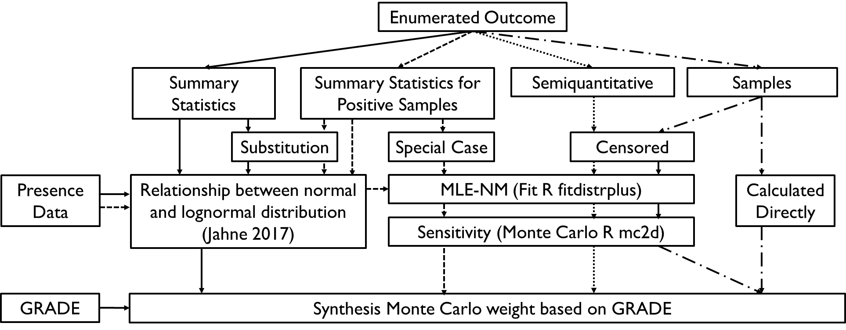

Slide 9
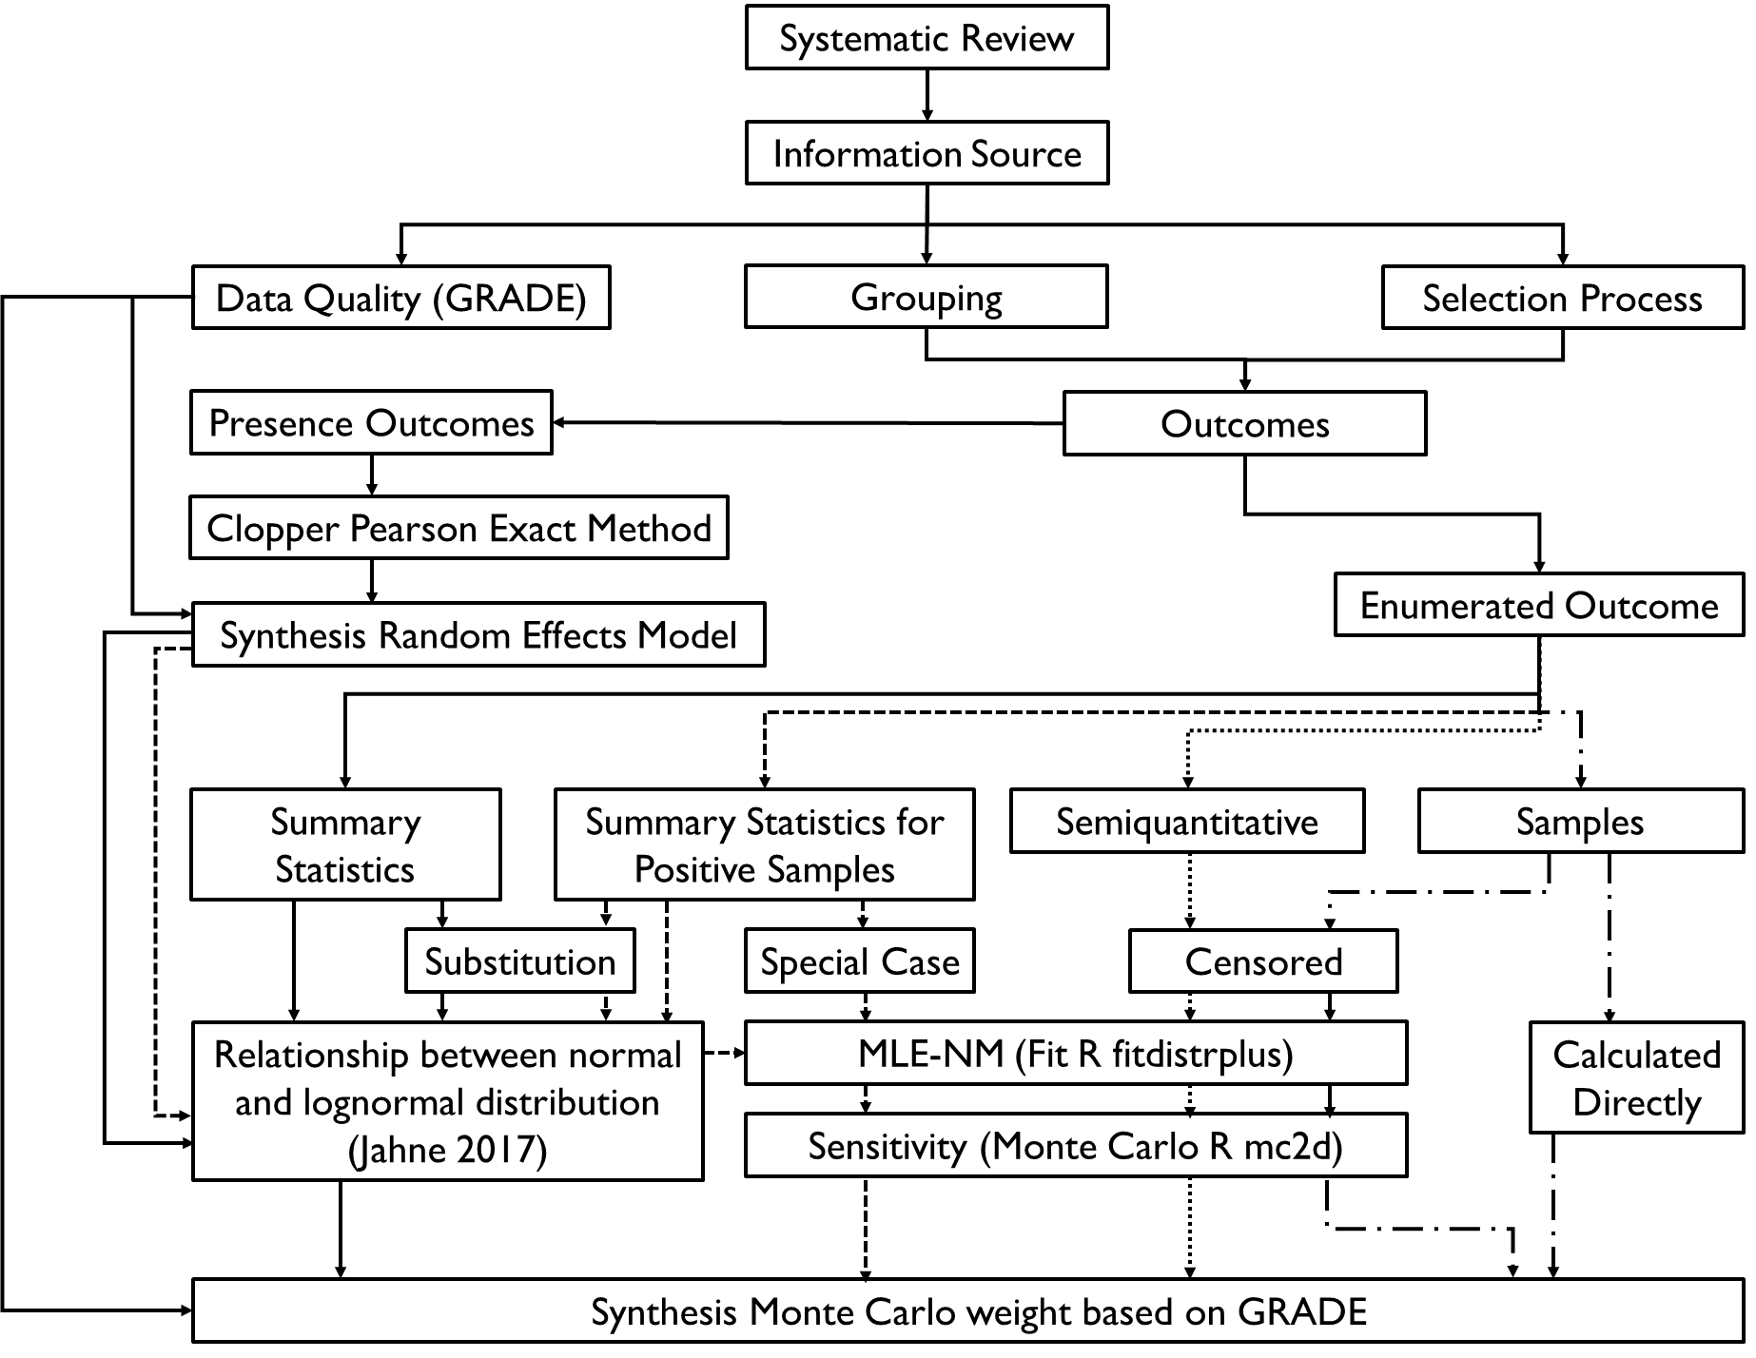

Slide 10
Systematic Review
Information Source
Data Quality (GRADE)
Grouping
Selection Process
Presence Outcomes
Outcomes
Clopper Pearson Exact Method
Enumerated Outcome
Synthesis Random Effects Model
Summary Statistics
Summary Statistics for Positive Samples
Semiquantitative
Samples
Substitution
Special Case
Censored
Relationship between normal and lognormal distribution (Jahne 2017)
MLE-NM (Fit R fitdistrplus)
Calculated Directly
Sensitivity (Monte Carlo R mc2d)
Synthesis Monte Carlo weight based on GRADE

Slide 11
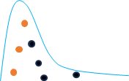
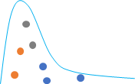
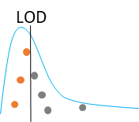

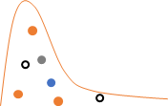

Samples Censored
MLE - NM
Monte Carlo Method
LOD
censored
censored
Dataset
Fit distribution using maximum likelihood
Impute censored points calculate new distribution parameters
Repeat 10000 times to find average distribution parameters
Semiquantitative
censored
censored
censored
censored
censored
censored
Dataset
Fit distribution using maximum likelihood
Impute censored points calculate new distribution parameters
Repeat 10000 times to find average distribution parameters
Summary Statistic for Positive Samples
LOD
LOD
Use mathematical relationships on summary statistic for positive samples
Use distribution to generate values above and below LOD
Calculate new distribution
Repeat 10000 times to find average distribution parameters
Synthesis
Weight each distribution based on GRADE
Generate 10000 values from distributions based on weight
Calculate new distribution
Repeat 10000 times to find average distribution parameters

Slide 12
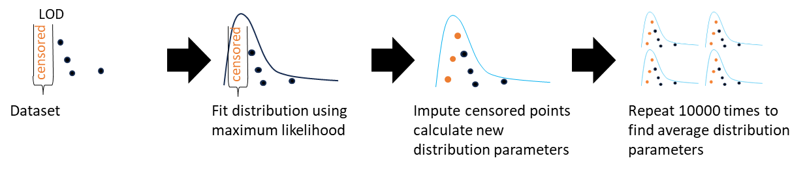
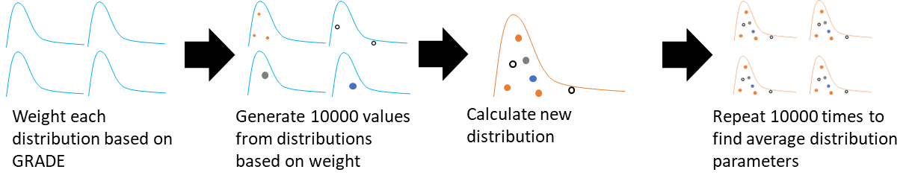
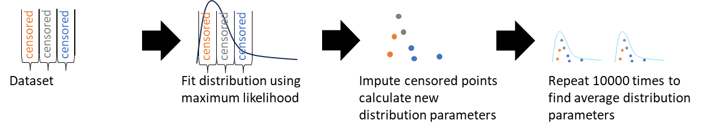
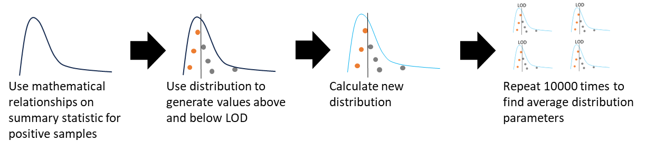

Slide 13
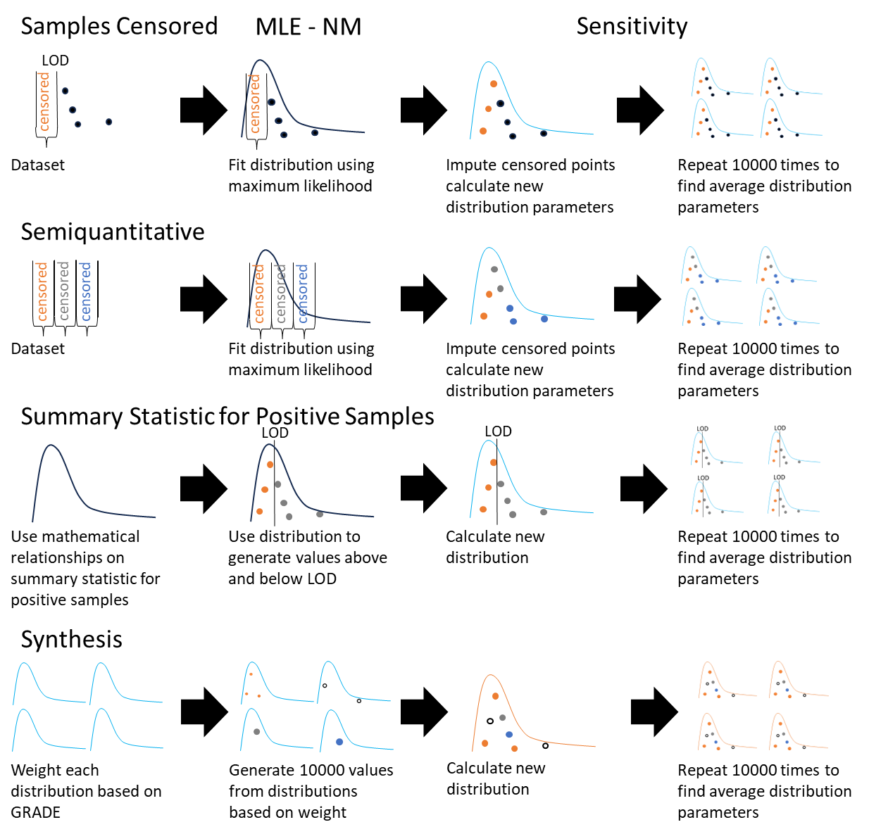

Slide 14
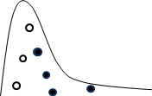
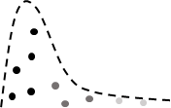
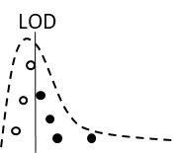
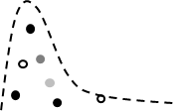
Samples Censored
MLE - NM
Monte Carlo Method
LOD
censored
censored
Dataset
Fit distribution using maximum likelihood
Impute censored points calculate new distribution parameters
Repeat 10000 times to find average distribution parameters
Semiquantitative
censored
censored
censored
censored
censored
censored
Dataset
Fit distribution using maximum likelihood
Impute censored points calculate new distribution parameters
Repeat 10000 times to find average distribution parameters
Summary Statistic for Positive Samples
LOD
LOD
Use mathematical relationships on summary statistic for positive samples
Use distribution to generate values above and below LOD
Calculate new distribution
Repeat 10000 times to find average distribution parameters
Synthesis
Weight each distribution based on GRADE
Generate 10000 values from distributions based on weight
Calculate new distribution
Repeat 10000 times to find average distribution parameters

Slide 15
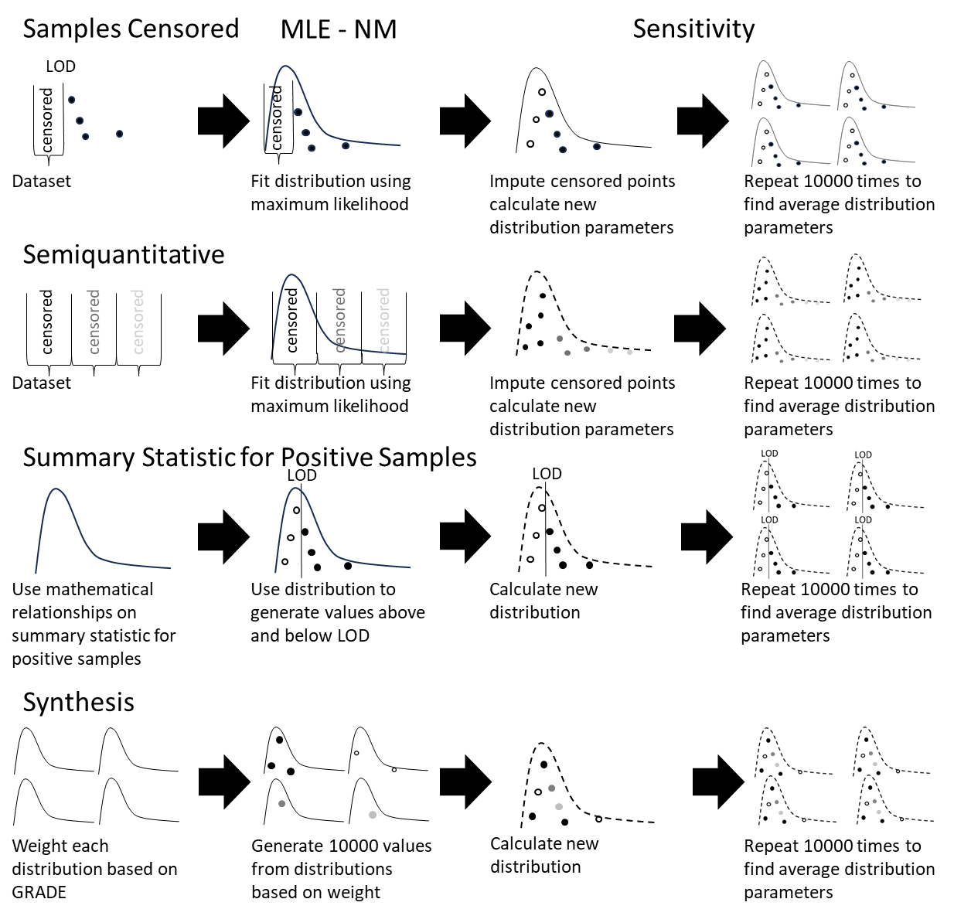

Slide 16


Slide 17
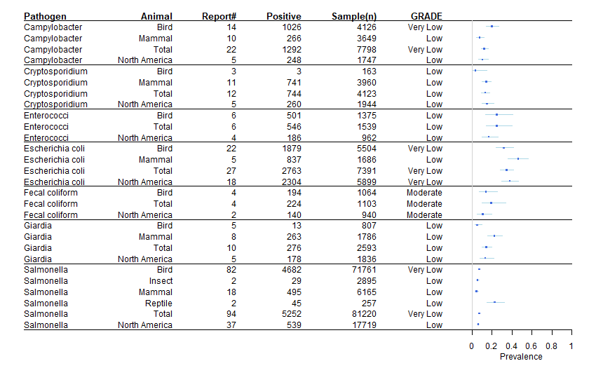
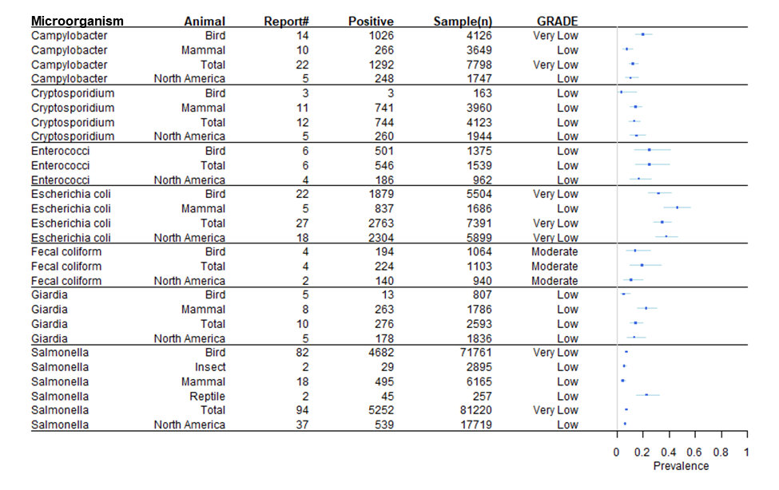
Microorganism

