Slide 1
subspace clustering
xuwf
2017.11.17
Notes:
今天主要给大家分享的是一个子空间聚类的问题，这个导航上次其实也从函数型数据方面进行分享过 我今天的这个分享主要是基于最近两个礼拜看的论文，更详细的阐述下子空间聚类的方法，慢慢的过渡到函数型子空间聚类。然后再把论文中的一些疑惑拿出来和大家讨论一下

Slide 2
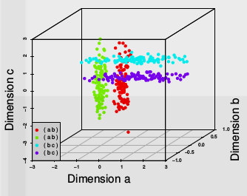
Intuition
Definition
Subspace clustering is an extension of feature selection that
attempts to find clusters in different subspaces of the same
dataset.
Data：The dataset is divided into four clusters of 100 instances, each existing in only two of the three dimensions.
Difficulty:In higher dimensional datasets this
problem becomes even worse and the clusters
become impossible to find, suggesting that
we consider fewer dimensions.
Note:PCA is not work!since relative distances are
preserved and the effects of the irrelevant dimension
remain.
Notes:
为什么要引入子空间的概念？解决高维数据聚类问题

Slide 3
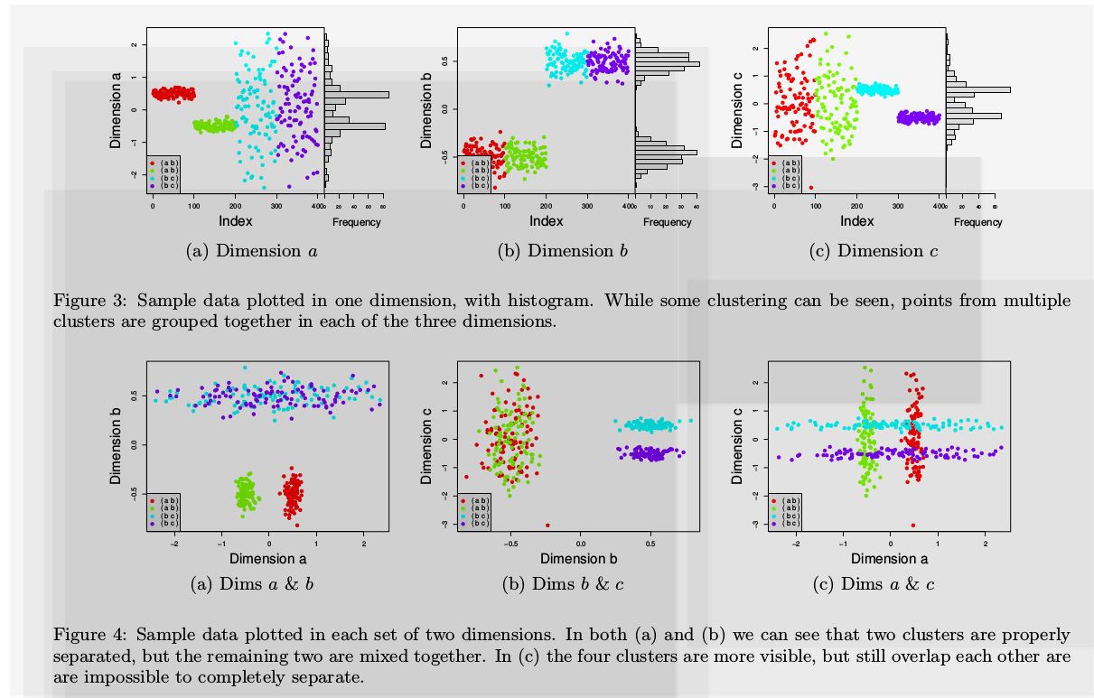
Intuition
Thus, the key to finding each of the
clusters in this dataset is to look in
the appropriate subspaces.
How to: we might try using a feature selection algorithm to remove one or two dimensions.
Notes:
如果维度急剧扩增 这种枚举法是行不通的 是个NP难问题

Slide 4
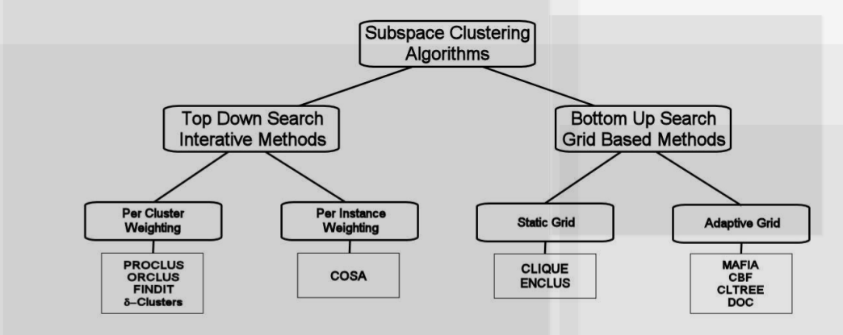
Methods
sophisticated heuristic search
Naive approach:A naive approach might be to search through all possible subspaces and use cluster validation techniques to determine the subspaces with the best clusters

Slide 5
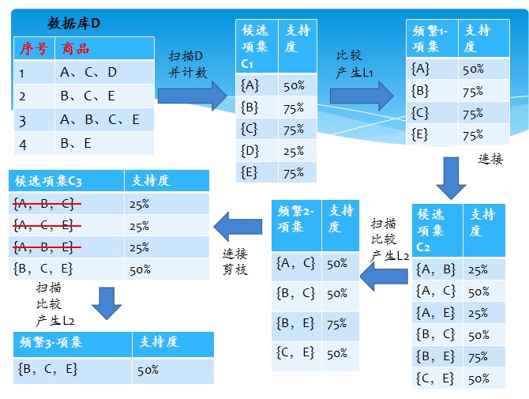
Bottom-Up Subspace Search Methods
an APRIORI style approach
Algorithms first create a histogram
for each dimension and selecting
those bins with densities above a
given threshold.
MAFIA:based on grid
two parameter:Step size of the grid,threshold of density
Notes:
Clusters may be found in the same, overlapping, or disjoint subspaces. The DNF expressions used to represent clusters are often very interpretable. The clusters may also overlap each other meaning that instances can belong to more than one cluster. This is often advantageous in subspace clustering since the clusters often exist in different subspaces and thus represent different relationships.

Slide 6
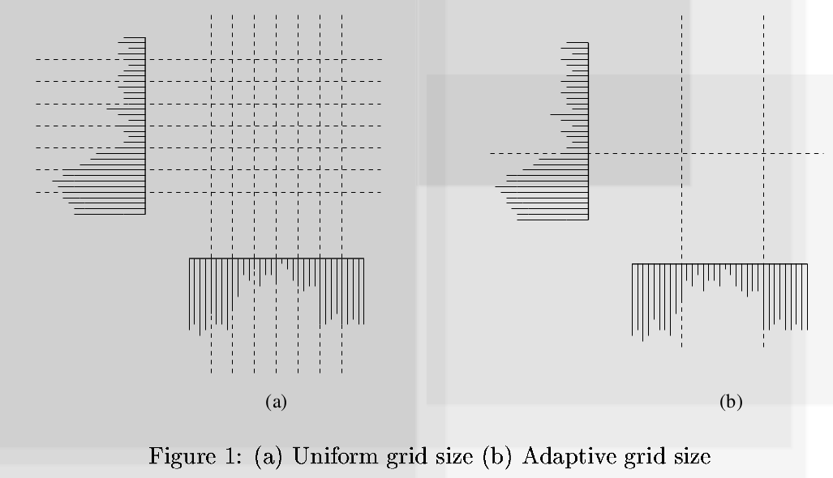
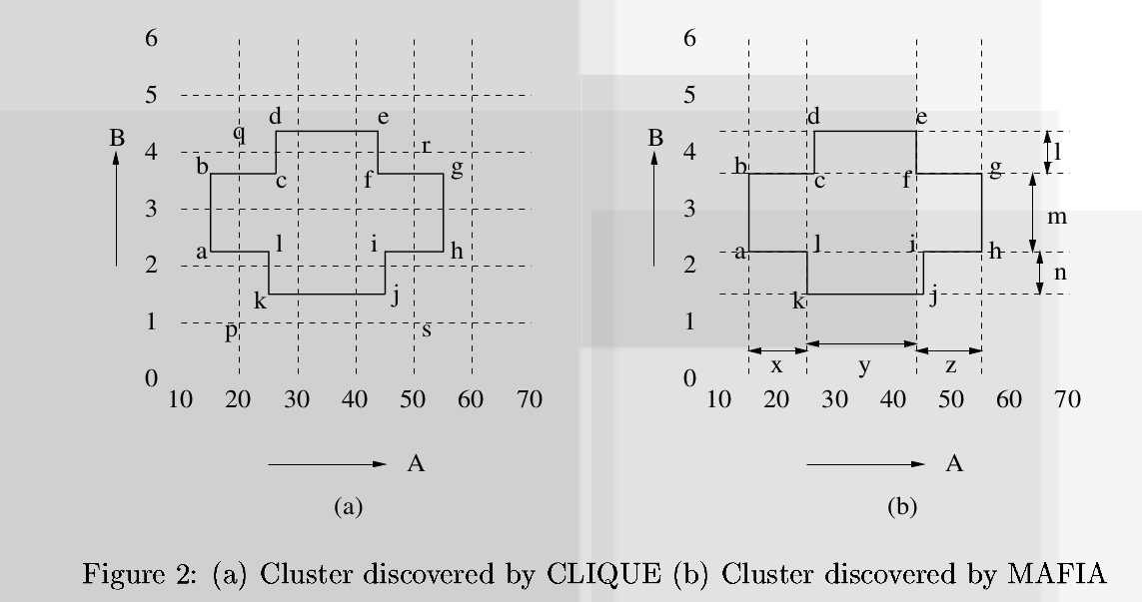
MAFIA
Notes:
所以我们的数据直接用这个算法是否也可行？解决高维数据聚类问题(density+grid)

Slide 7
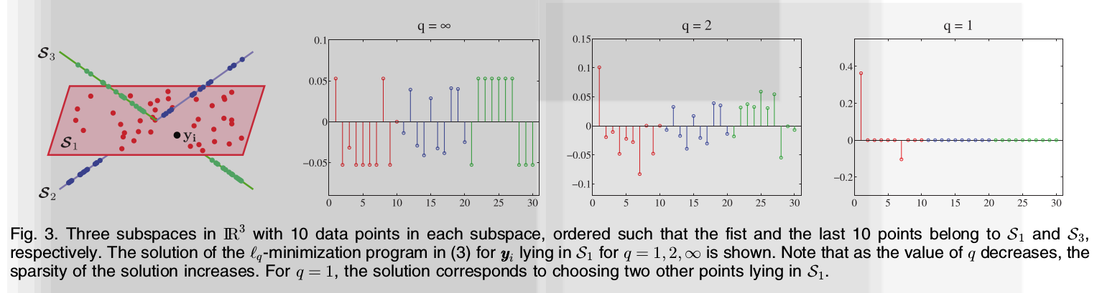
sparse subspace clustering
Spectral clustering-based methods.
Notes:
把一个数据点直接视为一个函数，不从属性维度进行考虑

Slide 8
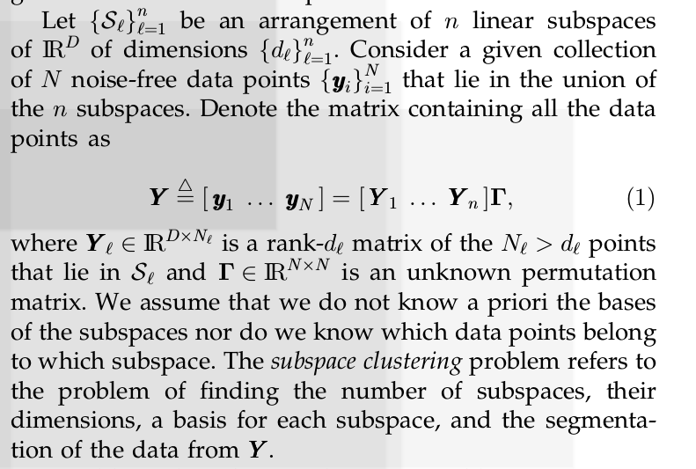
sparse subspace clustering
symbols
Notes:
置换矩阵

Slide 9
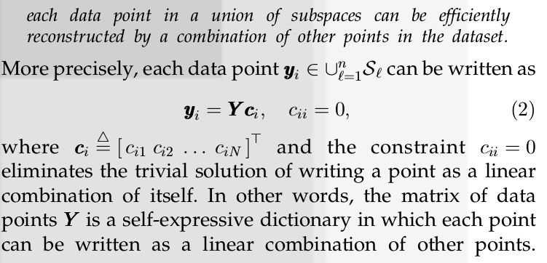
sparse subspace clustering
self-expressiveness

Slide 10
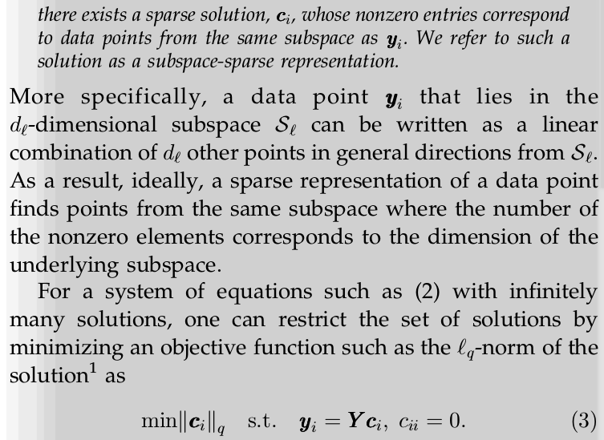
sparse subspace clustering
Notes:
回到fig3 能用同一个子空间表示即属于同一子空间 属于同一子空间ci的非0项数目肯定相等

Slide 11
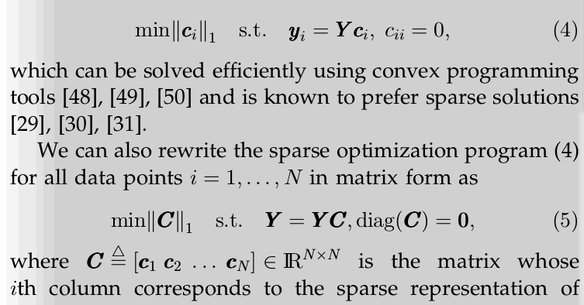
sparse subspace clustering
Notes:
ci确定子空间维数

Slide 12
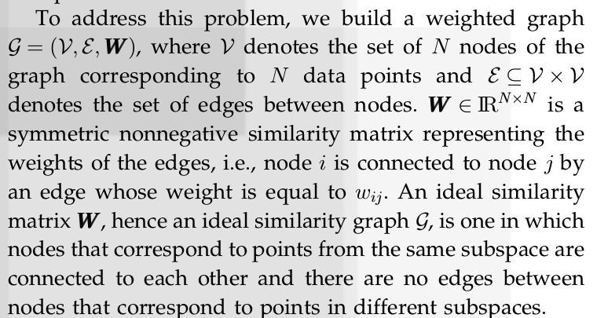
sparse subspace clustering
Clustering Using Sparse Coefficients
Notes:
数据如何分割成不同的子空间

Slide 13
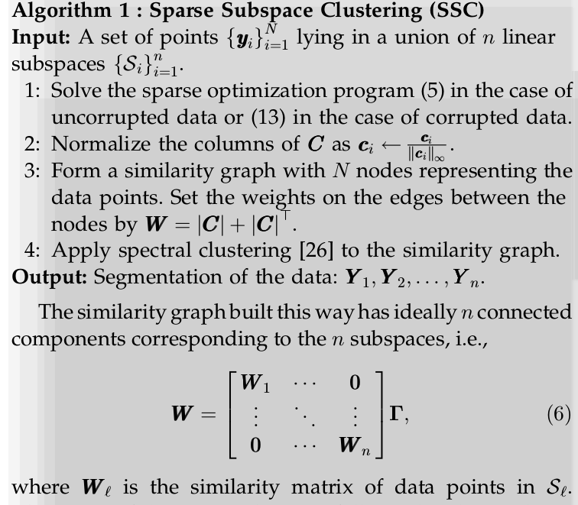
sparse subspace clustering
Notes:
w就是构建的邻接矩阵

Slide 14
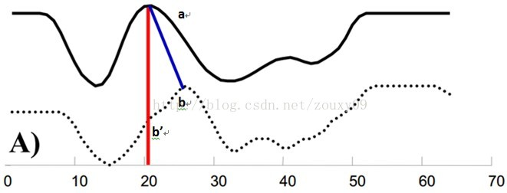

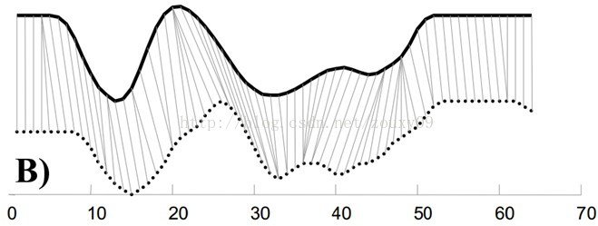
Functional subspace clustering
How to construct the adjacency matrix of functional data?
Notes:
DTW比较时间序列的相似性 这样是不是可以直接结束了？邻接矩阵已经出来了，然后sc DTW + SSC

Slide 15
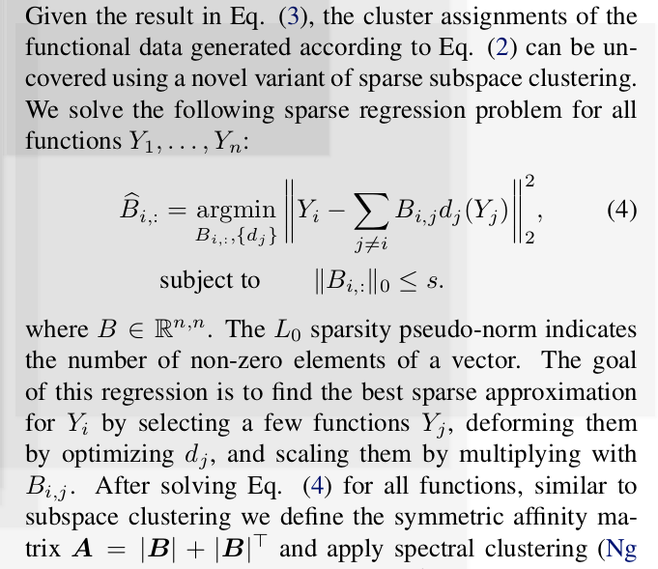
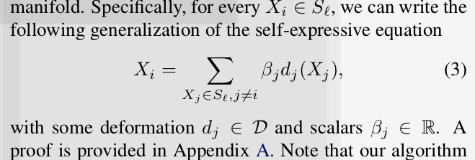
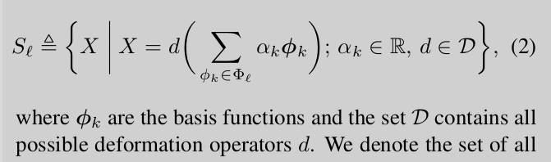
Functional subspace clustering
Notes:
Bijd（Yi）是Yi的线性表示 通过求Yi与子空间线性表示的Yi之前差值最小寻找每个函数型数据最适合的子空间并确定Bij这个权重矩阵

Slide 16
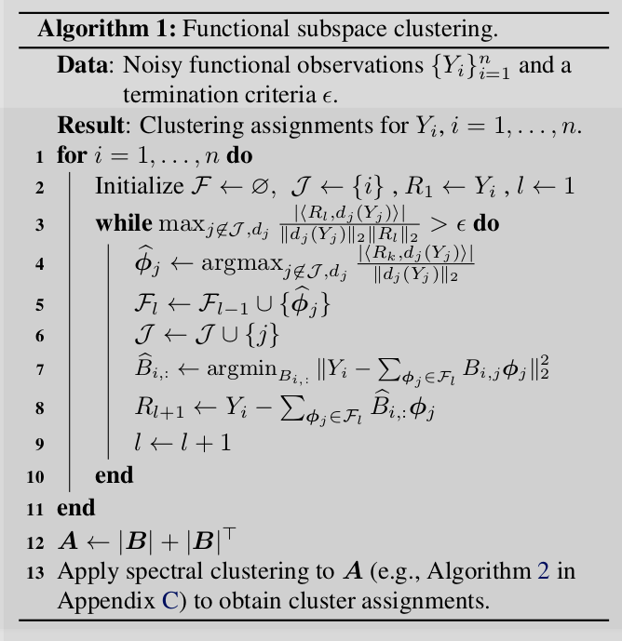
Functional subspace clustering
Algorithm
How to determine the value of
How to understand the residual
R？
Notes:
find a sparse matrix by loop

Slide 17
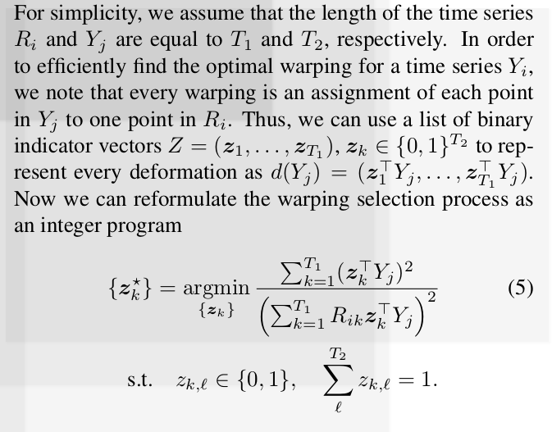
Functional subspace clustering
deformation operator d
Notes:
Zn*n

Slide 18
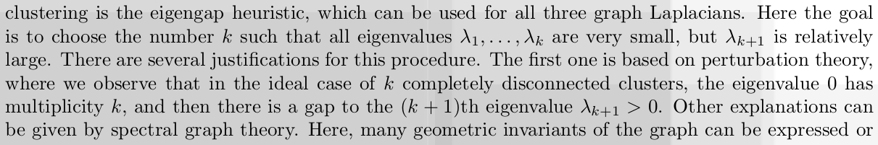
Spectral clustering
Spectral clustering is not a simple PCA plus kmeans
Selection of k

Slide 19
Reference
1. Subspace Clustering for High Dimensional Data: A Review
2. MAFIA:efficient and scalable subspace clustering for very large data sets
3. http://blog.csdn.net/WOJIAOSUSU/article/details/58251769?locationNum=11&fps=1
4. Sparse Subspace Clustering: Algorithm, Theory, and Applications
5. https://www.cnblogs.com/Daringoo/p/4095508.html （DTW）
6. Functional Subspace Clustering with Application to Time Series
7. A Tutorial on Spectral Clustering
8. http://blog.codinglabs.org/articles/pca-tutorial.html
9. http://www.taodocs.com/p-478979.html

