Slide 1

Investigating Animal Shelter Intake and Outcome Patterns
A Data Analysis Proposal for Long Beach Animal Shelter Group 5: Tran Trung Duc, Mai Tuan Minh

Slide 2
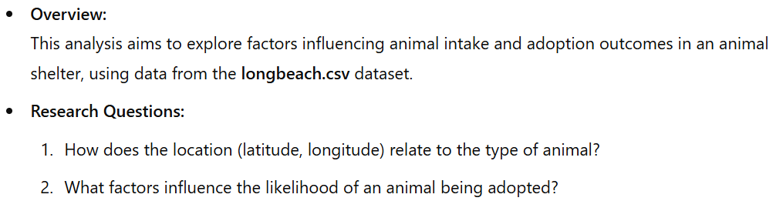

Introduction

Slide 3
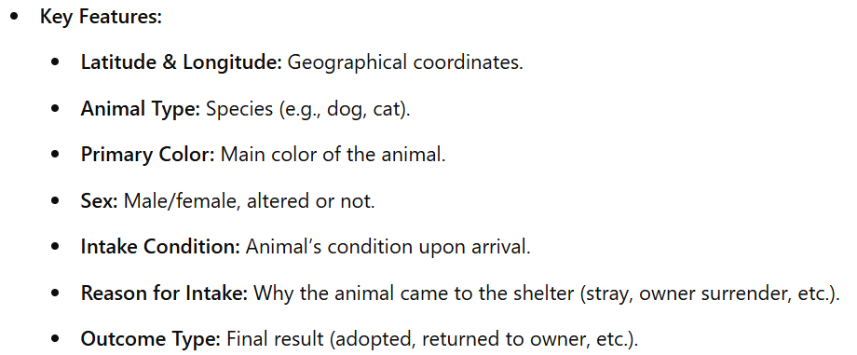
Dataset Overview

Slide 4
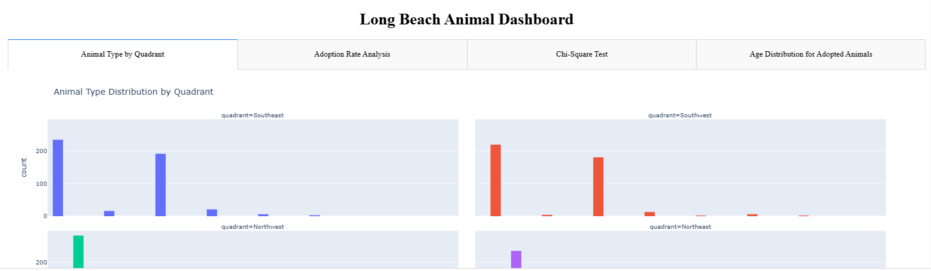
Interactive Dashboard

Slide 5
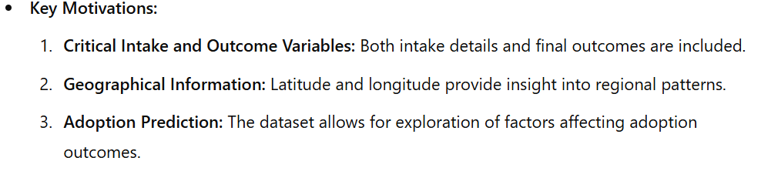
Reason for Choosing the Dataset

Slide 6
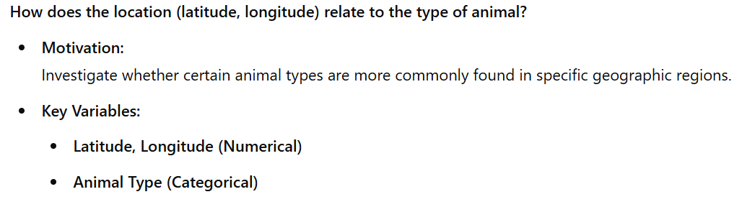
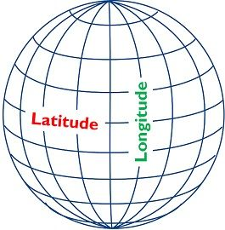
Research Question 1

Slide 7
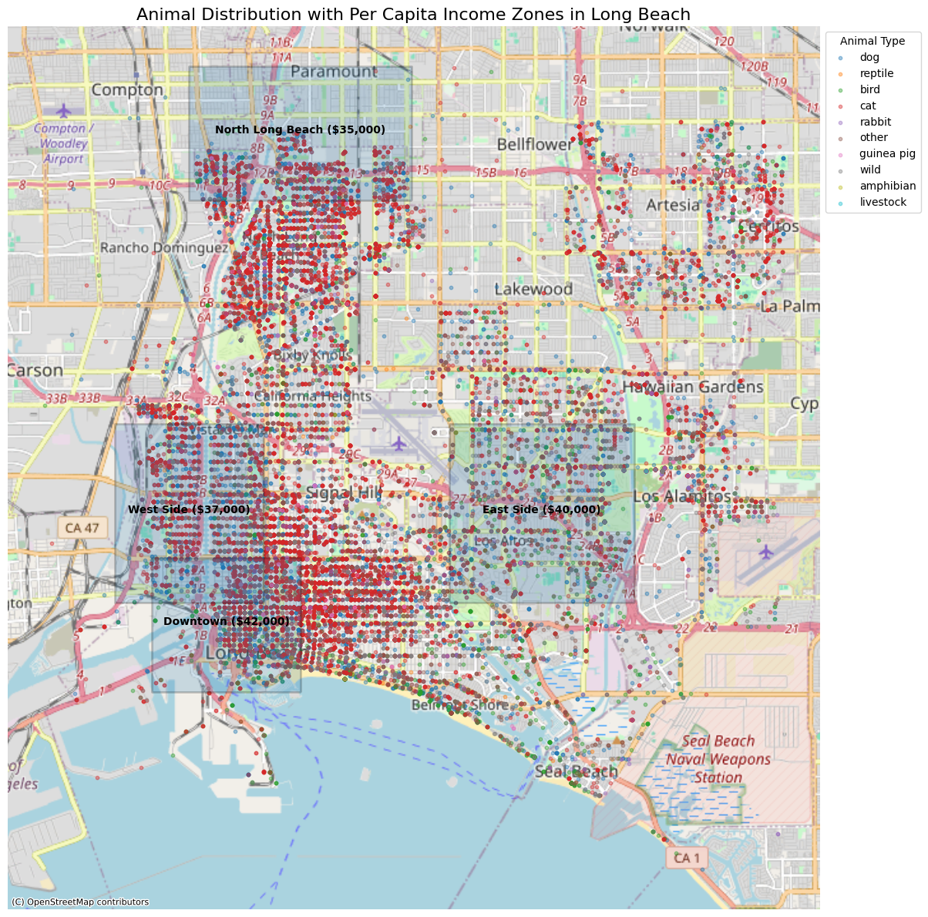
Geographical Distribution of Animal Types

Slide 8
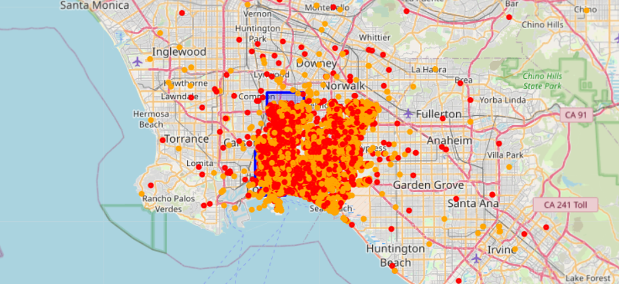
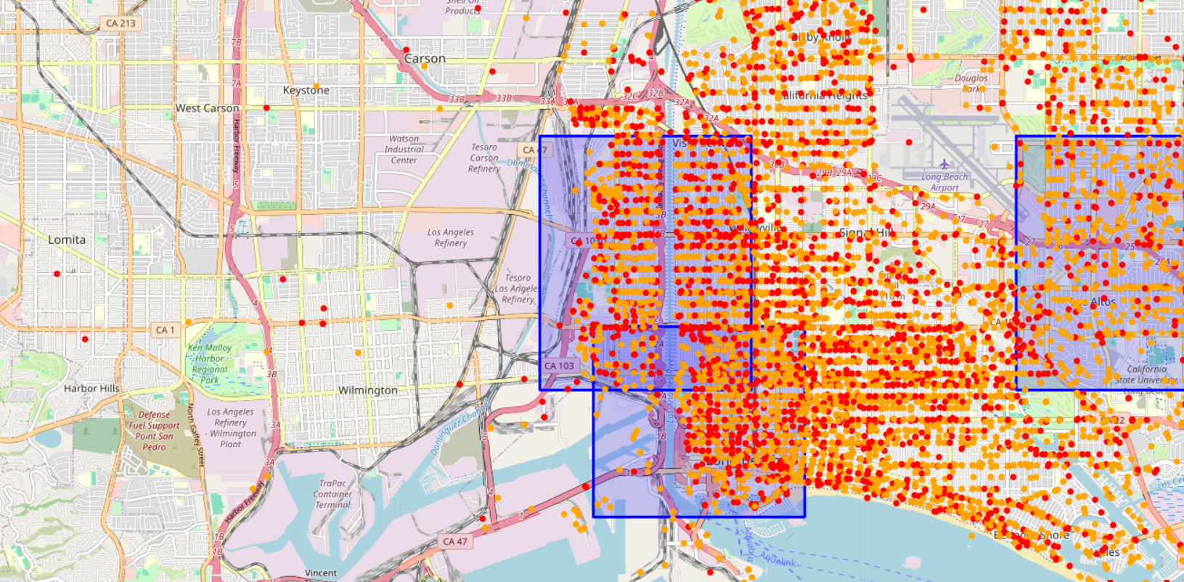
The map can zoom-in and out

Slide 9
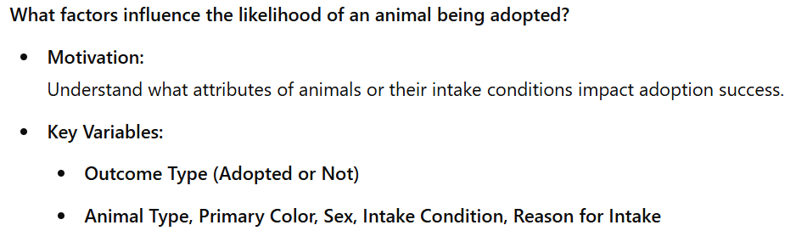
Research Question 2

Slide 10
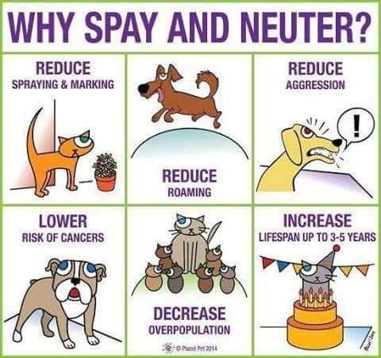
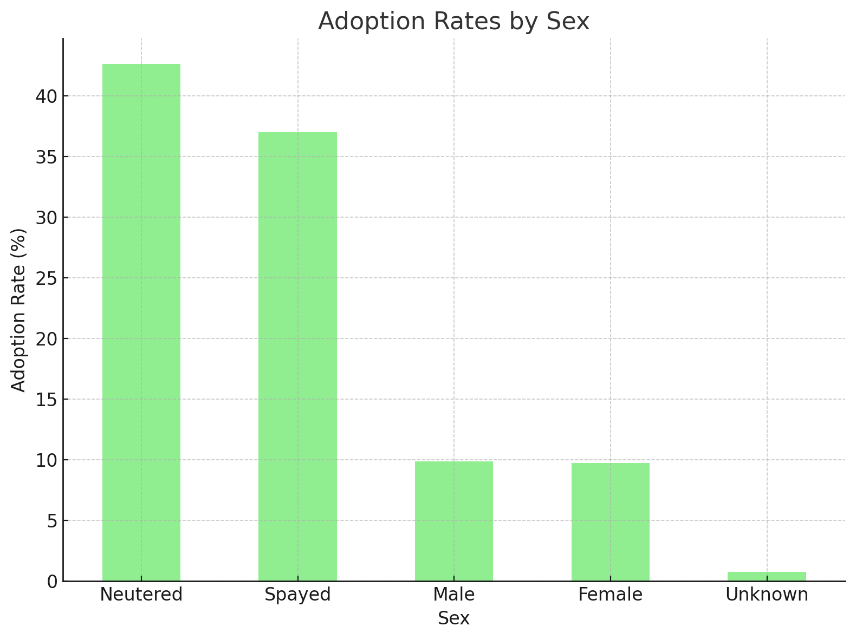
Adoption Rates by Sex

Slide 11
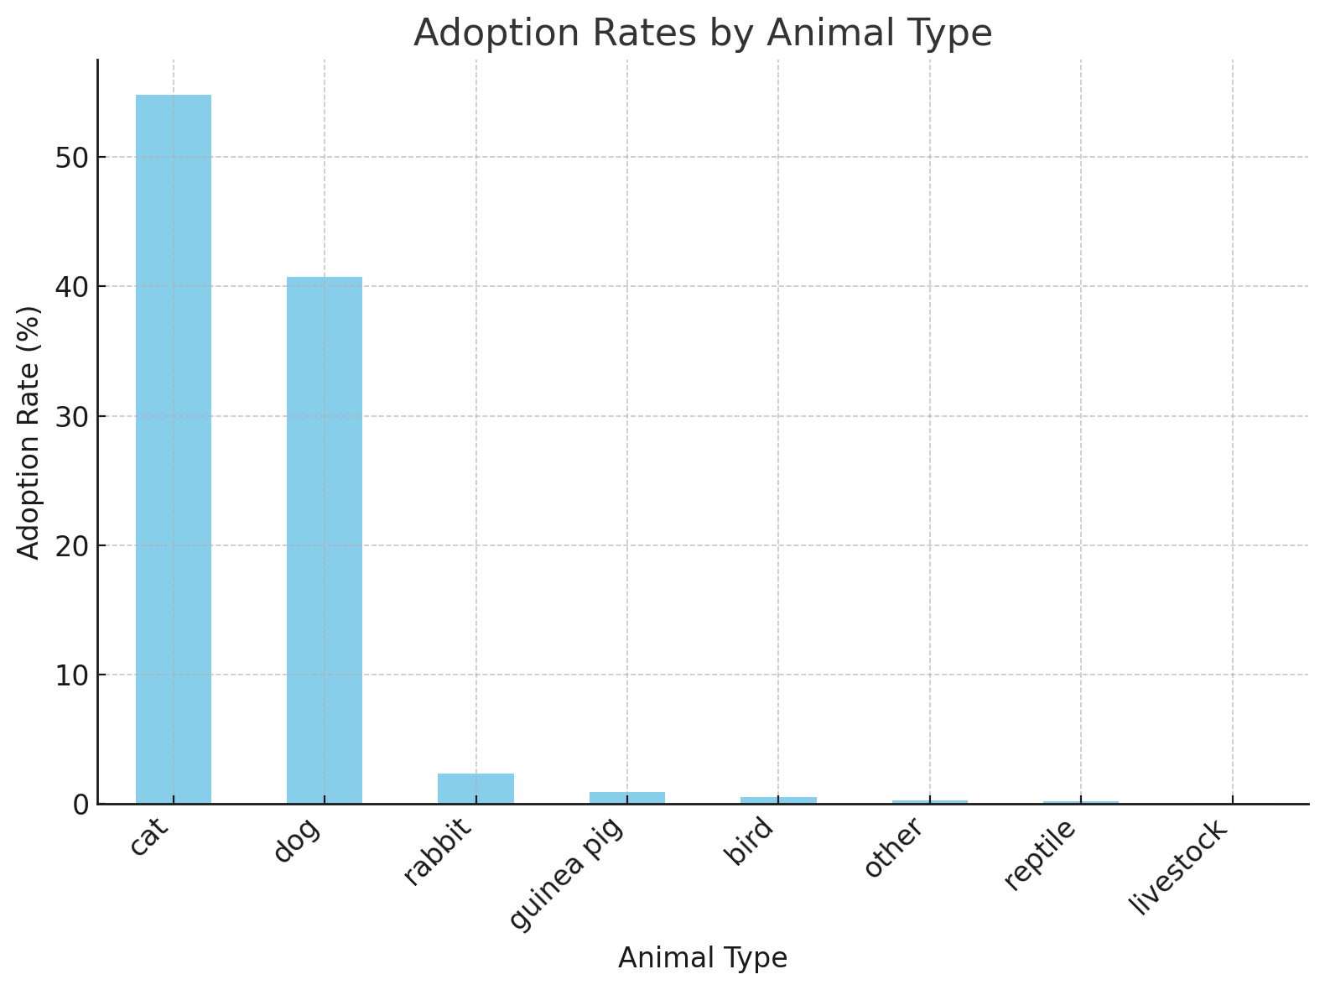
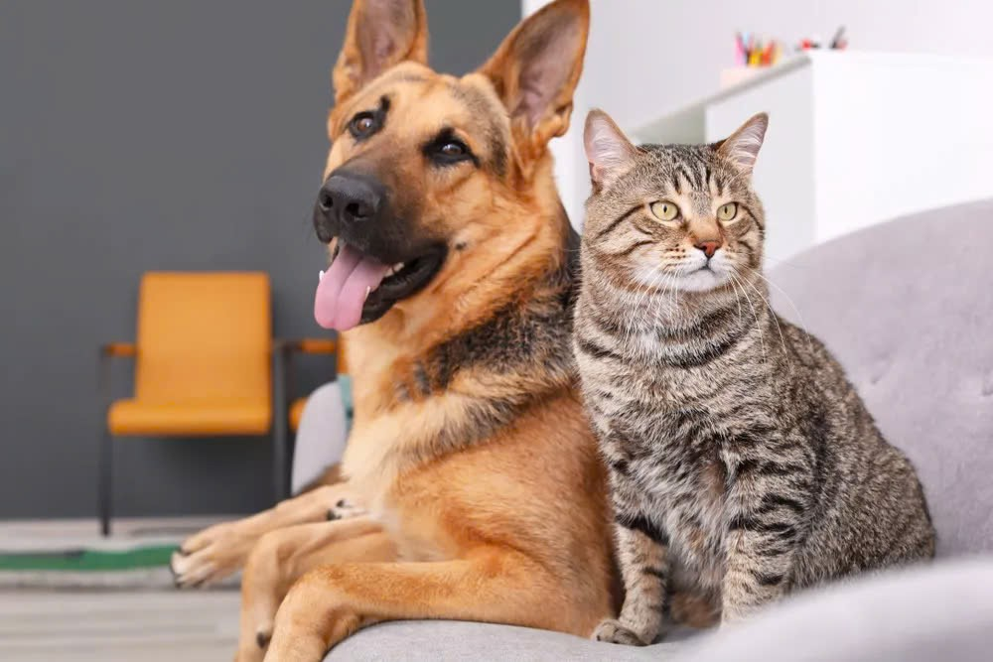
Adoption Rates by Animal Type

Slide 12
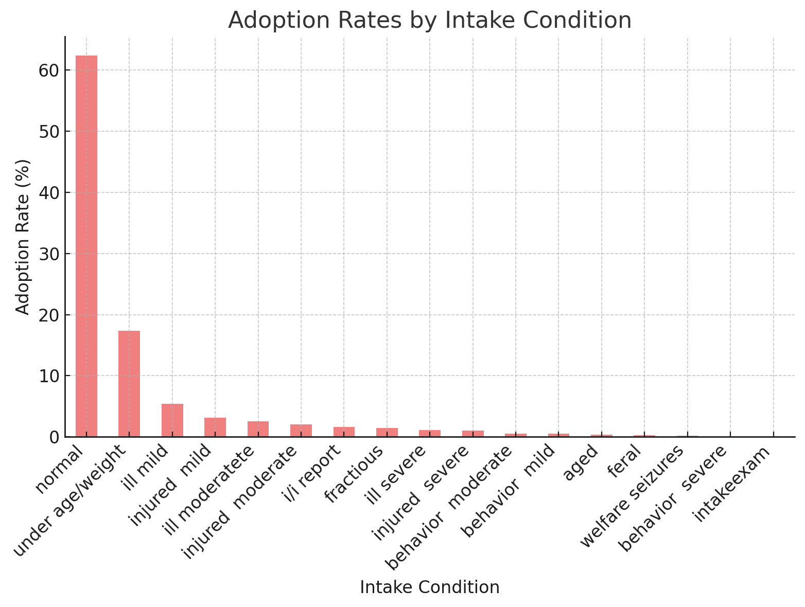
Adoption Rates by Intake Condition

Slide 13
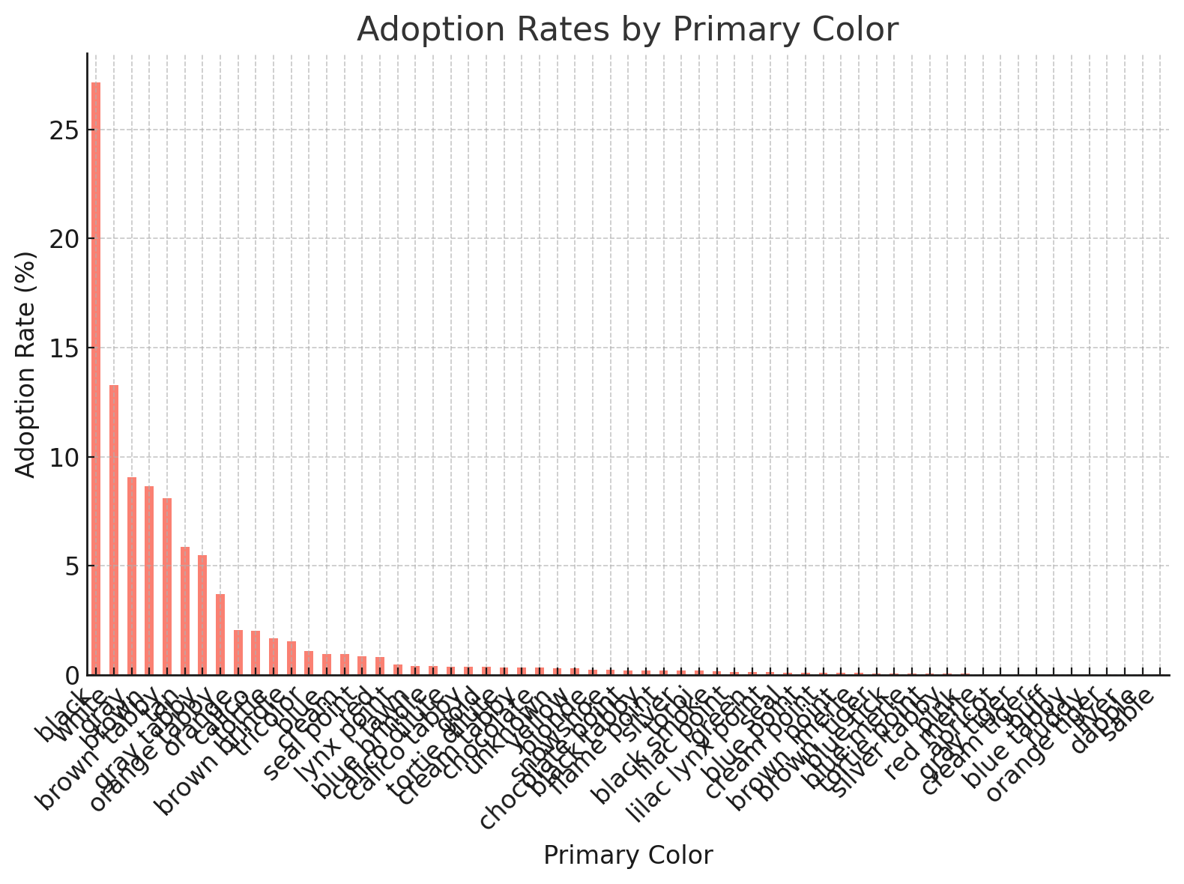
Adoption Rates by Primary Color

Slide 14
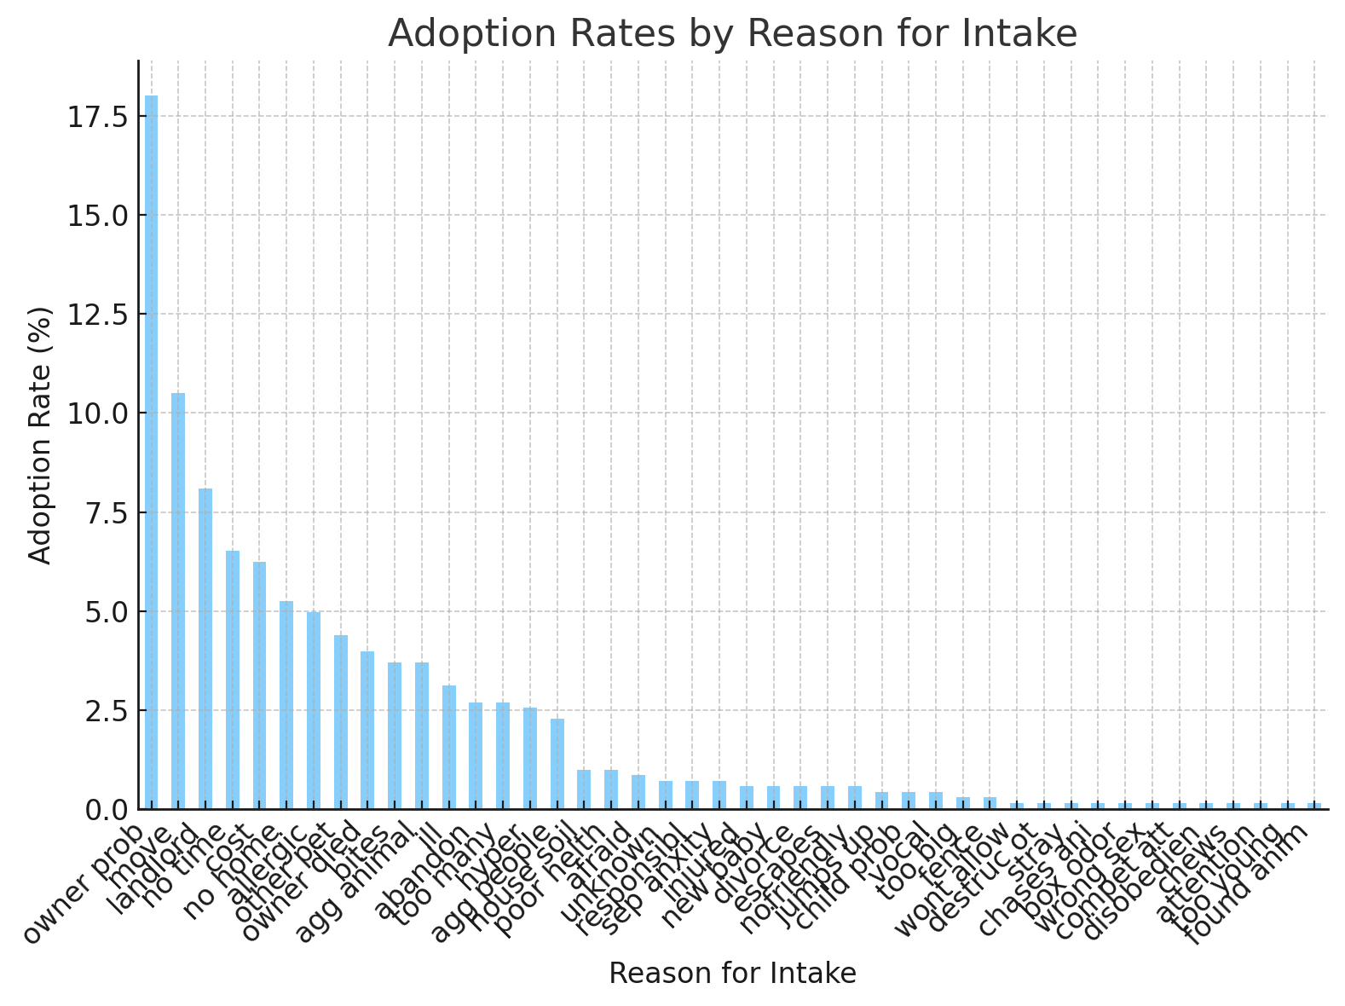
Adoption Rates by Reason for Intake

Slide 15
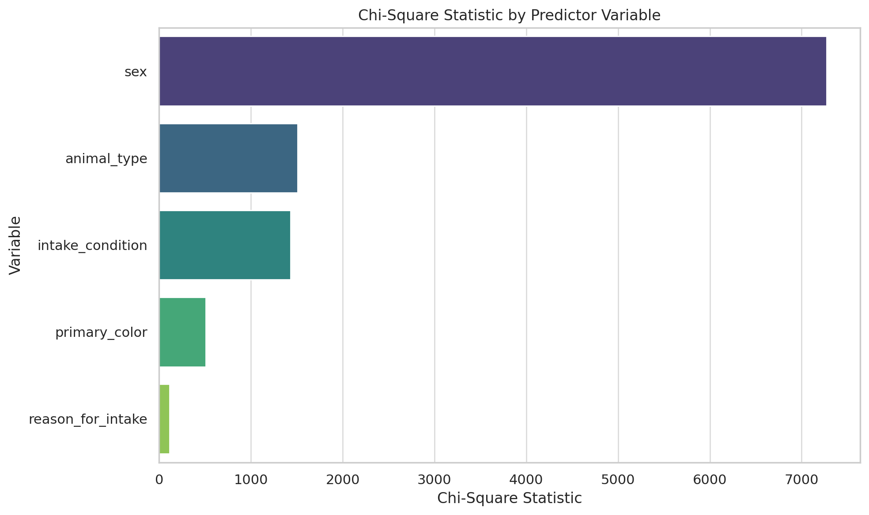
Apply Chi-square test

Slide 16
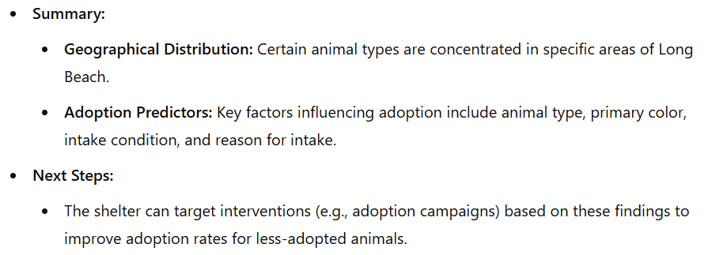
Conclusion

Slide 17

Q&A

