Slide 1

Singularity Free Combined Vector Field based Path Following and Obstacle Avoidance
Presented By
Supervisor
Dheeraj
Sikha Hota
BACHELOR TERM PROJECT - II

Slide 2

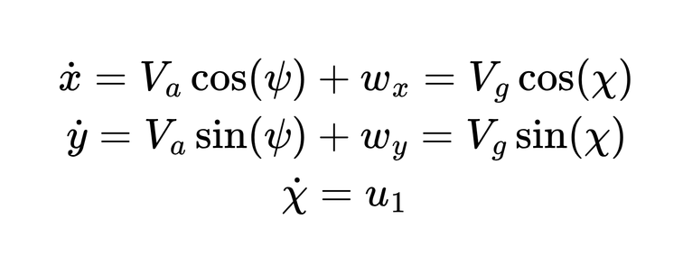
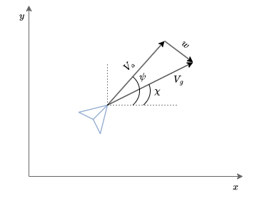
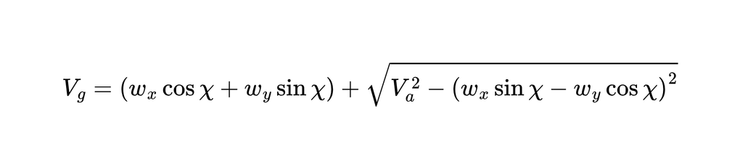
UAV Kinematic Model & Problem Setup
with Ground Speed (Vg), given as
Desired path: C₁ : f(x, y) = 0 (twice differentiable implicit curve)
Obstacle: C₂ : g(x, y) = 0 with safety margin δ
Pseudo-distances: r = f(x, y), robs = g(x, y)
  r = 0 ⟹ UAV on desired path
  robs = 0 ⟹ collision with obstacle
Notes:
4

Slide 3
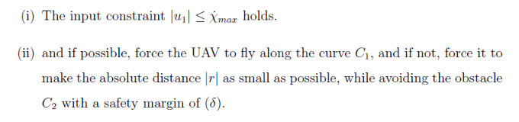
UAV Kinematic Model & Problem Setup
The Problem statement can then be summarized as, to design a controller u1 such that
Notes:
4

Slide 4
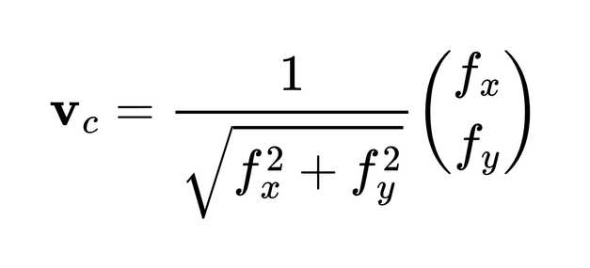
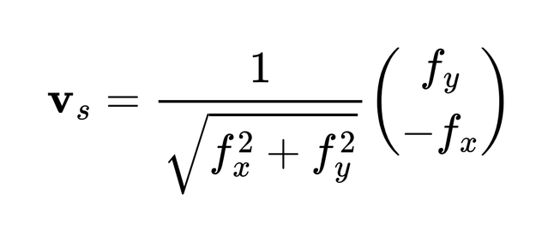
Combined Vector Field (CVF) — Core Idea
Helmholtz Decomposition
Any arbitrary vector field can be decomposed into a conservative (curl-free) part and a solenoidal (divergence-free) part.
Conservative Component (vc)
Solenoidal Component (vs)
• Gradient-based — pushes UAV toward or away from the curve
• Drives cross-track error to zero
• Orthogonal to conservative field everywhere
• Rotational — aligns UAV with curve direction
• Ensures tangential circulation along C₁
Notes:
5

Slide 5
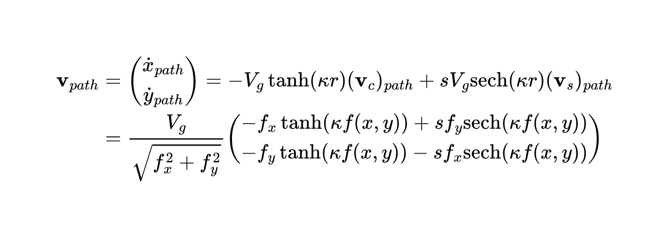
Path-Following Combined Vector Field
The CVF blends conservative and solenoidal components with nonlinear state-dependent weights:
Design Parameters:
κ > 0
Path-following design parameter. Larger κ ⟹ faster convergence (conservative part dominates far from path)
s = ±1
Selects clockwise or counterclockwise circulation along C₁
tanh(κr)
Near path (r≈0): weight → 0, solenoidal dominates (tangential motion)
sech(κr)
Far from path (|r|≫0): weight → 0, conservative dominates (pull toward path)
Notes:
6

Slide 6
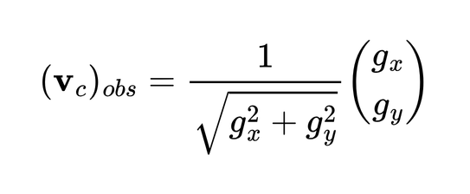
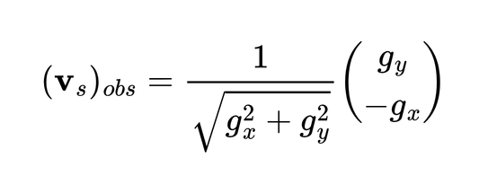
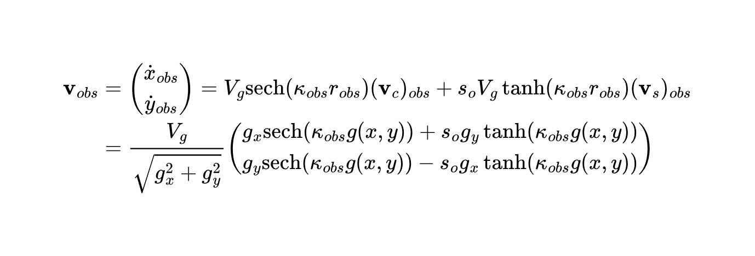
Obstacle-Avoidance Combined Vector Field
A symmetric CVF is constructed around the obstacle boundary C₂ : g(x,y) = 0, reversing the weighting logic:
Interpretation:
  Near obstacle (robs ≈ 0): sech(κobs·robs) ≈ 1 ⟹ conservative term dominates ⟹ strong repulsion
  Far from obstacle (robs ≫ 0): sech → 0, tanh → 1 ⟹ solenoidal term dominates ⟹ circulation
  so = −s ensures obstacle field curls opposite to path field, allowing the UAV to pass around obstacles
  κobs controls how far the obstacle field's repulsive influence extends
Notes:
7

Slide 7
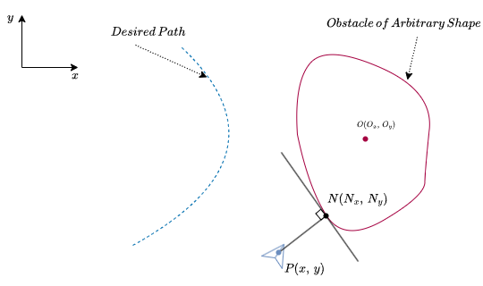
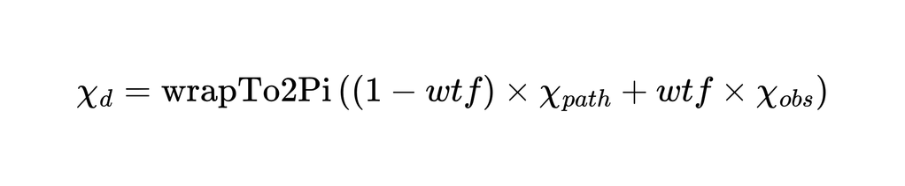
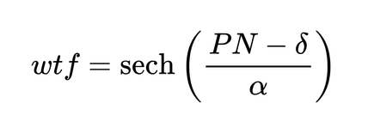
Singularity-Free Angle Blending Strategy
The Singularity Problem
Direct vector addition of vpath and vobs creates null points where equal-magnitude opposing vectors cancel → UAV loses guidance entirely.
Angle-Based Blending Solution
and
  PN = minimum perpendicular distance from UAV to obstacle
  wtf → 0 when far: guidance = χpath (path following only)
  wtf → 1 when PN ≈ δ: guidance blends toward χobs (avoidance)
  α controls the sharpness of field transition
  Angle addition guarantees no null vector regardless of field orientation
Notes:
8

Slide 8
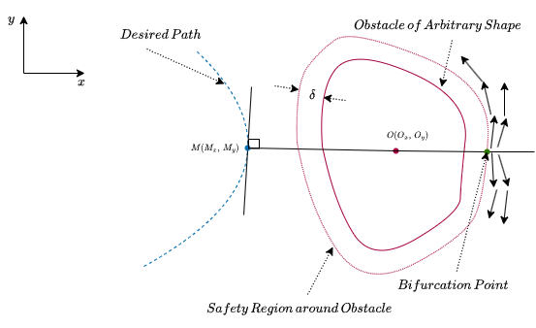
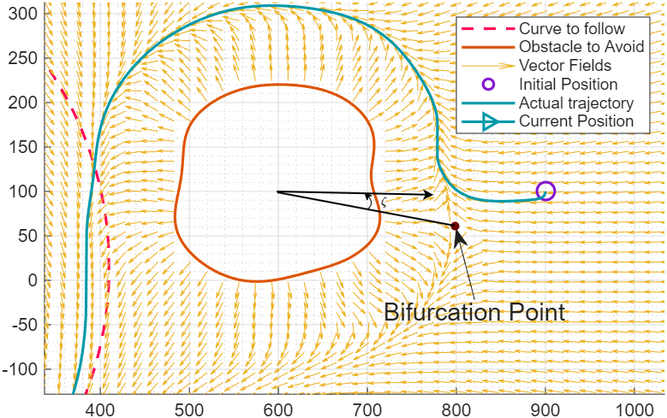
Algorithm For Angle Blending
Obstacle completely outside path (r>0 everywhere)
CASE I
Compute bifurcation angle ζ from foot of perpendicular M on C₁ from obstacle COM. Re-wrap χpath and χobs to [ζ, ζ+2π) for smooth blending.
Obstacle intersects path (r >= 0 and r < 0 regions)
CASE II
Inside region: enforce so to curl opposite path.
outside region: enforce so to curl same as path. Prevents trapping at premature stable points.
Obstacle completely inside path (r<0 everywhere)
CASE III
Apply same algorithm as CASE I. Bifurcation wrapping ensures symmetric approach from either side.
Notes:
9

Slide 9
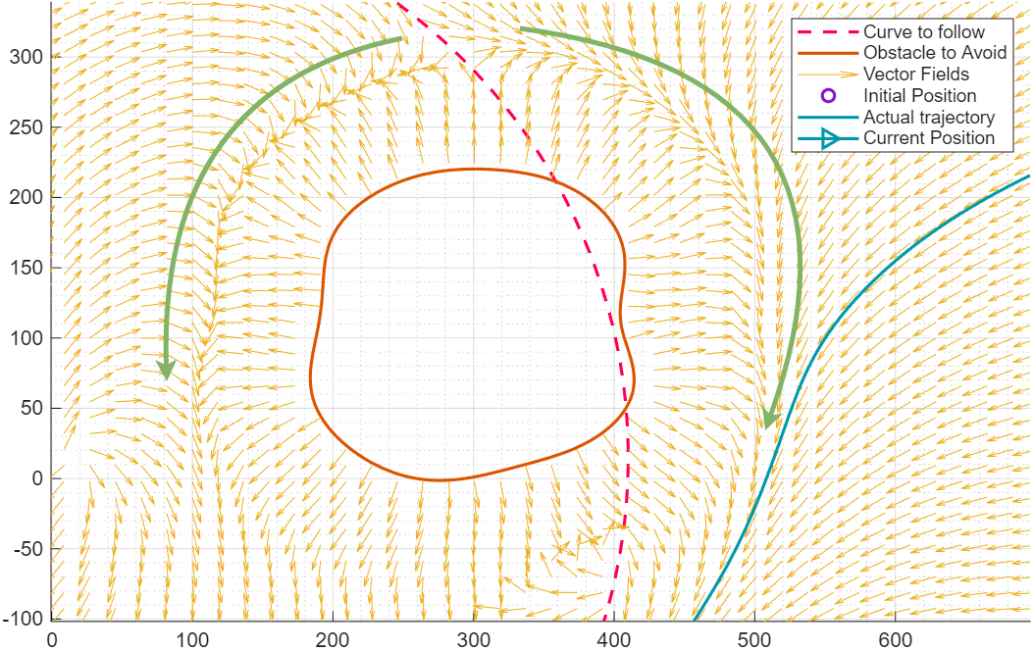
Algorithm For Angle Blending
Notes:
10

Slide 10
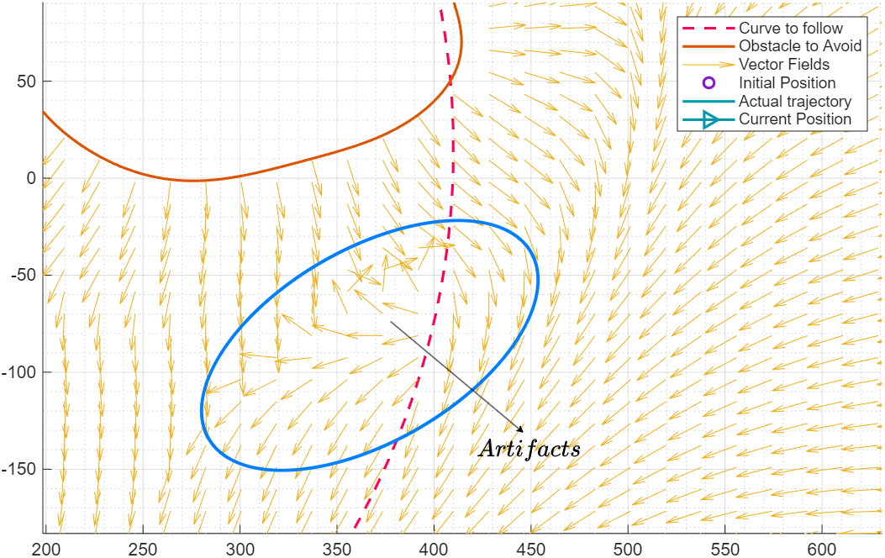
Limitations of the Current Algorithm
  Artifacts appear in CASE II due to forced 2π shift in χpath or χobs
  Bifurcation may occur at multiple points for complex geometries
  Premature stable points or loops can form near wrapping discontinuities
Notes:
10

Slide 11

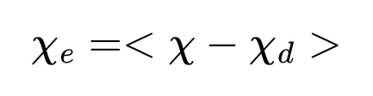
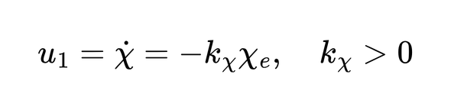
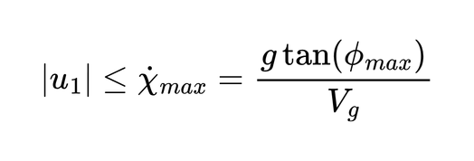
Controller Design
Saturated Proportional Course-Rate Controller
1
Desired course from CVF
2
Course error
(wrapped to (−π, π])
3
Control law
4
Saturation constraint
Notes:
11

Slide 12
Simulations
Simulation Parameters
  UAV Air speed (Va) : 15 m/s
  Initial Course Angle (χ0): - π/2 radians
  Rotational sense of Path Vector Field (s): +1 (clock-wise)
  Proportional feedback gain (kχ): 1.5
  Maximum allowable roll angle (Φmax): π/4 radians
  Wind : [6, 8]T m/s
The above parameters remains same for all simulations
Notes:
11

Slide 13
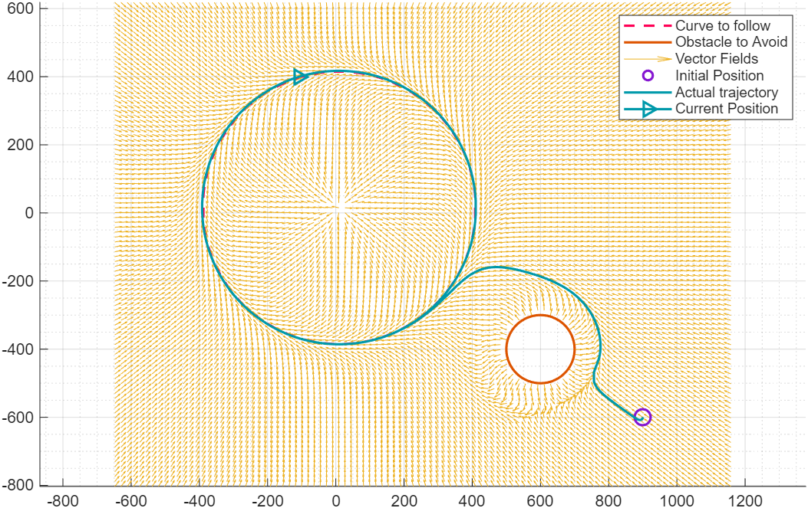
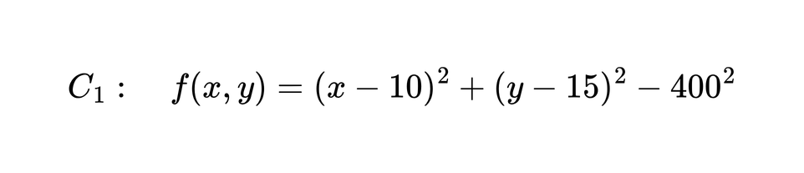
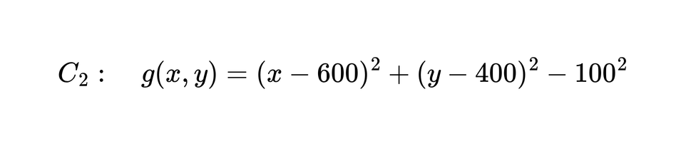
Simulation — Circular Path, Circular Obstacle
Case I: Obtacle is Completely Outside
  C₁ centered at (10, 15)m, R = 400m |
C₂ centered at (600, 400)m, R = 100m
  κ = 20 | κobs = 5
  Initial Position, P0(900. -600)m
Notes:
12

Slide 14
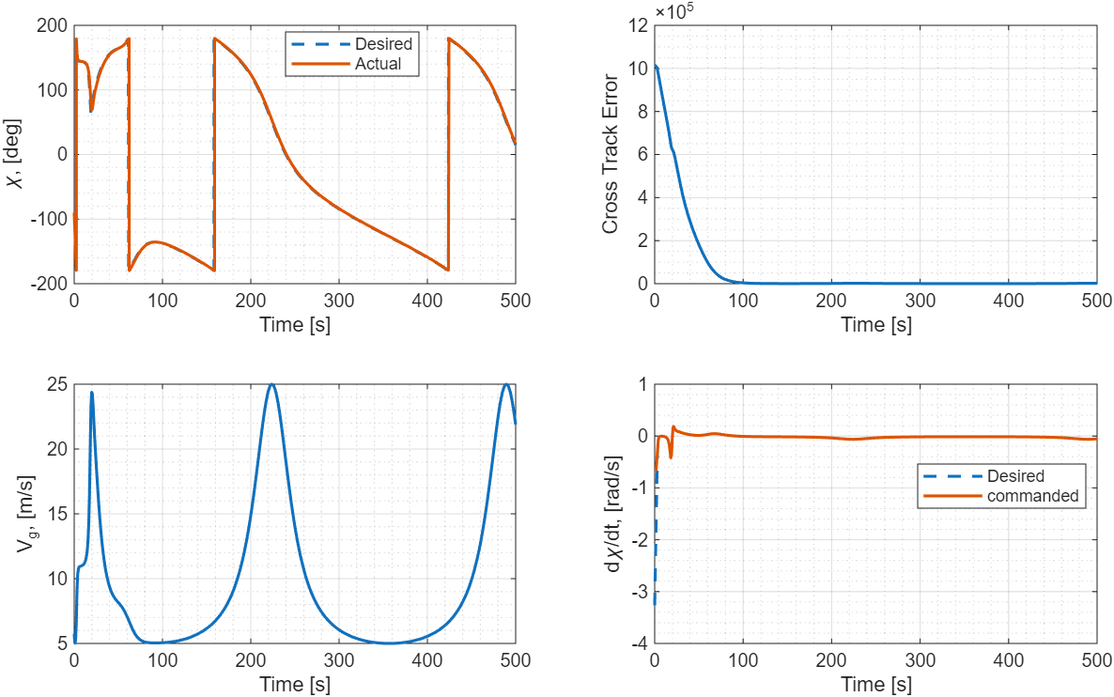
Simulation — Circular Path, Circular Obstacle
Notes:
15

Slide 15
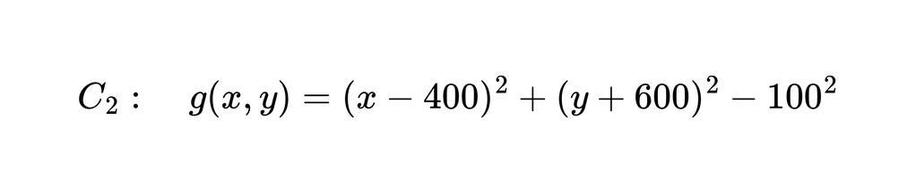
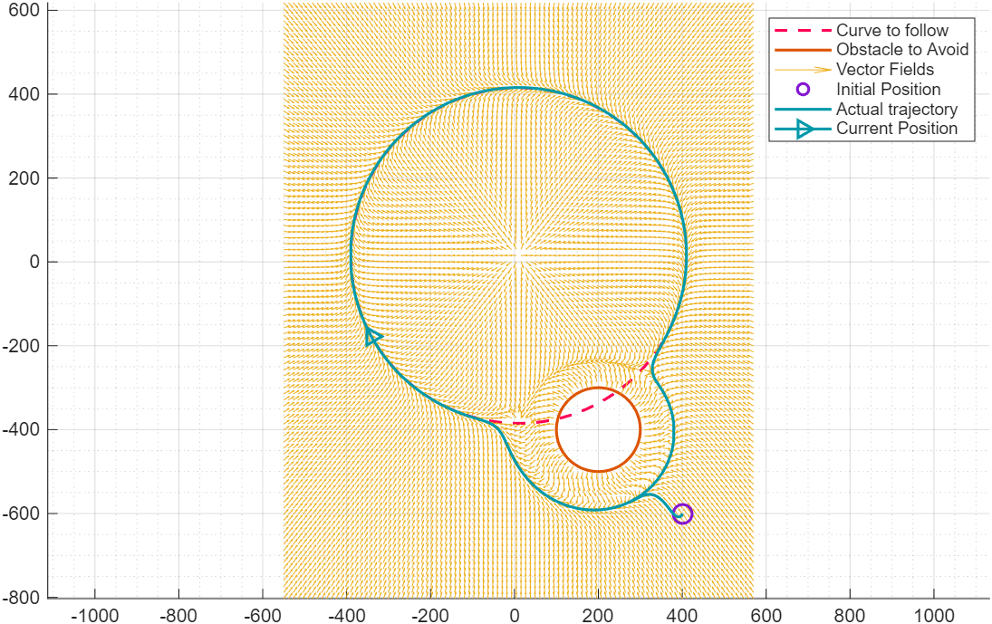
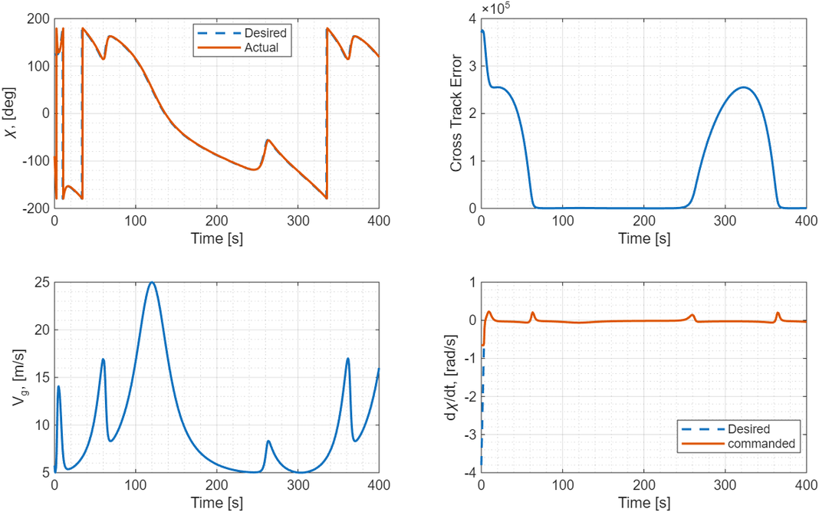
Simulation — Circular Path, Circular Obstacle
Case II: Obstacle intersects the desired path
with P0(400, -600)m.
Notes:
14

Slide 16
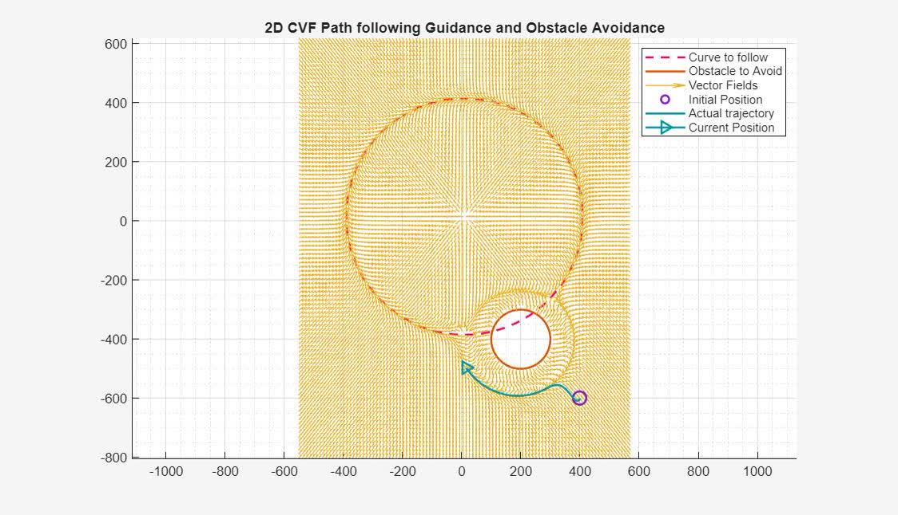
Simulation — Circular Path, Circular Obstacle
Notes:
15

Slide 17
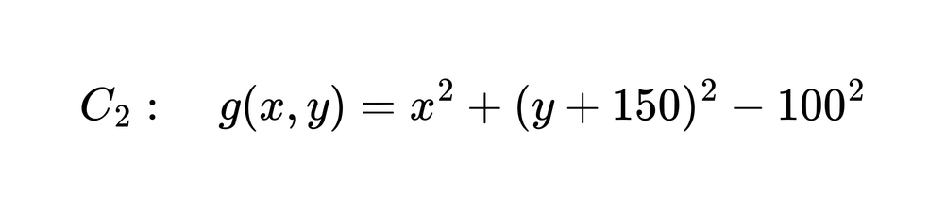
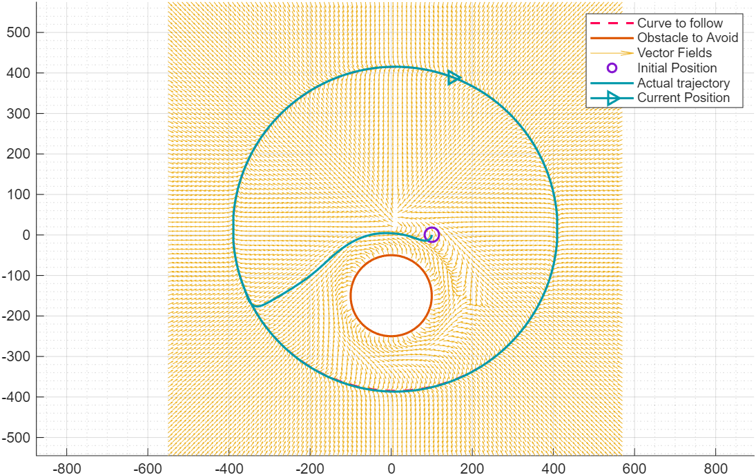
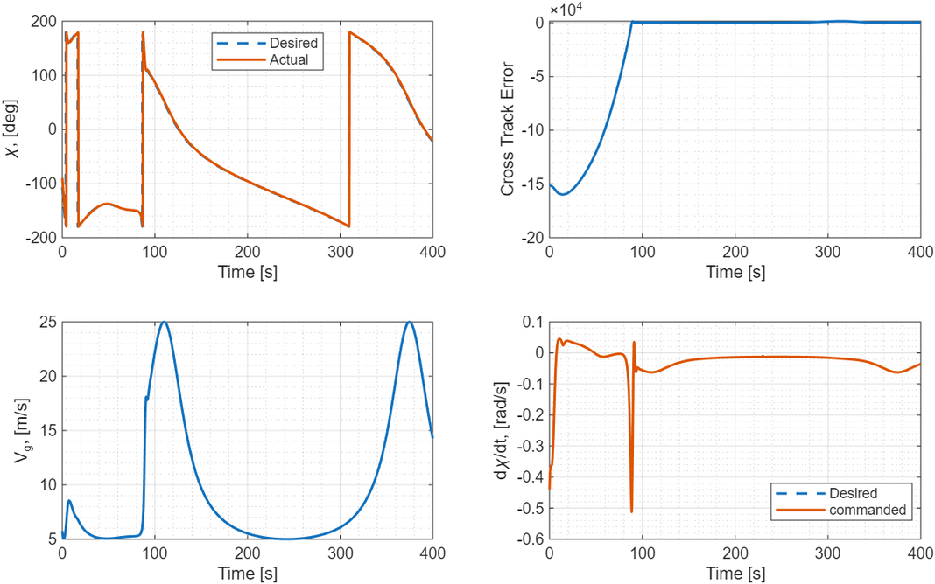
Simulation — Circular Path, Circular Obstacle
Case III: Obstacle is completely inside the desired path
with P0(100, 0)m.
Notes:
16

Slide 18
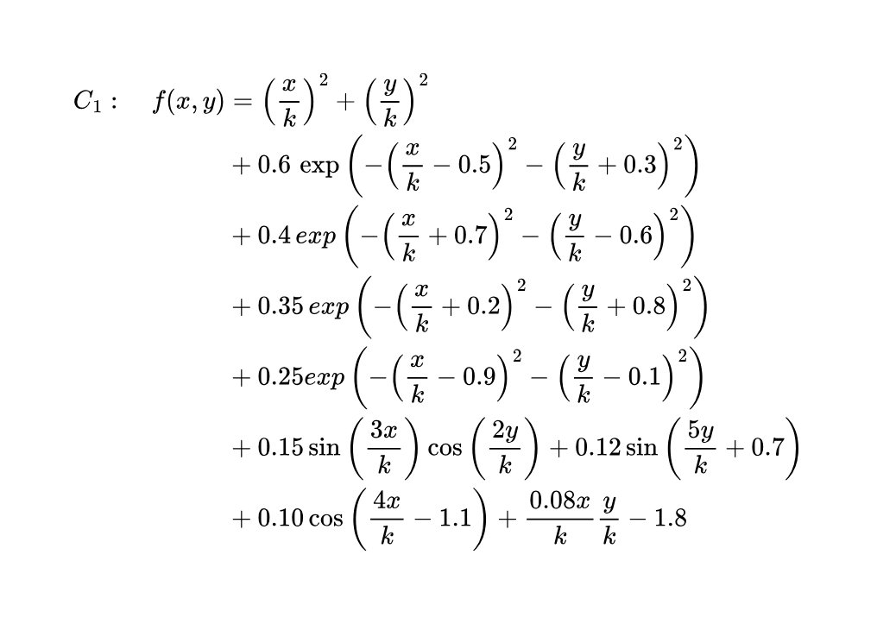
Simulation — Arbitrary Closed Path, Arbitrary Obstacle
The desired arbitrary closed path is given as,
Where, k = 400 and centered around (0, 0) and κ = 20 and κobs = 0.8, with all other parameters same as in circle-circle case.
Notes:
18

Slide 19
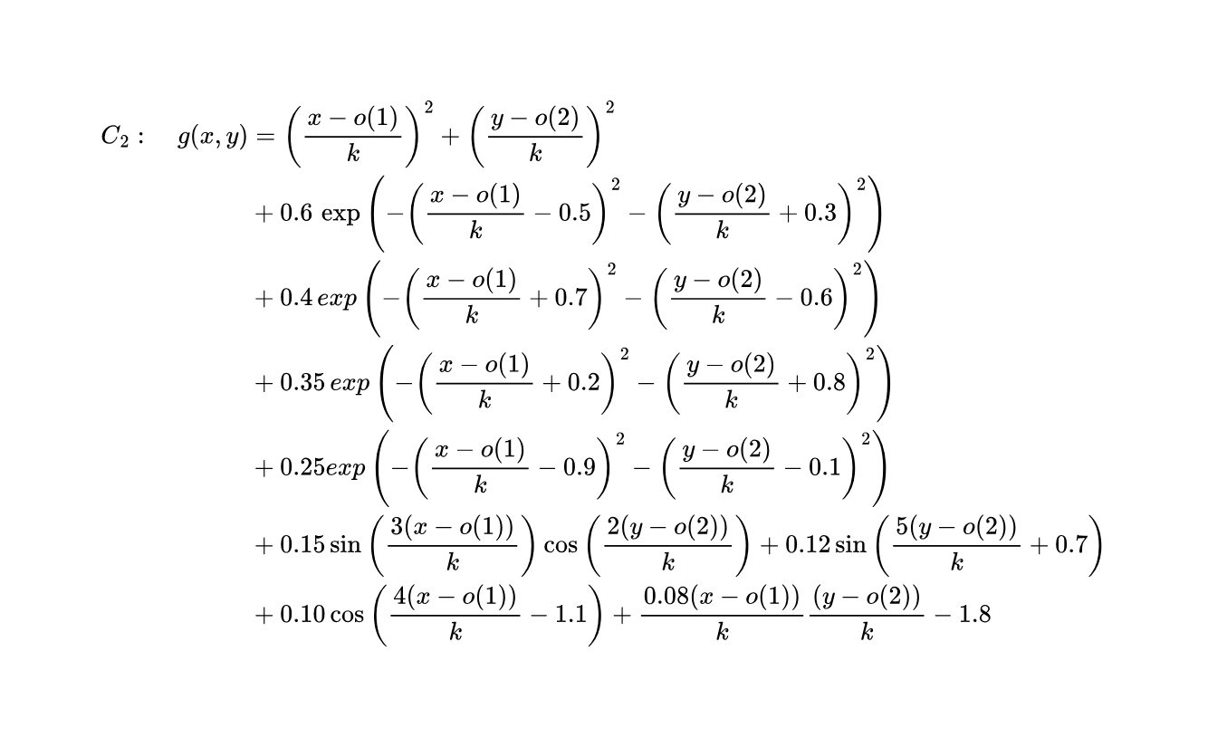
Simulation — Arbitrary Closed Path, Arbitrary Obstacle
Case I: Obstacle is completely outside
The obstacle can be given as
where k = 100 and o = [700, −500], with initial position of the UAV as P0(1000,−700)m
Notes:
18

Slide 20
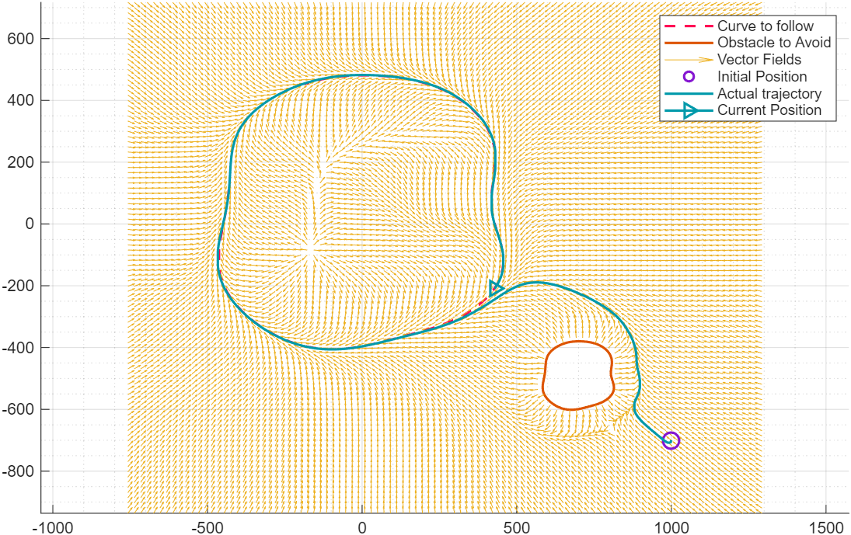
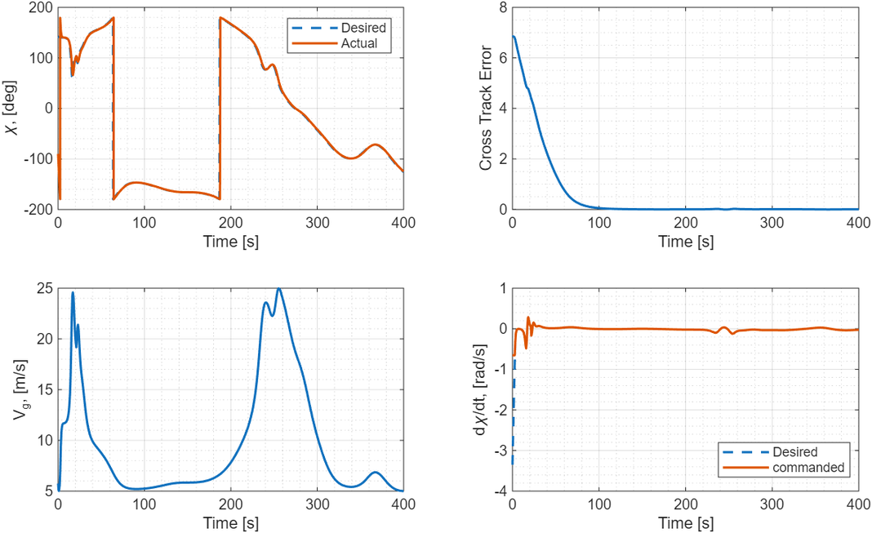
Simulation — Arbitrary Closed Path, Arbitrary Obstacle
Notes:
19

Slide 21
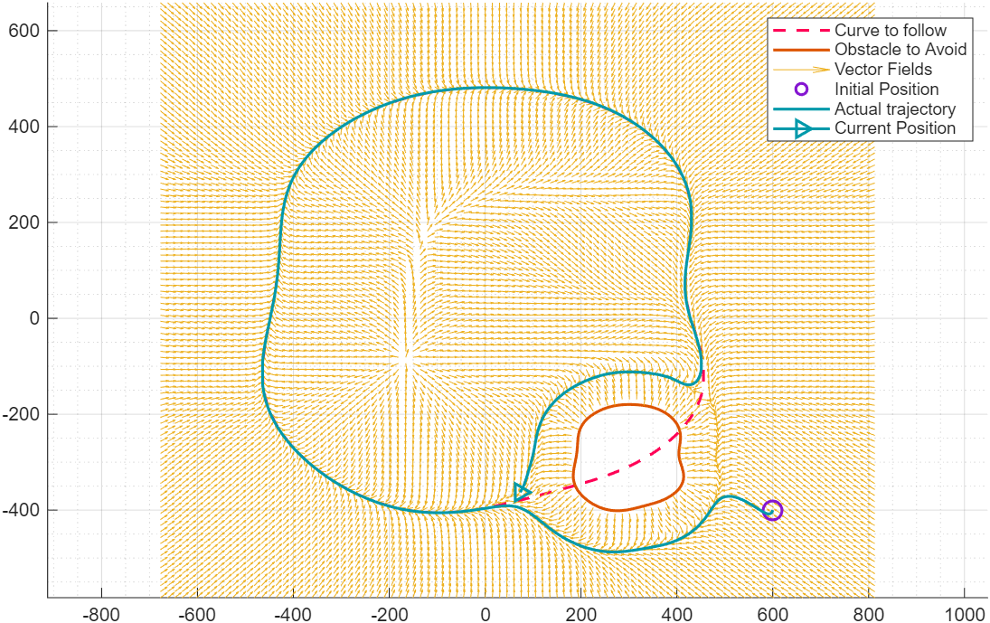
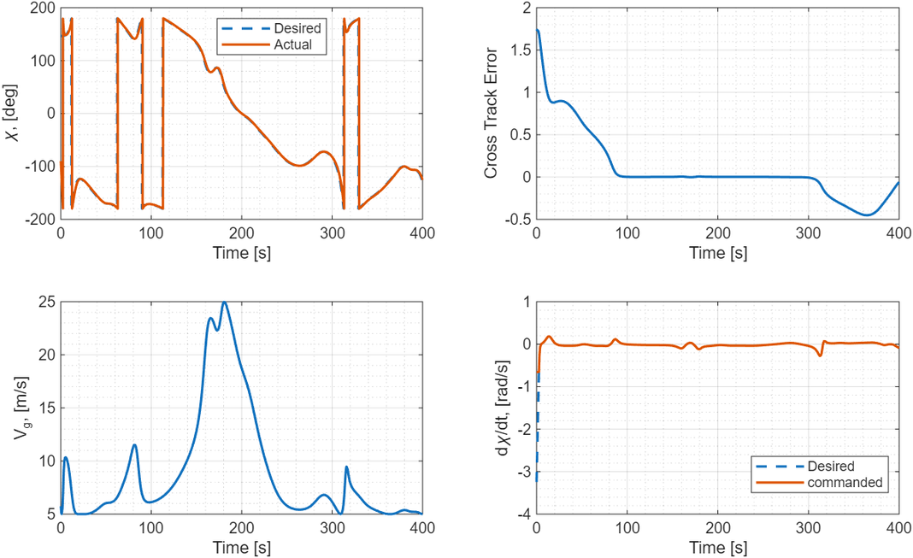
Simulation — Arbitrary Closed Path, Arbitrary Obstacle
Case II: Obstacle intersects the desired path
The obstacle can be given given by the same equation as in Case I, where k = 100 and o = [300, -300]
Initial position of the UAV as P0(600,−400)m
Notes:
18

Slide 22
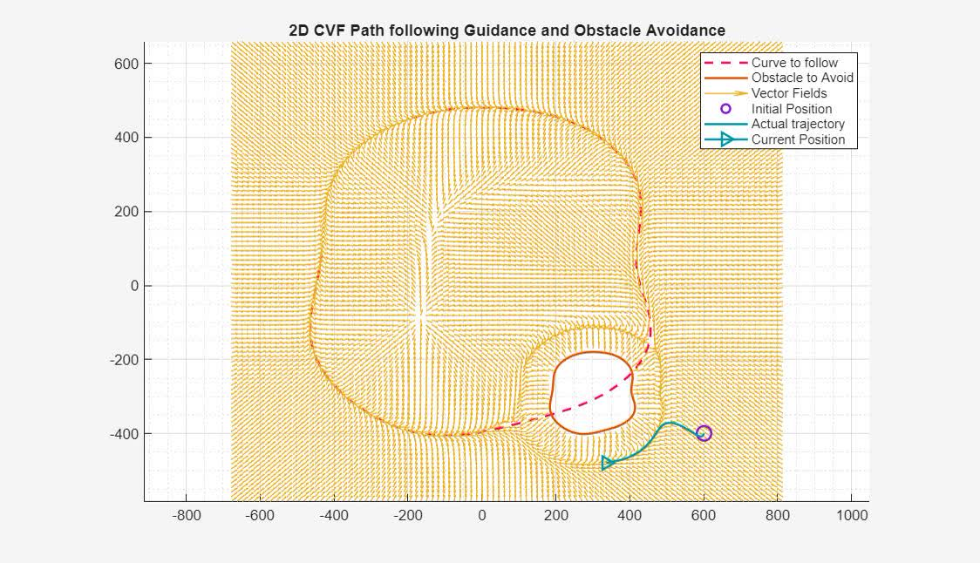
Simulation — Arbitrary Closed Path, Arbitrary Obstacle
Notes:
19

Slide 23
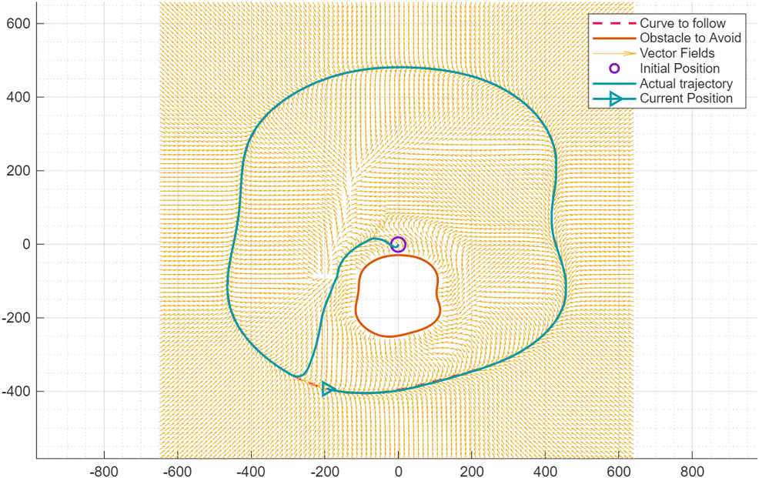
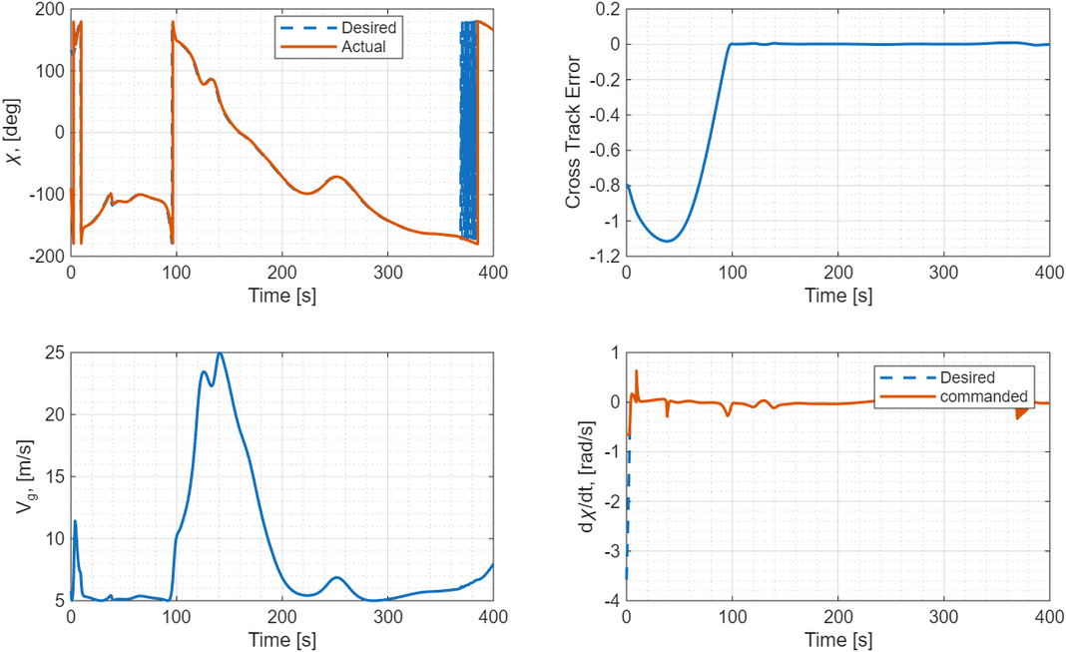
Simulation — Arbitrary Closed Path, Arbitrary Obstacle
Case III: Obstacle is completely inside
The obstacle can be given given by the same equation as in Case I, where k = 100 and o = [0, -150]
Initial position of the UAV as P0(0, 0)m
Notes:
18

Slide 24
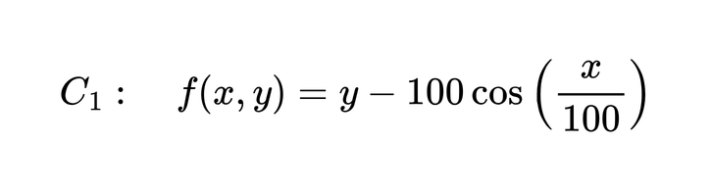
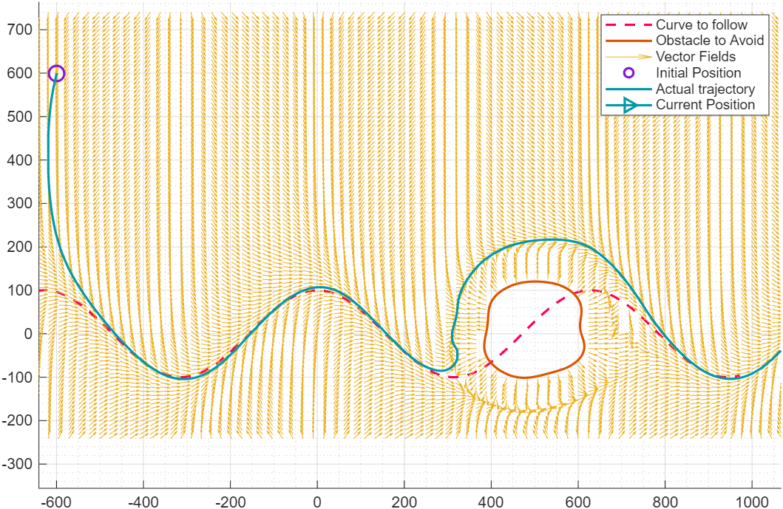
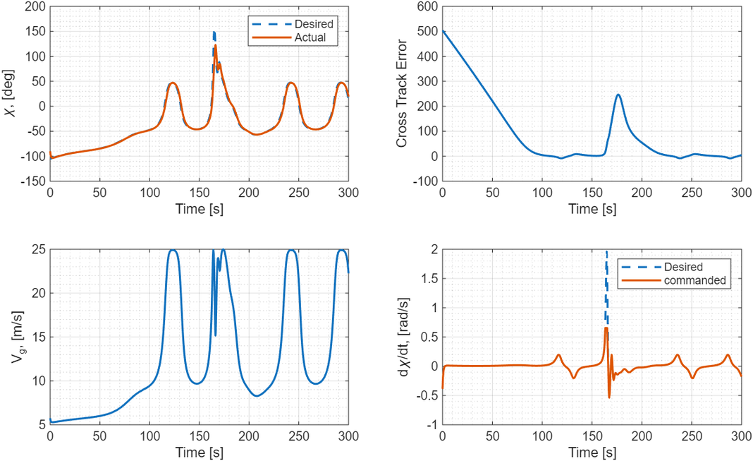
Simulation — Sine Path with Arbitrary Closed Obstacle
The desired arbitrary closed path is given as,
and the obstacle can be given given by the same equation as given in Aribraty-Arbotray simulations , with k = 100 and
o = [500, -0], κ = 20 and κobs = 0.8, with all other parameters same as in circle-circle case.
Notes:
24

Slide 25
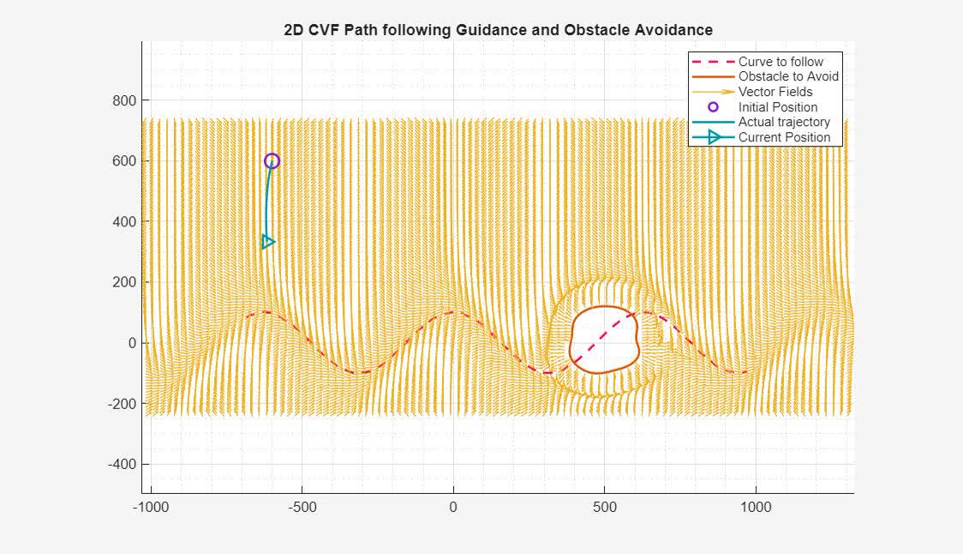
Simulation — Sine Path with Arbitrary Closed Obstacle
Notes:
25

Slide 26
Limitations
1
Parameter Sensitivity
4
Switching Parameter α
No universal κ or κobs across path/obstacle geometries. Each new curve requires re-tuning of design parameters.
Large α extends obstacle VF influence far from the obstacle, potentially preventing path convergence or inducing loops.
2
Angle Wrapping Fragility
5
No Formal Stability Proof
Bifurcation at ζ may fail for complex geometries with multiple bifurcations points, creating loops or premature stable equilibria.
Algorithm validated empirically via MATLAB simulation. A formal Lyapunov-based proof of convergence for the combined singularity-free CVF is not yet established.
3
Artifact Generation (CASE II)
Forced 2π angle shift in CASE II produces local vector field artifacts near the obstacle boundary.
Notes:
26

Slide 27
Conclusion & Future Work
Future Work
  Develop systematic parameter selection and auto-tuning for κ, κobs, α
  Improve blending strategy to avoid angle wrapping fragility and artifacts
  Extend framework to 3D path following and obstacle avoidance
  Formal Lyapunov stability and convergence proof for the singularity-free CVF
  Hardware-in-the-loop and experimental flight validation on a real UAV platform
The proposed singularity-free CVF framework demonstrates practical viability for real-time UAV guidance in obstacle-laden environments.
Notes:
27

Slide 28
Thank You
Notes:
28

