Slide 1
Sleep health and lifestyle dataset

Slide 2
INTRODUCTION
Analysis of sleep health and lifestyle factors using 374 records.
STUDY OF 13 columns including Age, Occupation, Sleep Duration, Stress Level, Daily Steps and Sleep Disorder.

Slide 3
Data summary
GENDER - Male , Female
AGE RANGE – 27-59 Years
OCCUPATION – accountant , doctor , engineer , lawyer , manager , nurse , sales representative , sales person , scientist , software engineer , teacher
SLEEP DURATION – 5.8-8.5 Hours
STRESS LEVEL – 3-8
DAILY STEPS- 3000–10000
SLEEP DISORDER DISTRIBUTION - No Disorder: 219 , Sleep Apnea: 78, Insomnia: 77

Slide 4
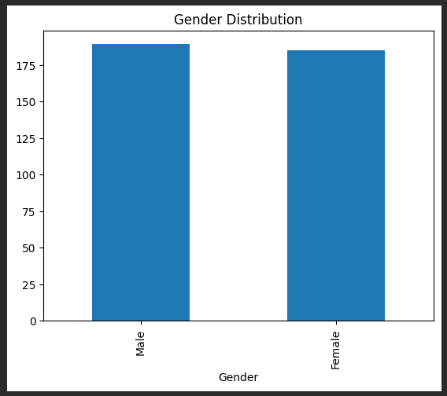
Gender Distribution

Slide 5
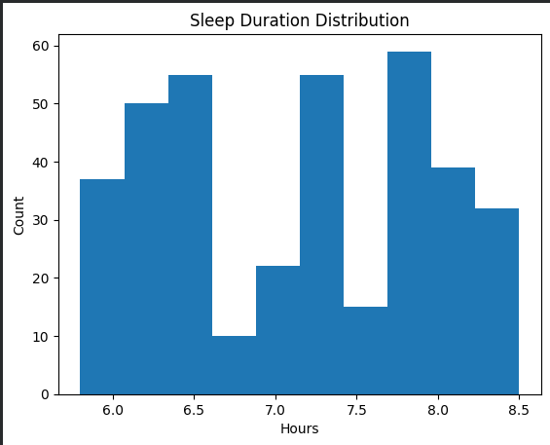
Sleep Duration Analysis

Slide 6
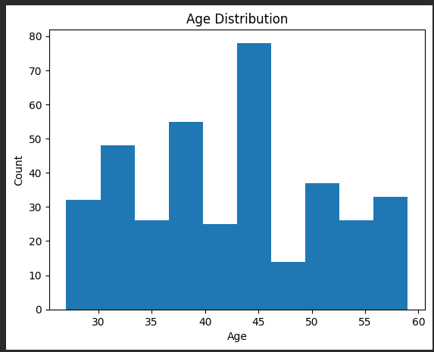
Age Distribution

Slide 7
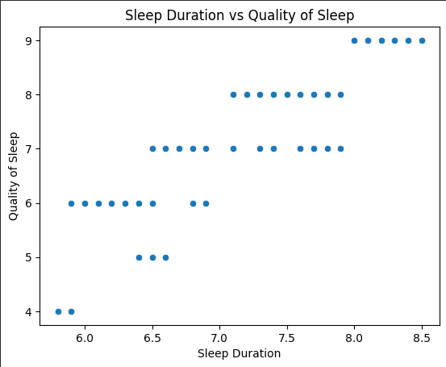
Sleep Duration vs Sleep quality
Positive relationship observed.
Participants sleeping 7–8 hours report better sleep quality.
Adequate sleep improves overall well-being

Slide 8
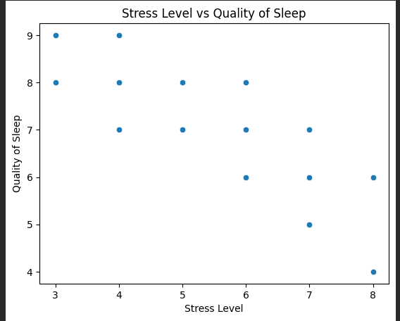
Stress Level vs Sleep Quality
Strong negative relationship.
Higher stress leads to poorer sleep quality
Stress management is crucial for healthy sleep.

Slide 9
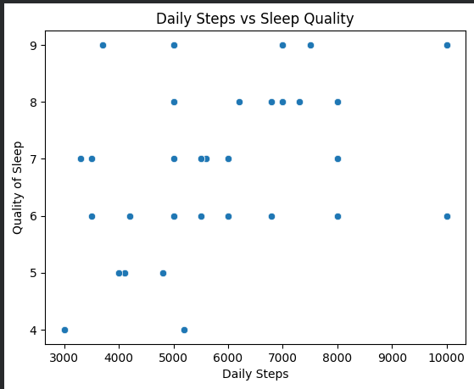
Daily Steps vs Sleep Quality
Slight positive relationship between daily steps and sleep quality.
More active individuals generally experience better sleep.
Physical activity supports healthy sleep patterns.

Slide 10
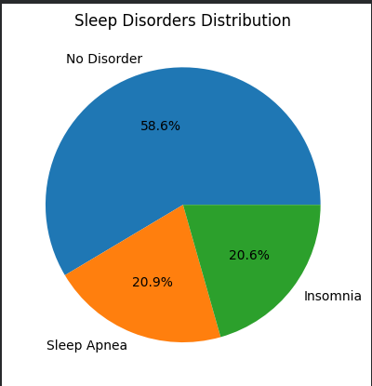
Sleep Disorders Distribution
58.6% PEOPLE HAVE NO DISORDER
20.9% PEOPLE HAVE SLEEP APNEA
20.6% PEOPLE HAVE INSOMINIA

Slide 11
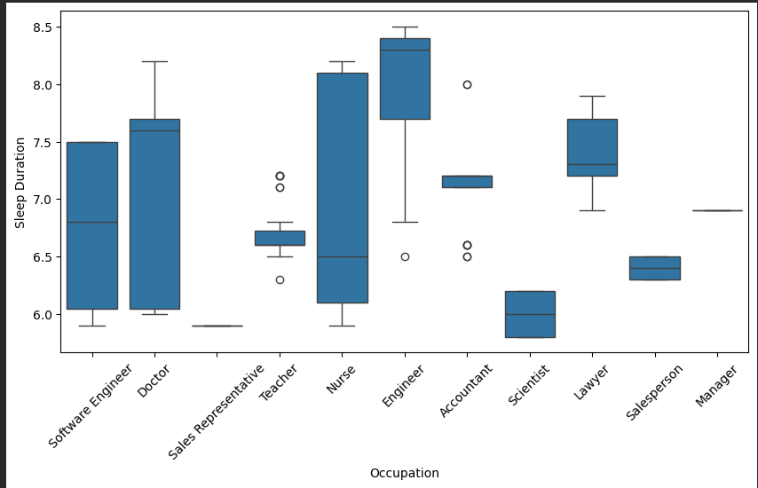
Occupation-wise Sleep Duration
Manager have the lowest sleeping hours
Nurse have the highest sleeping hours

Slide 12
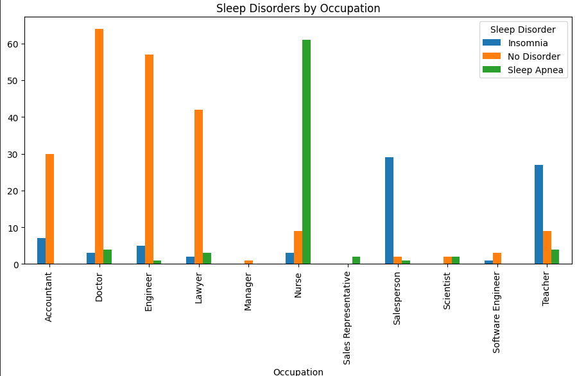
Sleep Disorders by Occupation
SLEEP APNEA IS MOST IN NURSE
INSOMNIA IS MOST IN SALESPERSON
DOSTOR HAVE NO DISORDER

Slide 13
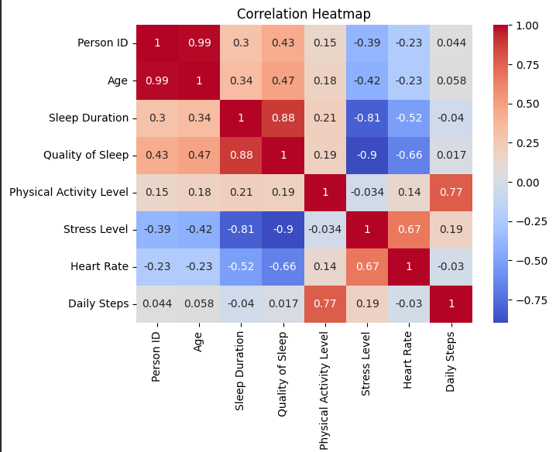
Correlation
Higher stress reduces sleep quality.
Physical activity is linked to better sleep.
Age is moderately associated with longer sleep duration

Slide 14
Top Insights
Highest Sleep Duration → Nurse
⚠ Highest Stress Level → Salesperson
😴 Most Sleep Apnea Cases → Nurse
🌙 Most Insomnia Cases → Salesperson
💤 Lowest Sleep Duration → Manager

Slide 15
Key Findings
Longer sleep duration improves sleep quality.
Higher stress reduces sleep quality.
Physical activity is linked to better sleep.
Sleep duration differs across occupations, suggesting work-life effects.
Healthy sleep habits, lower stress, and regular activity support better sleep health.
Stress has the strongest impact on sleep quality (r = -0.899).
Accountants and Lawyers show the healthiest lifestyle patterns.
Physical activity slightly improves sleep quality (r = 0.193).
Salespersons are most vulnerable to Insomnia.
Nurses are most vulnerable to Sleep Apnea.

Slide 16
Conclusion
Sleep quality improves with longer sleep duration.
Stress is the strongest factor affecting sleep quality.
Physical activity contributes positively to sleep health.
Nurses show the highest sleep duration but also the highest sleep apnea cases.
Salespersons are most vulnerable to insomnia.
Healthy sleep habits and stress management are essential for better well-being.

Slide 17
Recommendations
Maintain 7–8 hours of sleep daily.
Reduce stress through meditation and exercise.
Increase physical activity levels.
Monitor BMI to reduce sleep disorder risk.
Encourage healthy work-life balance in high-stress occupations.

Slide 18
Thank You
PRESENTED BY – DHEERAJ KUMAR
ROLL NO -2420404
COURSE – B.TECH
BRANCH – CSE DATA SCIENCE

