Slide 1

Simple Random Sampling
Name: Dheeraj Chaudhary
Roll: 17BCS009
Under the Guidence of: Dr Ramesh Athe

Slide 2
Population, Sample, Sampling
Population: Collection of all the items related to an enquiry is called population
Sample: A sample is a representative part of population
Sampling: Process of selecting sample from population is called sampling

Slide 3
Types of Sampling
Probability sampling: Probability of selection of each individual is known and pre determined
Non-probability sampling: Probability of selection of each individual is not known

Slide 4
Simple Random Sampling
The proces of selecting a sample that allows individual in the defined population to have an equal and independent chance of being selected for the sample

Slide 5
Steps in Random Sampling
Identify and define the population
Determine the desired sample size
List all members of the population
Assign all individuals on the list consecutive number from zero to the required number. Each individual must have the same number of digits as each other individual

Slide 6
5. Select an arbitrary number in the table of random numbers (we can also use lottery method, or random number generator)
6. For the selected number, look only at the number of digits assigned to each population member
7. If the number corresponds to the number assigned to any of the individual in the population, then that individual is included in the sample
8. Go to the next number in the column and repeat step #7 until the desired number of individuals has been selected for the sample

Slide 7
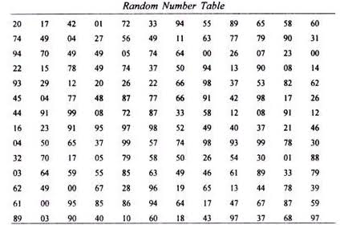

Slide 8
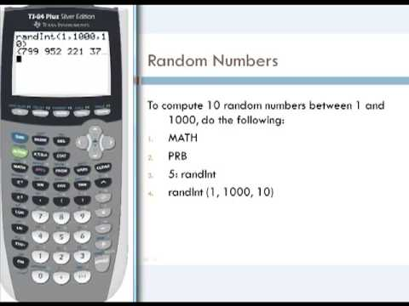

Slide 9
Advantages of SRS
Easy to conduct
Strategy requires minimum knowledge of the population to be sampled

Slide 10
Disadvantages of SRS
List of all the population is needed
  ~ Attaining complete list of population can become difficult
Contacting with all the population may be challenging, as sample may be scattered.

Slide 11
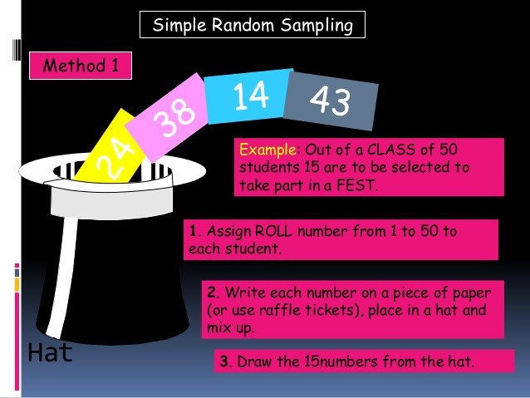
Example1.Using lottery method

Slide 12
Example2.Random table method
Suppose we want to select a sample of size 15 from a population of 5000 then number all 5000 items from 1 to 5000, select a page at random from table and choose first 15 numbers which are less than or equal to 15.
A company that manufactures batteries for Bikes, cars and trucks, wants to calculate the Life time of battery.
Students in a class are to be selected by teacher to explain something.

Slide 13
Thank You

