Slide 1
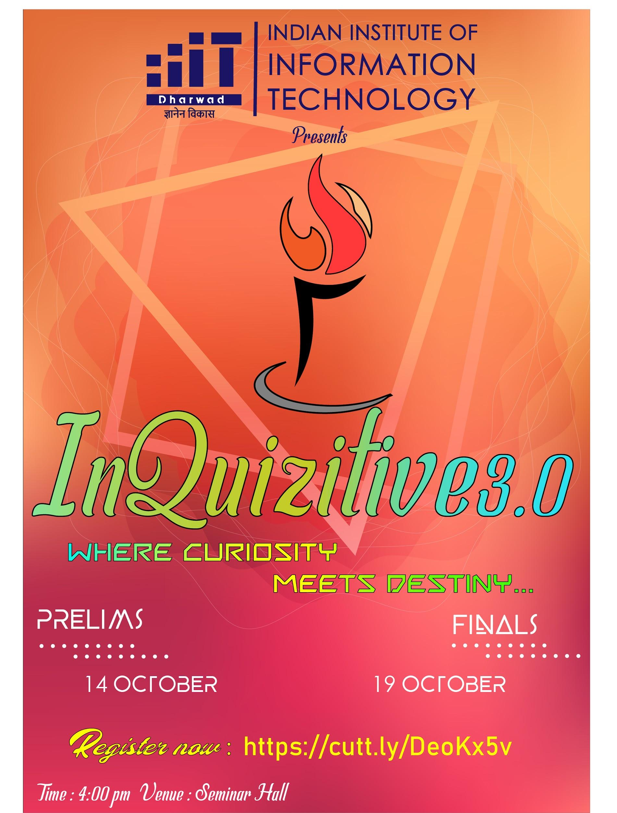

Slide 2
Let’s Begin!!!

Slide 3
Question -1
Who is the cabinet minister in charge of department of space and atomic energy?

Slide 4
Question -2
What is the full name of ISRO chairman?

Slide 5
Question -3
What is the name of the joint military exercise between India and Japan, which will be held in Mizoram from October 19 to November 2?

Slide 6
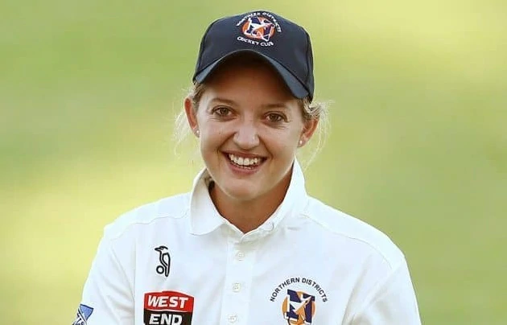
To which country does she belong? What is her name?
Question - 4
Place your screenshot here

Slide 7

Question -5
What does MiG stand for?

Slide 8
Question-6
Which is the first Indian Cinema released through Internet?

Slide 9
Question-7
In which year was
The National Anthem of India
sung for the first time?

Slide 10

Question-8*
Who is the author of the book
‘War and Diplomacy in Kashmir’?

Slide 11
Question-9
What type of phobia is
Hippopotomonstrosesquippedaliophobia?

Slide 12
Question-10
Who was the first Woman to win
a Nobel prize?

Slide 13
Question-11*
Which is the world’s largest wetland system?

Slide 14
Question-12
With which organisation does govt. Partner for ‘Crafted in India’ project?

Slide 15
Question-13*
Which country is the highest per capita emitter of carbon dioxide in the world?

Slide 16
Question-14
‘Plants for plastic’ campaign is associated/started by which state?

Slide 17
Question-15*
Scientists from which institute have developed the biggest ever computer chip using carbon nanotube(CNT)-RV16XNano?

Slide 18
Question-16*
Which firm has developed green crackers for Diwali this year?

Slide 19
Question-17
Which state has launched Urjagiri campaign to stop power theft?

Slide 20

Question-18*
Which print media giant’s logo is this?

Slide 21
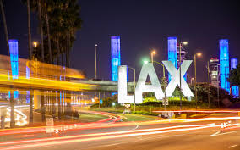
Question-19
Which place is this?

Slide 22
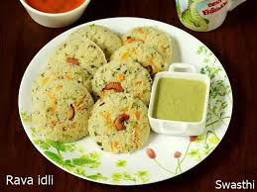
Question-20*
Where was this dish invented(full name)?

Slide 25
Answers:
Narendra modi
Kailasavadivoo Sivan
Dharma Gaurdian
Sarah Taylor
Mikoyan-Gurevich or Mikoyan
Vivah
1911
C. Dasgupta
Fear of long words
Marie Curie

Slide 26
Answers (cont.):
11. Pantanal
12. Google
13. Qatar
14. Assam
15. Massachusetts Institute of Technology (MIT)
16. CSIR
17. Uttrakhand
18.The Hindu
19. Los Angles Airport
20. Mavalli Tiffin Rooms (MTR) of Bangalore

Slide 27
Thanks!

