Slide 1
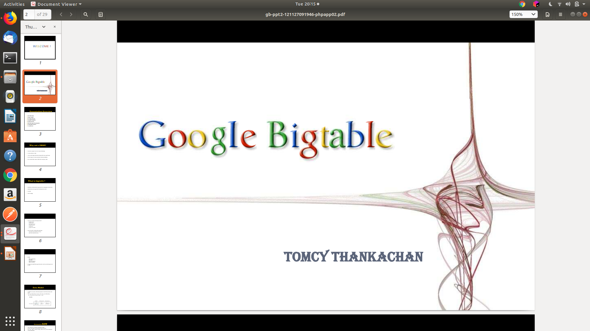

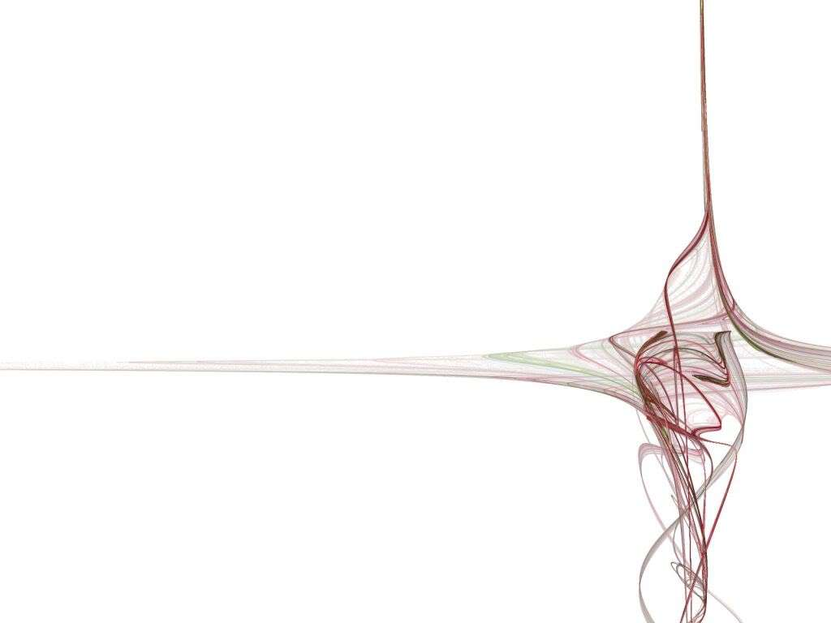

Course: Database Management System (DBMS CS502)
Name: Dheeraj Chaudhary
Roll no: 17BCS009
Under the Guidence of : Dr Uma S

Slide 2
CONTENTS
Introduction to Bigtable
Data Model
API
Building blocks
Implementation
Refinements
Performance Evaluation
Real Applications
Conclusions

Slide 3
Why a Bigtable
Scale is too large for most commercial Databases
Cost would be very high
Low-level storage optimizations help performance significantly
Hard to map semi-structured data to relational database
Non-uniform fields makes it difficult to insert/query data

Slide 4
1. Introduction to Bigtable
Bigtable is a distributed storage system for managing a very large size of data
Bigtable does not support a full relational data model
It provides client with a simple data model that supports dynamic control over data layout and format.
Scalable
Self managing

Slide 5
Introduction to Bigtable (cont...)
Many projects at google uses Bigtable to store data e.g,
  Google Analytics
  Google Finance
  Personalized search
  Google Documents
  Google Earth
  Web indexing etc.
Used for variety of demanding workloads
  Throughput oriented batch processing
  Latency sensitive data serving

Slide 6
Introduction to Bigtable (cont...)
Goals
  Wide applicability
  Scalability
  High performance
  High availability

Slide 7
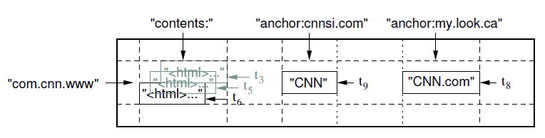
2. Data model
A Bigtable is a sparse, distributed, persistent multidimensional sorted map
The map is indexed by a row key, column key, and a timestamp
(row:string, column:string, time:int64) → string
Webtable

Slide 8
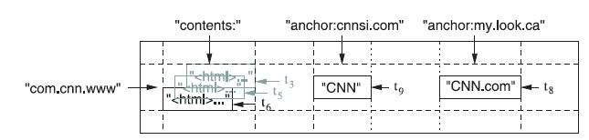
2.1 Datamodel - ROW
The row keys in a table are arbitrary strings.
Data is maintained in lexicographic order by row key
Each row range is called a tablet, which is the unit of distribution and load balancing.
row

Slide 9
2.2 Datamodel - Column
Column keys are grouped into sets called column families
Data stored in a column family is usually of the same type
A column key is named using the syntax: family : qualifier
Column family names must be printable , but qualifiers may be arbitrary strings
column

Slide 10
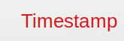
2.3 Datamodel - Timestamp
Each cell in a Bigtable can contain multiple versions of the same data
Versions are indexed by 64-bit integer timestamps
Timestamps can be assigned:
  automatically by Bigtable, or
  explicitly by client applications

Slide 11
3. APIs
The Bigtable API provides functions:
  Creating and deleting tables and column families.
  Changing cluster , table and column family metadata.
  Support for single row transactions
  Allows cells to be used as integer counters
  Client supplied scripts can be executed in the address space of servers

Slide 12
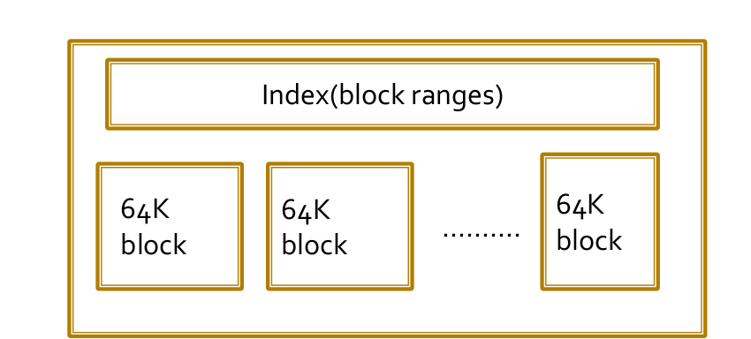
4. Building Blocks
Bigtable is built on several other pieces of Google infrastructure.
Google File system(GFS)
SSTable : Data structure for storage
Chubby: Distributed lock service.

Slide 13
4.1 What is GFS
GFS stands for Google File System
It’s a proprietary(means used for their personal use, not open source) distributed file system developed by Google for their services
It is specially designed to provide efficient, reliable access to data using large clusters of commodity hardware, means they are using low cost hardware, not state-of-the-art computers
Google uses relatively inexpensive computers running Linux Operating System and GFS works just fine with them

Slide 14
4.2 What is SSTable
SSTable stands for Sorted String Table
It is used internally to store Bigtable data
It provides a persistent, ordered immutable map from keys to values
Operations are provided to look up the values associated with a specified key
We can iterate over all key/values pairs in a specified key range

Slide 15
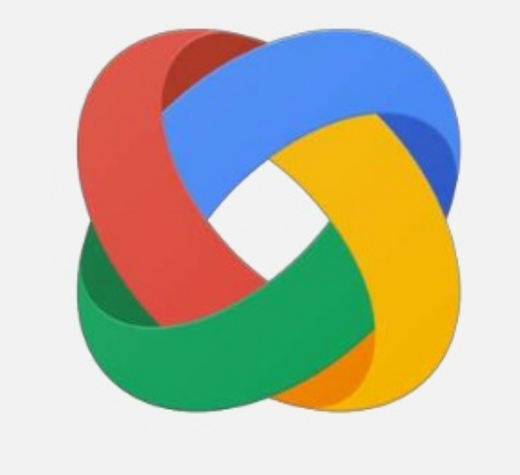
4.3 What is Chubby
Chubby is a Lock Service (it’s related to gain
access of shared resources
It is used to synchronize accesses
to shared resources
It is now used as a replacement of Google’s
Domain Name System.

Slide 16
4.3 What is Chubby (cont...)
A Chubby service consists of five active replicas, one of which elected to be the master and actively server request.
The service is live when majority of replicas are running and communicate with each other
It uses Paxos algorithm to keep replicas consistent in case of failure.
It provides a namespace that consists of directories and small files, that can be used as lock

Slide 17
4.3 What is Chubby (cont...)
Bigtable uses Chubby for variety of tasks
  To ensure that there is atmost one active master at any time
  To store the bootstrap location of Bigtable data
  To discover tablet server and finalize tablet server deaths
  To store Bigtable schema information
  To store access control list
If Chubby becomes unavailable for an extended period of time, Bigtable becomes unavailable

Slide 18
5. Implementation
Three major components
  Library linked into every client
  Single master server
    Assigning tablets to tablet servers
    Detecting addition and expiration of tablet servers
    Balancing tablet-server load
    Garbage collection files in GFS
  Many tablet servers
    Manages a set of tablets
    Tablet servers handle read and write requests to its table
    Splits tablets that have grown too large

Slide 19
5. Implementation (cont...)
Clients communicates directly with tablet servers for read/write
Each table consists of a set of tablets
  Initially, each table have just one tablet
  Tablets are automatically split as the table grows
Row size can be arbitrary (hundreds of GB)

Slide 20
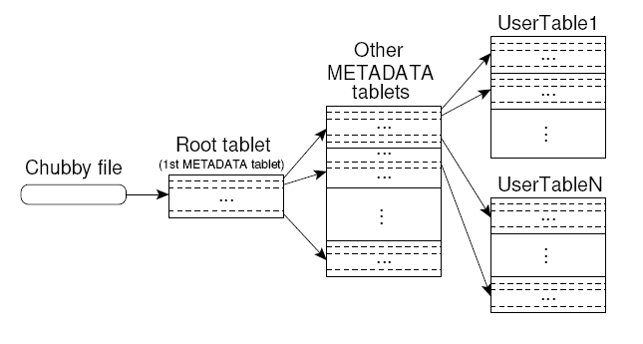
5.1 Locating Tablets
Three level hierarchy
  Level 1: Chubby file containing location of the root tablet
  Level 2: Root tablet contains the location of METADATA tablets
  Level 3: Each METADATA tablet contains the location of user tablets
Location of tablet is stored under a row key that encodes table identifier and its end row

Slide 21
5.2 Assigning tablets
Tablet server startup
  It creates and acquires an exclusive lock on , a uniquely named file on Chubby.
  Master monitors this directory to discover tablet servers.
Tablet server stops serving tablets
  If it loses its exclusive lock.
  Tries to reacquire the lock on its file as long as the file still exists.
  If file no longer exists, the tablet server will never be able to serve again.

Slide 22
5.2 Assigning tablets (cont...)
Master server startup
  Grabs unique master lock in Chubby.
  Scans the tablet server directory in Chubby.
  Communicates with every live tablet server
  Scans METADATA table to learn set of tablets.
Master is responsible for finding when tablet server is no longer serving its tablets and reassigning those tablets as soon as possible.
  Periodically asks each tablet server for the status of its lock
  If no reply, master tries to acquire the lock itself
  If successful to acquire lock, then tablet server is either dead or having network trouble

Slide 23
5.3 Tablet Serving
Updates committed to a commit log
Recently committed updates are stored in memory –memtable
Older updates are stored in a sequence of SSTables.

Slide 24
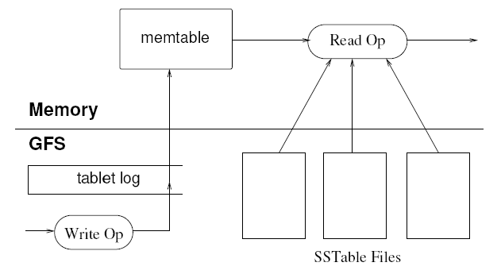
5.3 Tablet Serving
Write operation
  Server checks if it is well-formed
  Checks if the sender is authorized
  Write to commit log
  After commit, contents are inserted into Memtable
Read operation
  Check well-formedness of request.
  Check authorization in Chubby file
  Merge memtable and SSTables to find data
  Return data.

Slide 25
5.4 Compaction
In order to control size of memtable, tablet log, and SSTable files, “compaction” is used.
  Minor Compaction- Move data from memtable to SSTable.
  Merging Compaction - Merge multiple SSTables and memtable to a single SSTable.
  Major Compaction - that re-writes all SSTables into exactly one SSTable

Slide 26
6. Refinements
Locality groups
  Clients can group multiple column families together into a locality group.
Compression
  Compression applied to each SSTable block separately
  Uses Bentley and McIlroy's scheme and fast compression algorithm
Bloom filters
  Reduce the number of disk accesses

Slide 27
6. Refinements (cont...)
Caching
  Scan Cache: a high-level cache that caches key-value pairs returned by the SSTable interface
  Block Cache: a lower-level cache that caches SSTable blocks read from file system
Commit-log implementation
  Suppose one log per tablet rather have one log per tablet server

Slide 28
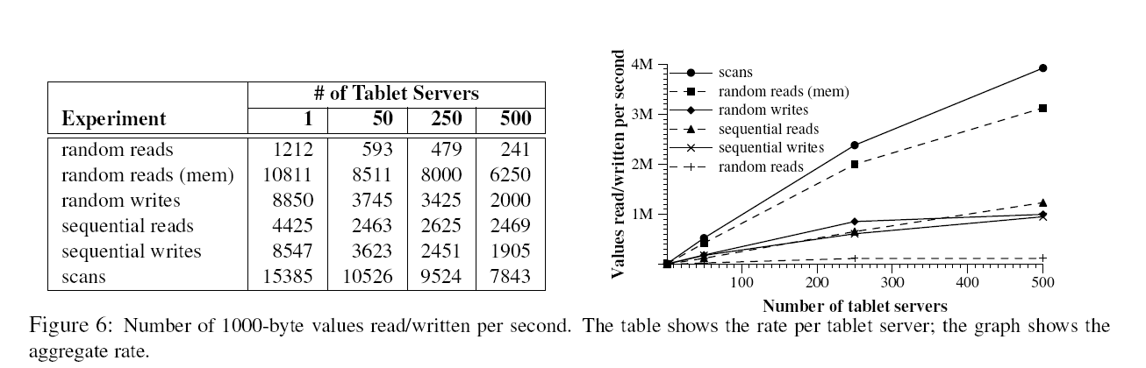
7. Performance Evaluation

Slide 29
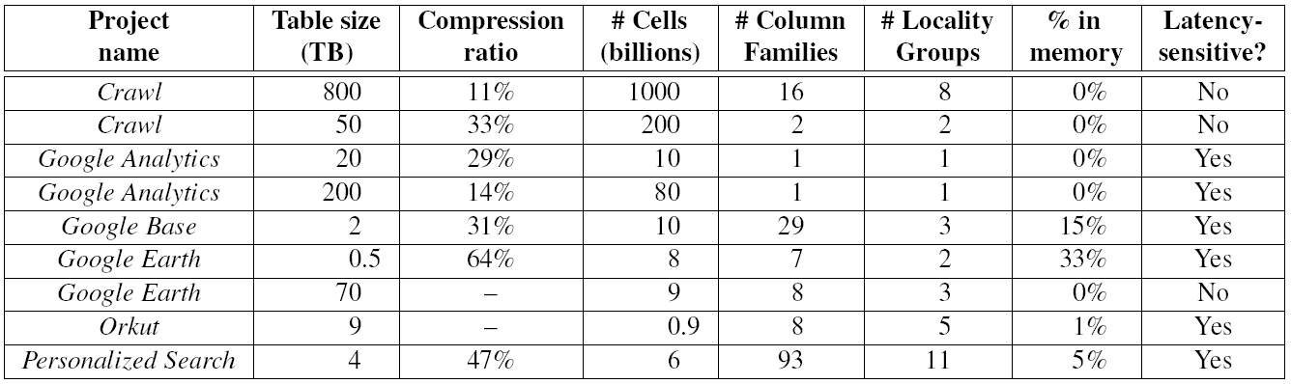
8. Application at Google

Slide 30
Conclusion
Satisfies goals of high-availability, high-performance, massively scalable data storage.
  It has been successfully deployed in real apps (Personalized
  Search, Orkut, GoogleMaps, ...)
Successfully used by various Google products (>60).
It’s a distributed systems, designed to store enormous volumes of data.
Thesesystems can be easily scaled to accommodate peta-bytes of data across thousands of nodes.

Slide 31
References
Bigtable: A Distributed Storage System for Structured Data by Fay Chang, Jeffrey Dean, Sanjay Ghemawat, Wilson C. Hsieh, Deborah A. Wallach, Mike Burrows, Tushar Chandra, Andrew Fikes, Robert E. Gruber
G HEMAWAT , S., G OBIOFF , H., AND L EUNG , S.-T. The Google file system. In Proc. of the 19th ACM SOSP (Dec. 2003), pp. 29–43
B URROWS , M. The Chubby lock service for loosely coupled distributed systems. In Proc. of the 7th OSDI (Nov. 2006).

Slide 32



