Slide 1




WELCOME

Slide 2

DAY
04
STRINGS
& FUNCTIONS

Slide 3
TABLE OF CONTENTS
01
02
Strings
Functions

Slide 4
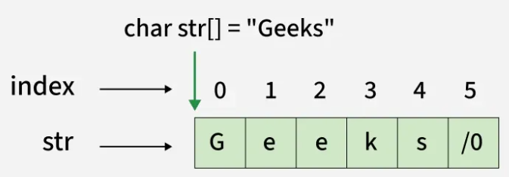
01
Strings
Declaration
char string[size];

Slide 5
Strings - Declaration
char string[size];

Slide 6
Strings - Initialization
char str[] = {'G', 'e', 'e', 'k', 's', '\0’};
or
char str[] = "Geeks";

Slide 7
Strings – Input/Output
scanf(“%s”, string); -> input
printf(“%s”, string); -> output

Slide 8
Strings – key functions
strlen(string) -> length of string
strcpy(from, to) -> copying a string
Imp: use #include<string.h>

Slide 9
Functions
02
main() is the main function of C

Slide 10
Functions - Syntax
return_type name(arguments) {
statements;
}

Slide 11

THANK YOU!

