Slide 1

Bharat Herald - Digital Transition & Market Re-Launch Strategy Post covid Era
Domain : Media & Publishing
Problem Statement - Bharat Herald’s Crisis :
Once printed 1.2M copies daily, but circulation dropped to <560K by 2024.
Pandemic accelerated the shift to digital-first competitors (DigiHindi Post, NewsZilla, InShorts).
2021 e-paper pilot failed due to poor usability & financial losses.
Consequences: advertiser trust declined, bureaus shut, layoffs, and fiscal strain.
My Role as Analyst
Assigned to analyse Bharat Herald’s operational & financial data (2019–2024).
Quantify what went wrong
Identify recovery potential
Recommend a phased roadmap for digital transformation
By Dheeraj

Slide 2
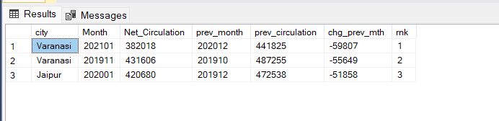
Business Request – 1: Monthly Circulation Drop Check
Generate a report showing the top 3 months (2019–2024) where any city recorded the sharpest month-over-month decline in net_circulation.
Varanasi city – went through decline phase in Net Circulation and has the highest decline in the month of
Jan 2021 followed by Nov 2019
Jaipur city – In Jan 2020 , there is decline in net circulation , this is the 3rd highest decline by month.

Slide 3
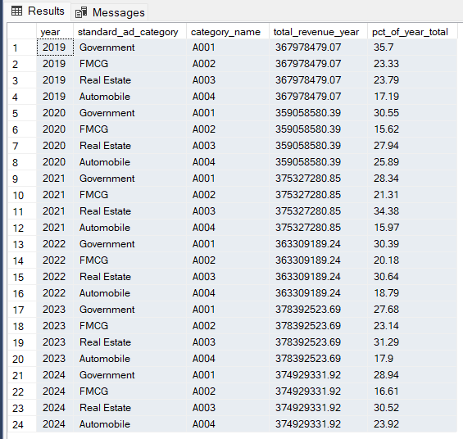
Business Request – 2: Yearly Revenue Concentration by Category
Identify ad categories that contributed > 50% of total yearly ad revenue.
There are no category of Ad’s that contributed to 50% of Yearly Ad Revenue.
Among all, In year 2019 and 2020, Government Ad’s contributed nearly 35% of the total revenue.
From 2021, Real-Estate Ad’s contribute more of the yearly revenue.

Slide 4
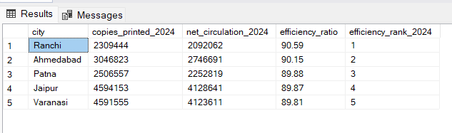
Business Request – 3: 2024 Print Efficiency Leaderboard
For 2024, rank cities by print efficiency = net_circulation / copies_printed. Return top 5.
Ranchi has 90.5% of Print efficiency in 2024 , stands Top and followed by Ahmedabad with 90.15% and Patna with 89.88 % in top 3

Slide 5
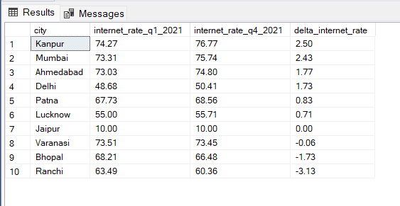
Business Request – 4 : Internet Readiness Growth (2021)
For each city, compute the change in internet penetration from Q1-2021 to Q4-2021 and identify the city with the highest improvement.
As Bharat Herald, Launched Digitalization in 2021, checking how the internet rate ( readiness growth ) Improved from 2021 Q1 to 2021 Q4
Among all the cities, Jaipur city is stable across the all quarters of 2021, no change
Ranchi has a big drop of readiness from Q1 to Q4 nearly 3.1 %, followed by Bhopal and Varanasi.
Kanpur and Mumbai Improved a lot in Readiness growth by end of the year by nearly 2.5% , followed by Ahmedabad and Delhi.

Slide 6
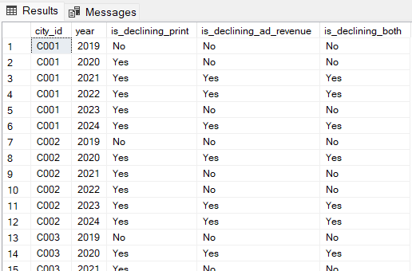
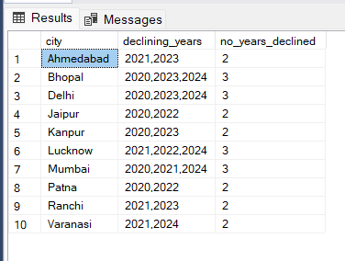
Business Request – 5: Consistent Multi-Year Decline (2019→2024)
Find cities where both net_circulation and ad_revenue decreased every year from 2019 through 2024 (strictly decreasing sequences).
There are no cities, that faced continuous decline through 2019 – 2024 in both net circulation and Ad Revenue
But Bhopal, Delhi, Lucknow, Mumbai faced decline in both circulation and revenue in 3 years as shown above but they are not continuous and consistent.

Slide 7
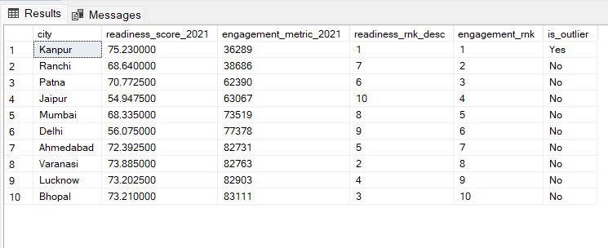
Business Request – 6 : 2021 Readiness vs Pilot Engagement Outlier
In 2021, identify the city with the highest digital readiness score but among the bottom 3 in digital pilot engagement.
readiness_score = AVG(smartphone_rate, internet_rate, literacy_rate)
“Bottom 3 engagement” uses the chosen engagement metric provided (e.g., engagement_rate, active_users, or sessions).
In 2021, Kanpur has the highest readiness score of 75.23 with very lowest engagement that considered as outlier.
As it is in the Top 3 Cities by Readiness and also bottom 3 by engagement .
To get more detailed and comprehensive Insights, I analysed the same data using power BI ……..

Slide 8
Live Dashboard :

