Slide 1

Bluestock Mutual Fund Analytics Platform
End-to-End Data Pipeline & Quantitative Strategy
Prepared By: Data Analyst Intern
Company: Bluestock Fintech Pvt. Ltd.
Scope: 40 Top Schemes | 87K+ Rows | 4.5 Years of Data

Slide 2




The Problem & Our Objective
The Problem
The Objective
The Indian mutual fund market is booming, but data is highly fragmented across disparate APIs and PDFs.
Build an automated end-to-end ETL pipeline and a centralized SQLite data warehouse.
Develop an interactive BI dashboard to rank 40 top-performing funds using advanced financial risk metrics.
Retail investors lack unified, quantitative tools to accurately compare risk-adjusted returns (Sharpe, Alpha) against benchmarks.

Slide 3




Data Sources & Quality Assurance
Live API Integration
AMFI Master Registry
Extracted 46,000+ daily NAV records via mfapi.in REST API.
Curated metadata and performance history for 40 top-performing mutual fund schemes.
Macro & Investor Data
Data Quality Assurance
Synthesized 32,000+ transaction records, SIP inflow trends, and folio growth metrics.
Applied automated forward-filling (ffill) to resolve NAV gaps during non-trading weekends.

Slide 4
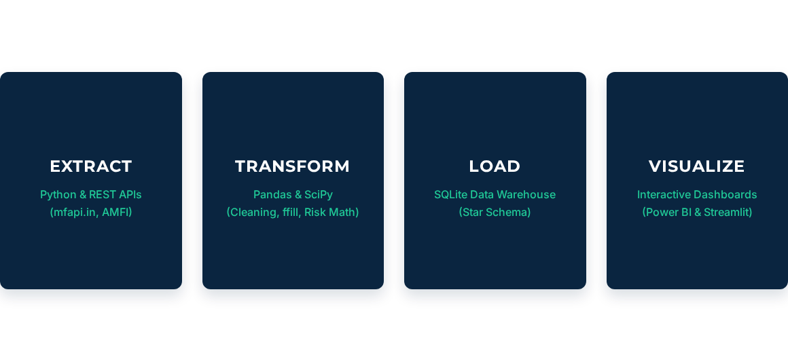
System Architecture & ETL Pipeline

Slide 5

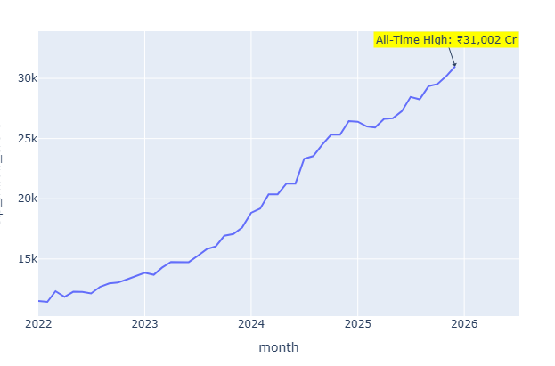
Macro Trends: The SIP Surge
₹31,002 Cr
All-Time High SIP Inflow (Dec 2025)
The Indian mutual fund industry surpassed ₹81 Lakh Crore in AUM, with Systematic Investment Plans emerging as the primary driver of consistent, robust capital inflows across the nation.

Slide 6
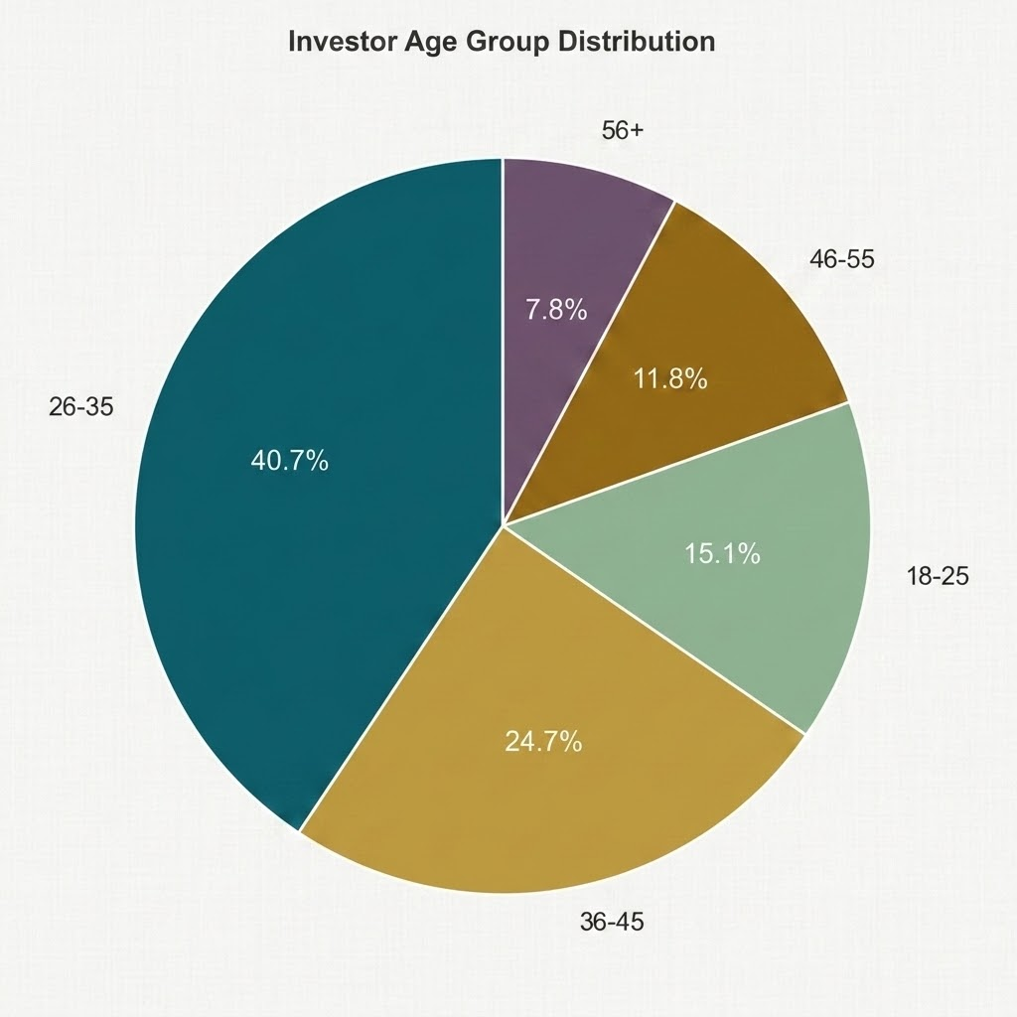
Investor Demographics & Behaviour
The 26–35 Shift
Millennials Dominate at 40.7%
Our demographic analysis reveals that the 26-35 age bracket forms the massive core of the investor base at 40.7%. When combined with the 36-45 cohort, over 65% of the market is driven by younger demographics, highlighting a strong preference for systematic, tech-forward investing."

Slide 7



Composite Fund Scorecard (0-100)
30%
25%
20%
15%
10%
3-Year Returns
Sharpe Ratio
Alpha vs Nifty 100
Expense Ratio (Inv)
Max Drawdown
Fund Name | Category | Sharpe Ratio | Alpha (%) | Final Score
Nippon India Small Cap Fund | Small Cap | 1.45 | 4.2 | 88.5
ICICI Prudential Bluechip | Large Cap | 1.22 | 1.8 | 82.1
SBI Equity Hybrid Fund | Hybrid | 0.95 | 0.4 | 65.4
HDFC Top 100 Fund | Large Cap | 0.88 | -0.2 | 58.2

Slide 8
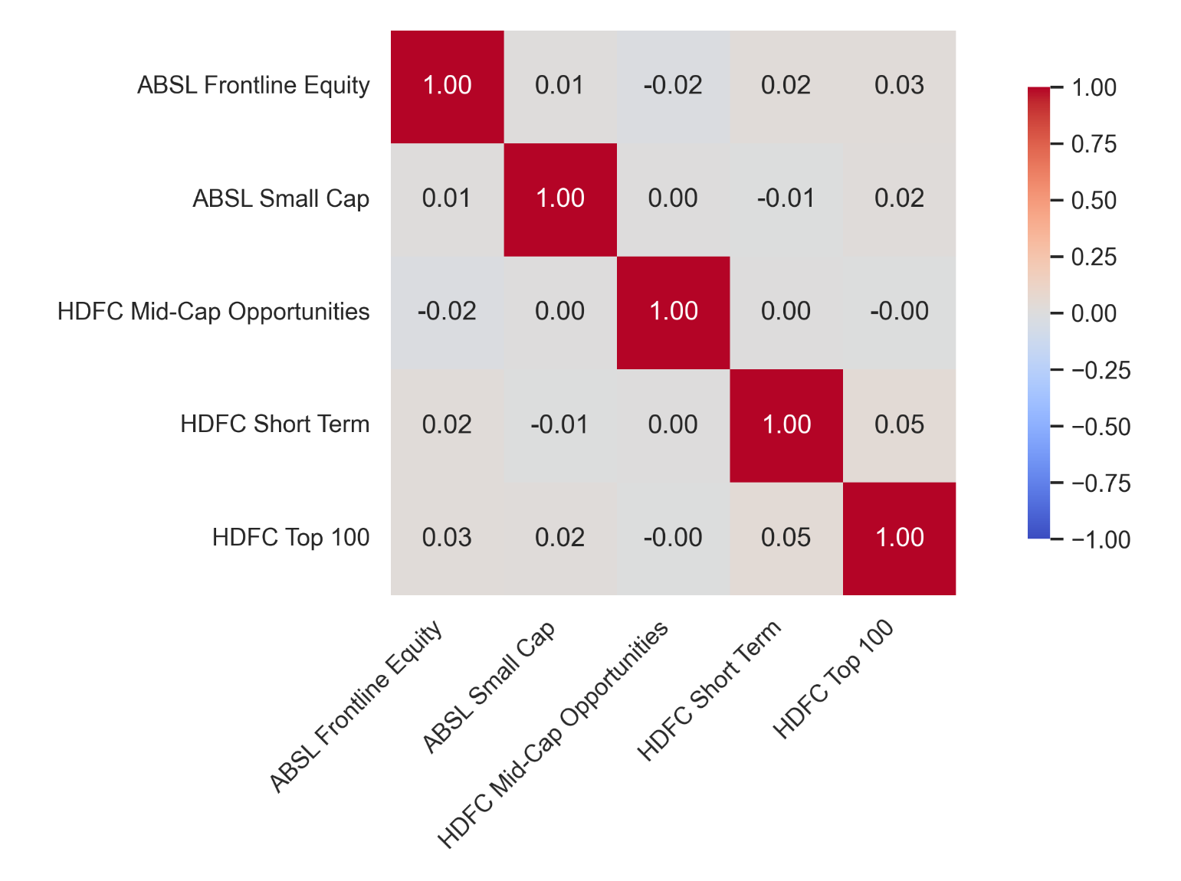
Advanced Risk Analytics
95% Value at Risk (VaR): Quantified maximum potential daily loss boundaries to protect downside capital.
Sortino Ratio: Isolated and penalized only downside volatility for superior clarity on true risk.
CAPM Modeling: Calculated fund Beta via OLS regression against the Nifty 100 benchmark.

Slide 9
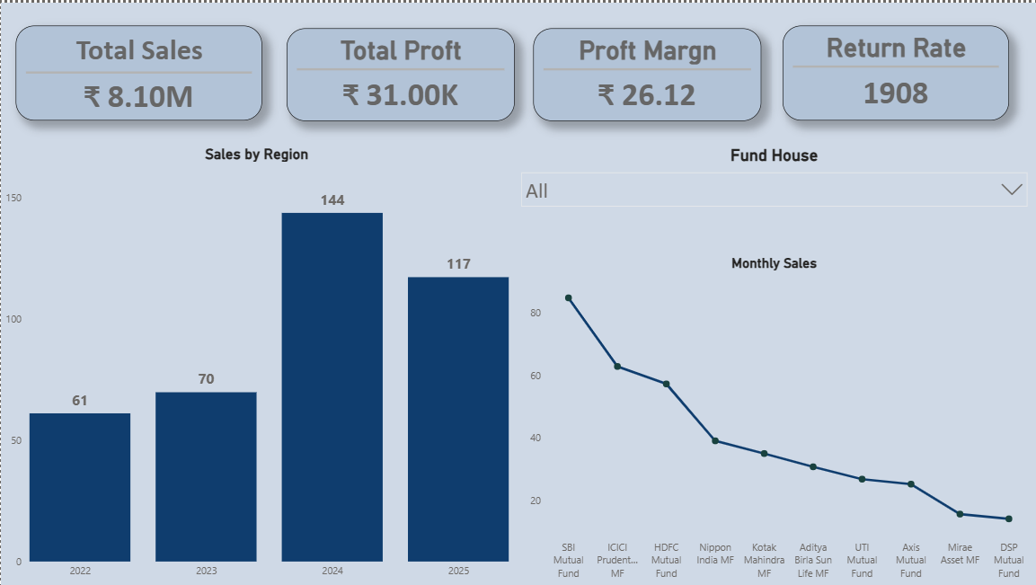
Dashboard Insights: Market Overview
analytics
Executive KPIs
Real-time tracking of ₹81L Cr AUM and 26.12 Cr Active Folios.
filter_alt
Interactive Slicers
Stakeholders can dynamically filter macroeconomic views by specific Fund Houses or Categories.

Slide 10
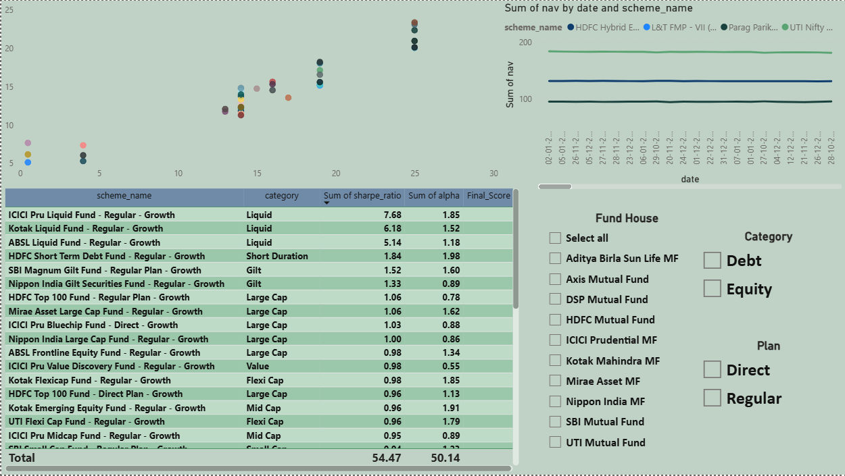
Dashboard Insights: Fund Performance
Risk vs. Return Plot
Visually isolates funds offering high Alpha with low Volatility (bubble size = AUM).
Real-time Drill-through
Pivot from industry overview to specific 4.5-year NAV trends and benchmark comparisons instantly.

Slide 11





Strategic Recommendations
Alpha is Scarce
Drawdown Resilience
Automated Recommendations
Only 15% of actively managed large-cap funds consistently outperformed their respective benchmarks post-expense ratio.
High-Sharpe ratio funds demonstrated significantly better capital preservation during periods of high market volatility.
Deploy the Python Recommender Engine algorithm into the retail app to match investors with their optimal risk-grade funds.

Slide 12


Thank You. Questions?
End-to-End Analytics Pipeline Ready for Production
View the Codebase: github.com/dheeraj-analytics/bluestock_mf_capstone.git

