Slide 1

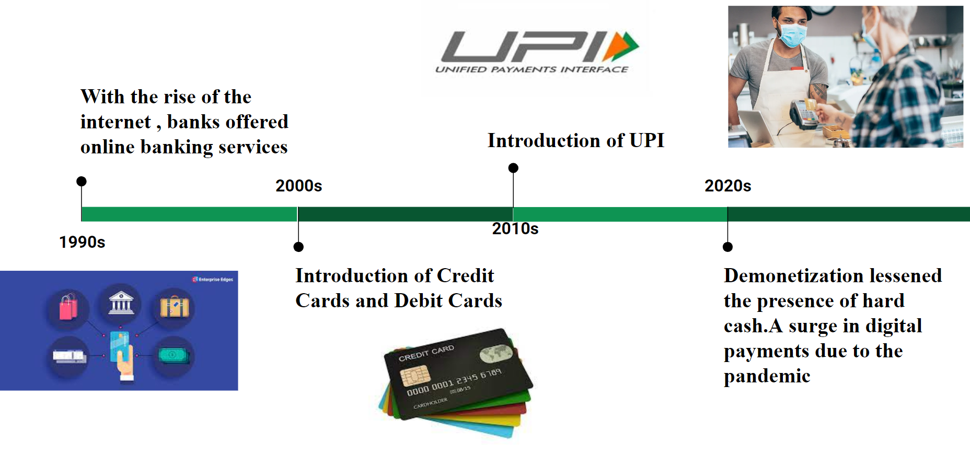
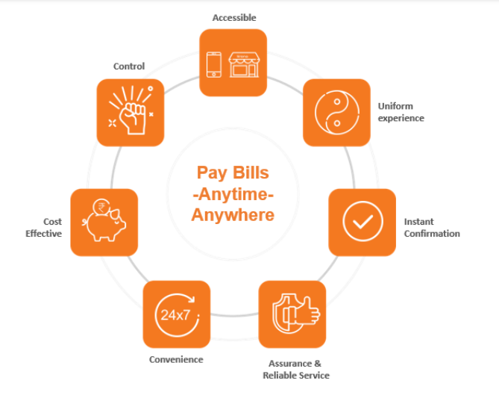


Digital Payments: Merits and Demerits ,
Bharat QR ,Bharat Interface for Money (BHIM) App , & Bharat Bill Payment System (BBPS),
R V College of Engineering
INTRODUCTION
DIGITAL PAYMENTS
BHIM App
POSSIBLE THREATS AND BEST PRACTICES
CONCLUSION and THE NEXT
In recent years, India has witnessed a significant digital revolution in the realm of financial transactions and payments. Several initiatives and technologies have been introduced to promote digital payments and financial inclusion. Among these, Bharat QR, BHIM App, and BBPS have emerged as key players. However, like any technological advancement, these digital payment systems come with their own set of merits and demerits.
Digital payments refer to electronic transactions made through various platforms, enabling individuals and businesses to transfer funds, make purchases, and settle bills electronically.
The major factors that affected the rise od digital payments are :
Demonetization
The COVID-19 Pandemic
BHIM App is a revolutionary digital payment system that has been developed by the National Payments Corporation of India (NPCI). It allows users to make instant payments using their mobile phones, without the need for cash or credit cards. With BHIM App, users can easily transfer money to anyone with a UPI ID or mobile number, pay bills, and even recharge their mobile phones.
The steps involved in making payment through BHIM App are:
Open the BHIM app and enter your UPI PIN.
Select "Send Money" and choose the recipient by mobile number, UPI ID, or scan their QR code.
Enter the payment amount and any optional remarks.
Confirm the transaction by entering your UPI PIN, and both you and the recipient will receive transaction notifications.
1)Download and Update Securely : Ensure you download the official Bharat QR or BHIM App from
trusted sources like official app stores and keep the app and your mobile device's operating system up to
date with the latest versions to benefit from security patches and bug fixes.
2)Avoid suspicious links: Be wary of clicking on links from unknown sources, as they may lead to
phishing websites or malware downloads.
3) Strong Authentication and Passwords: Create strong, unique passwords for your Bharat QR or BHIM App account, and avoid using easily guessable information. Whenever available, enable multi-factor authentication to provide an additional layer of
security to your account.
4)Avoid public Wi-Fi networks: Refrain from using public Wi-Fi networks for transactions, as they are
often unsecured and prone to interception. Instead, use secure networks or your mobile data connection to avoid data breaches.
5) Regularly review transactions: Keep a close eye on your account activity and transaction history to
detect any suspicious or unauthorized transactions. If you notice any unusual or unauthorized activity,
promptly report it to the appropriate authorities or your bank.
Digital payment methods are indeed very powerful tools but with great power comes great responsibility therefore we also have to know the possible cyber threats that come along with these apps. The following mentioned methods / technologies would be the future of digital payments they are:
Cryptocurrency & Blockchain
QR code innovations
Contactless & Wearable payments
Biometric Authentication
REFERENCES
[1] https://tinyurl.com/5n6zj72t
[2] https://tinyurl.com/3yeb9sn7
[3] https://tinyurl.com/4dab659y
[4] https://tinyurl.com/p95p5p5a
[5] National Payments Corporation of India (NPCI) official website
[6] NPCI's documentation on Bharat QR Code and BHIM App
[7] Reserve Bank of India (RBI) guidelines on digital payments.
OBJECTIVE
Image1: Timeline of the Digital Payments
BBPS
To critically evaluate the merits and demerits of key digital payment systems in India, namely Bharat QR, BHIM App, and BBPS, in order to provide a comprehensive understanding of their impact on the overall economy along with the cybersecurity aspects.
Bharat QR
The Bharat Bill payment system is a Reserve Bank of India (RBI) conceptualized system driven by National Payments Corporation of India (NPCI). It is a one-stop ecosystem for payment of all bills providing an interoperable and accessible “Anytime Anywhere” Bill payment service to all customers across India with certainty, reliability and safety of transactions.
Bharat QR is a revolutionary payment system that allows users to make digital payments using their smartphones. Bharat QR Code is a standardized QR code payment system introduced by the National Payments Corporation of India (NPCI). It enables users to make payments by scanning QR codes displayed at merchant outlets or websites.
The working of Bharat QR is as given below:
A customer scans the QR code using a compatible payment app on their smartphone.
The app decodes the QR code and retrieves payment details such as merchant ID and transaction amount.
The customer confirms the payment and authorizes the transaction using their preferred payment method, such as a linked bank account or mobile wallet.
The payment is processed, and a confirmation notification is sent to both the customer and the merchant.
ROLE OF CYBERSECURITY
Paying through Bharat QR and BHIM App involves various technologies to ensure a secure and efficient transaction process. They are:
1)QR Code Encoding &Decoding : To generate a Bharat QR Code, computer algorithms are used to encode and decode payment-related information such as the merchant's identifier, transaction amount, and other details into a QR code format.
2) Network Communication & Encryption : The payment app utilizes network protocols (such as HTTPS) to securely communicate with the merchant's server and cryptographic algorithms (such as SSL/TLS) are employed to encrypt the data.
3)Backend Systems & Data Validation and Verification : This involves using APIs (Application Programming Interfaces) to facilitate secure transaction processing. The payment gateway performs validation and verification ensuring the accuracy of the information.
4)User Authentication & Tokenization : The payment app incorporates user authentication mechanisms such as PINs, biometrics, or passwords to ensure that only authorized users can initiate transactions. Sensitive information, is replaced with unique tokens during the transaction process. This reduces the risk of data breaches.
TEAM MEMBERS
Talasila Dheeraj 1RV22CS216
Samarth D Gothe 1RV22CS173
Tarun Bhupathi 1RV22CS218
Shail R Patel 1RV22CS182
Image2: Features of Digital payments

