Slide 1
EDA ASSIGNMENT
- DHEERAJ J

Slide 2

Agenda
Dataset Overview and Problem Statement
Findings and Insights

Slide 3

DATASET OVERVIEW AND PROBLEM STATEMENT
DATASET:
The dataset consists of house prices for different cities in the United States of America. Some of the features of the dataset are the location of the property, number of bedrooms and bathrooms, Sqft of the property and the presence of waterfront.
PROBLEM STATEMENT:
Prediction of property prices is becoming increasingly important and beneficial. Property prices are a good indicator of both the overall market condition and the economic health of a country. The goal is to help us understand the relationship between house features and determine factors affecting the price of the property that can help in prediction of prices beforehand.

Slide 4
Insights and findings

Slide 5
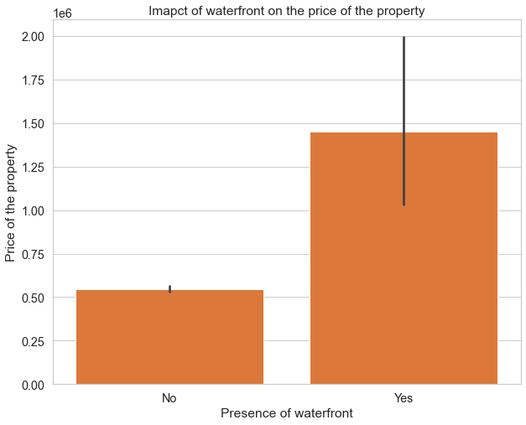
WHAT IS EXPECTED From THE SESSION?
IMPACT OF WATERFRONT ON THE PRICE OF THE PROPERTY
FINDINGS:
The bar plot represents the price of the property in the presence and absence of waterfront.
The price of the property increases with the presence of a waterfront.
INSIGHTS:
Waterfront property is generally regarded as expensive because of high demand due to its calming view.
Households can also use filtered water from the waterfronts for their daily activities. Resale values of these properties are also high.
SOURCE:
https://www.biggerpockets.com/member-blogs/468/1601-why-waterfront-homes-pose-as-great-financial-investments

Slide 6
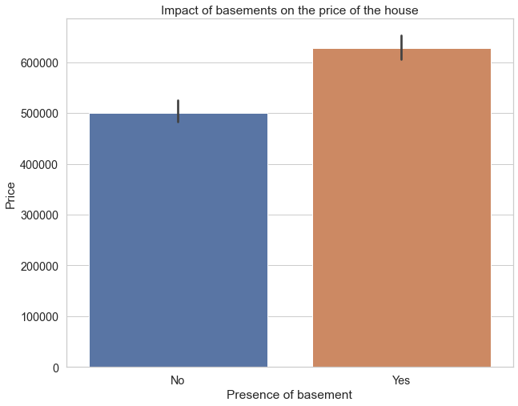
INSIGHT-1
IMPACT OF BASEMENT ON THE PRICE OF THE PROPERETY
FINDINGS
The plot depicts the average price of the property with and without the presence of basements.
The presence of basements increases the value of the property.
INSIGHTS
Basements are often used for storage, recreational area.
Basements also acts as a protection for main electrical lines pipelines.
A properly built basement can also be rented .
SOURCES:
https://www.washingtonpost.com/express/wp/2014/01/17/rental-culture-shock/

Slide 7
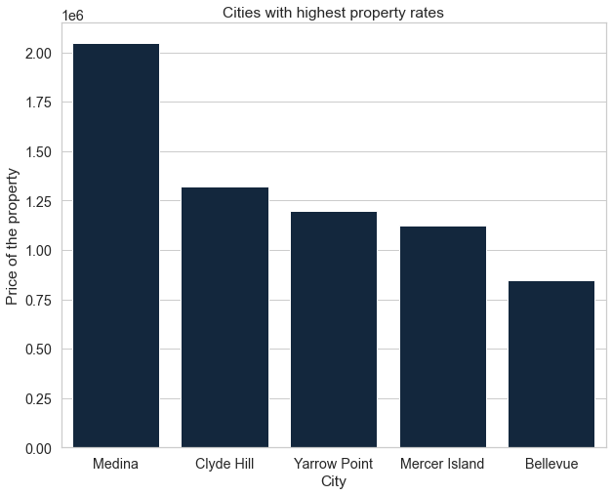
INSIGHT-1
CITIES WITH HIGHEST PROPERTY RATES
FINDINGS
The plot depicts the cities with highest property rates.
It can be inferred that Medina has the highest property rate of $ 2 Million.
INSIGHTS
All the cities with highest property rate are in the state of Washington where the demand is more but the supply is less, and the land is expensive.
Medina is covered with lakes and beaches and most houses have a private beach or a waterfront.
Both Clyde Hill and Medina have a very low crime rate due to their extensive surveillance system.
.
SOURCES
https://www.businessinsider.com/where-billionaires-bill-gates-jeff-bezos-live-photos-of-medina-washington-2017-12

Slide 8
Thank You

