Slide 1

NVIDIA IMPACT HACKATHON · RUNS LOCALLY ON DGX SPARK
A real-time, on-device legal & de-escalation copilot for frontline officers
Assistive and human-in-the-loop. It cites the law; it never decides.

Slide 2
THE GAP
The problem
Officers make split-second legal decisions under stress:
• Do I have grounds to search? What must I say first?
• Is arrest necessary, or is there a lesser option?
• Which rights are engaged right now?
Get it wrong and the cost is real: unlawful stops, avoidable escalation, evidence thrown out, lost public trust.
Today, body-worn video is review-only — it tells you what went wrong after the encounter. There is no real-time copilot that reads the scene and the law in the moment.
JARVIS · NVIDIA Impact Hackathon
01

Slide 3
SOLUTION
What we built
A live body-cam feed (video + audio) streams to a local pipeline that:
• Sees the scene — vision model describes people, objects, actions
• Hears the conversation — speech-to-text, with who-said-what (officer vs. subject)
• Reasons over real England & Wales law — cited, de-escalation-focused guidance
• Speaks it back — hands-free audio for the officer
• Records everything — tamper-evident audit log + replayable MP4 with synced transcript
Built to run entirely on a DGX Spark — body-cam footage and PII never leave the device.
JARVIS = Patrol Assist (the real-time system) + PoliceAI (the fine-tuned, law-grounded model).
JARVIS · NVIDIA Impact Hackathon
02

Slide 4
IN 5 STEPS
Demo flow
• Onboard the officer — record a ~7 s voice sample (enrolls a local voice embedding)
• Start patrol — camera + mic stream over a binary WebSocket at ~2 fps
• Live detections + transcript appear; transcript is tagged officer / subject in real time
• A cited guidance card surfaces (legal basis · action · tone · rights · next steps) and is read aloud
• Stop — the session is encoded to MP4 and stored; a background pass diarizes the audio for playback
Every input, model output, and officer action is written to an append-only session manifest.
JARVIS · NVIDIA Impact Hackathon
03

Slide 5
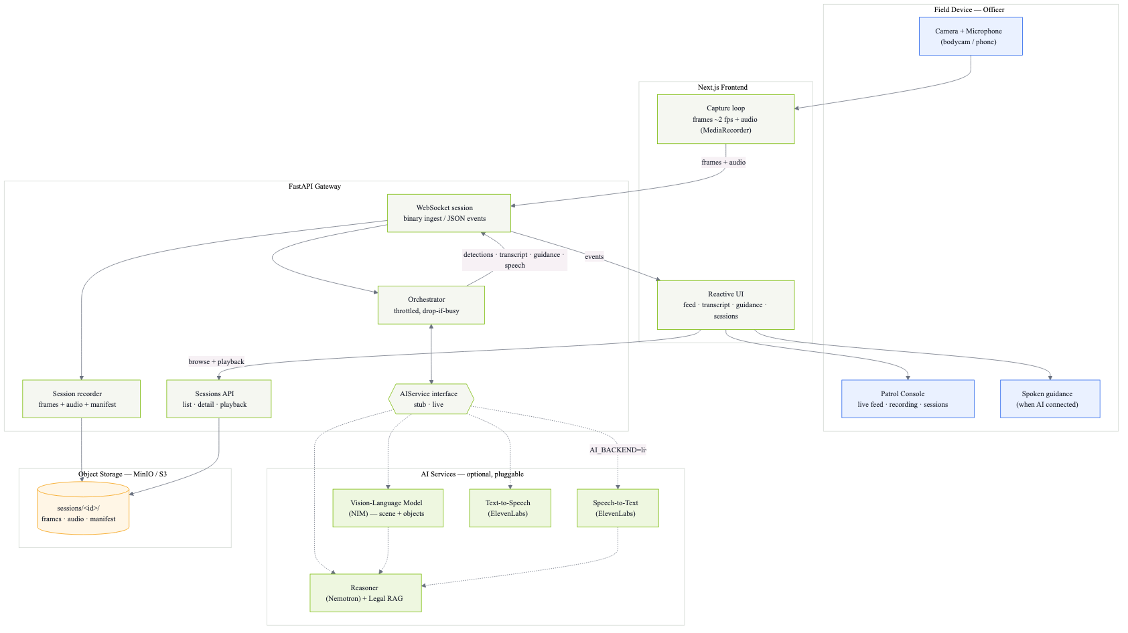
SYSTEM
Architecture
Field device → Next.js console → FastAPI orchestrator → pluggable AIService layer → reactive UI + TTS, every session persisted to MinIO/S3.
JARVIS · NVIDIA Impact Hackathon
04

Slide 6
EXECUTION & COMPLETENESS · 30 PTS
Technical depth — a system, not a wrapper
1 · Legal-reasoning dataset pipeline (built)
Built on real, openly-licensed England & Wales law: legislation.gov.uk · Find Case Law (The National Archives) · PACE Codes
• citation-tagged corpus → BM25 retrieval → SCENE-CARD examples (<think> reasoning + structured JSON) → validate. Every citation is cross-checked back against the corpus.
2 · Fine-tuned an NVIDIA model (trained)
• QLoRA on Nemotron-Super-49B → merged → GGUF Q4_K_M for local serving.
3 · Real-time orchestrator (built)
• Throttled drop-if-busy loop (≤1 analysis / 0.7 s) keeps latency bounded under load.
4 · Local inference services (built)
• Self-hosted vLLM (video) + llama.cpp (the fine-tuned LLM), both OpenAI-compatible, containerized.
JARVIS · NVIDIA Impact Hackathon
05

Slide 7
NVIDIA STACK · 30 PTS
NVIDIA ecosystem & the Spark story
We did not just call a cloud LLM — we fine-tuned and serve an NVIDIA model locally.
NVIDIA piece | How we use it
Nemotron-Super-49B | Fine-tuned with QLoRA into PoliceAI — reasoning + structured output
DGX Spark (GB10 Grace Blackwell) | Training + inference target; 128 GB unified memory
FP4 on 5th-gen Tensor Cores | Native 4-bit → fine-tune a 49B model in ~38 GB
NVIDIA vLLM container (nvcr.io) | Serves the local vision model
NIM / Nemotron API | Pluggable cloud reasoning backend
JARVIS · NVIDIA Impact Hackathon
06

Slide 8
THE SPARK STORY · 15 PTS
Why Spark, specifically
Unified memory. 128 GB holds the 49B model + KV cache + video-frame buffer + speaker embeddings simultaneously — no sharding, no juggling a 24 GB discrete GPU.
Privacy. Local inference means evidence-grade body-cam data and PII stay on the device — essential for policing and the chain of custody.
Latency. On-device guidance during a live encounter — no round-trip to a cloud API.
"Merely calling GPT-4 via API gets 0 points." We fine-tuned an NVIDIA model and run it locally.
JARVIS · NVIDIA Impact Hackathon
07

Slide 9
VALUE & IMPACT · 20 PTS
Value & impact
Insight quality — situation-specific, not generic.
A dashboard says “crime rises at night.” JARVIS reasons about the actual scene and cites the law:
Scene strong smell of cannabis · hands in pockets · 2-yr officer · night
Legal basis s.23(2) Misuse of Drugs Act 1971 — reasonable grounds to search
Say first all GOWISELY elements (PACE Code A 3.8)
Rights street search, not arrest — Code C custody rights not yet engaged
De-escalation answer “why am I stopped?” directly; speak slowly
Actual model output — every citation is validated back against the scraped corpus, not invented.
Usability — a tool an officer could use tomorrow.
• Officer: hands-free audio guidance, human-in-the-loop — nothing decided for them.
• Supervisor / legal reviewer: replayable MP4 + synced transcript + guidance log per session.
JARVIS · NVIDIA Impact Hackathon
08

Slide 10
INNOVATION · 20 PTS
Innovation & execution
Creativity — combine modalities that aren't usually combined:
• Vision (scene) + speaker diarization (officer vs. subject) + legal RAG reasoning + voice — reads the scene and the law together, in real time.
• Anti-hallucination by construction: trained to cite only retrieved law; a validator drops any record whose citations don't trace back to the corpus.
Performance & engineering:
• Drop-if-busy throttling → bounded real-time latency.
• FP16 QLoRA → 49B fine-tune fits in ~98 GB; quantized GGUF served via llama.cpp.
• Local resemblyzer voice embeddings → speaker labels with no API call.
JARVIS · NVIDIA Impact Hackathon
09

Slide 11
WHAT'S NEXT
Roadmap & the ask
Beyond the hack:
• Expand corpus + dataset (more incident types, force-policy packs).
• Per-force fine-tunes; on-device continuous learning from reviewed sessions.
• Field trial with a human-in-the-loop supervisor dashboard.
The ask: a DGX Spark in the loop turns this from a privacy-respecting prototype into something a real patrol could use tomorrow.
JARVIS — it reads the scene, cites the law, and keeps the human in command.
JARVIS · NVIDIA Impact Hackathon
10

Slide 12
APPENDIX
Technical detail
For Q&A

Slide 13
APPENDIX
Appendix · Data + fine-tuning pipeline
• Sources (openly licensed): legislation.gov.uk (CLML XML), Find Case Law / The National Archives (LegalDocML), curated PACE Codes A/C/G. Statutes incl. PACE 1984, MDA 1971, CJPOA 1994 (s.60), RTA 1988, POA 1986, HRA 1998, MHA 1983.
• Generation: 16 incident types × officer queries → deterministic SCENE CARDs → BM25 retrieval (top-8, with a guidance floor that always keeps PACE-Code slots) → Claude produces <think> + 6-key JSON.
• Validation (hard): exact system prompt · <think> present · JSON schema · no US law · no guilt opinion · citation grounding · dedupe → 98 records (88 train / 10 val).
• Fine-tune: Nemotron-Super-49B · QLoRA (r=16, α=32, FP4 base + BF16 adapters) · 3 epochs · LR 2e-4 · seq 4096 · transformers / trl / peft / bitsandbytes · merge → GGUF Q4_K_M.
JARVIS · NVIDIA Impact Hackathon
11

Slide 14
APPENDIX
Appendix · Real-time system internals
• Capture (browser): ~2 fps JPEG (q0.6); audio as 1 s continuous fragments + 4 s STT clips; binary WebSocket (1-byte kind + timestamp + dims + payload).
• Orchestrator: analyze at most once / 0.7 s, drop-if-busy; keeps last 2,000 chars of transcript as reasoning context; emits Detection / Transcript / Guidance / Speech events.
• Speaker ID: local resemblyzer d-vectors, 0.70 cosine threshold (live); post-session ElevenLabs Scribe diarization relabels officer / person1 / person2…
• Recording: frames + audio + events → MinIO; ffmpeg concat → H.264/AAC MP4; manifest drives playback.
• Local services: llava-video-to-text — vLLM serving LLaVA-1.6-Mistral-7B (8900); police-llm — llama.cpp serving the fine-tuned Nemotron GGUF (8000). src/video_to_text.py — remote Qwen2.5-VL (Nebius) dev/fallback path.
JARVIS · NVIDIA Impact Hackathon
12

