Slide 1

R
Web Basics - HTML
HTML Basics

Slide 2

Lesson Objectives
R
After completing this lesson, you will be able to:
Understand the structure of an HTML page.
Learn to apply physical/logical character effects.
Learn to manage document spacing.
New Semantic Elements in HTML 5

Slide 3
What is HTML?
R
HTML is a language for describing web pages.
It stands for Hyper Text Markup Language
HTML is a markup language and not a programming language
HTML uses markup tags to describe web pages.

Slide 4

Evolution of HTML
R
Html 1.0
1993, Sharing Information via web
Html 2.0
1995 HWG-IETF
Html 3.0
1995 Fill-out Forms,
Html 4.0
Html 5.0
1999 WHATWG & W3C
2014 Addition to the text,
multimedia, and hyperlink
features of the previous versions
CSS, Richer Forms
Support For Frames
Tables
Mathematical Equations
application of SGML used DTD
MIME Semantics on syntax and how it should be
Tim Berners-Lee
Director : W3C

Slide 5
HTML5 – The Good News !!!
R
Good support on modern mobile devices (iOS, Android) Simpler, more intuitive syntax
Video and Audio can be included without requiring a plug-in
Incremental improvements to previous HTML challenges Much needed next step in HTML evolution
Creative enhancements: Rounded corners, gradients, text layout
Promising support of Mobile JS Frameworks (Sencha, jQTouch)

Slide 6







HTML5 - Browser Support
R
Android 2.2
Chrome 6
Firefox 4.0
Safari Mobile
Opera
10.6
IE 9
Safari 5

Slide 7
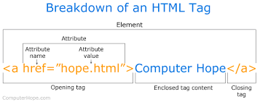
HTML Elements
R
Most Web documents are created using HTML. Documents are saved with extension .html or .htm.
Tags are strings in the language surrounded by a less-than (<) and a greater-than (>) sign.
Opening tag: <html> Ending tag: </html>
Can have Attributes
Attributes are Name-Value pairs added to HTML start tags.

Slide 8
Rules applicable for HTML5 Tags
R
Rules for HTML5 Tags are:
The document must included with an HTML5 DOCTYPE.
Tags and attriutes are case-insensitive.
Attributes do not need to be quoted.
End tags are not required for every element.
Some attributes may be empty such as checked and disabled .
For example, <input type=checkbox checked>
Only void elements such as br, img and link may be ”self-closed” with />.

Slide 9
HTML Elements (Code)
R
Code Snippet
An HTML document appears as follows:
<!DOCTYPE HTML>
<html>
<head>
<title>Title of page</title>
</head>
<body>
This is my ﬁrst homepage. <b>This text is
bold</b>
</body>
</html>

Slide 10
HTML Document Sections
R
HTML Head Section:
<head>…</head>
Page Title, Base URL, Meta Information
HTML Body Section:
<body>…</body>
Text, Images, Tables Colors, etc.

Slide 11
Head Section: Page Title (Code)
R
Code Snippet
Document Title is displayed using <title>…..</title> tag.
<!DOCTYPE HTML>
<html>
<head>
< title>
My First Page
</ title>
</head>
</html>

Slide 12
Head Section: Document Base URL
R
Code Snippet
<!DOCTYPE HTML>
<html>
<head>
<title> Document Base URL Manipulation </title>
<base href=“URL/”>
</head>
</html>
More Examples:
<base href=“http://www.state.edu/images/”>
<base href=“ftp://ftp.state.edu/images/”>

Slide 13
Head Section: Meta Information
R
The <meta> tag provides metadata about the HTML document such as
descriptions and keywords for search engine.
Metadata will not be displayed on the page, but will be machine parsable. Examples:
<meta …….>
<meta name="keywords" content="HTML, CSS” />
<meta name="author" content=“Username">
<meta http-equiv=refresh content=60 />
<meta http-equiv=refresh content=“20;url=c:/html/htm3.htm” />
<meta charset="UTF-8">

Slide 14
HTML Body Section
R
<body> Element:
Represents information content.
Each document can have at most one <body> element.
Body element is placed between </head> and </html> elements.
Attributes supported in <body> element are:
Event Handler attributes like ononline, onoﬄine, onunload, onpagehide, onpageshow, etc..
Global attributes like id, style, class, hidden, lang, etc..

Slide 15
Document (Body) Contents
R
Body Text
HTML truncates spaces in your text.
Use <br> to insert new lines.
Use <p> tag to create paragraphs.
Other Elements of Body Section:
<table> tags are used to create tables.
<img> tags are used to insert images.

Slide 16
Comments in HTML Document
R
Increase code readability. Ignored by the browser.
Example of HTML comment:
<!-- This is a Sample HTML Comment -->

Slide 17
Home Page Concepts
R
Most popular home pages reﬂects the personality of the sponsoring
organization or corporation.
Keep the initial home page short and to the point.
First element visitor sees is a collection of navigation buttons to navigate to other pages.
When you publish a URL in print or any other marketing material, it points to the location of your home page.

Slide 18
Physical Character Effects
R
Tags applies physical character effects by formatting the characters are
listed below:
Tag Name | Description | Example
<b>..</b> | To specify bold text | Language
<i>..</i> | Displays content in italic to deﬁne a part of text in an alternate voice or mood | Language
<u>..</u> | Tags make text between them underlined | Language
<s>..</s> | Tags make text between them appear striked out | Language
<sub>..</sub > | To specify subscript text | H₂o
<sup>..</sup > | To deﬁne superscript text | 27th May

Slide 19
Logical Character Effects
R
Heading Styles:
<hn>…………</hn>
Value of n can range from 1 to 6
Syntax
<h1>This is level 1 heading</h1>

Slide 20
Logical Character Effects (Contd…)
R
<code> | Displays any code part in the web page.
<var> | Displays any variable on the web page.
<kbd> | Displays computer commands and arguments.
<em> | Highlights speciﬁc areas of text enclosed within it.
<strong > | Used for deﬁning important text.
<dfn> | Designed speciﬁcally for words and phrases deﬁned in text.
<addres s> | Speciﬁes information about the creator e.g. Address, mailing address.

Slide 21
Special Characters in HTML
R
Character Entities
Comprise following three parts:
Ampersand (&),
Entity name or a #
Character code
Semicolon (;)
Included in HTML page using:
Character code/Entity number: Include any character
using its ISO Latin 1 character code.
To display “>” symbol, character code is 62 i.e. &#62;

Slide 22
Managing Document Spacing
R
Horizontal Spacing
Use <hr> tag for including horizontal rule in an HTML document
Vertical Spacing
<p>: Paragraph Break
<br>: Line Break

Slide 23
Preformatted Text (Code)
R
<pre>…</pre> Tags display preformatted blocks of text with a ﬁxed-space
font.
<pre> tag displays text with white space, line breaks, and tabs. Examples:
<!DOCTYPE html>
<html>
<head><title> Preformatted Text</title>
<body>
<pre>Browser would display this paragraph
as you are viewing here.
No need to provide line or paragraph breaks.
</pre>
</body>
</html>

Slide 24
Divisions in an HTML Document (Code)
R
The <div> tag deﬁnes a division or a section in an HTML document.
The <div> tag is used to group block-elements to format them with CSS. Syntax:
Example:
<div>………..</div>
<!DOCTYPE html>
<html>
<body>
<div style=“text-align: center”>Text is center aligned.</div>
<div style=“text-align: left”>Text is left aligned.</div>
</body>
</html>

Slide 25
<span> in an HTML Document
R
The HTML <span> tag is used for grouping and applying styles to inline
elements.
The span tag is used with inline elements whilst the div tag is used with block-level content.
Example:
<!DOCTYPE html>
<html>
<body>
HyperText Markup Language is the standard markup language used to create <span style="color:blue;font-weight:bold"> static </span> web pages </body>
</html>

Slide 26
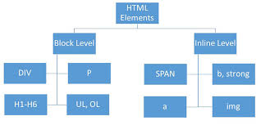
Block level element
R
Block elements separate content into blocks
Each block element is displayed on its own with a line break before and after it
Example for block elements are <p>,<div>, <ol>, <ul>, <li> etc..
<div> element is a block level element that can be used as a container for other HTML elements

Slide 27
Inline element
R
Inline elements wont separate content into blocks
Inline elements are normally displayed without line breaks. Inline element is just displayed in the ﬂow of the paragraph
Example for Inline elements are <b>,<i>,<u>,<em>, <a>, <td>, <img>, etc..
<span> element is an inline element that can be used as a container for text.

Slide 28
Rules
R
All inline elements and text need to be nested inside another block element
before they can go in the <body> element
Block elements are not allowed inside an inline element Keep block elements out of your <p> element
Put text and inline elements inside block elements before adding them to a
<blockquote>
For an example:
<ol> and <ul> can have only <li>
We can put text, inline elements or block elements inside <li>

Slide 29
Example of Inline and Block elements
R
<!DOCTYPE html>
<html>
<body>
<p>HyperText Markup Language is the standard markup language used to create <span style="color:blue;font- weight:bold"> static </span> web pages. JavaScript is a scripting language used to make web page content as
<span style="color:orange;font- weight:bold">dynamic</span>.</p>
</body>
</html>

Slide 30
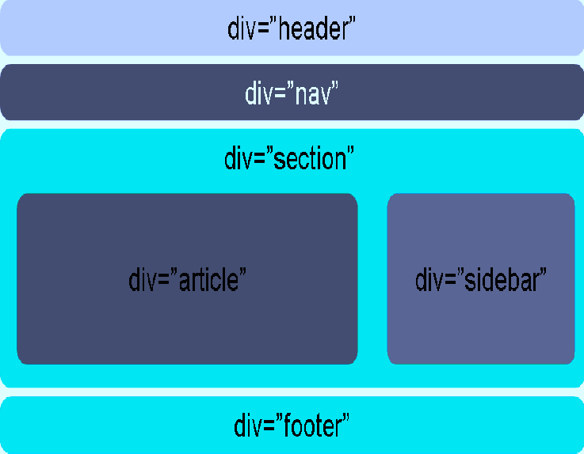
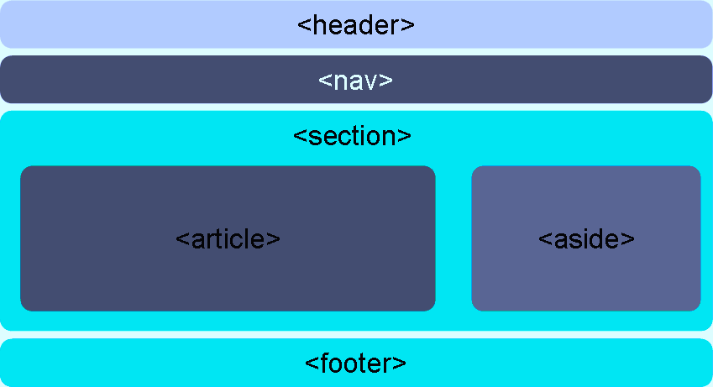
Laying out a page with HTML5
R
Most HTML 4 pages include a
variety of common structures,
such as headers, footers and columns
It’s common to mark them up
using div elements, giving each a descriptive id or class
HTML 5 addresses this issue by
introducing new elements for
representing each of these different sections
Elements that make it much easier to structure pages

Slide 31
New Semantic Elements in HTML 5
R
HTML Tag | Description
<article> | Deﬁnes a complete, self-contained block of related elements.
<aside> | Deﬁnes some content aside from the content it is placed in (like a sidebar
<footer> | Deﬁnes a footer for a document or section which contains the author of the document, copyright information, links to terms of use, contact information
<header> | Deﬁnes a header for a document or section. It can be used as a container for introductory content.
<nav> | Deﬁnes a set of navigation links
<section> | Deﬁnes a section in a document

Slide 32

Summary
R
In this lesson, you have learnt about
The structure of an HTML page.
Physical/logical character effects
Managing document spacing.
New Semantic elements in HTML5

Slide 33

Review Question
R
Question 1:Which of the following are newly added content
tags in HTML5?
Option1: article
Option2: div
Option3: section
Option4: p
Question 2:HTML document is saved with an extension
.xml.
True/False
Question 3:A Var tag is used to display the in the web page.

Slide 34
Review Question: Match the Following
R
1. Code
2. Var
3. Kbd
4. Emphasis
5. Strong
6. Deﬁnition
a) Tag displays user-entered computer commands and arguments
b) Tag is used for deﬁning important text.
c) Tag displays any code part on the web page.
d) Tag displays any variable on the web page.
e) This tag designed speciﬁcally for words and phrases that are deﬁned in the text.
f) Tag for generic emphasis means this tag highlight speciﬁc areas of text.

Slide 35
R
Web Basics – HTML5
Tables

Slide 36
Creating Tables
R
Table contains data in the format of rows and columns.
For an example, department information’s are displayed in the tabular
format as shown below
Row
Deptno | Dname | Location
10 | Accountin g | New York
20 | Research | Dallas
30 | Sales | Chicago
40 | Operation s | Boston
Column named as
“Deptno”
The above “Department” table contains 4 rows and 2 columns.

Slide 37
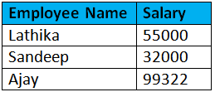
Creating Tables
R
An HTML table can be created using <table> elements
<table>
Deﬁne an HTML table
Other elements like <tr>, <caption>,.. can be nested inside <table> element
An HTML table has two kinds of cells
Header Cells
<th>
– Deﬁnes a table header
Standard Cells
<tr>
Deﬁnes a table row
A row can have one or more <td> or <th> elements
<td>
Deﬁnes a table cell data
Header Cells
Standard
Cells

Slide 38
Creating Tables
R
Syntax
<table>
<tr> <th>Column1 Header</th> <th>Column2 Header</th></tr>
<tr> <td>Cell 1,1</td> <td>Cell 1,2</td>
</tr>
<tr> <td>Cell 2,1</td> <td>Cell 2,2</td>
</tr>
</table>

Slide 39
Creating Tables
R
Some more elements which can be used while creating tables are:
<thead>
Group header content in an HTML table
<tbody>
Group the body content in an HTML table
<tfoot>
Group footer content in an HTML table
<caption>
Deﬁnes a caption for the table
<caption> element should follow with <table> element immediately.
<caption> element value will be center aligned and displayed above the table

Slide 40
Creating Tables
R
Syntax
Table column headings:
<table>
<caption>This is table caption</caption>
<tr>
<th>COLUMN 1</th>
<th>COLUMN 2</th>
<th>COLUMN 3</th>
</tr>
</table>

Slide 41
Creating Tables
R
Syntax
<table>
<thead>
<tr><td>.....</td></tr>
</thead>
<tfoot>
<tr><td>.....</td></tr>
</tfoot>
<tbody>
<tr><td>....</td></tr>
<tbody>
</table>

Slide 42
Blank Data Cell (Code)
R
Inserting Blank Data Cell :
<td></td>
<td><br></td>

Slide 43
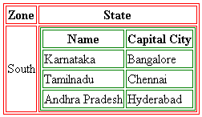
Nested Tables (Code)
R
A cell can contain another table within it.
<table>
<tr> <th>Zone</th> <th> State </th> </tr>
<tr> <td>South</td>
<td><table>
<tr> <th>Name</th> <th>Capital City</th> </tr>
<tr> <td>Karnataka</td> <td>Bangalore</td> </tr>
<tr> <td>Tamilnadu</td> <td>Chennai</td> </tr>
<tr> <td>Andhra Pradesh</td> <td>Hyderabad</td>
</tr>
</table></td></tr>
</table>

Slide 44
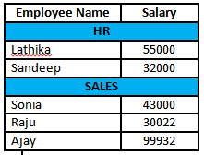
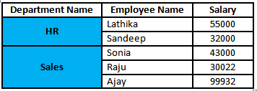
Table Formatting
R
Cell Spanning
Table cells can span across more than one column or row.
Types of cell spanning
Row spanning
Column spanning
Example of Colspan
Example of Rowspan

Slide 45
Cell Spanning (Code)
R
Row spanning/Column spanning:
Use rowspan and colspan attribute either in <td> or <th> element.
<table>
<tr>
<th rowspan=m>Multiple Column
Header</th>
<th colspan=n>Multiple Row Header</th>
</tr>
</table>
m & n are integers specifying number of rows and columns respectively.

Slide 46
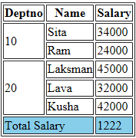
Cell Spanning Demo
R

Slide 47
Grouping of Columns
R
<colgroup> tag speciﬁes a group of one or more columns in a table for formatting
The <col> tag speciﬁes column properties for each column within a
<colgroup> element.
Use <colgroup> and <col> tags to group columns with common properties
like
Span attribute :
Identiﬁes number of columns in the current group.
Default value is 1
Provide span attribute and omit <col> tag
Example for grouping 3 columns and applying background color as green
<table>
<colgroup span=“3” style=“background-color:green”> </colgroup>
<col>
<col>
<tr>
table contents……
</tr>
</table>

Slide 48
Lesson Summary
R
After completing this module you know:
Structure of an HTML table
Control table format such as cell spanning
Use tables to format contents of an HTML Page.

Slide 49
Review - Questions
R
Question 1: Cell spanning is used to joining cells together to make a larger cell.
True/False
Question 2: The <col> tag deﬁnes the attribute values
for one or more columns in a table.
True/ False
Question 3: In which tag usage of rowspan/colspan attribute is valid?
<th>
<tr>
<td>
None of the above

Slide 50
R
Web Basics – HTML 5
List

Slide 51
Numbered List
R
List of items can be numbered or ordered is called numbered/ordered List
Tags can be used for creating ordered list are:
<ol>
<li>
<li> tag
Deﬁnes a list item.
Should be used as a child tag of either <OL> or <UL> tag.
<ol> tag
<ol> deﬁnes an ordered list.
An ordered list can be numerical or alphabetical.
Attributes in <ol> tag are
start
type

Slide 52
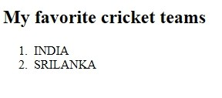
Example
R
Example (Code)
Output
<!DOCTYPE html>
<html>
<body>
<h2>My favorite cricket teams</h2>
<ol>
<li>INDIA</li>
<li>SRILANKA</li>
</ol>
</body>
</html>

Slide 53
Attributes in <OL> tag
R
Type Attribute:
Speciﬁes the kind of marked to use in the list
Valid values for the Type Attribute
A-Uppercase letters
a-Lowercase letters
I-Uppercase Roman letters
i-Lowercase Roman letters
1-Standard numbers, default
Start Attribute
Speciﬁes the start value of an ordered list

Slide 54
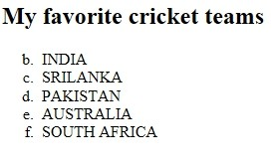
Example
R
Example:
<!DOCTYPE html>
<html>
<body>
<h2>My favorite cricket teams<h2>
<ol start="2" type="a">
<li>INDIA
<li>SRILANKA
<li>PAKISTAN
<li>AUSTRALIA
<li>SOUTH AFRICA
<ol>
</body>
</html>
Output

Slide 55
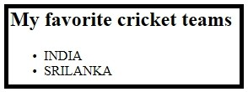
Bulleted List
R
List of items preﬁxed with bullets is called Bulleted /Unordered List
<ul> tag
<ul> deﬁnes an unordered list.
An unordered list items will be marked with bullets (small black circles).
Example
<!DOCTYPE html>
<html>
<body>
<h2>My favorite cricket teams</h2>
<ul>
<li>INDIA</li>
<li>SRILANKA</li>
</ul>
</body>
</html>
Output

Slide 56
Attributes in <UL> tag
R
Style Attribute:
Can be used in <UL> tag to deﬁne the style of the marker.
Style Attribute Value | Description
list-style-type:disc | The list items will be marked with bullets (default)
list-style-type:circle | The list items will be marked with circles
list-style-type:square | The list items will be marked with squares
list-style-type:none | The list items will not be marked
list-style-image: url(‘logo.gif'); | The list items will be marked with an image
Example
<UL style=“list-style-type:circle”> will be used to preﬁx unordered list of items with square.

Slide 57
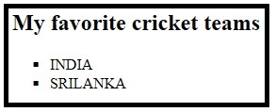
Example (Code):
R
Example
<!DOCTYPE html>
<html>
<body>
<h2>My favorite cricket teams</h2>
<ul style="list-style-
type:square">
<li>INDIA</li>
<li>SRILANKA</li>
</ul>
</body>
</html>
Output

Slide 58
Lesson Summary
R
In this lesson, you have learnt about:
Types of available list items
Create bulleted, numbered and glossary listed items

Slide 59
Review Question: Questions
R
Question 1:Which tag is used at the beginning of an Ordered List
<ol>
<ul>
<li>
Question 2:To create a bulleted list <UL> tag is used
True/ False
Question 3: attribute is used to modify the appearance of bullets

Slide 60
Review Question: Match the Following
R
1. <dd>
2. <dt>
3. <ol type=I>
4. <ol type=A>
5. <ol type=1>
6. <ul style=“list-style- type:circle”>
a. 1-Standard numbers
b. Square Form
c. A-Uppercase letters
d. I-Uppercase Roman letters
e. Data Deﬁnition
f. Data Term

Slide 61
R
Web Basics – HTML5
Working with Links

Slide 62
Hyperlink in HTML
R
Links allow users to navigate and ﬁnd information on the Internet as easy as possible.
HTML links are hyperlinks.
A hyperlink is a text or an image you can click on, and jump to another document.
Tag to create a link is <a> which stands for anchor.
Syntax:
<a href=“url”>link text</a>
By default, links will appear as this in all browsers:
An unvisited link is underlined and text is highlighted in blue color (Click me)
A visited link is underlined and text is highlighted in purple color ( Click me )
An active link is underlined and text is highlighted in red color ( Click me )

Slide 63
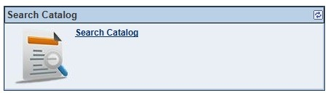






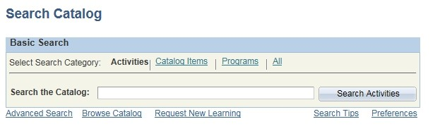
How does Hyperlink works?
R
Request
Web client
Response
Internet
Web Server

Slide 64
Create Links
R
Link to local document in an application(Relative linking)
<a href=“contactus.html”>Click Here</a>
Link to local document in an application(Absolute linking)
<a href=“http://localhost:8080/Example/contactus.html”
>Click Here</a>
Link to web document
I have some <a href=“http://www.state.edu/info/info.htm”> information</a> about education.

Slide 65
Links to an E-Mail
R
Link to an electronic mail:
An URL tag called “mailto” identiﬁes the address to which an e-mail has to be sent.
Syntax:
<a href=“mailto:mailid?subject =content&cc=cc-
_{E}m_{xa}a_{m}il_{p}i_{l}d_{e}&_{s:}bcc=bcc-mailid”>Link text</a>
▪
<a href=“mailto:eDude@igate.com?subject =More
Info”>Contact Me</a>
Please <a href=“mailto:author@igate.com>mail</a>your comments to me

Slide 66
CC and BCC in Email (Code)
R
<!DOCTYPE html>
<html>
<body>
<!----add the CC and BCC's--->
<a href="mailto:edude@capgemini.com?Subject=Hello&Cc=jane@cap gemini.com&bcc=joe@capgemini.com"> Mail us </a>
</body>
</html>

Slide 67
Links to Speciﬁc Part of a Page
R
id attribute, used in the anchor tag identiﬁes a section of a page.
Set HREF to the section name. Precede the name with a # symbol
<a id=“address1”></a>
B 44, Sector 59, Noida, Uttar Pradesh 201301, India
…Contents of the page…
I am working in <a href=“#address1”>Careerera</a>

Slide 68
Providing Target for a Hyperlink
R
Target attribute of the <a> tag speciﬁes where to load the linked document.
<a href=“link2.htm” target=“frame2”>Document 2</a>
It takes following values:
name of the existing window/target
_blank
_self
_parent
_top
By default it loads the linked document in the current window.

Slide 69
_blank (Code)
R
Target attribute of the <a> tag speciﬁes where to load the linked document.
<a href=“link2.htm” target=“frame2”>Document 2</a>
It takes following values:
name of the existing window/target
_blank
_self
_parent
_top
By default it loads the linked document in the current window.

Slide 70
_self (Code)
R
“_self”:
Puts new document in the same window and frame as the current document.
Works the same as if you had not used TARGET at all.
This code produces this go to:
<a href="selftarget.html" target="_self">next</a> page

Slide 71
_top (Code)
R
“_top”:
loads linked document in the topmost frame. This means that the new page ﬁlls the entire window.
<a href="selftarget.html"
target="_top">top</a>

Slide 72
_parent (Code)
R
“_parent”:
Used when a frameset ﬁle is nested inside another one
A link in one of the inner frameset documents which uses "_parent" loads the new document where the inner frameset ﬁle had been
<a href="bigframe.html" target="_parent">bigframe</a>

Slide 73
Hyperlinks in Lists Items (Code)
R
Add links to list items and table contents:
<ul>
<li><a href=home.html>mumbai</a></li>
<li><a href=home.html>pune</a></li>
<li><a href=home.html>nasik</a></li>
</ul>

Slide 74
Hyperlinks in Table Elements (Code)
R
Add links to table contents:
<table border=1>
<tr><th>team<th>points<th>grade</tr>
<tr><td>
<a
href=home.html>mumbai</a></td><td>90</td><td>a</td>
</tr>
<tr><td>
<a href=home.html>pune</a></td><td>86</td><td>b</td>
</tr>
<tr><td>
<a href=home.html>nasik</a></td><td>80</td><td>c</td>
</tr>
</table>

Slide 75
Summary
R
In this lesson, you have learnt about
How hyperlink works in web pages
Creation of hyperlinks in web pages
Including hyperlinks to list items and table contents

Slide 76
Review Question
R
Question 1:The id attribute along with # used in the anchor tag identiﬁes:
Page section.
Path to load the linked document.
Address to send the e-mail to.
Question 2:URL tag mailto, identiﬁes the address from
where e-mail is to be received.
True/ False
Question 3: attribute of the <a> tag speciﬁes where to load the linked document.

Slide 77
Review Question: Match the Following
R
1. “_blank”
2. “_self”
3. “_top”
4. mailto
5. Relative Linking
6. Absolute Linking
a. Identiﬁes address to send the e-mail to.
b. Only ﬁlename is needs to be speciﬁed.
c. Gives entire address of the page.
d. Puts the new document in the same window and frame as the current document
e. Opens the new document in a new window.
f. Loads linked document in the topmost frame.

Slide 78
R
Web Basics – HTML5
Image Handling

Slide 79
Roles of images in web pages
R
Web pages are comprised of text and images. Some of the roles of images in web pages are
To make web page content more interesting to be read
To increase clarity on web page content by transmitting right message
Provoking reactions
To ensure that the user response is anticipated
Some of the widely used image formats
GIF : Graphical Interchangeable Format
JPEG : Joint Photographic Expert Group
PNG : Portable Network Graphics

Slide 80
Adding images in webpages
R
Images are added into a HTML document using <img> tag.
<img> tag has 2 required attributes such as src and alt
Syntax:
<img src=“url” alt=“Alternate text”/>
The src attribute deﬁnes the url (web address) of the image
Alt attribute deﬁnes alternative text to display for non-graphical browsers. The alt attribute is required
Example:
<img src="html5.gif" alt="The oﬃcial
HTML5 Icon">

Slide 81
Attributes of an Inline Image
R
Other attributes of <img> tag are:
width: Sets the width of the image.
height: Sets the height of the image.

Slide 82
Text & Image Alignment (Code)
R
Style Attribute:
Can be used in <img> tag to deﬁne the alignment of text and image.
Style Attribute Value | Description
vertical-align:bottom | The bottom of the element is aligned with the lowest element on the line
vertical-align:middle | The element is placed in the middle of the parent element
vertical-align:top | The top of the element is aligned with the top of the tallest element on the line
ﬂoat:right | The element ﬂoats to the left
ﬂoat:left | The element ﬂoats to the right
ﬂoat:none | The element ﬂoats to the none
<br clear=LEFT/RIGHT> can be used to stop text ﬂowing around an image

Slide 83
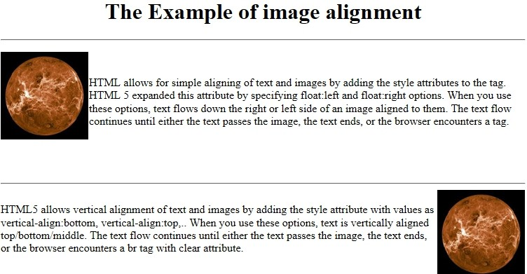
Demo
R

Slide 84
Use of Image as a Hyperlink (Code)
R
Images used as hyperlinks:
<a href="5image1.html"><img src="home.gif"></a>
Images contained within a table:
<table>
<tr><th>Product</th><th>Cost</th><th>Image</th></tr>
<tr> <td>Pencil</td> <td>$8</td>
<td><img src="pencil.gif"></td> </tr>
<tr> <td>Brush</td> <td>$15</td>
<td><img src="paintbrush.gif"></td></tr></table>

Slide 85
Lesson Summary
R
In this lesson, you have learnt about:
Role of images in web pages
How to add images in web pages
How to use images as hyperlinks

Slide 86
Review - Questions
R
Question 1: Client-side image maps are usually faster than server-side image maps.
True/ False
Question 2: contain the linking information on the server.

Slide 87
R
Web Basics – HTML5
Frames

Slide 88
Introduction to FRAME
R
With frames, more than one HTML document content can be nested in a
web page.
Need for frames in webpage:
Reusability
Static navigation can be visible all the time
Design issues can be resolved.
Advertisement can be displayed which promotes web site

Slide 89
Introduction to IFRAME
R
Inline Frame Element (<iframe>) is used to embed another HTML page into the current page.
<iframe> can be used within a HTML document body just like an <img> tag.
Syntax:
<iframe src=“url”></iframe>
Types of documents which can be embedded using IFRAME are
Image(GIF, JPEG, etc..)
PDF
Audio
Video
HTML document, etc..

Slide 90
IFRAME Tag Attributes
R
Attribut e Name | Attribute Value | Description
name | Name of the frame | Mentions the name of iframe.
height | pixels | Denotes the height level of iframe.
width | pixels | Denotes the width level of iframe.
src | URL of the ﬁle | The address/URL of the content to be ﬁxed in iframe.
sandbox | "", allow-forms, allow- same-origin, allow- scripts, allow-top- navigation | Creates limitations for iframe contents.
seamless | seamless | Deﬁnes that iframe should look like the part of the containg document.
srcdoc | HTML code | The HTML content of a page to be shown in iframe.

Slide 91
Example
R
<!DOCTYPE html>
<html>
<body>
<iframe src="HTML5.pdf" width="600" height="400">
<p>Your browser does not support iframes.</p>
</iframe>
<p>Inline Frame Element is used to embed another HTML page into the current page. can be used within a HTML document body just like an tag. A section that contains embedded content is called the parent context.</p>
</body>
</html>

Slide 92
Lesson Summary
R
In this lesson, you have learnt about
Need of frames in webpages
Embedding of content in HTML document using <iframe> tag.

Slide 93
Review – Match the Following
R
1. src | a. Sets the height of the frame.
2. NAME | b. Sets the width of the frame.
3. WIDTH | c. Creates limitations for iframe contents.
4. HEIGHT | d. Assigns a name to a frame.
5. SANDBOX | e. Source document’s URL is displayed in this frame.

Slide 94
R
Web Basics – HTML5
HTML Forms for User Input

Slide 95
Lesson Objectives
R
After completing this module you will be able to:
Understand the role of forms in web pages
Understand various HTML elements used in
forms.
Single line text ﬁeld
Text area
Check box
Radio buttons
Password ﬁelds
Pull-down menus
File selector dialog box

Slide 96
HTML Forms for User Input
R
HTML forms are used to accept user inputs and then submit data for
processing.
A form is an area that contains form elements.
Types of elements which can be included in a form are
Label
Single line text ﬁeld
Password ﬁeld
Text area
Drop down menu
Radio button
Checkbox
File selector box, etc..

Slide 97
HTML Forms for User Input
R
User input forms are created using <form> tag.
Syntax:
<form method=“get/post” action=“URL” enctype=“Encryption Type”>
Field deﬁnitions
</form>
action: the URL of the script
method: the HTTP request method to use, sometimes GET, but usually
POST
enctype: Speciﬁes how the data is to be encoded.
application/x-www-form-urlencoded : spaces->+, special chars -> ASCII HEX)
Multipart/form-data : No char encoding
text/plain: Spaces are converted to "+" symbols, but no special characters are encoded

Slide 98
HTML Forms for User Input
R
Some more attributes which can be used in <form> tag are
Attribute Name | Attribute Value | Description
name | Form name as a string | Mentions the name of a form.
autocomple te | On, off | Speciﬁes whether a form should have autocomplete on or off
target | _blank, _self, _parent, _top | Speciﬁes where to display the response that is received after submitting the form
novalidate | novalidate | Speciﬁes that the form should not be validated during form submission.

Slide 99
HTML Form Elements
R
<input> element is the most used form tag.
An <input> tag includes the following attributes
name: Name of the ﬁeld which is required to send data(Key/Value pair) during form submission
id: A unique identiﬁed of the ﬁeld
value: Sets a default value of the ﬁeld
maxlength: Speciﬁes the maximum number of characters allowed in an
<input> element
readonly: Speciﬁes that an input ﬁeld is read-only
size: Speciﬁes the width, in characters, of an <input> element
Disabled: speciﬁed that an input element should be displayed.
type attribute of <input> tag speciﬁes the ﬁeld type

Slide 100
Text- related Elements
R
Text related elements can be created as shown below:
Code | Element
<input type=“text”> | Single line text box
<input type=“password”> | Password ﬁeld
<input type=“hidden”> | Hidden ﬁeld
Multiple line text input control
If input exceeds more than one line, then create Multi-line input control using HTML <textarea> tag
Syntax:
<textarea rows=“ " cols=“ " name=“ “>
Rows : Number of rows of text area box
Cols: Number of columns of text area box
Name: name of the element

