Slide 1
Objectives
In this session, you will learn to:
  Describe the basic hierarchy of Collections framework
  Describe Map interface
  Examine generic and legacy collection classes
  Use type parameters in generic classes
  Examine the enhanced for loop

Slide 2
The Collections API
A collection is a single object representing a group of objects known as its elements.
The Collections API contains the following interfaces:
  Collection
  Set
  List

Slide 3
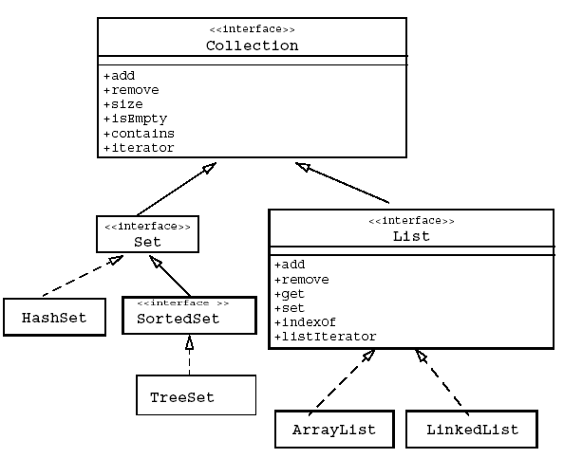
The Collections API (Contd.)
The following figure displays the primary interfaces and implementation classes of the Collections API.

Slide 4
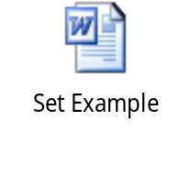
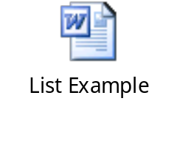
Collection Implementations (Contd.)
Let us understand the concept of Set implementation by using the embedded document.
Let us understand the concept of List implementation by using the embedded document.

Slide 5
The Map Interface
A Map object:
  Describes mappings from keys to values.
  Does not allow duplicate keys and a key can map to one value at most.
The Map interface provides three methods that allow map contents to be viewed as collections:
  entrySet: Returns a Set that contains all the key value pairs.
  keySet: Returns a Set of all the keys in the map.
  values: Returns a Collection containing all the values contained in the map.

Slide 6
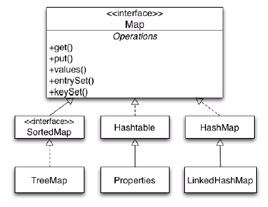
The Map Interface (Contd.)
The following figure displays the API for the Map interface, its sub-interfaces, and implementing classes.

Slide 7
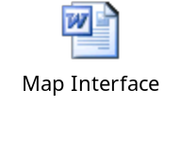
The Map Interface (Contd.)
Let us understand the concept of Map interface by using the embedded document.

Slide 8
Legacy Collection Classes
The collection classes in the JDK version 1.0 and 1.1 still exist in the current JDK with the same interface, but they have been retooled to interact with the new Collections API.
The Vector class implements the List interface.
The Stack class is an extension of Vector that adds the typical stack operations: push, pop, and peek.
The Hashtable is an implementation of Map.
The Properties class is an extension of Hashtable that only uses Strings for keys and values.
The Enumeration is an interface similar to, but incompatible with, the Iterator interface.

Slide 9
Ordering Collections
The Comparable and Comparator interfaces are useful for ordering and sorting the elements in a collection.
The Comparable interface imparts natural ordering to classes that implement it.
The Comparator interface is used to specify order relation. It can also be used to override natural ordering.

Slide 10
The Comparable Interface
The Comparable interface is a member of the java.lang package.
By implementing the Comparable interface, an order to the objects of any class is provided.
Collections that contain objects of classes can be sorted that implement the Comparable interface.

Slide 11
The Comparator Interface
The Comparator interface is a member of the java.util package.
It is used to compare objects in the custom order instead of the natural order.
It is also used to sort objects that do not implement the Comparable interface.

Slide 12
Generics
Generics provides compile-time type safety and eliminates the need for casts.
The following code snippet displays the use of non-generics collections:
    ArrayList list = new ArrayList();
    list.add(0, new Integer(42));
    int total = ((Integer)list.get(0)).intValue();
The following code snippet displays the use of generics collections:
  ArrayList<Integer> list = new ArrayList<Integer>();
    list.add(0, new Integer(42));
    int total = list.get(0).intValue();

Slide 13
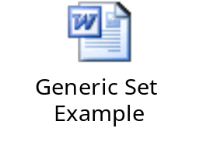

Generics (Contd.)
Let us understand the concept of generic Set implementation by using the embedded document.
Let us understand the concept of generic Map implementation by using the embedded document.

Slide 14
Generics: Examining Type Parameters
The following table lists the comparison between the non-generic version and the generic version of the ArrayList class.
Category | Non Generic Class | Generic Class
Class Declaration | public class ArrayList extends AbstractList implements List | public class ArrayList<E> extends AbstractList<E> implements List <E>
Constructor Declaration | public ArrayList (int capacity) | public ArrayList (int capacity)
Method declaration | public void add(Object o) public Object get(int index) | public void add(E o) public E get(int index)
Variable declaration examples | ArrayList list1; ArrayList list2; | ArrayList <String> a3; ArrayList <Date> a4;
Instance declaration examples | list1 = new ArrayList(10); list2 = new ArrayList(10); | a3= new ArrayList<String> (10); a4= new ArrayList<String> (10);

Slide 15
Demo: Generics
Let us see the demonstration of the concept of generics using ArrayList class.

Slide 16
Generics: Refactoring Existing Non-Generic Code
With generic collections, specify generic types without type arguments. This is called as raw types. This feature is allowed to provide compatibility with the non-generic code.
At compile time, all the generic information from the generic code is removed, leaving behind a raw type.
It enables interoperability with the legacy code as the class files generated by the generic code and the legacy code would be the same.
At runtime, ArrayList<String> and ArrayList<Integer> get translated into ArrayList, which is a raw type.

Slide 17
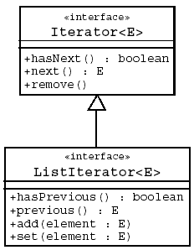
Iterators
Iteration is the process of retrieving every element in a collection.
The Iterator interface enables to scan forward through any collection.
The following figure displays a generic Iterator interface for the Collections API.

Slide 18
The Enhanced for Loop
The enhanced for loop has the following characteristics:
  It simplifies iteration over collections.
  It is much shorter, clearer, and safer to use.
  It is effective for arrays.
  It is easy to understand while implementing nested loops.
  It eliminates the Iterator disadvantages.
The following code snippet displays an enhanced for loop used in collections:
  public void deleteAll(Collection<NameList> c) {
  for (NameList nl: c) {
  nl.deleteItem();
  }
  }

Slide 19
Summary
In this session, you learned that:
  A collection is a single object representing a group of objects. These objects are known as elements.
  The Collections API contains the following interfaces:
    Collection
    Set
    List
  A Map object:
    Describes mappings from keys to values.
    Does not allow duplicate keys and a key can map to one value at most.
  The Vector class implements the List interface.
  The Stack class is an extension of Vector that adds the typical stack operations: push, pop, and peek.

Slide 20
Summary (Contd.)
  The Comparable and Comparator interfaces are useful for ordering and sorting the elements in a collection.
  Generics provides compile-time type safety and eliminates the need for casts.
  The Iterator interface enables you to scan forward through any collection.
  The enhanced for loop can be used to iterate through a collection.
  The enhanced for loop has the following characteristics:
    It simplifies iteration over collections.
    It is much shorter, clearer, and safer to use.
    It is effective for arrays.
    It is easy to understand while implementing nested loops.
    It eliminates the Iterator disadvantages.

